Slide 1
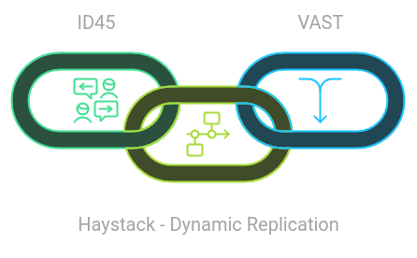
Project ID 36 Haystack - Dynamic Replication
Submitted By
TEAM_45
Vilal Al and Shriom Tyagi

Slide 2

Strategy Applied to Complete the Project
Defined Objectives: Established clear goals for implementing dynamic replication in Haystack.
Requirement Analysis: Identified key metrics like access frequency and storage constraints.
Modular Design: Adopted a modular architecture for scalability and maintainability.
Dynamic Replication Logic: Implemented a flexible algorithm to calculate replicas based on file access.
Fault Tolerance: Integrated mechanisms to improve reliability and system recovery.
Performance Metrics: Designed metrics to monitor storage, access patterns, and replication impact.
Efficient Storage Utilization: Balanced storage costs by minimizing unnecessary replicas.
Sample Data & Testing: Generated realistic data to validate system functionality.
Graphical Representation: Visualized system performance through graphs for clarity.
Iterative Development: Followed an iterative process to refine features and resolve issues.
Comprehensive Documentation: Prepared detailed reports for better understanding and future reference.
TEAM_45

Slide 3
Work Distribution
S. No. | Task Name | Done By
1 | Designed the replication logic and implemented the calculateReplicas function. | Vilal Ali
2 | Developed API routes for file upload, metrics, and monitoring replication. | Vilal Ali
3 | Configured the replicationConfig and handled system metrics computation. | Vilal Ali
4 | Created controllers and services for file management and storage operations. | Shriom Tyagi
5 | Integrated monitoring features for replicas and nodes. | Shriom Tyagi
6 | Implemented logging utilities and error-handling mechanisms. | Shriom Tyagi
7 | Designed the metrics Dashboard and implemented data visualization with graphs. | Vilal Ali
8 | Integrated API calls with state management for fetching and displaying data. | Vilal Ali
9 | Developed file upload and replication status views with a responsive table. | Shriom Tyagi
10 | Handled user interactions and data binding for seamless functionality. | Shriom Tyagi
11 | Prepared detailed reports for better understanding and future reference. | Vilal Ali
TEAM_45

Slide 4

Problem Statement
Replication in Distributed Systems
Fixed replication strategies lead to inefficient storage utilization.
Popular files may face access bottlenecks.
Low-demand files unnecessarily consume resources.
Key Challenge:
How to dynamically optimize replicas based on real-time access patterns?
Where do we start !!!!
TEAM_45

Slide 5
Objectives
Optimize storage utilization by dynamically adjusting replicas.
Improve fault tolerance and availability.
Scale seamlessly with large datasets and user concurrency.
Provide real-time monitoring for users.
TEAM_45

Slide 6
Key Features
Dynamic Replication: Adjust replicas based on access frequency.
Fault Tolerance: Ensure high availability even during node failures.
Scalability: Support growing datasets and concurrent access.
User Interface: Real-time file metadata monitoring and upload.
TEAM_45

Slide 7
High-Level Architecture
Components:
Frontend: React.js and Bootstrap for user interaction.
Backend: Node.js with Express.js for request handling.
Storage Nodes: Distributed systems for storing replicas.
Metadata Manager: Tracks file replica count, access frequency, and locations.
TEAM_45

Slide 8
Workflow
File Upload:
Users upload files through the interface.
Metadata is created, and initial replicas are assigned.
File Access:
Each access updates the file's access frequency.
Dynamic Adjustment:
Replica counts are recalculated based on frequency.
Replicas are redistributed across storage nodes.
TEAM_45

Slide 9
Implementation Details
Frontend:
File upload with Browse File Dialog
Metadata visualization.
Backend:
Replica adjustment logic based on:
Access frequency thresholds.
Configurable parameters (replicationconfig.js).
APIs for file management.
TEAM_45

Slide 10
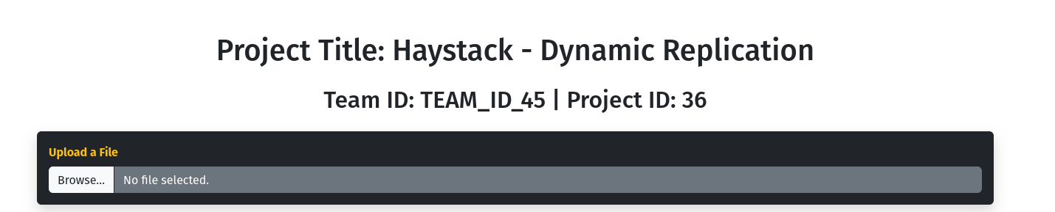
Output Screenshots
File Upload Interface
TEAM_45

Slide 11
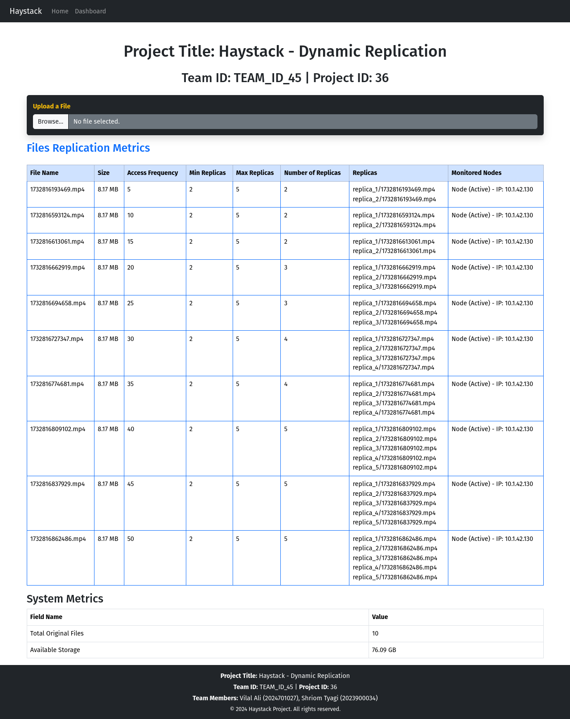
Output Screenshots
Metadata Viewer
TEAM_45

Slide 12
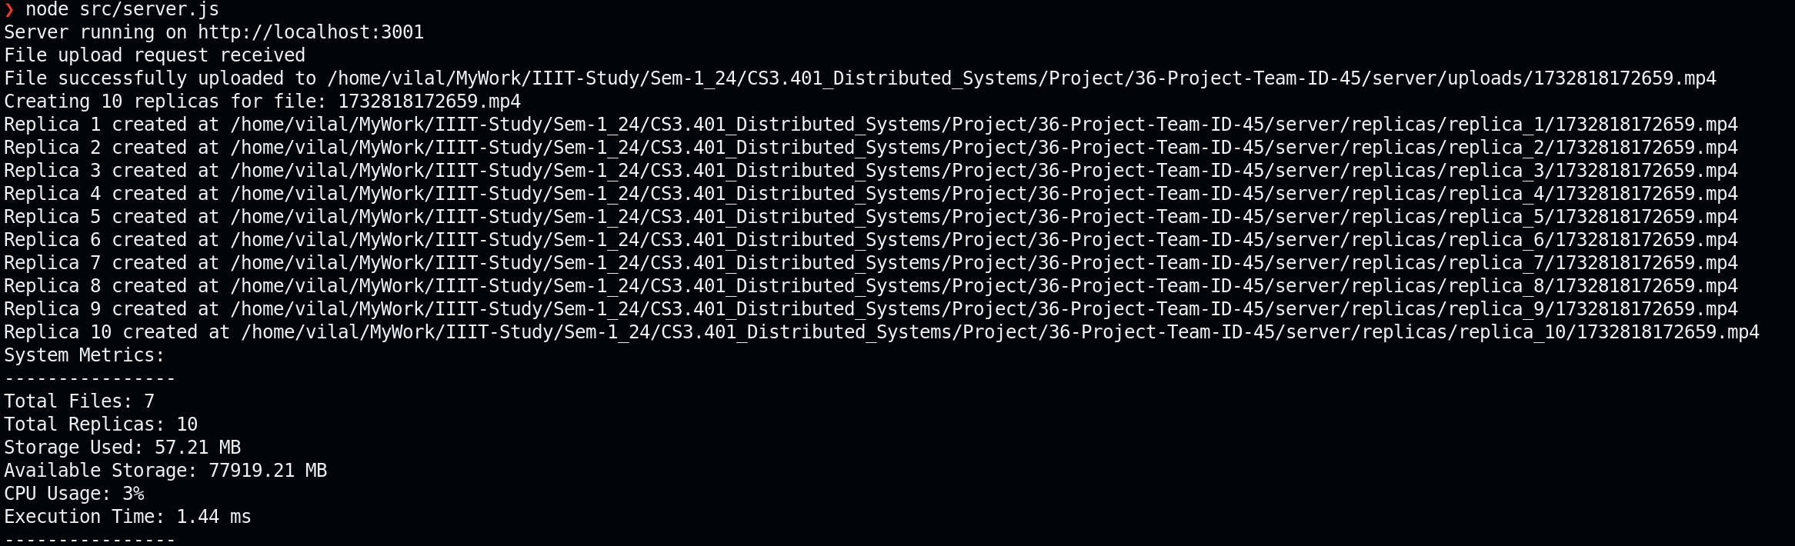
Output Screenshots
Backend Console
TEAM_45

Slide 13
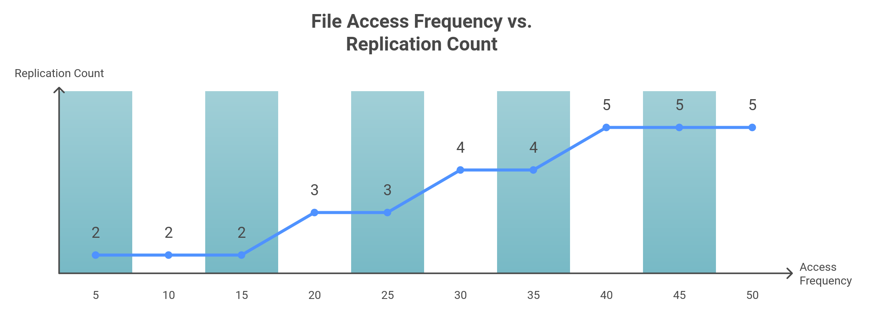
Comparative Analysis
File Access Frequency vs. Replication Count:
TEAM_45

Slide 14
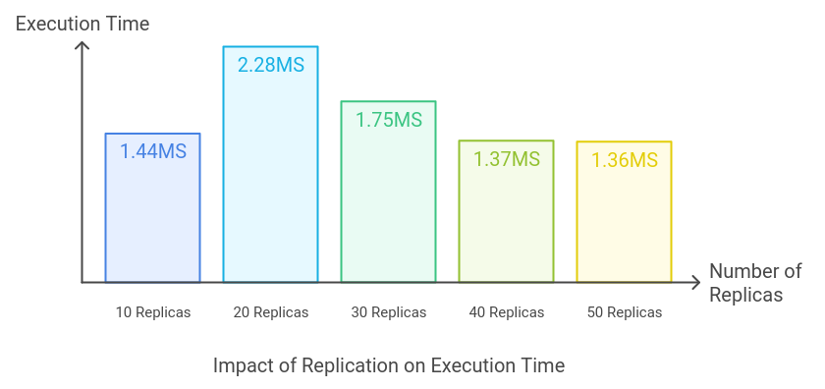
Comparative Analysis
Replication Impact on Execution Time:
TEAM_45

Slide 15
Future Scope
gRPC Transition: Replace REST APIs with gRPC for real-time communication.
Cloud Integration: Support for AWS, GCP, and Azure storage systems.
AI-Driven Replication: Predict access patterns and optimize replicas proactively.
TEAM_45

Slide 16
Conclusion
Conclusion:
Haystack - Dynamic Replication optimizes resource utilization while ensuring fault tolerance and scalability.
It addresses the inefficiencies of traditional replication strategies.
TEAM_45

Slide 17
Q&A
???
…
TEAM_45

Slide 18

TEAM_45

