Slide 1

CVR COLLEGE OF ENGINEERInG
Department of Emerging Technologies
PERSONALIZED PORTFOLIO RESUME GENERATOR
Team Members:
S. JYOTHSNA – 22B81A6619
V. PAVANI – 22B81A6628
CH. SRAVANI – 22B81A6646

Slide 2
INTRODUCTION
In the contemporary job market, standing out among a sea of applicants is crucial. One effective way to achieve this is by presenting a personalized and visually appealing resume.
A Personalized Resume Generator is a tool designed to assist individuals in creating customized resumes that reflect their personal style, professional experiences, and career aspirations.

Slide 3
PROBLEM STATEMENT
The Personalized Portfolio Resume Generator project addresses this challenge by providing a solution that enables users to create customized and visually appealing resumes .
The primary problem this project seeks to distinguish jobseekers from the multitude of applicants vying for the same positions.

Slide 4
PROJECT OBJECTIVES
Develop a User-Friendly Interface
Offer extensive Customization Options
Ensure Secure Data Handling
Facilitate Easy Eport and Sharing

Slide 5
SOFTWARE AND HARDWARE SPECIFICATIONS
Software Requirements:
Languages :
HTML, CSS, JavaScripting and Node.js
Database :
MongoDB
Tools/IDE:
Visual Studio Code, or any preffered code editor

Slide 6
SOFTWARE AND HARDWARE SPECIFICATIONS
Hardware Requirements:
System Specifications :
At least 4GB RAM and 128GB Hard Disk
Operating System :
Windows, macOS or Linux
Processor :
Intel Core i5 or equivalent

Slide 7
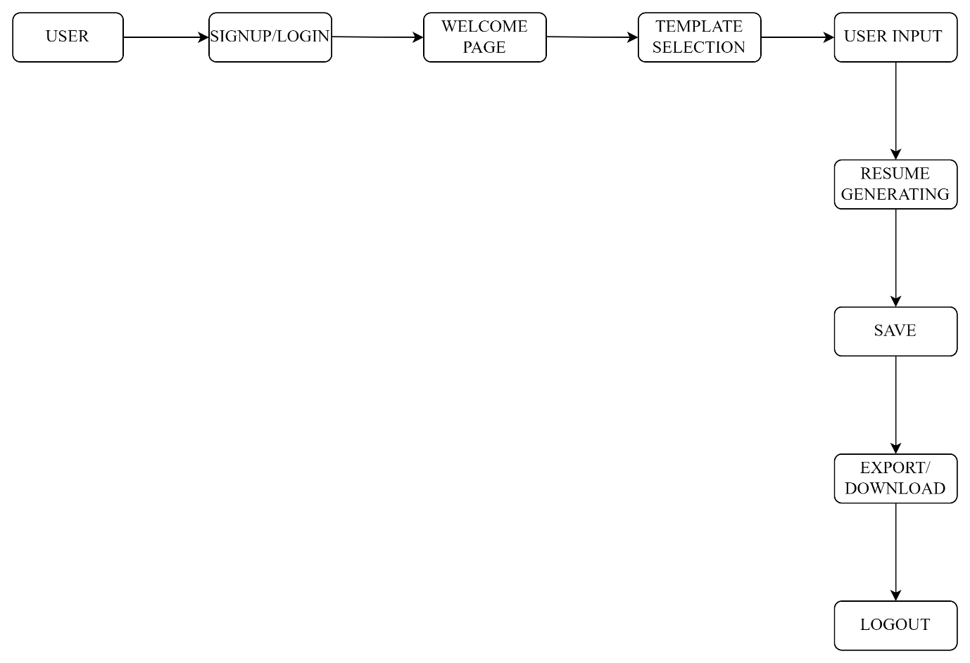
DESIGN METHODOLOGY
System Architecture

Slide 8
SYSTEM ARCHITECTURE
A personalized portfolio resume generator enables users to create customized, professional resumes through an intuitive interface.
Upon signing up or logging in, users can select from various templates and customize sections such as Profile, Experience, Projects, and Skills by filling out forms .
All changes are saved automatically, once finalized, users can export their portfolios as PDF and user can download it.

Slide 9
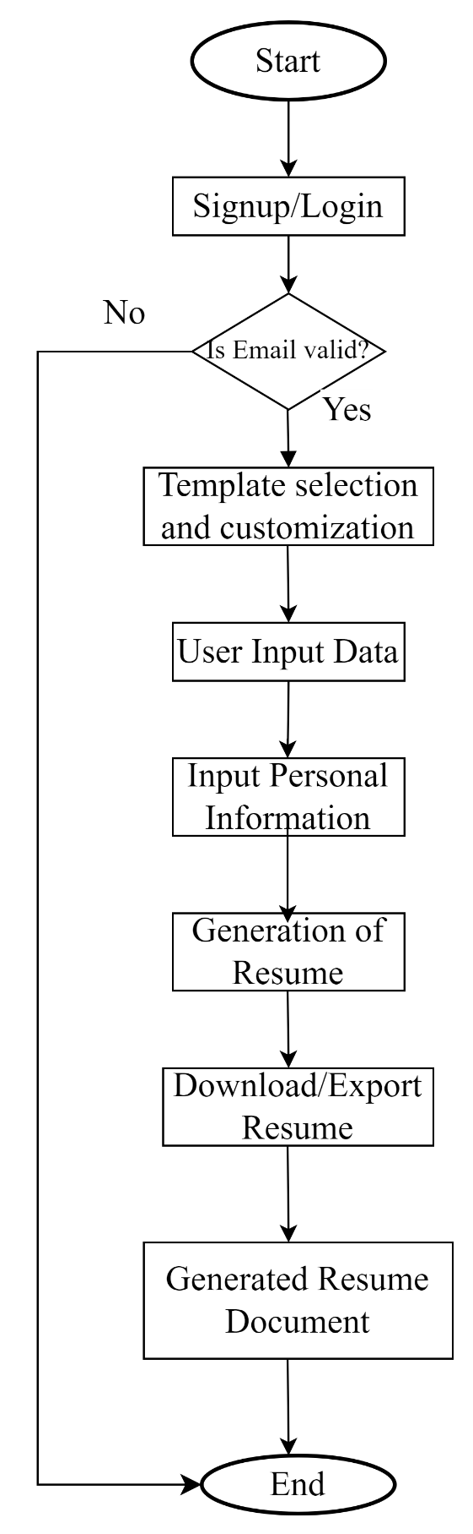
DATA FLOW DIAGRAM

Slide 10
TECHNOLOGY DESCRIPTION
Html
HTML is used to structure the content of the resume. It defines the layout and sections of the portfolio, such as the header, summary, work experience, education, skills, and contact information.
Additionally, HTML forms are integral for collecting user data, allowing individuals to input their personal and professional details, which are dynamically incorporated into the resume template.

Slide 11
TECHNOLOGY DESCRIPTION
CSS
CSS is responsible for the styling and visual presentation of the resume. CSS controls the appearance of HTML elements, managing fonts, colors, margins, padding, and overall layout to create an aesthetically pleasing and professional-looking resume.
It ensures that the portfolio is responsive, adapting seamlessly to different screen sizes and devices through the use of media queries.

Slide 12
TECHNOLOGY DESCRIPTION
JavaScript
JavaScript plays a pivotal role in a personalized portfolio resume generator by providing interactivity, dynamic content updates, and seamless user experiences. It enables real-time form validation, ensuring that user inputs are correctly formatted before submission.
It also facilitates asynchronous data fetching, enabling integration with external APIs to automatically pull in additional information or validate credentials.

Slide 13
TECHNOLOGY DESCRIPTION
Node.js
Node.js plays a crucial role in a personalized portfolio resume generator by providing a robust and scalable backend environment to handle server-side operations.
It enables real-time data processing and storage, allowing users to save, retrieve, and update their resume information seamlessly and the generator can efficiently manage user authentication, ensuring secure access to personal data.

Slide 14
TECHNOLOGY DESCRIPTION
MongoDB
MongoDB plays a vital role in a personalized portfolio resume generator by serving as the backend database for storing and managing user data efficiently.
It provides a flexible and scalable solution for storing diverse information such as user profiles, work experiences, education details, skills, and contact information.

