Slide 1
Rev-mart
E-Commerce Web Application
Team Members
Shubham
Abhijeet
Gayatri
Pratik
Vilas

Slide 2
Index
Introduction
Problem Statement
Objective
Features of Rev-mart
Technology Stack
Implementation Details
User/Admin Features
System Architecture
Working
Challenges Faced
Snapshots
Conclusion

Slide 3
Introduction
Rev-mart is developed with a focus on creating a scalable, and secure e-commerce solution. Customers can easily browse products, add items to their wishlist, and make secure purchases, while administrators can manage product listings and user data.
The application is structured using Spring MVC and adheres to best practices for security, ensuring that user data is protected throughout the shopping process.
The application offers both admin and user login functionality

Slide 4
Problem Statement
Rapid e-commerce growth creates challenges in delivering secure and seamless shopping experiences.
Rev-mart addresses these challenges with a user-friendly, secure platform.

Slide 5
Objective
Develop a secure, efficient, and scalable e-commerce platform.
Provide user-friendly interface for both customers and admin.
Enable personalized shopping experiences through features like wishlists and cart.
Ensure robust data security and privacy in every transaction.

Slide 6
Features of Rev-mart
Rev-Mart
Admin and User
Wishlist
Add Product
Payments
Category

Slide 7


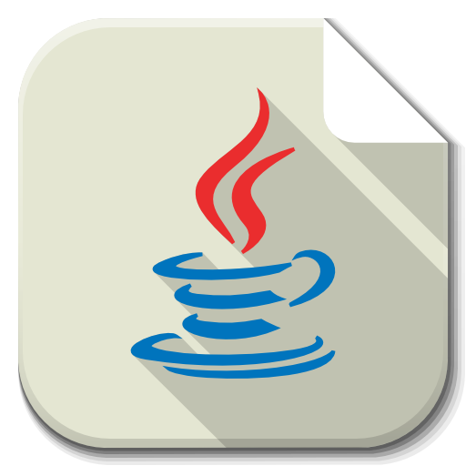


Technology And Tool Stack
Spring MVC
Eclipse
Workbench
Java
GitHub

Slide 8
Implementation Details
Framework
Rev-mart is developed using Spring MVC (Model-View-Controller) architecture, which provides a clean separation of concerns between the Controller, Service, and Repository/DAO layers.
Backend
The backend is implemented using Spring Boot, which simplifies configuration and deployment. It is used for managing product information, user accounts, admin functionality, and security.
Database
Hibernate handles CRUD operations (Create, Read, Update, Delete) through its SessionFactory, enabling efficient communication between the application and the MySQL database without manually writing SQL queries.
Frontend
JSP (JavaServer Pages) is used for the view layer, providing dynamic web pages for both user and admin interfaces.

Slide 9
User Features
Admin Features
Product management
Order management
Dashboard
User management
Browse Product
Add To Cart/Wishlist
Check Orders
Payment

Slide 10
System Architecture
Controller
Service
DAO
Client UI
Model
Database

Slide 11
Working
Client UI:
Sends HTTP requests to the controller
Controller Layer:
Receives HTTP requests and delegates tasks to the service
Service Layer:
Handles business logic and communicates with the DAO
DAO Layer:
Executes database operations
Model:
Represents data objects that flow between layers and map to the database schema.
Database:
Stores persistent data

Slide 12
Challenges Faced
Integration Issues
Ensuring smooth integration between Spring MVC, Hibernate, and MySQL.
Error Handling
Managing and debugging errors effectively, especially with complex transaction scenarios
User Experience
Designing a user-friendly interface and ensuring a smooth user experience across different devices.
Data Consistency
Handling data consistency and transaction management across multiple database operations.

Slide 13
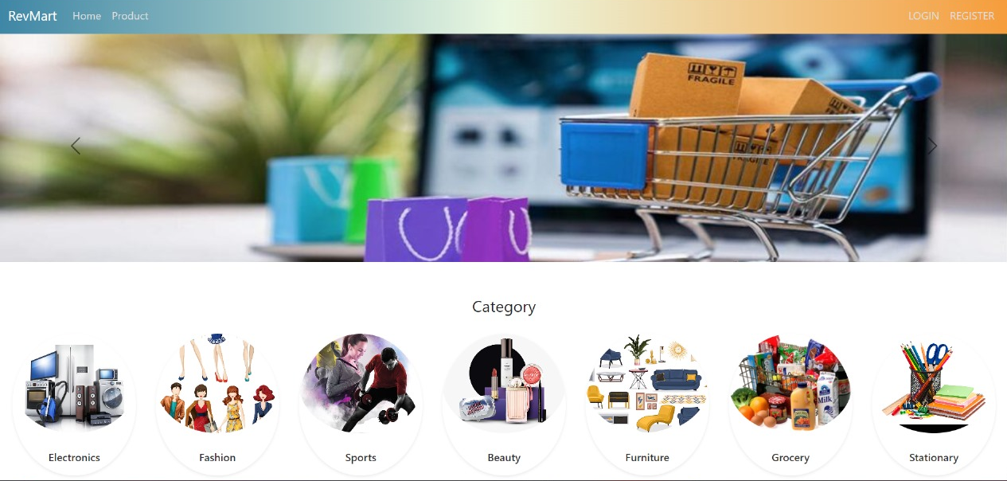
Snapshots
Home Page

Slide 14
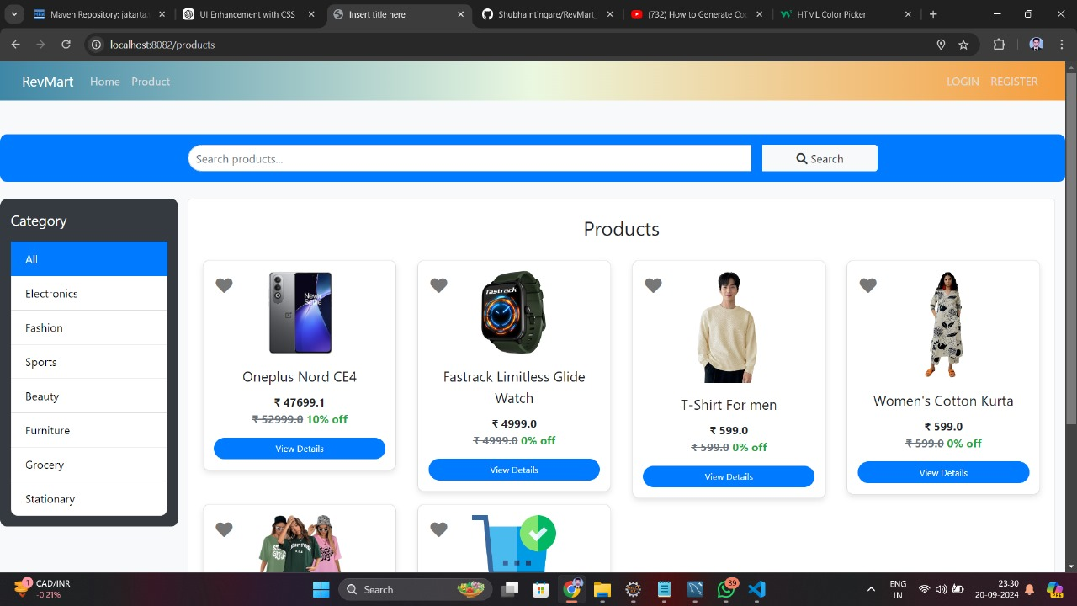
Snapshot
Product

Slide 15
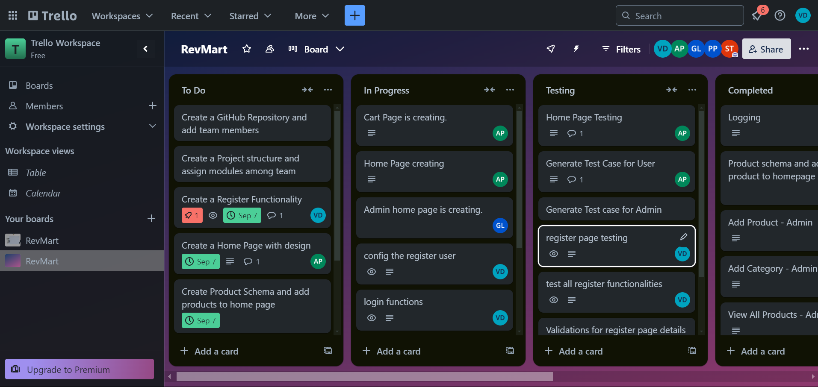
Snapshot
Trello

Slide 16
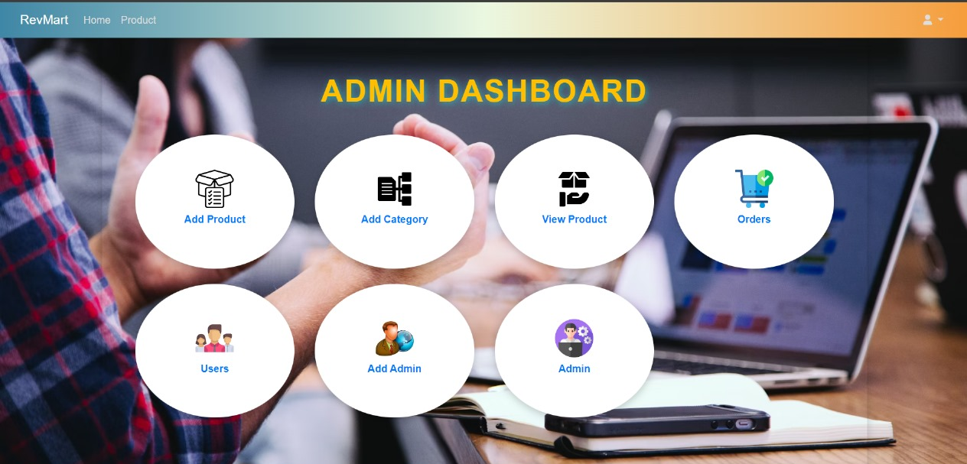
Snapshot
Admin Dashboard

Slide 17
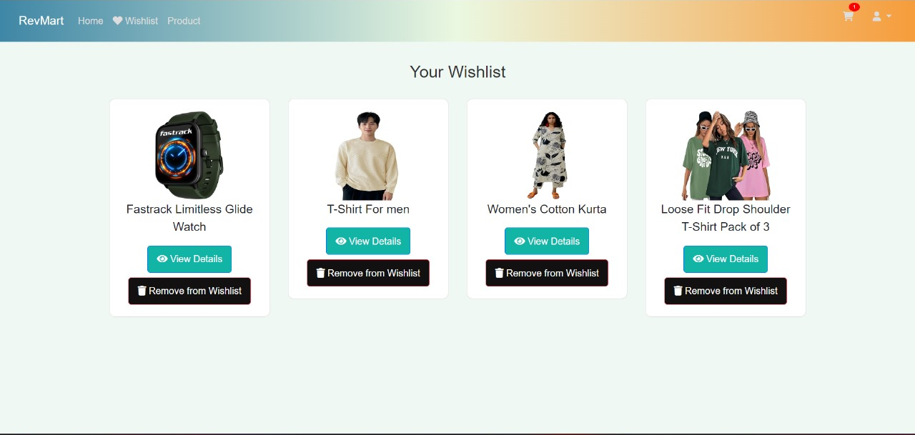
Snapshot
Wishlist

Slide 18
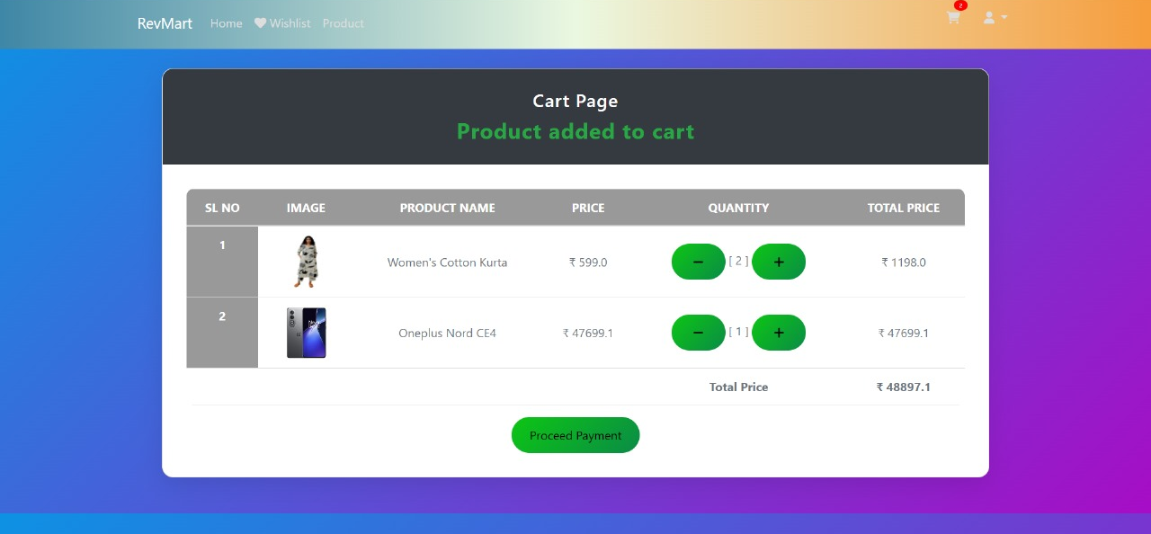
Snapshot
Cart Page

Slide 19
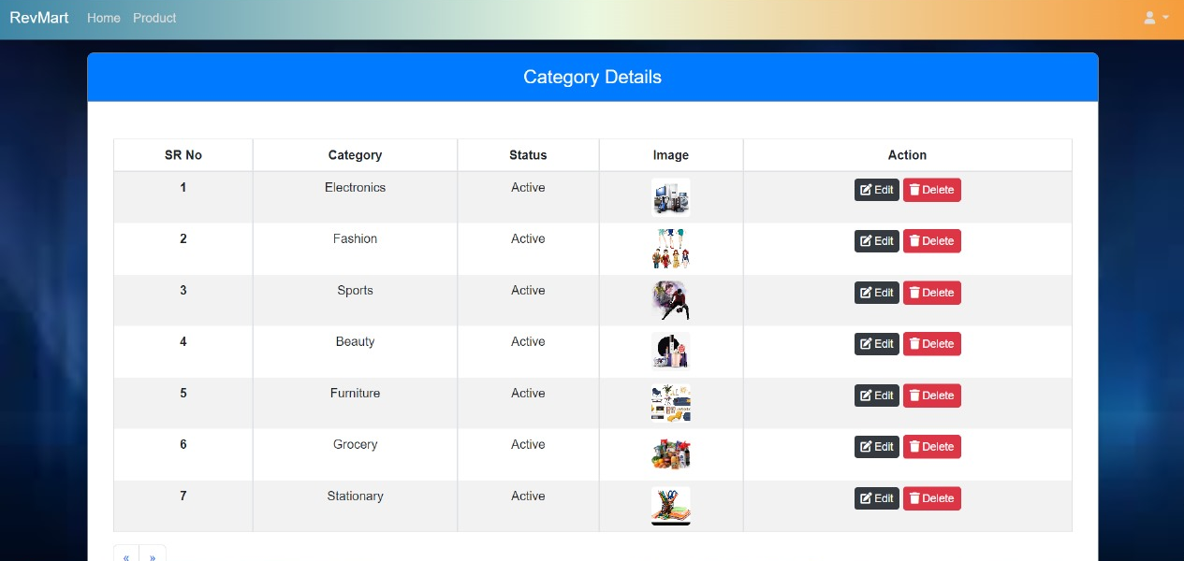
Snapshot
Category

Slide 20
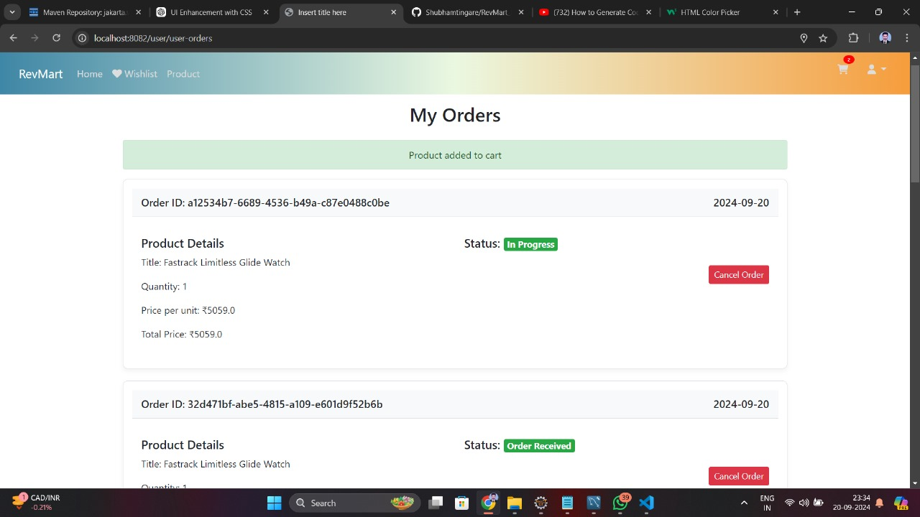
Snapshot
My Orders

Slide 21
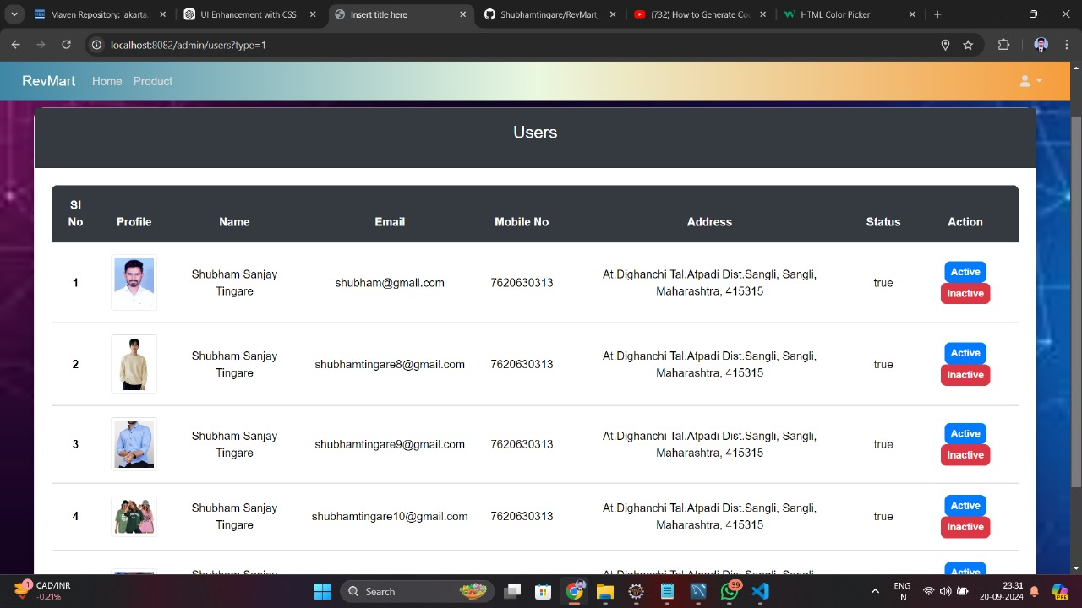
Snapshot
Users

Slide 22
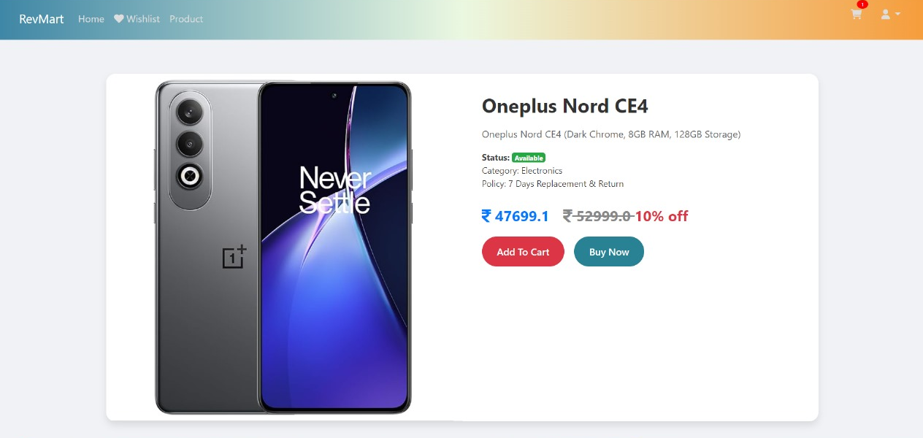
Snapshot
Product details

Slide 23
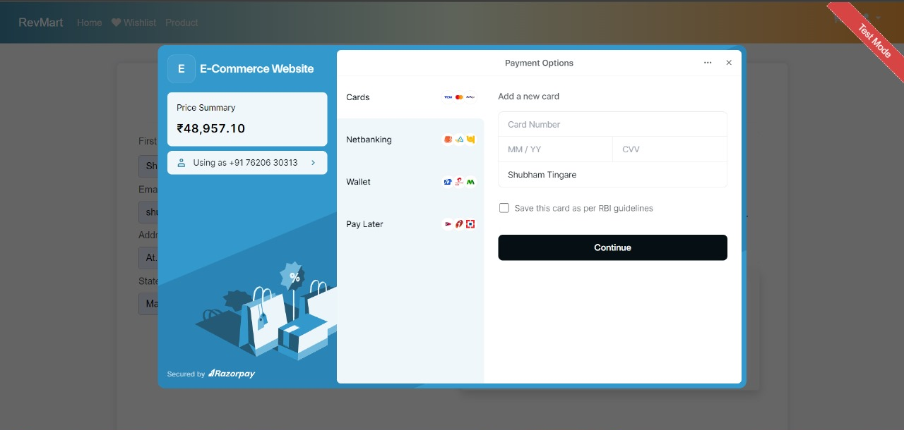
Snapshot
Payment System

Slide 24
Conclusion
Rev-mart offers a user-friendly interface, secure transactions, and features like product management and payment processing.
Utilizes Spring MVC for web development, Hibernate for data handling, and MySQL for managing data efficiently.
Overcame challenges in integrating various technologies to deliver a smooth and reliable e-commerce platform.

Slide 25
Thank you

