Slide 1
IBM Big-Data Analytics-Use Case 2
Amazon reviews data analysis for Camera
By:
RooGeeks
Vilas Mamidyala
Dinesh Kumar Bandam
Ranjitha reddy Bhumireddy
Sushma Mitta

Slide 2
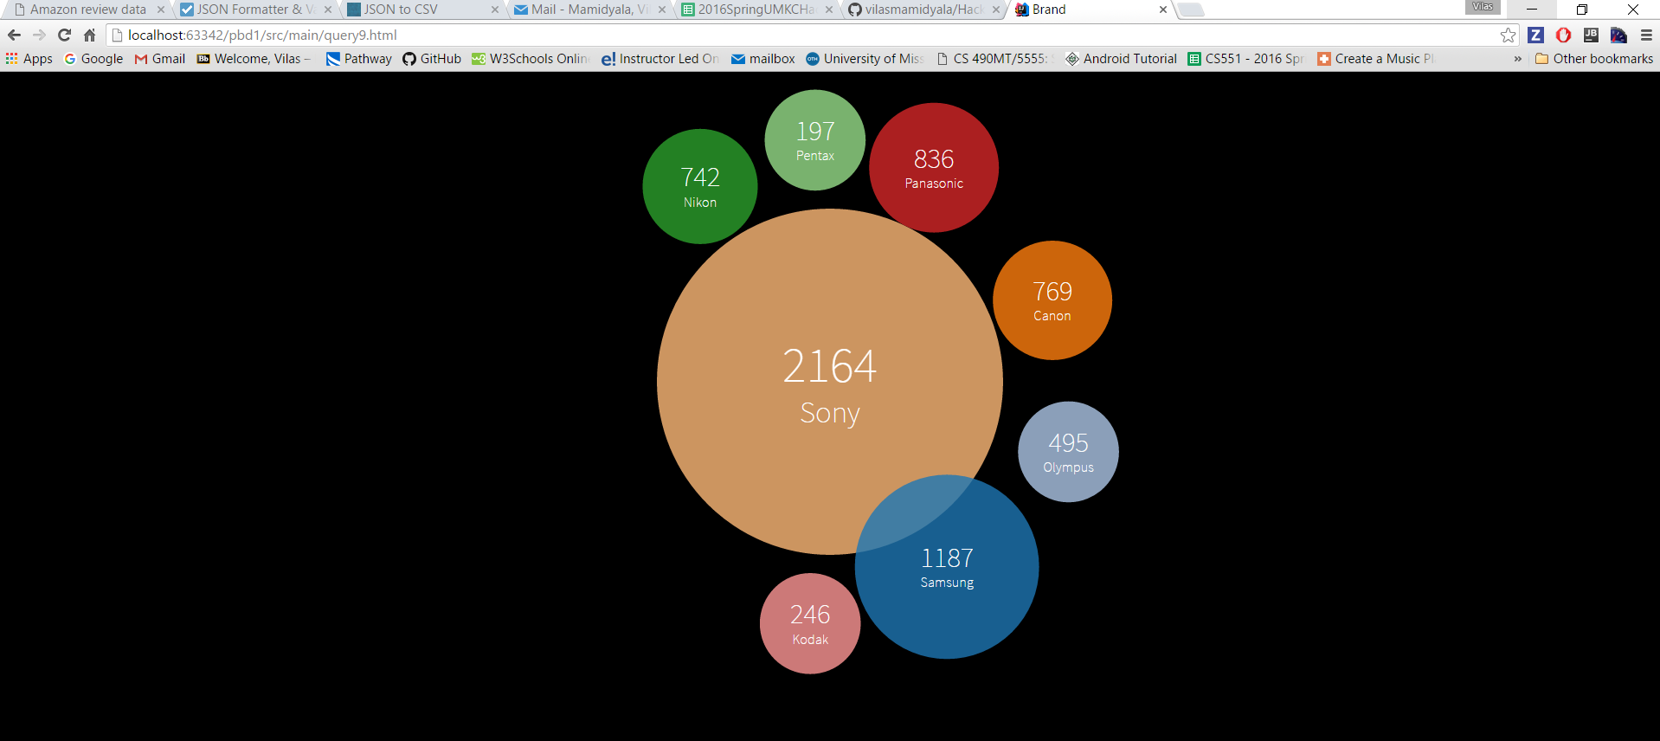

Slide 3
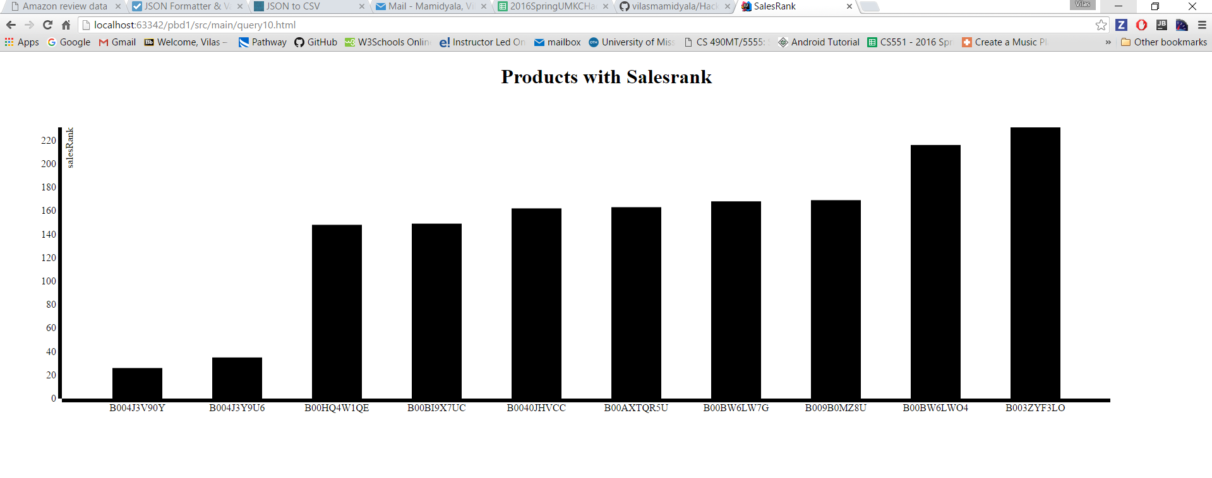

Slide 4
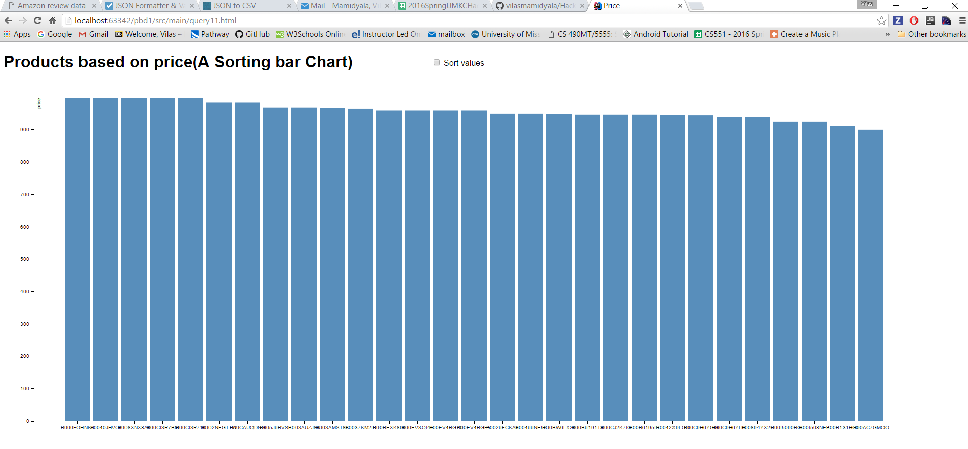

Slide 5
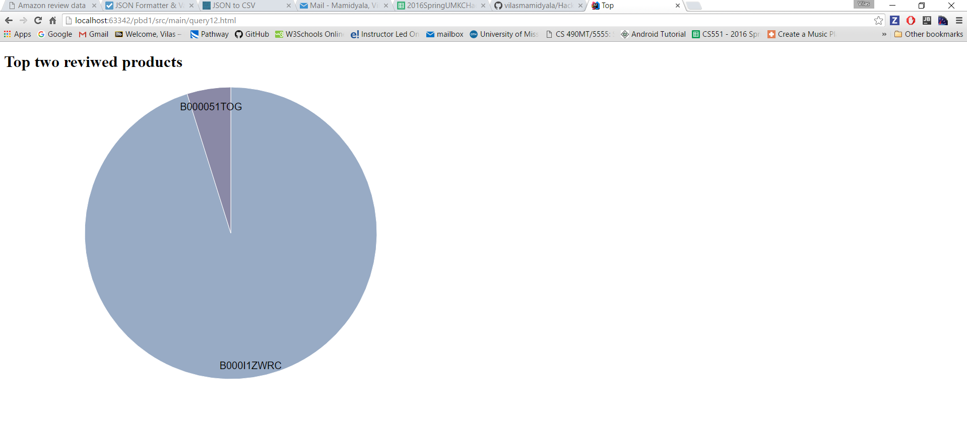

Slide 6
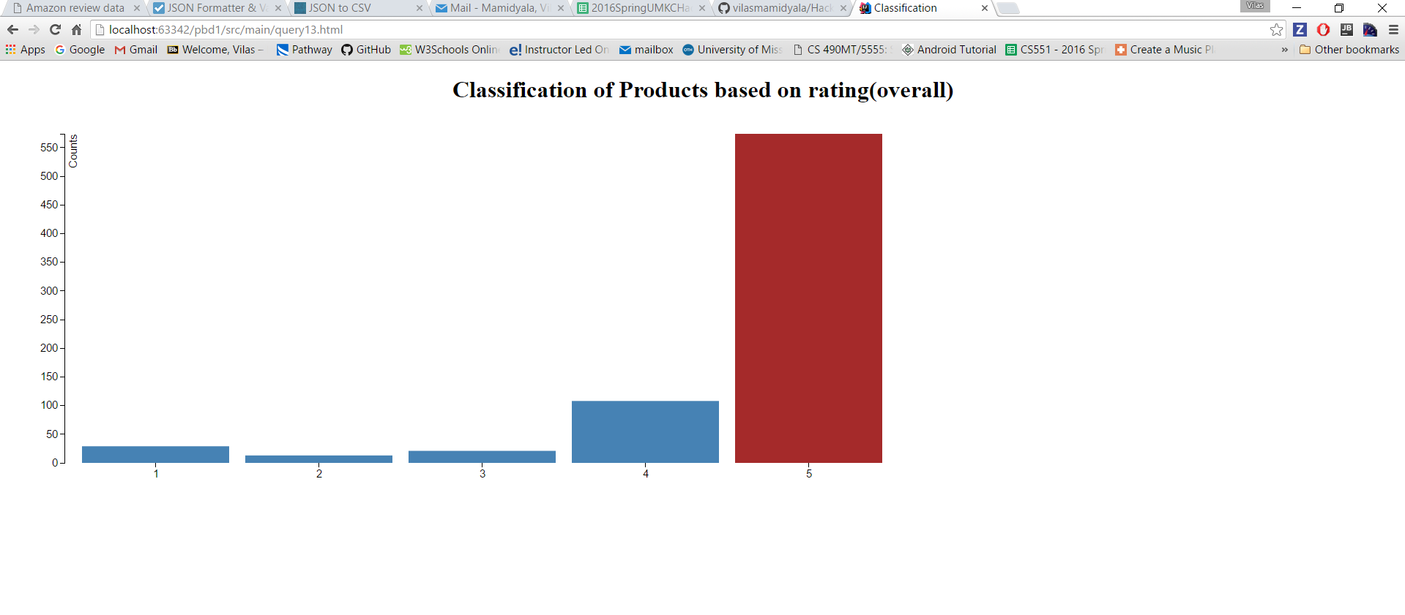

Slide 7
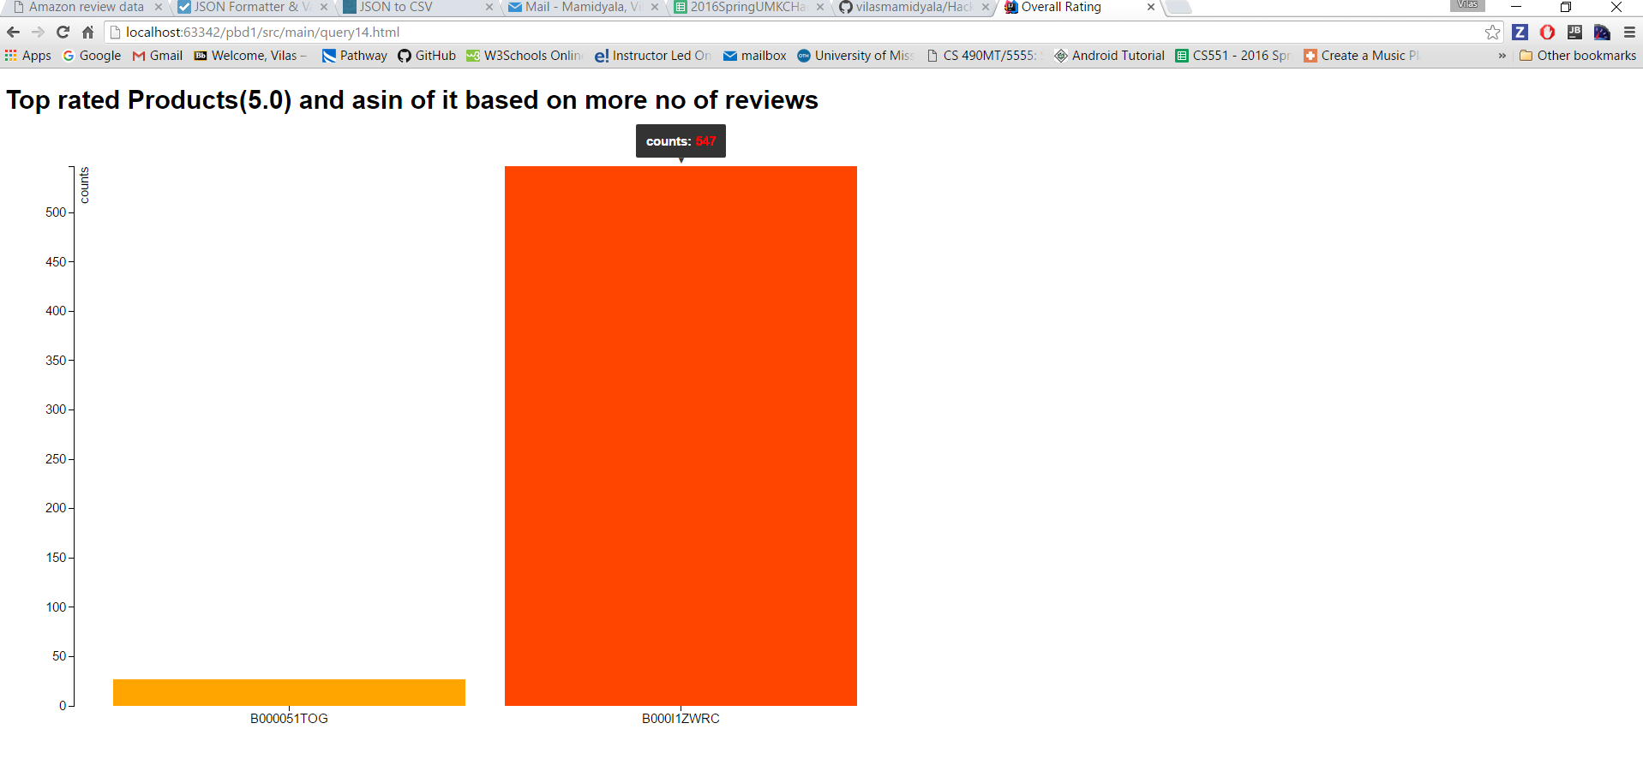

Slide 8
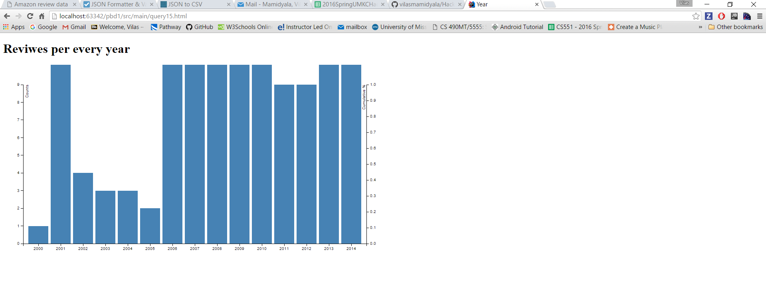

Slide 9
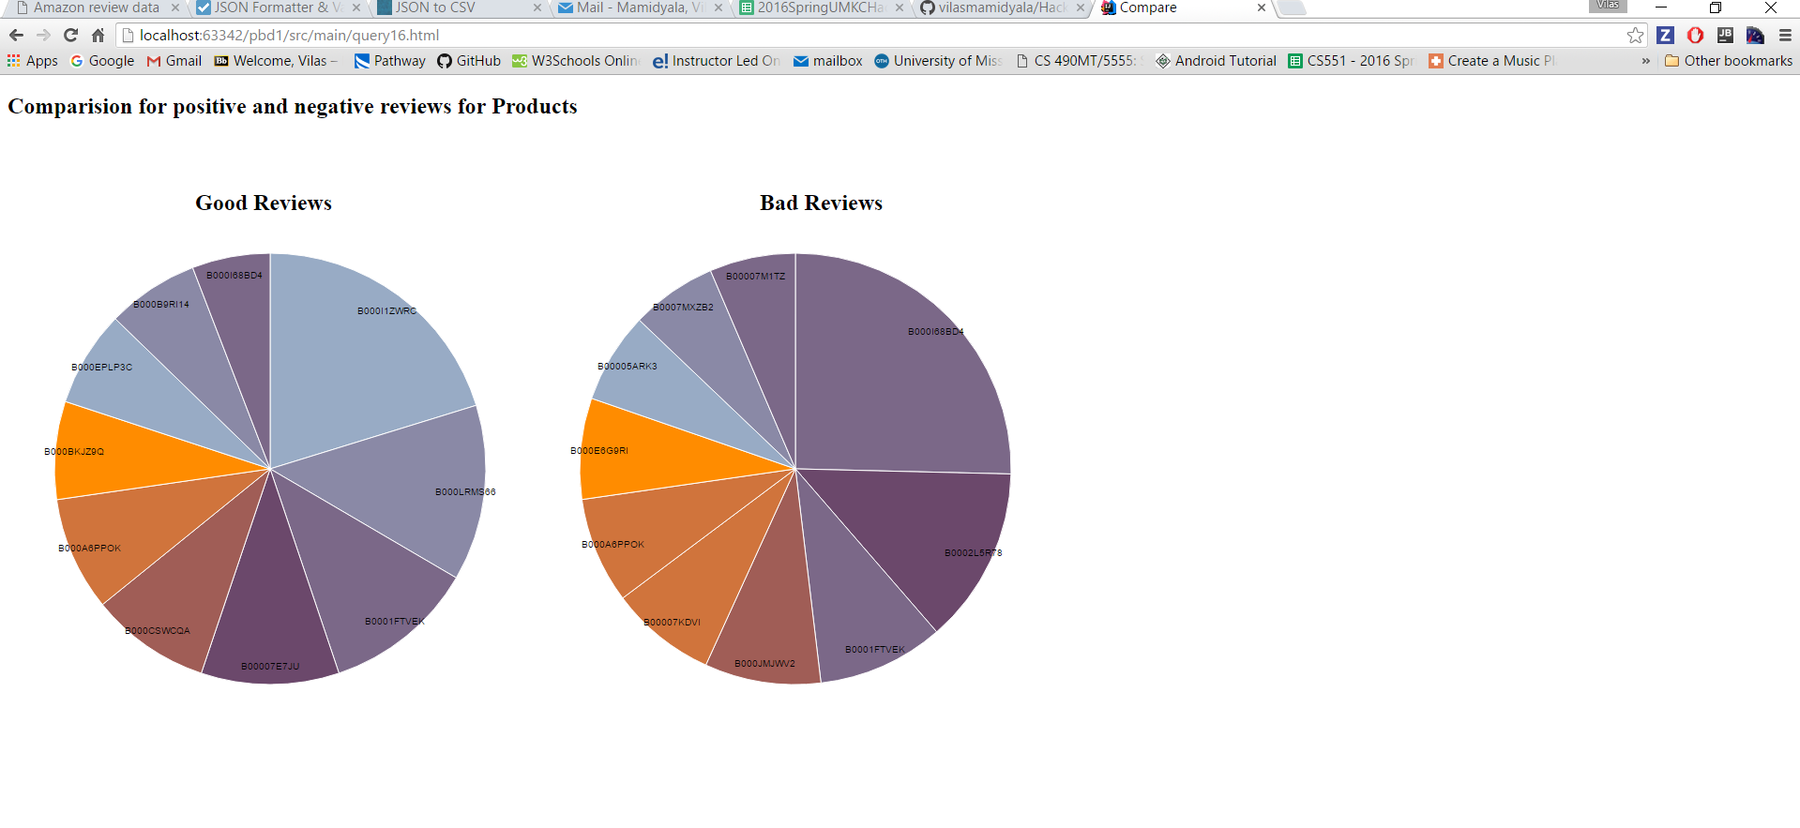

Slide 10
Thank you

