Slide 1
MEMENTO PATTERN
By
Team 5:
Vilas Mamidyala
Dinesh kumar bandam
Ranjitha reddy Bhumireddy

Slide 2
MEMENTO PATTERN
What is a Memento Pattern?
Memento pattern is used to restore state of an object to a previous state. Memento pattern falls under behavioral pattern category.
It has 3 main classes.
Memento: The basic object that is stored in different states.
Originator: Sets and Gets values from the currently targeted Memento. Creates new Mementos and assigns current values to them.
Caretaker: Holds an ArrayList that contains all previous versions of the Memento. It can store and retrieve stored Mementos.

Slide 3
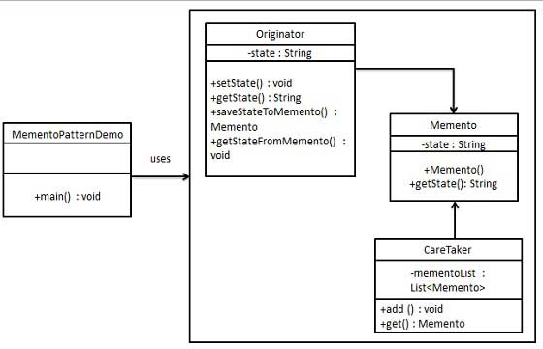
Memento Class Diagram

Slide 4
Memento Implementation
Memento pattern uses three actor classes. Memento contains state of an object to be restored. Originator creates and stores states in Memento objects and Caretaker object is responsible to restore object state from Memento. We have created classes Memento, Originator and CareTaker.
MementoPatternDemo, our demo class, will use CareTaker and Originator objects to show restoration of object states.

Slide 5
Step 1:
Create Memento class.
Memento.java
package Memento;
public class Memento {
private String state;
public Memento(String state){
this.state = state;
}
public String getState(){
return state;
}
}

Slide 6
Step 2:
Create Originator class Originator.java
package Memento;
public class Originator {
private String state;
public void setState(String state){
this.state = state;
}
public String getState(){
return state;
}
public Memento saveStateToMemento(){
return new Memento(state);
}
public void getStateFromMemento(Memento Memento){
state = Memento.getState();
}
}

Slide 7
Step 3:
Create CareTaker class CareTaker.java
package Memento;
public class CareTaker {
private List<Memento> mementoList = new ArrayList<Memento>();
public void add(Memento state){
mementoList.add(state);
}
public Memento get(int index) {
return mementoList.get(index);
}
}

Slide 8
Step 4:
Use CareTaker and Originator objects. MementoPatternDemo.java:
public class MementoPatternDemo {
public static void main(String[] args) {
Originator originator = new Originator();
CareTaker careTaker = new CareTaker();
originator.setState("State #1");
originator.setState("State #2");
careTaker.add(originator.saveStateToMemento());
originator.setState("State #3");
careTaker.add(originator.saveStateToMemento());
originator.setState("State #4");
System.out.println("Current State: " + originator.getState());
originator.getStateFromMemento(careTaker.get(0));
System.out.println("First saved State: " + originator.getState());
originator.getStateFromMemento(careTaker.get(1));
System.out.println("Second saved State: " + originator.getState());
}
}

Slide 9
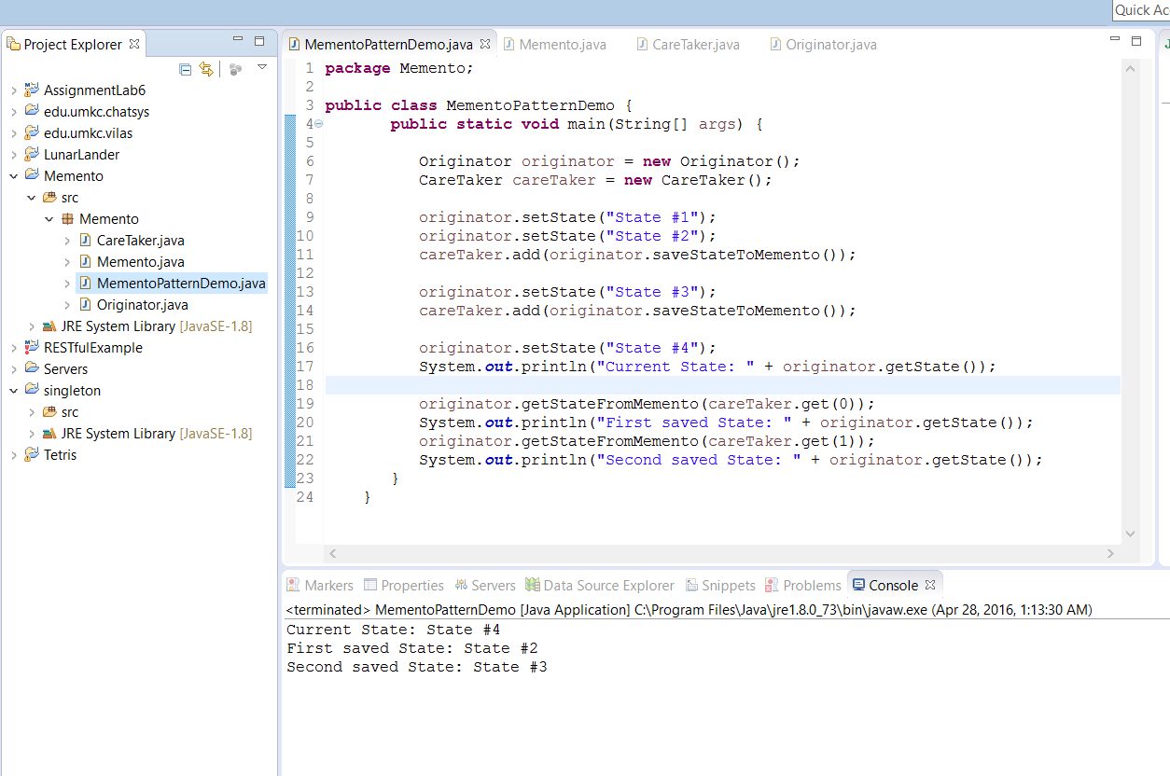
Step 5:
Verify Output:

Slide 10
References:
http://www.tutorialspoint.com/design_pattern/memento_pattern.htm
http://www.newthinktank.com/2012/10/memento-design-pattern-tutorial/

Slide 11
Thank you ☺

