Slide 1
SINGLETON PATTERN
By
Team 5:
Vilas Mamidyala
Dinesh kumar bandam
Ranjitha reddy Bhumireddy

Slide 2
SINGLETON PATTERN
What is a Singleton Pattern?
Singleton pattern ensures that a class has only one instance and provides a global point of access to it.
Singleton pattern is one of the simplest design patterns in Java.
Using singleton it will allow Controlled access to sole instance, reduces name space and Permits refinement of operations and representations.
Examples:
  There can be many printers in a system but there should only be one printer spooler.
  Thread pools, SQL Connection Pools, Registry objects, Objects handling user preferences, Caches, Factory classes, Builder classes and Statistics utilities like a hit counter, log4net, when you call its logger, it uses a singleton class to return it.

Slide 3
Singleton Pattern
    How do we ensure that a class has only one instance and that the instance is easily accessible?
    A global variable makes an object accessible, but does not keep you from instantiating multiple objects.
    A better solution is to make the class itself responsible for keeping track of its sole instance. The class ensures that no other instance can be created (by intercepting requests to create new objects) and it provides a way to access the instance.
    Use the Singleton pattern when
    There must be exactly one instance of a class, and it must be accessible to clients from a well-known access point.
    When the sole instance should be extensible by sub-classing, and clients should be able to use an extended instance without modifying their code.

Slide 4
Singleton Structure
  Singleton
  static Instance()
SingletonOperation()
GetSingletonData()
static uniqueinstance
singletonData
return uniqueinstance

Slide 5
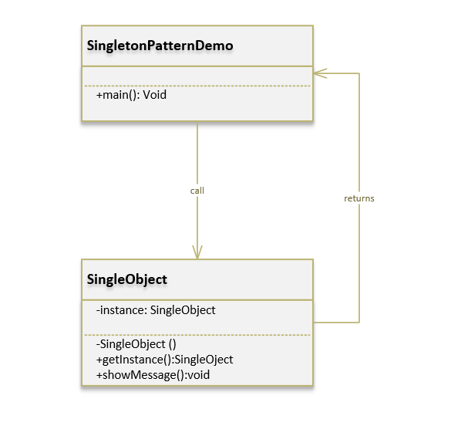
Singleton Class Diagram

Slide 6
Singleton Implementation
Ensuring a unique instance
The Singleton pattern makes the sole instance a normal instance of a class, but that class is written so that only one instance can ever be created. A common way to do this is to hide the operation that creates the instance behind a static class operation that guarantees that only one instance is created.
Example:
We're going to create a SingleObject class. SingleObject class have its constructor as private and have a static instance of itself.
SingleObject class provides a static method to get its static instance to outside world. SingletonPatternDemo, our demo class will use SingleObject class to get a SingleObject object.

Slide 7
Step 1:
Create a Singleton Class named SingleObject.java
package SingleObject;
public class SingleObject {
//create an object of SingleObject
private static SingleObject instance = new SingleObject();
//make the constructor private so that this class cannot be
//instantiated
private SingleObject(){}
//Get the only object available
public static SingleObject getInstance(){
return instance;
}
public void showMessage(){
System.out.println("This is about singleton pattern");
}
}

Slide 8
Step 2:
Get the only object from the singleton class.SingletonPatternDemo.java
package SingleObject;
public class SingletonPatternDemo {
public static void main(String[] args) {
//illegal construct
//Compile Time Error: The constructor SingleObject() is not visible
//SingleObject object = new SingleObject();
//Get the only object available
SingleObject object = SingleObject.getInstance();
//show the message
object.showMessage();
}
}

Slide 9
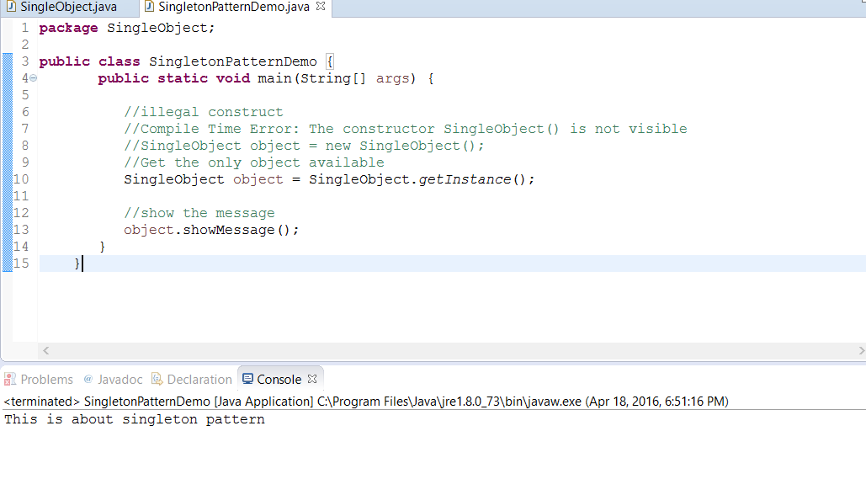
Step 3:
Verify the output.

Slide 10
References:
http://www.newthinktank.com/2012/09/singleton-design-pattern-tutorial/
http://www.tutorialspoint.com/design_pattern/singleton_pattern.htm

