Slide 1
Spring Factory Method Using Static
Computer ( Abstract)
getRam(),getHdd(),getCpu()
Main
ApplicationContext
calling ComputerFactory
through Beans.xml
ComputerFactory
Public static Computer
getComputer(type,ram,hdd,cpu)
Reads Beans.xml
PC( Concrete)
PC(ram,hdd, cpu)
//getters and setters ram/hdd/cpu
Server( Concrete)
Server(ram,hdd, cpu)
//getters and setters ram/hdd/cpu
Beans.xml

Slide 2
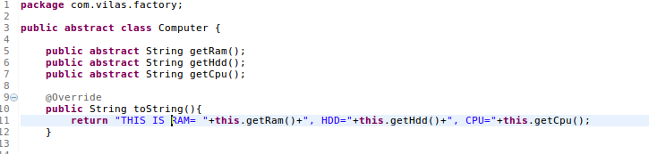
Creating an Computer Interface

Slide 3
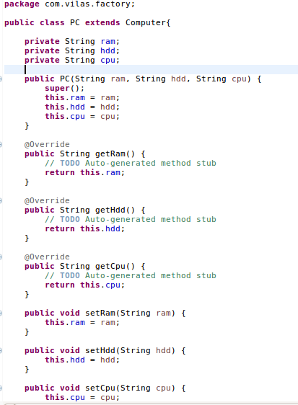
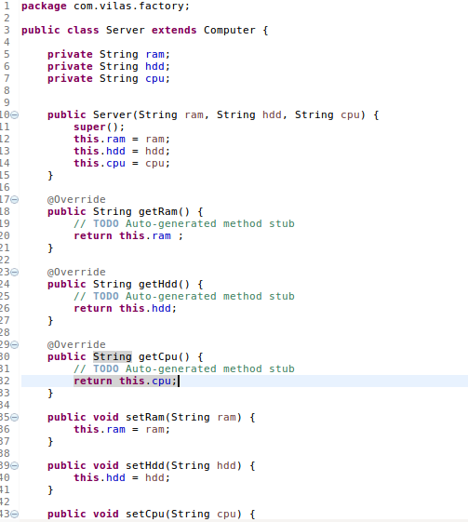
Extending the Abstract Class

Slide 4
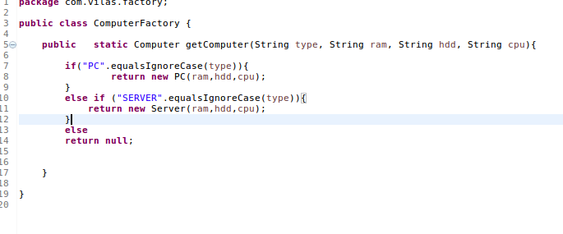
Creating an Factory Class

Slide 5
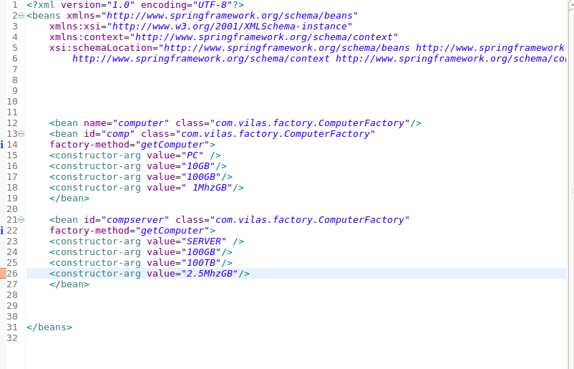
Configuring Beans.xml

Slide 6
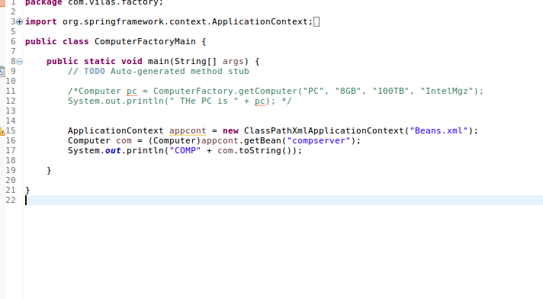
Testing the Factory Class

Slide 7
Project Setup – Pom.xml on Maven Project
<properties>
<!-- Generic properties -->
<java.version>1.6</java.version>
<project.build.sourceEncoding>UTF-8</project.build.sourceEncoding>
<project.reporting.outputEncoding>UTF-8</project.reporting.outputEncoding>
<!-- Spring -->
<spring-framework.version>3.2.3.RELEASE</spring-framework.version>
<!-- Hibernate / JPA -->
<hibernate.version>4.2.1.Final</hibernate.version>
<!-- Logging -->
<logback.version>1.0.13</logback.version>
<slf4j.version>1.7.5</slf4j.version>
<!-- Test -->
<junit.version>4.11</junit.version>
</properties>
<dependencies>
<!-- Spring and Transactions -->
<dependency>
<groupId>org.springframework</groupId>
<artifactId>spring-context</artifactId>
<version>${spring-framework.version}</version>
</dependency>
<dependency>
<groupId>org.springframework</groupId>
<artifactId>spring-tx</artifactId>
<version>${spring-framework.version}</version>
</dependency>

Slide 8
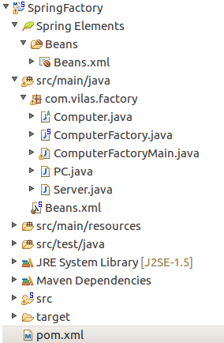
Project Setup

