Slide 1
Java 8 Training
Vilas Varghese Corporate Trainer
vilas_varghese@yahoo.com
1

Slide 2
Rules.. Can we?
Decide to be punctual?
Decide to communicative?
2

Slide 3
Agenda
Interface static and default methods
Functional paradigm Lambda expressions Stream API Collectors
Optional
Date and Time API
3

Slide 4
Prerequisite
Oracle Java 8 installed on your machine
https://www.oracle.com/in/java/technologies/javase/javase-jdk8-downloads.html
Exact Version -> Java SE 8u281
Eclipse
https://www.eclipse.org/downloads/packages/installer
Git
https://git-scm.com/downloads
4

Slide 5
Why languages evolve?
5

Slide 6
Why languages evolve?
To meet developers expectations
To remain relevant
To keep up-to-date with advancements
hardware
Security fixes
Better approaches to perform certain task
6

Slide 7
Why you should learn Java 8?
To embrace functional programming paradigm
Lambdas
Declarative data processing New and improved API’s
Date and Time API Stream API Concurrency utilities
Improved support for clean API design Optional
Interface default and static methods
7

Slide 8
Section 01 Interface API Design
8

Slide 9
Three main components of API Design
Interfaces
Abstract Classes Classes
9

Slide 10
Let’s write a simple Calculator
Calculator >> Interface
BasicCalculator >> Implementation
10

Slide 11
Static methods
Allow API designer to define static methods inside an interface
for defining static utility methods
11

Slide 12
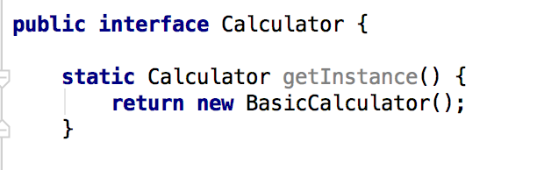
Static method example
12

Slide 13
Interfaces can now have
static and default(instance) methods
13

Slide 14
Why we need this?
Ability to evolve API with time
Remain source compatible
14

Slide 15
Demo >> Evolving API’s
15

Slide 16
Default Methods
Interfaces can supply non-abstract methods
Enables interfaces to evolve with time
Eliminate need for companion or utility classes
16

Slide 17
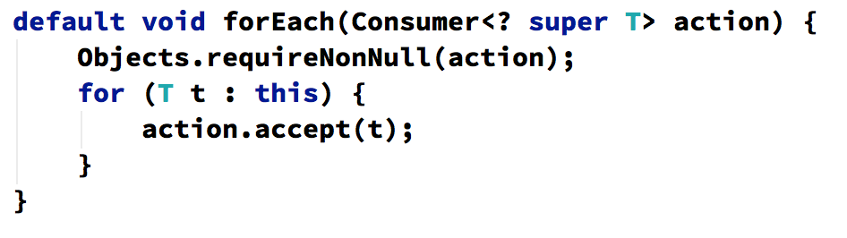
Example of default method
Iterable’s forEach method
17

Slide 18
Multiple inheritance
With interfaces having the capability to define methods, we have behaviour level multiple interfaces
18

Slide 19
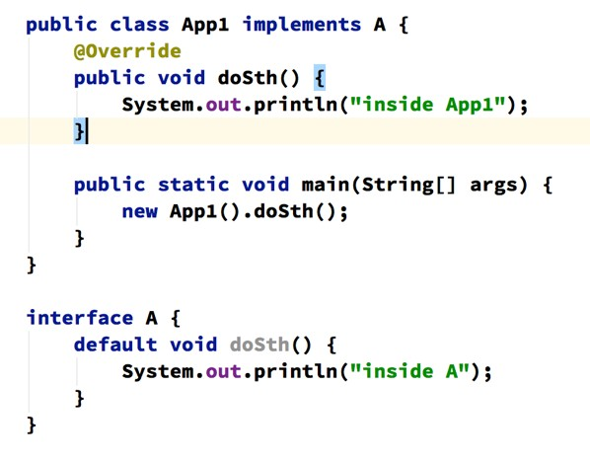
Interface Class Hierarchy
19

Slide 20
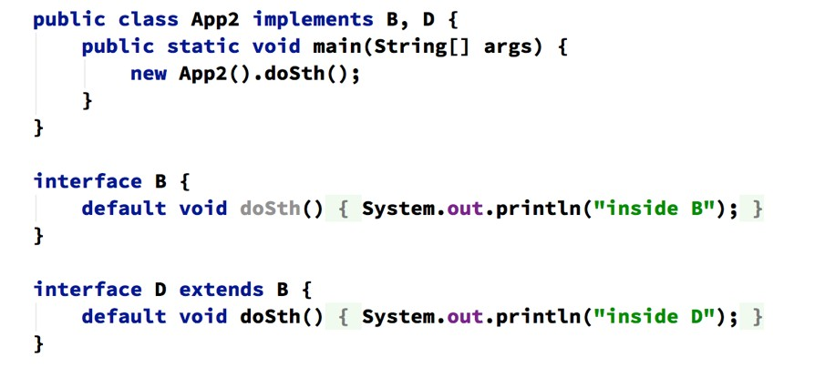
Multiple Interface Hierarchy
20

Slide 21
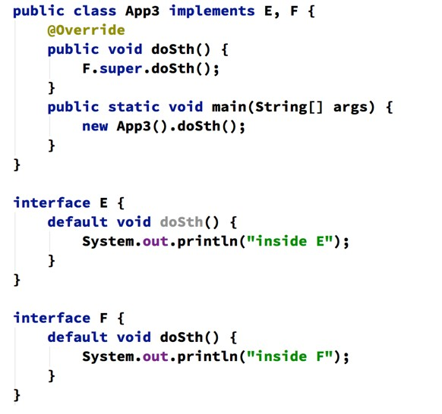
Diamond problem
21

Slide 22
Section 02 Functional Paradigm
22

Slide 23
Programming paradigm
A programming paradigm is a fundamental style of computer programming.
Imperative, declarative, functional, object-oriented, procedural, logical, etc.
A programming language can follow one or more paradigms.
23

Slide 24
Imperative vs Functional Paradigm
Imperative programming paradigm
Computation: Uses statements that change a program’s state.
Program: Consists of sequence of commands that tell a program how it should achieve the result.
Functional programming paradigm
Computation: Evaluation of expressions
Expression: Formed by using functions to combine basic values.
Focusses on what the program should accomplish rather than how
Examples on next page
24

Slide 25
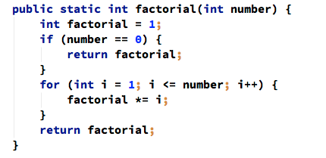
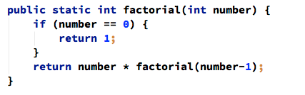
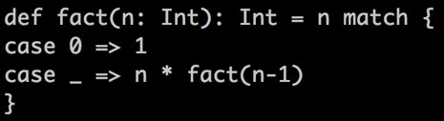
Canonical example — Factorial
Imperative style >>
Functional style >>
Scala >>

Slide 26
Functional Programming
Functional programming was invented in 1957
Before Object Oriented programming Before structured programming
Memory was too expensive to make functional programming practical

Slide 27
Functional programming
“Functional programming is so called because a program consists entirely of functions.”
- John Hughes, Why Functional Programming Matters

Slide 28
What is a function?
A side effect free computation that always result in same value when passed with same argument.

Slide 29
Why should we embrace functional programming?
Functional programs are simpler
No side effects
Fewer concurrency issues

Slide 30
Functional Languages
Haskell
ML
Erlang
F# - (Hybrid) Scala - (Hybrid) Clojure
Java 8 - (Hybrid)

Slide 31
Key Functional Programming Concepts
Function
A side effect free computation that always result in same value when passed with same argument.
Higher order function
function that takes function as argument or return functions.
Referential transparency
allows you to replace function with its value Recursion
function calls itself Lazy evaluation
function is not evaluated until required

Slide 32
Introduce Example Domain
Task management application
Task TaskType
Demo >> domain.Task

Slide 33
SECTION 03 LAMBDAS

Slide 34
Lambda expression
A new feature introduced in Java 8
A representation of anonymous function that can be passed around.
Allows you to pass behaviour as code that can be executed later
Allows you to encapsulate changing behaviour in a lambda expression
Earlier this was achieved via the use of anonymous inner classes

Slide 35
Demo >> lambda
Demo >> Example0_Lambda

Slide 36

Lambda expression
The (first, second) are parameters of the compare method
first.length() - second.length() is the function body
-> is the lambda operator

Slide 37
Lambda syntax
(String a, String b) -> {return a + b;}
- (a,b) -> a + b
a -> a*a
- () -> a
() -> {System.out.println(“hello world”);}

Slide 38

Type Inference
The act of inferring a type from context is called
Type Inference.
In most cases, javac will infer the type from context.
If it can’t resolve then compiler will throw an error.
Demo >> Example2_Lambda

Slide 39
Lambdas are Typed
Type of a lambda expression is an interface
Only interfaces with single abstract method can be used
These interfaces are called functional interfaces
You can use @FunctionalInterface annotation to mark your interface a functional interface

Slide 40
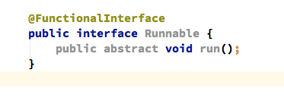
Example @FuntionalInterface
Demo >> Next slide

Slide 41
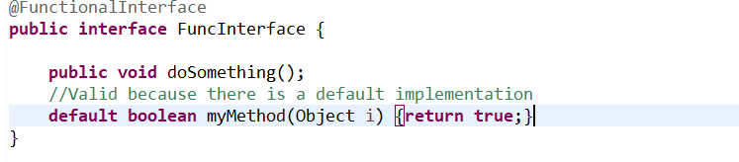
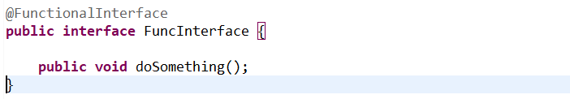
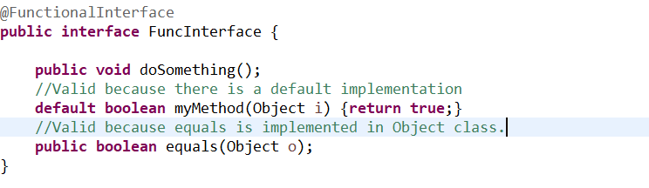
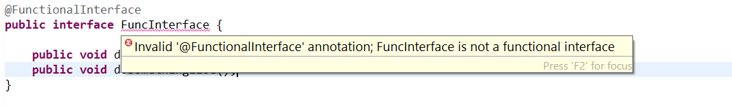
Invalid @FunctionalInterface

Slide 42
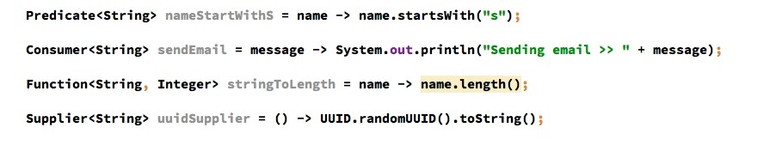
Look at few @FunctionalInterface
Most of the time you don’t have to write your own @FunctionalInterface
You can leverage interfaces defined in
java.util.function package
Some shown below:
Demo >> Example3_Functionalnterfaces.java

Slide 43
Test your lambda knowledge
>> Exercise1_Lambda.java

Slide 44
Where can I use lambda expression?
You can use lambdas wherever you use an interface with single method
Some examples callbacks, comparisons, filtering, transformation, actions,etc.
Spring templates are example where lambda could be used

Slide 45
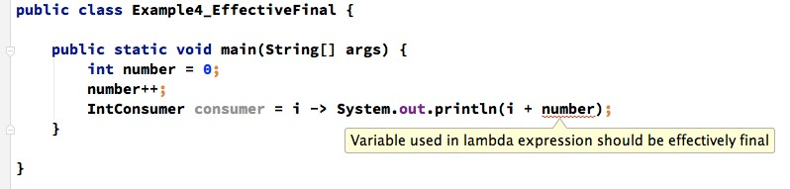
Using local variables >> Effective final

Slide 46
Method References

Slide 47
Method reference
Lets you create lambda expression from existing method implementation
Shorthand for lambdas calling only a specific method
String str -> str.length() String::length

Slide 48
Demo >> Method Reference

Slide 49
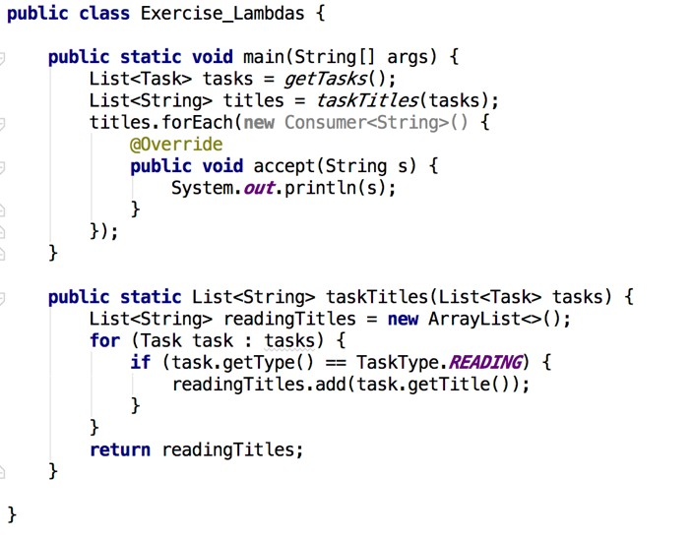
Exercise >> Let’s apply what we have learnt so far

Slide 50
SECTION 04 STREAM PROCESSING

Slide 51
Stream Processing
Why we need a new data processing abstraction?
Stream vs Collection Using Stream API

Slide 52
Why?
Collection API is too low level
Developers needed a higher level declarative data processing API
Processing data in parallel

Slide 53
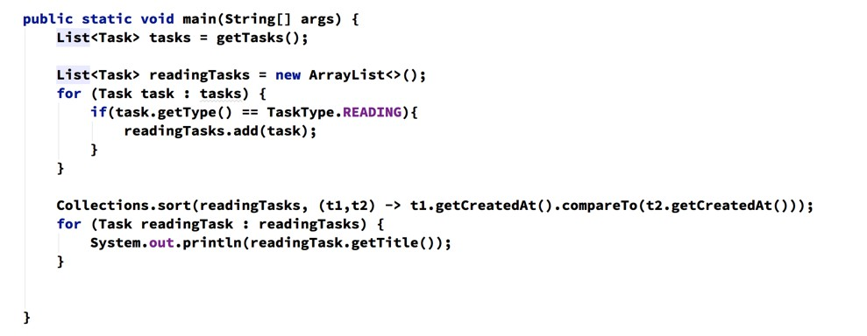
Data processing before Java 8
What does this code do?

Slide 54
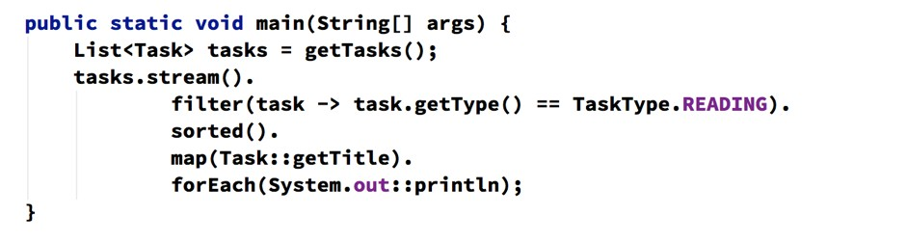
Data processing in Java 8
Isn’t this code beautiful?

Slide 55
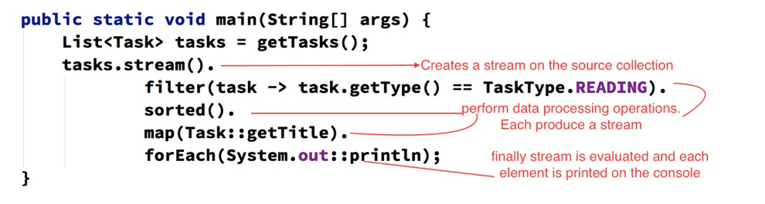
Understanding the code

Slide 56
Why Java 8 code is better?
Developer’s intent is clear
Declarative >> What over How
Reusable chainable higher level construct Unified language for data processing
No boilerplate code.!! Yay :)

Slide 57
Stream
Stream is a sequence of elements from a source supporting data processing operations
source -> collection with elements
data processing operations -> filter, map, etc.

Slide 58










Collection vs Stream
Collection | Stream
Read and write operation | Only read operations. You can’t add or remove elements.
Eagerly evaluated | Lazily evaluated
Collections are about data | Streams are for performing computations on data
Client has to iterate over collection >> External iteration | internal iteration
You can iterate over collection multiple times | You can only process a stream once

Slide 59
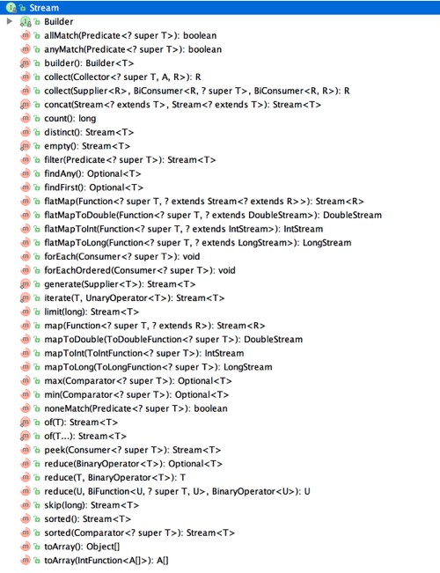
Stream API

Slide 60
Stream operations
Intermediate operations >> which results in another stream
map, filter, sort, distinct, etc
Terminal operations >> which produce a non-stream result
collect, foreach,

Slide 61
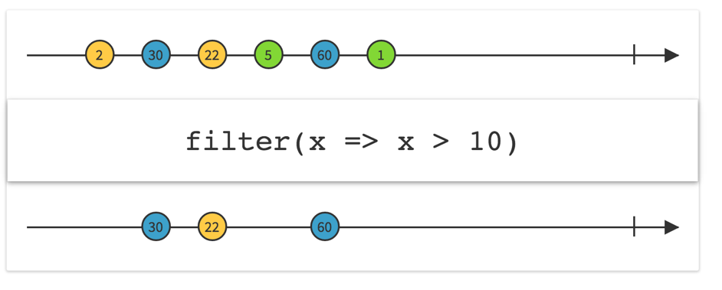
filtering
Demo >> Example2_FilterStream

Slide 62
Filtering operations
Find all the reading tasks sorted by their creation date
Find all distinct tasks and print them
Find top 5 reading tasks sorted by their creation date
Pagination with Skip and Limit Count all reading tasks

Slide 63
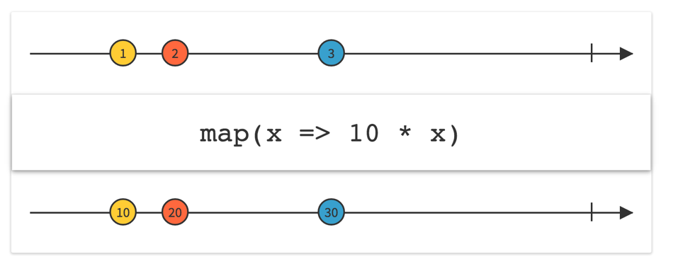
map operation
Example3_MapStreams

Slide 64
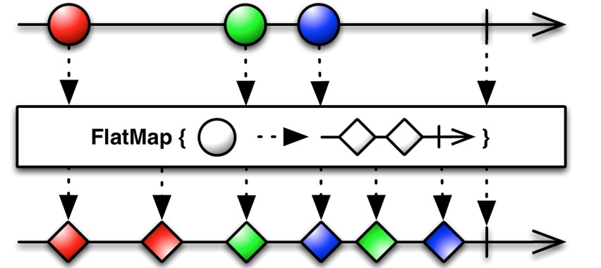
flatmap operation

Slide 65
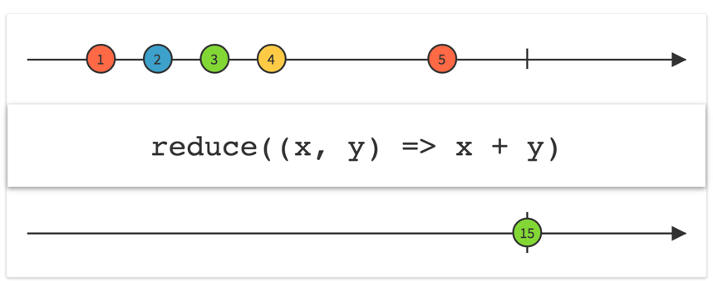
reduce operation

Slide 66
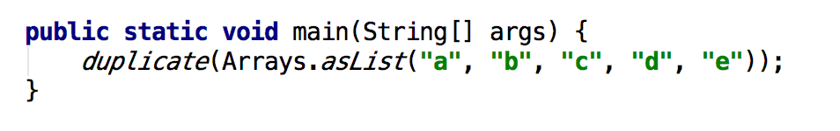

Duplicate Elements in a List
Output >>

Slide 67
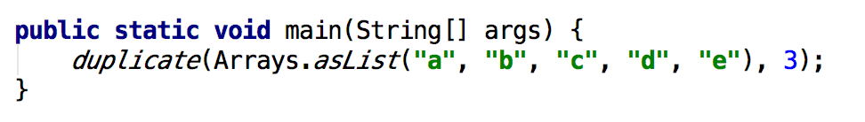

Duplicate Elements n times in a List
Output >>

Slide 68
Working with numeric streams
IntStream
LongStream DoubleStream
68

Slide 69
Parallel Stream
You can create an instance of parallel stream by calling the parallel operator
69

Slide 70
SECTION 05 COLLECTORS
70

Slide 71
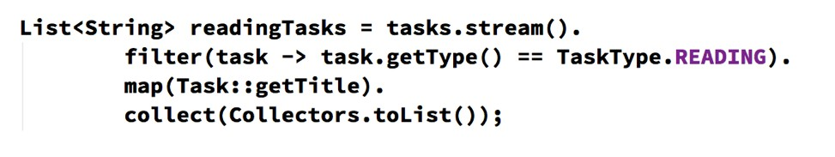
Collector
Reduce a stream to a single value
collect is a reduction operation
They are used with collect terminal method
71

Slide 72
Demo >> Power of Collector
Group tasks by Type >> Java 7 and Java 8
72

Slide 73
What you can do with collect?
Reducing stream to a single value
Group elements in a stream Partition elements in a stream
73

Slide 74
Collectors class
A utility class that contains static factory methods for most common collectors
that collect to a Collection grouping
partitioning
74

Slide 75
Reducing to a single value
Single value could be
numeric type domain object a collection
Demo >> Example2_ReduceValue
75

Slide 76
Grouping elements
Group elements by key
You can do both single level and multilevel grouping
Demo >> Example3
76

Slide 77
Partitioning
It is a special case of grouping
Groups source collection into at most two partitioned by a predicate
Returned map has following syntax Map<Boolean, List<Task>>
Demo >> Example4
77

Slide 78
Sec 06 Optional<T>
78

Slide 79
How many of you have experienced NullPointerException?
79

Slide 80
Null History
It was designed by Sir Tony Hoare in 1965
creator of Quicksort
He was designing Algol W language
null was designed to signify absence of value
Most programming languages like Java, C++, C#, Scala, etc all have Null
He called it was a Billion Dollar Mistake
http://www.infoq.com/presentations/Null-References-The-Billion-Dollar-Mistake-Tony- Hoare

Slide 81
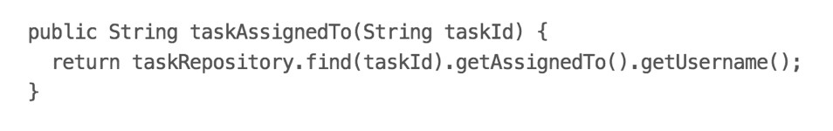
What could possibly go wrong?
81

Slide 82
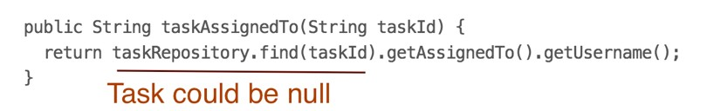
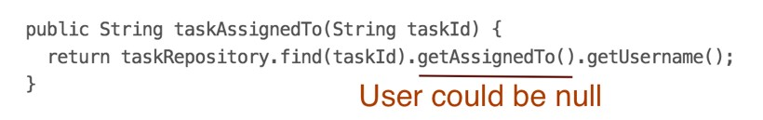
NullPointerException
82

Slide 83
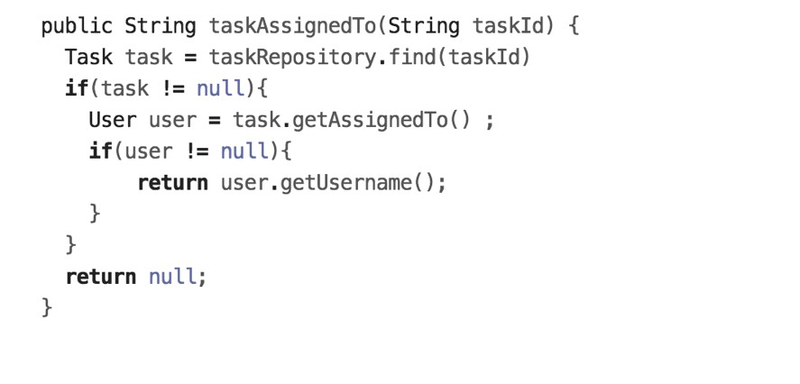
We end up writing …
83

Slide 84
Biggest problem with code
Absence of value is not visible in the API
84

Slide 85
Possible solutions
Null Object Pattern << Before Java 8
Optional << From Java 8
85

Slide 86
Optional
A container that may or may not contain a value
If a function returns Optional then the client would know that value might not be present
Common concept is functional languages MayBe, Nothing >> Haskell
Option, Some, None >> Scala Optional<T> >> Java 8
86

Slide 87
Demo >> Optional TaskRepository
87

Slide 88
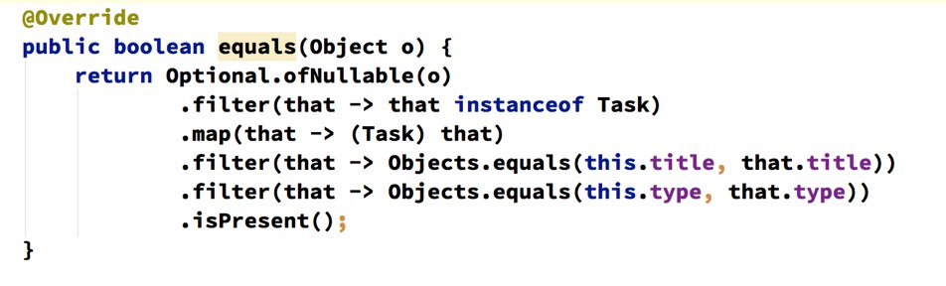
Another Example
88

Slide 89
SECTION 07 DATE AND TIME API
89

Slide 90
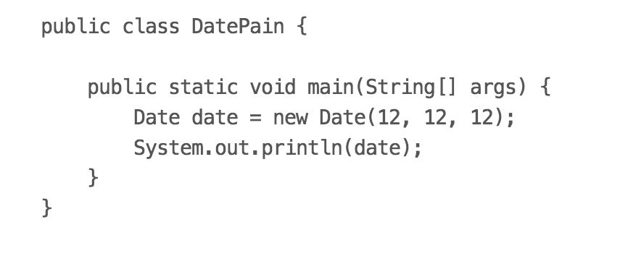
What does the below program prints?
90

Slide 91
Existing Date API Problems
Sun Jan 12 00:00:00 IST 1913
Which 12 is for date field?
12 is for December right?? No. It’s January
Year 12 is 12 CE?? Wrong 1913. starts from 1900 Hmmm. why there is time in date??
There is timezone as well?? Who asked??
91

Slide 92
Existing Date API
Date API was introduced in JDK in 1996
There are many issues with Mutability
Date is not date but date with time Separate Date class hierarchy for SQL No concept of timezone
Boilerplate friendly
92

Slide 93
Calendar API
Still mutable
Can’t format a date directly
You can’t perform arithmetic operations on date.
Calendar instance does not work with formatter
93

Slide 94
New API — Getting Started
Developed as part of JSR 310
Heavily inspired by Joda-Time library New package — java.time
94

Slide 95
New types for humans
LocalDate - a date with no time or timezone
LocalTime - a time with no date or timezone
LocalDateTime - LocaDate + LocalTime
All types are immutable
95

Slide 96
Demo >> LocalDate, LocalTime, and
LocalDateTime
96

Slide 97
New Type >> Instant
A machine friendly way to describe date and time
Number of seconds passed since epoch time
Nanosecond precision
Useful to represent event timestamp
97

Slide 98
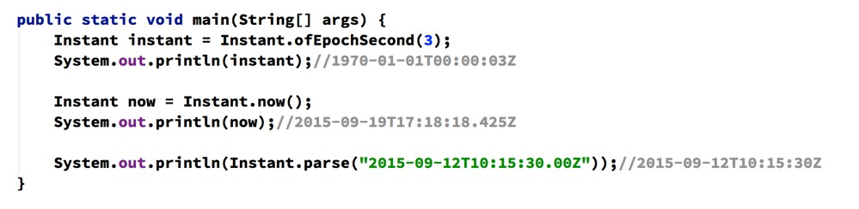
Demo >> Instant
98

Slide 99
Duration and Period
Duration represents quantity or amount of time in seconds or nano-seconds like 10 seconds
Duration d = Duration.between(dt1,dt2)
Period represents amount or quantity of time in years, months, and days
Period p = Period.between(ld1,ld2)
99

Slide 100
Demo >>
100

Slide 101
Temporal Adjuster
When you need to do advance date-time manipulation then you will use it
Examples
adjust to next sunday
adjust to first day of next month adjust to next working day
101

Slide 102
Demo >>
102

