Slide 1
PGPCC - Mentor session
Flow and Structure for MS12
Week 1 & 2
“Microservices”

Slide 2

Agenda
Total duration 120 mins
Introduction to Microservice Architecture
Event drive pub/sub in Experian
Understanding the low level details
Q&A from participants

Slide 3

Evolutionary Design
In Martin Fowler’s own words - “Microservice practitioners, usually have come from an evolutionary design background and see service decomposition as a further tool to enable application developers to control changes in their application without slowing down change. Change control doesn't necessarily mean change reduction - with the right attitudes and tools you can make frequent, fast, and well-controlled changes to software.”

Slide 4
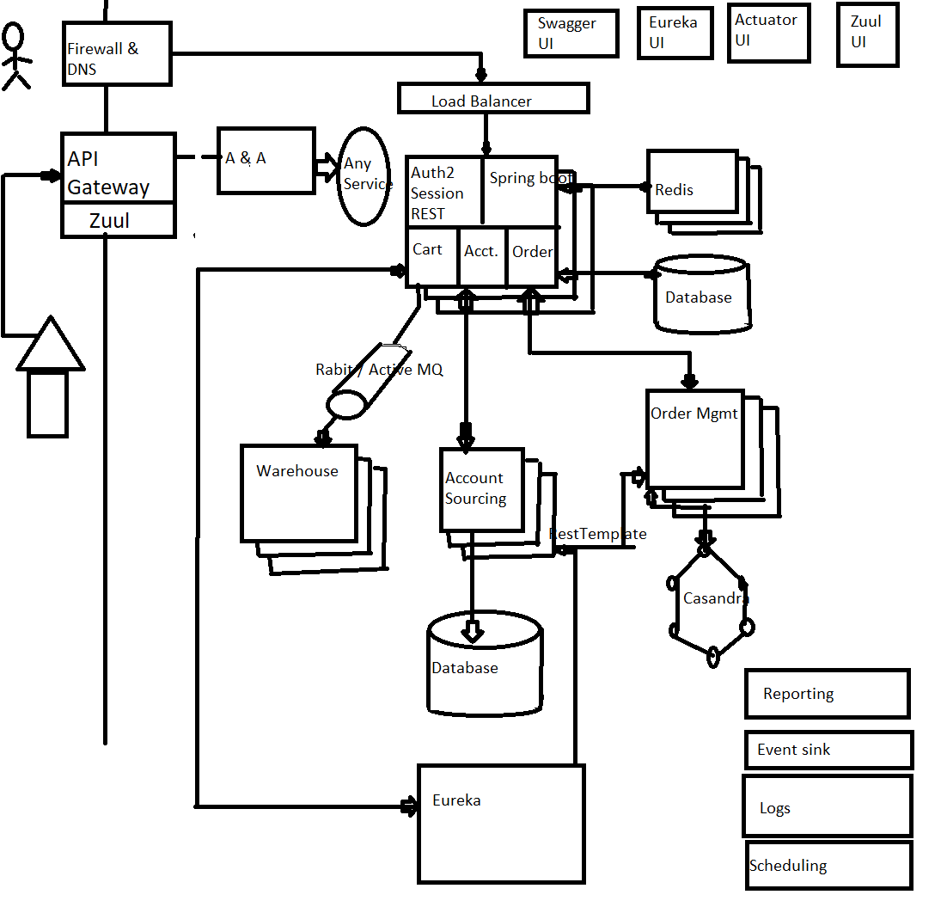
Microservices Architecture – A case study
Notes:
https://www.youtube.com/watch?v=c_WNBmEc6EE&did=ta_card&trk=ta_card
Actuator: produces metrics. Can be used for close circuiting.

Slide 5
Challenges created by Microservices
Service Discovery
Load Balancing
Fault Tolerance
Distributed Tracing
Telemetrics
Security
Mutual TLS between Services
Network policies/Whitelisting
Certificate expiry
Granularity
Bounded Contexts
Data Modelling
Independently releasable
Service contracts
Smart services, dumb-pipes

Slide 6
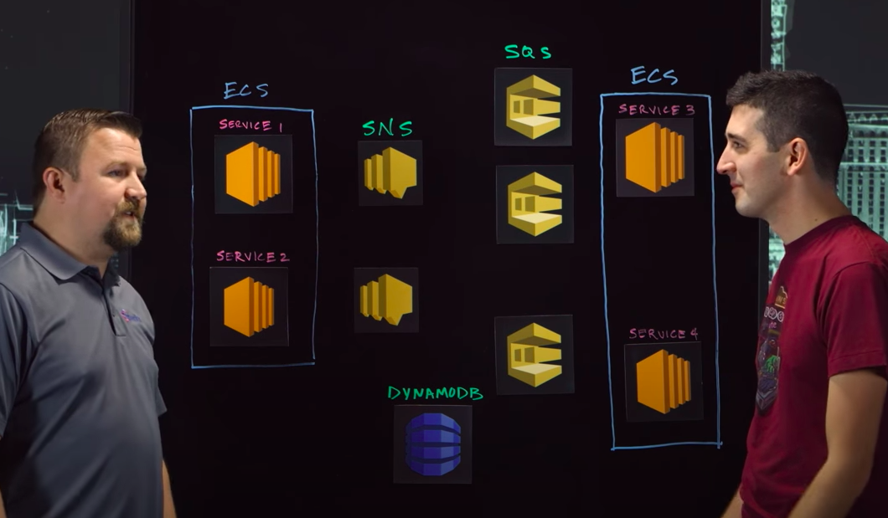
Experian: Event-Driven Pub-Sub with SNS and SQS
Notes:
https://www.youtube.com/watch?v=c_WNBmEc6EE&did=ta_card&trk=ta_card
https://www.jeremydaly.com/how-to-use-sns-and-sqs-to-distribute-and-throttle-events/ Yet another good read: https://www.jeremydaly.com/serverless-microservice-patterns-for-aws/#distributedtrigger almost guaranteed delivery + throttling our messages. SQS: If an SQS queue is not available, SNS will retry 10 times immediately, then 100,000 times every 20 seconds for a total of 100,010 attempts over more than 23 days before the message is discarded from SNS. If it is critical that all published messages be successfully processed, developers should have notifications delivered to an SQS queue (in addition to notifications over other transports). we could lose events if we don’t set up Dead Letter Queues (DLQs).

Slide 7
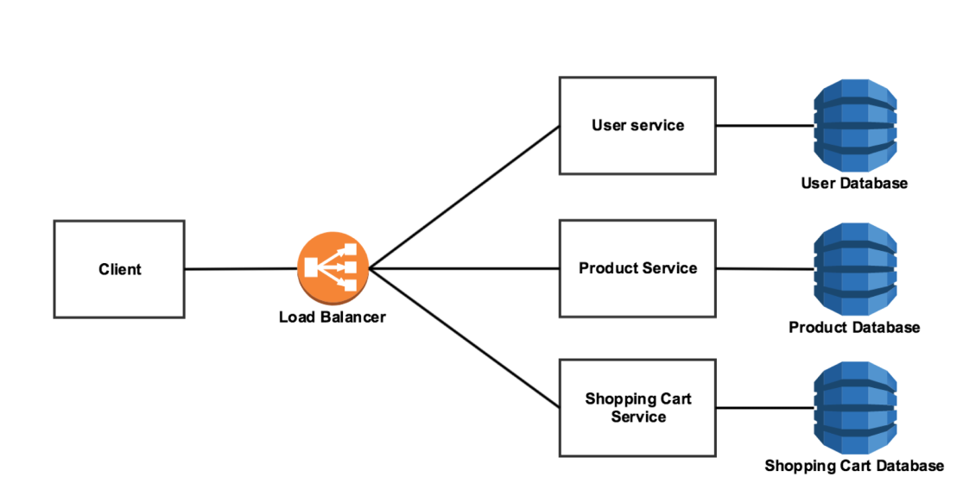
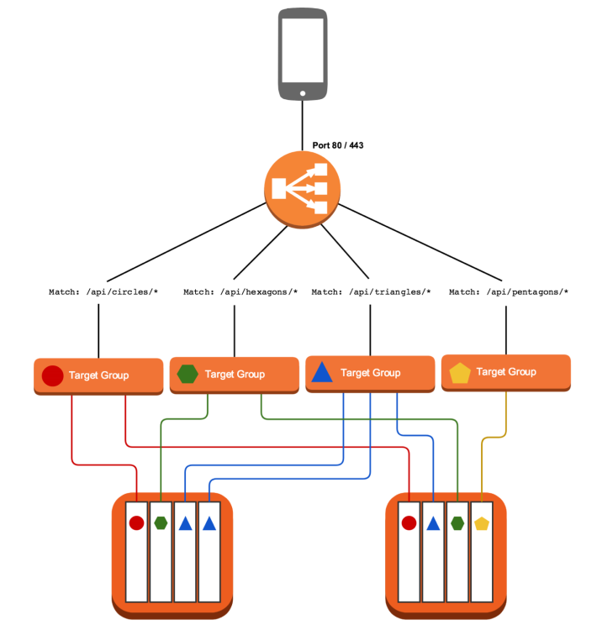
One public interface, split out to multiple services
Notes:
Talking points -
1. Different services can be exposed via a single public DNS interface (powered by a loadbalancer)
2. Path based routing can help direct traffic to the appropriate service
3. Each service can be a set of target groups and weighted routing can help achieve canary release
4. Point 3 above will also help in quick rollbacks
5. Immutable infrastructure deployment policy should be used to avoid configuration drift

Slide 8
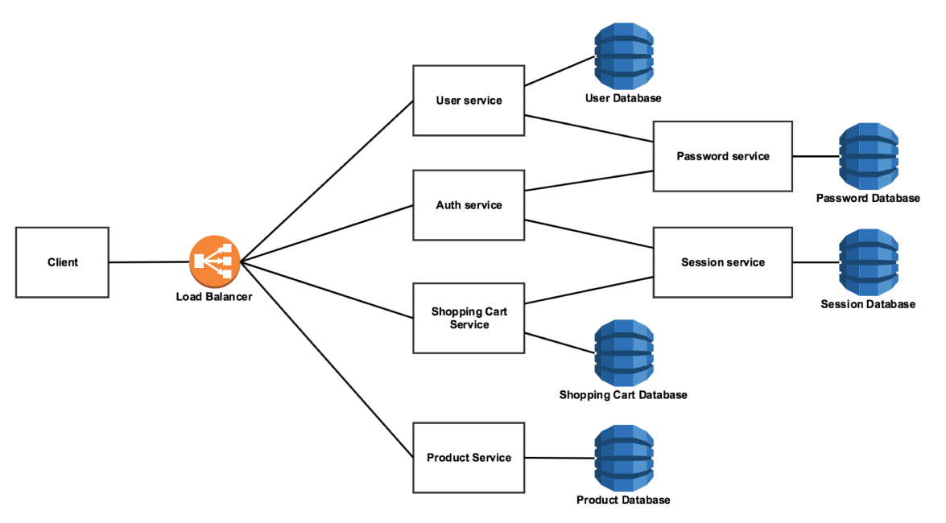
Realtime background services
Notes:
Talking points -
1. Not all services need to be customer facing
2. Internal services act as supporting services for the others
3. Internal services can be sitting behind an “Internal loadbalancer” or “Client side load balancing” can be considered in the public facing services calling the internal services
4. There is no other difference from an operations perspective between internal and external services

Slide 9
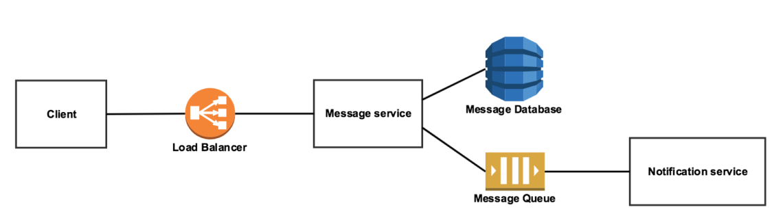
Asynchronous background services
Notes:
Talking points -
1. Certain usecases require batch processing or take longer to execute. In these cases it makes no sense for the client to wait for the processing to finish
2. A queue can be used very effectively to group messages and process them in batches
3. It is possible to have another queue where the result of the processing can be deposited for the caller to look at in the future
4. This is a very powerful way in which services can be decoupled

Slide 10
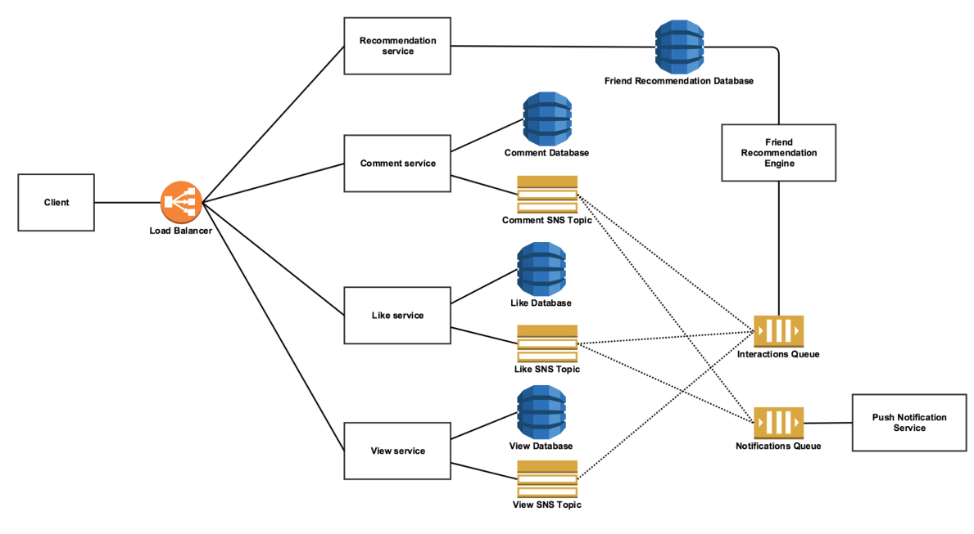
Decoupled asynchronous service fan-out
Notes:
Talking points -
1. A fanout deposites messages in different queues for parallel asynch processing
2. This kind of architecture promotes concurrent business process execution
3. It also allows to attach and detach business processes over time apart from achieving de-coupling among services

Slide 11
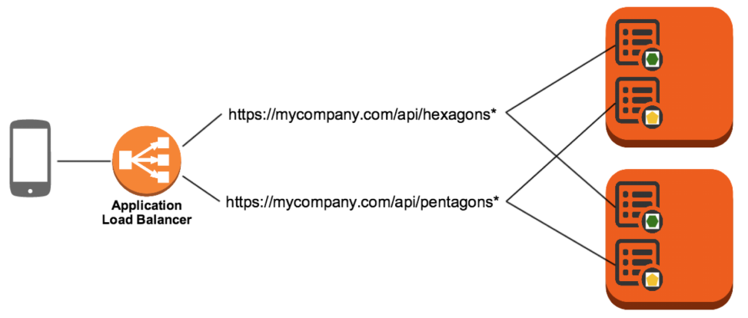
Application Load Balancer for Service Discovery

Slide 12
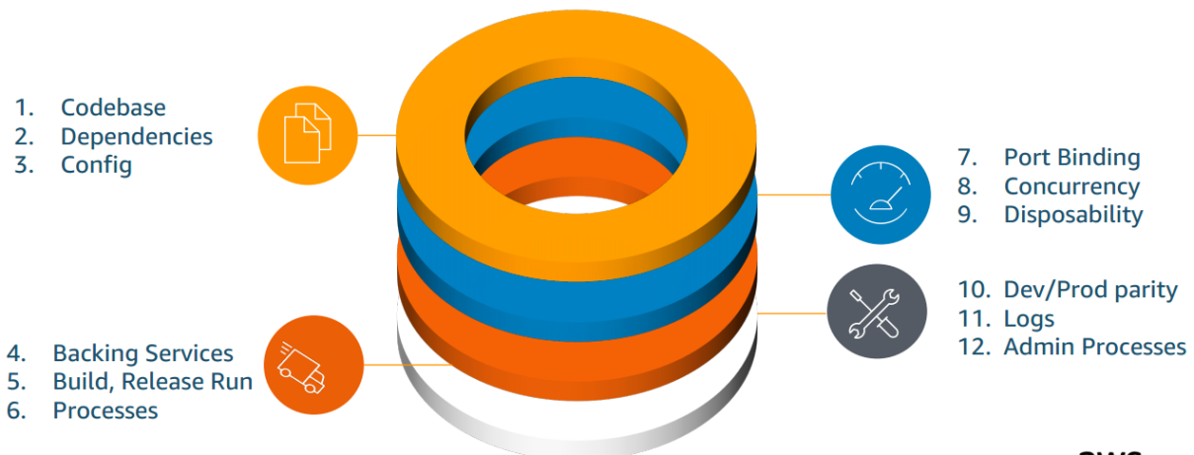
AWS Microservice whitepaper
Microservices architectures are not a completely new approach to software engineering, but rather a combination of various successful and proven concepts such as:
Agile software development
Service-oriented architectures
API-first design
Continuous Integration/Continuous Deployment (CI/CD)
In many cases, design patterns of the Twelve-Factor App are leveraged for microservices.
Notes:
Whitepaper link https://docs.aws.amazon.com/whitepapers/latest/microservices-on-aws/introduction.html

Slide 13
Thank you
Happy Learning!

