Slide 1
E₃₀
E₂₁
E₁₂
E₀₃
E₂₀
E₁₁
E₀₂
20
12
E₁₀
E₀₁
6
2
E₀₀

Slide 2
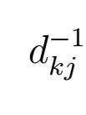
Element in the inverse of the Slater Matrix
Evaluated for the k-th particle at position r_{j}
The j-th single particle wavefunction

