Slide 1


LEARN UI/UX PRINCIPLES AND APPLY IN REDESIGNING AND BUILDING DEGREY WEBSITE
University of Transport and Communication
High-Quality program English-Vietnamese IT
By: Pham Ngoc Hai
The supervisor: Dr. Nguyen Quoc Tuan
Hanoi, June 2024

Slide 2
01
Introduction

Slide 3
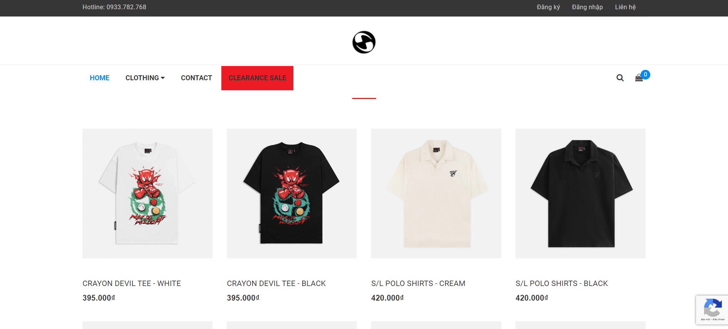
Introduction of the Topic
Source: nowsaigon.com

Slide 4
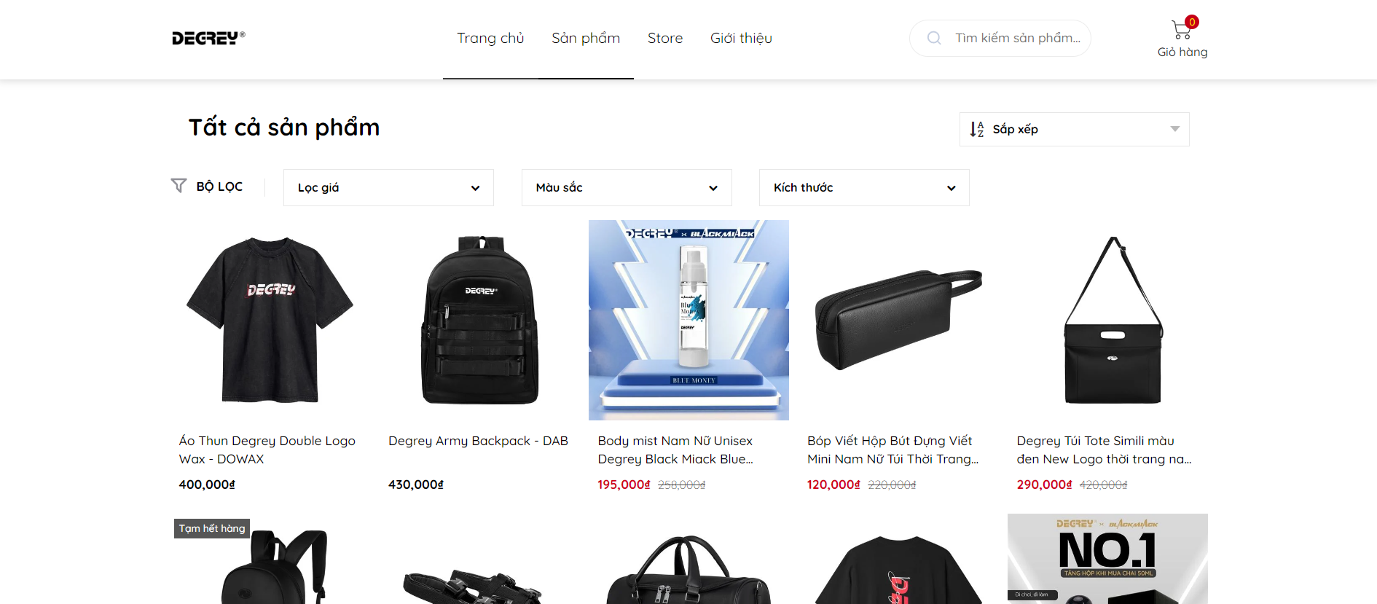
Reason for choosing the topic
Source: degrey.vn

Slide 5
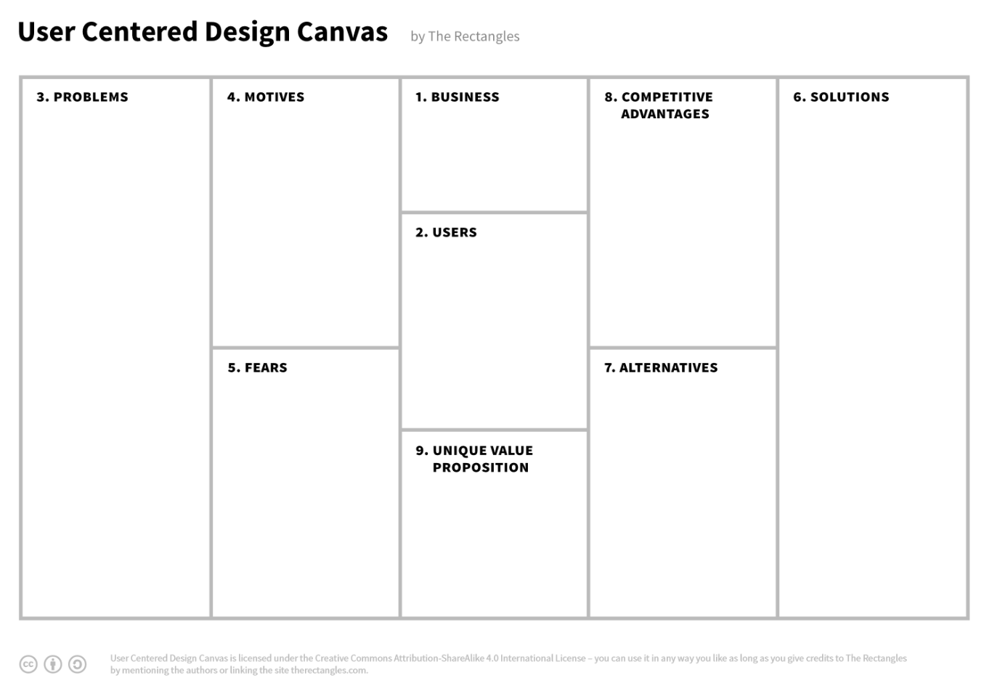
Website requirements
Based on UI/UX design criteria
Customers can purchase and make payments
Feedback on the products when they have bought
Products Management
Orders Management
Orders history
Login/Register/Logout

Slide 6




Tools utilized
01
02
03
04
Figma
Boostrap
SQL Sever
ASP.NET Core

Slide 7
02
System analysis

Slide 8
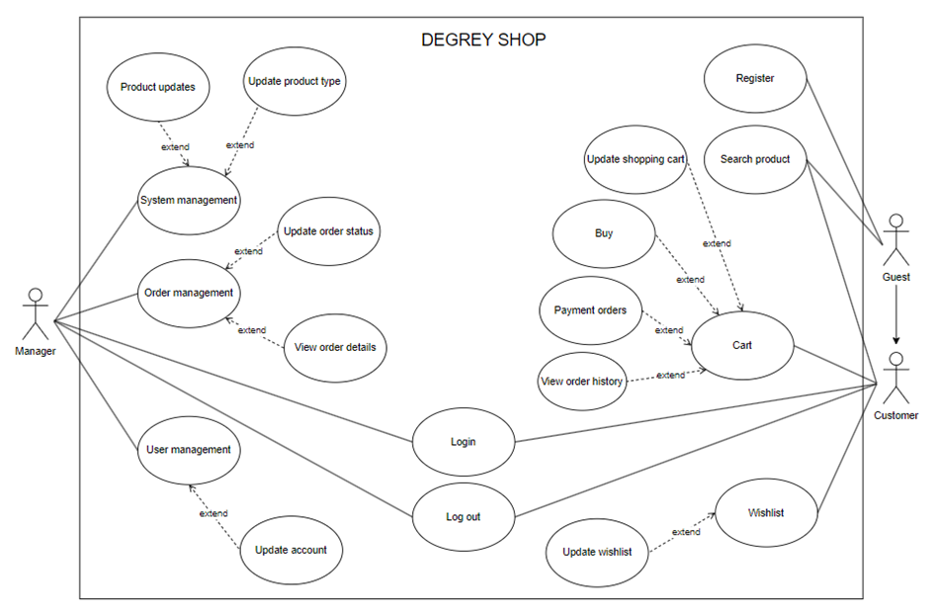
System Analysis
Use-case diagram

Slide 9
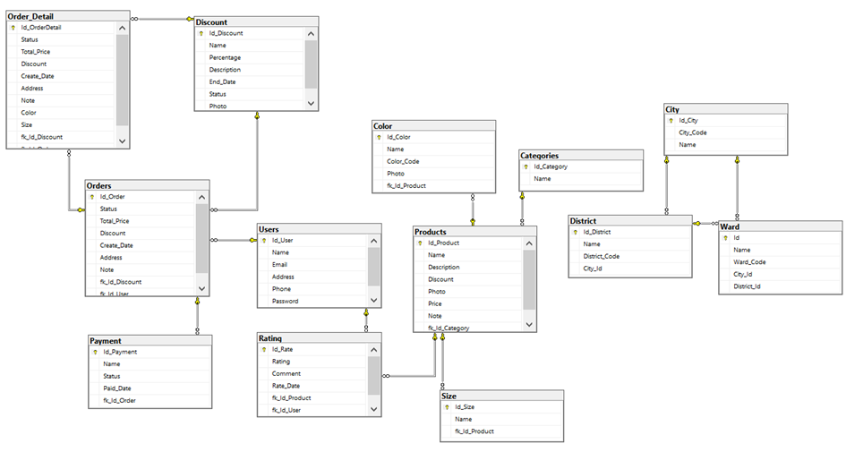
Relational model

Slide 10
03
Building the application
And running test

Slide 11
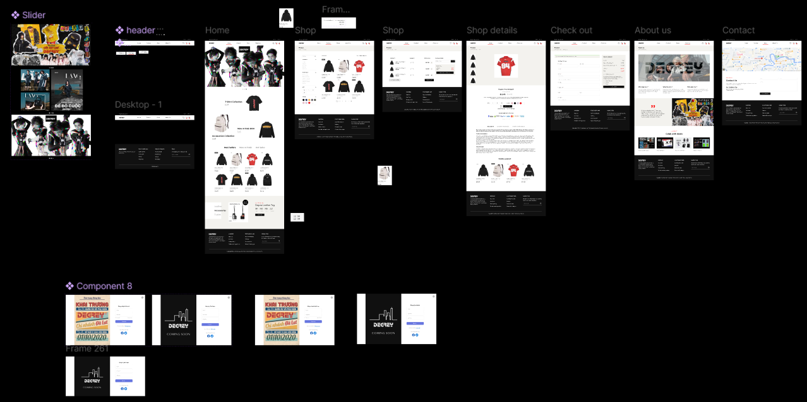
User’s interface design

Slide 12
04
Conclusion

Slide 13
The result
After the project implementation period, the project has achieved the following results:
The project applied the UI/UX design process
User can easily access and use
The system operates efficiently in all function
Project ready for future deployment

Slide 14
The remaining issues
Beside the completed tasks, there are still tasks yet to be completed.
The security and speed issue of the system has not been emphasized.
Wishlist, price range filtering have not been completed
Some function can be further divided and developed to optimize the user experience

Slide 15
Future development
The project has many features that can be developed in the future.
User can edit their personal information.
More login option through Facebook, Google,...
Customer tiers with various benefits and discounts.
Calculations of product availability by color and size

Slide 16

Feedback from teachers, and peers

Slide 17

Thanks
Topic: Learn UI/UX principles and apply them in redesigning and building Degrey website
By: Pham Ngoc Hai
The supervisor: Dr. Nguyen Quoc Tuan

