Slide 1
NR Fano Paper De-Scope (Line of Logic)
A.N. Villano
University of Colorado Denver

Slide 2
Logic For Paper.
The Dougherty and Lindhard analyses imply a variance on ionization production for NRs that is “large”
Edelweiss has previously published an NR variance that is larger than predicted by resolutions
Multiple-scatters generally widen the NR bands but only account for a fixed percentage of C
Using our analysis of the yield distribution we can extract the “effective” Fano factor for NRs
There are several impacts on DM analyses at high and low recoil energies

Slide 3
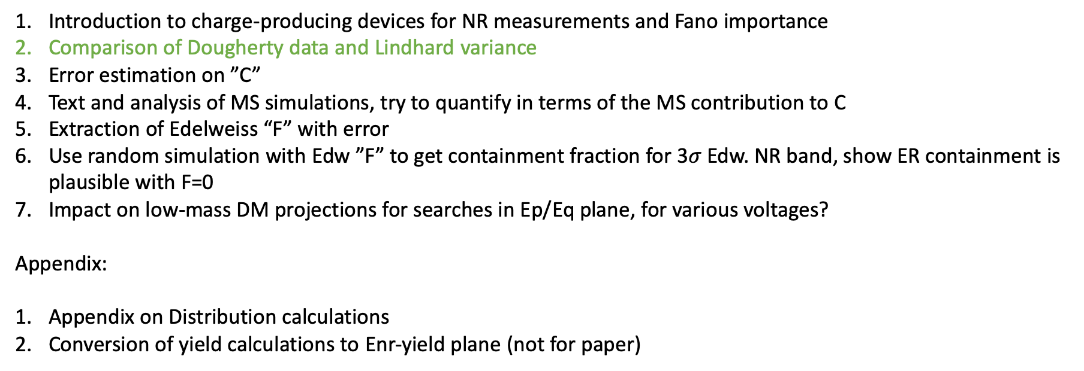
Things we need.
Introduction to charge-producing devices for NR measurements and Fano importance
Comparison of Dougherty data and Lindhard variance
Error estimation on ”C”
Text and analysis of MS simulations, try to quantify in terms of the MS contribution to C
Extraction of Edelweiss “F” with error
Use random simulation with Edw ”F” to get containment fraction for 3$σ$ Edw. NR band, show ER containment is plausible with F=0
Impact on low-mass DM projections for searches in Ep/Eq plane, for various voltages?
Appendix:
Appendix on Distribution calculations
Conversion of yield calculations to Enr-yield plane (not for paper)

Slide 4
Error estimation on Edw. “C”
Use Edw. Resolutions and F=0 along with Edw.-sized detector MS simulation to create a sample with Y’ = Y + N(0,C) using several values of C
Technical issue: may need to resample the MS sim to get many mock data sets for fitting (like a ”bootstrap”).
Construct a two-dimensional yield-Er function with C the only parameter use our v2 model with F=0
Do a Likelihood fit to many two-dimensional mock data sets—the parameters should be C, and a&b from the Yield model aEr^b.

Slide 5
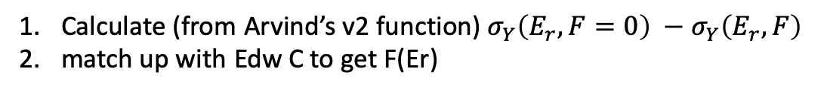
Extraction of Edelweiss “F”
Calculate (from Arvind’s v2 function) $σ_{Y}\left(E_{r}, F=0\right) −σ_{Y}\left(E_{r},F\right)$
match up with Edw C to get F(Er)

Slide 6
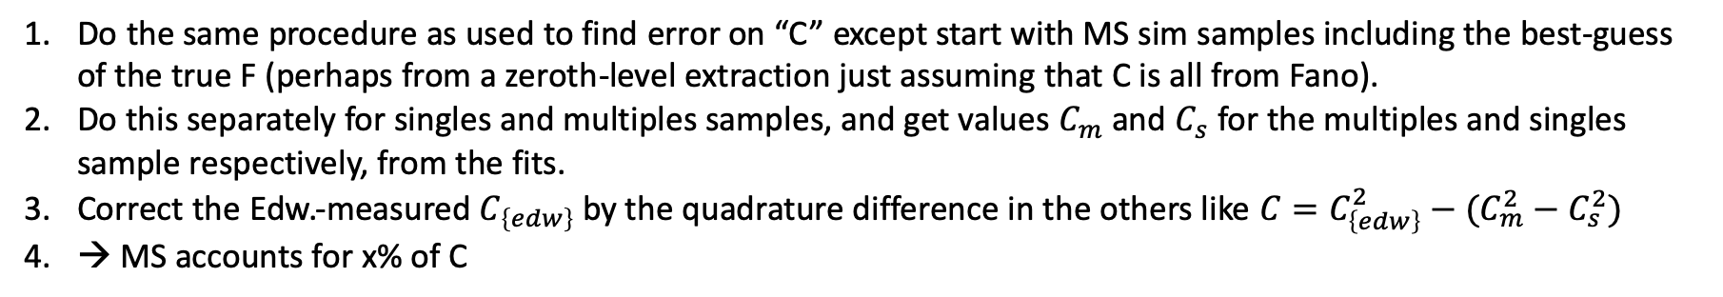
Text and Analysis of MS Simulation
Do the same procedure as used to find error on “C” except start with MS sim samples including the best-guess of the true F (perhaps from a zeroth-level extraction just assuming that C is all from Fano).
Do this separately for singles and multiples samples, and get values $C_{m}$ and $C_{s}$ for the multiples and singles sample respectively, from the fits.
Correct the Edw.-measured $C_{\left\{edw\right\}}$by the quadrature difference in the others like $C=C_{\left\{edw\right\}}^{2}−(C_{m}^{2}−C_{s}^{2})$
→ MS accounts for x% of C

