Slide 1
NR Fano Paper De-Scope (Line of Logic)
A.N. Villano
University of Colorado Denver

Slide 2
Logic For Paper.
The Dougherty and Lindhard analyses imply a variance on ionization production for NRs that is “large”
Edelweiss has previously published an NR variance that is larger than predicted by resolutions
Multiple-scatters generally widen the NR bands but only account for a fixed percentage of C
Using our analysis of the yield distribution we can extract the “effective” Fano factor for NRs
There are several impacts on DM analyses at high and low recoil energies

Slide 3
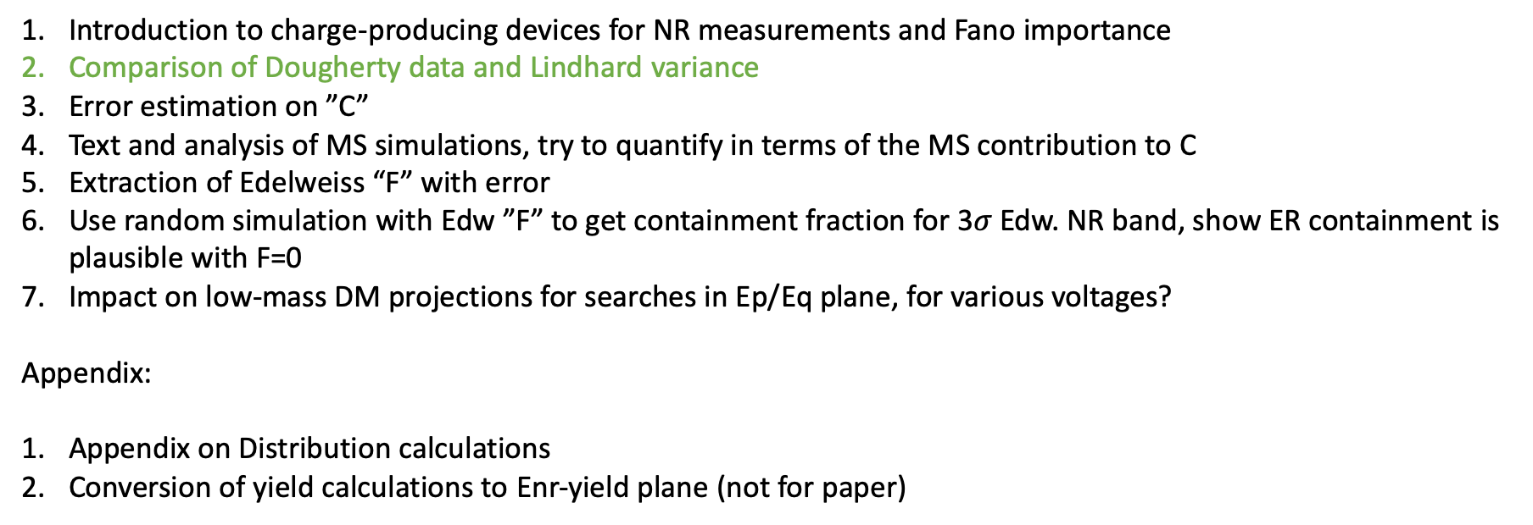
Things we need.
Introduction to charge-producing devices for NR measurements and Fano importance
Comparison of Dougherty data and Lindhard variance
Error estimation on ”C”
Text and analysis of MS simulations, try to quantify in terms of the MS contribution to C
Extraction of Edelweiss “F” with error
Use random simulation with Edw ”F” to get containment fraction for 3$σ$ Edw. NR band, show ER containment is plausible with F=0
Impact on low-mass DM projections for searches in Ep/Eq plane, for various voltages?
Appendix:
Appendix on Distribution calculations
Conversion of yield calculations to Enr-yield plane (not for paper)

Slide 4
Error estimation on Edw. “C”
Calculate

Slide 5
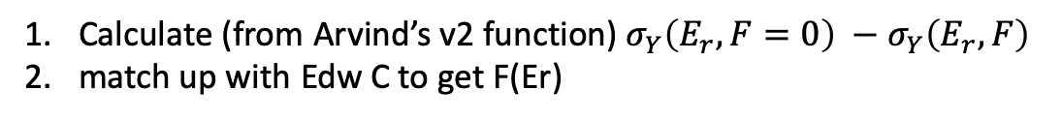
Extraction of Edelweiss “F”
Calculate (from Arvind’s v2 function) $σ_{Y}\left(E_{r}, F=0\right) −σ_{Y}\left(E_{r},F\right)$
match up with Edw C to get F(Er)

Slide 6
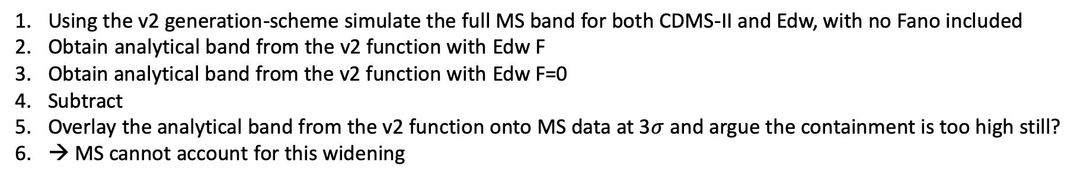
Text and Analysis of MS Simulation
Using the v2 generation-scheme simulate the full MS band for both CDMS-II and Edw, with no Fano included
Obtain analytical band from the v2 function with Edw F
Obtain analytical band from the v2 function with Edw F=0
Subtract
Overlay the analytical band from the v2 function onto MS data at 3$σ$ and argue the containment is too high still?
→ MS cannot account for this widening

