Slide 1


Playing with Formean & Puppet
Presentado por
Comunidad Fedora
Rino Rondan
Fedora Ambassador & Sponsor RPM Package Maintainer
This work is licensed under a Creative Commons Attribution-ShareAlike 3.0 Unported License.

Slide 2




Sobre @villadamine
Sysadmin
Empaquetador y Embajador en Fedora
Fan de Villa Dalmine
Clicista de Fixie y MTB

Slide 3


Temas
¿ Que pasa con Foreman ?
  Provisioning
  Configuration
  Monitor
  Demo
Y si probamos puppet
  Conceptos varios
  Demo

Slide 4

The Foreman

Slide 5

Provisioning
Creacion de nuevas maquinas o contenedores en multiples ambientes
  Bare metal, oVirt, libvirt, VMware, Docker, EC2, Rackspace, Digital Ocean, OpenStack, etc.

Slide 6

Provisioning
Provisioning types:
  PXE - usando PXELinux y kickstart, preseed, AutoYAST, etc
  Image-based - cloning, configurado atraves de SSH o con user-data (cloudinit)
Utilizando virtualizacion, Creamos la vm
Para hacer todo junto se hace orquestacion usando servicios de Smart Proxies:
  DNS - DHCP / TFTP
  FreeIPA Realm - Configuration Management

Slide 7
Configuration
Automatic registration & setup of clients, including autosigning certs/keys
Defining:
  Classes / states
  Parameters / pillars
Inventory data:
  Facts / Grains
  results of configuration runs
Puppet
Via plugins:
  Chef
  Salt
  Ansible

Slide 8
Monitoring
Generic Report API with graphs/trends:
  System Inventories
  Reports from runs
  Generic reports: ABRT, OpenSCAP
Context sensitive search:
  Not full-text (SQL level)
  Keyword completion
  Works across whole application

Slide 9
Arquitectura distribuida
Smart Proxies located locally on Foreman itself or independent – (orchestration)
Large organizations and/or multi-tenancy:
  Organizations (Divisions)
  Locations
Strong RBAC model
  Users / Groups
  Permissions / Filters
LDAP / MS-AD integration

Slide 10
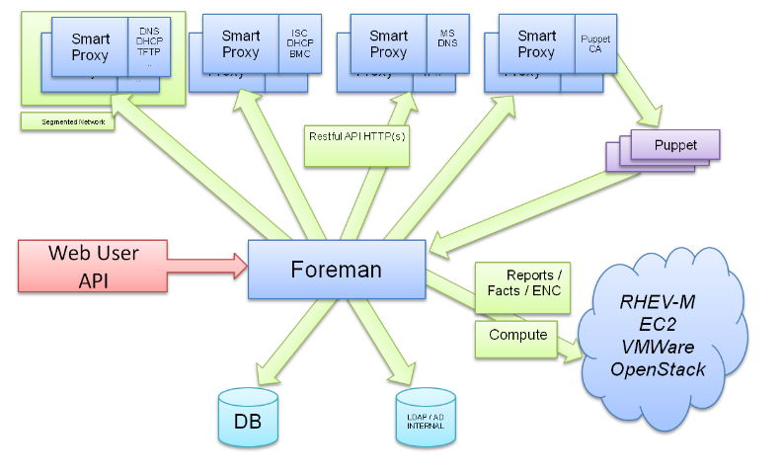
Arquitectura

Slide 11
Historia
Project started in July 2009
Initial set of features: Puppet + PXE provisioning
213 unique contributors (winter 2015)
Core team sponsored by Red Hat (GMT +10 -8)
Translated to 13 languages
Healthy and friendly community
Reported usage: Red Hat, CERN, EMC, Citrix, DHL, BBC, Digg, Good Data, Mozilla, eBay/Paypal (100,000 nodes)

Slide 12


Instalacion
Repositories for RHEL/Fedora, Debian/Ubuntu
Puppet-based installer
Able to install, configure and manage:
  Foreman app
  Smart-proxies
  Services: DNS, DHCP, TFTP, Puppet
  Selected plugins
  # foreman-installer -h | wc -l
  439

Slide 13
Demo

Slide 14
Personalizacion
Customize Foreman to support your workflows!
  Configuration options in UI: Adminster → Settings
  Smart proxy configuration values (features)
  Automation with API + CLI
  Foreman Plugins
  Smart Proxy Plugins
  Foreman Hooks Plugin

Slide 15
Api & CLI
Full UI coverage
All of our API is documented
Documentation DSL generates dynamic Ruby bindings
Full RESTful API
  Docs at /apidoc on your Foreman server
  Also available at http://www.theforeman.org/api/1.9/index.html

Slide 16
Hammer
On par with UI
Username/Password authentication
Easy to use, great for working in shell
hammer puppet-class list

Slide 17
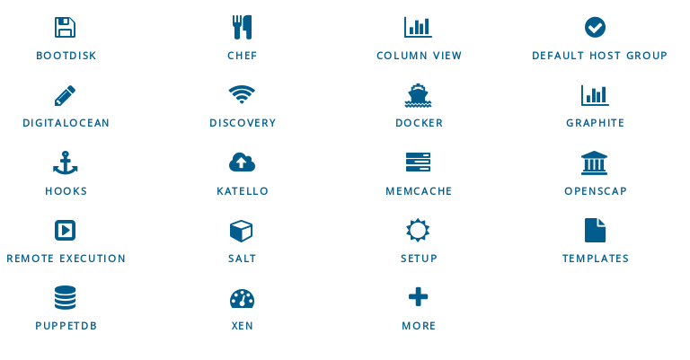
Plugins

Slide 18
Docker - Plugin
Manage many docker hosts
Deploy new containers easily & view their status, logs, etc
Multiple registry support & integration with Katello
https://github.com/theforeman/foreman-docker

Slide 19

Contacto Foreman
Visit http://theforeman.org/
Find :
  IRC: irc.freenode.net
    #theforeman
    #theforeman-dev
  Mailing Lists on Google groups
    foreman-users
    foreman-dev

Slide 20
Puppet y ahora ??
Automation tool
Infrastructure as code
Models systems with a Domain Specific Language
Centralized server stores all configs

Slide 21
Puppet y ahora ??
Idempotency
Cross Platform
Resource Types
Providers
Resources, Classes, and Nodes

Slide 22
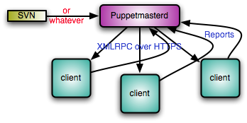
Puppet y ahora ??

Slide 23
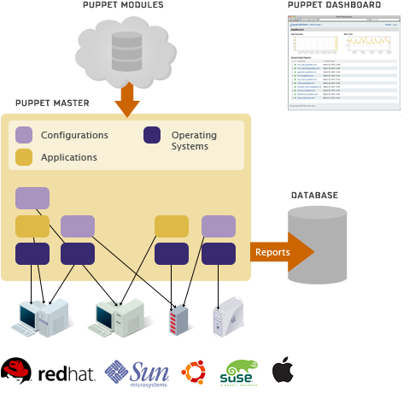
Puppet y ahora ??

Slide 24
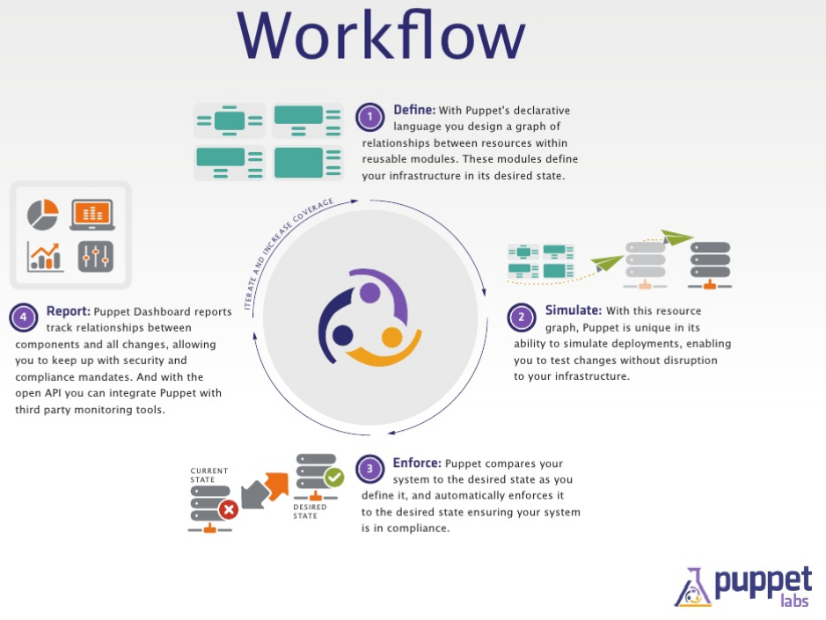
Puppet y ahora ??

Slide 25
Links de Fuentes y Varios
The Foreman
Introdution to Foreman
Contribution to Foreman
Quickstart Foreman
Documentation
Plugins Foreman
Puppet Docs

Slide 26
Preguntas?
Contacto:
villadalmine@fedoraproject.org
Irc #fedora-ar #fedora-latam
This work is licensed under a Creative Commons Attribution-ShareAlike 3.0 Unported License.

