Slide 1
Virtualization Management
Ovirt Project
Rino Rondan
Fedora Ambassador & Packager
Fedora Argentina
Flisol,Parana Entre Rios, 25/04/2015

Slide 2
Agenda
What is oVirt?
Where did it come from?
What does it do?
Architecture
Roadmap
What's next?

Slide 3
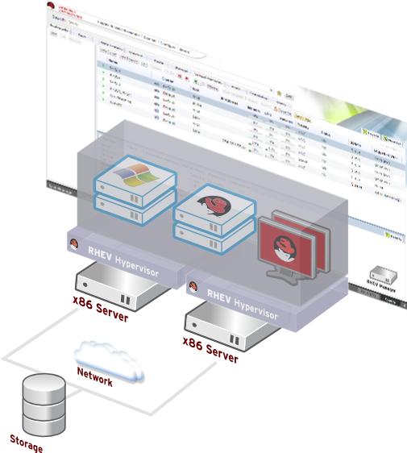
What is oVirt?
Large scale, centralized management for server and desktop virtualization
Based on leading performance, scalability and security infrastructure technologies
Provide an open source alternative to vCenter/vSphere
Focus on KVM for best integration/performance
Focus on ease of use/deployment
Notes:
What is Ovirt?
ROBUST PLATFORM
FEATURE REACH
SVI & VDI
MANAGING VIRTUALIZED DC – THOUSANDS OF VMS ?HYPERVISORS
KVM
A PARALLEL to VMWARE VSPHERE/ VCENTER
SINGLE POINT OF MANAGEMENT – NET STORAGE

Slide 4
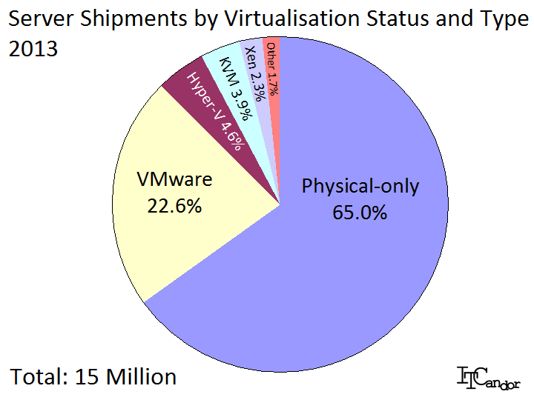
Competitive Landscape
Notes:
[NOTE: Because of age, this slide's graphic should not be used past June 2015. Use something else, because points in notes are still good.]
OVIRT IS THE SOURCE FOR RHEV STACK AND OTHER COMMERCIAL PRODUCTS, SUCH AS WIND RIVER'S OPEN VIRTUALIZATION PRODUCT AND UDS ENTERPRISE
RHEV POSITIONING IN THE MARKET
DESPITE THE FACT WE ARE RELATIVE NEWCOMERS
SECOND AFTER VMWARE ON MANAGEMENT (OVIRT)

Slide 5
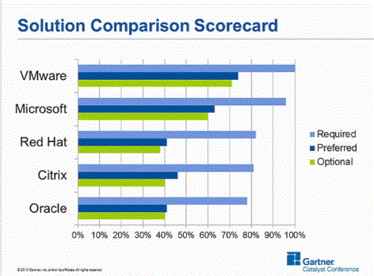
Competitive Landscape
Notes:
[NOTE: This slide is getting dated, too. Use with caveats below.]
WE ARE CLOSING GAPS ON FEATURES
ON PERFORMANCE WE NOW SURPASS VMWARE, AND OVIRT IS NOW AVAILABLE ON PPC PLATFORM

Slide 6
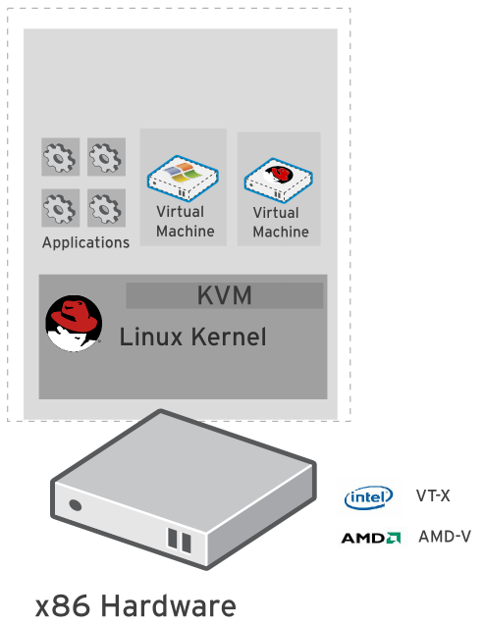
Kernel-based Virtual Machine (KVM)
Included in Linux kernel since 2006
Runs Linux, Windows and other operating system guests
Advanced features
  Live migration
  Memory page sharing
  Thin provisioning
  PCI Pass-through
KVM architecture provides high
“feature-velocity” – leverages the power of Linux

Slide 7
Using KVM
/usr/libexec/qemu-kvm -name vm-f16-buildmachine -S -M rhel6.4.0 -cpu Westmere -enable-kvm -m 2048 -smp 2,sockets=2,cores=1,threads=1 -uuid a8ccdb60-8a42-44f5-9669-d74c3b2eff43 -smbios type=1,manufacturer=Red Hat,product=RHEV Hypervisor,version=6Server-6.4.0.4.el6,serial=30353036-3837-4247-3831-30394635324C_78:e7:d1:22:46:d8,uuid=a8ccdb60-8a42-44f5-9669-d74c3b2eff43 -nodefconfig -nodefaults -chardev socket,id=charmonitor,path=/var/lib/libvirt/qemu/vm-f16-buildmachine.monitor,server,nowait -mon chardev=charmonitor,id=monitor,mode=control -rtc base=2013-10-08T12:16:16,driftfix=slew -no-shutdown -device piix3-usb-uhci,id=usb,bus=pci.0,addr=0x1.0x2 -device virtio-serial-pci,id=virtio-serial0,bus=pci.0,addr=0x4 -drive if=none,media=cdrom,id=drive-ide0-1-0,readonly=on,format=raw,serial= -device ide-drive,bus=ide.1,unit=0,drive=drive-ide0-1-0,id=ide0-1-0 -drive file=/rhev/data-center/f79b0b28-c82f-11e0-8739-78e7d1e48c4c/5bab6470-8825-4e3a-b408-ebcde93678b6/images/4c213cd2-c4d5-441b-a1ac-dfb1a6868699/11b3e132-50a5-481b-b48b-e3b1f2879e69,if=none,id=drive-virtio-disk0,format=qcow2,serial=4c213cd2-c4d5-441b-a1ac-dfb1a6868699,cache=none,werror=stop,rerror=stop,aio=native -device virtio-blk-pci,scsi=off,bus=pci.0,addr=0x5,drive=drive-virtio-disk0,id=virtio-disk0,bootindex=1 -drive file=/rhev/data-center/f79b0b28-c82f-11e0-8739-78e7d1e48c4c/5bab6470-8825-4e3a-b408-ebcde93678b6/images/02330fa2-d1ff-48e0-a843-842c2376756f/5a283126-4d27-4eef-86dd-fb538d8d08e4,if=none,id=drive-virtio-disk1,format=qcow2,serial=02330fa2-d1ff-48e0-a843-842c2376756f,cache=none,werror=stop,rerror=stop,aio=native -device virtio-blk-pci,scsi=off,bus=pci.0,addr=0x6,drive=drive-virtio-disk1,id=virtio-disk1 -netdev tap,fd=31,id=hostnet0,vhost=on,vhostfd=32 -device virtio-net-pci,netdev=hostnet0,id=net0,mac=00:1a:4a:23:12:13,bus=pci.0,addr=0x3,bootindex=2 -chardev socket,id=charchannel0,path=/var/lib/libvirt/qemu/channels/vm-f16-buildmachine.com.redhat.rhevm.vdsm,server,nowait -device virtserialport,bus=virtio-serial0.0,nr=1,chardev=charchannel0,id=channel0,name=com.redhat.rhevm.vdsm -chardev socket,id=charchannel1,path=/var/lib/libvirt/qemu/channels/vm-f16-buildmachine.org.qemu.guest_agent.0,server,nowait -device virtserialport,bus=virtio-serial0.0,nr=2,chardev=charchannel1,id=channel1,name=org.qemu.guest_agent.0 -chardev spicevmc,id=charchannel2,name=vdagent -device virtserialport,bus=virtio-serial0.0,nr=3,chardev=charchannel2,id=channel2,name=com.redhat.spice.0 -spice port=5904,tls-port=5905,addr=10.35.16.4,x509-dir=/etc/pki/vdsm/libvirt-spice,tls-channel=main,tls-channel=display,tls-channel=inputs,tls-channel=cursor,tls-channel=playback,tls-channel=record,tls-channel=smartcard,tls-channel=usbredir,seamless-migration=on -k en-us -vga qxl -global qxl-vga.ram_size=67108864 -global qxl-vga.vram_size=67108864

Slide 8
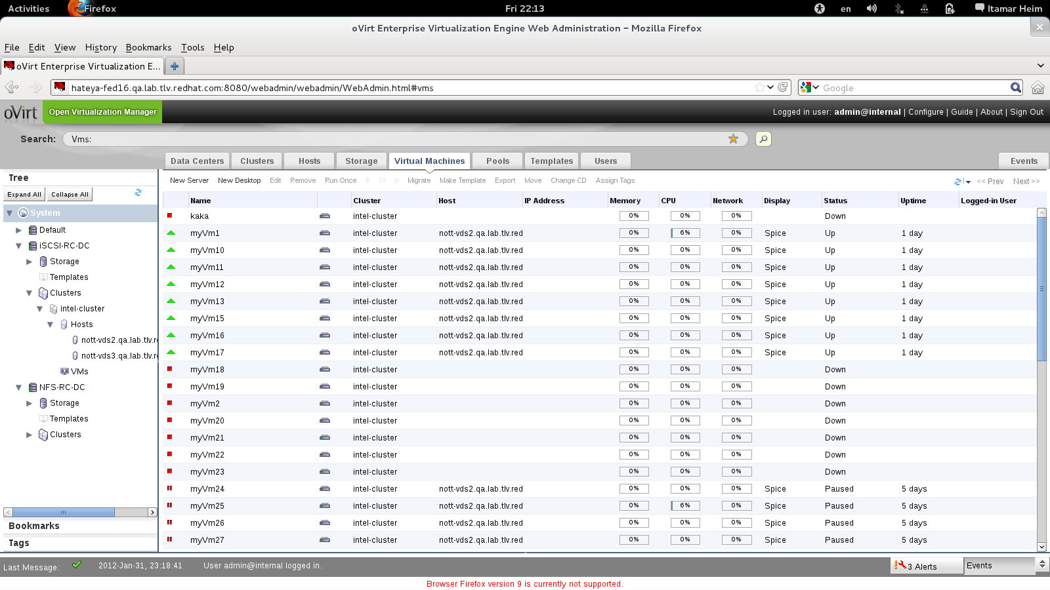
How Does It Look?
Notes:
SO HOW DOES IT LOOK
THIS IS THE ADMIN CONSOLE
WEB BASED UI
HANDLES ALL THE MANAGED ENTITIES
DC, CLUSTER, HOSTS, VMS
NET, STORAGE,

Slide 9
VIRT & KVM Features
How Large-Scale Systems are Managed
Live snapshot
Over-commit
CPU, Memory, I/O
Transparent huge pages
ACPI support
Live Migration
Live Storage Migration
KSM
PCI Device Assignment
SMP Guests
ballooning
I/O Throttling
Hotplug
SPICE
NUMA
SR-IOV
PCI pass through
Massive scalability
VEPA
sVirt
Notes:
BUILD COMMUNITY AROUND THE VIRTUALIZATION STACK
FOCUSED AROUND KVM

Slide 10
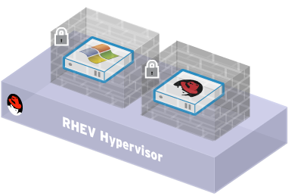
Security
oVirt inherits the security features of Linux
SELinux security policy infrastructure
Provides protection and isolation for virtual machines and host
Compromised virtual machine cannot access other VMs or host
sVirt Project
Sub-project of NSA's SELinux community. Provides “hardened” hypervisors
Multilevel security. Isolate guests
Contain any hypervisor breaches
Notes:
For security, RHEV uses the SELinux security engine built into RHEL and designed for government security. This feature is on by default and effectively isolates Vms from each other and from the physical host.
In future versions of RHEV, we'll be leveraging the sVirt project, which is a VM-enabled version of SELinux, that provides multilevel security, access control of resources such as disk storage and network, and can be tuned to the most challenging security requirements.

Slide 11
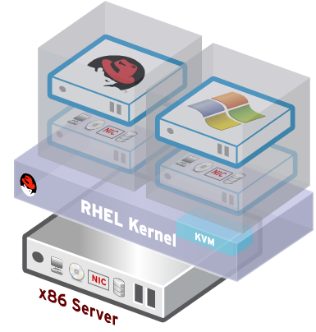
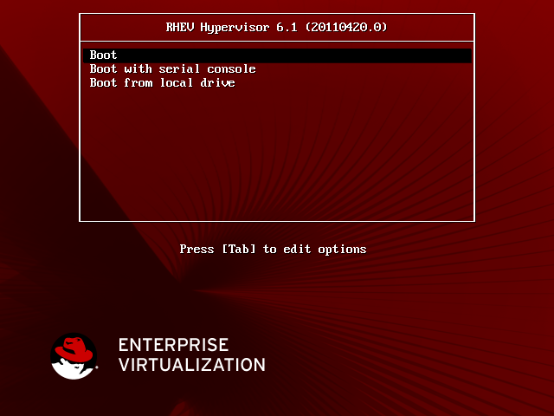
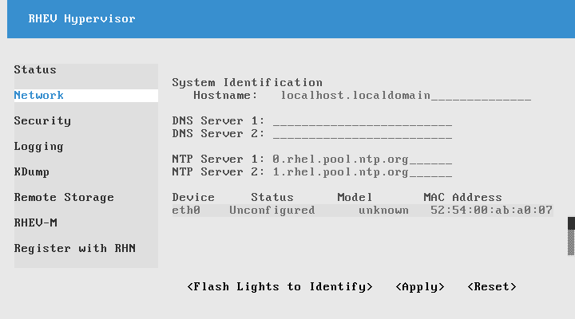
oVirt Node
Standalone hypervisor
  Small footprint < 100MB
    Customized 'spin' of Fedora + KVM
    'Just enough' Fedora to run virtual machines
    Runs on all RHEL hardware
    with Intel VT/AMD-V CPUs
  Easy to install, configure and upgrade
    PXE boot, USB boot, CD or Hard drive

Slide 12
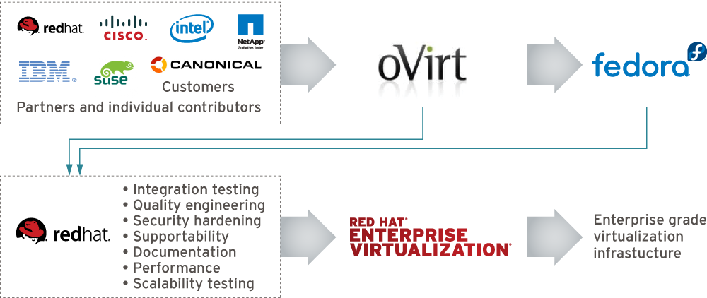
Who is Behind It
Notes:
[Note: Make sure this is updated!]
Open source for three years
Release cycle is every 6 months so we already have 4 stable versions out there, the last one that was released in April 2014 is oVirt 3.4 that included features like live snapshots, self-hosted engines, and hot-plug CPUs.

Slide 13
oVirt: Not a Single Project
Current List of Upstream Projects
oVirt-Engine
VDSM
oVirt-Node
Ovirt-Engine-SDK
oVirt-Engine-CLI
oVirt-Guest-Agent
oVirt-Image-Uploader
oVirt-iso-Uploader
oVirt-Log-Collector
oVirt-DWH
oVirt-Reports
Incubation Projects
  MOM
  Nomad
Test Projects
Notes:
BUILD COMMUNITY AROUND THE VIRTUALIZATION STACK
FOCUSED AROUND KVM

Slide 14
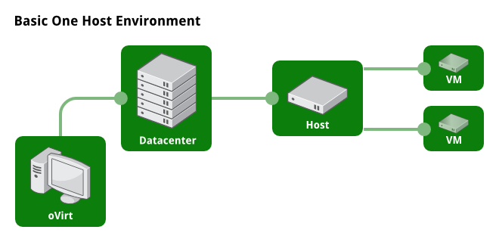
One Host Environment
Notes:
What kind of topologies you can manage via oVirt

Slide 15
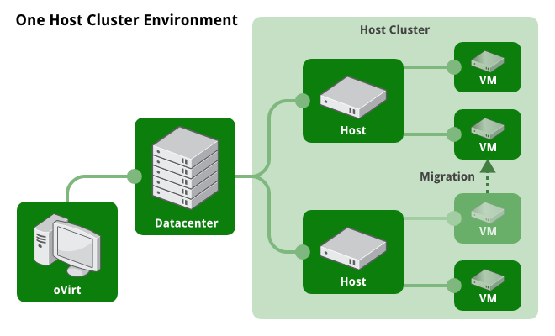
Multiple Hosts

Slide 16
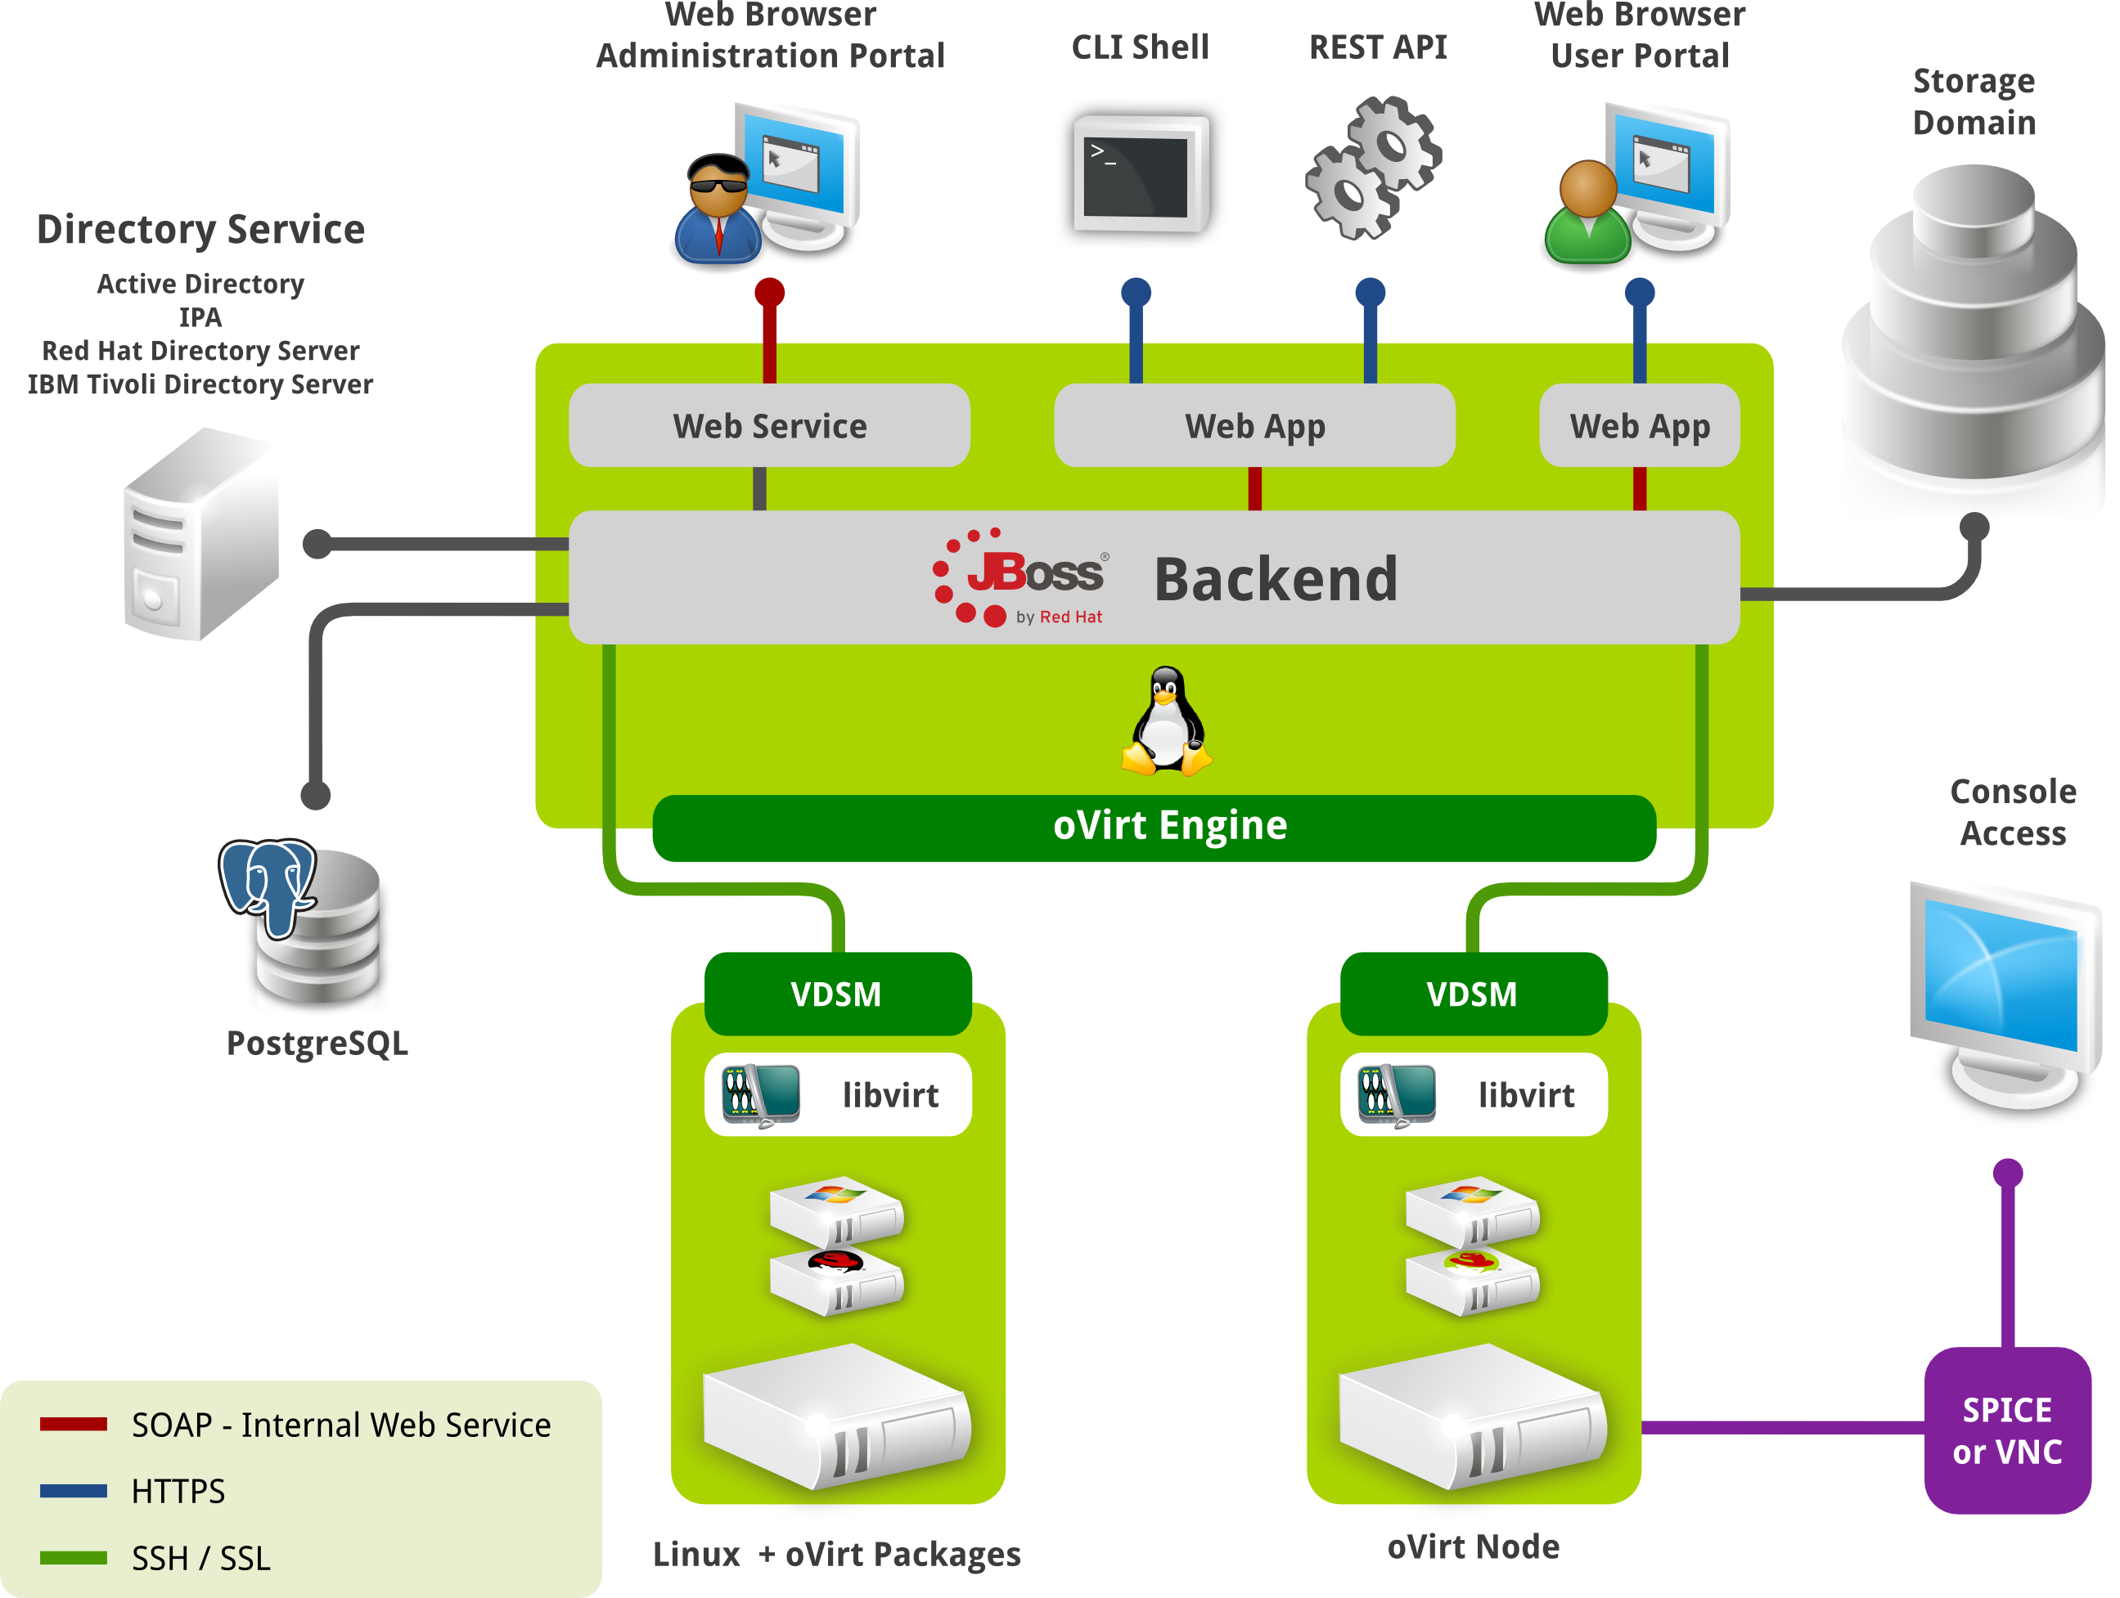

Slide 17
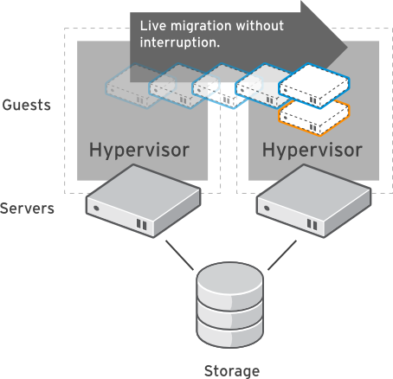
Live Migration
Dynamically move virtual machines between hosts
  No service interruption
  Applications continue to run
Migrate even I/O intensive workloads such as databases
Perform hardware maintenance without application downtime
Dynamically balance workloads between host systems

Slide 18
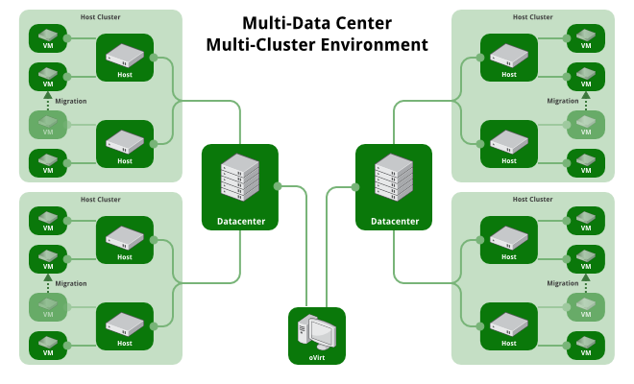
Multi-Datacenter/Multi-Host

Slide 19
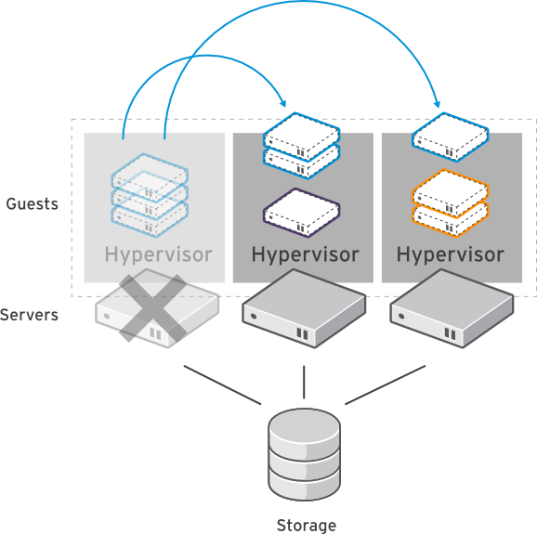
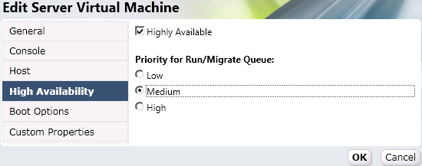
High Availability
Build a highly available enterprise infrastructure
Continually monitor host systems and virtual machines
Automatically restart virtual machines in case of host failure
  Restart virtual machine on another node in the cluster
Use live migration to “fail-back” a VM to it's original host when the server is restored

Slide 20
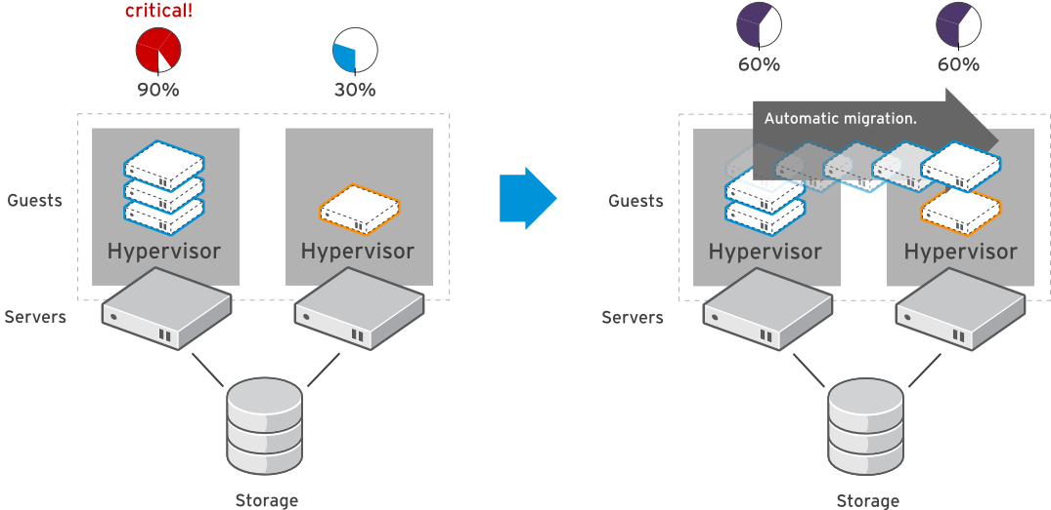
System Scheduler
Dynamically balance workloads in the data center.
Automatically live migrate virtual machines based on resources
Define custom policies for distribution of virtual machines
Maintain consistent resource usage across the enterprise data center

Slide 21
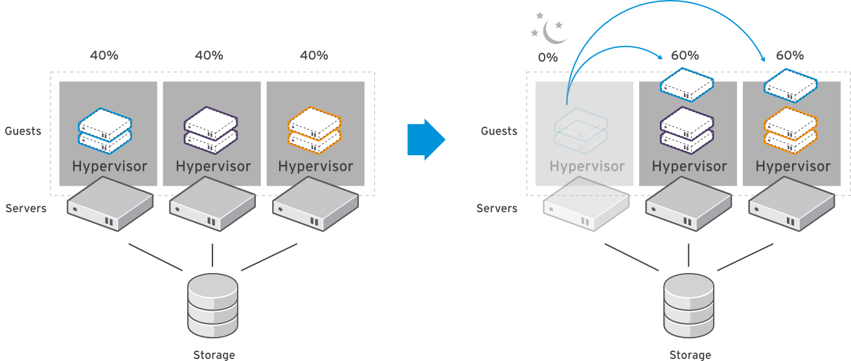
Power Saver
Define policies to optimize workload on a fewer number of servers during “off-peak” hours

Slide 22
Three Pillars of Management
Simplicity
Stability
Functionality

Slide 23
Simplicity
Installation
  sudo yum install -y ovirt-engine
  sudo engine-setup
Varied user interaction mechanisms
  Intuitive web interface
  Python CLI
  Python/Java SDK
Ovirt Node
Configuration
  One place, single utility

Slide 24
Stability
Involvement of big companies
  RHEV is based on oVirt
  IBM, Netapp, Cisco etc.
Open governance model - Merit based
Regular release schedule
  Well known release schedule
  Stabilization periods
  Community test days
CI
Active users community
  Deployed in production, Alter Way

Slide 25
Functionality
Notes:
SO HOW DOES IT LOOK ?
ADMIN CONSOLE
Search driven
Tree view
Components (DC, Cluster, Host)
Networks
SP

Slide 26
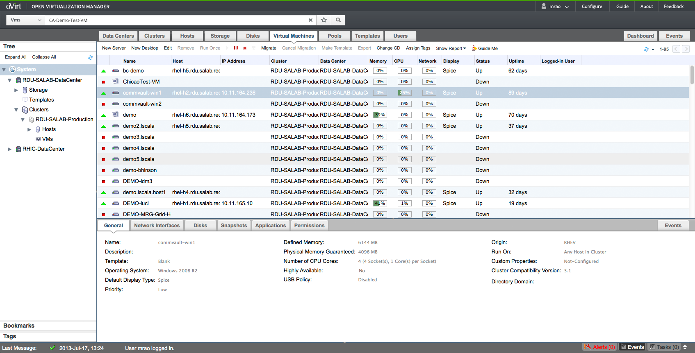
Administration Portal

Slide 27
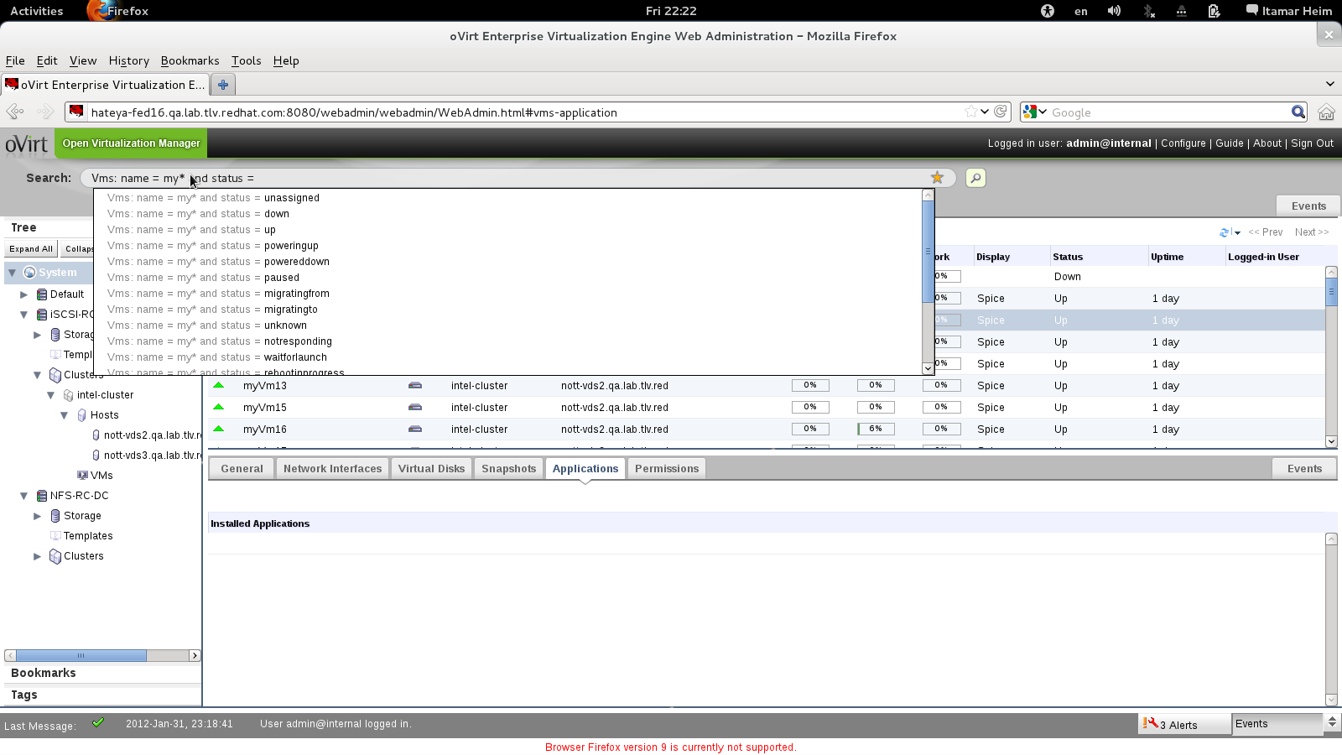
Search Auto Complete
Notes:
SEARCH IS A MUST WHEN MANAGING THOUSANDS OF VMS
AUTO COMPLETE

Slide 28
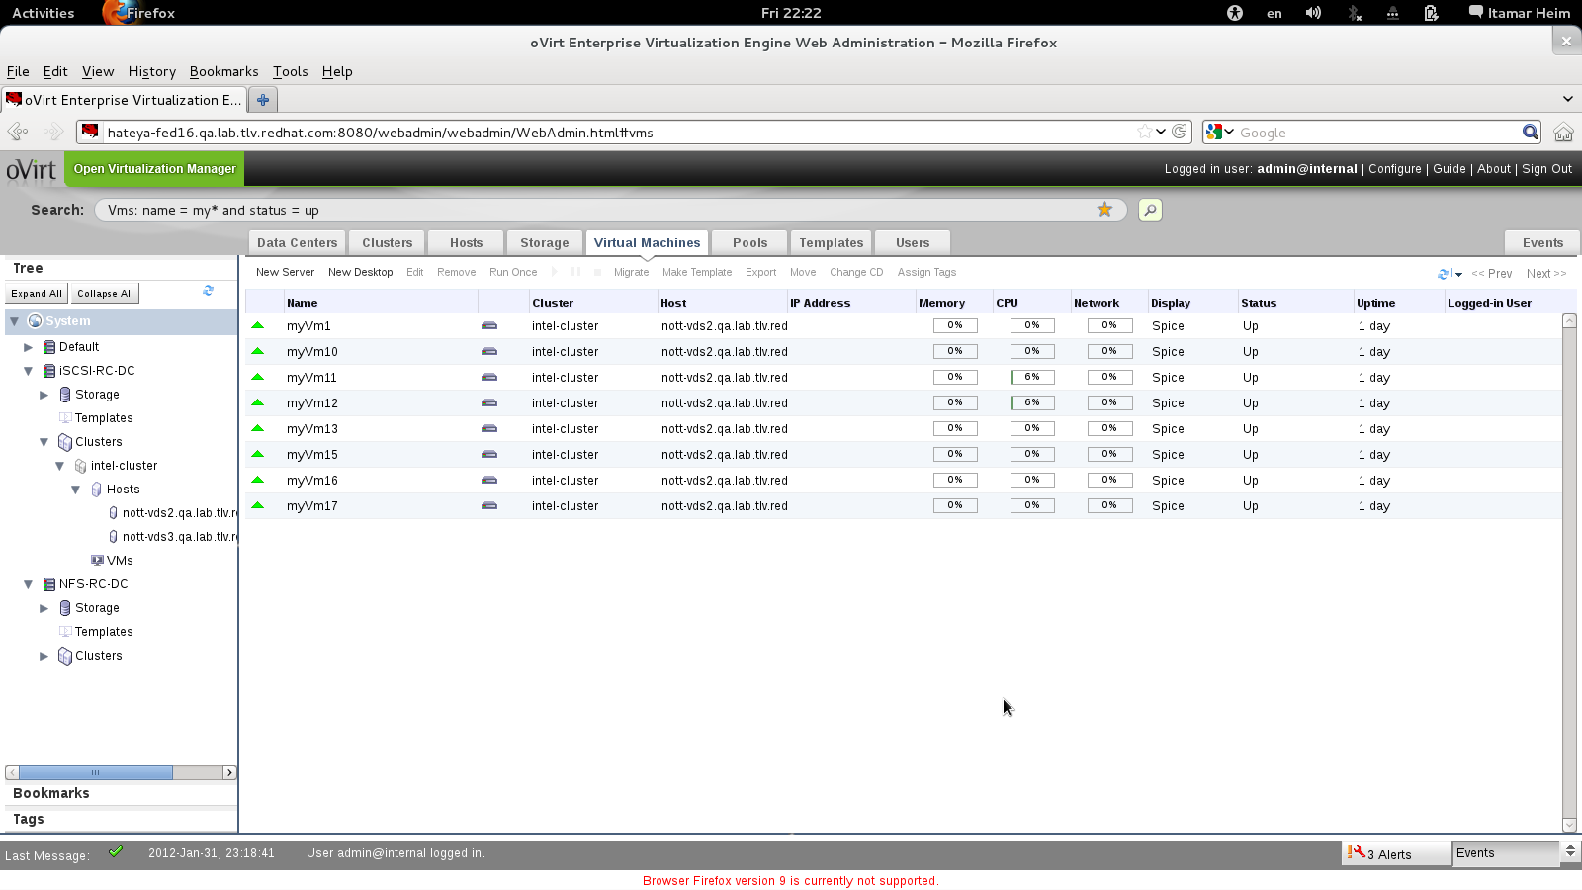
Search Results

Slide 29
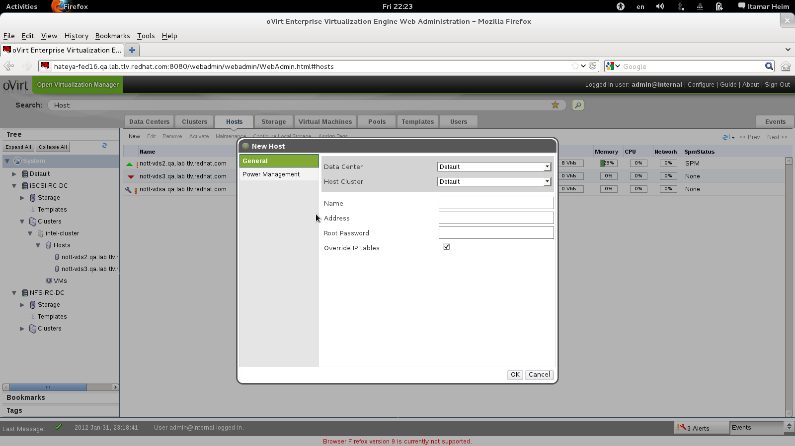
Add Host As Simple As
Notes:
USABILITY
NO LINUX KNOWLEDGE IS REQUIRED
ADD HOST
SPECIFY DC CLUSTER NAME ADDRESS ROOT_PASS (override iptables)

Slide 30
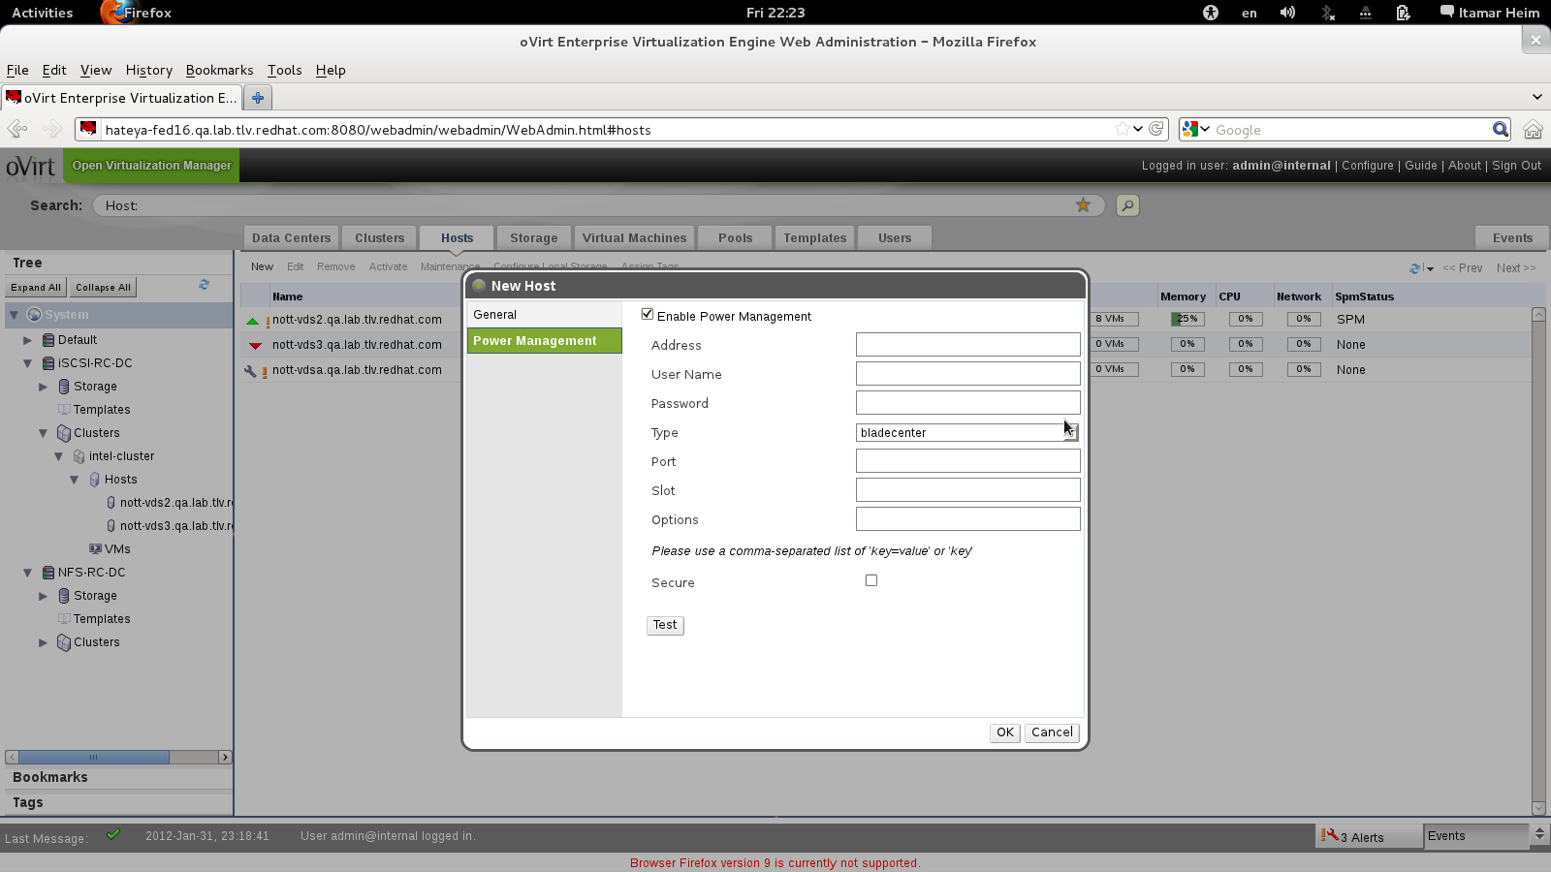
Power Management
Notes:
WE support power managment
Just add all relevant parameters

Slide 31
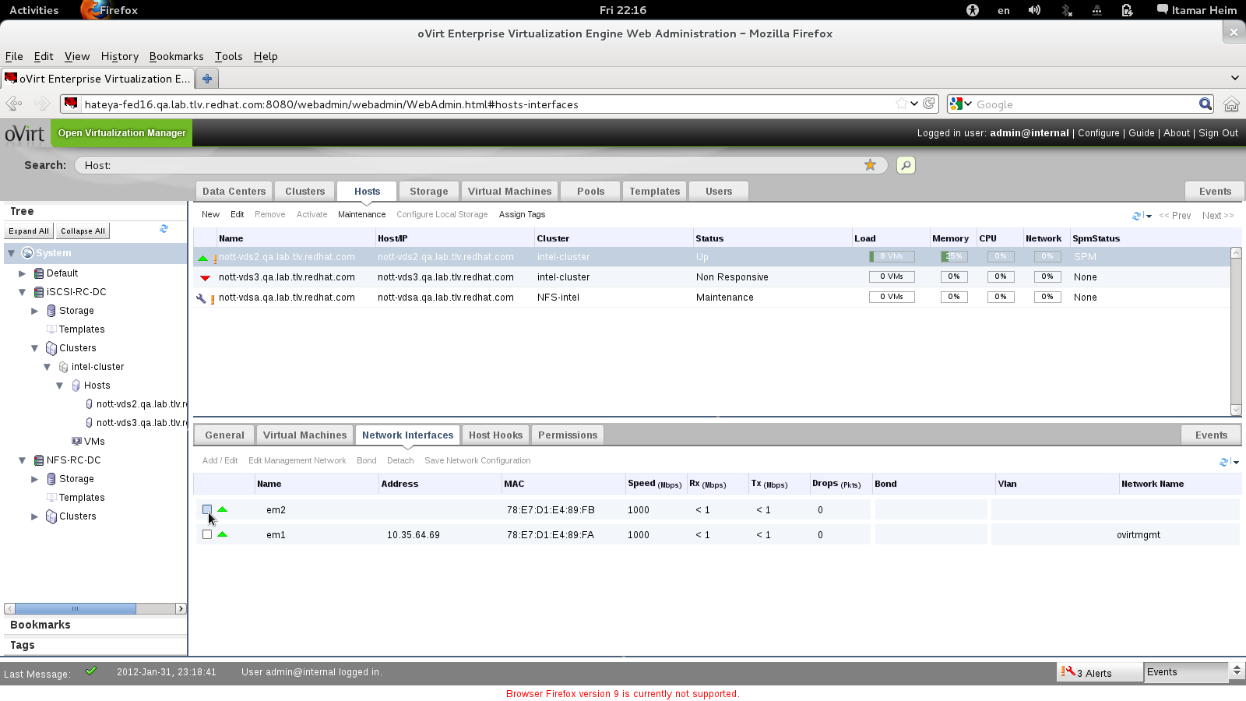
Configure Networks
Notes:
NETWRKING IN VIRT INCLUDE PLATFORM AND VMs NETWORK
HERE WE LOOK AT THE HOST PHYSICAL NETWORK LAYOUT

Slide 32
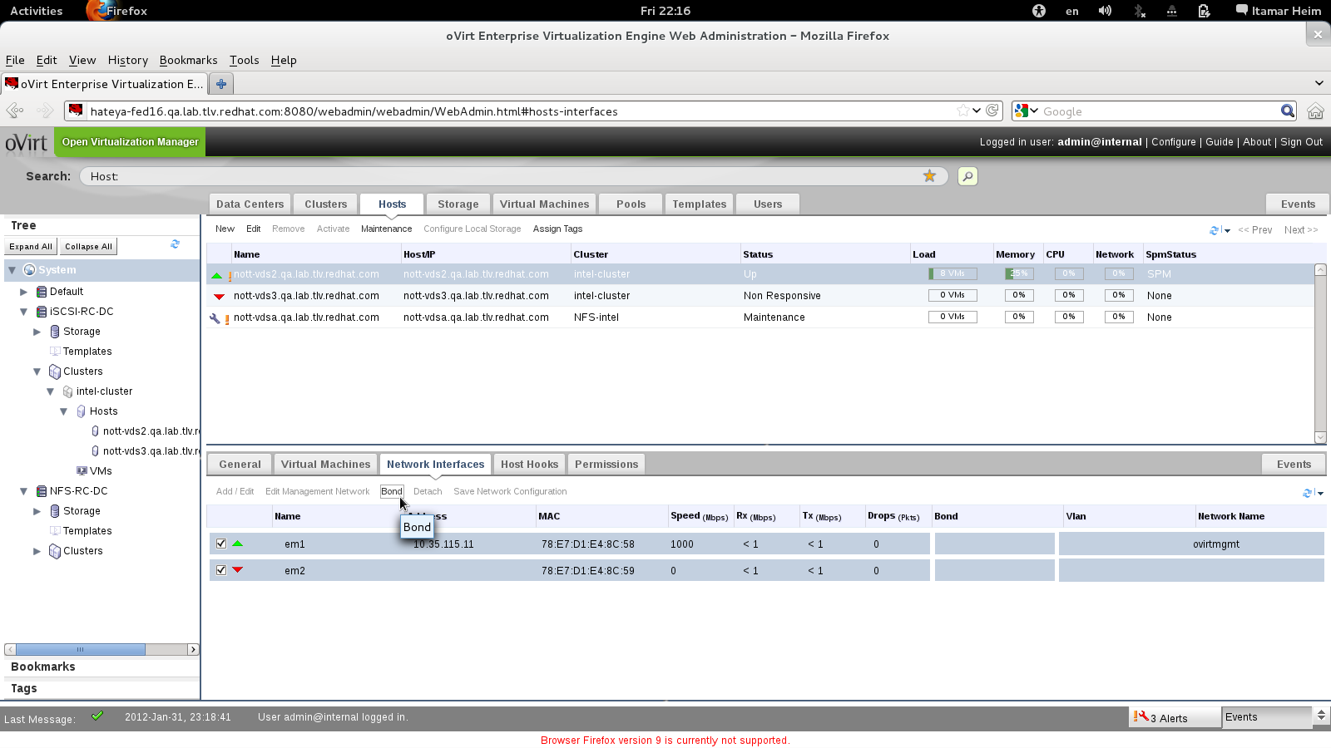
Or Bonds

Slide 33
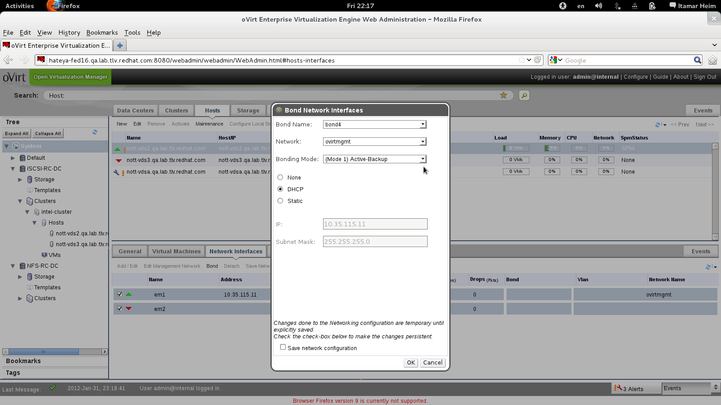
Without Scripts or Config Files

Slide 34
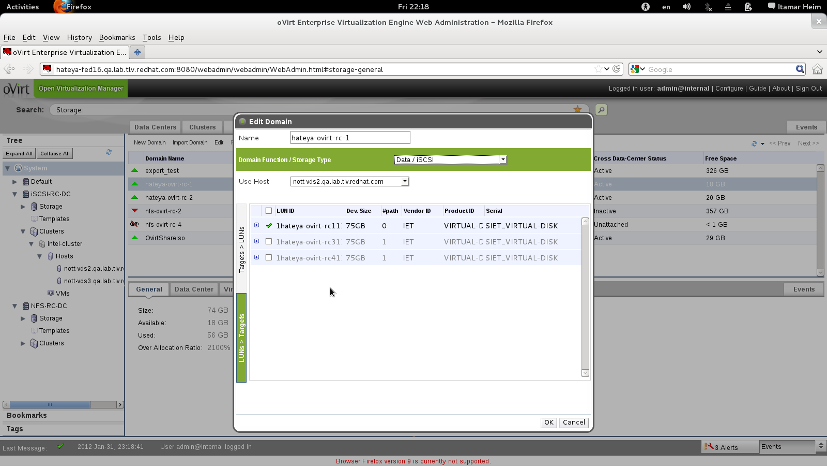
Configure Storage Once for Entire Cluster

Slide 35
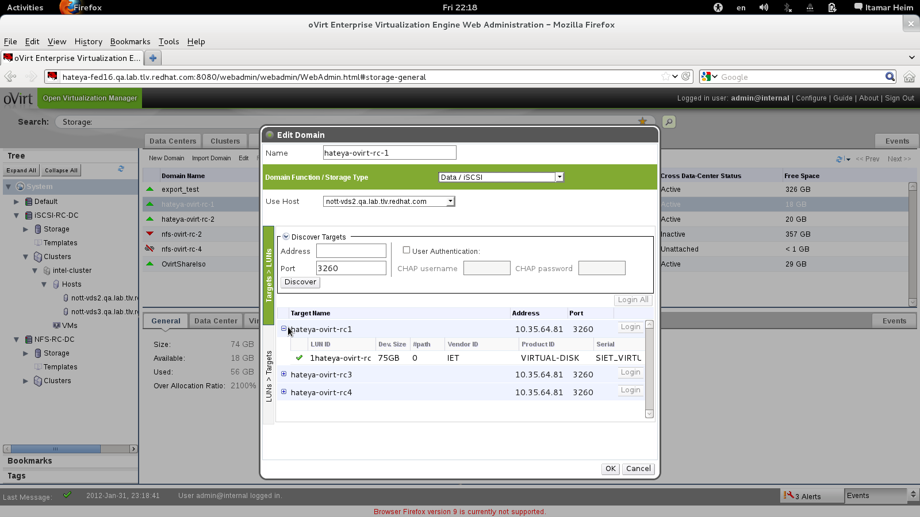
Extend with More LUNs as Needed

Slide 36
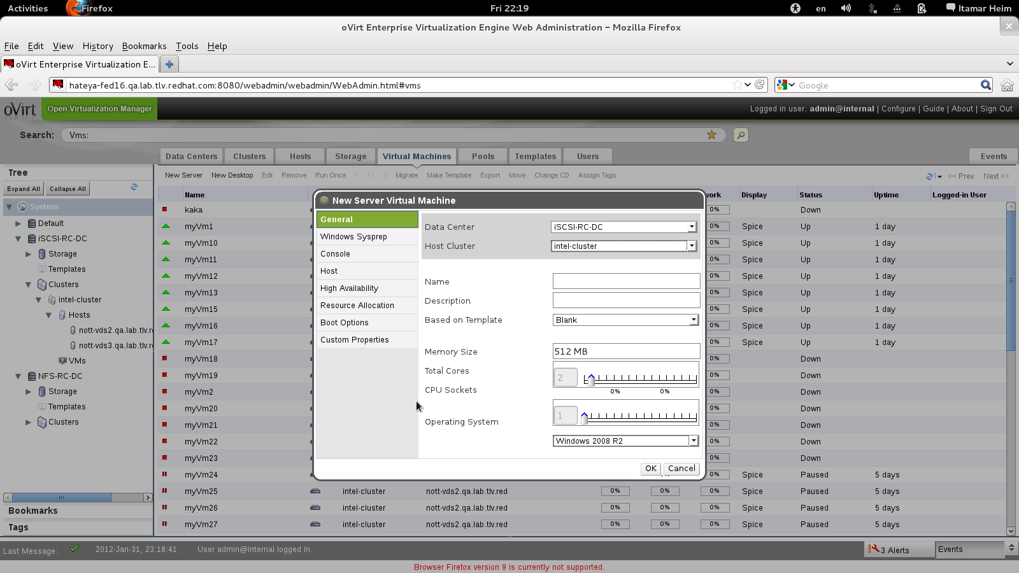
Add Servers or Desktops

Slide 37
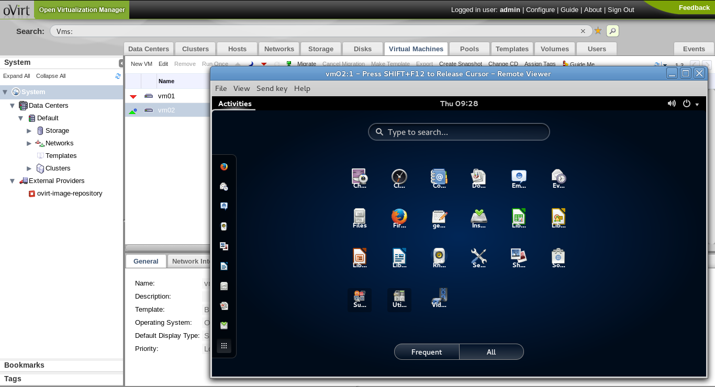
VM UP!

Slide 38
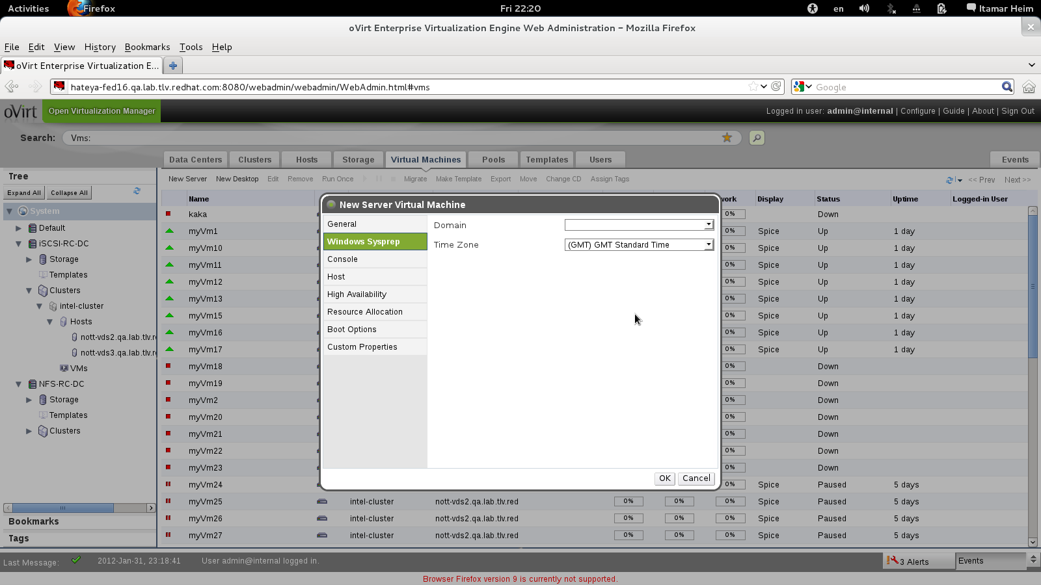
Even Windows via Sysprep

Slide 39
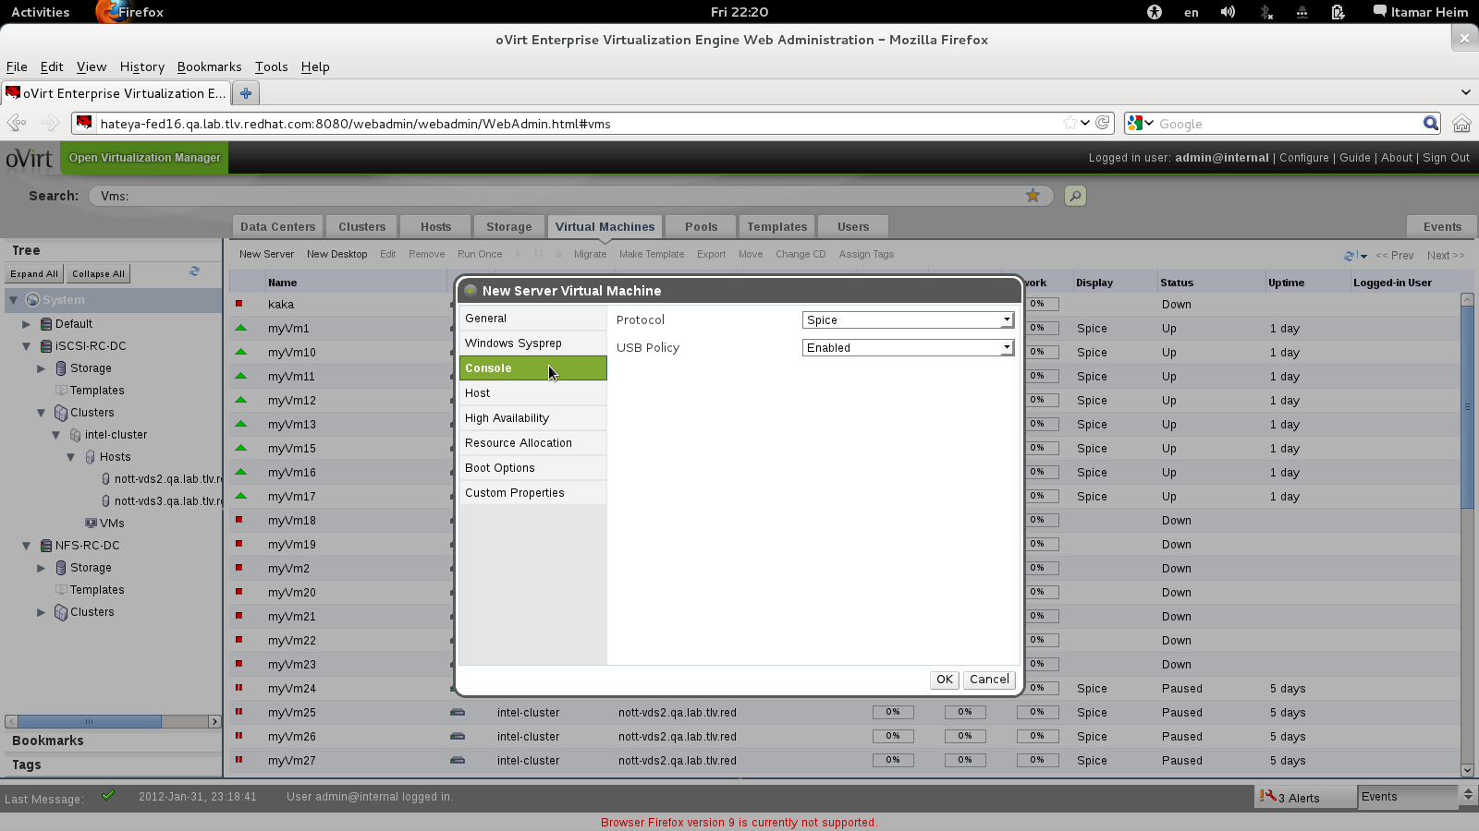
SPICE or VNC

Slide 40
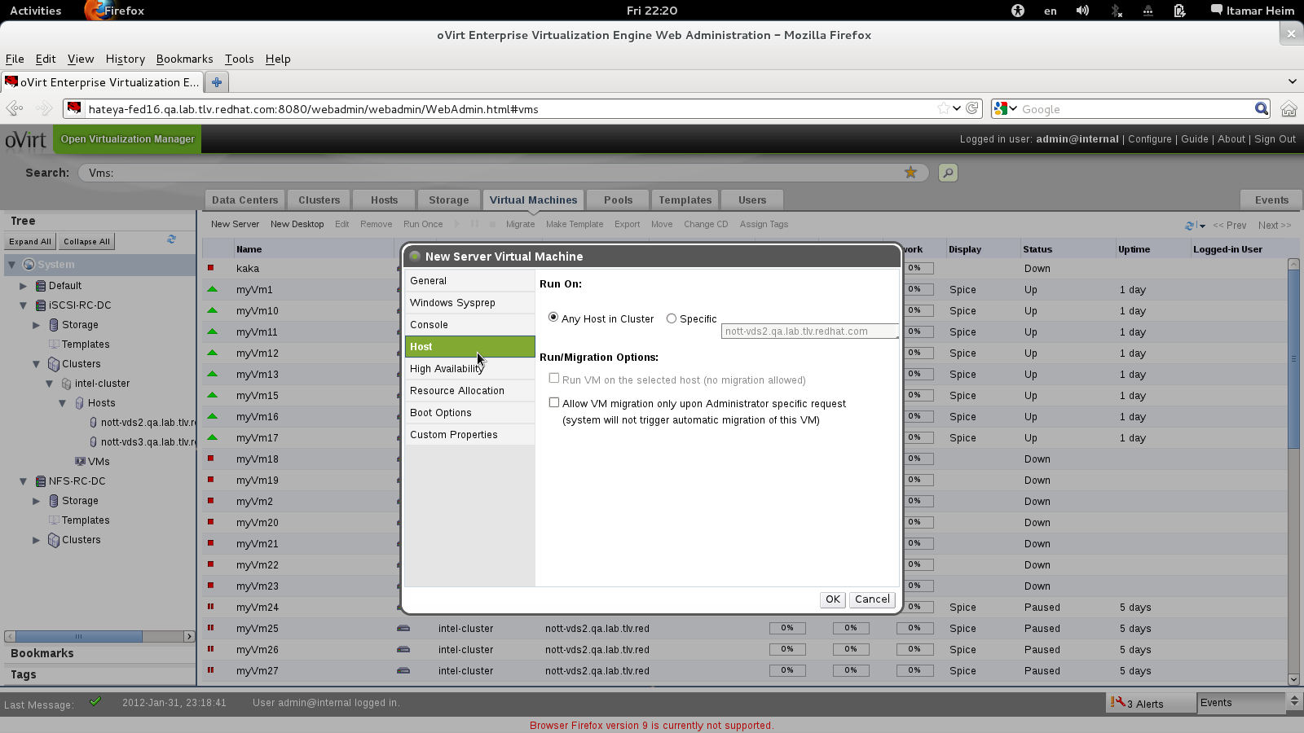
Migratable or Not

Slide 41
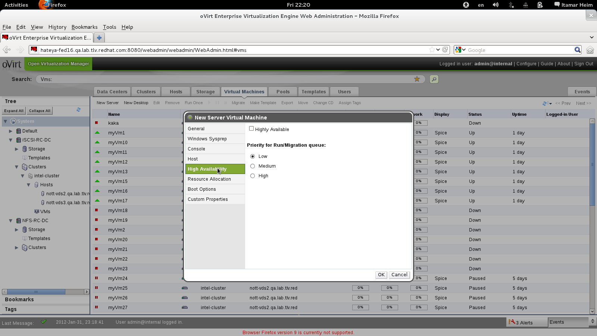
Highly Available?

Slide 42
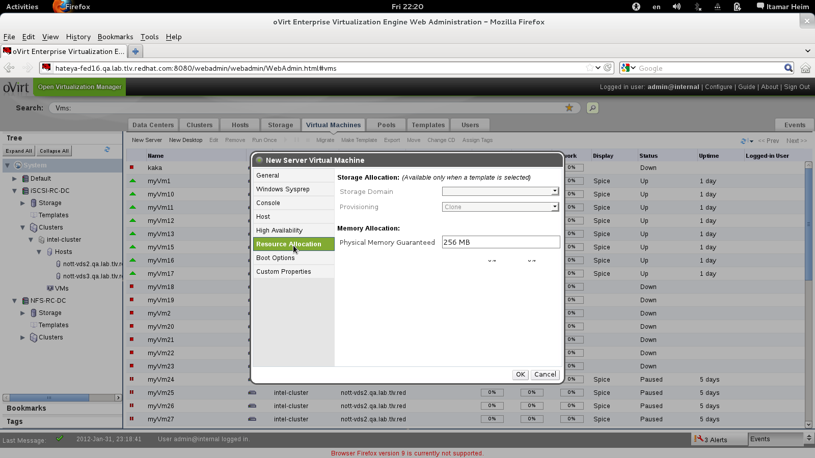
Control Allocated Resources (Disk, Memory)

Slide 43
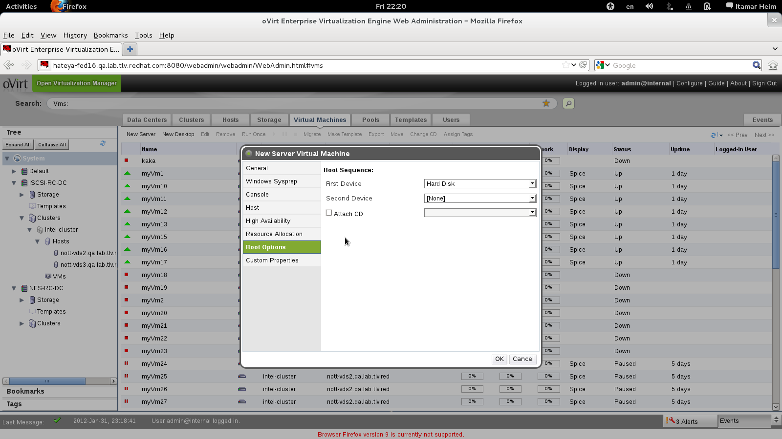
Boot Devices

Slide 44
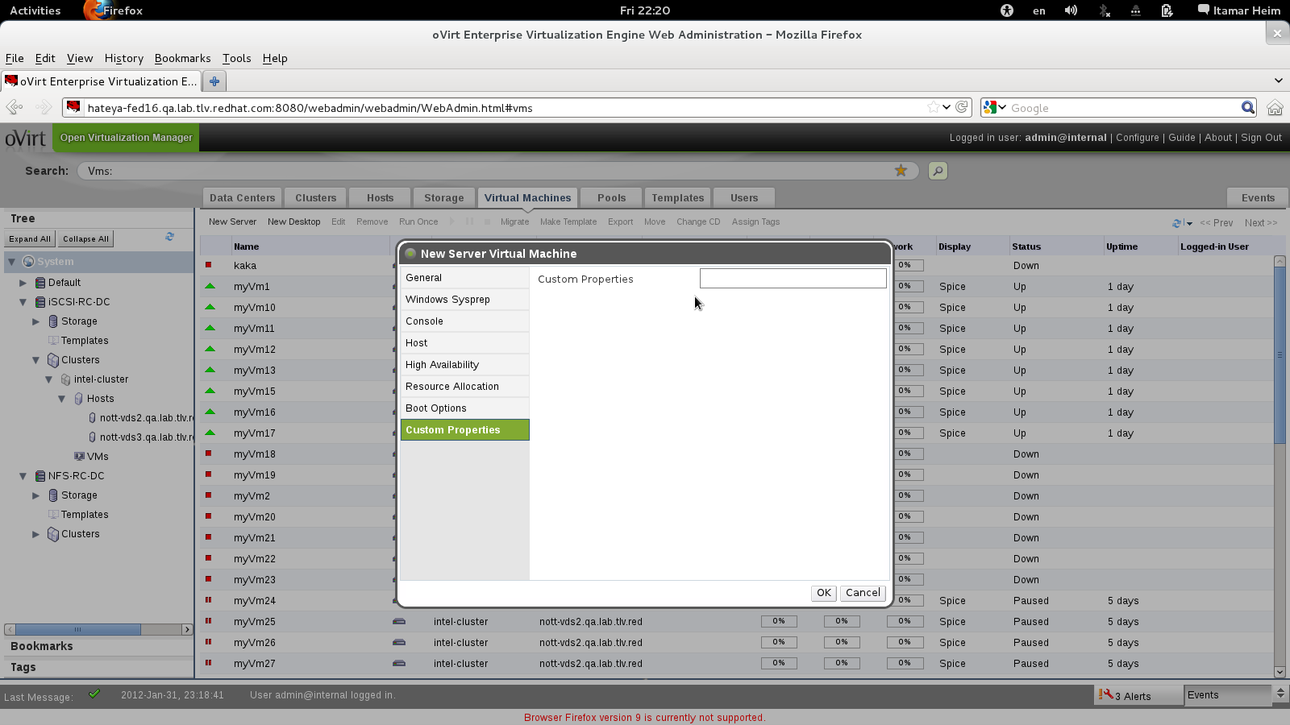
Advanced Options via Custom Properties

Slide 45
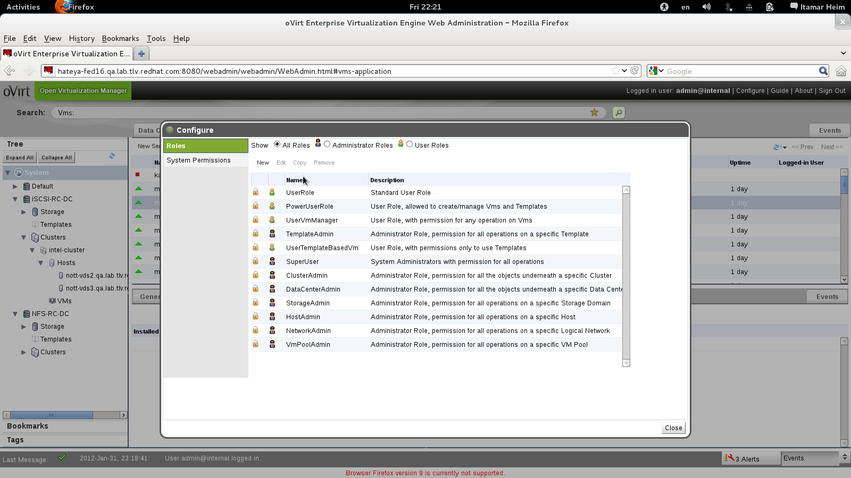
Assign Permissions to Objects by Roles

Slide 46
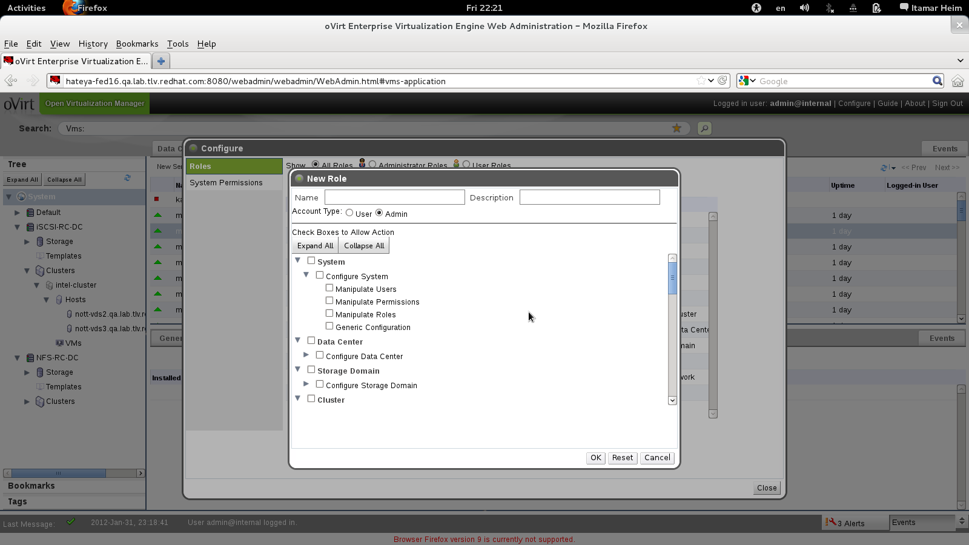
Define Your Own Roles

Slide 47
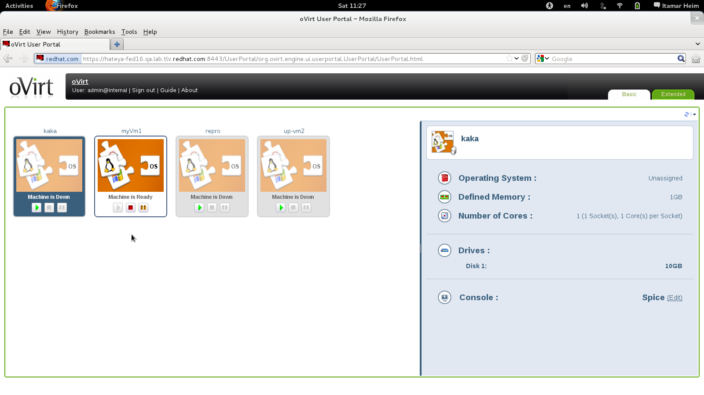
User Portal
Notes:
Started from VDI – need to give the user access
Spice enables better vdi performance
All they want is easy access to their desktop
Spice access the host not the VM
Applies server Vms as well

Slide 48
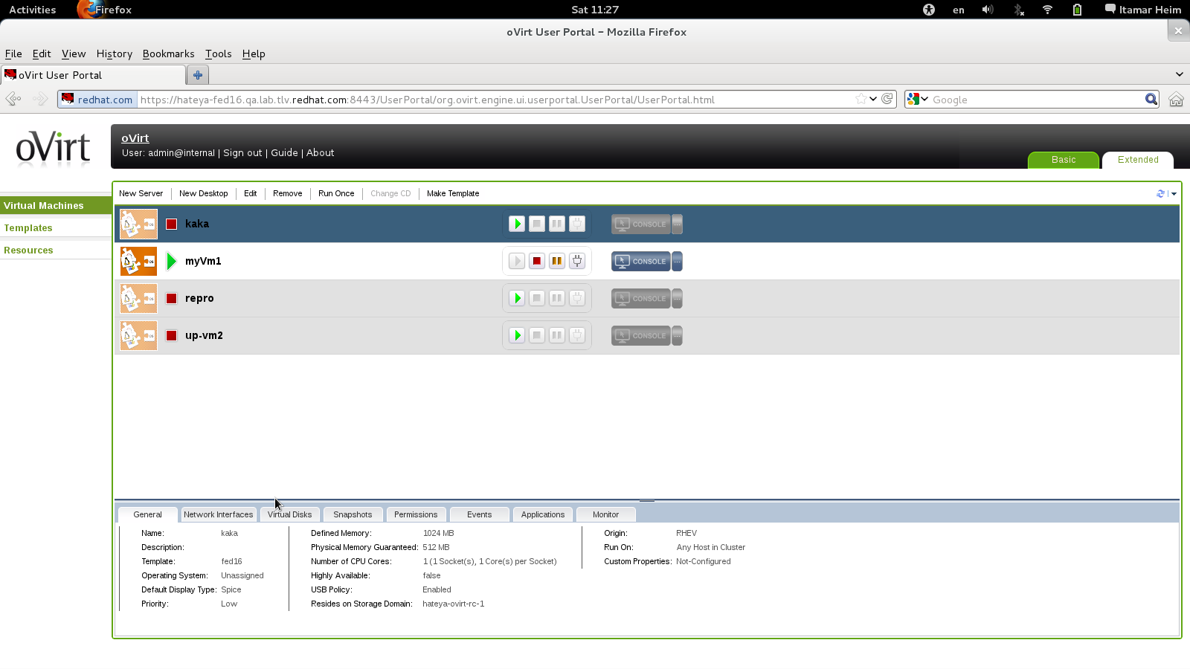
Self-Provisioning Portal
Notes:
SOMETIMES WE WANT USERS TO BE ABLE TO CREATE VMS
WE DON”T WANT TO LET THE USER LOGIN TO THE ADMIN CONSOLE
WE WANT A SIMPLIFIED USER INTERFACE
SIMILAR IN FUNCTIONALITY TO ADMIN CONSOLE
DEALS ONLY WITH VMS AND TEMPLATES
LAB MANAGER/ QA MANAGER CAN CREATE VMS AND DELEGATE ACCESS TO THEM
NO HOST/STORAGE?NETWORK DEFINITION

Slide 49
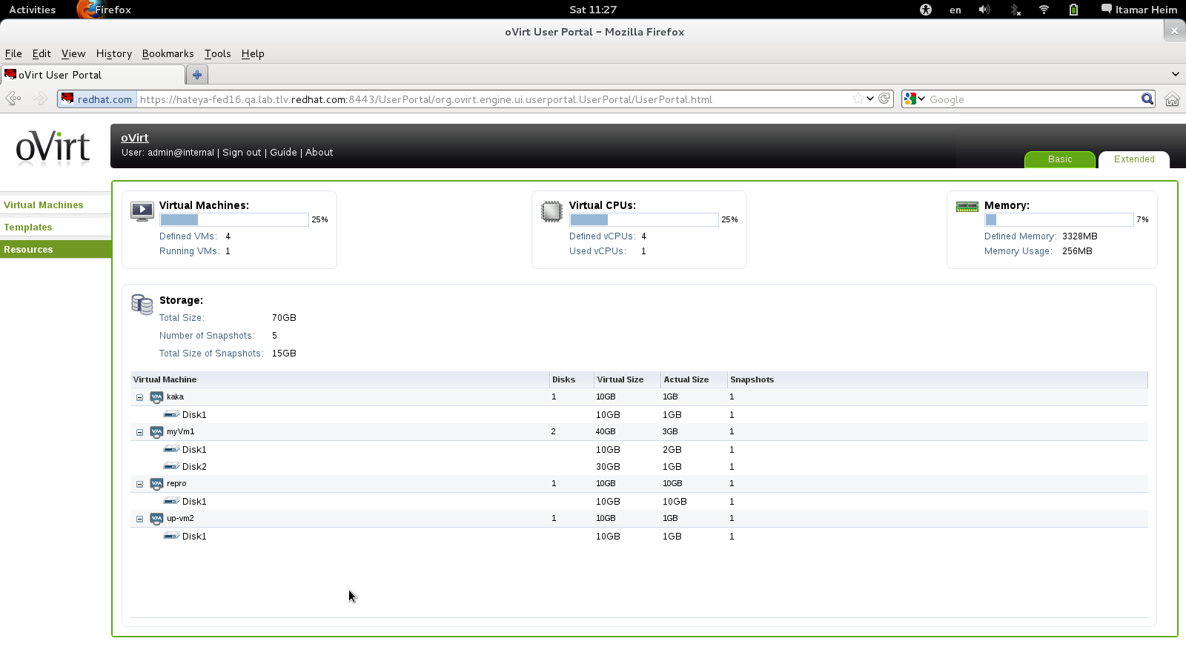
User Resource View
Notes:
RESOURCE VIEW

Slide 50
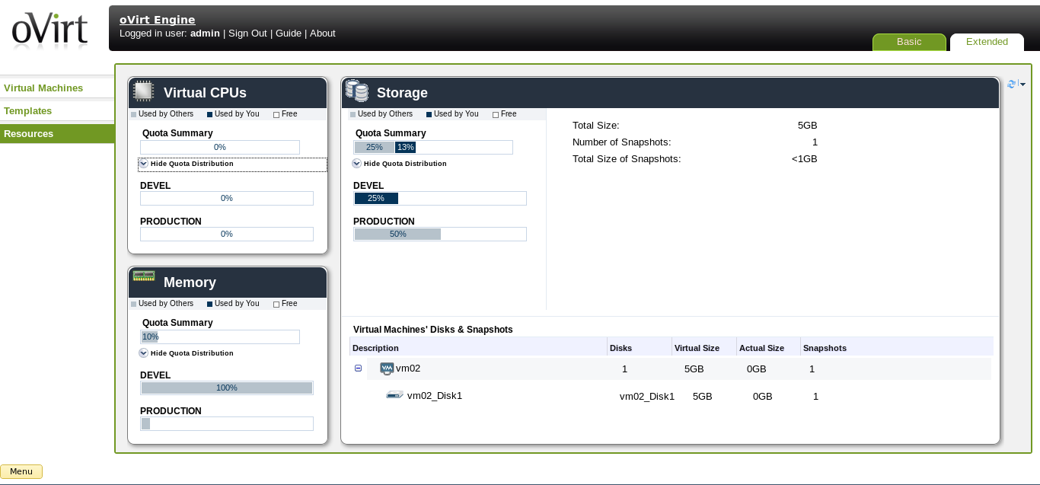
User Portal - Extended

Slide 51
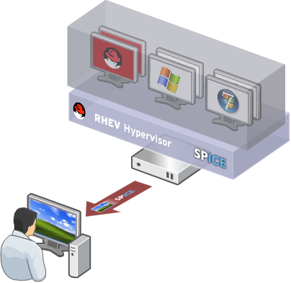
Virtual Desktop Infrastructure (VDI)
Centralized management, security and policy enforcement
Virtual desktops with user experience of a physical PC
Multiple monitors
HD-quality video
Bi-directional audio/video for VoIP or video-conferencing
Smartcard support
USB support
Industry-leading density of virtual desktops/server
Notes:
- VDI – is all about giving a user the same experiace as physical machine
- SPICE , MULTI-MONITOR, High Quality Videos, bi directional VIDEO AUDIO (WEB CAMS + MICROPHONE)
- spice fully integrated with ovirt
- Activex FOR WIN
- XPI for linux/firefox
- launched from web interface
KSM - density

Slide 52

Architecture

Slide 53
Architecture From 30,000 Feet
Hosts (VDSM)
Engine
Client (web portals)
Notes:
Centralized management system
3 main actors
Client – view setup information and submit actions
Server –HA service, process the queries and actions submitted by the clients
Serves as inventory
Many actions requires operations in the host level
Agent – Tailored to the management needs
Provides all functionality in the host level

Slide 54
oVirt High-Level Architecture
Postgres
oVirt
Engine
Java
Admin Portal
gwt
AD
R
E
S
T
SDK/CLI
python
IPA
User Portal
gwt
Guest agent
Guest agent
Shared Storage
FC/iSCSI/NFS
Linux VM
Win VM
Linux/Windows
client
libvirt
VDSM
Host | Node
SPICE
Local Storage
Notes:
Xiao Guangrong, IBM

Slide 55
Engine Core (Backend)
VM & Template Life Cycle
create, schedule, snapshot
Load
Balancing
HA
Storage
Configuration & Monitoring
Network
Configuration & Monitoring
Host
Register/Install
Host
Monitoring
Host
Maintenance
Host
Fencing
Authentication, Authorization
Audit
Inventory

Slide 56
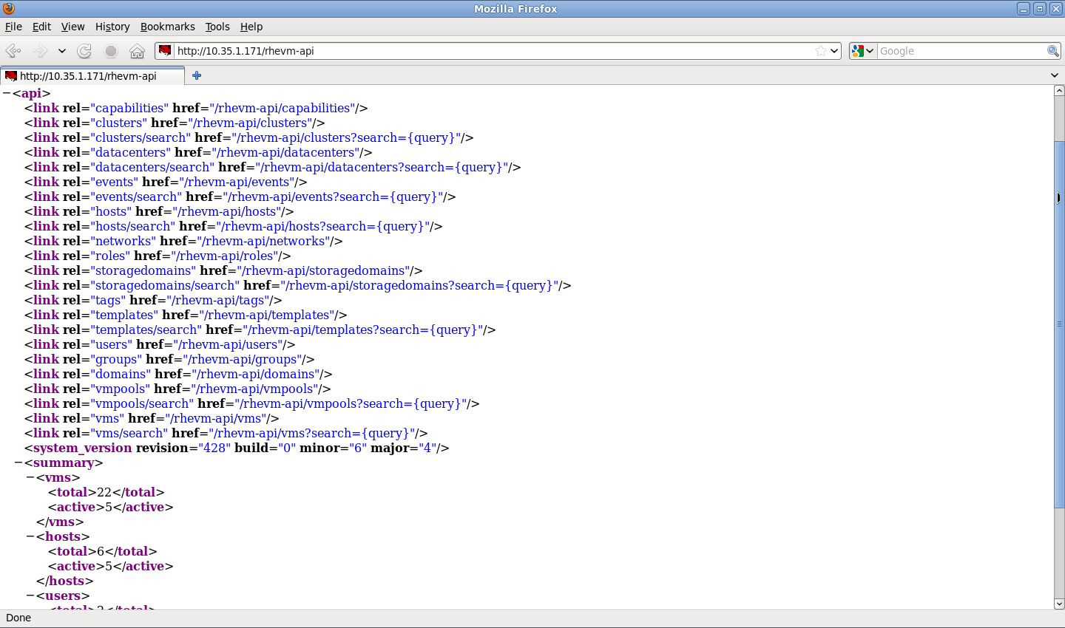
REST API

Slide 57
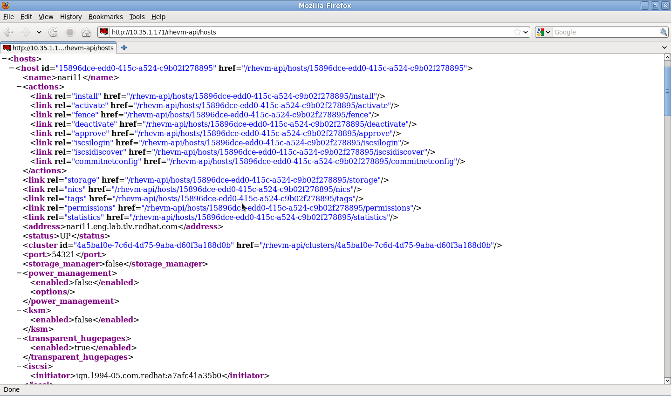
Hosts Collection

Slide 58
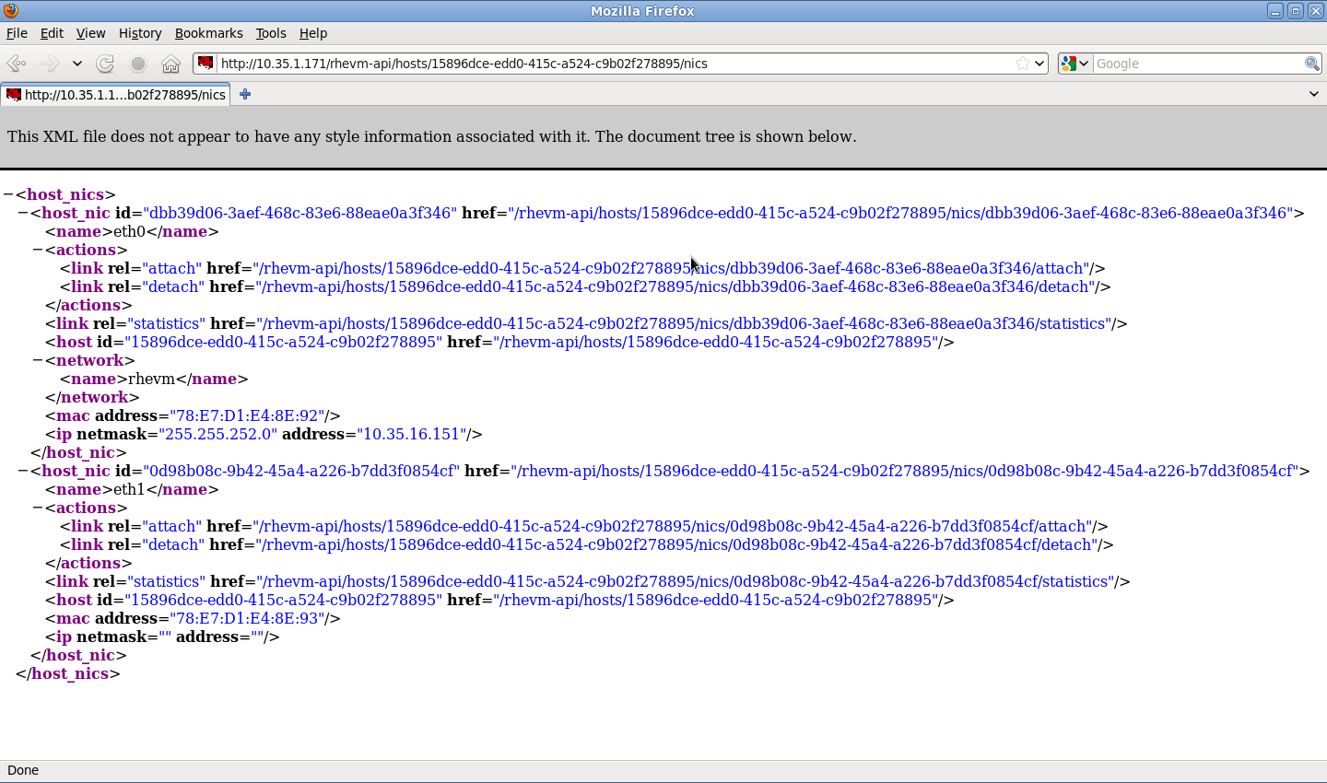
Host Networks Collection

Slide 59
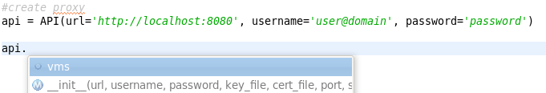

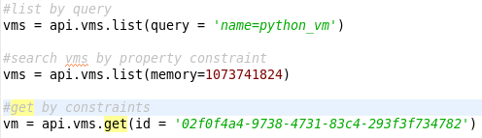

Python SDK
- Creating the proxy
- Listing all collections
- Listing collection's methods.
- Querying collection with oVirt search
engine.
- Querying collection by custom constraint.
- Querying collection for specific resource.
- Accessing resource methods and
properties.

Slide 60




Python SDK (cont.)
- Accessing resource properties and
sub-collections.
- Accessing sub-collection methods.
- Querying sub-collection by custom
constraint.
- Retrieving sub-collection resource.
- Accessing sub-collection resource
properties and methods.

Slide 61


oVirt CLI

Slide 62

Data Warehouse Based on Talend ETL

Slide 63

oVirt Reports

Slide 64


oVirt Reports

Slide 65

Notification Service
oVirt allows registration to certain audit events
The notification service sends emails per audit message to relevant users
Also monitors engine itself

Slide 66

Hooks
“Hook” mechanism for customization
  Allows administrator to define scripts to modify VM operation
    eg. Add extra options such as CPU pinning, watchdog device, direct LUN access, etc
  Allows oVirt to be extended for new KVM features before full integration is done
  An easy way to test a new kvm/libvirt/linux feature

Slide 67
Hooks
Hook scripts are called at specific VM lifecycle events
    VDSM (management agent) Start
    Before VM start
    After VM start
    Before VM migration in/out
    After VM migration in/out
    Before and After VM Pause
    Before and After VM Continue
    Before and After VM Hibernate
    Before and After VM resume from hibernate
    On VM stop
    On VDSM Stop
Hooks can modify a virtual machines XML definition before VM start
Hooks can run system commands – eg. Apply firewall rule to VM

Slide 68
Sample Hooks
CPU pinning
SR/IOV
Smart card
Direct LUN
Hugepages
Promiscuous mode network interface
Cisco VN-Link
Fileinject
Floppy
Hostusb
Isolatedprivatevlan
Numa
Qos
Scratchpad
smbios

Slide 69

UI-Plugin: Foreman Main Tab

Slide 70

UI-Plugin: oVirt Monitoring sub-tab
More info at: https://labs.ovido.at/monitoring/wiki/ovirt-monitoring-ui-plugin

Slide 71
New and Planned Features
Live snapshots
Live storage migration
Quotas
Hot plug
Multiple storage domains
Shared disks
iScsi disk
Shared file system support
Storage array integration
Gluster support
Qbg/Qbh
virt-resize, pv-resize
libguestfs integration
Stable device addresses
Network types
Backup API
SLA
SDM
External Providers

Slide 72
Goals of the oVirt project
Build a community around all levels of the virtualization stack – hypervisor, manager, GUI, API, etc.
To deliver both a cohesive complete stack and discretely reusable components for open virtualization management
Provide a release of the project on a well defined schedule
Focus on management of the KVM hypervisor, with exceptional guest support beyond Linux
Provide a venue for user and developer communication and coordination
Notes:
BUILD COMMUNITY AROUND THE VIRTUALIZATION STACK
FOCUSED ON LARGE SCALE DEPLOYMENTS
FOCUSED AROUND KVM

Slide 73
Governance
Merit based, open governance model
Built using the best concepts taken from Apache and Eclipse Foundations
Governance split between board and projects
  oVirt Board
  Multiple projects under the oVirt brand
Notes:
MERIT BASED
BASED ON APACHI AND ECLIPSE FOUNDATION

Slide 74
Getting oVirt
Obtain from oVirt website -
  http://www.ovirt.org/Download
Fedora repositories
Live USB - http://wiki.ovirt.org/wiki/OVirt_Live
Build from source

Slide 75

Let's Test

Slide 76
How To Contribute
Join the community
- Find bugs, File Them, Correct Them.
- Translate, Write Documentation.
- Design Interfaces, Develop new features
- Share your experiences.
Everyone can make a difference.
Mailing lists:
  http://lists.ovirt.org/mailman/listinfo
IRC:
  #ovirt on OFTC
Website and Repository:
  http://www.ovirt.org
  http://www.ovirt.org/wiki
  http://www.ovirt.org/project/subprojects/

Slide 77
What's Next
Next Version
  3.5.2 Candidate Testing 18 March
  http://www.ovirt.org/Upcoming_events
  http://www.ovirt.org/OVirt_3.5.2_Release_Notes
  http://resources.ovirt.org/pub/ovirt-3.5-pre/iso/
  http://www.ovirt.org/Repository_mirrors#Current_mirrors﻿
Next Workshop
  26 of April Flisol
  Fudcon
  Latinoware
  FISL16

Slide 78

THANK YOU!
http://www.ovirt.org
villadalmine@fedoraproject.org
#fedora-latam – irc.freenode.net
https://www.facebook.com/groups/ovirt.openvirtualization/
http://lists.ovirt.org/mailman/listinfo/users

