Slide 1
Virtualization Management
Ovirt Project
Rino Rondan
Fedora Ambassador & Packager
Fedora Argentina
PampaSeg Santa Rosa, La Pampa, 11/12/2015

Slide 2
Agenda
What is oVirt?
Quick Resume
What does it do?
Architecture
New Feautures
Roadmap
What's next?

Slide 3
What is oVirt?

Slide 4
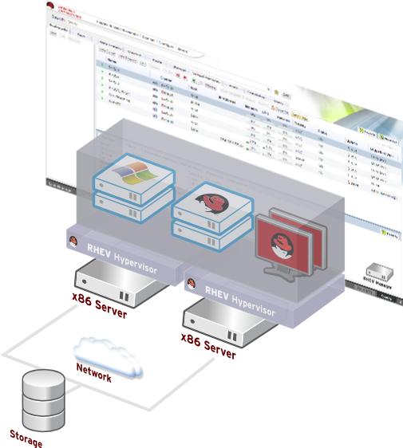
What is oVirt?
Large scale, centralized management for server and desktop virtualization
Based on leading performance, scalability and security infrastructure technologies
Provide an open source alternative to vCenter/vSphere
Focus on KVM for best integration/performance
Focus on ease of use/deployment
Notes:
What is Ovirt?
ROBUST PLATFORM
FEATURE REACH
SVI & VDI
MANAGING VIRTUALIZED DC – THOUSANDS OF VMS ?HYPERVISORS
KVM
A PARALLEL to VMWARE VSPHERE/ VCENTER
SINGLE POINT OF MANAGEMENT – NET STORAGE

Slide 5
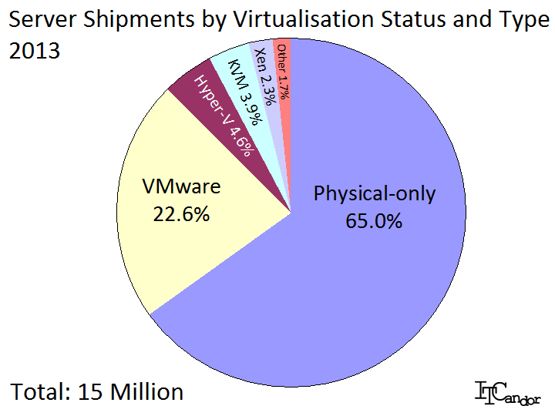
Competitive Landscape
Notes:
[NOTE: Because of age, this slide's graphic should not be used past June 2015. Use something else, because points in notes are still good.]
OVIRT IS THE SOURCE FOR RHEV STACK AND OTHER COMMERCIAL PRODUCTS, SUCH AS WIND RIVER'S OPEN VIRTUALIZATION PRODUCT AND UDS ENTERPRISE
RHEV POSITIONING IN THE MARKET
DESPITE THE FACT WE ARE RELATIVE NEWCOMERS
SECOND AFTER VMWARE ON MANAGEMENT (OVIRT)

Slide 6
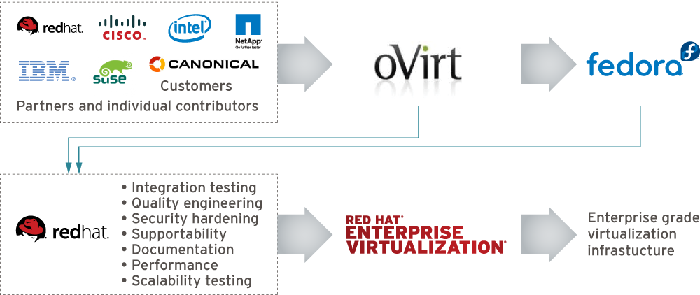
Who is Behind It
Notes:
[Note: Make sure this is updated!]
Open source for three years
Release cycle is every 6 months so we already have 4 stable versions out there, the last one that was released in April 2014 is oVirt 3.4 that included features like live snapshots, self-hosted engines, and hot-plug CPUs.

Slide 7
Quick Resume

Slide 8
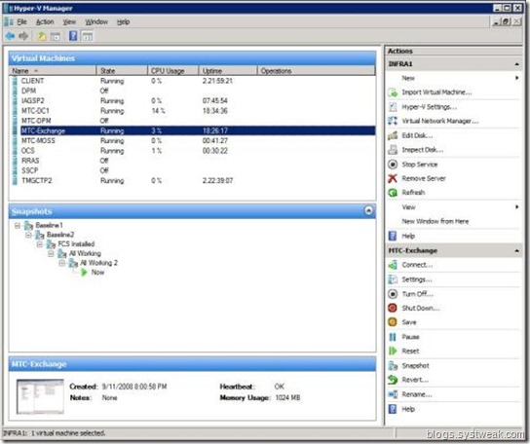
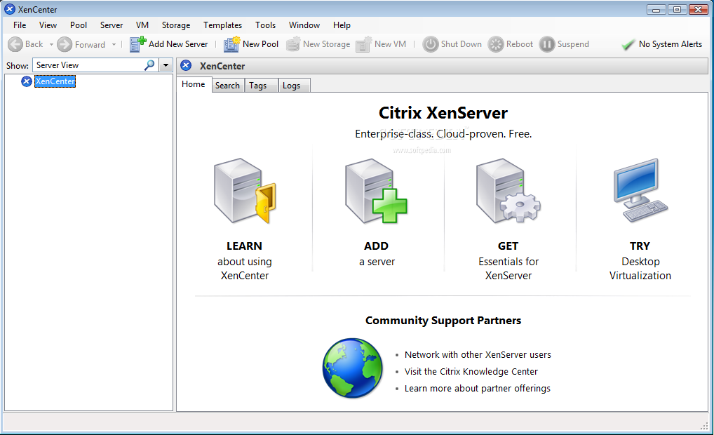
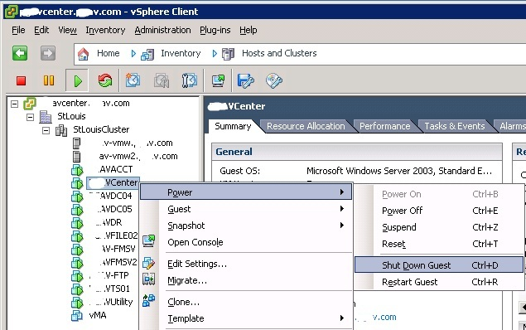
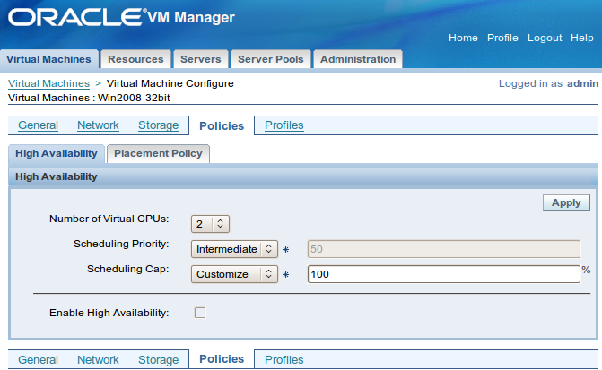
A bounch of players

Slide 9
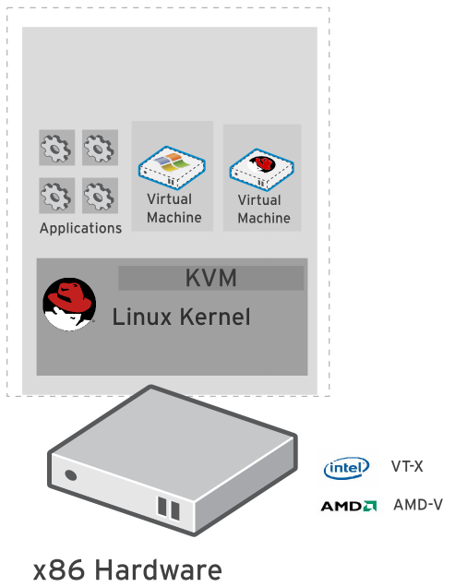
Kernel-based Virtual Machine (KVM)
Included in Linux kernel since 2006
Runs Linux, Windows and other operating system guests
Advanced features
  Live migration
  Memory page sharing
  Thin provisioning
  PCI Pass-through
KVM architecture provides high
“feature-velocity” – leverages the power of Linux

Slide 10
Using KVM
/usr/libexec/qemu-kvm -name vm-f16-buildmachine -S -M rhel6.4.0 -cpu Westmere -enable-kvm -m 2048 -smp 2,sockets=2,cores=1,threads=1 -uuid a8ccdb60-8a42-44f5-9669-d74c3b2eff43 -smbios type=1,manufacturer=Red Hat,product=RHEV Hypervisor,version=6Server-6.4.0.4.el6,serial=30353036-3837-4247-3831-30394635324C_78:e7:d1:22:46:d8,uuid=a8ccdb60-8a42-44f5-9669-d74c3b2eff43 -nodefconfig -nodefaults -chardev socket,id=charmonitor,path=/var/lib/libvirt/qemu/vm-f16-buildmachine.monitor,server,nowait -mon chardev=charmonitor,id=monitor,mode=control -rtc base=2013-10-08T12:16:16,driftfix=slew -no-shutdown -device piix3-usb-uhci,id=usb,bus=pci.0,addr=0x1.0x2 -device virtio-serial-pci,id=virtio-serial0,bus=pci.0,addr=0x4 -drive if=none,media=cdrom,id=drive-ide0-1-0,readonly=on,format=raw,serial= -device ide-drive,bus=ide.1,unit=0,drive=drive-ide0-1-0,id=ide0-1-0 -drive file=/rhev/data-center/f79b0b28-c82f-11e0-8739-78e7d1e48c4c/5bab6470-8825-4e3a-b408-ebcde93678b6/images/4c213cd2-c4d5-441b-a1ac-dfb1a6868699/11b3e132-50a5-481b-b48b-e3b1f2879e69,if=none,id=drive-virtio-disk0,format=qcow2,serial=4c213cd2-c4d5-441b-a1ac-dfb1a6868699,cache=none,werror=stop,rerror=stop,aio=native -device virtio-blk-pci,scsi=off,bus=pci.0,addr=0x5,drive=drive-virtio-disk0,id=virtio-disk0,bootindex=1 -drive file=/rhev/data-center/f79b0b28-c82f-11e0-8739-78e7d1e48c4c/5bab6470-8825-4e3a-b408-ebcde93678b6/images/02330fa2-d1ff-48e0-a843-842c2376756f/5a283126-4d27-4eef-86dd-fb538d8d08e4,if=none,id=drive-virtio-disk1,format=qcow2,serial=02330fa2-d1ff-48e0-a843-842c2376756f,cache=none,werror=stop,rerror=stop,aio=native -device virtio-blk-pci,scsi=off,bus=pci.0,addr=0x6,drive=drive-virtio-disk1,id=virtio-disk1 -netdev tap,fd=31,id=hostnet0,vhost=on,vhostfd=32 -device virtio-net-pci,netdev=hostnet0,id=net0,mac=00:1a:4a:23:12:13,bus=pci.0,addr=0x3,bootindex=2 -chardev socket,id=charchannel0,path=/var/lib/libvirt/qemu/channels/vm-f16-buildmachine.com.redhat.rhevm.vdsm,server,nowait -device virtserialport,bus=virtio-serial0.0,nr=1,chardev=charchannel0,id=channel0,name=com.redhat.rhevm.vdsm -chardev socket,id=charchannel1,path=/var/lib/libvirt/qemu/channels/vm-f16-buildmachine.org.qemu.guest_agent.0,server,nowait -device virtserialport,bus=virtio-serial0.0,nr=2,chardev=charchannel1,id=channel1,name=org.qemu.guest_agent.0 -chardev spicevmc,id=charchannel2,name=vdagent -device virtserialport,bus=virtio-serial0.0,nr=3,chardev=charchannel2,id=channel2,name=com.redhat.spice.0 -spice port=5904,tls-port=5905,addr=10.35.16.4,x509-dir=/etc/pki/vdsm/libvirt-spice,tls-channel=main,tls-channel=display,tls-channel=inputs,tls-channel=cursor,tls-channel=playback,tls-channel=record,tls-channel=smartcard,tls-channel=usbredir,seamless-migration=on -k en-us -vga qxl -global qxl-vga.ram_size=67108864 -global qxl-vga.vram_size=67108864

Slide 11
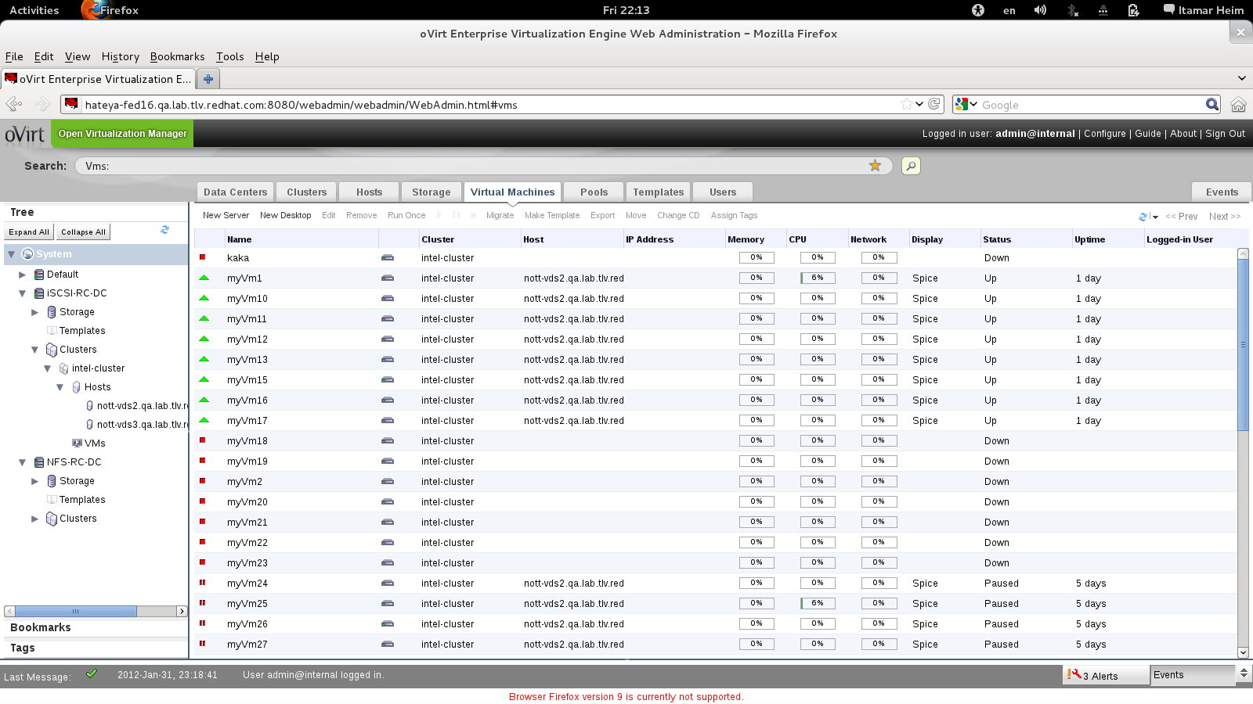
How Does It Look?
Notes:
SO HOW DOES IT LOOK
THIS IS THE ADMIN CONSOLE
WEB BASED UI
HANDLES ALL THE MANAGED ENTITIES
DC, CLUSTER, HOSTS, VMS
NET, STORAGE,

Slide 12
VIRT & KVM Features
How Large-Scale Systems are Managed
Live snapshot
Over-commit
CPU, Memory, I/O
Transparent huge pages
ACPI support
Live Migration
Live Storage Migration
KSM
PCI Device Assignment
SMP Guests
ballooning
I/O Throttling
Hotplug
SPICE
NUMA
SR-IOV
PCI pass through
Massive scalability
VEPA
sVirt
Notes:
BUILD COMMUNITY AROUND THE VIRTUALIZATION STACK
FOCUSED AROUND KVM

Slide 13
oVirt: A list of basic Features
High Availability
Live Migration
Storage Live Migration
CPU/Memory Overcommit
System Scheduler
V2V
Storage iSCSI, FC, NFS, GlusterFS, Local...
Template / Pools
Memory Deduplication and Balloon
VDI / SPICE
Disk Alignment scan
and...
Notes:
BUILD COMMUNITY AROUND THE VIRTUALIZATION STACK
FOCUSED AROUND KVM

Slide 14
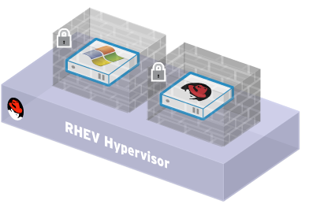
Security
oVirt inherits the security features of Linux
SELinux security policy infrastructure
Provides protection and isolation for virtual machines and host
Compromised virtual machine cannot access other VMs or host
sVirt Project
Sub-project of NSA's SELinux community. Provides “hardened” hypervisors
Multilevel security. Isolate guests
Contain any hypervisor breaches
Notes:
For security, RHEV uses the SELinux security engine built into RHEL and designed for government security. This feature is on by default and effectively isolates Vms from each other and from the physical host.
In future versions of RHEV, we'll be leveraging the sVirt project, which is a VM-enabled version of SELinux, that provides multilevel security, access control of resources such as disk storage and network, and can be tuned to the most challenging security requirements.

Slide 15
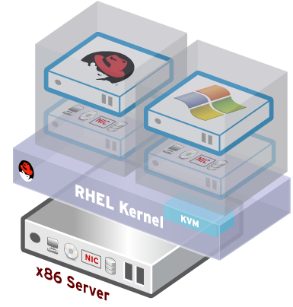
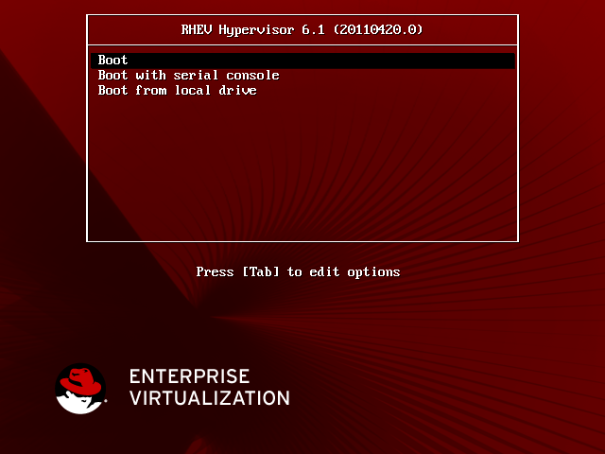
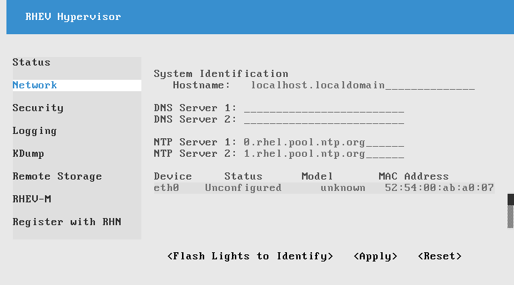
oVirt Node
Standalone hypervisor
  Small footprint < 100MB
    Customized 'spin' of Fedora + KVM
    'Just enough' Fedora to run virtual machines
    Runs on all RHEL hardware
    with Intel VT/AMD-V CPUs
  Easy to install, configure and upgrade
    PXE boot, USB boot, CD or Hard drive

Slide 16
oVirt: Not a Single Project
Current List of Upstream Projects
oVirt-Log-Collector
oVirt-DWH
Ovirt-Reports
oVirt-API
oVirt-mom
Ovirt-userportal
oVirt-hosted-engine
oVirt-webadmin
oVirt-Engine
VDSM
oVirt-Node
Ovirt-Engine-SDK
oVirt-Engine-CLI
oVirt-Guest-Agent
oVirt-Image-Uploader
Notes:
BUILD COMMUNITY AROUND THE VIRTUALIZATION STACK
FOCUSED AROUND KVM

Slide 17
oVirt: features
High Availability
Live Migration
Load Balancing (DRS)
Power Saver (DPM)
Maintenance Manager (oVirt Node Updates)
Image Management (Templates, Thin Provisioning, Snapshots)
Storage and Network Management
Monitoring and Reporting
V2V and P2V (VMware, XEN, KVM -> oVirt)
VDI for Windows and Linux guests
Notes:
BUILD COMMUNITY AROUND THE VIRTUALIZATION STACK
FOCUSED AROUND KVM

Slide 18
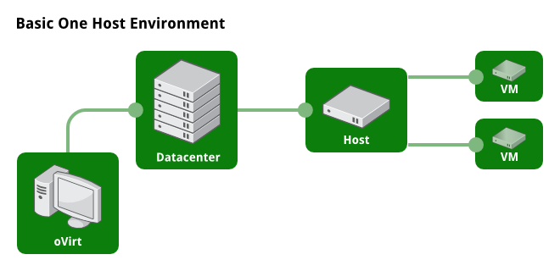
One Host Environment
Notes:
What kind of topologies you can manage via oVirt

Slide 19
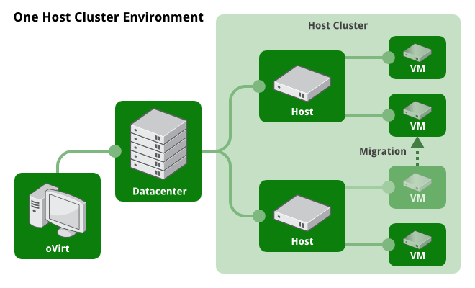
Multiple Hosts

Slide 20
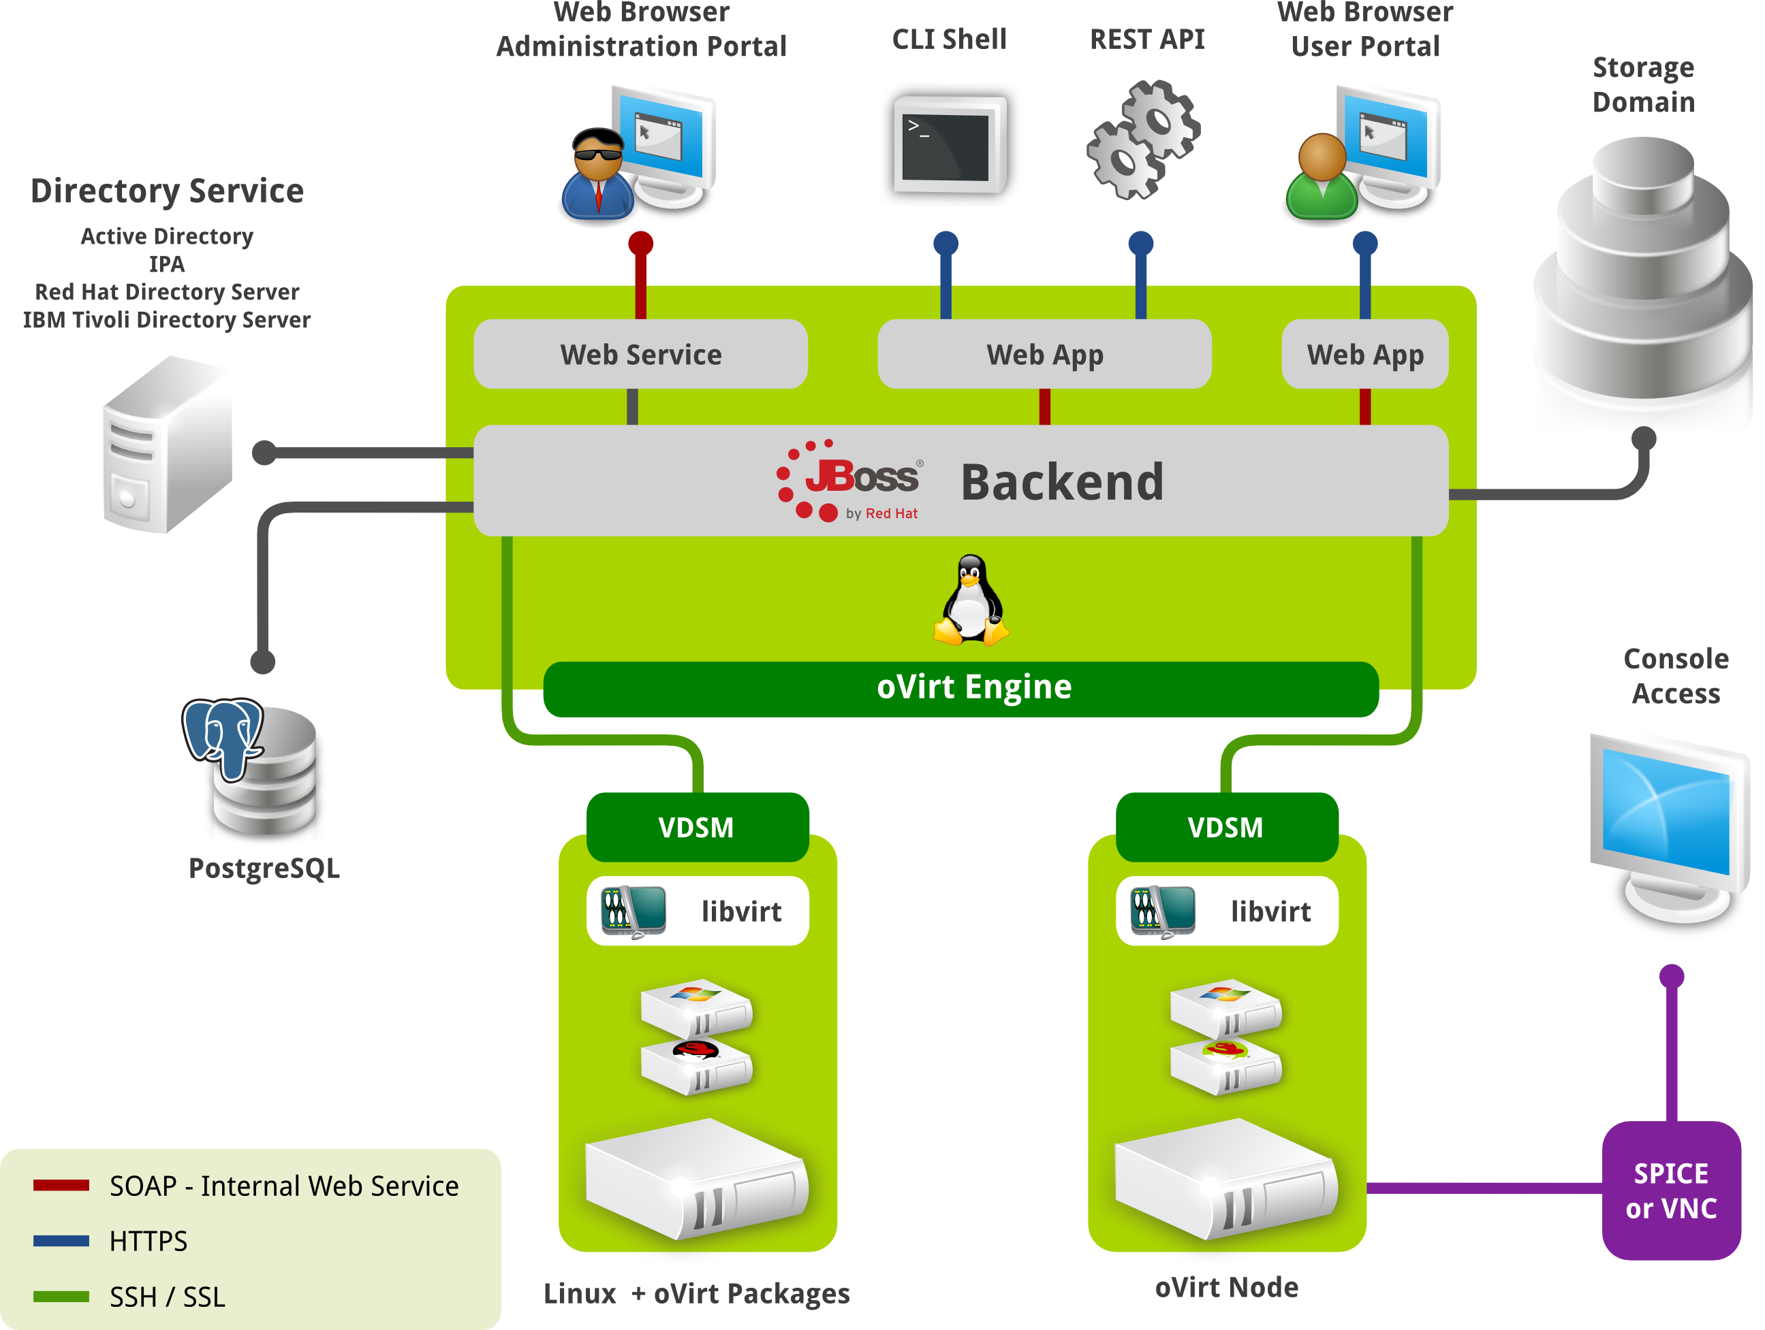

Slide 21
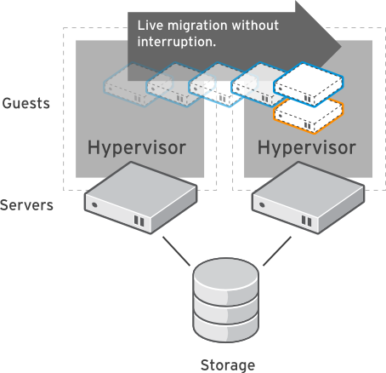
Live Migration
Dynamically move virtual machines between hosts
  No service interruption
  Applications continue to run
Migrate even I/O intensive workloads such as databases
Perform hardware maintenance without application downtime
Dynamically balance workloads between host systems

Slide 22
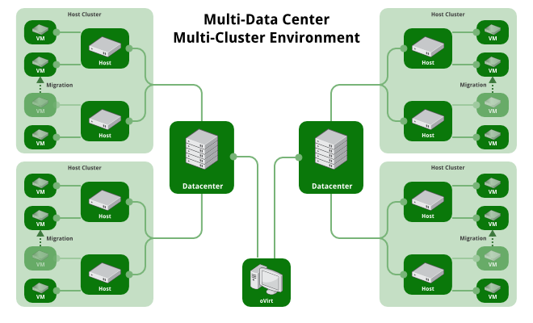
Multi-Datacenter/Multi-Host

Slide 23
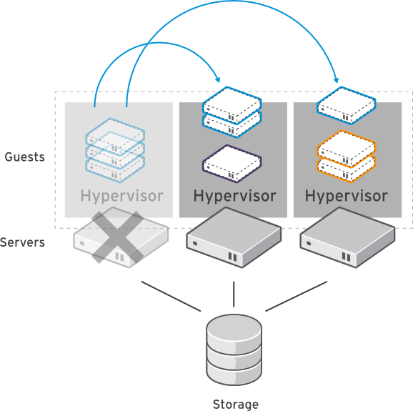
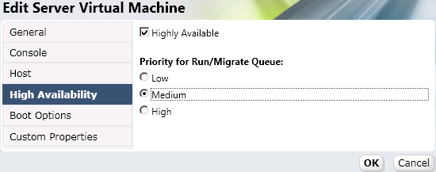
High Availability
Build a highly available enterprise infrastructure
Continually monitor host systems and virtual machines
Automatically restart virtual machines in case of host failure
  Restart virtual machine on another node in the cluster
Use live migration to “fail-back” a VM to it's original host when the server is restored

Slide 24
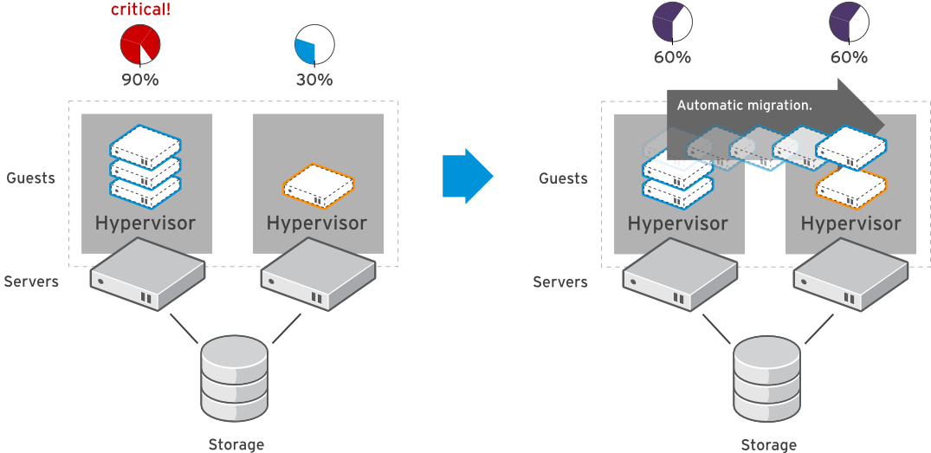
System Scheduler
Dynamically balance workloads in the data center.
Automatically live migrate virtual machines based on resources
Define custom policies for distribution of virtual machines
Maintain consistent resource usage across the enterprise data center

Slide 25
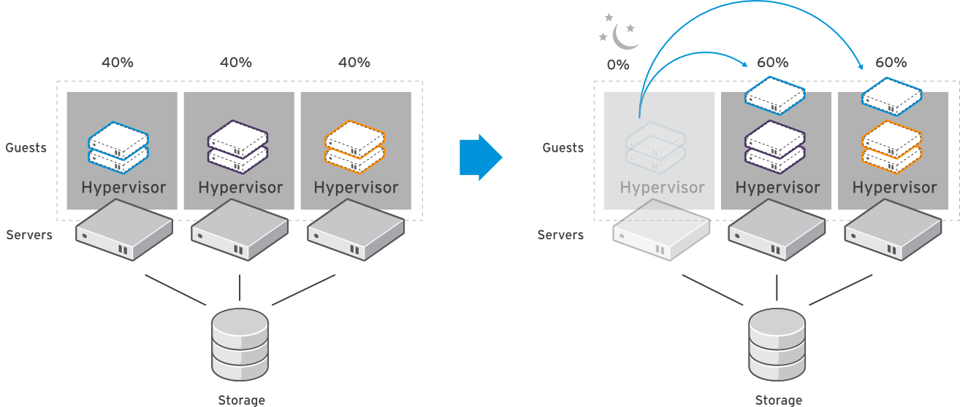
Power Saver
Define policies to optimize workload on a fewer number of servers during “off-peak” hours

Slide 26
What does it do?

Slide 27
Three Pillars of Management
Simplicity
Stability
Functionality

Slide 28
Simplicity
Installation
  sudo yum install -y ovirt-engine
  sudo engine-setup
Varied user interaction mechanisms
  Intuitive web interface
  Python CLI
  Python/Java SDK
Ovirt Node
Configuration
  One place, single utility

Slide 29
Stability
Involvement of big companies
  RHEV is based on oVirt
  IBM, Netapp, Cisco etc.
Open governance model - Merit based
Regular release schedule
  Well known release schedule
  Stabilization periods
  Community test days
CI
Active users community
  Deployed in production, Alter Way

Slide 30
Functionality
Notes:
SO HOW DOES IT LOOK ?
ADMIN CONSOLE
Search driven
Tree view
Components (DC, Cluster, Host)
Networks
SP

Slide 31
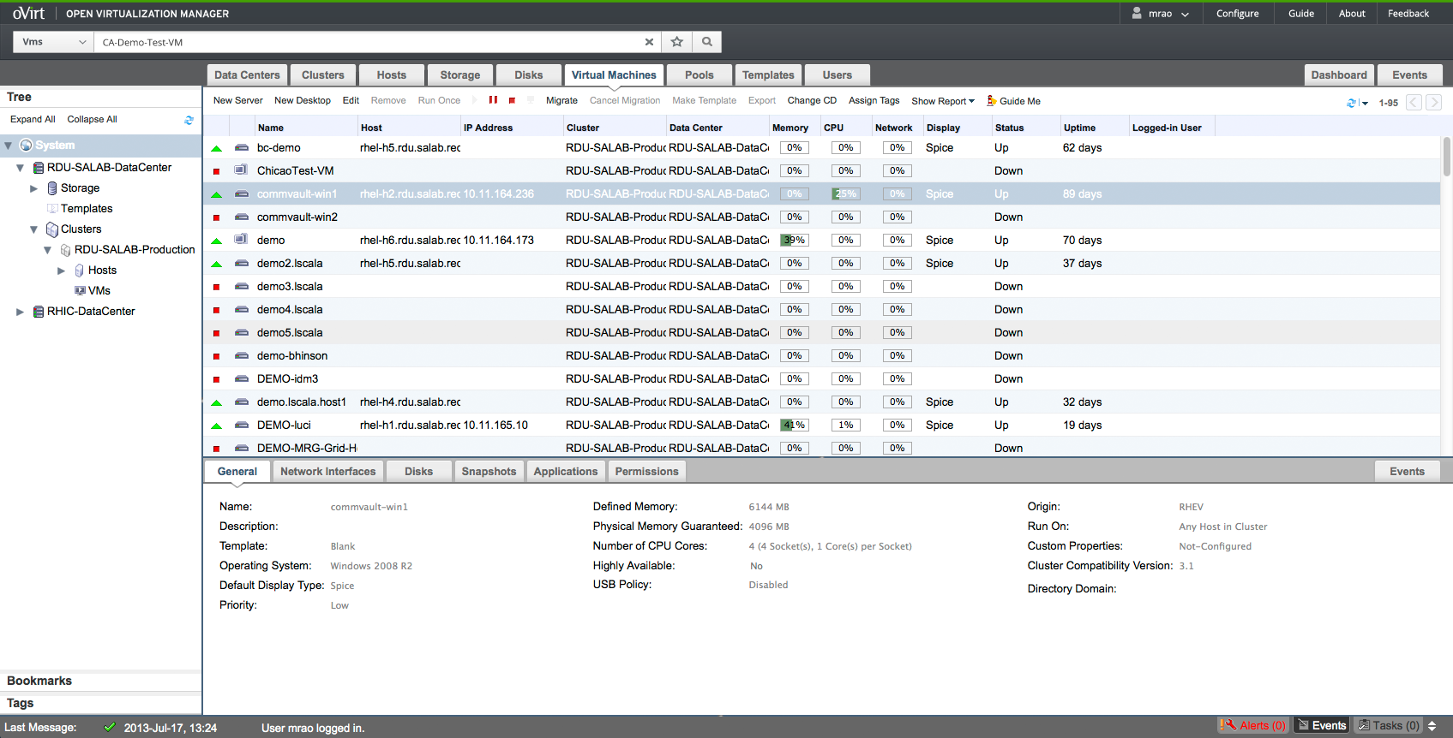
Administration Portal

Slide 32
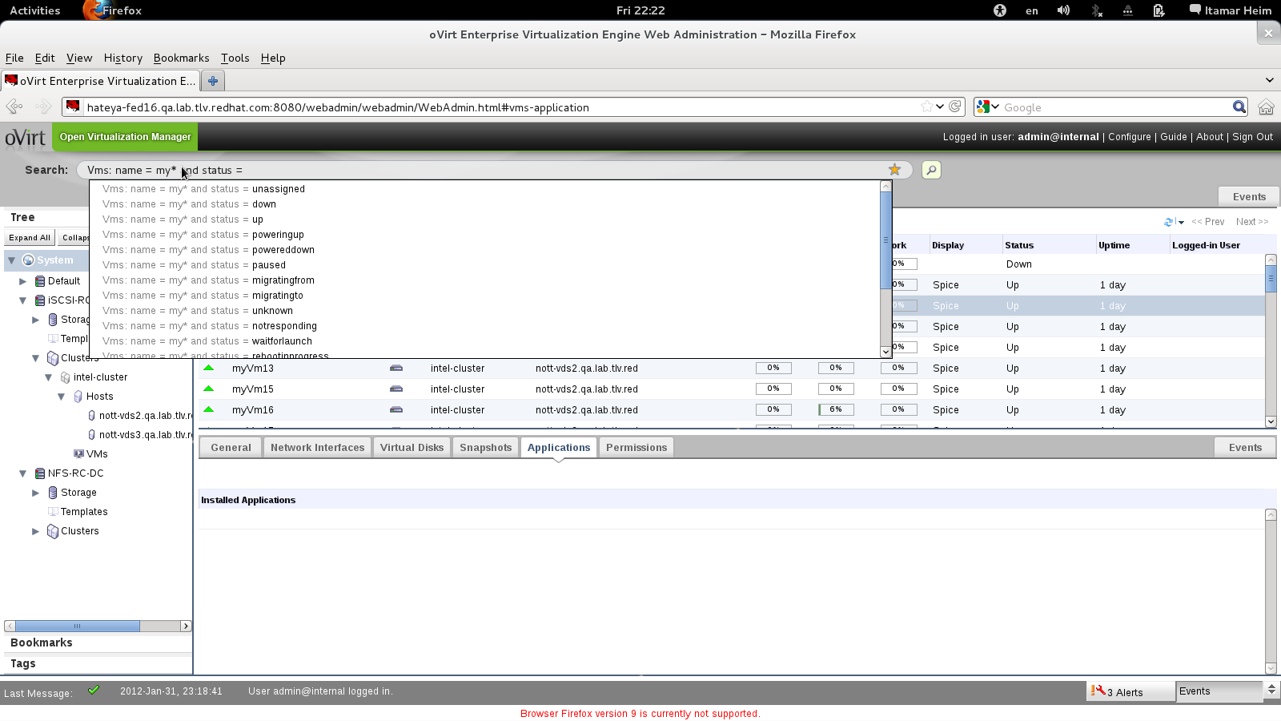
Search Auto Complete
Notes:
SEARCH IS A MUST WHEN MANAGING THOUSANDS OF VMS
AUTO COMPLETE

Slide 33
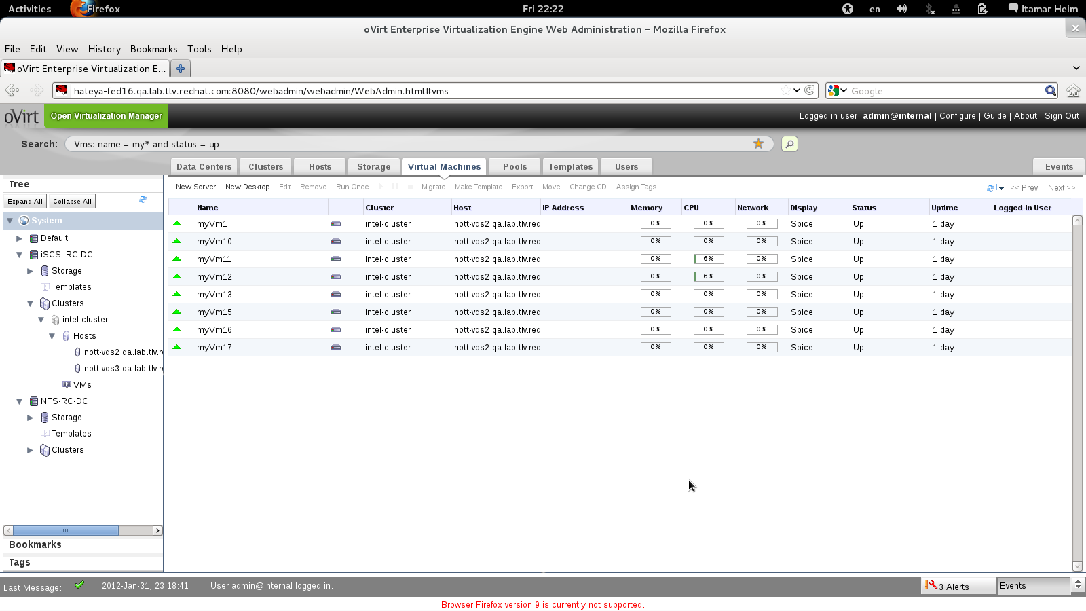
Search Results

Slide 34
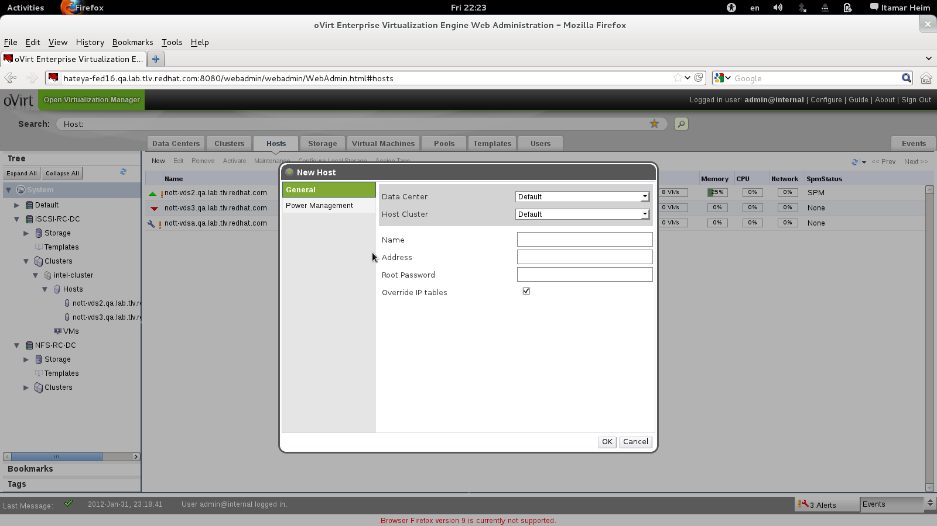
Add Host As Simple As
Notes:
USABILITY
NO LINUX KNOWLEDGE IS REQUIRED
ADD HOST
SPECIFY DC CLUSTER NAME ADDRESS ROOT_PASS (override iptables)

Slide 35
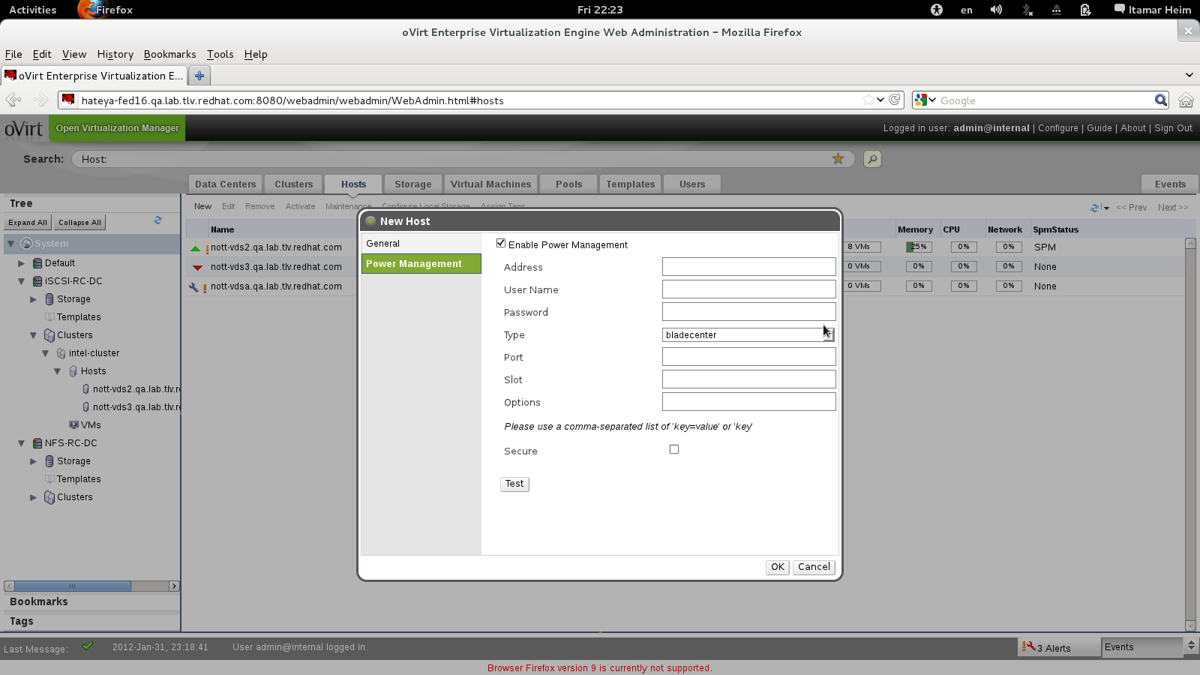
Power Management
Notes:
WE support power managment
Just add all relevant parameters

Slide 36
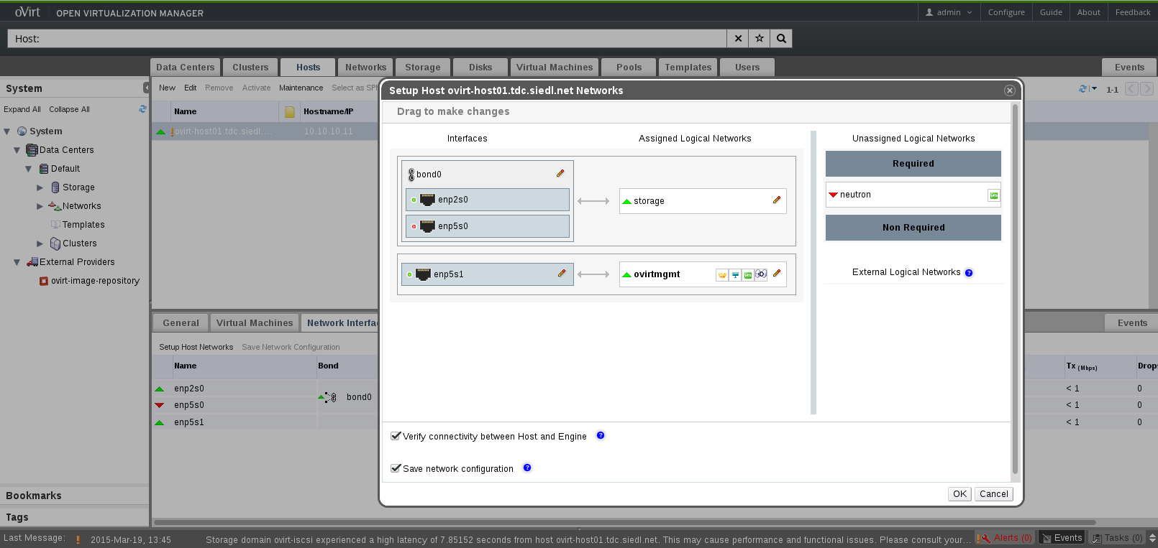
Configure Networks
Notes:
NETWRKING IN VIRT INCLUDE PLATFORM AND VMs NETWORK
HERE WE LOOK AT THE HOST PHYSICAL NETWORK LAYOUT

Slide 37
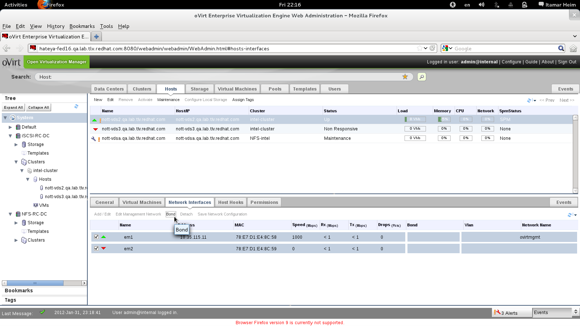
Or Bonds

Slide 38
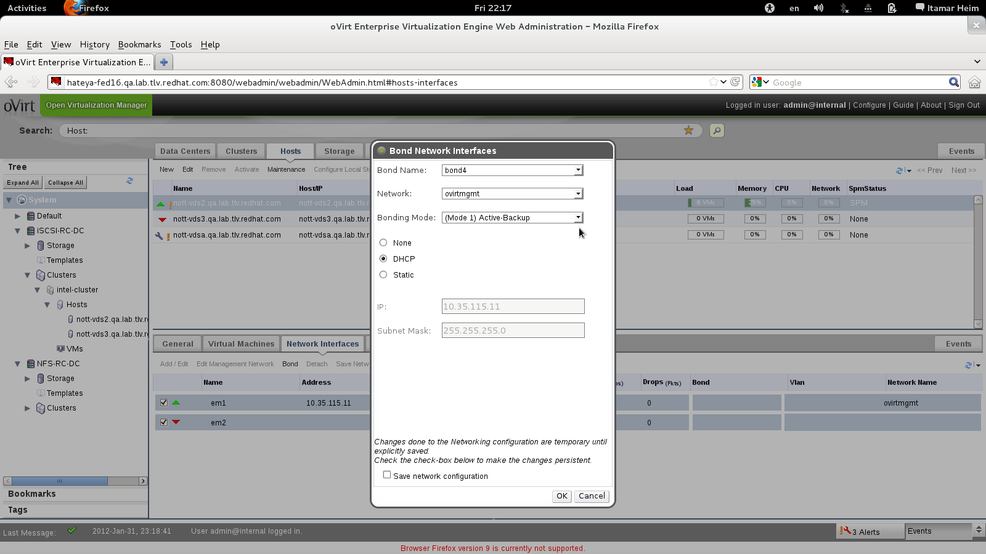
Without Scripts or Config Files

Slide 39
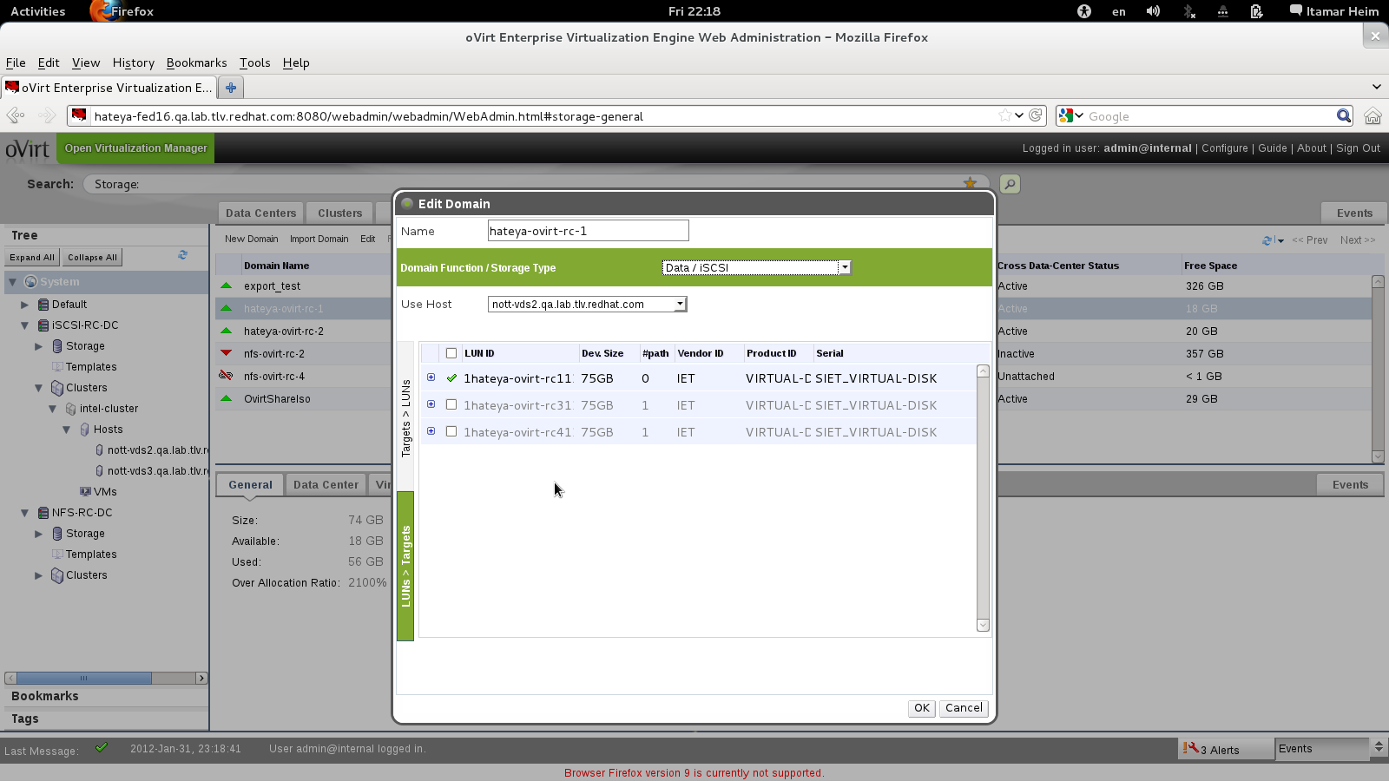
Configure Storage Once for Entire Cluster

Slide 40
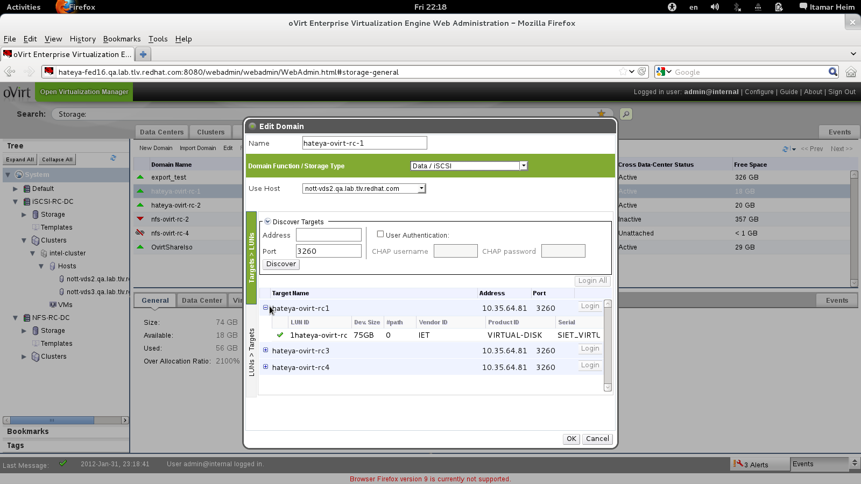
Extend with More LUNs as Needed

Slide 41
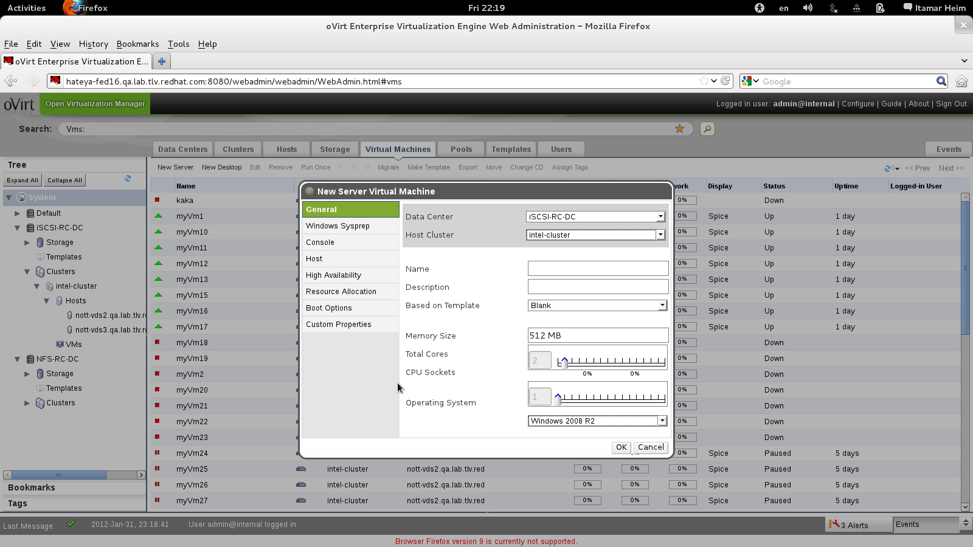
Add Servers or Desktops

Slide 42
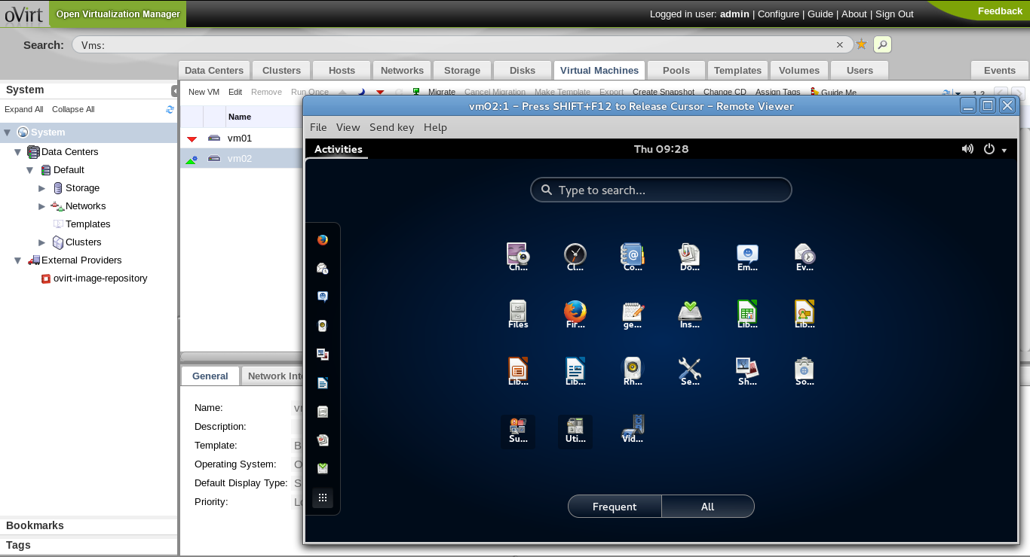
VM UP!

Slide 43
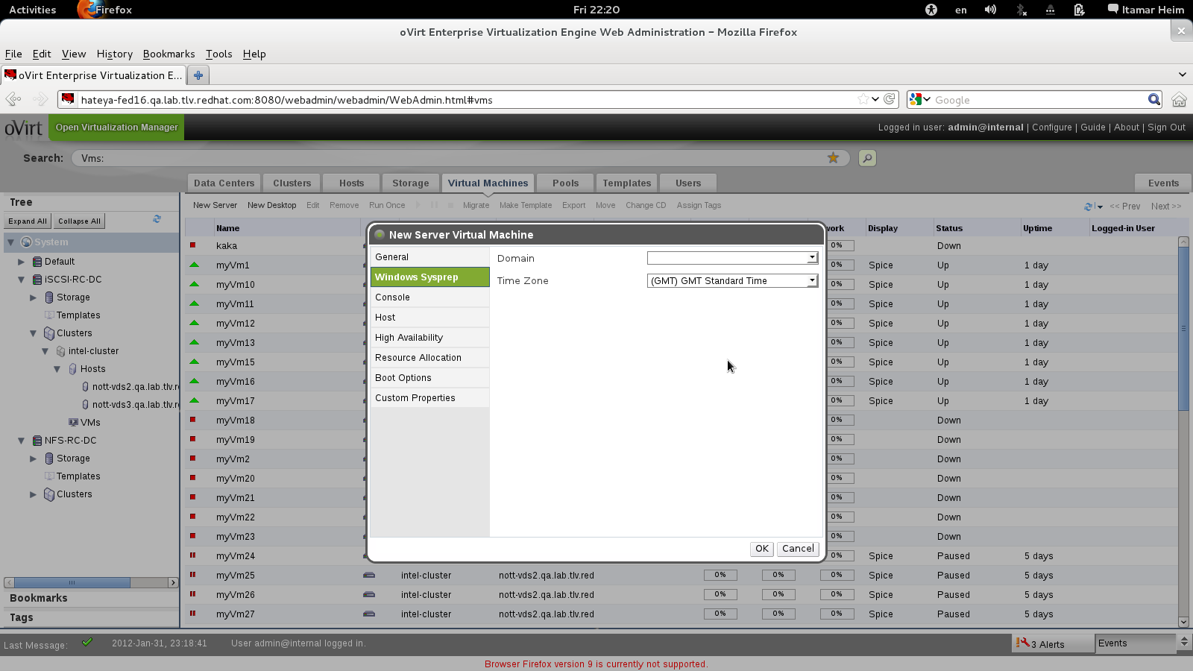
Even Windows via Sysprep

Slide 44
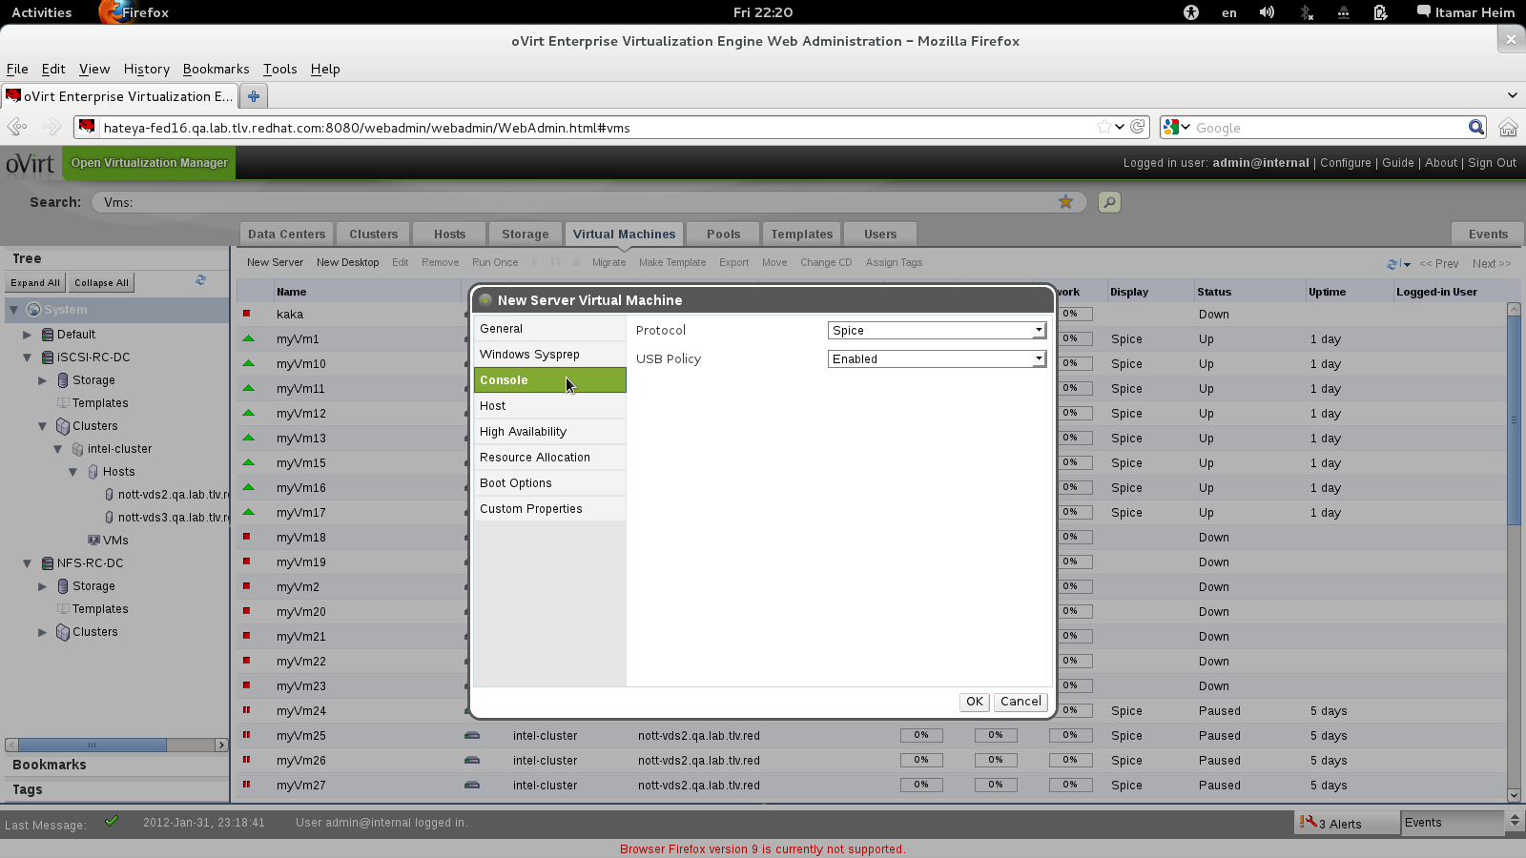
SPICE or VNC

Slide 45
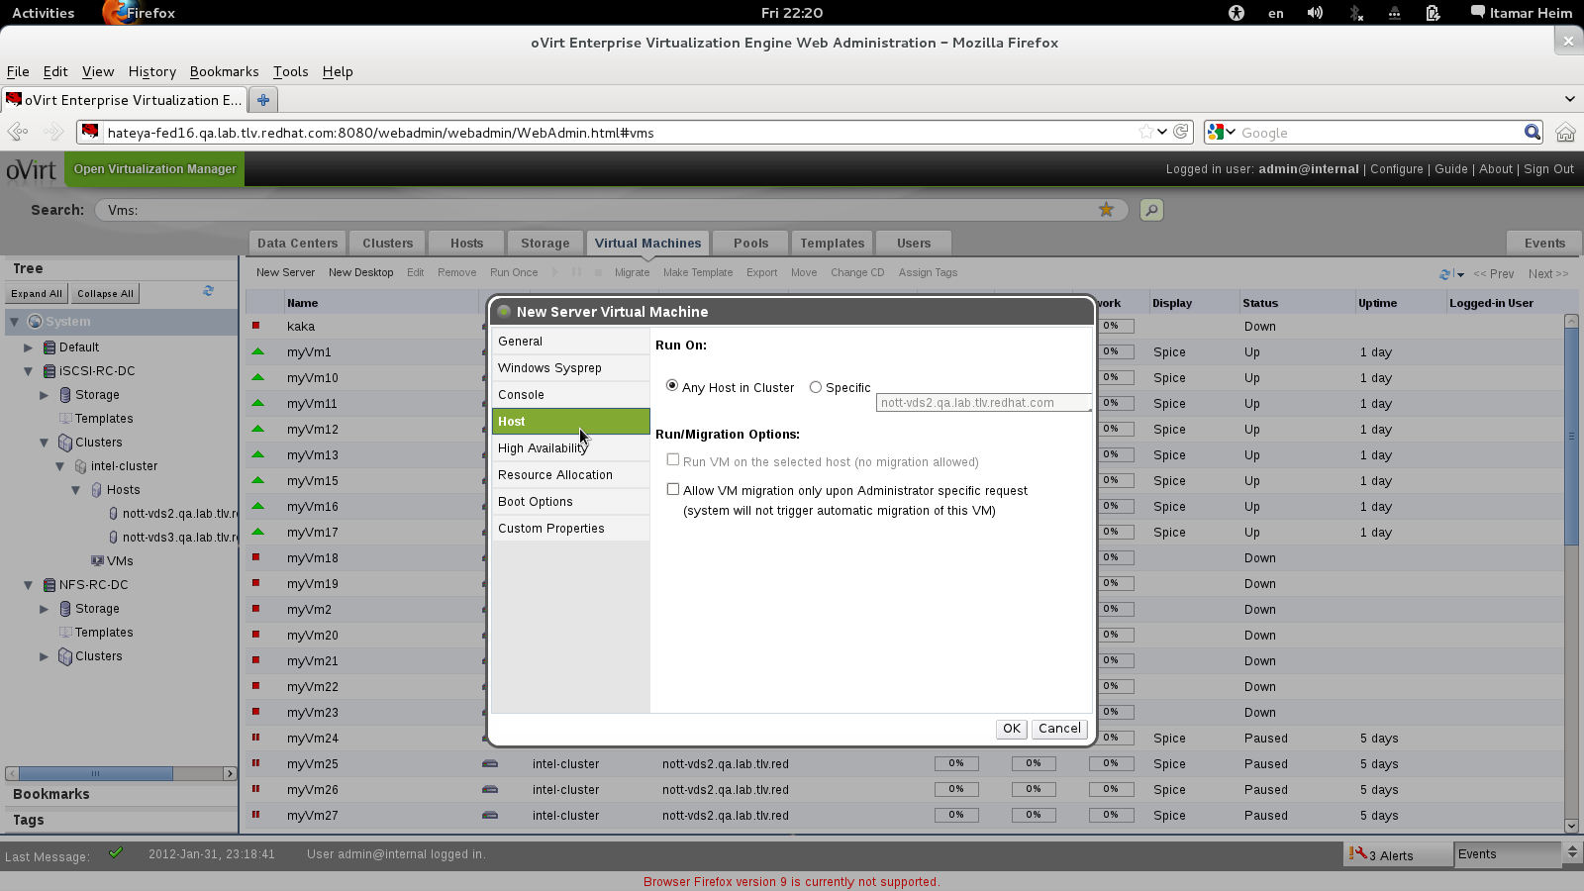
Migratable or Not

Slide 46
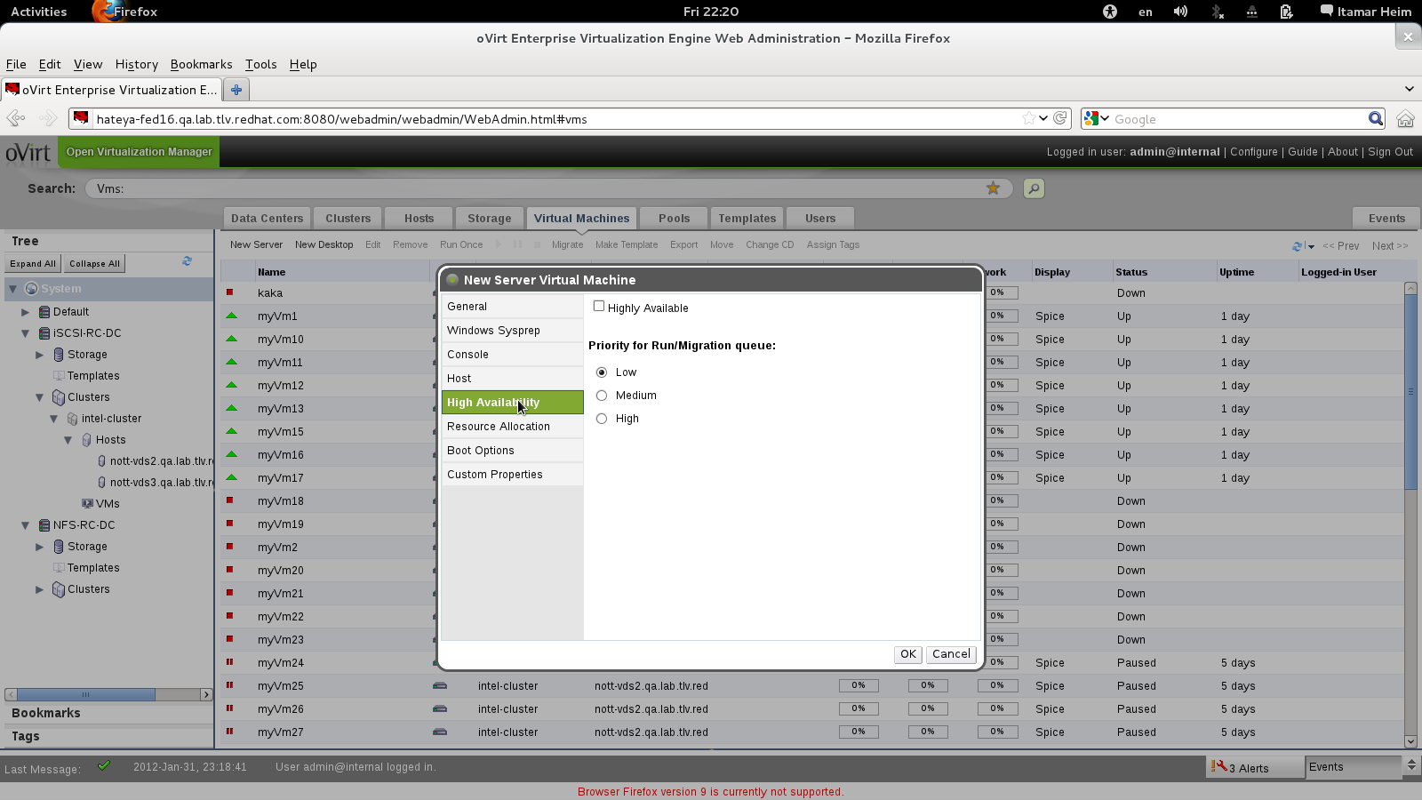
Highly Available?

Slide 47
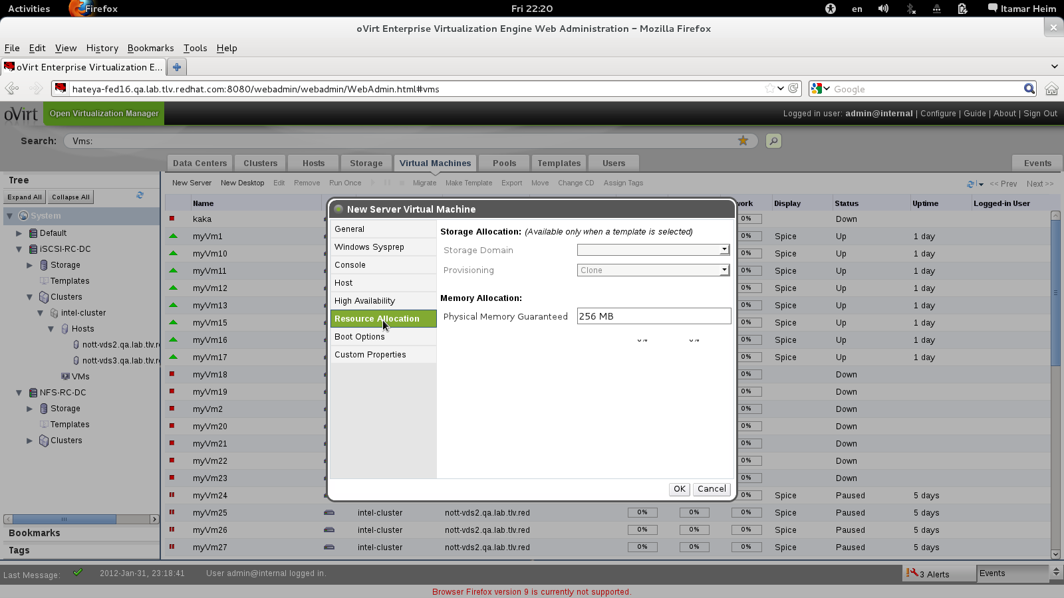
Control Allocated Resources (Disk, Memory)

Slide 48
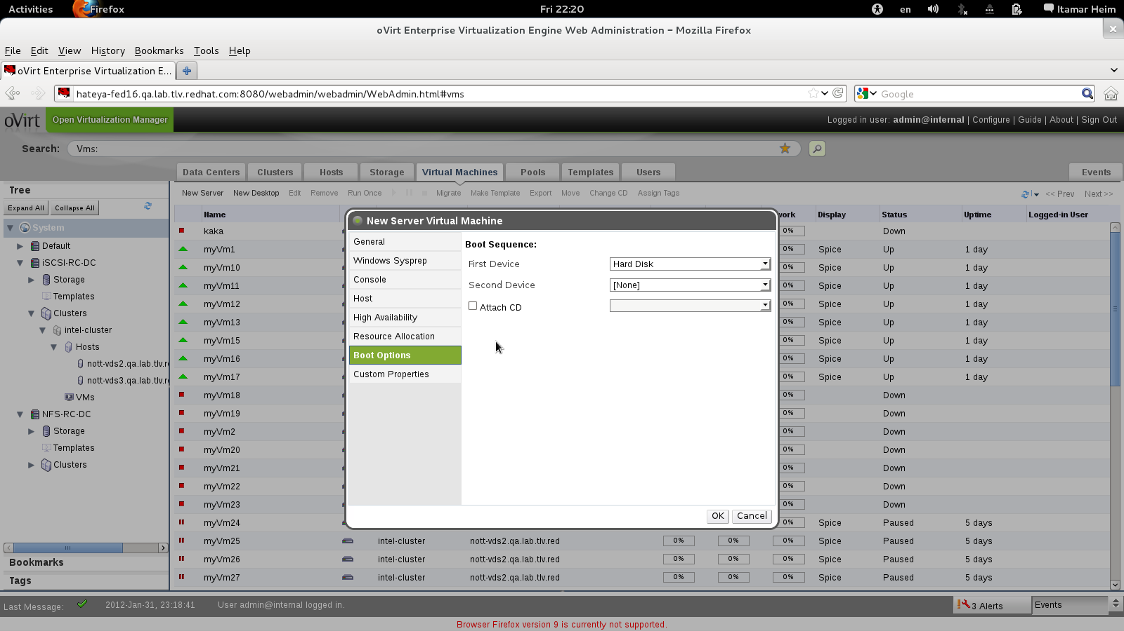
Boot Devices

Slide 49
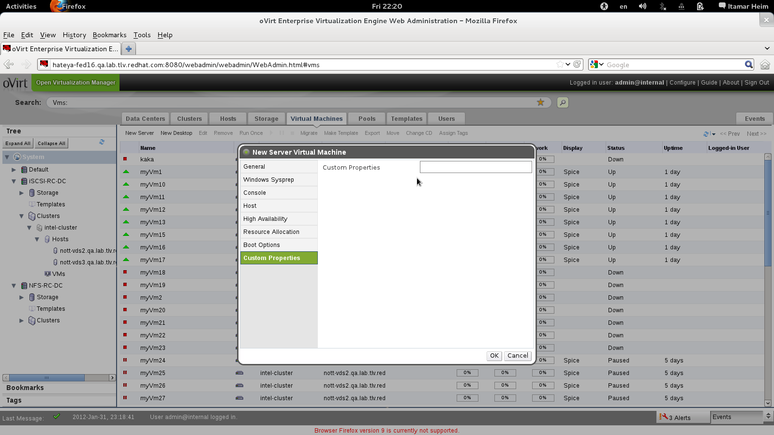
Advanced Options via Custom Properties

Slide 50
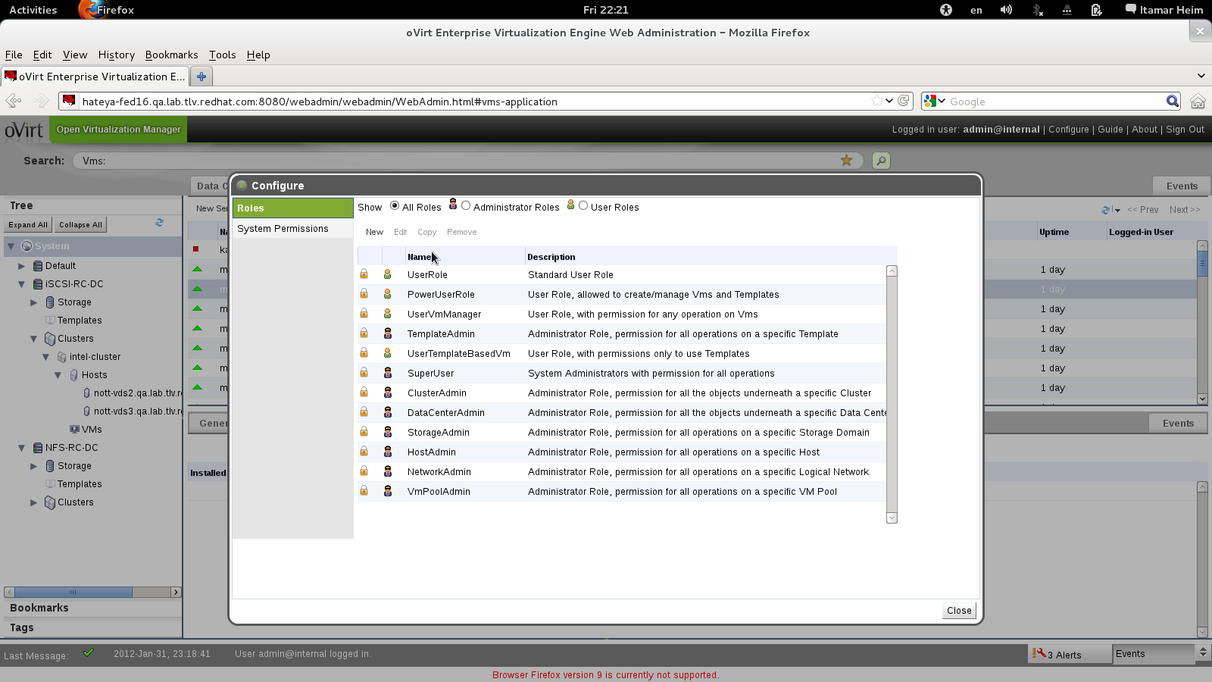
Assign Permissions to Objects by Roles

Slide 51
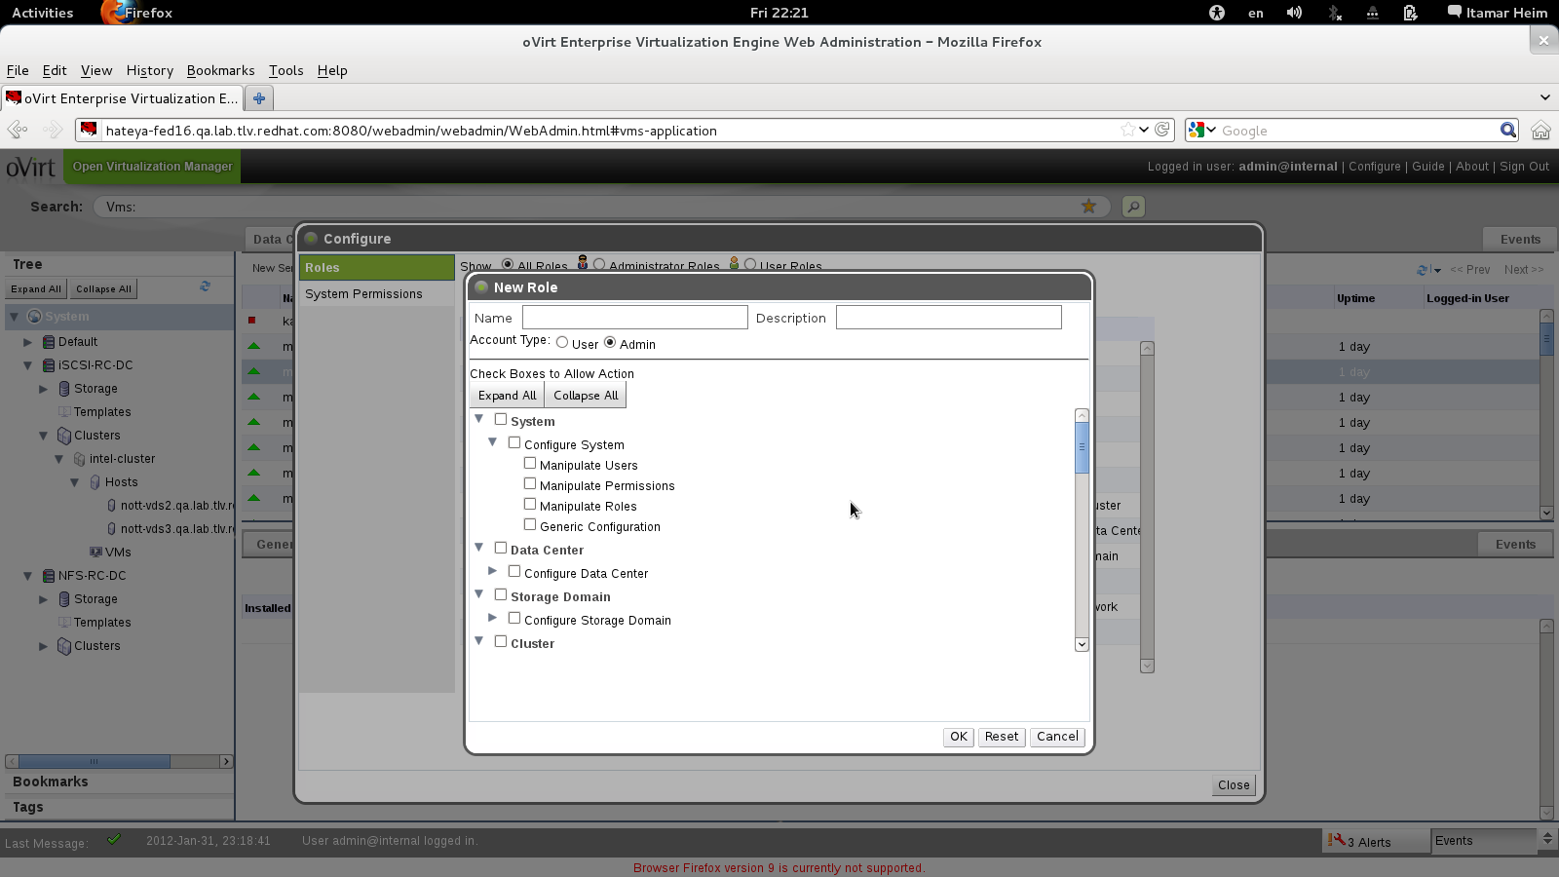
Define Your Own Roles

Slide 52
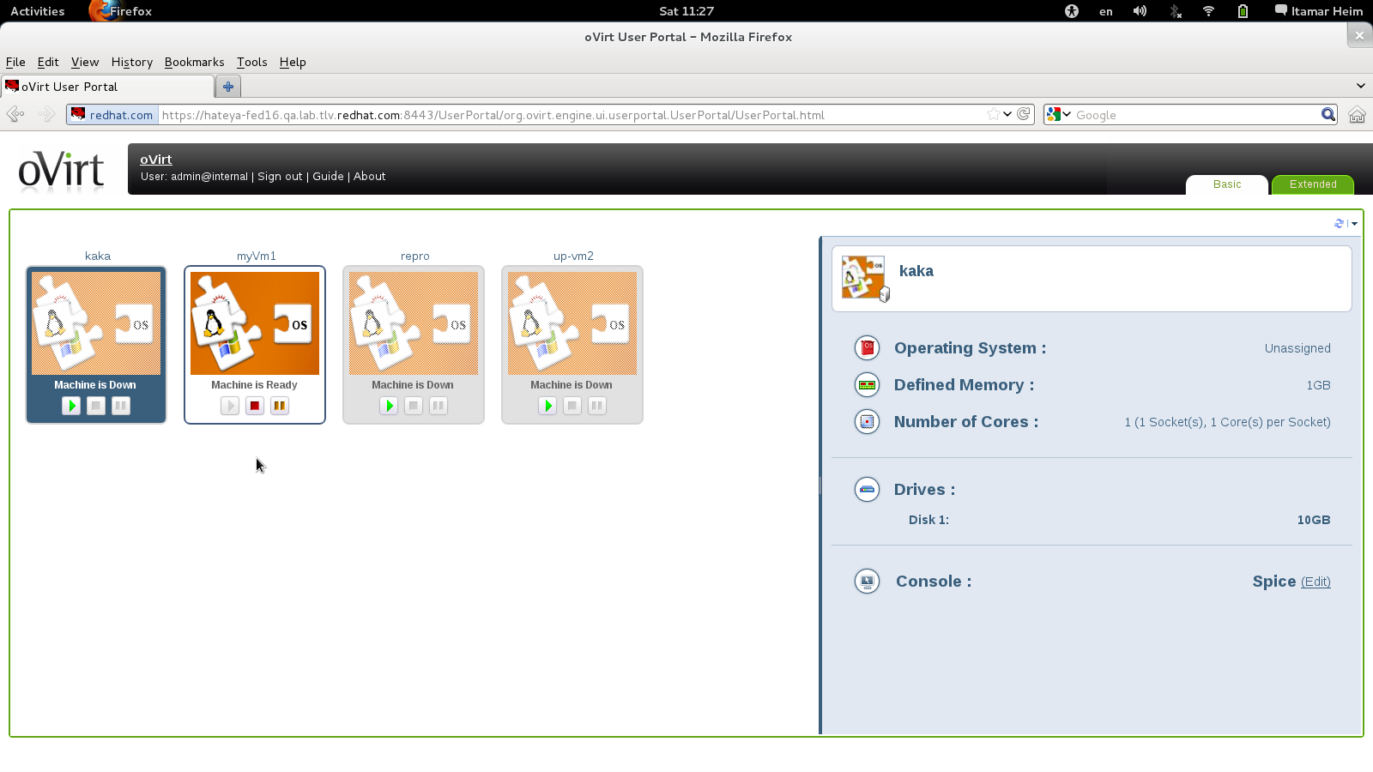
User Portal
Notes:
Started from VDI – need to give the user access
Spice enables better vdi performance
All they want is easy access to their desktop
Spice access the host not the VM
Applies server Vms as well

Slide 53
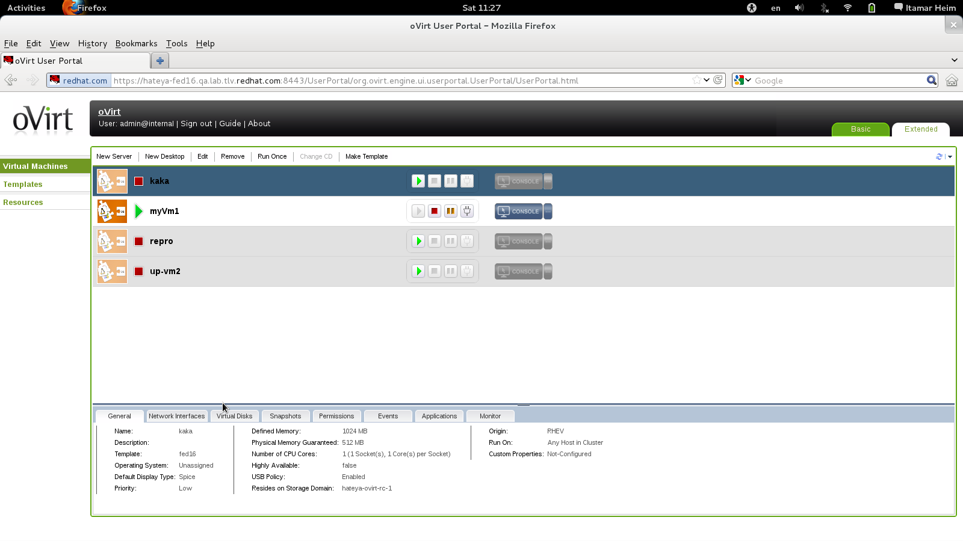
Self-Provisioning Portal
Notes:
SOMETIMES WE WANT USERS TO BE ABLE TO CREATE VMS
WE DON”T WANT TO LET THE USER LOGIN TO THE ADMIN CONSOLE
WE WANT A SIMPLIFIED USER INTERFACE
SIMILAR IN FUNCTIONALITY TO ADMIN CONSOLE
DEALS ONLY WITH VMS AND TEMPLATES
LAB MANAGER/ QA MANAGER CAN CREATE VMS AND DELEGATE ACCESS TO THEM
NO HOST/STORAGE?NETWORK DEFINITION

Slide 54
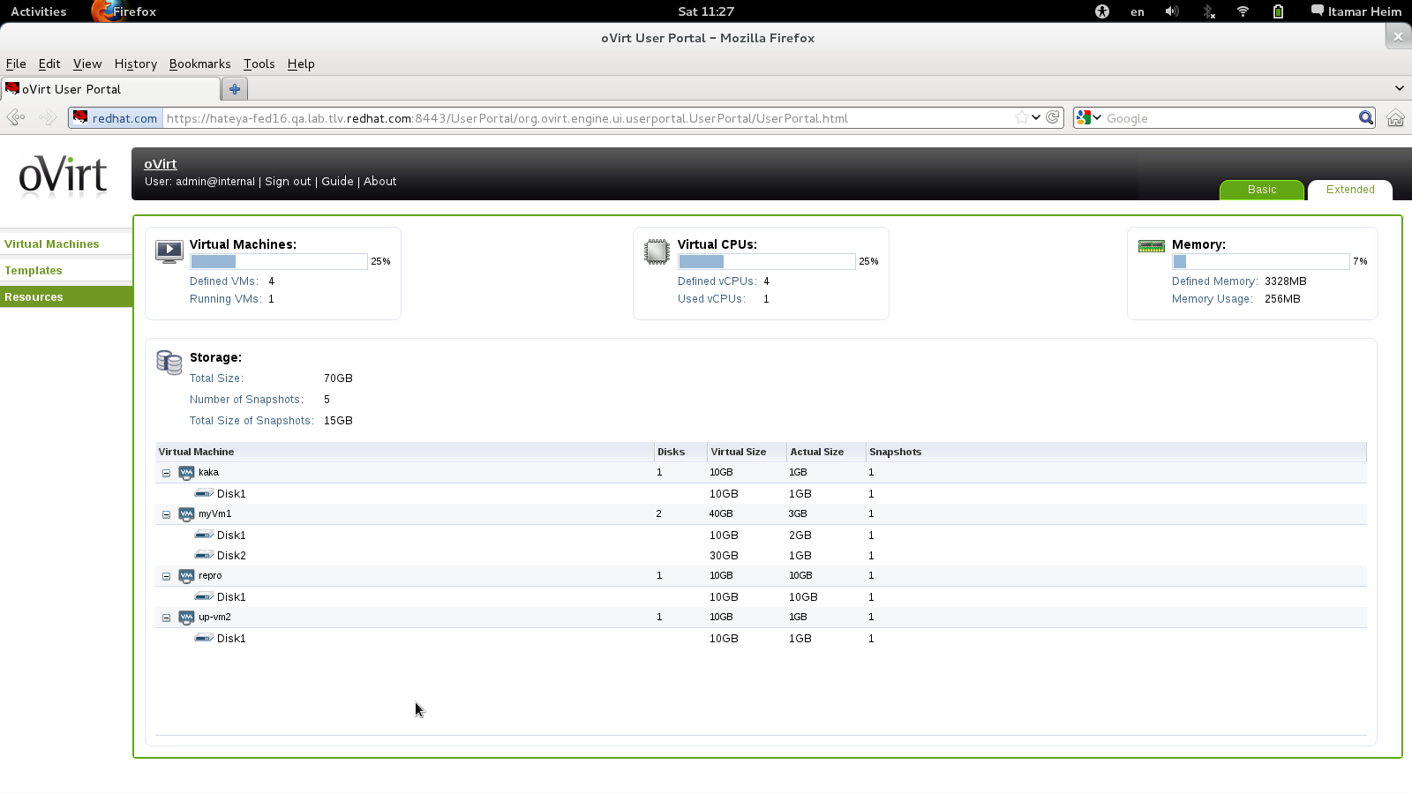
User Resource View
Notes:
RESOURCE VIEW

Slide 55
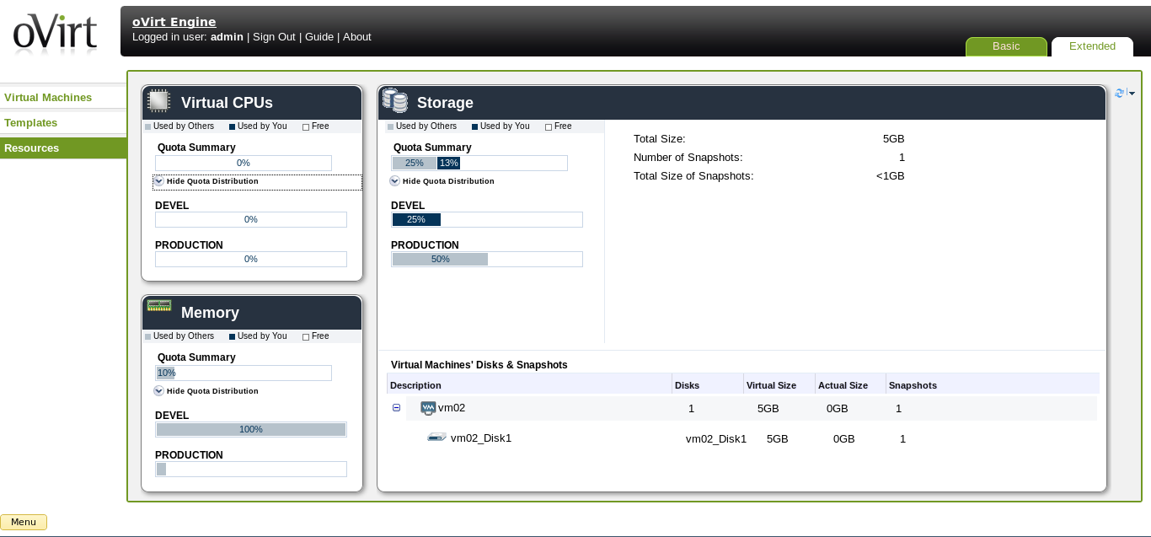
User Portal - Extended

Slide 56
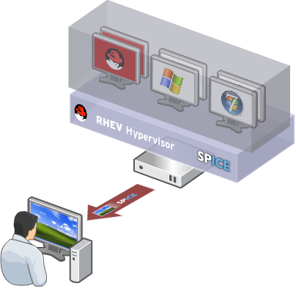
Virtual Desktop Infrastructure (VDI)
Centralized management, security and policy enforcement
Virtual desktops with user experience of a physical PC
Multiple monitors
HD-quality video
Bi-directional audio/video for VoIP or video-conferencing
Smartcard support
USB support
Industry-leading density of virtual desktops/server
Notes:
- VDI – is all about giving a user the same experiace as physical machine
- SPICE , MULTI-MONITOR, High Quality Videos, bi directional VIDEO AUDIO (WEB CAMS + MICROPHONE)
- spice fully integrated with ovirt
- Activex FOR WIN
- XPI for linux/firefox
- launched from web interface
KSM - density

Slide 57

Architecture

Slide 58
Architecture From 30,000 Feet
Hosts (VDSM)
Engine
Client (web portals)
Notes:
Centralized management system
3 main actors
Client – view setup information and submit actions
Server –HA service, process the queries and actions submitted by the clients
Serves as inventory
Many actions requires operations in the host level
Agent – Tailored to the management needs
Provides all functionality in the host level

Slide 59
oVirt High-Level Architecture
Postgres
oVirt
Engine
Java
Admin Portal
gwt
AD
R
E
S
T
SDK/CLI
python
IPA
User Portal
gwt
Guest agent
Guest agent
Shared Storage
FC/iSCSI/NFS
Linux VM
Win VM
Linux/Windows
client
libvirt
VDSM
Host | Node
SPICE
Local Storage
Notes:
Xiao Guangrong, IBM

Slide 60
Engine Core (Backend)
VM & Template Life Cycle
create, schedule, snapshot
Load
Balancing
HA
Storage
Configuration & Monitoring
Network
Configuration & Monitoring
Host
Register/Install
Host
Monitoring
Host
Maintenance
Host
Fencing
Authentication, Authorization
Audit
Inventory

Slide 61
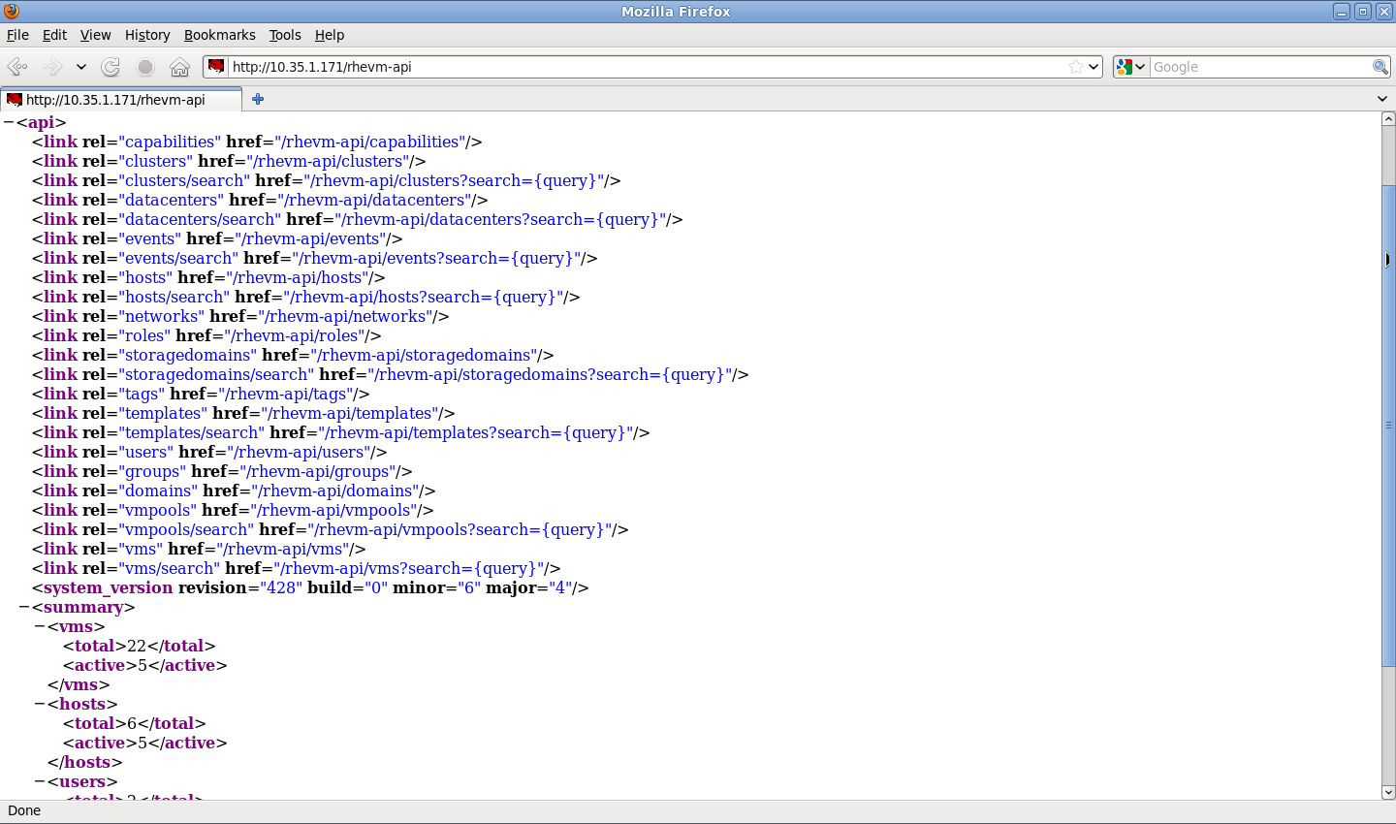
REST API

Slide 62
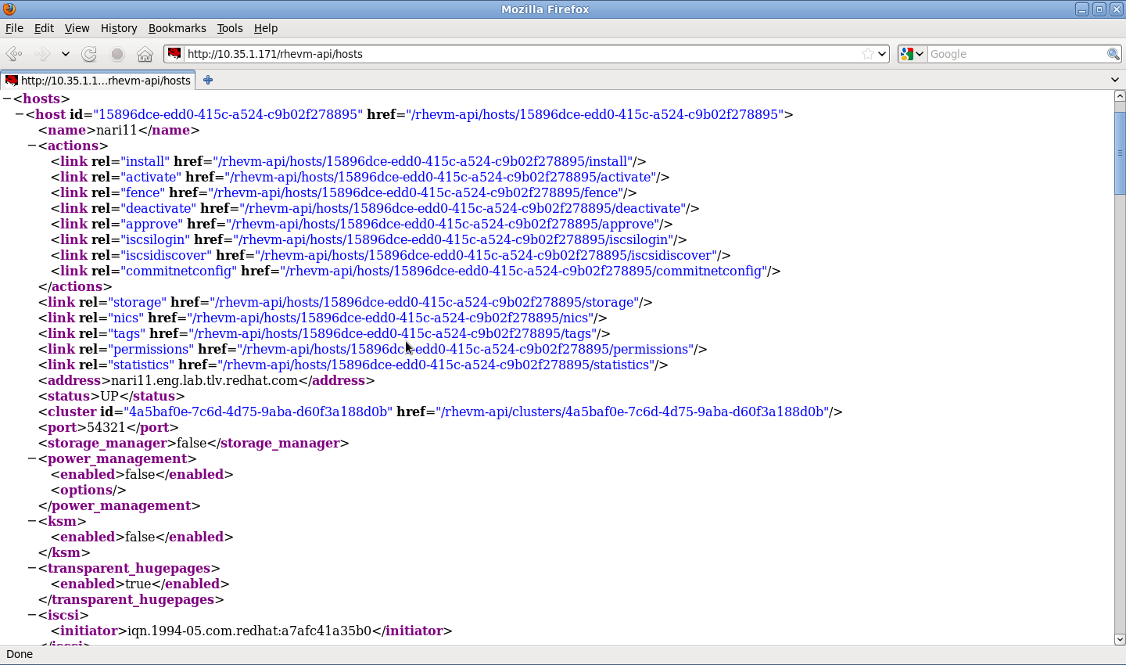
Hosts Collection

Slide 63

Host Networks Collection

Slide 64




Python SDK
- Creating the proxy
- Listing all collections
- Listing collection's methods.
- Querying collection with oVirt search
engine.
- Querying collection by custom constraint.
- Querying collection for specific resource.
- Accessing resource methods and
properties.

Slide 65




Python SDK (cont.)
- Accessing resource properties and
sub-collections.
- Accessing sub-collection methods.
- Querying sub-collection by custom
constraint.
- Retrieving sub-collection resource.
- Accessing sub-collection resource
properties and methods.

Slide 66


oVirt CLI

Slide 67

Data Warehouse Based on Talend ETL

Slide 68

oVirt Reports

Slide 69


oVirt Reports

Slide 70

Notification Service
oVirt allows registration to certain audit events
The notification service sends emails per audit message to relevant users
Also monitors engine itself

Slide 71

Hooks
“Hook” mechanism for customization
  Allows administrator to define scripts to modify VM operation
    eg. Add extra options such as CPU pinning, watchdog device, direct LUN access, etc
  Allows oVirt to be extended for new KVM features before full integration is done
  An easy way to test a new kvm/libvirt/linux feature

Slide 72
Hooks
Hook scripts are called at specific VM lifecycle events
    VDSM (management agent) Start
    Before VM start
    After VM start
    Before VM migration in/out
    After VM migration in/out
    Before and After VM Pause
    Before and After VM Continue
    Before and After VM Hibernate
    Before and After VM resume from hibernate
    On VM stop
    On VDSM Stop
Hooks can modify a virtual machines XML definition before VM start
Hooks can run system commands – eg. Apply firewall rule to VM

Slide 73
Sample Hooks
CPU pinning
SR/IOV
Smart card
Direct LUN
Hugepages
Promiscuous mode network interface
Cisco VN-Link
Fileinject
Floppy
Hostusb
Isolatedprivatevlan
Numa
Qos
Scratchpad
smbios

Slide 74
New Features

Slide 75
New Features in oVirt 3.5
Live Merge
  Live Merge Snapshots
  Requires Fedora 20 with virt-preview yum-Repo
Import Storage Domain
  Import existing Data Storage Domain (e.g. for disaster recovery)
Advanced Foreman Integration
  Provision and add hypervisors to oVirt from bare metal
Enhanced Anthentication, Authorization and Accounting Support

Slide 76
Live Merge
Delete disk snapshots while VM is UP
Available in fedora virt-preview
'Remove' snapshot command is no longer disabled when a VM is running
RemoveSnapshotSingleDiskLiveCommand
vdsm Race condition protection
(!!!) libvirt will fail to perform live merges due to a problem with the SELinux policy https://bugzilla.redhat.com/show_bug.cgi?id=1102881

Slide 77
Import Data Storage Domain
In addition to the ISO and Export domains, now Data domain can also be imported
Disks volumes and VMs'/Templates' OVF files which can be retrieved in a DC
Need 3.5v compatibility version set
VMs will be registered with down status.
Detach will not be permitted if there are VMs/Templates which are delete protected / in preview mode / are part of pools
Storage Domain can not be detached if it contains disks which are related to a running VM, unless this disks are inactive.
Shareable and Direct lun disks are not supported in the OVF

Slide 78
Foreman Integration
Foreman is a complete lifecycle management tool for physical and virtual servers
To help adding hypervisor hosts that are managed by Foreman to the oVirt engine, VM configuration, package management, etc.
Supported in oVirt>=3.5 over RHEL>=6.6

Slide 79
AAA (Authentication, Authorization and Accounting)
oVirt-engine-extension-aaa-ldap: LDAP based authentication and authorization
oVirt-engine-extension-aaa-misc HTTP Authentication: SSO Helper
oVirt-engine-extension-aaa-misc RegExp Mapper: Mapper implementation to transform user and principal names
Authentication: A process to resolve and validate user credentials
Authorization: A process to retrieve principal name information such as unique id, group membership, attributes
Mapping: A user name and/or principal name transformation. Helpful when authn and authz needs different inputs than provided.

Slide 80
Optaplanner (Tech-prev)
A feature to be able to make (hints) a better usage of the hardware
Cluster-aware, computes an optimized VM to Host assignment solution based on snapshots (list of hosts and Vms)
Separated from the ovirt-engine to not damage datacenter performance. Uses API
Each cluster will have a new subtab – Optimizer results - and makes it possible to start a migration by clicking the relevant buttons from there.
Each VM will have two new elements in their context menu - Optimize start and Cancel start optimization
This solution should obey the cluster policy to some extent

Slide 81
HE iSCSI Support
iSCSI storage for Hosted Engine data domain is now supported
hosted-engine.conf will need to store some of the iSCSI portal / target parameters
An answer file will need to store answers for all of the questions except for portal password

Slide 82


New Features in oVirt 3.5
New PaternFly Interface
Advanced Scheduling with Optaplaner

Slide 83

UI-Plugin: oVirt Monitoring sub-tab
More info at: https://labs.ovido.at/monitoring/wiki/ovirt-monitoring-ui-plugin

Slide 84

UI-Plugin: Foreman Main Tab

Slide 85

New Features in oVirt 3.5
Neutron Virtual Appliance
  Appliance for OpenStack Neutron (Networking)

Slide 86
New Features in oVirt 3.5
Hosted Engines supports:
  iSCSI Storage
  VLAN-tagged network interfaces
  Bonded Network Interfaces
  RHEL/CentOS 7
oVirt Windows Guest Tools available as RC

Slide 87
New Features in oVirt 3.5.1
Red Hat Enterprise Linux 7 / CentOS 7 Support
oVirt Engine Extensions
  Log4J logger bridge (remote Logging)
  LDAP Authentication and Authorization
Migration of local DWH Reports to remote

Slide 88
Planned Features in oVirt 3.6

Slide 89
Planned Features in oVirt 3.6
Release planned September 2015
Management Network as a Role
  Different VLANs for ovirtmgmt in different Clusters
Host Networking API
Detailed Host Networking API
Isolated (Host-only) Networks
Drop support for Fedora 20
Add support for Fedora 22

Slide 90

Planned Features in oVirt 3.6
Add support for Debian/Ubuntu hosts
No support for new features on EL6 hosts
OpenStack Cinder Integration (Ceph)
GlusterFS:
  Support for GeoReplication
  Network for Gluster
  Gluster Volume Snapshots
Hosted Engine:
  FC Support
  GlusterFS Support

Slide 91
Use Cases and Getting Started with oVirt

Slide 92
Use Cases
Server Virtualization
Desktop Virtualization (VDI)
Private Clouds
  Use DWH/PostgreSQL database for resource usage or runtime billing
  Developer Portal
Virtualized Call Centers
Virtualized Computer Rooms (Schools, Universities)
Remote offices
Admin VMs

Slide 93
Interaction with OpenStack

Slide 94

Interaction with OpenStack
oVirt AND OpenStack

Slide 95
Interaction with OpenStack
oVirt AND OpenStack
Horizon
Neutron
Glance/Cinder
Nova

Slide 96
Ovirt Community

Slide 97


Slide 98














OS
HW
oVirt Node

Slide 99
Goals of the oVirt project
Build a community around all levels of the virtualization stack – hypervisor, manager, GUI, API, etc.
To deliver both a cohesive complete stack and discretely reusable components for open virtualization management
Provide a release of the project on a well defined schedule
Focus on management of the KVM hypervisor, with exceptional guest support beyond Linux
Provide a venue for user and developer communication and coordination
Notes:
BUILD COMMUNITY AROUND THE VIRTUALIZATION STACK
FOCUSED ON LARGE SCALE DEPLOYMENTS
FOCUSED AROUND KVM

Slide 100
Wiki
Install/Quick Start
Admin. Guide
User Guide
Use Cases
Features Doccumentation

Slide 101
Numbers
Commiters:
  ovirt-engine: ~159
  vdsm: ~171
List members:
  users@ovirt.org: ~800
  users-pt@ovirt.org: ~50
  devel@ovirt.org: ~400

Slide 102
Governance
Merit based, open governance model
Built using the best concepts taken from Apache and Eclipse Foundations
Governance split between board and projects
  oVirt Board
  Multiple projects under the oVirt brand
Notes:
MERIT BASED
BASED ON APACHI AND ECLIPSE FOUNDATION

Slide 103
Getting oVirt
Obtain from oVirt website -
  http://www.ovirt.org/Download
Fedora repositories
Live USB - http://wiki.ovirt.org/wiki/OVirt_Live
Build from source

Slide 104

Let's Test

Slide 105
How To Contribute
Join the community
- Find bugs, File Them, Correct Them.
- Translate, Write Documentation.
- Design Interfaces, Develop new features
- Share your experiences.
Everyone can make a difference.
Mailing lists:
  http://lists.ovirt.org/mailman/listinfo
IRC:
  #ovirt on OFTC
Website and Repository:
  http://www.ovirt.org
  http://www.ovirt.org/wiki
  http://www.ovirt.org/project/subprojects/

Slide 106
What's Next
Next Version
  3.5.5 Candidate Testing
  http://www.ovirt.org/Upcoming_events
  http://www.ovirt.org/OVirt_3.5.5_Release_Notes
  http://resources.ovirt.org/pub/ovirt-3.5-pre/iso/
  http://www.ovirt.org/Repository_mirrors#Current_mirrors﻿
Next Workshop
  Software Freedom Day
  Fudcon
  Latinoware

Slide 107

THANK YOU!
http://www.ovirt.org
villadalmine@fedoraproject.org
#fedora-latam – irc.freenode.net
https://www.facebook.com/groups/ovirt.openvirtualization/
http://lists.ovirt.org/mailman/listinfo/users

