Slide 1
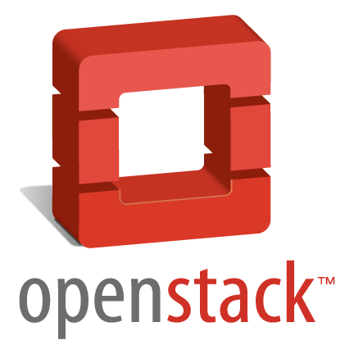
Openstack in Fedora
A walkthrought by the cloud computing
Presented by
Eduardo Echeverria
Fedora Ambassador & Sponsor RPM Package Maintainer
This work is licensed under a Creative Commons Attribution-ShareAlike 3.0 Unported License.

Slide 2

Cloud Computing
Saas (Software as a service)
PaaS (Platform as a service)
IaaS (Infrastructure as a service)

Slide 3
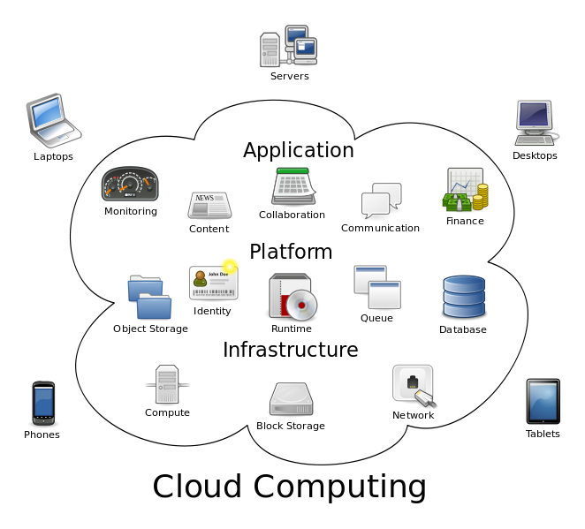
Cloud Computing

Slide 4


How start Openstack
Rackspace
Privative Cloud since 2005
IaaS
StaaS
Released under ASL 2.0 en 2010
Nebula
IaaS
Released under free license in 2010
NASA y Rackspace started it in 2010
OpenStack Compute Nova is derivaded of Nebula
OpenStack Object Store (Swift)

Slide 5
Openstack Goals
“Create a free software platform for cloud computing that meets the needs of public cloud providers and private, regardless of size,that be easy to implement and massively scalable."

Slide 6

Openstack releases
Series | Status | Releases | Fecha
Havana | Current stable release, security-supported | Due | Oct 17, 2013
Grizzly | security-supported | 2013.1 | Apr 4, 2013
Folsom | EOL | 2012.2 | Sep 27, 2012
Essex | EOL | 2012.1 | Apr 5, 2012
Diablo | EOL | 2011.3 | Sep 22, 2011
Cactus | Deprecated | 2011.2 | Apr 15, 2011
Bexar | Deprecated | 2011.1 | Feb 3, 2011
Austin | Deprecated | 2010.1 | Oct 21, 2010

Slide 7

Openstack Components
OpenStack Compute (nova)
OpenStack Object Store (swift)
OpenStack Image (glance)
OpenStack Identity (keystone)
OpenStack Dashboard (horizon)
OpenStack Network Service (Neutron)
OpenStack Block Storage (Cinder)

Slide 8
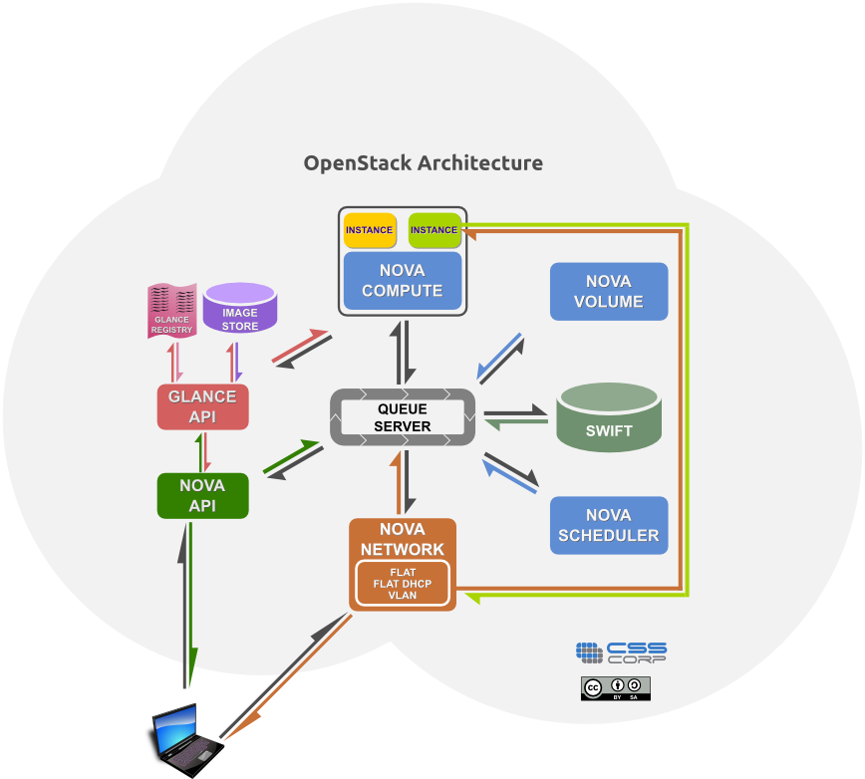
How works?

Slide 9

Example of use case
•Using nova's API (directly or through Horizon) to create an instance.
•nova-api will require to authenticate with keystone
•After you have been authenticated, the glace can provide the images for the instance and
also the flavor
•After the features have been selected, this request will be send by nova-scheduler
•Nova-scheduler will decide which node will run the instance
•Nova-compute of the selected node will be in charge to run the instance using the
hypervisor
•Quantum/Neutron can be used to setup the network
•Cinder can be used so associate volumes to the instance

Slide 10
How to Start
You can deploy it with 3 steps!
sudo yum install -y http://rdo.fedorapeople.org/openstack-grizzly/rdo-release-grizzly.rpm
sudo yum install -y openstack-packstack
packstack --allinone --os-quantum-install=n

Slide 11
Questions?
Contacto:
echevemaster@fedoraproject.org
This work is licensed under a Creative Commons Attribution-ShareAlike 3.0 Unported License.

