Slide 1

Project Atomic
Presentado por
Comunidad Fedora
Fedora Ambassador & Sponsor RPM Package Maintainer
This work is licensed under a Creative Commons Attribution-ShareAlike 3.0 Unported License.

Slide 2




Sobre @villadamine
Sysadmin
Empaquetador y Embajador en Fedora
Fan de Villa Dalmine
Clicista de Fixie y MTB

Slide 3


Temas
¿ Que es Project Atomic ?
Anatomia de un Atomic Host
Conceptos de Docker
Demo
Como participar

Slide 4
¿ What is Project Atomic ?
Minimal operation system
Benefits of our favorite Enterprise Linux
Robust atomic upgrades and systemd
Ready to take on cloud, virtualized or bare metal
Not a new distribution – Atomic Hosts are built from CentOS, Fedora, or Red Hat Enterprise Linux.

Slide 5

¿ Why Atomic ?
We can run Linux containers on CentOS, Fedora, and RHEL already!
Provide a streamlined host optimized for running and managing containers.
All applications should be deployed as containers, rather than installing on the host.
Host should be “cattle” and updates should be easy to deploy and manage.

Slide 6
What Atomic Hosts Provide
Streamlined host based on CentOS, Fedora, or RHEL packages + container stack.
rpm-ostree
/usr/bin/atomic
Docker
Kubernetes
Cockpit
Super Privileged Containers (SPC)

Slide 7
What Atomic Hosts Won't Provide
Atomic hosts are “immutable” – don't expect to
install packages on running systems
Official images are minimal – that means your
favorite tool probably won't be added
– Aside from Atomic development or troubleshooting, you should never be logged into an Atomic Host
More than necessary

Slide 8
CentOS, Fedora, or RHEL?
Aside from rpm-ostree, all of the components that make up an Atomic Host are shared w/the parent distribution.
You want support? Go RHEL Atomic Host.
CentOS Atomic is currently under development, and hasn't released any “official” images.
Fedora 23 released in November – developed by the Cloud Working Group.
A CentOS rebuild of RHELAH is released

Slide 9
rpm-ostree's history
OStree initially developed for GNOME continuous by Colin Walters
The rpm-ostree stuff came slightly later “Git for operating systems”
– bootable, immutable, & versioned filesystem trees
– works on top of any *nix filesystem
– support for UID/GID, extended attr, handling bootloader, and more.

Slide 10
Why rpm-ostree?
“Atomic” updates make more sense for an immutable system
Preserves the tooling to create packages, allows re-use of RPMs rather than re-inventing the wheel
Easy rollback in the event you need to return to known-good tree
Clean transaction for updates

Slide 11
How rpm-ostree works (high level)
Filesystem is read-only, except /var and /etc
/etc is 3-way merged when you do an update
All data (e.g. containers) is unchanged on upgrade
Problem with an upgrade? `rpm-ostree rollback`

Slide 12
/usr/bin/atomic
Coherent entry point to the system: manage host and containers with the atomic command.
Fill gaps in Linux container implementations.
– e.g. “atomic install foo” can install a container with its k8s configuration and/or systemd unit file.
– “atomic run” grabs the LABEL “run” with its Docker cmd line.
Saves the user much typing.
The “atomic host” command can be used for rpm-ostree updates.

Slide 13
Super-Privileged Containers (SPC)
We mean it when we say “run everything in
containers” on Atomic
Usually containers have limited interaction w/the
host
SPC containers can be run with `atomic run` which
saves the need for long docker commands to enble
privileges

Slide 14
Shipping Super-Privileged Containers (SPC)
RHEL Atomic Tools Container Image – debugging
tools like strace, traceroute, man pages, etc. needed to troubleshoot an image.
RHEL Atomic rsyslog Container Image – runs
rsyslogd service to send logs to central server, etc.
(journald collects data either way)
RHEL Atomic sadc Container Image – runs sadc
from sysstat to be used w/`sar`
More to come!

Slide 15
Cockpit
Cockpit started prior to Atomic
Server manager for administering Linux servers via
the Web browser
Doesn't interfere with normal admin tools
Designed to be multi-server
Support for managing containers, Kubernetes
http://cockpit-project.org/

Slide 16
Nulecule (in early development)
Specification for multi-container application
w/dependencies (“Atomic App”)
Lets developer describe application, sysadmin define parameters for app at runtime
Creates super-orchestration parameters for Kubernetes
Defines on-demand scheduling of resource utilization
Basis for policy-based orchestration via Mesos
Supports Docker, ACI and potentially other container
formats
github.co

Slide 17
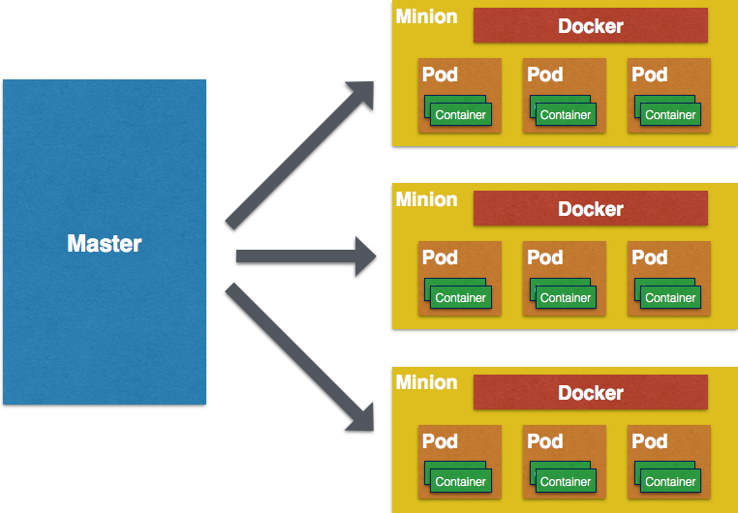
Kubernets
Initially used GearD from OpenShift, phased out in
favor of Kubernetes
Working with upstream to improve / develop
Kubernetes for container management

Slide 18
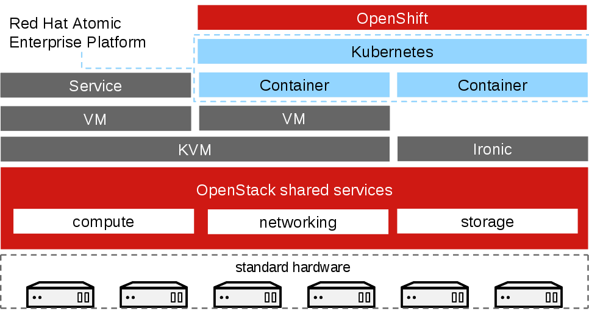
Review

Slide 19
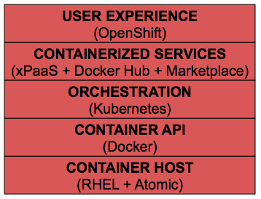
Review

Slide 20

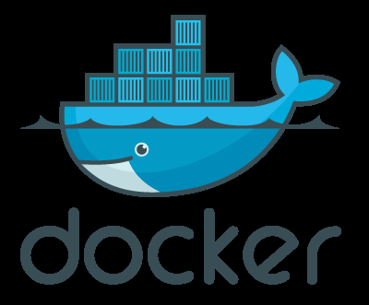
Docker
Virtualización similar a OpenVZ
Permite crear contenedores dinamicos.
No necesita un kernel patcheado
Los contenedores son migrables entre entornos
Ideal para servicios de PaaS

Slide 21

Virtualización
Necesita hipervisor
Necesita un SO full para cada instancia
Consume ingentes recursos

Slide 22
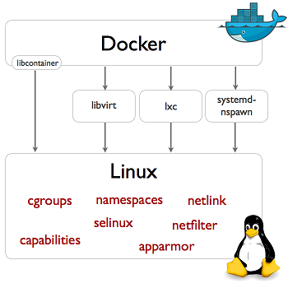
De que hace uso docker
Namespaces Kernel
Cgroups
Un libconteiner

Slide 23
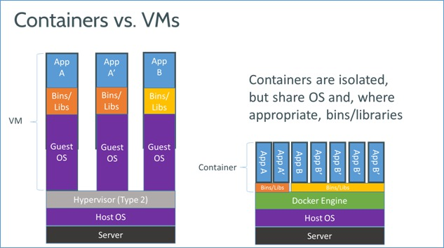
Diferencias entre VM y containers

Slide 24
Contenedores
Es una interfaz de espacio de usuario para las funciones de contención del núcleo de Linux.
A través de una potente API y herramientas simples, se permite a los usuarios de Linux a crear y gestionar aplicaciones de sistema

Slide 25
Contenedores Docker
Los contenedores hechos en docker pueden encapsular cualquier carga útil, y se ejecutará en forma consistente en prácticamente cualquier servidor. El mismo archivo contenedor que el desarrollador construye y prueba en un ordenador portátil se podrá ejecutar a escala, en producción en las máquinas virtuales, servidores fisicos, clusters OpenStack, instancias públicas, o una combinacion de todas las anteriores

Slide 26
Usos comunes de Docker
La automatización del envasado y el despliegue de aplicaciones
Creación de entornos, PAAS privados ligeros
Pruebas automatizadas e integración continua / despliegue
Implementar y ampliar las aplicaciones web, bases de datos y servicios de back-end

Slide 27
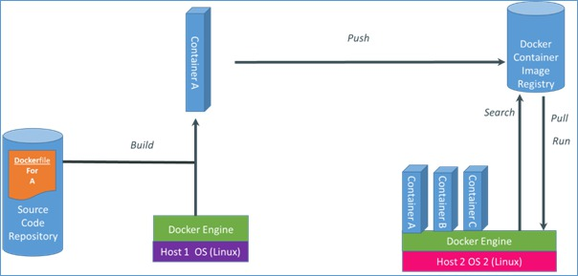
Como funciona docker

Slide 28
Atomic Host
Fedora / Centos
Imagen Para Ovirt/Openstack/EC2/Libvirt
Desde una Host a un Cluster de Atomic
Manejo de Storage, Redes, Docker
Seguridad con Selinux
VER → http://www.projectatomic.io/download/

Slide 29
Atomic Registry
Basado en Origin y Cockpit
Mejora de Docker Registry Library
Web Console
Soporta RBAC
Kubernets-Based Cluster
Image Streams
VER → http://www.projectatomic.io/registry/
VER → http://docs.projectatomic.io/registry/

Slide 30
Atomic App
Basado en Nulecule
Corre en un container
Bootstrap de apps para su armado y ejecucion
Providers:
Kubernetes OpenShift Marathon Docker
VER→http://www.projectatomic.io/docs/atomicapp/
VER → https://github.com/projectatomic/atomicapp/blob/master/docs/start_guide.md

Slide 31
Arrancando la Demo - Pasos
Configurar Cloud-init
Actualizar rpm-ostree
Configurar storage
Configurar Cockpit
Configurar Docker cache registry
Docker con ejemplos

Slide 32

Cloud-init
$cat meta-data
instance-id: id-devopsconf
local-hostname: fedora.atomic.devopsconf.2015;
$ cat user-data
#cloud-config
password: atomicfedora
ssh_pwauth: True
chpasswd: { expire: False }
ssh_authorized_keys:
- ssh-rsa ... foo@foo.com
$ genisoimage -output init.iso -volid cidata -joliet -rock user-data meta-data

Slide 33

Preparando Vm
Cp atomic-fedora.qcow2 ~/devopsconf/atomic-master.qcow2
Con virt-manager configuramos la vm poniendo el iso generado
Encendemos la vm y chequeamos que nos podamos loguear
Apagamos la vm y agregamos un disco
Chequeamos que el disco este bien
Actualizamos ( atomic host upgrade , rpm-ostree upgrade)

Slide 34
Preparando Vm - Red
/etc/sysconfig/nework
NETWORKING=yes
/etc/sysconfig/networking-scritps/ifcg-placa
DEVICE=eth0
IPADDR=ip
NETMASK=255.255.255.0
GATEWAY=gw
ONBOOT=yes
DNS1=IP
/etc/resolv.conf – > chattr -i /etc/resolv.conf
Ifdown placa, ifup placa

Slide 35

Preparando Storage
Apagamos la vm y agregamos un disco de 10g
Encendemos y armamos un vg
Editamos /etc/sysconfig/docker-storage-setup
DEVS="/dev/sdb"
VG="docker-pool"
DATA_SIZE=95%FREE
CHUNK_SIZE=512K
AUTO_EXTEND_POOL=no
GROWPART=true
ROOT_SIZE=12G
Docker-storage-setup
xfs_growfs /
Docker info
Atomic host status

Slide 36
Instalando Cockpit - container
sudo atomic info fedora/cockpitws
sudo atomic install fedora/cockpitws
sudo vi /etc/systemd/system/cockpitws.service

Slide 37
Instalando Cockpit - servicio
[Unit]
Description=Cockpit Web Interface
Requires=docker.service
After=docker.service
[Service]
Restart=on-failure
RestartSec=10
ExecStart=/usr/bin/docker run --rm --privileged --pid host -v /:/host --name %p fedora/cockpitws /container/atomic-run --local-ssh
ExecStop=-/usr/bin/docker stop -t 2 %p
[Install]
WantedBy=multi-user.target

Slide 38
Instalando Cockpit - systemd
sudo systemctl daemon-reload
sudo systemctl enable cockpitws.service
sudo systemctl start cockpitws.service
sudo systemctl status cockpitws.service
Ip:9090

Slide 39
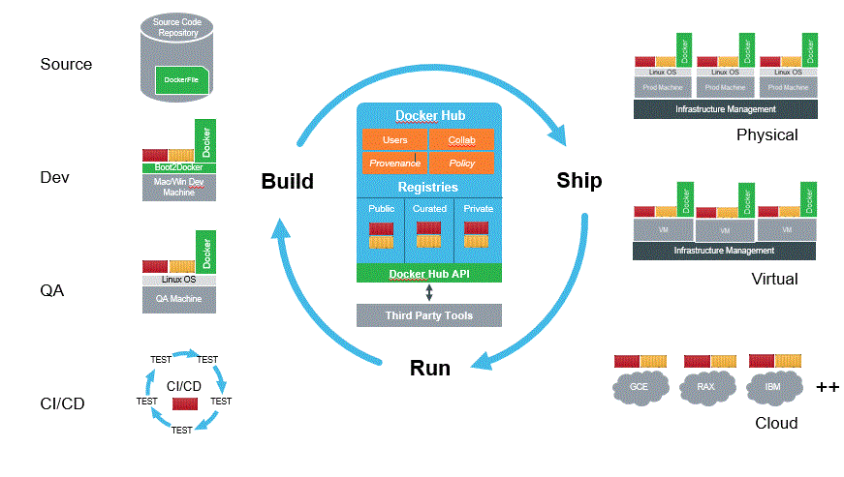
Docker Examples

Slide 40
Docker Creando Containers
docker run -i -t fedora bash
yum install -y httpd && exit
Sudo docker ps -a
sudo docker commit c16378f943fe fedora-httpd
sudo docker images

Slide 41
Docker Dockerfile
FROM fedora-httpd
MAINTAINER Slave email: admin@sysadmin.com
# Add the tar file of the web site
ADD mysite.tar /tmp/
# Docker automatically extracted. So move files to web directory
RUN mv /tmp/mysite/* /var/www/html
EXPOSE 80
ENTRYPOINT [ "/usr/sbin/httpd" ]
CMD [ "-D", "FOREGROUND" ]

Slide 42
Docker Armando Container
# docker build -rm -t mysite .
# docker run -d -P mysite
# docker ps
# curl localhost:49153

Slide 43
Docker un solo paso
# mkdir mysite
# mv mi_proyecto/* mysite
# tar cvf mysite.tar mysite

Slide 44
Docker Examples V
FROM fedora
MAINTAINER A D Ministator email: admin@mycorp.com
# Update the image with the latest packages (recommended)
RUN dnf update -y; yum clean all
# Install Apache Web Server
RUN dnf install -y httpd; yum clean all
# Add the tar file of the web site
ADD mysite.tar /tmp/
# Docker automatically extracted. So move files to web directory
RUN mv /tmp/mysite/* /var/www/html
EXPOSE 80
ENTRYPOINT [ "/usr/sbin/httpd" ]
CMD [ "-D", "FOREGROUND" ]

Slide 45
Docker Terminando
# docker build -rm -t newsite httpd/
# docker run -d -P newsite

Slide 46
Docker Ejemplo Integrador
Start a container with a shell
# docker run -p 8080:80 -i -t fedora /bin/bash
Install the necessary software in the container
# yum install -y httpd
Create custom content
# echo 'Hello world!' > /var/www/html/index.html

Slide 47
Docker Ejemplo Integrador
Confirm the web server publishes the correct content
# /usr/sbin/httpd -D FOREGROUND
# curl http://rhel-atomic-host.fqdn:8080
For httpd, create a startup script
# vi /usr/sbin/my_httpd_startup.sh
# chmod 755 /usr/sbin/my_httpd_startup.sh
#!/bin/bash
rm -rf /run/httpd
install -m 710 -o root -g apache -d /run/httpd
install -m 700 -o apache -g apache -d
/run/httpd/htcacheclean
exec /usr/sbin/httpd -D FOREGROUND

Slide 48
Docker Examples V
FROM fedora-custom-httpd
MAINTAINER A D Ministator email: admin@mycorp.com
# Add the tar file of the web site
ADD mysite.tar /tmp/
# Docker automatically extracted. So move files to web directory
RUN mv /tmp/mysite/* /var/www/html
EXPOSE 80
ENTRYPOINT [ "/usr/sbin/my_httpd.sh" ]

Slide 49
Docker Ejemplo Integrador
Hacemos un commit y luego exportamos
Docker save fedora-http > fedora.tar
Docker import fedora.tar
Docker run -p 8080:80 -i -t fedora-http2 /bin/bash

Slide 50
Docker Ejemplo con Links
docker run --name DB -e MYSQL_ROOT_PASSWORD=admin -e MYSQL_DATABASE=admin -d mariadb
docker run -p 80:80 -e WORDPRESS_DB_PASSWORD=admin -d --name WP --link DB:mysql wordpress

Slide 51
Links De Herramientas
  Cockpit as container:
  http://www.projectatomic.io/blog/2015/06/running-cockpit-as-a-service/
  Slides
  http://www.projectatomic.io/blog/2015/04/container-camp-presentation-and-slides/
  Project Atomic
  http://www.projectatomic.io/download/
  Project Atomic Quickstart
  http://www.projectatomic.io/docs/quickstart/
  Project Atomic Docs
  http://www.projectatomic.io/docs/
  Project Atomic Blog
  http://www.projectatomic.io/blog/

Slide 52

Puntos de Encuentro
  Website: projectatomic.io
  Github: github.com/projectatomic
  Facebook.com/projectatomic
  Twitter: @projectatomic
  Mailing Lists:
  http://www.projectatomic.io/community/

Slide 53
Preguntas?
Contacto:
villadalmine@fedoraproject.org
Irc #fedora-ar #fedora-latam
This work is licensed under a Creative Commons Attribution-ShareAlike 3.0 Unported License.

