Slide 1
DATA SCIENCE CAREER TRACK
CAPSTONE 2
MILESTONE REPORT
by Edward Franke

Slide 2
AGENGA
Executive Summary
Idea Discussion
Findings
Conclusion

Slide 3
Executive Summary
The purpose for this project is to find a correlation connected to chest x-rays containing pneumonia that can separate them in real time compared to normal healthy chest x-rays. The dataset is a cleaned dataset from Kaggle.com. Tensorflow and Keras has discovered connections and methods to determine which x-rays have pneumonia with varying success.

Slide 4
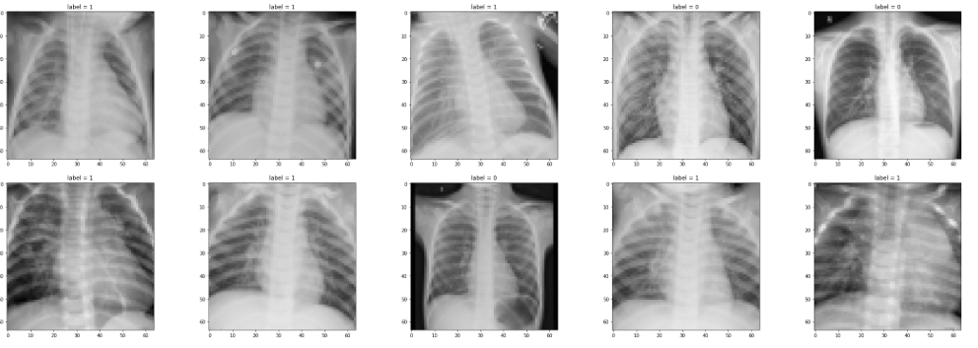

Slide 5
Idea
IDEA: A model to detect pneumonia is chest x-rays. (problem to solve)
CLIENT: Medical Industry
REASON: Pneumonia is a very serious condition that has the potential for death. I have personal knowledge of how serious it can be. The sooner it can be detected, the better the chance for survival and less damage to the lungs.
DATA: From Kaggle, 2 cleaned datasets with 5863 images and over 112,000 images.
SOLUTION: Create a model or analysis to discover what makes an x-ray image of the chest to have pneumonia and to capture this automatically.
DETAILS: See below.
DELIVERABLES: Code and a presentation outlining the discoveries.

Slide 6
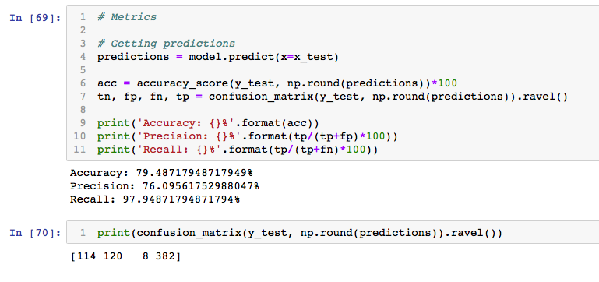
Findings
Pneumonia Dataset
Tensorflow and Keras has discovered some connections.

Slide 7
Findings
NIH Dataset
The NIH dataset contains 112,000 x-rays with varying ailments or no ailments. The code used for the Pneumonia dataset is ineffective on this dataset.
Code written specifically for this dataset gathers labels from a csv file and is also able to analyze the images to determine the ailment being searched for. This code was originally set to discover Fibromyalgia but was modified to detect Pneumonia.

Slide 8
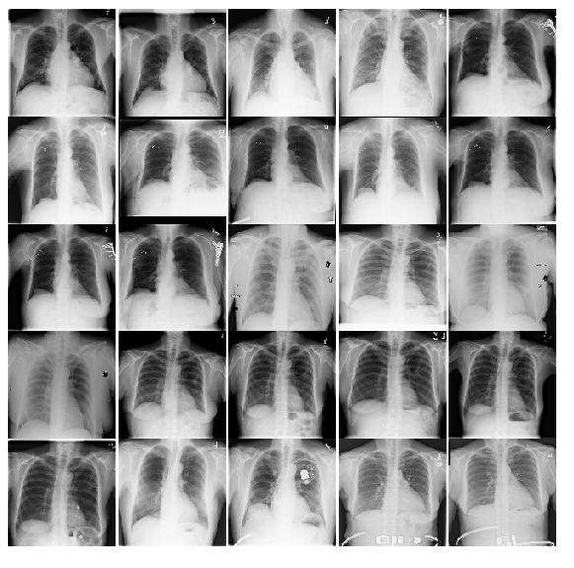
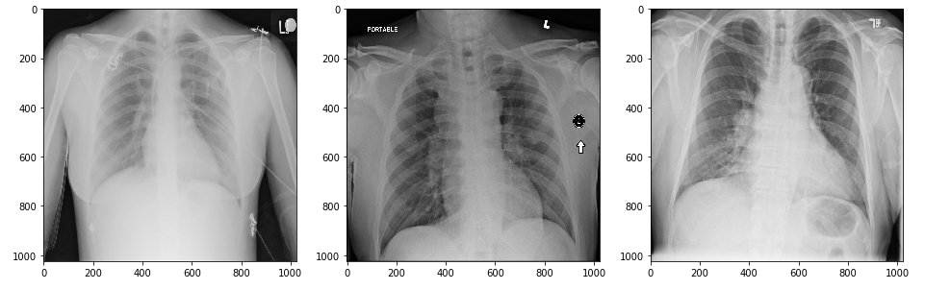

Slide 9
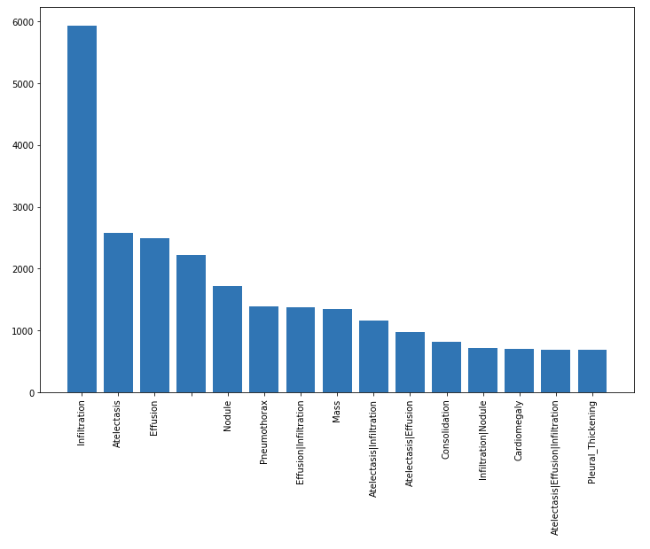
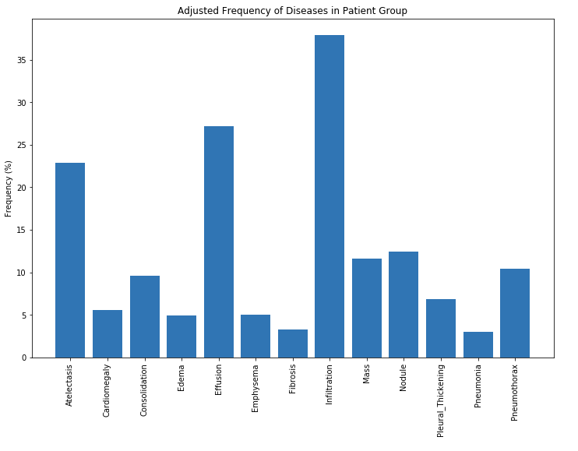

Slide 10
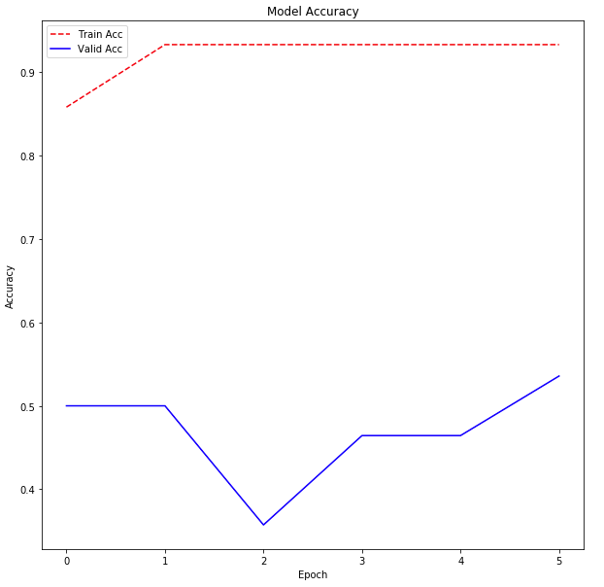
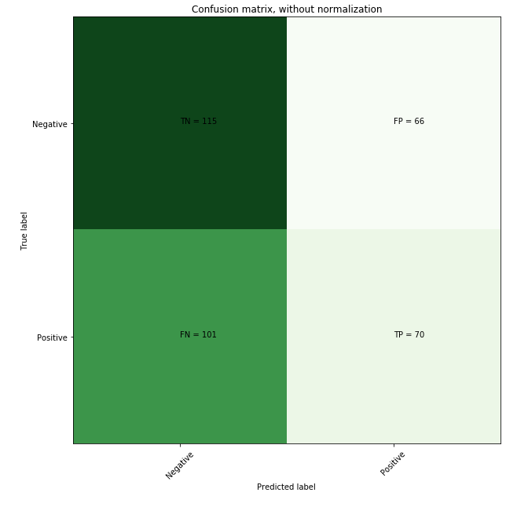

Slide 11
Conclusion
Tensorflow and Keras has discovered some connections. With the number of Epochs increased, the accuracy will also increased but this will also require decent computer processing power due to the number of images being processed.

