Slide 1
CAEN 1260 Firmware

Slide 2
Device Differences
1260
5560
At UC Denver – using for dev
Designed for soft/firmware dev for 5560
2 LEMO input + 2 LEMO I/O
At UMN – using for experiment
Designed for data collection
32 LEMO input + 2 LEMO I/O
Additional port types – USB, RJ45 (“SYNC”)
This presentation discusses firmware as built on the 1260 because the diagrams are simpler.
The 5560 firmware will function the same but have more channels and memory registers.
The 5560 is more powerful and has more clock options than the 1260.
“Anything you can do, I can do better.”

Slide 3
Input to 1260
Output from 1260
Analog channels: Analog detector input
Many register values
Set by utility programs (already written)
LEMO 1: Timestamp formatted as LEMO trigger for DCRC
Custom DCRC firmware by Sten
Alternate version of towerfe3, towerfe3_NaI, built to save this stamp to data
LEMO 2/SYNC: Trigger pulse
For diagnosis
All_Energies (Custom Packet): Data on pulse energies
Collected + stored separately from Midas
Matching timestamp

Slide 4
Main Trigger Process
ANALOG IN CH 0
analog 0 > low trigger
trig_low CH 0
OR (low)
analog 0 > high trigger
trig_high CH 0
VETO
(low and not high)
ANALOG IN CH 1
analog 1 > low trigger
trig_low CH 1
OR (high)
analog 1 > high trigger
trig_high CH 1
Trigger
Notes:
If this trigger is 1, then it tells the 1260 that an event has occurred and it should start sending and writing data.
Q/A: Technically there is an alternate trigger process – if(debug == 3){trigger manually each time `forcetrig` reg is set;}

Slide 5
Basic Firmware Layout
Generate
Trigger Code
Custom Packet All_Energies
0x80000000
Integrate
CH 0
Linux program reads & stores packet data
trigger_code
timestamp
0xc001
timestamp
Trigger
Integrate
CH 1
timestamp
energy_01
energy_00
Retrieve
Timestamp
DCRC triggers and saves timestamp
Notes:
Trigger code indicates which channels triggered. – Q/A These are represented as binary. Since the values are gated, it’s possible for multiple channels to trigger simultaneously.
0x80000000 is a header – Q/A: For the sake of alignment, if part of a packet is missing, it is a failsafe to tell us where the next packet begins so we don’t read part of the next packet as the end of this one.

Slide 6
User-facing Programs
setregisters – Sets various registers, most notably detector enabling and thresholds.
scanrate – gets the rate at different lower thresholds and reports them back.
scanupper – gets the rate at different upper thresholds and reports them back.
scanwindow – gets the rate at different upper + lower thresholds of the same width and reports them back.
singlerate – gets the rate once, at current thresholds.
packettest – retrieves packet data with energies, timestamps, and trigger codes.
Notes:
All programs have built-in help functions.
Underlined are the two programs I anticipate using during data collection.

Slide 7
Running the acquisitions asynchronously
Advantages
Disadvantages
No chance of bogging down MIDAS/CDMS DAQ, which runs many time-sensitive operations
Reduced development time
Minimal changes to CDMS DAQ required -> easy to go back to old version
Two sets of data in different formats
Chance of “dead events” where one DAQ was running and the other was not.
Notes:
What this means is that we essentially have two data acquisitions running asynchronously but simultaneously. One is the SuperCDMS DAQ and the other is a new, simple one for the CAEN device
Easy to go back to the old version of the CDMS DAQ if we need to, e.g. if we don’t want to use the NaI array for triggering for whatever reason

Slide 8
Improvements Since Visit
Data saved by DAQ now has timestamps largely accurate to what was sent
Order is correct
Values are not repeated
Some values dropped – pileup, and see next slide
Work has been ported from CAEN 1260 to CAEN 5560
Experimental baseline adjustment
Reduce need for recalibration
Improve accuracy of pulse integration

Slide 9
Current Issues
Timestamps are mostly similar, sometimes with a difference of 1-2
Still true? Or resolved alongside other issues?
If we send more than 24 timestamps at once, we lose some data at the end
Discussing with Sten/Terry how to best read the data
Method used for other registers may not work because data is stored in different type of memory
Confirmed to be DAQ issue via interactive telnet

Slide 10
To Do
Test current CAEN/DCRC communication
Dev code that will zip the two datasets together
It exists but it requires a lot of manual input or deletes too much data
Reduce time spent running the two programs non-simultaneously
Results in “dead events” that can’t be aligned and complicate the alignment algorithm
Adjust packet retrieval program for continuous running
Interruption does not cause graceful exit, kills 1 or more packets

Slide 11
Backup Slides

Slide 12
Basic Firmware Layout (Timing Details)
Generate
Trigger Code
Hold code
via gate
Custom Packet All_Energies
0x80000000
data
Integrate
CH 0
ready
trigger_code
AND
timestamp
0xc001
timestamp
Trigger
Integrate
CH 1
timestamp
energy_01
energy_00
Tell FIFO to send
Retrieve
Timestamp
Hold timestamp
in FIFO
Linux program reads & stores packet data
DCRC triggers and saves timestamp
Notes:
0x80000000 is a header – Q/A: For the sake of alignment, if part of a packet is missing, it is a failsafe to tell us where the next packet begins so we don’t read part of the next packet as the end of this one.

Slide 13
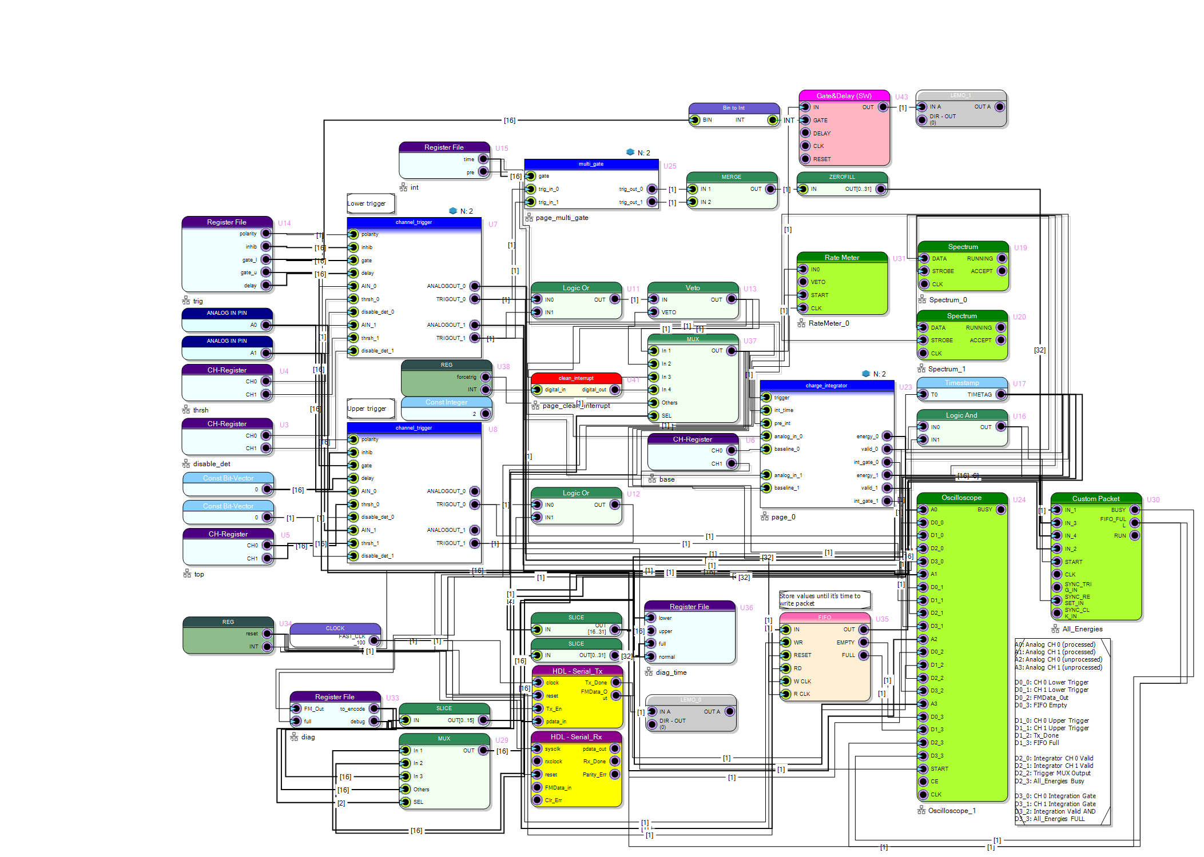
R76Replica
https://github.com/villano-lab/NaI_Array_Firmware/tree/master/R76Replica

Slide 14
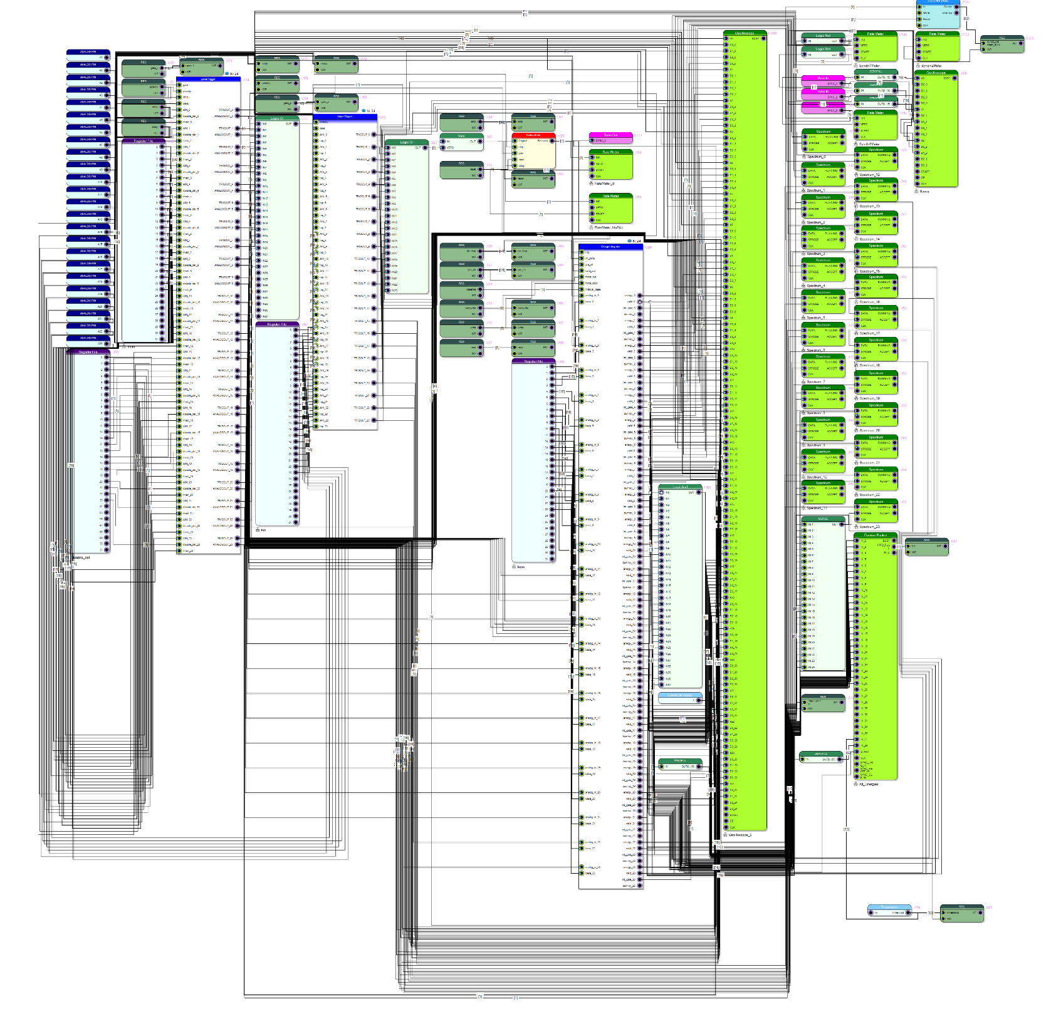
R76Firmware
https://github.com/villano-lab/NaI_Array_Firmware/tree/master/R76Replica

Slide 15
All Programs
setregisters – Sets various registers, most notably detector enabling and thresholds.
smalltest – Will not be ported to 5560; sets a small few registers and will be wrapped into setregisters.
getspectrum – non-functional. Should return spectra of integrated energies per channel. Instead returns un-/incorrectly-interpreted data.
Abandoned because the packets give the same information in different format.
scanrate – gets the rate at different lower thresholds and reports them back.
scanupper – gets the rate at different upper thresholds and reports them back.
scanwindow – gets the rate at different upper + lower thresholds of the same width and reports them back.
singlerate – gets the rate once, at current thresholds.
teststatus – retrieves status information about various CAEN firmware functions.
packettest – retrieves packet data with energies, timestamps, and trigger codes.
fifotest – defunct. Retrieved a register (no longer exists) to verify data went into a FIFO.
fttest – Defunct. Tested possibility of connection using an alternate backend.
Notes:
Bold: Fully functional or will continue to be developed.
Italic: used for debugging purposes
Underlined: used for main data collection
All programs have built-in help functions.

