Slide 1
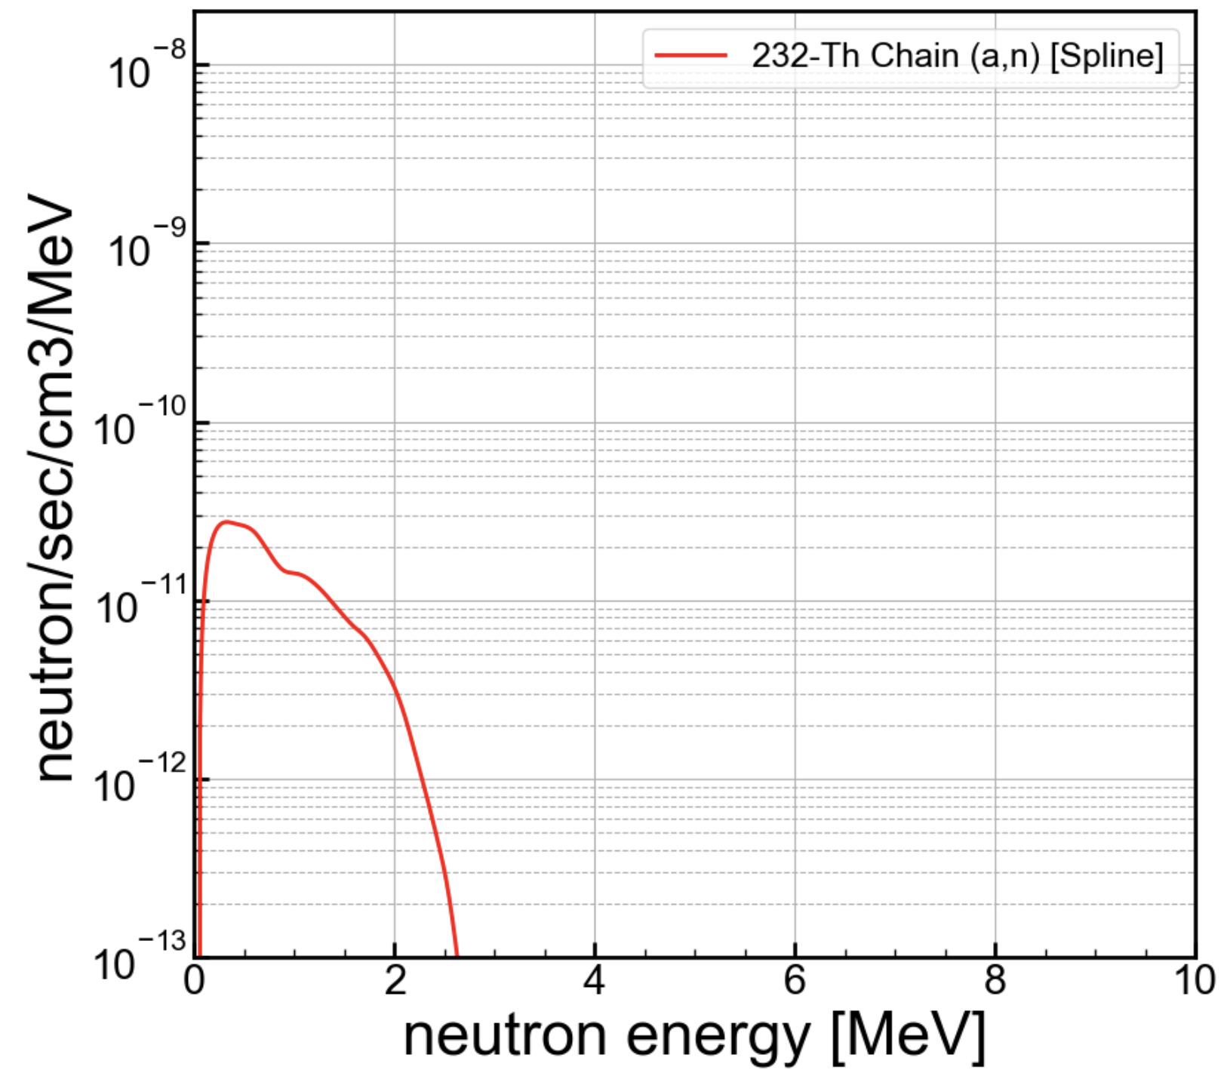
This is the neutron volumetric spectrum that SOURCES 4A (mod) predicts for Copper with 1 ppb Th contamination.
I want to use this to find out how many primary decays (from ²³²Th) it takes to create 1 neutron.
Producing 1 neutron in the Cu volumes of SuperCDMS will obviously not amount to many registered interactions in the detectors. Many will not hit the detectors at all. However, we could test this by creating a volumetric neutron source in the Cu of SuperSim.

Slide 2
Integrating this spectrum, I get a total volumetric source rate of 2.85x10⁻¹¹ neutrons/s/cm³/ppb.
Remember, this is for 1 ppb of Th contamination. It is likely we have a lot more than this. However, in a simulation, to get meaningful background distributions we certainly need many counts. So, if I calculate how many decays it takes to get 1 neutron, that will be a benchmark because if we simulated the neutrons as a volumetric source, there would be a neutron for every primary simulated event.
I will calculate it like this (the bottom number is just the number above in bold):
NB: In one year, 1 ppb contamination is equivalent to 0.00090 neutrons/cm³. Equivalently, this corresponds to 1113 years to get 1 neutron in each cm³.
Number of decays /s/cm³/1ppb
Number of produced neutrons /s/cm³/1ppb

Slide 3
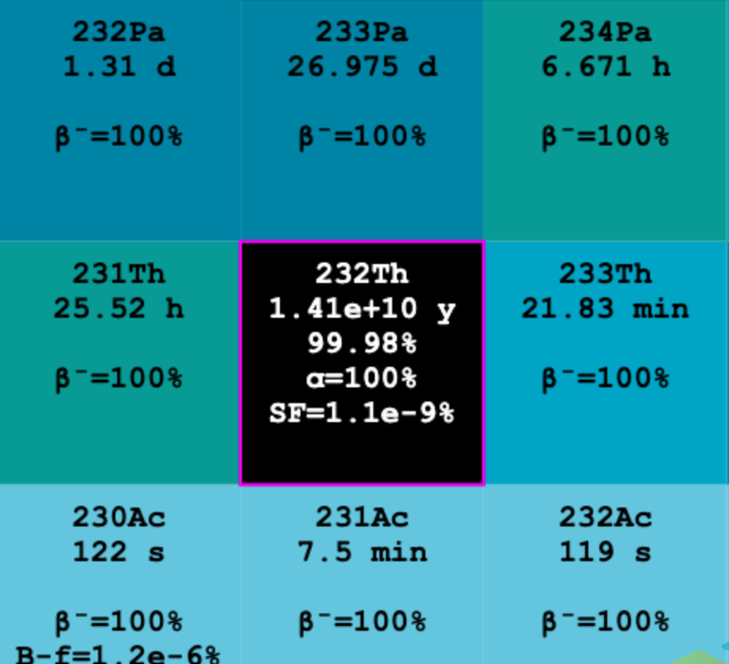
Probably, the way one would simulate the Th progeny in Geant4 is to place a ²³²Th atom in the contaminated material at a random location, and, let it decay. All the subsequent daughter decays will be captured in that event, no matter what the half life.
In practice, the α-decays further down the chain will happen at the same rate as the Th decay, assuming secular equilibrium. That means for each Th decay there are a handful of α-decays, each with the possibility of creating a neutron by the (α,n) process.
The half life for ²³²Th is 1.41x10¹⁰ y, see left from nndc.bnl.gov

Slide 4
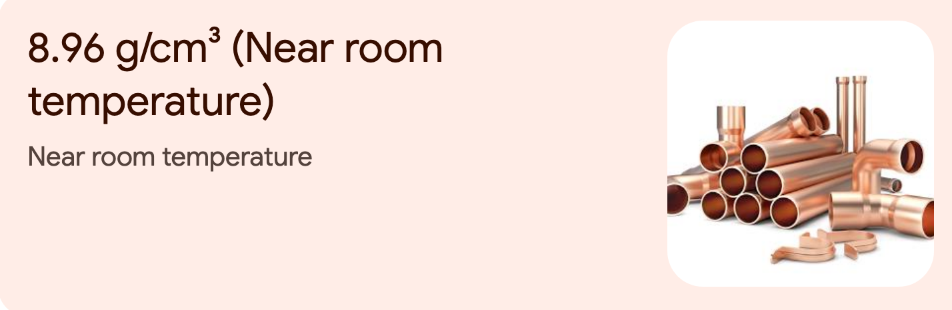
First, we want to find out how many Cu atoms per cm³ and then use 1 ppb to find the total number of Th atoms per cm³ per ppb. Given that, we can use the decay equation to compute the denominator on the previous page.
1 amu is 1.674x10⁻²⁴ g – I looked that up – it’s based on carbon atoms being exactly 12 amu. So, the density of Cu is 5.35x10²⁴ amu/cm³.
A copper atom is 63.5 amu. The number density of room temp. copper is therefore: 9.99x10²² atoms/cm³.

Slide 5
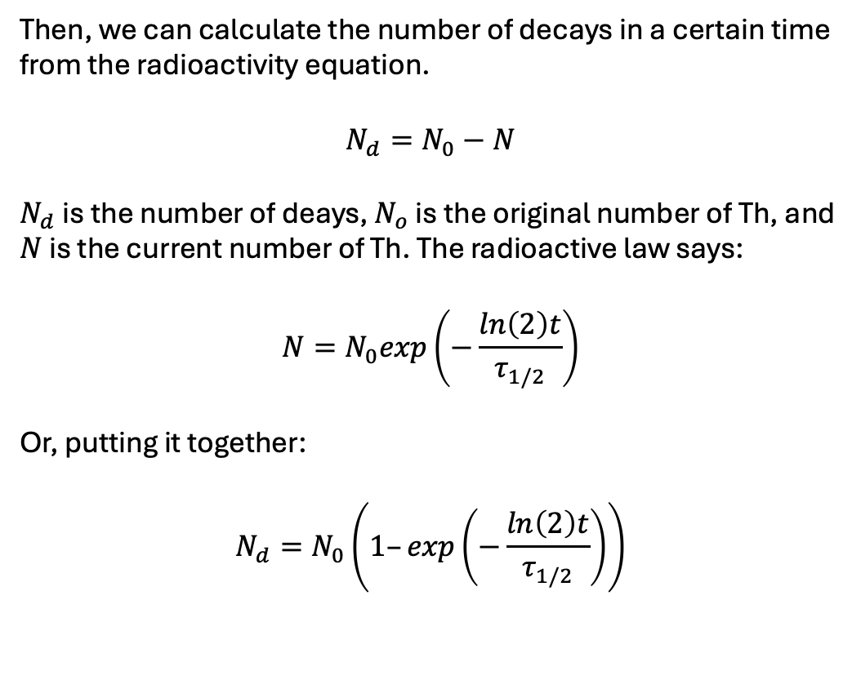
Based on the density of Cu, and the level of 1 ppb, the number of Th atoms present in copper is 9.99x10¹³ atoms/cm³/ppb.
Then, we can calculate the number of decays in a certain time from the radioactivity equation.
$$N_{d}=N_{0}−N$$
$N_{d}$is the number of deays, $N_{o}$ is the original number of Th, and $N$ is the current number of Th. The radioactive law says:
$$N=N_{0}exp\left(−\frac{ln\left(2\right)t}{τ_{1/2}}\right)$$
Or, putting it together:
$$N_{d}=N_{0}\left(1–exp\left(−\frac{ln\left(2\right)t}{τ_{1/2}}\right)\right)$$

Slide 6
For 1 yr the exponential factor in the parentheses is 4.92x10⁻¹¹. That gives 4,911 decays /year/cm3/ppb.
Converting to per second gives: 1.56x10⁻⁴ decays /s/cm³/ppb
So, we can apply it to the equation:
Number of decays /s/cm³/1ppb
Number of produced neutrons /s/cm³/1ppb
1.56x10⁻⁴ decays /s/cm³/ppb
2.85x10⁻¹¹ neutrons/s/cm³/ppb
And get: 5,403,509 decays/neutron

Slide 7
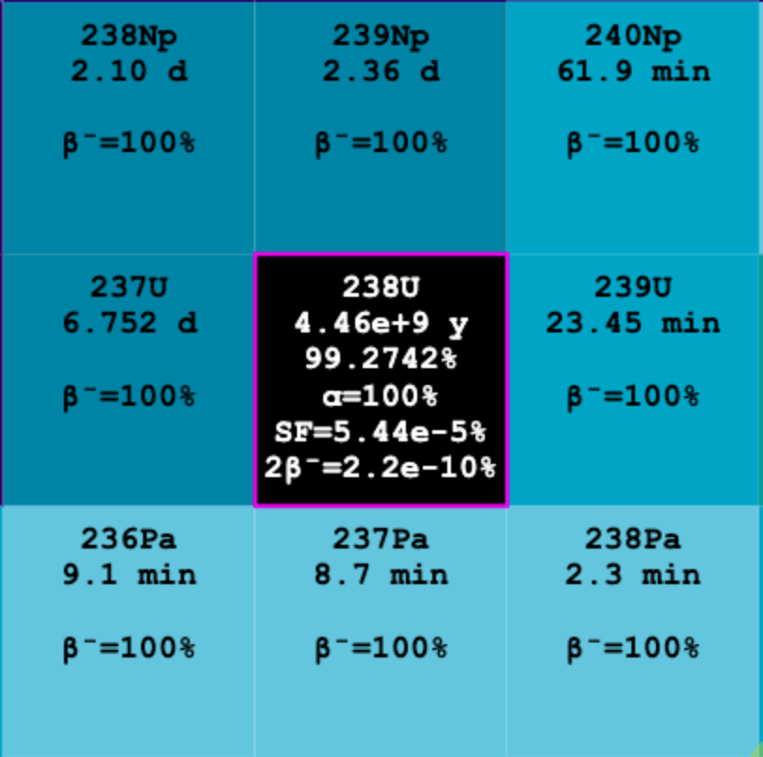
Spontaneous fission is also a contributor to neutrons. Th has very little S.F. but ²³⁸U has a lot more (see left, branching of 5.4x10⁻⁵ % compare with ~10⁻⁹ % for Th).
In fact, our radiogenics are probably dominated by spontaneous fission of ²³⁸U. This could be simulated natively in SuperSim as well, if G4 has accurate S.F. simulation. I want to estimate how many decays we need for this one.

Slide 8
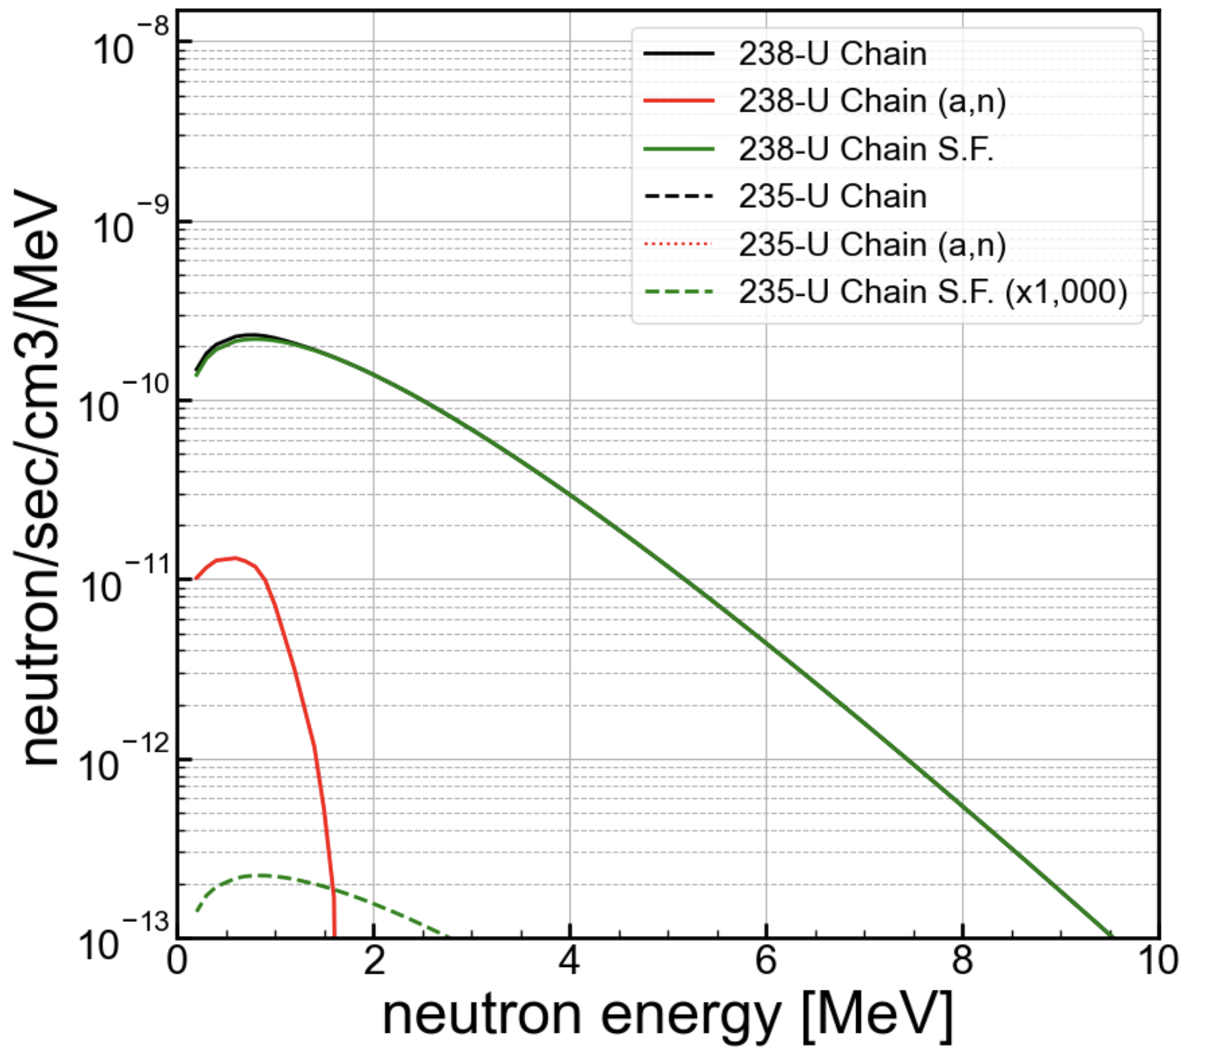
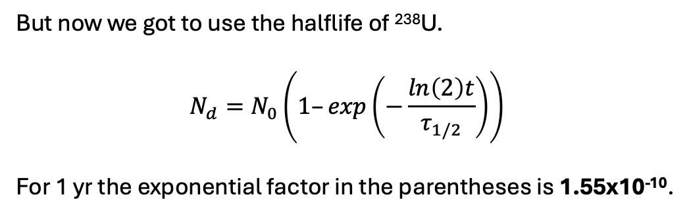
Integrating this spectrum for ²³⁸U S.F., I get a total volumetric source rate of 5.37x10⁻¹⁰ neutrons/s/cm³/ppb.
The same calculation as before: based on the density of Cu, and the level of 1 ppb, the number of ²³⁸U atoms present in copper is 9.99x10¹³ atoms/cm³/ppb.
But now we got to use the halflife of ²³⁸U.
$$N_{d}=N_{0}\left(1–exp\left(−\frac{ln\left(2\right)t}{τ_{1/2}}\right)\right)$$
For 1 yr the exponential factor in the parentheses is 1.55x10⁻¹⁰.
That gives 15,526 decays /yr/cm³/ppb, but S.F. is only 5.44x10⁻⁵ % , so that is 8.4x10⁻³ S.F. /yr/cm³/ppb. Or:
2.68x10⁻¹⁰ S.F. /s/cm³/ppb

Slide 9
So, we can apply it to the equation:
Number of S.F. /s/cm³/1ppb
Number of produced neutrons /s/cm³/1ppb
2.68x10⁻¹⁰ S.F. /s/cm³/ppb
5.37x10⁻¹⁰ neutrons/s/cm³/ppb
And get: 0.499 S.F./neutron or around 2.0 neutrons/S.F.
This number is much more feasible than the (a,n), and it roughly aligns with how many neutrons expected from fission. We might in this case worry, however, that S.F. in G4 is modelled correctly—especially the correlations in neutrons emitted.

