Slide 1
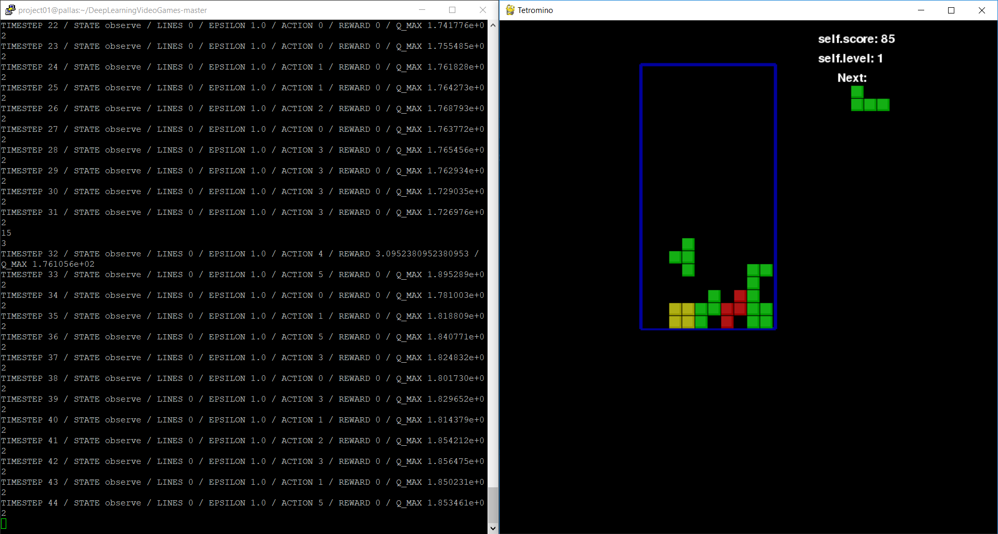
Tetris ai
Libraries used:
Pygame
Tensorflow
Os
Together with Putty and X-tunneling to create the testing interface

Slide 2
Progress
The DQN agent I built off of could achieve lines every once in a while but never truly achieved human-level skill even after training for 8+ hours.
Turns out, the original agent that is just focused on winning and losing performs better than the agent with additional optimizations, but both are still below human-level skill at the game.
Lines cleared in 700k timesteps (~8 Hours of training):
“Optimized” File – 159 Lines cleared total
Untouched file – 230 Lines cleared total

