Slide 1
SENSOR STAR NETWORK TOPOLOGY STACK TI 15.4-STACK LINUX SDK WITH BEAGLEBONE BLACK
MARTIN VILLASENOR

Slide 2
Goal
Main Goal
Two remote sensor boards will broadcast temperature and ambient light sensor data from two different locations. The BeagleBone will receive this data as an embedded host and will display results on a web browser. Alternatively, the data is sent to the cloud.
Objectives
The goal will be accomplished by obtaining three CC1350 Launchpads, one Sensors Boosterpack, one BeagleBone Black and an Internet connection. This will form a star topology with one of the CC1350 launchpad at the center (Collector). The other Launchpads will be sending their sensor data. The BeagleBone will interface with Collector and will display results on a web browser and will be sending data to the cloud.

Slide 3
Outcome - Accomplishments
Outcome – result of your project?
Two Launchpads were configured to send sensor data constantly. One Launchpad sends Light Intensity and temperature data, while the other Launchpad sends temperature data only. This data is received by a collector Launchpad which interfaces with the BeagleBone with the TI 15.4-stack Linux Gateway SDK. A web browser will be opened connecting to the collector to show the network and corresponding sensor data.
This project is an initial point to continue adding more sensors to the network and managing this data on the Beaglebone for analysis and actuators response as well as sending this information to the cloud to implement an IoT system.
The goal will be to have the two launchpads remotely sending data from two distant locations from one end of my house to the other. The light sensing data could be used to control a motor to shut blinds and the temperature data could be used to turn on a fan or perform temperature analysis of the entire house for insulation efficiency studies. Additionally, the Launchpads are powered via a USB connection. In the future these will be standalone powered by a battery cell for better isolation.

Slide 4
Components Used in Design
1BeagleBone Black
https://beagleboard.org/black
3 CC1350 Wireless Launchpad
http://www.ti.com/tool/LAUNCHXL-CC1350
Includes the TMP006 temperature sensor.
1 Sensors BoosterPack (1)
http://www.ti.com/tool/BOOSTXL-SENSORS
Includes the OPT3001 Light Sensor and the TMP007 Temperature Sensor.
1 USB to TTL Serial Cable adapter FTDI
https://www.amazon.com/gp/product/B014GZTCC6/ref=oh_aui_detailpage_o08_s00?ie=UTF8&psc=1
1 micro SD card
1 Insgnia SD memory card reader

Slide 5
Tools used in Design
Code Composer Studio
http://www.ti.com/tool/CCSTUDIO
UniFlash Standalone Flash Tool For SimpleLink
http://www.ti.com/tool/UNIFLASH
VmWare Workstation 15 Player
https://www.vmware.com/products/workstation-player.html
Ubuntu 18.04.1 LTS image
https://www.ubuntu.com/download/desktop
Tera term application
https://ttssh2.osdn.jp/index.html.en
BalenaEtcher Image Flash utility.
https://www.balena.io/etcher/
PuTTY ssh client
https://www.putty.org/

Slide 6
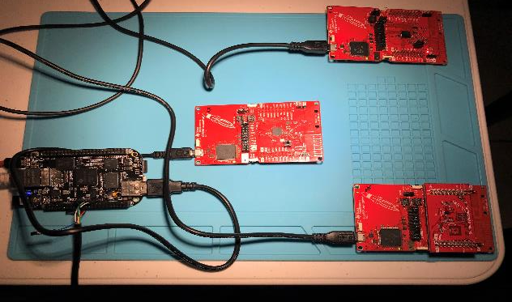
Schematics
Star Topology
CC1350 sensor 1
AWS IoT Cloud Services
BeagleBone
Sensor Boosterpack
CC1350 Collector
UART
CC1350 2 Sensor
Ubuntu Platform Host

Slide 7
Pre-requisites used in Design
Prerequisites
Major Components: 1 BeagleBoneBlack, 3 CC1350 Launchpads, 1Sensors BoosterPack module, 1 FTDI cable.
Development Environment: Windows 10 PC, Ubuntu image as Linux Host, TI CodeComposerStudio, SimpleLink SDK Driver API reference, Uniflash Standalone Flash Tool for SimpleLink devices, TI-15.4 Stack Simplelink CC13x0 SDK, TI 15.4-Stack Linux Gateway SDK.
Cloud service: AWS IoT service

Slide 8
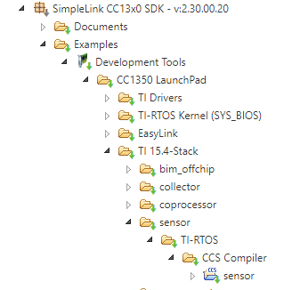
Implementation Details
CC1350 Launchpad with Sensors BoosterPack Setup
Install Code Composer Studio Version 7.4.0.00015
Using Resource Explorer download the SimpleLink CC13x0 SDK version 2.30.00.20
Import Sensor_cc1350lp project from TI 15.4-Stack folder

Slide 9
Implementation Details
Place Sensors BoosterPack on top of CC1350 Launchpad aligned with matching pins. Connect USB from Windows PC to debug USB port on Launchpad. Plug in the other two CC1350 Launchpads too.
Open UniFlash application with all CC1350 Launchpad boards connected. Obtain serial numbers from the Detected Devices window. My board with the Sensors Boosterpack contains serial number L40007FZ.
In TargetConfigs folder, edit the CC1350F128.ccxml file to add serial number L40007FZ for the sensor_cc1350lp project. This is useful when connecting all 3 boards and have the CCS debug this board recognizing it by its serial number.
Open and edit “sensor.c” file. Added new Include libraries and I2C code to recognize and obtain Ambient Light data. Temperature reading and transmission is in code by default. The Sensor BoosterPack utilizes the TI OPT3001. The TI TMP006 Temperature Sensor is integrated with the Launchpad.

Slide 10
Implementation Details
Build project. Fix Include and library location issues. In my case I had to fix this. Debug project into Lauchpad. This should now have the Sensor example code with readings and RF transmission of temperature and lux data.
Open PuTTY and select COM port (br 115200)for board. Press reset button and observe the “Starting…” message. It is now waiting for the collector board to open the network.
CC1350 Launchpad Collector (MAC-CoP) setup
Using UniFlash program the pre-built hex image located in C:\ti\simplelink_cc13x0_sdk_2_30_00_20\examples\rtos\CC1350_LAUNCHXL\ti154stack\hexfiles\default\collector_default_cc1350lp.hex onto Launchpad.
CC1350 Launchpad Sensor setup
Using UniFlash program a pre-built hex image located in C:\ti\simplelink_cc13x0_sdk_2_30_00_20\examples\rtos\CC1350_LAUNCHXL\ti154stack\hexfiles\default\sensor_default_cc1350lp.hex onto Launchpad.
Open PuTTY and select COM port (br 115200)for board. Press reset button and observe the “Starting…” message. It is now waiting for the collector board to open the network.

Slide 11
Implementation Details
Host Development Environment setup (Ubuntu)
Download VMWARE player.
Download Ubuntu iso image and save on Windows PC.
Open VMWare player, create new virtual machine pointing to downloaded Ubuntu iso image. On hardware setup select RAM usage. In my case I selected 6GB so I experience minimum sluggishness when using VM.
Ubuntu will run on top of Windows. When plugging in USB cables, the VM will detect connection and prompt you to select which driver to use, the Host (Windows) or the VM( Ubuntu).
Go through normal Operating System setup ( Login, passwords, etc.)

Slide 12
Implementation Details
Setting up BeagleBoneBlack
Download Debian image from beagleboard.org.
Download and install Etcher program.
Flash Debian image onto micro SD card using Etcher program.
Insert micro SD card with new flashed image into BeagleBone board. Press Switch button 2 and connect USB to microUSB port to boot. Keep button 2 pressed.
Connect the USB to TTL Serial Cable adapter FTDI to the beaglebone J1 pins. I connected ground, TX and RX pins corresponding to pin 1,4 and 5. Open Tera term. Find corresponding COM port from device manager and use this for Tera term connection setup. Select 115200 baud rate.
Boot Beaglebone again and observe bios and kernel messages on the screen.

Slide 13
Implementation Details
Connect Ethernet cable to Ethernet port for Internet connectivity. Beaglebone is setup with local IP address of 192.168.7.2 which will be used to login with ssh terminal on Ubuntu machine.
On Ubuntu open a terminal and type ssh debian:temppwd@192.168.7.2 to access beaglebone filesystem. Password is prompted again, type temppwd
The system needs to be updated. Use commands
$ sudo -s
temppwd
$ apt-get update
$ apt-get upgrade
$ apt-get install libcurl4-gnutls-dev libexpat1-dev gettext libz-dev libssl-dev
$ apt-get install git
$ apt-get install autoconf automake libtool
$ apt-get install libncurses-dev bison flex patch
$ apt-get install cvs texinfo build-essential
$ apt-get install gcc-arm-linux-gnueabi
$ apt-get clean

Slide 14
Implementation Details
Update Kernel
cd /opt/scripts/tools/
git pull
sudo ./update_kernel.sh
sudo reboot
Install the TI 15.4-Stack Linux Gateway SDK
In the Ubuntu machine, ensure VM is connected to the internet, open FireFox Web browser and download the TI 15.4-Stack Linux Gateway SDK. The beaglebone will host the gateway.
Copy the downloaded file to a thumbdrive and place file in Beaglebone by plugging in the thumbdrive to its USB port type A. On ssh terminal connected to beaglebone I performed copy as
mkdir /home/einstein/Gateway_Linux_SDK
mkdir /tmp/usb
mount /dev/sda1 /tmp/usb
cd /tmp/usb
cp ti154stack_linux_x64_2_07_00_16.run /home/einstein/Gateway_Linux_SDK
Execute ./ti154stack_linux_x64_2_07_00_16.run on beaglebone
This opens a Setup window. Press forward button, agree to TI License Agreement and install directory to desired location in beaglebone.

Slide 15
Implementation Details
Running the Gateway on Beaglebone
Go to the installed folder /ti and unzip the tar.gz file bbb_prebuilt.tar.gz using command
tar –xvf bbb_prebuilt.tar.gz
This will uncompress the prebuilt folder which contains the bin and gateway subfolders, and the run_demo.sh shell script.
I was getting an error when trying to run the run_demo.sh script. I opened it using vi and discovered the run_gateway.sh script was not running due to an error on directory location. The script assumed the shell script was in /gateway/run_gateway.sh, however there was an additional /gateway/gateway/run_gateway.sh directory. So I changed the variable GATEWAY_DIR to fix error.
Plugin the CC1350 collector board into the USB port A of beaglebone.

Slide 16
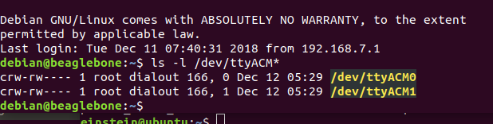
Implementation Details
Once CC1350 connected to beaglebone, on the terminal type
ls –l /dev/ttyACM*
It should display two ACM connections as shown here
Execute script ./run_demo.sh
The result should display “Connected to App Server” indicating the gateway is running.
Open a web browser ( Firefox in my case) and type on the URL http://192.168.7.2:1310
This will display a web page named TI-15.4 Stack-2.0.0 Collector App. This initially does not display any sensor nodes.

Slide 17
Implementation Details
Select the open button on the Network open for New Devices section. This accept the other CC1350 boards to enter the network.
If nothing happens, check the /bin folder and see if nv-simulation.bin is present. If it is remove it.
rm nv-simulation.bin
Terminate the gateway session and execute the run_demo.sh again. Press to open network again.
Now the sensor nodes will appear and the Network display will start with a blue dot. Eventually two nodes will appear connected to it.
If sensor nodes don’t appear still, reboot beaglebone and run the demo again. I had to start fresh sometimes to get both sensor nodes working correctly.

Slide 18
Implementation Details
Connecting to AWS IoT Gateway
The following steps will be done in Ubuntu environment.
Create an account with AWS amazon at https://aws.amazon.com
Once created sign in to console
Go to “Build a solution” section and select the “Connect and IoT device”.
Press Get started, and select Linux/OSX platform and IoT Device SDK Node.js type. I attempted the Python type but I continued obtaining errors which I will figured out in the future.
Name your thing. I named mine sensor_node.
Once the thing is created, download the connection kit.

Slide 19


Implementation Details
Place the downloaded zip file in desired location. Copy this file to a thumbdrive and place it in the beaglebone.
Created new folder in beaglebone and named it sensor_node. Placed new zip file in this location.
Unzipped the file with unzip command. The contents contain the certificate, public and private keys.
Changed permissions on start.sh to be executable by
chmod +x start.sh
Execute ./start.sh
Now the application connecting to the AWS gateway is running

Slide 20
Implementation Details
In the AWS IoT page, go to Manage and select Things. The sensor_node thing is displayed.
Selecting it show the thing Amazon Resource Name which uniquely identifies the thing.
To test the connection go to Test section in the AWS IoT main page. The MQTT client page will be displayed. This is where we subscribe a topic to communicate with our device with publish commands.
I didn’t know what the topic the example was running. I had to open the “device-example.js” ( I found in start.sh that this script was called to run the example) and found the topic name as “topic_1”.

Slide 21
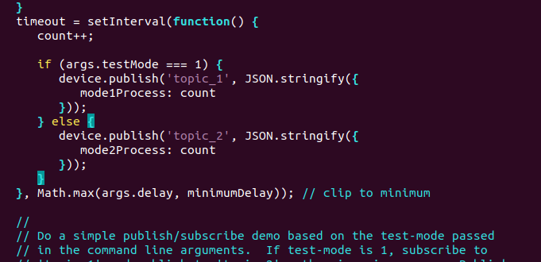
Implementation Details
Showing topics used
Subscribe this topic in MQTT client page. Once subscribed this will be shown on the subscriptions pane.
Publish message. I edited the message and tested it. The message is being received on the beaglebone terminal.

Slide 22
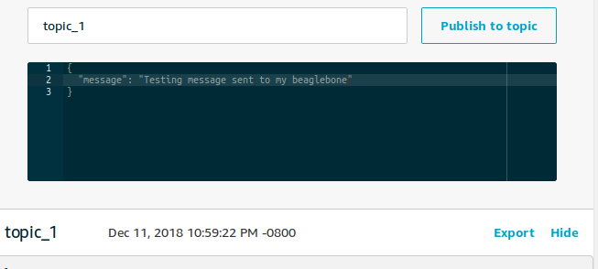
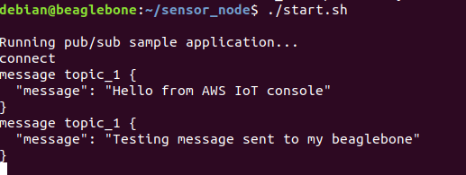
Implementation Details
Message received

Slide 23
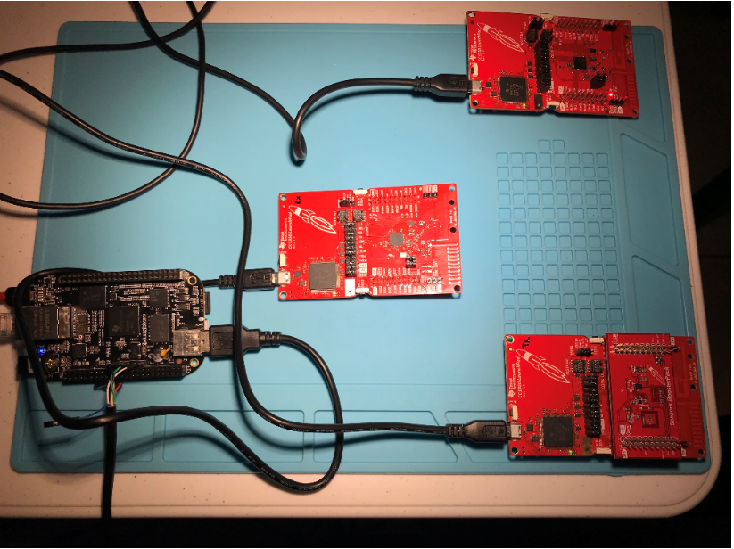
Actual project set-up

Slide 24
Demo
https://youtu.be/UGPT5s53AFs

Slide 25
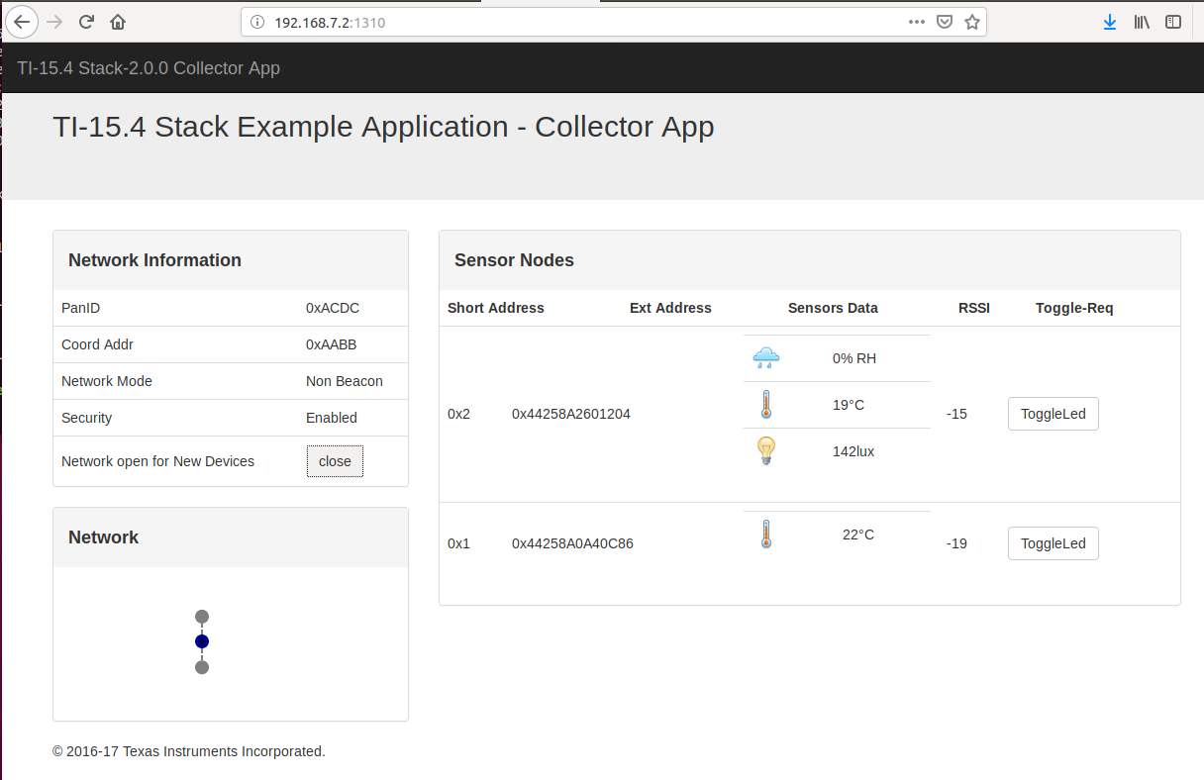
Results and Conclusions

Slide 26
Results and Conclusions
The goal was accomplished except for sending data to the cloud due additional training and exercise requirements. However, the goal from the sensor endpoints to the connection to the AWS IoT service has been accomplished. Throughout this exercise it was demonstrated how each component was configured and integrated with other components physically and logically. The end result showed how two sensor nodes ( CC1350 Lauchpads) sent data remotely to the collector node ( CC1350 Launchpad). This node receives the data and with the Linux SDK interface it send its data through the serial connection ACM0. The Beaglebone’s Linux system hosts the gateway that allows this coming data to be displayed on a web browser. This display shows the Network node topology and the sensor node information for each type of sensor type included.
This project is an open project which will be expanded and improved. There were many questions still unsolved, from the sensor nodes to the AWS IoT service, that I plan to examine and find the answer which will also help on improving the continuation of this project.

Slide 27
Results and Conclusions
Open questions
Attempted to use the Thing Shadows service utility on the AWS IoT, but there is a learning curve required to manage this tool. This will be continued for future development.
I am still trying to figure out how send my sensor data to the AWS database. This will be done in the future.
I will use the Rules engine to act on the data received. This will be done in the future.
Attempted to use the IOT Dashboard from stackArmor. However, the stackArmor requires a registration and provide reason of using their service. I registered, but I have not received answer from them to access and use their dashboard.
I tried to run the other js examples in the aws-iot-device-sdk folder. But I continued getting errors. I plan to figure out how implement some of these examples correctly.
Still trying to figure out how get my sensor data from the npi server used by the collector application. I examined the “collector.cfg” to figure out how to get this data but could not help. I will continue researching this problem.

Slide 28
Reference
Sub 1-GHz Sensor to Cloud Industrial IOT Gateway Reference Design Application Note
http://www.ti.com/tool/TIDEP0084
TI 15.4-Stack-Linux Gateway Project Zero
http://dev.ti.com/tirex/content/simplelink_academy_cc13x0sdk_2_30_02_00/modules/154-stack/154-stack_03_linux_project_0/154-stack_03_linux_project_0.html
Element 14 Road test Sub-1 GHz Sensor to Cloud IoT Gatway
The TI 15.4-Stack Linux Developer’s Guide
http://dev.ti.com/tirex/content/simplelink_cc13x0_sdk_1_30_00_06/docs/ti154stack/ti154stack-ldg/ti154stack-ldg/index.html
Basic example to use OPT3001 on CC2650 Launchpad
https://sunmaysky.blogspot.com/2016/03/basic-example-to-use-opt3001-on-cc2650.html
TI E2E Community Sub-1 GHz Forum
https://e2e.ti.com/support/wireless-connectivity/sub-1-ghz/f/156/t/560486

Slide 29
References
Sensor and Collector TI 15.4-Stack Project Zero
http://dev.ti.com/tirex/content/simplelink_academy_cc13x0sdk_1_14_02_04/modules/154-stack_01_sensor_collector/154-stack_01_sensor_collector.html
SimpleLink MCU SDK Driver API Reference
http://dev.ti.com/tirex/content/simplelink_cc13x0_sdk_1_40_00_10/docs/tidrivers/doxygen/html/index.html
BOOSTXL-SENSORS Sensors BoosterPack Plug-in Module
http://www.ti.com/lit/ug/slau666b/slau666b.pdf
StackArmor Gateway Reference Design Application Note
Exploring BEAGLEBONE Tools and Techniques For Building with Embedded Linux by Derek Molloy.
http://derekmolloy.ie/tag/beaglebone-black/
Beagleboard.org

