Slide 1
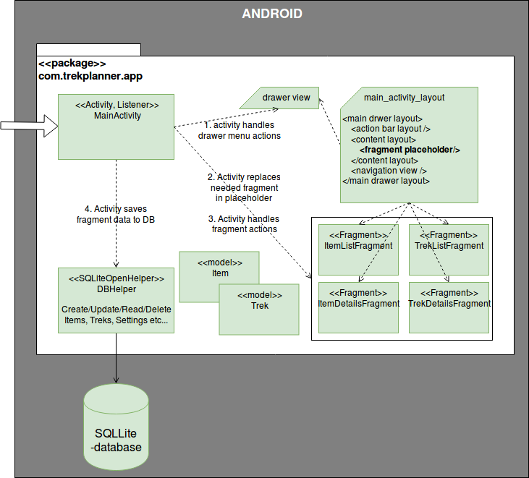
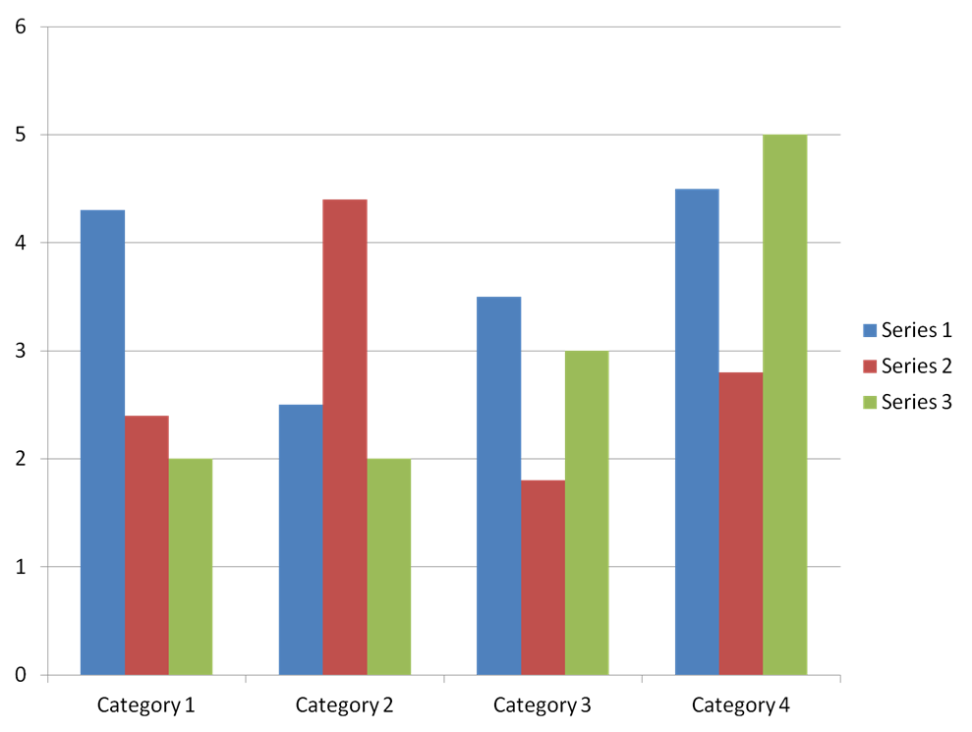
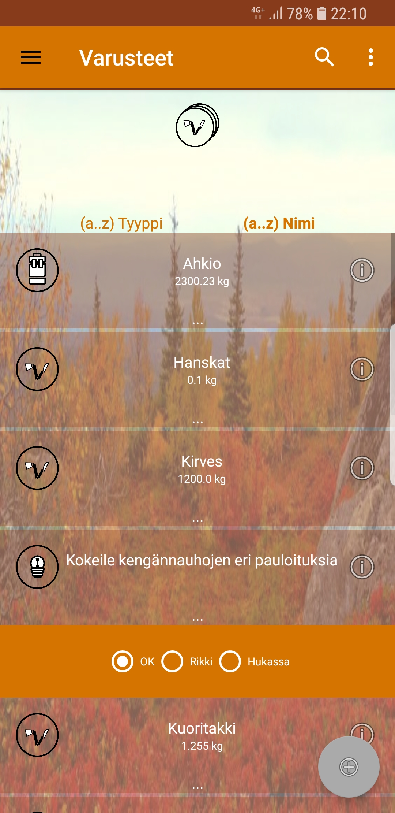
Trek planner application
Ville Nieminen, Abdishakur Hassan, Henry Väisänen, Sami Saariaho, Iikka Konola, TVT16SMO
School of Engineering and Natural Recources, Information Technology, Software Engineering
Introduction
Trek planner is an application for trekkers. The application provides packing list specifically for trekking and camping.
FIGURE 1. Application architecture
Objectives
The objective was to get a well-functioning application that is useful for trekking. The application was developed with Android Studio and designed for those mobile phones that have android operating system. Model-View-Controller (MVC) architectural model was used when developing trek planner application.
It’s possible with the application to create a packing list, the list can be searched by name, edited, removed, and added new items that are needed for trekking.
The app also helps to know the items that are on the packing list that were not used and those that were used most, the total weight of the packing list when planning the trekking trip. The user can also save photo of the item as well as take photos of the trekking trip.
Methods
Trek planner application development was used sourceforge service and Git version control system. We held weekly online sprint meetings, developers choose and assign available tasks by themselves. There was a strong cooperation and discussions about the tasks between the group.
FIGURE 2. Screenshot items list
Results
The result was same as we planned for. We wanted to add extra features to our application but due to limited time for the project, it was not possible for us to continue adding more features.
We had several bugs, but we managed to fix them.
FIGURE 3. Todo add better image
Conclusions
Our project was fun, and we learnt a lot about Android mobile programming and we also got experience about mobile application development.
References
https://developer.android.com/training/implementing-navigation/nav-drawer.html
http://www.vogella.com/tutorials/AndroidFragments/article.html
Mobile programming project
ECTS credits:
Date of publication: 2018, Spring
Instructor Eino Niemi

