Slide 1
Kernel image processing
Parallel and sequantial implementation using CPU
Luogo e data arial bold 14

Slide 2
Mean Shift Clustering
Luogo e data arial regular 8 pt
Kernel image processing
Introduction
Kernel image processing is a technique used to modify or enhance images using a small matrix called kernel
The kernel is applied to each pixel in the image, performing a convolution on the surrounding pixels to calculate the new value of the current pixel
The size of the kernel and the values in the matrix determine the specific operation that is applied to the image

Slide 3
Mean Shift Clustering
Luogo e data arial regular 8 pt
Kernel image processing
Pseudocode
Given an image and kernel perform the following steps for each pixel:
Multiply each corresponding pixel value of the kernel with the corresponding pixel of the image
Sum the products obtained
Assign the sum to the corresponding pixel of the output image.
This algorithm is computationally expensive but we can parallelize it because is an “embarrassing parallel” problem
We will see the parallelization using CPU and GPU

Slide 4
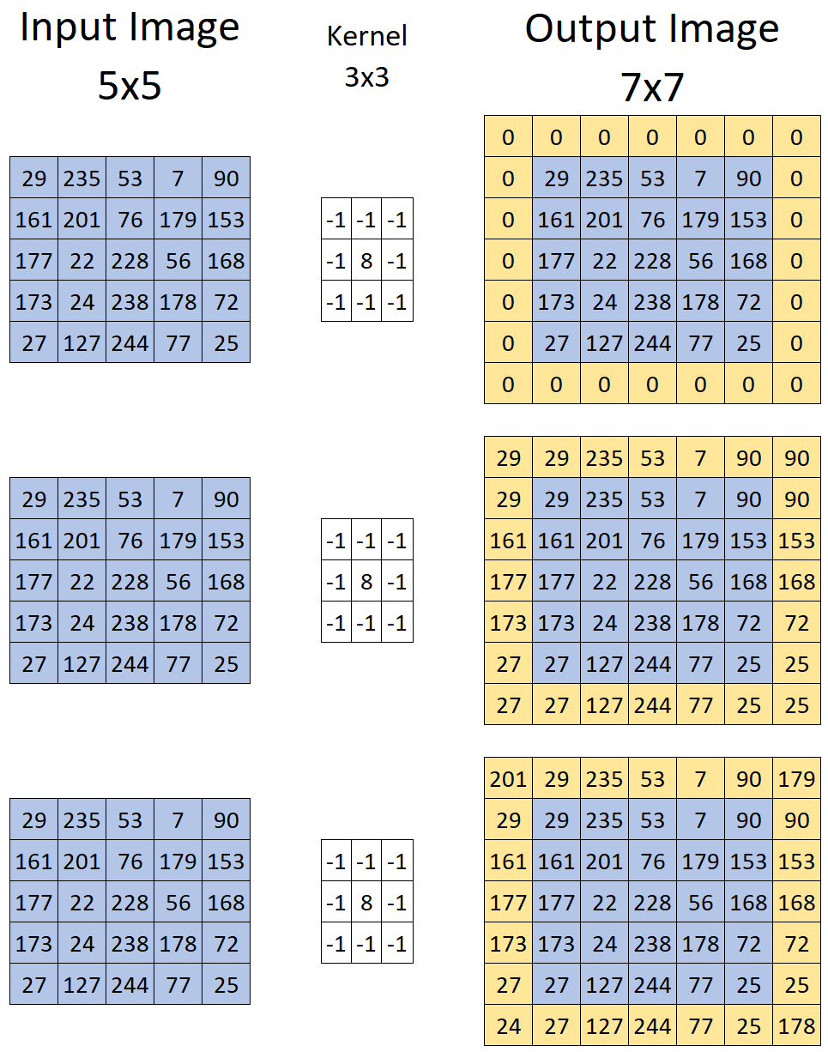
Mean Shift Clustering
Luogo e data arial regular 8 pt
Kernel image processing
Padding
Technique used to handle the edges of an image when applying a kernel
Add a border of pixels around the original image, before applying the kernel
Types of padding:
Zero Padding: adds 0s around the image
Pixel replication: copies the values of the pixels from the edges of the original image
Pixel mirroring: reflects the values of the pixels across the edges of the original image

Slide 5
Mean Shift Clustering
Luogo e data arial regular 8 pt
Kernel image processing
CPU Sequential version
Image *ConvolutionCPU::apply_convolution_sequential(Image *image, Kernel *kernel, type_padding padding) {
Image*img_padded=PaddingImage::apply_padding_to_image(image, kernel->get_size(),padding);
const unsigned char *img = img_padded->get_image();
const int WIDTH = image->get_width();
const int HEIGHT = image->get_height();
const int K_SIZE = kernel->get_size();
const float *mask = kernel->get_kernel();
const int shift = K_SIZE / 2;
const float norm = kernel->get_normalization_factor();
unsigned char *result_img = (unsigned char*) malloc(sizeof(unsigned char)*WIDTH*HEIGHT);
float sum = 0.0f;
for (int i = 0; i < HEIGHT; i++) {
for (int j = 0; j < WIDTH; j++) {
for (int k = 0; k < K_SIZE; k++) {
int index_r = i + k;
for (int w = 0; w < K_SIZE; w++) {
int index_c = j + w;
sum += img[index_r * (WIDTH+K_SIZE-1) + index_c] * mask[k * K_SIZE + w]; }}
sum = sum * norm;
result_img[i * WIDTH + j] = (unsigned char)(sum > 255 ? 255 : sum < 0 ? 0 : sum);
sum = 0.0f;}}
Image *out_image = new Image(result_img, WIDTH, HEIGHT);
delete img_padded;
return out_image;}
Before to start we have to pad the image
Scroll the padded image with kernel to calculate convolution
Store the sum in a new matrix
Create new object Image using as input the new values

Slide 6
Mean Shift Clustering
Luogo e data arial regular 8 pt
Kernel image processing
Parallel version CPU
Image *ConvolutionCPU::apply_convolution_parallel(Image *image, Kernel *kernel, type_padding padding) {
Image *img_padded = PaddingImage::apply_padding_to_image(image, kernel->get_size(), padding);
const unsigned char *img = img_padded->get_image();
const int WIDTH = image->get_width();
const int HEIGHT = image->get_height();
const int K_SIZE = kernel->get_size();
const float *mask = kernel->get_kernel();
const int shift = K_SIZE / 2;
const float norm = kernel->get_normalization_factor();
unsigned char *result_img =(unsigned char*)malloc(sizeof (unsigned char)*WIDTH*HEIGHT);
float sum = 0.0f;
#pragma omp parallel for firstprivate(HEIGHT, WIDTH, K_SIZE, shift, sum, norm) schedule(dynamic) collapse(2)
for (int i = 0; i < HEIGHT; i++) {
for (int j = 0; j < WIDTH; j++) {
for (int k = 0; k < K_SIZE; k++) {
for (int w = 0; w < K_SIZE; w++) {
int index_r = i + k, index_c = j + w;
sum += img[index_r * (WIDTH + (K_SIZE - 1)) + index_c] * mask[k * K_SIZE + w]; }}
sum = sum * norm;
result_img[i * WIDTH + j] = (unsigned char)sum > 255 ? 255 : sum < 0 ? 0 : sum;
sum = 0.0f; }}
Image *out_image = new Image(result_img, WIDTH, HEIGHT);
delete img_padded
return out_image;}
Use OpenMp to parallelize the code
Schedule dynamic because the PC has 4 high performance cores and 8 efficient cores

Slide 7
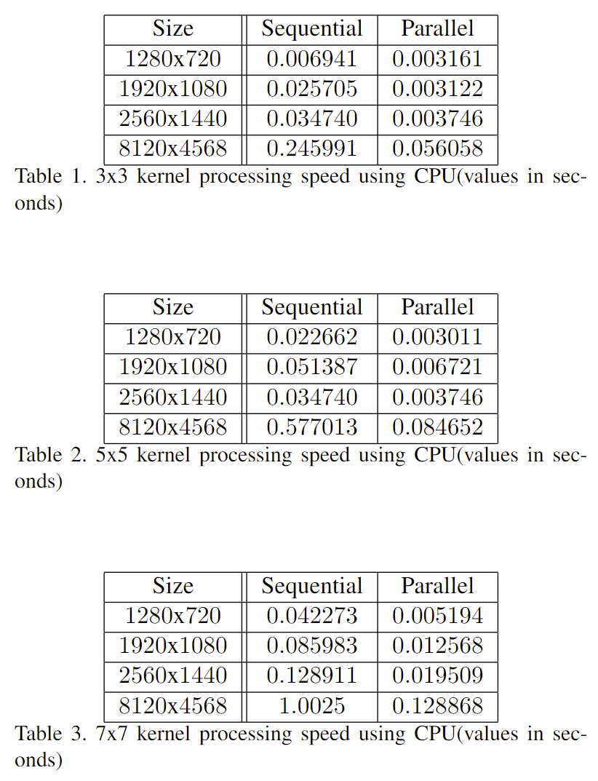
Mean Shift Clustering
Luogo e data arial regular 8 pt
Kernel image processing
Results CPU version
In parallel computation we use 20 cores (8*2+4)
Parallel version is faster than sequential in all test cases
Speed up ranges between 2 and 9
Speed up is greater as kernel size increases
Improvements are significant but not enough to elaborate a millions of images
GPU can perform better than CPU

Slide 8
Mean Shift Clustering
Luogo e data arial regular 8 pt
Kernel image processing
GPU
set-up
………
cudaMalloc(&d_img,img_padded->get_width()*img_padded->get_height() * sizeof(unsigned char));
cudaMalloc(&d_out_img, img->get_width()*img_padded->get_ height()* *sizeof(unsigned char));
cudaMemcpy(d_img, img_padded->get_image(),img_padded->get_width()* img_padded->get_height()*sizeof(unsigned char),cudaMemcpyHostToDevice);
if (type_mem == shared || type_mem == global) {
cudaMalloc(&d_kernel, K_SIZE * K_SIZE * sizeof(float));
cudaMemcpy(d_kernel,kernel->get_kernel(),K_SIZE*K_SIZE*sizeof( float), cudaMemcpyHostToDevice);
} else
cudaMemcpyToSymbol(kernel_const,kernel->get_kernel(),K_SIZE* K_SIZE * sizeof(float), 0, cudaMemcpyHostToDevice);
int grid_size_x = (WIDTH + BLOCK_WIDTH - 1) / BLOCK_WIDTH;
int grid_size_y = (HEIGHT + BLOCK_WIDTH - 1) / BLOCK_WIDTH;
dim3 block_dim(BLOCK_WIDTH, BLOCK_WIDTH);
dim3 grid_dim(grid_size_x, grid_size_y);
// start pseudo-code
convolution_type_mem<<<grid_dim, block_dim, dynamic_alloc>>> (d_out_img, d_img, WIDTH, HEIGHT, K_SIZE, norm);
// end pseudo-code
unsigned char *h_out_img=(unsigned char*)malloc(image->get_width() * image->get_height() * sizeof(unsigned char));
cudaMemcpy(h_out_img,d_out_img,image->get_width()*image-> get_height()*sizeof(unsigned char),cudaMemcpyDeviceToHost);
Image *out_img=new Image(h_out_img,image->get_width(),
image->get_height());
………
Allocate GPU memory for input and output image
Copy in GPU memory all values from the input image
Depends on the type of convolution we either allocate other global memory for kernel or copy kernel into constant memory
Calc block dim and grid dim using 16 as BLOCK_WIDTH
Copy the result given by the kernel and create a new output image

Slide 9
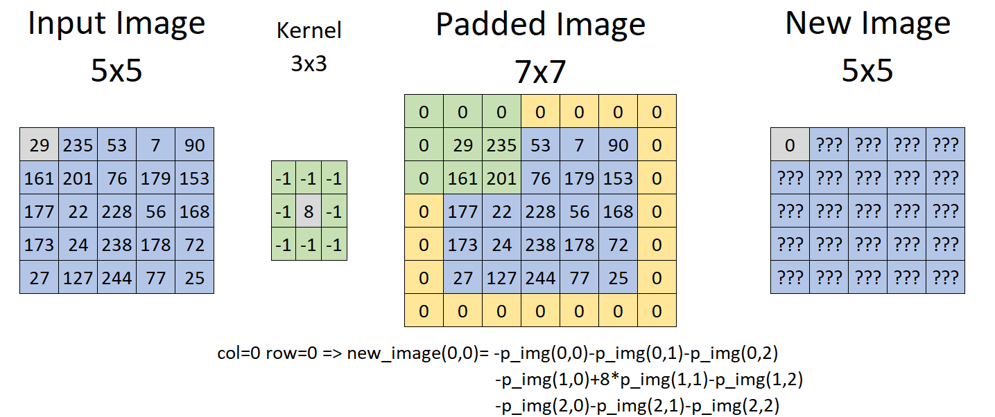
Mean Shift Clustering
Luogo e data arial regular 8 pt
Kernel image processing
GPU Global and
Constant memory
__global__ void convolution_global_memory(const float *d_kernel, unsigned char *out_img, unsigned char *d_img, const int WIDTH, const int HEIGHT, const int K_SIZE, const float norm) {
int col = threadIdx.x + blockIdx.x * blockDim.x;
int row = threadIdx.y + blockIdx.y * blockDim.y;
float sum = 0.0f;
if (col < WIDTH && row < HEIGHT) {
for (int i = 0; i < K_SIZE; i++) {
for (int j = 0; j < K_SIZE; j++) {
int index_c = col + j;
int index_r = row + i;
sum += d_img[index_r * (WIDTH + K_SIZE - 1) + index_c] * d_kernel[i * K_SIZE + j]; }}
sum = fmaxf(0.0f, fminf(sum * norm, 255.0f));
out_img[row * WIDTH + col] = (unsigned char)sum;}}
Bound sum between 0-255
Store new value in the output matrix
In constant memory I used kernel_const instead of d_kernel

Slide 10
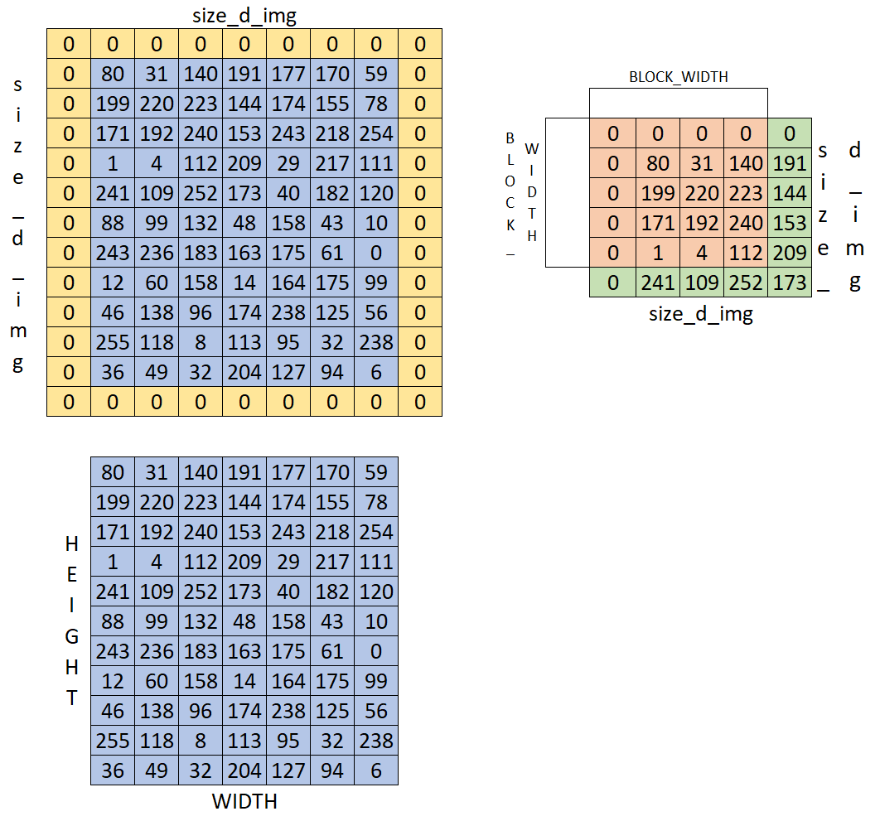
Mean Shift Clustering
Luogo e data arial regular 8 pt
Kernel image processing
Intro shared version
Load partial image
We need to load also the pixel out of BLOCK_WIDTH to compute correctly the output value
The number of extra values to load depends on kernel size

Slide 11
Mean Shift Clustering
Luogo e data arial regular 8 pt
Kernel image processing
GPU Shared memory
extern __shared__ unsigned int dynamic_array[];
const int size_d_img = (BLOCK_WIDTH + K_SIZE - 1);
unsigned char *d_img = (unsigned char *)&dynamic_array[K_SIZE * K_SIZE];
float *mask = (float *)&dynamic_array;
int col = threadIdx.x + blockIdx.x * blockDim.x;
int row = threadIdx.y + blockIdx.y * blockDim.y;
int c = threadIdx.x;
int r = threadIdx.y;
int tid_block = threadIdx.x + threadIdx.y * BLOCK_WIDTH;
int shift = K_SIZE / 2;
d_img[r * size_d_img + c] = 0;
if (r == BLOCK_WIDTH - 1 || c == BLOCK_WIDTH - 1) {
for (int i = 0; i < K_SIZE; i++) {
for (int j = 0; j < K_SIZE; j++) {
int index_c = c + j;
int index_r = r + i;
d_img[index_r * size_d_img + index_c] = 0;
}
}
}
if (tid_block < K_SIZE * K_SIZE)
mask[tid_block] = d_kernel[tid_block];
__syncthreads();
………
Initialize dynamic matrix into shared memory
Copy kernel values into shared memory
Wait all threads before continue

Slide 12
Mean Shift Clustering
Luogo e data arial regular 8 pt
Kernel image processing
GPU Shared memory
………
if (col < WIDTH && row < HEIGHT) {
d_img[(r + shift) * size_d_img + c + shift] = img[col + WIDTH * row];
// printf("%d,%d ",(row),(col));
if (r == 0 || c == 0 || r == BLOCK_WIDTH - 1 || c == BLOCK_WIDTH - 1) {
for (int i = 0; i < K_SIZE; i++) {
for (int j = 0; j < K_SIZE; j++) {
int index_c = c + j;
int index_r = r + i;
int index_row = row - shift + i;
int index_col = col - shift + j;
// printf("%d,%d ",(row - shift + i),(col - shift + j));
if (index_row >= 0 && index_row < HEIGHT && inde_col >= 0 && inde_col < WIDTH)
d_img[index_r * size_d_img + index_c] = img[WIDTH * (index_row) + (inde_col)];
}
}
}
}
float sum = 0.0f;
__syncthreads();
………
Load image values into shared memory block
Due to we need also the elements to compute the border we have to load also them
Wait until all threads finish

Slide 13
Mean Shift Clustering
Luogo e data arial regular 8 pt
Kernel image processing
GPU Shared memory
………
if (col < WIDTH - shift && row < HEIGHT - shift && col >= shift && row >= shift) {
for (int i = 0; i < K_SIZE; i++) {
int index_r = r + i;
for (int j = 0; j < K_SIZE; j++) {
int index_c = c + j;
sum += d_img[index_r * size_d_img + index_c] *
mask[i * K_SIZE + j];
}
}
sum = fmaxf(0.0f, fminf(sum * norm, 255.0f));
out_img[(row-shift)*(WIDTH-(K_SIZE-1))+col-shift]=(unsigned char)sum;
}
Check the bounds to compute only usefull values
Bound the pixel value between 0-255
Save the value into output image

Slide 14
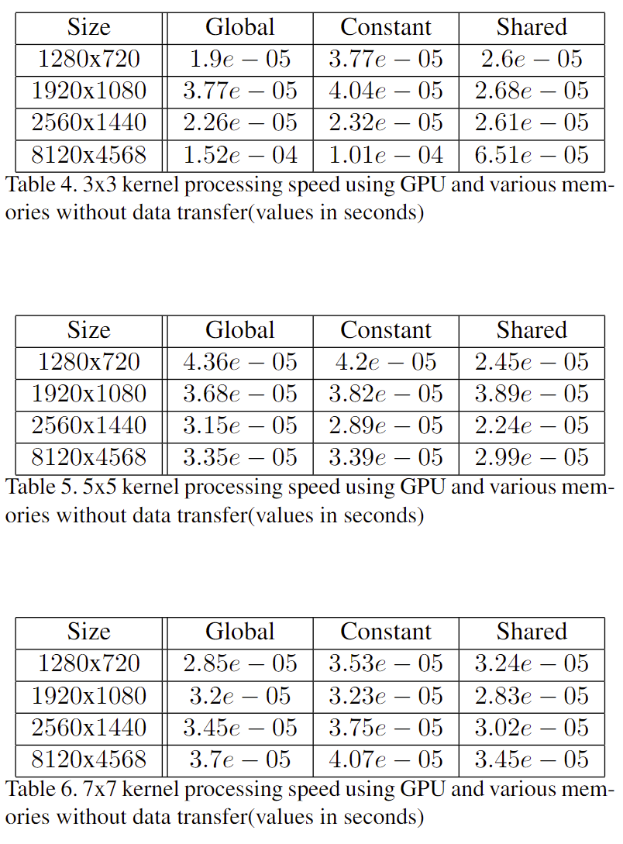
Mean Shift Clustering
Luogo e data arial regular 8 pt
Kernel image processing
Results GPU without
data transfer
Best performance obtained using shared memory
The performance differences between all implementations is not so much
All of these results recordered without considering data transfer between CPU and GPU

Slide 15
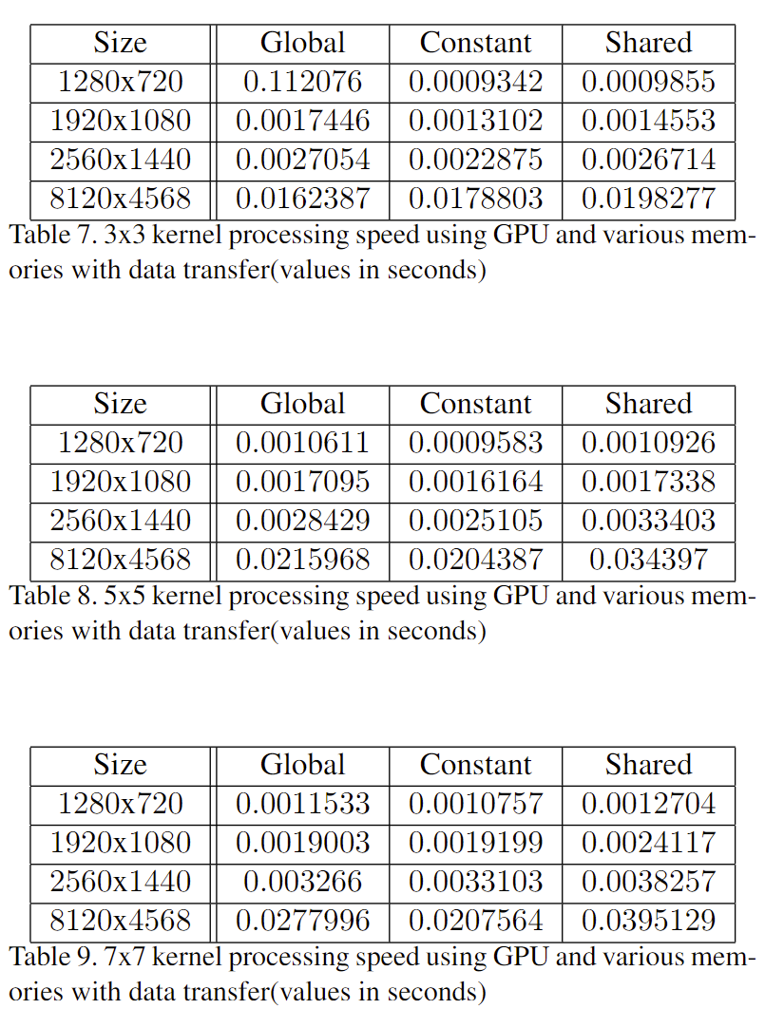
Mean Shift Clustering
Luogo e data arial regular 8 pt
Kernel image processing
Results GPU with
data transfer
We obtain an opposite result
Now shared memory gets the worst results in general due to the dynamic allocation
Constant memory has the best performance in most cases

Slide 16
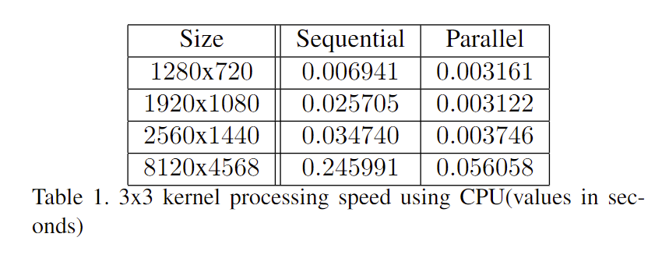
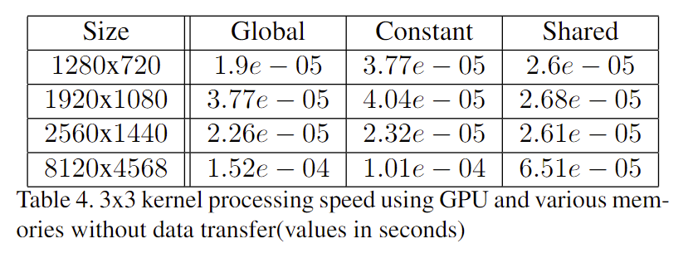
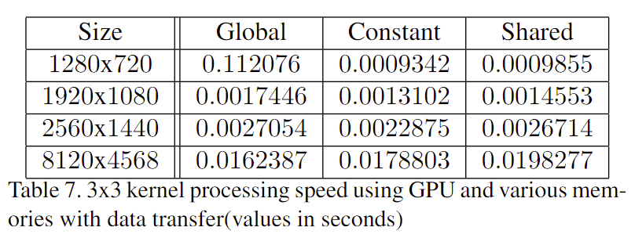
Mean Shift Clustering
Luogo e data arial regular 8 pt
Kernel image processing
Results GPUvsCPU
GPU performs better than CPU
The most of time is loss during data transfer
Without data transfer the speed up ranges between 160 and 860
With data transfer speed up ranges between 1.4 and 3.4

