Slide 1
Mean Shift Clustering
Parallel and sequantial implementation using CPU
Luogo e data arial bold 14

Slide 2
Mean Shift Clustering
Luogo e data arial regular 8 pt
Mean Shift Clustering
Introduction
The algorithm begins by loading all dataset points
The points are then iteratively shifted towards the mean of the data points within a given neighborhood that depends on the bandwidth.
The algorithm converges when the points no longer move significantly.
Each point is assigned to the closest centroid
Mean Shift clustering is sensitive to the choice of kernel bandwidth

Slide 3
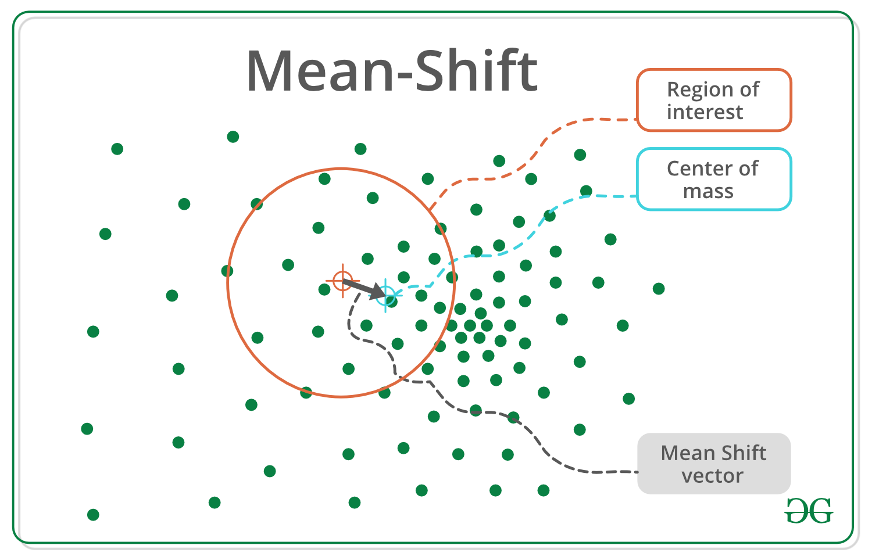
Mean Shift Clustering
Luogo e data arial regular 8 pt
Mean Shift Clustering
Pseudocode
For each point, repeat the following steps until convergence:
Create a neighborhood around the point by considering all data points within a certain distance (depends by the bandwidth).
Compute the mean of the neighborhood.
Shift the point to the mean.
Repeat step 1 until no further changes occur in the assignment of data points to clusters.
Find all centroids removing duplicates
Assign each data point to the closest seed.

Slide 4
Mean Shift Clustering
Luogo e data arial regular 8 pt
Mean Shift Clustering
Sequential version
To compute distance we use an inline function that calculates the distance without root to improve speed
To compute the mean point of a neighborhood we use 2 functions:
sum_product
division
Both exploit vectorization to improve general performance
static inline float calc_L2_norm_approx(Point &x1, Point &x2) {
float distance = 0;
int dim = x1.coords.size();
#pragma omp unroll full
for (int i = 0; i < dim; i++)
distance += (x1.coords[i] - x2.coords[i])
* (x1.coords[i] - x2.coords[i]);
return distance;
}
inline Point &sum_product(const Point &p, const float &weight) {
const int dim = coords.size();
#pragma omp unroll full
for (int i = 0; i < dim; i++)
coords[i] += p.coords[i] * weight;
return *this;
}
inline Point &division(const float &weight) {
const int dim = coords.size();
#pragma omp unroll full
for (int i = 0; i < dim; i++)
coords[i] = coords[i] / weight;
return *this;
}

Slide 5
Mean Shift Clustering
Luogo e data arial regular 8 pt
Mean Shift Clustering
Sequential version
do {
highest_norm = -1;
double start = omp_get_wtime();
for (int i = 0; i < tot; i++) {
for (int j = i; j < tot; j++) {
float dist = Point::calc_L2_norm_approx(points[i], points[j]);
if (dist <= bandwidth) {
mean_vectors[i].weight += 1;
mean_vectors[j].weight += 1;
mean_vectors[i].sum_product(points[j], 1);
mean_vectors[j].sum_product(points[i], 1);
}
}
mean_vectors[i].division(mean_vectors[i].weight);
mean_vectors[i].weight = 0;
}
for (int i = 0; i < tot; i++) {
float norm = Point::calc_L2_norm_approx(points[i], mean_vectors[i]);
highest_norm = norm > highest_norm ? norm : highest_norm;
points[i] = mean_vectors[i];
}
double end = omp_get_wtime();
iterations++;
} while (highest_norm > threshold && iterations < max_iterations);
Compute the mean vector for each point according to the bandwidth
We compute the distance between two points only one time creating a dependence in the inner loop
Compute mean vector norm for each point
Store the highest norm that we’ll be use as stop criteria

Slide 6
Mean Shift Clustering
Luogo e data arial regular 8 pt
Mean Shift Clustering
Sequential version
std::vector<Point> MeanShiftSequential::compute_centroids(std::vector<Point>&points){
std::vector<Point> centroids;
centroids.push_back(points[0]);
labels.reserve(points.size());
labels.push_back(0);
for (int i = 1; i < points.size(); i++) {
std::vector<float> best_match = find_nearest_centroid(points[i], centroids);
if (best_match[1] > bandwidth) {
labels.push_back(centroids.size());
centroids.push_back(points[i]);
} else
labels.push_back(best_match[0]);
}
return centroids;
}
Calculate all the centroids and assign a label to each point
Compare all points with the centroids found so far
Check if either the point has already had a cluster or it’s a new centroid
Store the highest norm that we’ll be use as stop criteria
std::vector<float> MeanShiftSequential::find_nearest_centroid(Point &point, std::vector<Point> &centroids) {
std::vector<float> best_match =
{0, Point::calc_L2_norm_approx(point, centroids[0])};
for (int j = 1; j < centroids.size(); j++) {
float dist = Point::calc_L2_norm_approx(point, centroids[j]);
if (dist < best_match[1]) {
best_match[0] = j;
best_match[1] = dist;
}
}
return best_match;
}

Slide 7
Mean Shift Clustering
Luogo e data arial regular 8 pt
Mean Shift Clustering
Parallel version
do {
highest_norm = -1;
#pragma omp parallel shared(points, mean_vectors) firstprivate(tot) num_threads(n_threads)
{
float scalar = 0;
float dist = 0;
#pragma omp for firstprivate(mean) schedule(dynamic)
for (int i = 0; i < tot; i++) {
for (int j = 0; j < tot; j++) {
dist = Point::calc_L2_norm_approx(points[i], points[j]);
if (dist <= bandwidth) {
mean.sum_product(points[j], 1.0f);
scalar += 1.0f;
}
}
mean.division(scalar);
mean_vectors[i] = mean;
mean.set_zeros();
scalar = 0;
}
#pragma omp for reduction(max : highest_norm)
for (int i = 0; i < tot; i++) {
float norm = (Point::calc_L2_norm_approx(points[i], mean_vectors[i]));
highest_norm = norm > highest_norm ? norm : highest_norm;
points[i] = mean_vectors[i];
}
}
iterations++;
} while (highest_norm > threshold && iterations < max_iterations);
Enable parallel code using #pragma omp parallel
Compute distance between all points in parallel way decouple for loops
Look for the highest norm using a reduction directive

Slide 8
Mean Shift Clustering
Luogo e data arial regular 8 pt
Mean Shift Clustering
Parallel version
ClusterCentroids &ClusterCentroids::operator+=(Point &obj) {
int dim = centroids.size();
bool is_new_element = true;
for (int i = 0; i < dim && is_new_element; i++) {
float dist = Point::calc_L2_norm_approx(obj, centroids[i]);
if (dist < bandwidth)
is_new_element = false;
}
if (is_new_element)
centroids.push_back(obj);
return *this;
}
}
ClusterCentroids class contains a vector where we save the centroids
ClusterCentroid will be usefull in the reduction clause
Use a similar function to find the nearest centroids but it returns only the closest label
unsigned short int MeanShiftParallel::find_nearest_centroid(Point &point, std::vector<Point> &centroids) {
unsigned short int closest_index = 0;
float min_distance = Point::calc_L2_norm_approx(point, centroids[closest_index]);
for (int j = 1; j < centroids.size(); j++) {
float dist = Point::calc_L2_norm_approx(point, centroids[j]);
if (dist <= min_distance) {
closest_index = j;
min_distance = dist;
}
}
return closest_index;
}

Slide 9
Mean Shift Clustering
Luogo e data arial regular 8 pt
Mean Shift Clustering
Parallel version
std::vector<Point> MeanShiftParallel::compute_centroids(std::vector<Point> &points) {
ClusterCentroids list_centroid = ClusterCentroids(points[0], bandwidth);
int tot = points.size();
unsigned short int closest_index = 0;
#pragma omp declare reduction(+ : ClusterCentroids : omp_out += omp_in) initializer(omp_priv = omp_orig)
#pragma omp parallel shared(points, labels, list_centroid) firstprivate(tot)
{
#pragma omp for reduction(+ : list_centroid)
for (int i = 0; i < tot; i++)
list_centroid += points[i];
#pragma omp for firstprivate(list_centroid,bandwidth, closest_index)
for (int i = 0; i < tot; i++) {
labels[i] = find_nearest_centroid(points[i], list_centroid.centroids);
}
}
return list_centroid.centroids;
}
Declare custom reduction where omp_out holds the final value of the combiner operation
Calculate centroids list using for with reduction directive
Label each point in the dataset according to the closest centroid

Slide 10
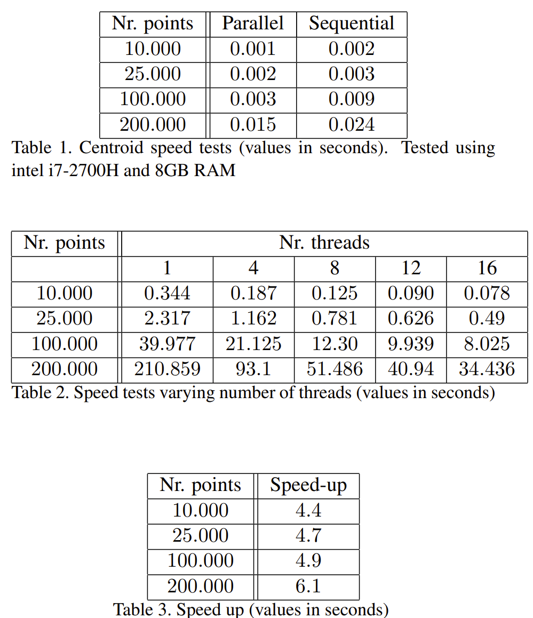
Mean Shift Clustering
Luogo e data arial regular 8 pt
Mean Shift Clustering
Results
Speed increased using more cores
Obtained good result in parallel centroid computation but insignificatively looking the global execution time
Increasing number of threads we obtain better results
Every time we add 4 threads the time gained is less to the previous one

