Slide 1
parser combinators in n different languages
let csv = separatedList(
separatedList(float, str(",")),
newline,
);
data Parser a = P (String -> Maybe (a, String))
instance Monad Parser where
-- ...
type IResult<I, O, E = Error<I>> = Result<(I, O), Err<E>>;
struct parser_t {
char *(*parse)(char *, void *, void *);
void *data;
};

Slide 2
parser combinators in n different languages
let csv = separatedList(
separatedList(float, str(",")),
newline,
);
data Parser a = P (String -> Maybe (a, String))
instance Monad Parser where
-- ...
type IResult<I, O, E = Error<I>> = Result<(I, O), Err<E>>;
struct parser_t {
char *(*parse)(char *, void *, void *);
void *data;
};
(Where n ≥ 3)

Slide 3
parser combinators in n different languages
let csv = separatedList(
separatedList(float, str(",")),
newline,
);
data Parser a = P (String -> Maybe (a, String))
instance Monad Parser where
-- ...
type IResult<I, O, E = Error<I>> = Result<(I, O), Err<E>>;
struct parser_t {
char *(*parse)(char *, void *, void *);
void *data;
};
(Where n ≥ 3)
(by villuna)

Slide 4


parser combinators in n different languages
let csv = separatedList(
separatedList(float, str(",")),
newline,
);
data Parser a = P (String -> Maybe (a, String))
instance Monad Parser where
-- ...
type IResult<I, O, E = Error<I>> = Result<(I, O), Err<E>>;
struct parser_t {
char *(*parse)(char *, void *, void *);
void *data;
};
(Where n ≥ 3)
(by villuna)
Featuring Rust!!!!!!!!

Slide 5
About me

Slide 6
About me
I go by many names

Slide 7
About me
I go by many names
Maths and Comp Sci student here at UQ (5th year, wow)

Slide 8
About me
I go by many names
Maths and Comp Sci student here at UQ (5th year, wow)
I tutored COMP3400 last semester

Slide 9
About me
I go by many names
Maths and Comp Sci student here at UQ (5th year, wow)
I tutored COMP3400 last semester
I’m currently writing this slides midnight last night :33333333

Slide 10
Background – Why am I talking about parsers??

Slide 11
Background – Why am I talking about parsers??
I started programming when I was a kid. Had to write some manual parsers.

Slide 12
Background – Why am I talking about parsers??
I started programming when I was a kid. Had to write some manual parsers.
Conclusion reached – writing parsers SUCKS 👎 👎 👎

Slide 13
Background – Why am I talking about parsers??
I started programming when I was a kid. Had to write some manual parsers.
Conclusion reached – writing parsers SUCKS 👎 👎 👎
Went to uni and took COMP3400 and COMP4403,
and learned what we are about to discuss

Slide 14
Background – Why am I talking about parsers??
I started programming when I was a kid. Had to write some manual parsers.
Conclusion reached – writing parsers SUCKS 👎 👎 👎
Went to uni and took COMP3400 and COMP4403,
and learned what we are about to discuss
Conclusion reached – parsers are pretty sick

Slide 15
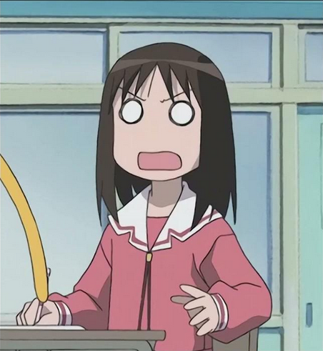
Background – Why am I talking about parsers??
I started programming when I was a kid. Had to write some manual parsers.
Conclusion reached – writing parsers SUCKS 👎 👎 👎
Went to uni and took COMP3400 and COMP4403,
and learned what we are about to discuss
Conclusion reached – parsers are pretty sick
Artist’s impression of me discovering that parsers rule

Slide 16
Background – Why am I talking about parsers??
I started programming when I was a kid. Had to write some manual parsers.
Conclusion reached – writing parsers SUCKS 👎 👎 👎
Went to uni and took COMP3400 and COMP4403,
and learned what we are about to discuss
Conclusion reached – parsers are pretty sick
Started writing a game and got to write my OWN parser using parser combinators, in Rust.
Artist’s impression of me discovering that parsers rule

Slide 17
Background – Why am I talking about parsers??
I started programming when I was a kid. Had to write some manual parsers.
Conclusion reached – writing parsers SUCKS 👎 👎 👎
Went to uni and took COMP3400 and COMP4403,
and learned what we are about to discuss
Conclusion reached – parsers are pretty sick
Started writing a game and got to write my OWN parser using parser combinators, in Rust.
Conclusion reached – parser combinators are very fun and you can use them in whatever your favourite language is (not just Haskell!!!)
Artist’s impression of me discovering that parsers rule

Slide 18
Part 1 – What are we parsing anyway?

Slide 19
First there is the format
If we want to write a parser, we first have to define the format of what we are parsing.

Slide 20
First there is the format
If we want to write a parser, we first have to define the format of what we are parsing.
We define a grammar

Slide 21
First there is the format
If we want to write a parser, we first have to define the format of what we are parsing.
We define a grammar
(covered in COMP4403 – compilers and interpreters)
The grammar then tells us how to write the parser.

Slide 22
My first grammar

Slide 23
My first grammar
symbolName ::= /* the structure of the text */

Slide 24
My first grammar
name ::= "uqcs"

Slide 25
My first grammar - Alternatives
name ::= "uqcs"
greeting ::= "hello" | "gday" | "hiii :3"

Slide 26
My first grammar - Sequences
name ::= "uqcs"
greeting ::= "hello" | "gday" | "hiii :3“
message ::= greeting ", " name

Slide 27
My first grammar
name ::= "uqcs"
greeting ::= "hello" | "gday" | "hiii :3“
message ::= greeting ", " name
In this grammar, a message could be 3 possible strings:
“hello, uqcs”
“gday, uqcs”
“hiii :3, uqcs”
And no others

Slide 28
Some more grammar rules
Anything in square brackets is optional:
optionalName ::= [ "uqcs" ] // matches "" or "uqcs"

Slide 29
Some more grammar rules
Anything in square brackets is optional:
optionalName ::= [ "uqcs" ] // matches "" or "uqcs"
Anything in curly brackets is matched 0 or more times (i.e. it can be repeated):
manyNames ::= { "uqcs" } // matches "", "uqcs", "uqcsuqcs" "uqcsuqcsuqcs", “uq

Slide 30
A grammar that matches integers
integer ::= '0' | onenine { digit }
onenine ::= '1' | ... | '9'
digit ::= '0' | '1' | ... | '9'

Slide 31
A grammar that matches integers
integer ::= '0' | onenine { digit }
onenine ::= '1' | ... | '9'
digit ::= '0' | '1' | ... | '9'
You read this as “an integer is either 0, or a digit from 1-9,
followed by any number of digits from 0-9

Slide 32
Title
Content

