Slide 1

Andreas Lang, September 2025

Slide 2
Agenda
01
Intro
02
Outcome needed
03
Orga / Draft
04
Plan 4 Plan / Draft
05
Open Topics to be aligned

Slide 3
Intro

Slide 4
Point of Departure
Foundations exist, operating large programs at scale in next years requires more than tactical change.
Foundations are laid
We face critical challenges at scale
Change requires more
Delivery environments established.
Hard policies on APIs.
Manual E2E process for product test data in place.
Manual load test as yearly rehearsal for peak exit.
Established approach for manual and automated testing in ecommerce teams.
Complex change (e.g., OCS) limit continuous delivery for parallel ongoing work.
Low degree of automated E2E testing requires high manual efforts to ensure peak season stability.
No visible KPI and Metrics for lower environments data and system stability.
Test data management coverers limited scope of product data with partial automation only.
Missing clear quality gates between environments.
Countries E2E tests requirements fulfilled insufficiently.
Environment separation on network level missing.
Accept we are not where we need to be.
Don’t reinvent the wheel for each platform / application.
Don’t try to solve everything.
Commit to a shared approach, contribute in a matrix.
Establish advocates thought the developer community to drive change federated.
Business connect & test case definitions
Test process & guideance

Slide 5
Strategic pillars
Focus Areas to address our key challenges
Engineering
Data
Processes & Governance
Continuous Testing in CI/CD
Tool-Based Solutions
Standardized QA Framework
Embedding Quality in DevOps Teams
Centralized TDM Team
Cross Platform Feature Configuration
Ongoing Improvement
Test Data Live Cycle & Integrations
Release Planning & Change Controls
Significant reduction of E2E/UAT and Hypercare efforts and time-frames.
Shift left: Quality is embedded early and throughout the development lifecycle.
Easy access to reliable, secure and compliant test data.
Reduce data provisioning and testing timeframes.
Maximize output for test automation
Streamline the process of releasing software changes
Balance speed with quality and compliance.
Enable multiple teams and multiple roll-out phases to work on a limited number of lower environments.

Slide 6
Outcome needed

Slide 7
Deliverables
To address all open topics, we need at least four different areas to investigate:
Efficient Processes & Tools
High available Test Infrastructure
Ready 2 use test approach
Ramp Up training for Countries available
QA improved CI/CD pipeline + Golden Path
Defined Quality Gates per Environment
Efficient tooling for test in place
Defined Set of Roles
Maximum availability of test systems
Automated health checks for all test systems
Templates & golden Path for implementation
APIs to expose health state per system
Central “Test System Availibiliy” system
Fast and efficient data provisioning
New WoW within Test Infrastructure Provisioning
Defined business test cases (dependency!)
Defined test data per test case
Toolset (make/buy) to distribute test data
secure & reliable
fast & automated
Team to support and maintain testdata
A test environment that is able to switch seamless between different countries
Test & Rollout Schedule per country (dependency!)
Test Environment Plan per country
Toggle Management Approach
POC of preferred solution with 2-3 teams
Implementation and Rollout of Toggle Management

Slide 8


Working Cluster and more detailed outcomes
NextGen QA
Dependency to Business / Overall Project
Design Authority
Decisions on
Test Standard
Test Processes
Test Tools
QA Engineering
Test Architecture & Desing
Test Environment Design
Test Environment Setup/Gap
Test environment Schedule
…
Project Management
Project-&Milestone Plan
Backlog Creation
Tracking
Risk Management
Reporting
Governance, Tools & Processes
Test Data Automation
Environment Health & Availability
Environment Toggling
Overall Test Approach & Process
Deployment & Fixing Process
Quality Gates
Definition of Test Stages
Pre-Conditions for Deployment
CI/CD QA Requirements
Golden Path for CI/CD
Overall Tooling Approach for Testing & Test Cases
Overall Process Testing & QA
Change Mngmt & Training
Team Support & Enablement
Definition of core-processes
Definition of test data needed
Gap Analysis AsIs & ToBe
Approach how to close the gap
Checkpoint: Buy or Build
Agentic AI as approach (see Backup)
Synthetic Data
Masking
Provisioning
…
Change Management
Rollout and Training
Definition of Teams to contribute
Definition of health checks
Prepare a template to reuse
Implement health checks and APIs in respective teams
Implement a central tooling
Rollout and Training
Maintenance
Documentation of Test & Rollout Schedule
Creation of an environment schedule by country
Analyzing toggle management as a solution to switch environments
Document teams impacted
Check for Make or Buy Solutions
Implement Solution to realize / support test schedule
Train & Rollout (Developer Toggling)

Slide 9
Organizational Setup

Slide 10


Organizational Setup
NextGen QA
Andreas Lang / Sebastian Neumeyer
Project Lead
NN Test Architect
Environment Design & Architecture
Claudia Dreiocker
PMO
Governance, Tools & Processes
Test Data Automation
Environment Health & Availability
Environment Toggling & Prep
Simon Trockel Lead
Levente Miklos Lead
Jochen Bürkle Lead
Alexander Herzig Lead
NN External PMO & Change Mnmt.
Test Data Product Team @Accesa + Artur Hayrapetyan
NN External Engineer & Architecture
NN External
Toggle Specialist
NN External(s) Tool & Process Specialist QA
NN Test Data Engineer
To be scaled on demand
NN Engineer (1-n)
1 Engineer per Team @20%
NN Engineer (1-n)
1 Engineer per Team @20%
NN Engineer (1-n)
1 Engineer per Team @20%
Besides the one-time efforts to be spent, there must be a team/platform in place for the future, that to cover ongoing efforts

Slide 11
Plan 4 Plan

Slide 12
Plan 4 Plan
To be build once content / deliverables are aligned

Slide 13
Topics to be aligned

Slide 14
Backup

Slide 15
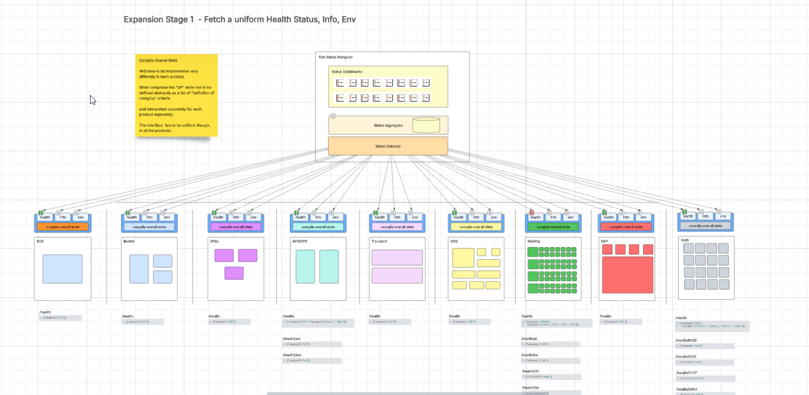
Link: Test status health: Lucidchart

Slide 16
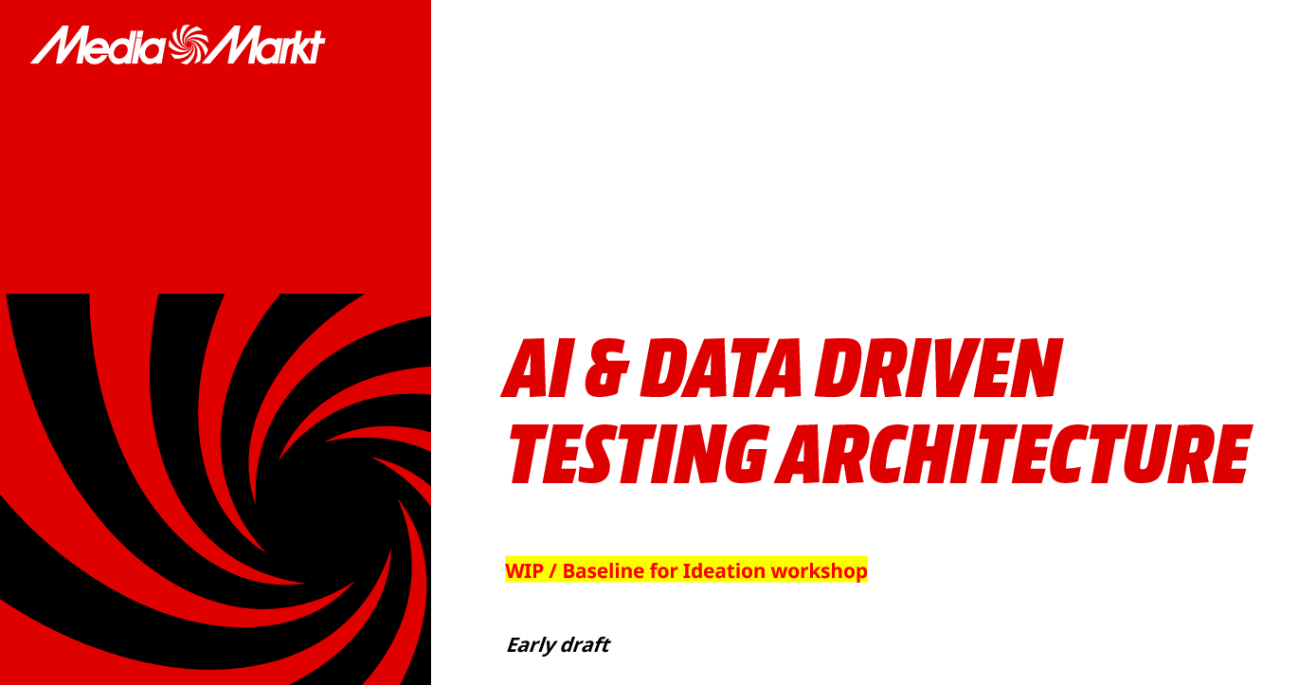
Link: Test status health: Lucidchart
Link: Leverage AI and Data for QA & Engineering.pptx

