Slide 1
GridSearchCV

Slide 2
Hyper-Parameters in Machine Learning
Before we dive into tuning your hyper-parameters, let’s take a moment to recap what the differences between parameters and hyper-parameters are in a machine learning model.
Parameters in a machine learning model refer to the variables that an algorithm itself produces (such as a coefficient) to produce a prediction. These parameters are not set or hard-coded and depend on the training data that is passed into your model. Because of this, they’re likely to change when your data changes.
On the other hand, hyper-parameters are variables that you specify while building a machine-learning model. This means that it’s the user that defines the hyper-parameters while building the model. For example, in a k-nearest neighbour algorithm, the hyper-parameters can refer the value for k or the type of distance measurement used.
In short, hyper-parameters control the learning process, while parameters are learned.
This is where the “art” of machine-learning comes into play. The choice of your hyper-parameters will have significant impact on the success of your model. Being able to tune your model is finding what the best hyper-parameters are.

Slide 3
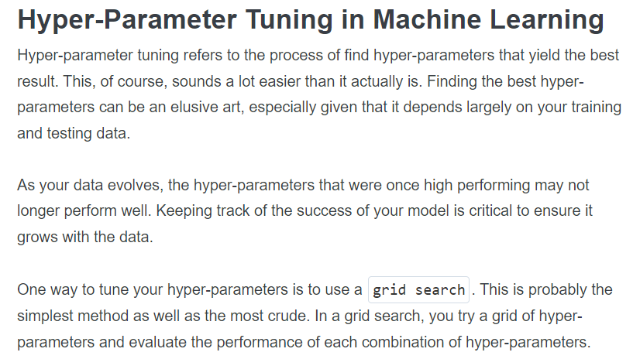

Slide 4
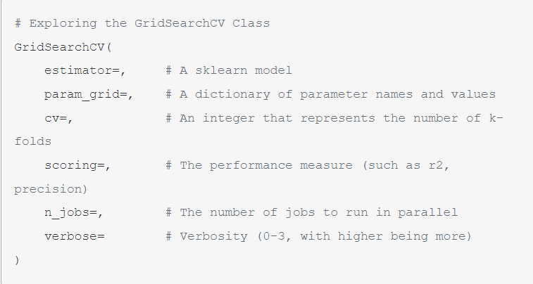

Slide 5
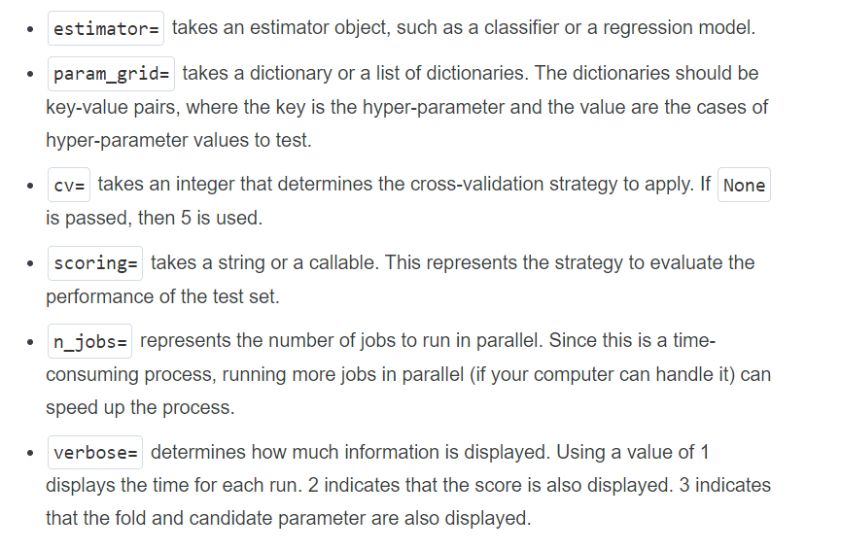

Slide 6
Thank You

