Slide 1
Random Forest Algorithm

Slide 2
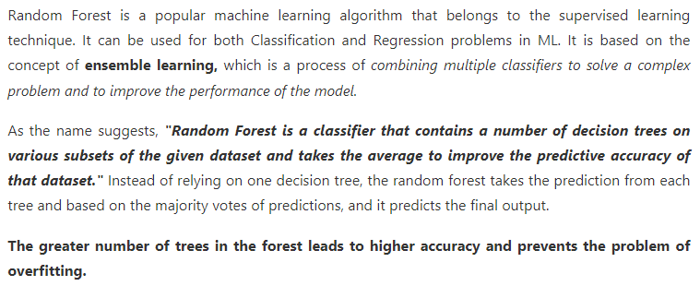

Slide 3
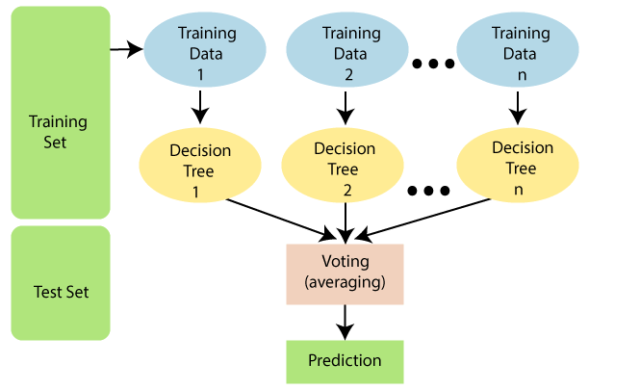

Slide 4
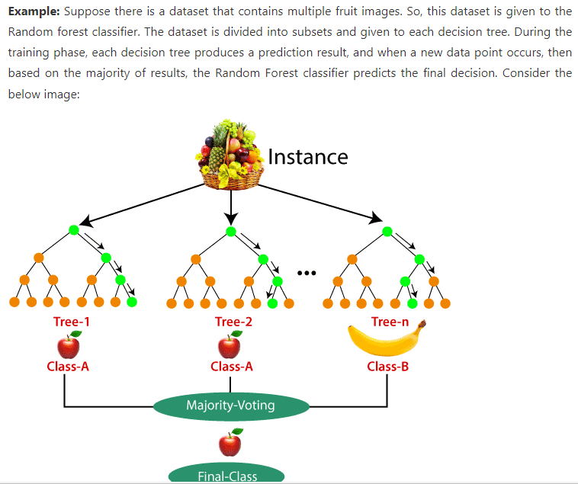

Slide 5
Thank You

