Slide 1




LLM4S: BUILD RELIABLE AI SYSTEMS IN SCALA
OAISYS AI PRACTITIONERS CONFERENCE 2025
Presented by Kannupriya Kalra & Shubham Vishwakarma

Slide 2
Why this matters
The problem:
  Most LLM frameworks force you to choose
  Fast iteration OR type safety
  Production readiness OR developer velocity
What if you didn’t have to choose?
  LLM4S brings type-safe, functional AI development to the JVM. Reliability is built into the type system.

Slide 3
AI hype vs Reality
The data doesn’t lie:
  MIT report: 95% of generative AI pilots at companies are failing
  88% of AI pilots fail to reach production
  Steep drop: 80% investigated → 50% piloted → 5% successfully implemented
Why pilots fail:
  Hallucination and lack of grounding Scaling and latency issues
  Management gaps: observability, measurability, feedback cycles
  The shift: From "cool prototypes" → to "critical systems"

Slide 4
What is LLM4S?
Mission: Type safety, functional programming, and JVM reliability for AI development
A framework for building LLM applications in Scala. Works directly with your existing systems.
A reliable AI system = LLM + Context + Data + Tools + Observability + Governance + Feedback Cycles
  Context grounds responses
  Data ensures truth
  Tools enable action
  Observability tracks behavior
  Governance builds trust
  Feedback cycles allow optimization

Slide 5
5 Pillars of Reliability
LLM4S design philosophy:
1. Composable modules - RAG, agents, tracing, tools
2. Type safety - Catch prompt and context errors at compile time
3. Tracing and observability - Understand, debug, and optimize
4. Multi-provider support - OpenAI, Anthropic, Gemini, Ollama, Azure
5. Scalability - Plug-and-play architectures with consistent APIs
Reliability isn’t post-facto testing —> it’s design.
Building AI like software: structured, measurable, and predictable.

Slide 6
Core Capabilities
Multi-provider support
  OpenAI, Anthropic, Azure, Ollama, OpenRouter - One interface, zero lock-in
Type safety first
  Compile-time error checking - No runtime surprises
Functional error handling
  Either-based composition - No exceptions thrown
Agent framework
  Single and multi-agent workflows - Tool calling with auto-generation
Multimodal support
  Text, images, voice - RAG with built-in retrieval

Slide 7
Why join this Open-source project?
  First AI framework in Scala ecosystem
→ Be part of something historic
→ Shape the future direction
  Learn from the best
→ Staff engineers, architects, engineering leaders mentor you
  Weekly live coding sessions
→ Real learning, not just tutorials
  Google Summer of Code funding
→ Get paid to contribute
  Global community

Slide 8
The Team
Core maintainers:
Rory Graves - Lead maintainer and chief architect
  Staff engineer, Scala compiler contributor
Kannupriya Kalra - Lead maintainer and community lead
  Engineering leader, Scala Center mentor
Atul S. Khot - Core contributor and design architect
  Smart constructors, functional error handling, type class design
Vitthal Mirji - Core contributor and Low-level design
  Error handling hierarchy, Type class designs, FP patterns
Dmitry Mamonov - Core contributor and integration specialist

Slide 9
Every Sunday: Live Coding
When: Sunday 9am London time
Where: LLM4S Discord - llm4s-dev-hour channel
Calendar: Weekly Luma invite
What happens:
  Community votes on features
  Mob programming live
  Pair programming with staff engineers
  Design architecture collaboratively
  Ship features to production

Slide 10
First in the Scala Ecosystem
Career impact:
  Portfolio standout: "Contributed to the first Scala AI framework"
  Early adopter advantage: Shape the ecosystem before mainstream
  Unique expertise: Be the Scala plus AI expert
  Conference talks: Present your contributions at major events
  Hiring magnet: Companies need this skillset now
Technical impact:
  Influence design decisions: Your ideas shape the future
  Learn cutting-edge patterns: Before they’re documented
  Build reputation: Known in Scala and AI communities
  OSS credibility: Recognized by Scala Center, Lightbend, Typelevel

Slide 11
Progress & Momentum
2025 achievements:
  Selected for Google Summer of Code 2025
  4 GSoC contributors funded by Google
  Cross-compilation support (Scala 2.13 and 3.x)
  Multi-provider abstraction complete
  Agent framework with tool calling
  Langfuse tracing integration
  Docker-based secure execution
Conference presentations:
  Bay Area Scala, Scala India, Functional World, Dallas Scala Enthusiasts
  Scala Days, GSoC Lightning Talks, ICFP/SPLASH
v1.0 production scheduled release - December 2025

Slide 12
Production Ready
What production ready means:
Type safety:
Compile-time error checking, Exhaustive pattern matching, Smart constructors
Error handling:
Either-based composition, Recoverable vs non-recoverable errors, Retry strategies
Observability:
Langfuse tracing integration, Token usage tracking, Performance metrics
Scalability:
Async operations with Futures, Context management, Connection pooling
Security:
Docker Container Isolation, API key Management, Secure Workspace Execution

Slide 13
Global Community
Contributors across the globe: USA, United Kingdom, Poland, India, Turkey, Germany, Switzerland, Singapore
GSoC 2025 contributors:
Elvan Konukseven (Switzerland) - Agentic toolkit
Gopi Trinadh Maddikunta (India) - RAG in a box
Anshuman Awasthi (India) - Multimodal support
Shubham Vishwakarma (India) - Tracing system
Join the community:
Discord: https://discord.gg/4uvTPn6qww
GitHub: https://github.com/llm4s/llm4s

Slide 14
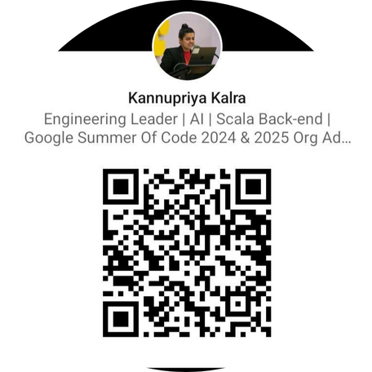
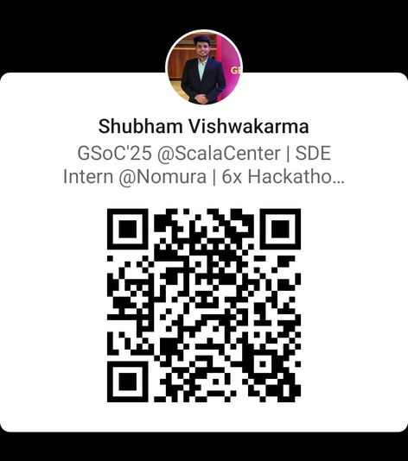
THANK YOU & GET STARTED!
Join us today:
Discord: https://discord.gg/4uvTPn6qww GitHub: https://github.com/llm4s/llm4s
Weekly dev hour links: https://luma.com/calendar/cal-Zd9BLb5jbZewxLA
See you in dev hours every Sunday 2 30pm IST.
Let’s build the future of AI together.
Connect with us :)

