Slide 1
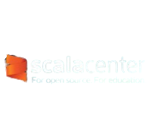
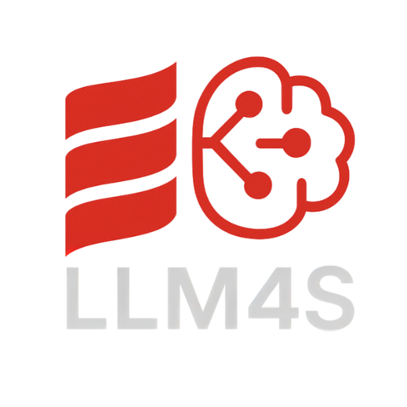

Enhancing LLM4S with Multimodal Capabilities
Anshuman Awasthi [GSoC 2025 Contributor]

Slide 2

About Me
Namaste, This is Anshuman Awasthi
From: Indian Institute of
Information Technology Lucknow, India
LinkedIn:
GitHub:

Slide 3



Introduction
ĮĮM4S = Įarge Įanguage Models for Scala
Enables Scala developers to interact with AI models directly from their applications
Open-source, maintained by the Scala Center & community
Scala Center – Non-profit organization dedicated to the education and advocacy, of the Scala programming language

Slide 4

Project Overview
Project Name: Support image, voice and other ĮĮM Modalities
Goal: Extend ĮĮM4S beyond text to support speech recognition, text-to-speech, and image generation
Purpose: Enable Scala developers to build rich, interactive AI- powered applications

Slide 5

Key Deliverables: Automatic Speech Recognition (ASR) integration , ľext-to-Speech (ľľS) Module Integration,
Image Generation Support, Image Processing Support
Impact: Expands the scope of ĮĮM4S, making it more versatile and developer-friendly
Tech Stack: Scala, Huggingface/OpenAI APIs, Whisper, ľľS Engines, Image generation models(Stable Diffusion)

Slide 6
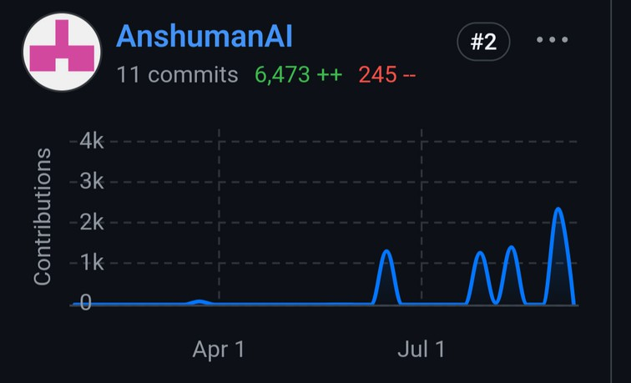



Contributions
13 PRs, 8 Effective Merges, LoC-
Issues Solved (Non PR): 4
Delivered Image Generation Capabilities Delivered Image Processing Capabilities
Delivered Text to Speech and Speech to Text Capabilities

Slide 7


Impact & Future Work
Library can now be used to create Rich Apps, good example being Szork.
Szrok is DND style Gen AI game .
Future work : Work on Additional Issues and functionalities.

Slide 8
Reflection and Acknowledgment
Thanks to the community, Mentors (Rory Graves and Kannupriya Kalra) and Scala Center.

