Slide 1


GSOC 2025
Lightning Talk
presented by Elvan Konukseven

Slide 2
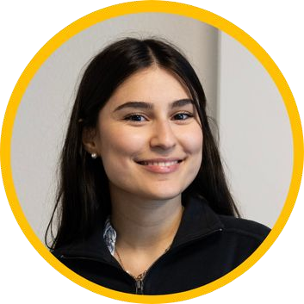

About me
First year Computer Science MSc student at ETH Zurich.
Got introduced to Scala through Martin Odersky’s course at EPFL.
Elvan Konukseven
Switzerland
- Currently contributing to the agentic toolkit of LLM4S

Slide 3
My work so far
11 merged PR’s & 3 fundamental features implemented :
Implemented an MCP connector → for LLM-tool interactions
Built an Assistant Agent → built in assistant for LLM4S users
Worked on Context Management → to extend agent’s capability

Slide 4
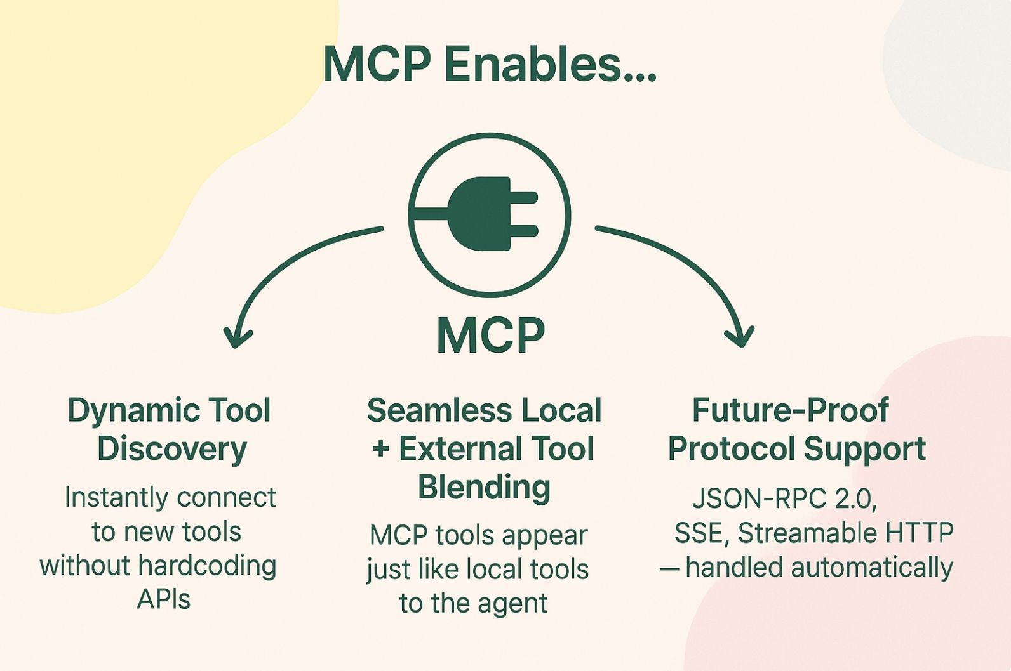
Model Context Protocol
Plug into any tool, effortlessly
MCP extends LLM4S agent's possible toolset and allows developers to seamlessly connect to any MCP server.

Slide 5
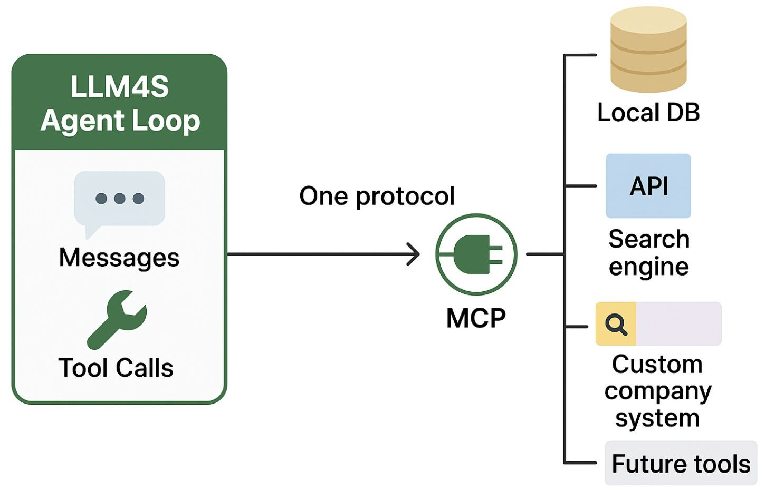
One Protocol. Every Tool. Powered by LLM4S.
One Protocol, Any Tool – MCP unifies every tool source — from local DBs to cloud APIs to future systems — into a single interface your agent already understands.
Agent Loop Ready – The LLM4S agent loop handles messages and tool calls natively; MCP just drops new capabilities straight into that flow, no code changes.
Scalable by Design – Add, swap, or upgrade tools without touching the core → growth without friction.

Slide 6
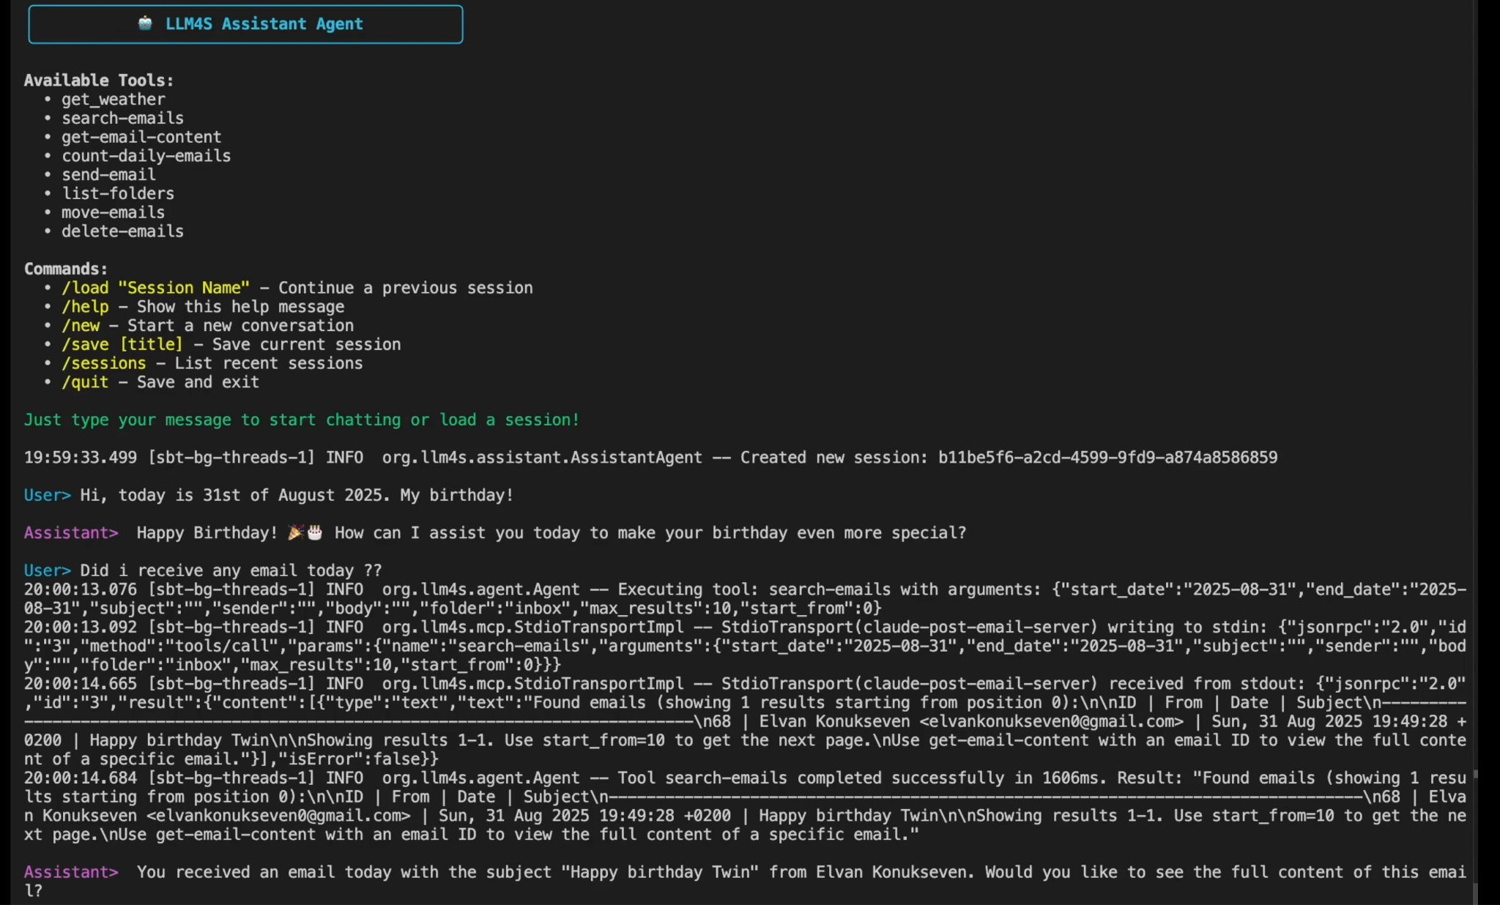
The Assistant Agent
Interactive Loop
Session Management
User Experience

Slide 7
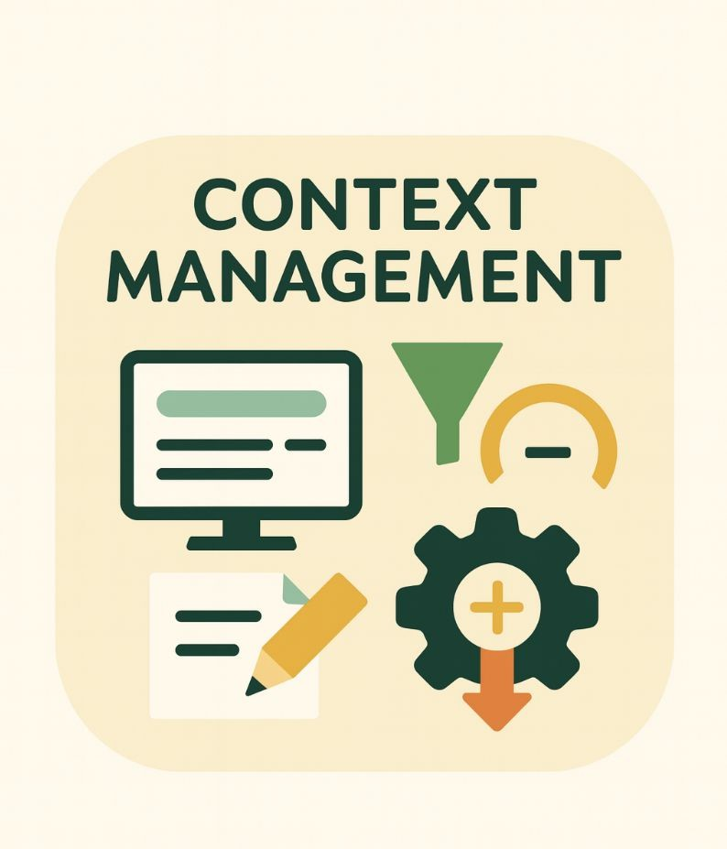
Context Management
Token-aware window:
Keep only as much chat history as fits a token cap.
Rolling structured summary:
A tiny state that captures key facts. This lets you safely drop old turns without losing context.
Deterministic compression first:
Before adding tool outputs to the prompt, run a filter that keeps only signal (code, tables, IDs, errors) and strips noise (boilerplate, ads, duplicates).
Backup LLM compressor
Use a second LLM to compress the largest offenders with strict, factual instructions.

Slide 8
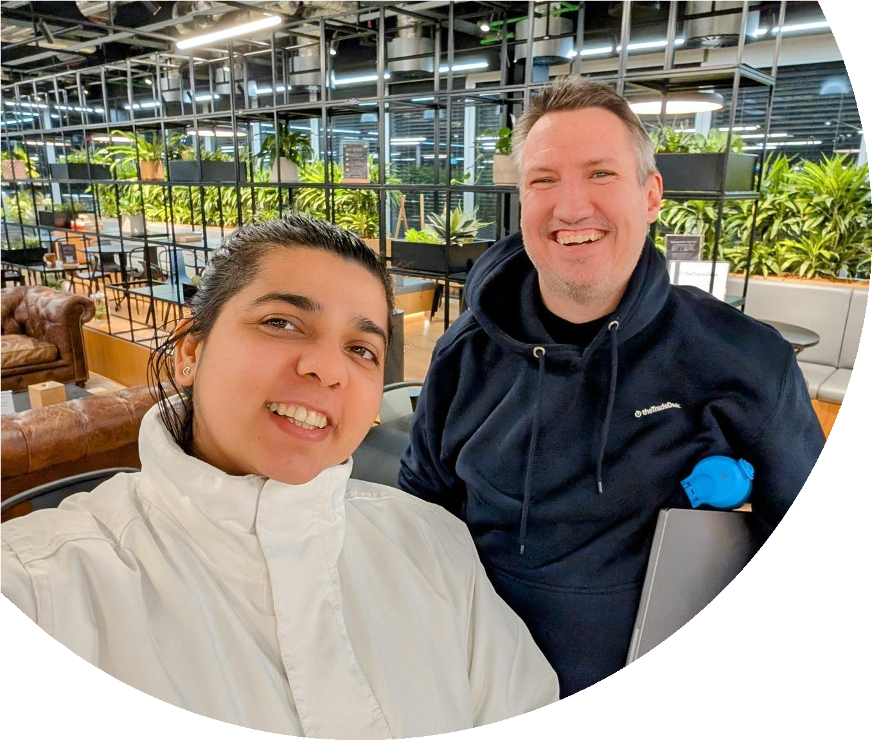
My mentors:
Rory Graves
A Scala advocate and software engineer with 30+ years of experience across diverse systems. He has contributed to Scala compiler optimizations and supports AI/ML research while mentoring developers. Beyond tech, he is a martial artist, windmill tour guide, and public speaking mentor.
LinkedIn: https://www.linkedin.com/in/roryjgraves/
rory.graves@fieldmark.co.uk
Kannupriya Kalra
Backend engineer and community leader specializing in type-safe, functional AI development. With 10+ years’ experience, she’s led engineering at Sky, mentored Google Summer of Code contributors, and spoken at conferences worldwide, shaping how typed languages integrate with modern AI.
LinkedIn: https://www.linkedin.com/in/kannupriyakalra/
kannupriyakalra@gmail.com

