Slide 1
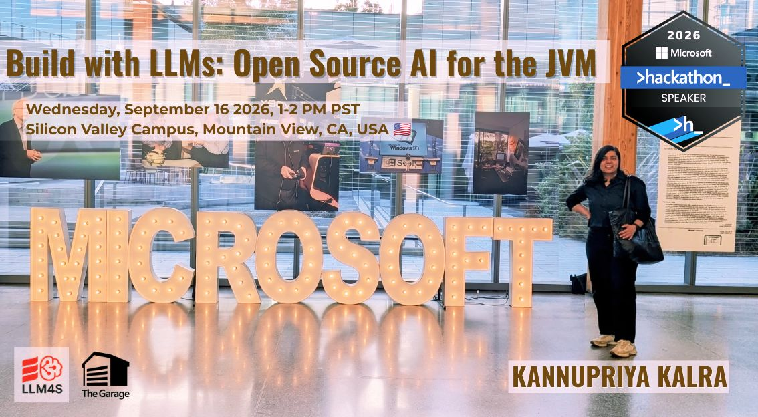

Slide 2
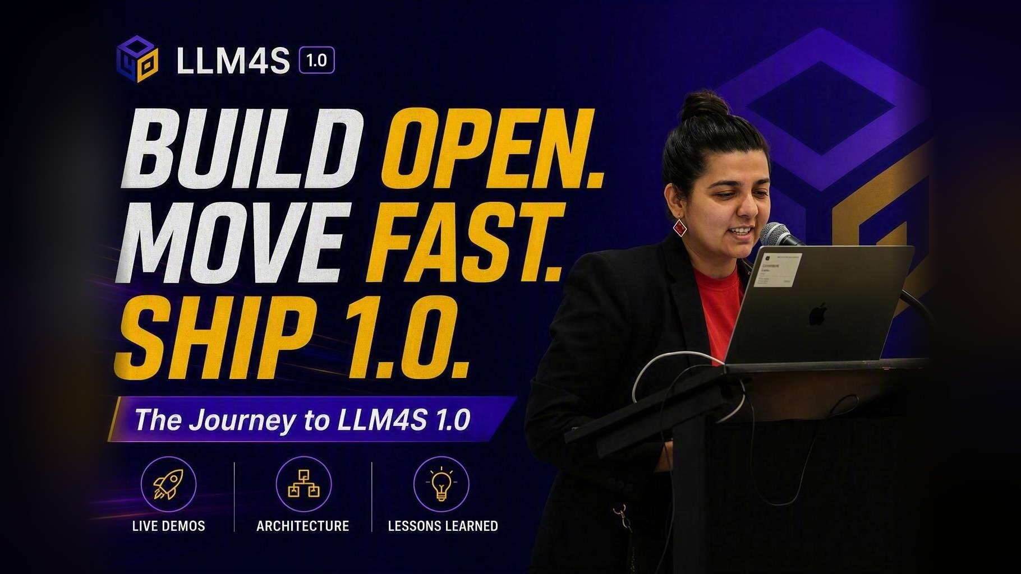

Slide 3
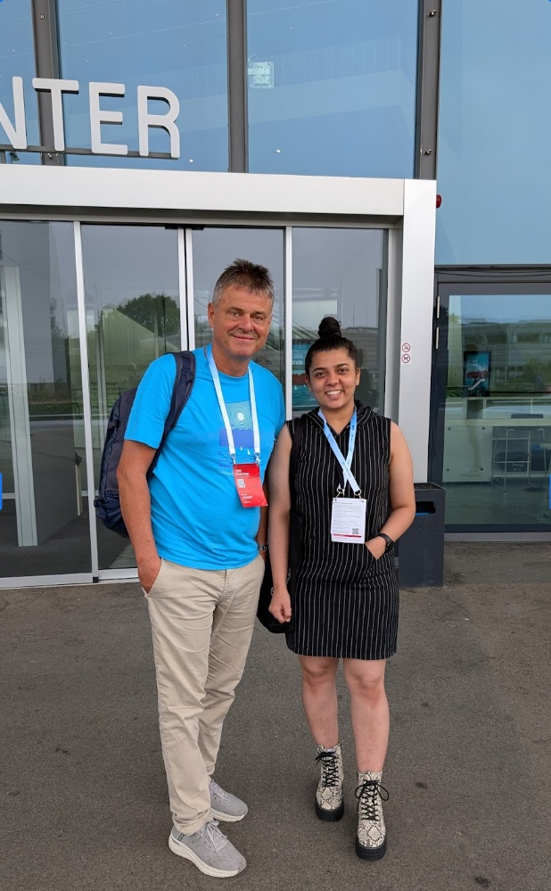
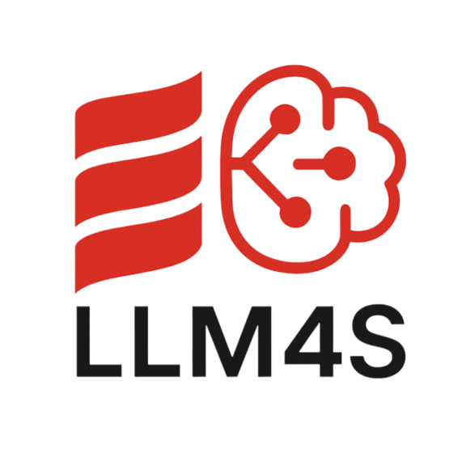
ABOUT THE SPEAKER
Kannupriya Kalra
Co-Founder, LLM4S Foundation · AI thought leader, London
Creator of LLM4S: an AI-native platform for Scala and the JVM
Open source: contributes to the AI and Scala ecosystem through the Scala Center and Google Open Source
Google Summer of Code: led the Scala Center programmes in 2024 and 2025
Author: four AI courses with Manning Publications, New York, with more practical AI learning resources in progress
Global speaker: AI, Scala and open source in more than ten countries
Engineering: built scalable backend systems in functional Scala at Sky, London
Mission: empowering developers through hands-on GenAI projects, open-source contributions and responsible AI education
With Martin Odersky, creator of the Scala language, at Scala Days 2025 in Lausanne, Switzerland, discussing LLM4S
3
Microsoft Global Hackathon 2026 · Silicon Valley Campus, Mountain View · September 16, 2026

Slide 4
THE PLAN
Today's journey
01
02
03
04
05
The real AI problem
Why Scala and the JVM
LLM4S in code
What we built and learned
LLM4S at Microsoft
Why demos work and systems don't
Types, errors as values, and the runtime you already run
Architecture and real code for every major capability
Szork, production patterns, wins and failures, the road to 1.0
Scala, the JVM, open source, and what to build this week
4
Microsoft Global Hackathon 2026 · Silicon Valley Campus, Mountain View · September 16, 2026

Slide 5



THE REAL AI PROBLEM
Demos amaze. Systems collapse under real load.
Why pilots stall
95%
of enterprise GenAI pilots show no measurable business return
Ungrounded answers
Models hallucinate when nothing ties them to real data.
MIT NANDA, The GenAI Divide, Jul 2025 (preliminary; 153 leaders, 52 interviews)
Latency and cost at scale
What feels instant in a demo gets slow and expensive under real traffic.
88%
of AI proofs of concept never reach wide deployment
No way to see or measure
No traces, no metrics, no feedback loop, so no way to improve.
Only 4 of every 33 made it to production.
IDC with Lenovo, AI CIO Playbook 2025 (Mar 2025)
The shift: from cool prototype to critical system.
5
Microsoft Global Hackathon 2026 · Silicon Valley Campus, Mountain View · September 16, 2026

Slide 6






FROM MODELS TO SYSTEMS
An LLM is not a product
LLM
Context
Data
Tools
+
grounds each response
keeps answers true
lets the model act
a powerful component
Observability
Governance
Feedback
shows what it did and why
keeps it safe and compliant
lets you keep improving
LLM4S gives every one of these layers a typed, testable home.
6
Microsoft Global Hackathon 2026 · Silicon Valley Campus, Mountain View · September 16, 2026

Slide 7
THE JOURNEY
From idea to 1.0, in public
Feb 2025
May 2025
Dec 2025
Aug 2026
Introduced at Bay Area Scala
Google Summer of Code
v0.2.0: full RAG pipeline
v0.4.x: Scala 3, modules
San Francisco, right here in the Bay Area
4 contributors: agents, RAG, multimodal, tracing
Evaluation, guardrails, cost tracking
Splitting an 84k-line core into focused modules
Apr 2025
Jul 2025
Feb 2026
Next
v0.1.0 on Maven Central
Weekly Dev Hour begins
v0.3.0: Result, not exceptions
1.0: a frozen API spine
OpenAI, Anthropic, Result types, tool calling
Live mob programming every Sunday
Last exception-throwing APIs removed
Compatibility you can build a business on
7
Microsoft Global Hackathon 2026 · Silicon Valley Campus, Mountain View · September 16, 2026

Slide 8

THE PEOPLE
Built by a global community
Directors and maintainers
Google Summer of Code 2025 contributors
Kannupriya Kalra
Elvan Konukseven
KK
Switzerland · Agentic toolkit
Co-founder, LLM4S Foundation. Creator of LLM4S, maintainer and community lead.
Gopi Trinadh Maddikunta
India · RAG in a box
RG
Rory Graves
Anshuman Awasthi
Director and maintainer, chief architect. Staff engineer and Scala compiler contributor.
India · Image, voice and multimodal
Shubham Vishwakarma
India · Tracing and observability
Steering committee
Atul S. Khot
Vitthal Mirji
Iyad M. Issa
400+
200+
69
1,100+
members
contributors
code contributors
commits
Giovanni Ruggiero
Dmitry Mamonov
Including principal and staff engineers from France, Poland and beyond
Sources: llm4s/llm4s people.md and contributor graph (2026); GSoC 2025, Scala Center
8
Microsoft Global Hackathon 2026 · Silicon Valley Campus, Mountain View · September 16, 2026

Slide 9
MOMENTUM
Real traction, in the last 14 days
GitHub traffic for llm4s/llm4s, the 14 days to 16 Sep 2026
537
git clones
113
unique cloners
505
page views
206
unique visitors
Source: GitHub repo Insights > Traffic, llm4s/llm4s, captured 16 Sep 2026
9
Microsoft Global Hackathon 2026 · Silicon Valley Campus, Mountain View · September 16, 2026

Slide 10



WHY SCALA AND THE JVM
Why Scala for LLM applications?
Most LLM work happens in Python.
Types turn runtime surprises into compile errors
Message roles, config, tool schemas and provider cases are checked before you ship.
We believe production AI deserves a stronger foundation: one where mistakes surface at compile time, not at 2am.
Errors are values
Result[T] makes every failure path explicit and composable.
Immutable conversations
State you can persist, resume, test and reason about.
The JVM you already run
Mature libraries, real concurrency, deployed next to your services.
10
Microsoft Global Hackathon 2026 · Silicon Valley Campus, Mountain View · September 16, 2026

Slide 11


TYPES IN PRACTICE
The typo that compiled and shipped
Before: roles were strings
After: roles are an enum
// role is just a String
val msg = Message(
role = "asistant", // typo
content = reply
)
// compiles, passes review,
// misbehaves in production
// a closed set of cases
enum MessageRole:
case System, User, Assistant, Tool
MessageRole.Asistant
// error: value Asistant is not
// a member of MessageRole
43
files migrated from strings to types
6
type classes introduced
1
compile error instead of a production bug
Simplified from the real LLM4S change (PR #216)
11
Microsoft Global Hackathon 2026 · Silicon Valley Campus, Mountain View · September 16, 2026

Slide 12
TYPES IN PRACTICE
Errors are values, not surprises
47
val result = for {
config <- Llm4sConfig.provider()
client <- LLMConnect.getClient(config)
response <- client.complete(
messages = List(UserMessage("Explain MCP")),
model = None
)
} yield response
result match {
case Right(c) => println(c.content)
case Left(err) => println(s"Error: $err")
}
try-catch blocks deleted in one safety refactor
v0.3.0
removed the last APIs that threw exceptions, in favor of Result
1
typed error hierarchy, replacing "Unknown error" for everything
12
Microsoft Global Hackathon 2026 · Silicon Valley Campus, Mountain View · September 16, 2026

Slide 13


ARCHITECTURE
How LLM4S fits together
LLM4S API
Result[T] · typed config · streaming · reliability
Agents
tools · MCP · handoffs · guardrails · memory
Observability
Your JVM app
Langfuse, OpenTelemetry, tokens, latency, cost
RAG
pgvector · Qdrant · SQLite · BM25 hybrid · reranking · eval
Scala 3 today. Java, Kotlin and Spring are on the 1.0 road.
Media
speech-to-text · text-to-speech · images
Workspace sandbox
Providers
OpenAI · Azure OpenAI · Anthropic · Gemini · Ollama · +6
Docker-isolated tool execution
13
Microsoft Global Hackathon 2026 · Silicon Valley Campus, Mountain View · September 16, 2026

Slide 14
THE CORE API
One call, any provider
Every LLM4S call returns a Result. You compose steps, and the compiler makes you handle failure.
Switch model with config, not code
val result = for {
config <- Llm4sConfig.provider() // reads env
client <- LLMConnect.getClient(config)
response <- client.complete(
messages = List(
SystemMessage("You are a helpful assistant."),
UserMessage("What is Scala?")
),
model = None // uses config
)
} yield response
result match {
case Right(c) => println(c.content)
case Left(err) => println(s"Error: $err")
}
export LLM_MODEL=openai/gpt-4o
# or
export LLM_MODEL=azure/gpt-4o
# or, fully local
export LLM_MODEL=ollama/mistral
Eleven providers, one interface
OpenAI
Azure OpenAI
Anthropic
Gemini
Ollama
DeepSeek
Mistral
Cohere
OpenRouter
Requesty
Z.ai
Code and provider list: llm4s.org docs and README, llm4s/llm4s v0.4.1 (2026)
14
Microsoft Global Hackathon 2026 · Silicon Valley Campus, Mountain View · September 16, 2026

Slide 15



TOOL CALLING
Letting the model act, safely
Agent
// a plain Scala function
def getWeather(location: String): String =
s"The weather in $location is sunny, 72F"
val weatherTool = ToolFunction(
name = "get_weather",
description = "Current weather for a location",
function = getWeather _
)
val tools = new ToolRegistry(Seq(weatherTool))
agent.run("What's the weather in Paris?", tools)
Tool registry
Local tools
MCP servers
Your Scala methods, built-in tools, sandboxed shell
GitHub, databases, internal services, anything that speaks MCP
Built-in tools: date and time, HTTP, web search, files
Tools can run in a Docker-isolated workspace
15
Microsoft Global Hackathon 2026 · Silicon Valley Campus, Mountain View · September 16, 2026

Slide 16




MODEL CONTEXT PROTOCOL
Plug in any MCP server
One protocol for tools
val server = MCPServerConfig.streamableHTTP(
name = "mcp-tools-server",
url = "http://localhost:8080/mcp",
timeout = 30.seconds
)
// local tools and remote MCP tools, one registry
Using.resource(new MCPToolRegistry(
Seq(server), Seq(weatherTool), 10.minutes
)) { tools =>
agent.run(
query = "Convert 100 USD to EUR, then check Paris",
tools = tools,
maxSteps = Some(5)
)
}
Connect a server once, and the agent discovers its tools.
Mix local and remote
Local tools take precedence when names collide.
Transport fallback
Streamable HTTP, SSE or stdio, handled for you.
An open standard
Backed across the industry, including Microsoft and GitHub.
16
Microsoft Global Hackathon 2026 · Silicon Valley Campus, Mountain View · September 16, 2026

Slide 17


AGENT ORCHESTRATION
Agents that hand off, check and remember
handoff to a specialist
User
Input guardrail
Triage agent
Billing agent
Output guardrail
Answer
Support agent
Memory
short-term · long-term · entities
Handoffs
Guardrails
Persistent state
LLM-driven delegation to specialist agents, with context carried across.
Length, profanity, JSON and tone checks, plus LLM-as-judge.
Memory in-process, SQLite, Postgres or a vector store. Save and resume sessions.
17
Microsoft Global Hackathon 2026 · Silicon Valley Campus, Mountain View · September 16, 2026

Slide 18
AGENTS IN CODE
Handoffs and guardrails, in a few lines
Hand off to a specialist
Guard what goes in and out
val mathAgent = new Agent(
client = client,
systemMessage = Some(SystemMessage(
"You are a math expert."))
)
mainAgent.run(
query = "What is the integral of x^2?",
tools = ToolRegistry.empty,
handoffs = Seq(
Handoff.to(mathAgent, "Math question"))
)
agent.run(
query = userInput,
tools = tools,
inputGuardrails = Seq(
new LengthCheck(min = 1, max = 10000),
new ProfanityFilter(),
new PromptInjectionDetector()),
outputGuardrails = Seq(
new JSONValidator(),
new PIIMasker())
)
// failures return Left(GuardrailError(...))
18
Microsoft Global Hackathon 2026 · Silicon Valley Campus, Mountain View · September 16, 2026

Slide 19








RAG
Grounded by design: retrieve, then generate
Ingest
Chunk + embed
Hybrid search
Rerank
Answer
PDFs, web pages, databases
Sentence-aware chunking
Vectors plus BM25 keywords
Cross-encoder reranking
Grounded in retrieved context
Pick your store
Respect permissions
Measure quality
pgvector, Qdrant or SQLite, with keyword search in PostgreSQL or SQLite FTS5.
Permission-based RAG, so people only retrieve what they're allowed to see.
RAGAS-style evaluation and a benchmarking harness, plus cost tracking.
RAG in a Box: a turnkey RAG service built on LLM4S. REST API, pgvector, hybrid search, Docker Compose. github.com/llm4s/rag_in_a_box
19
Microsoft Global Hackathon 2026 · Silicon Valley Campus, Mountain View · September 16, 2026

Slide 20
OBSERVABILITY + STREAMING
See every step, as it happens
Stream agent events
Tracing, one setting
agent.runWithEvents(query, tools) {
case TextDelta(text, _) =>
print(text) // real-time tokens
case ToolCallStarted(_, name, _, _) =>
println(s"Calling $name...")
case ToolCallCompleted(_, name, _, _, ms, _) =>
println(s"$name completed in ${ms}ms")
case AgentCompleted(_, steps, totalMs, _) =>
println(s"Done in $steps steps (${totalMs}ms)")
case _ => ()
}
# Langfuse in production
TRACING_MODE=langfuse
LANGFUSE_PUBLIC_KEY=pk-lf-...
LANGFUSE_SECRET_KEY=sk-lf-...
Console tracing for local development
OpenTelemetry export module
Token usage, latency and cost per call
Raw provider exchange logs for debugging
20
Microsoft Global Hackathon 2026 · Silicon Valley Campus, Mountain View · September 16, 2026

Slide 21




SPEECH + MULTIMODAL
Beyond text: voice and images
Speech-to-text
Text-to-speech
Images
Turn voice into input for the same agents and tools.
Give your app a voice without leaving the JVM.
Generate and analyze images through one API.
Honest labels: speech and image APIs are marked Experimental for 1.0. They work today, and they may still change. We'd rather tell you now than surprise you later.
21
Microsoft Global Hackathon 2026 · Silicon Valley Campus, Mountain View · September 16, 2026

Slide 22



BUILT WITH LLM4S
What's already been built
RAG in a Box
Workspace agents
69 examples
Starter kit
A turnkey RAG service: document ingestion, hybrid search and grounded answers over a REST API.
Agents that run commands and work with code inside a Docker-isolated workspace.
Chat, streaming, agents, guardrails, memory, RAG, tools and reasoning modes. Clone and run.
sbt new llm4s/llm4s.g8 creates a working project with CI, formatting and tests.
Independent visibility: LLM4S is tracked on Linux Foundation LFX Insights, listed in its LLM API gateways and local inference collection alongside Ollama, vLLM and LiteLLM.
Sources: llm4s/llm4s and llm4s/szork READMEs; llm4s.org examples; LFX Insights (2026)
22
Microsoft Global Hackathon 2026 · Silicon Valley Campus, Mountain View · September 16, 2026

Slide 23

BUILT WITH LLM4S
Szork: an AI Dungeon Master
A voice-controlled text adventure that reimagines Zork. An LLM4S agent runs the game: it narrates the story, manages the world and inventory, and reacts to anything the player says.
Live demo, Scala Days 2025
Watch the recording
EPFL, Lausanne, Switzerland
youtube.com/watch?v=5od95FbNjiI
Agent as Dungeon Master
Dynamic story, game state and inventory
Speak your moves
Speech-to-text for natural commands
LLM4S features in play
Narrated aloud
Text-to-speech brings the story to life
Agents
Tool calling
Speech-to-text
Illustrated scenes
Text-to-speech
Image generation
Persistent state
AI-generated art for every new location
github.com/llm4s/szork
23
Microsoft Global Hackathon 2026 · Silicon Valley Campus, Mountain View · September 16, 2026

Slide 24


LESSONS FROM THE OPEN-SOURCE JOURNEY
What worked, what failed, what we learned
What worked
What failed
What we learned
Types over strings: whole classes of bugs gone
One 84k-line core artifact: every user got everything
Freeze a small spine, let the edges move
Result[T] everywhere instead of exceptions
Unused JDBC drivers and parsers leaking onto users' classpaths
Module boundaries follow the dependency graph
A starter kit: setup from 20 minutes to 60 seconds
"Unknown error" for every failure, early on
Label maturity honestly: Frozen, Beta, Experimental
Building in public: weekly live coding and GSoC mentoring
Inconsistent artifact names, and one accidentally mis-published version
Say no to scope: 1.0 targets Scala 3 only
24
Microsoft Global Hackathon 2026 · Silicon Valley Campus, Mountain View · September 16, 2026

Slide 25
THE ROAD TO 1.0
What 1.0 promises
Frozen at 1.0
Beta
Experimental
Source and binary compatible across 1.x. Deprecate before removing.
Usable now, still hardening. Migration notes ship with every change.
Useful and evolving. Expect the API to change.
llm4s-core
RAG and vector stores
Speech
llm4s-agent
Memory (+ Postgres)
Image generation + processing
llm4s-observability
MCP
Knowledge graph
OpenAI + compatible clients
Shared media types
Anthropic, Gemini, Ollama
Community providers
Today: v0.4.1 is released, and the module split is in progress on main. Binary compatibility is enforced with MiMa checks.
25
Microsoft Global Hackathon 2026 · Silicon Valley Campus, Mountain View · September 16, 2026

Slide 26


WHAT'S NEXT
The road ahead
On the road to 1.0
Also exploring: AI for hardware design
Java facade and Kotlin coroutine API
Scala already powers hardware design through Chisel. We're exploring LLM4S agents for that workflow:
Spring Boot starter, Maven and Gradle examples
Chisel and FIRRTL integration
Verification agents that generate tests
Design space exploration for area, timing and power
Provider capability matrix and contract tests
Threat model, benchmarks and release gates
Status: proposal
Hardware roadmap on GitHub. Collaborators welcome.
Maintained reference applications
26
Microsoft Global Hackathon 2026 · Silicon Valley Campus, Mountain View · September 16, 2026

Slide 27





GET INVOLVED
Why contribute, and how to join
Why contribute
How to join
Learn from experienced engineers
Staff engineers and architects review, pair and mentor.
LLM4S Dev Hour
Sundays, 9am London. The community votes on features, then we mob-program, pair and ship.
Shape the design
Discord
Your ideas influence where a young framework goes.
Questions, design discussions and help.
Mentorship programs
Using LLM4S at work?
GSoC 2025 alumni project, with ideas for GSoC, LFX and European Summer of Code.
Sponsor the LLM4S Foundation to keep it maintained.
Career impact
GitHub
Discord
Real portfolio work, conference talks and a rare Scala plus AI skill set.
27
Microsoft Global Hackathon 2026 · Silicon Valley Campus, Mountain View · September 16, 2026

Slide 28




THE BIGGER PICTURE
Built on the same open foundations
LLM4S and Microsoft already meet in open source. Same runtime, same protocols, same home for code.
OpenJDK
MCP
GitHub
Azure OpenAI
THE RUNTIME
THE TOOL PROTOCOL
WHERE IT'S BUILT
THE MODELS
LLM4S runs on the JVM. Microsoft builds and contributes to OpenJDK.
LLM4S agents speak MCP; Microsoft and GitHub joined its Steering Committee (2025).
LLM4S is developed in public on GitHub, with MIT-licensed code anyone can use.
A first-class LLM4S provider, on the same code path as every other model.
The LLM4S side of the umbrella: the LLM4S Foundation, Google Summer of Code under the Scala Center, a 400+ person community, and independent health tracking on Linux Foundation LFX Insights.
Sources: llm4s.org; SiliconANGLE on MCP Steering Committee (May 2025); Microsoft OpenJDK
28
Microsoft Global Hackathon 2026 · Silicon Valley Campus, Mountain View · September 16, 2026

Slide 29

MICROSOFT AND SCALA
Scala already runs across Microsoft's world
Scala inside Microsoft
Scala in the enterprise
Microsoft's Java team said its internal systems span Scala, Kotlin and Java (InfoQ, 2021).
Apache Spark
The dominant big-data engine, written in Scala. Databricks stewards it and sits on the Scala Center board.
SynapseML
Microsoft's open-source ML library for Spark, published for Scala and pre-installed in Microsoft Fabric.
Akka and Kafka
Widely used JVM infrastructure for concurrency and streaming, built in Scala and Java.
Spark on Azure
Azure Databricks and Microsoft Fabric both support Scala for Spark workloads.
Financial services and retail
Scala runs data platforms and back-end systems across large enterprises.
Kafka, from LinkedIn
LLM4S brings type-safe agents to where this Scala already runs.
Apache Kafka was created at LinkedIn (Microsoft since 2016) in Scala and Java.
Sources: InfoQ (2021); Apache Spark / Databricks; Scala Center advisory board
29
Microsoft Global Hackathon 2026 · Silicon Valley Campus, Mountain View · September 16, 2026

Slide 30
MICROSOFT AND THE JVM
Microsoft invests in Java, and runs on it
Open-source investment in Java
500K+
2019
Joined OpenJDK; acquired Java performance firm jClarity
2021
Launched Microsoft Build of OpenJDK, a free LTS distribution
JVMs in production at Microsoft, running hundreds of internal systems
2021
Strategic member of the Eclipse Foundation and Eclipse Adoptium
2021
Joined the Java Community Process, which guides Java's future
“We use more Java than one can imagine.”
Satya Nadella, 2021 (~5 years ago; figure not updated since)
One toolkit for every JVM team
Scala teams use LLM4S today. Artifacts are on Maven Central, so Maven and Gradle builds can pull them in. A Java facade, Kotlin coroutine API and Spring Boot starter are on the 1.0 road, so Java and Kotlin teams get a first-class path too.
Microsoft for Java Developers blog (2021); ADTmag, InfoQ
Sources: Microsoft blogs (2019, 2021); Eclipse Foundation; JCP.org. Ages relative to 2026
30
Microsoft Global Hackathon 2026 · Silicon Valley Campus, Mountain View · September 16, 2026

Slide 31
MICROSOFT GLOBAL HACKATHON 2026
LLM4S in a week
The hackathon runs all week. Here's a realistic arc from empty folder to a deployed AI service.
MON
TUE
WED
THU
FRI
Set up + first agent
Give it tools
Ground it in your data
Make it safe to show
Ship + demo
sbt new llm4s/llm4s.g8
new ToolRegistry(Seq(myTool))
RAG in a Box + pgvector
input + output guardrails
docker + AKS
One command scaffolds a working Scala project. Point LLM_MODEL at Azure OpenAI, run your first agent.
Wrap your own functions as tools, or connect an MCP server so the agent can act on real systems.
Add retrieval over your docs, stored in Azure Database for PostgreSQL. Answers cite real sources.
Add length, profanity and prompt-injection checks, PII masking, and turn on tracing to see every step.
Package the service in a container, run it on AKS or Container Apps, and demo it with the trace on screen.
Commands and modules from llm4s.org docs; Azure services from Microsoft Learn (2026)
31
Microsoft Global Hackathon 2026 · Silicon Valley Campus, Mountain View · September 16, 2026

Slide 32

MICROSOFT GLOBAL HACKATHON 2026
What you could build with LLM4S
GitHub triage agent
Internal docs Q&A
On-call assistant for JVM services
An agent connected to GitHub over MCP that reads new issues, labels them and drafts a first response.
Grounded answers over team wikis and runbooks, stored in Azure Database for PostgreSQL with pgvector.
A triage agent that checks health endpoints and hands off to specialist agents for each system.
MCP · tools · guardrails
RAG · pgvector · Azure OpenAI
Agents · handoffs · tracing
Guarded support bot
A Szork for your team
Ship it on Azure
Input and output guardrails, PII masking and full traces, ready for real users.
A voice-driven onboarding adventure that teaches new hires your systems.
Package your LLM4S service as a container and run it on AKS or Azure Container Apps.
Guardrails · observability
Speech · images · agents
Production patterns
Built on LLM4S capabilities (llm4s.org) and Azure services (Microsoft Learn)
32
Microsoft Global Hackathon 2026 · Silicon Valley Campus, Mountain View · September 16, 2026

Slide 33
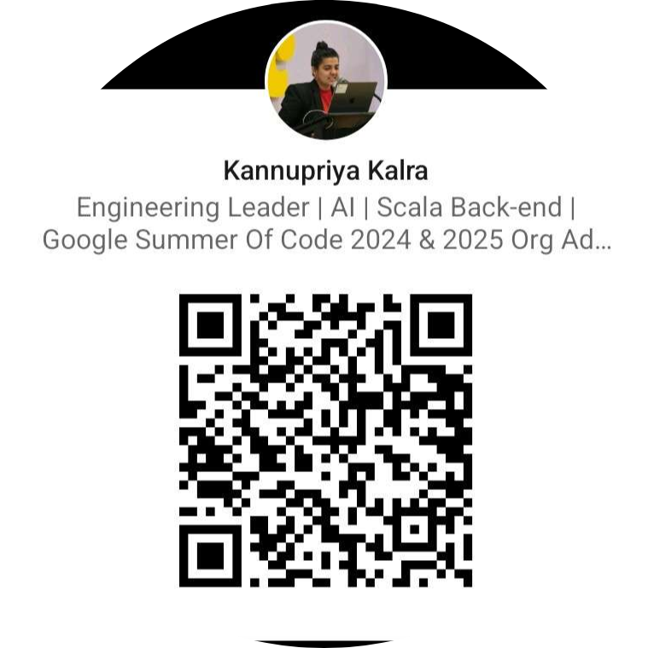
KEY TAKEAWAYS
Build the cool stuff, and make it work in production.
01
Reliable AI is designed in, not tested in at the end.
02
Frameworks beat ad-hoc scripts once you have real users.
03
Types and Result values make LLM apps predictable.
Connect on LinkedIn
04
LLM4S brings this to the JVM you already run.
Questions?
kannupriya@llm4s.org · rory@llm4s.org
kannupriyakalra@gmail.com
llm4s.org · github.com/llm4s
33
Microsoft Global Hackathon 2026 · Silicon Valley Campus, Mountain View · September 16, 2026

Slide 34

Thank you!
Star us on GitHub, then come build with us.
GitHub
Docs
Discord
github.com/llm4s/llm4s
llm4s.org
Join the community
Microsoft Global Hackathon 2026 · Silicon Valley Campus, Mountain View · September 16, 2026

