Slide 1
MACHINE LEARNING GUILD
CLASSIFICATION

Slide 2
MACHINE LEARNING GUILD
AGENDA: WEEK
MON
TUE
WED
THUR
FRI
INTROS, SETUP, & 101
REGRESSION & BOOSTING
CLUSTERING, CLASSIFICATION, DECISION TREES & SVM
TIME SERIES, NEURAL NETWORKS, & NLP
PLOTLY DASH & CAPSTONE PITCHES

Slide 3
MACHINE LEARNING GUILD
AGENDA: TODAY
WED
8:00 AM - 8:30 AM
8:30 AM - 9:15 AM
9:15 AM - 9:30 AM
9:30 AM - 10:30 AM
10:30 AM - 12:30 PM
12:30 PM - 1:30 PM
1:30 PM - 2:00 PM
2:00 PM -3:00 PM
3:00 PM - 4:00 PM
4:00 PM - 5:00 PM
INTRODUCTION TO CLUSTERING TECHNIQUES
K-MEANS
BREAK
OTHER CLUSTERING TECHNIQUES
INDEPENDENT CLUSTERING EXERCISE
LUNCH
INTRODUCTION TO CLASSIFICATION MODELS
LOGISTIC REGRESSION
NAÏVE BAYES
DECISION TREES, RANDOM FOREST, KNN, SVM

Slide 4
INTRODUCTION
CLASSIFICATION?
Categorical
Continuous
Supervised
???
???
Unsupervised
???
???

Slide 5
INTRODUCTION
CLASSIFICATION!
Categorical
Continuous
Supervised
Classification
Regression
Unsupervised
Clustering
Dimension Reduction

Slide 6
CLASSIFICATION
WHEN… CLASSIFICATION?
Discuss in your groups:
What are some examples of classifications we encounter in our lives?
How might we measure the success of a classification?

Slide 7
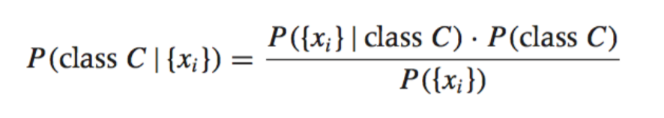
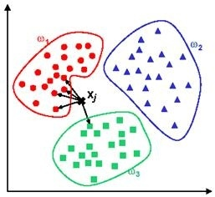
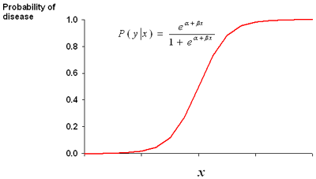
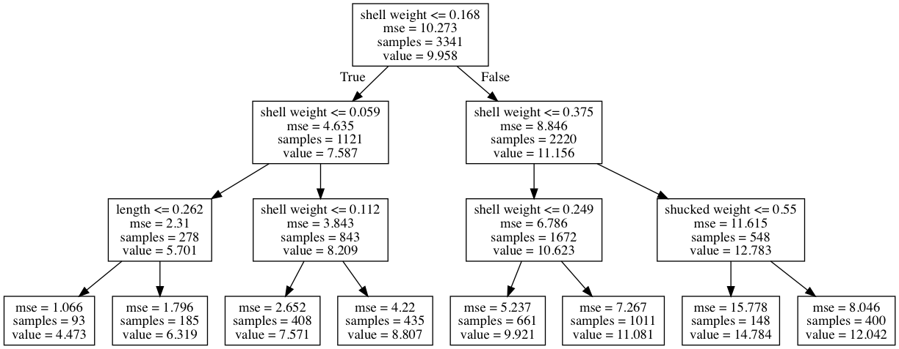
CLASSIFICATION
WHICH… CLASSIFICATION?
NAÏVE BAYES
KNN
LOGISTIC REGRESSION
DECISION TREES

Slide 8
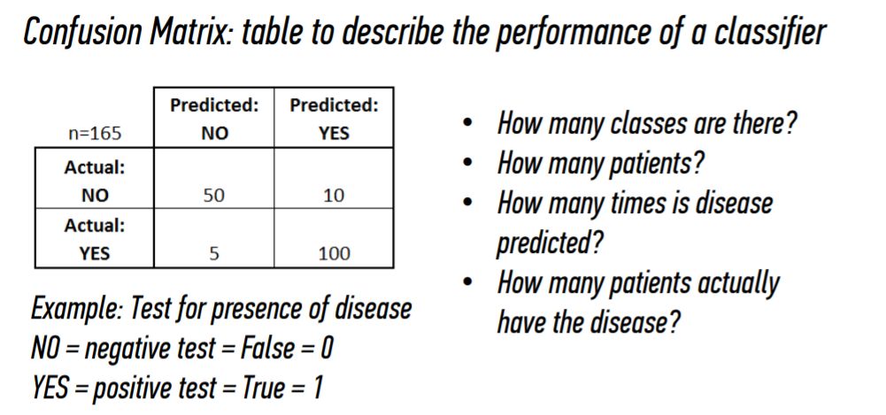
CLASSIFICATION
HOW… MEASURE PERFORMANCE?

Slide 9
CLASSIFICATION
HOW… MEASURE PERFORMANCE?
2
165
110
105

Slide 10
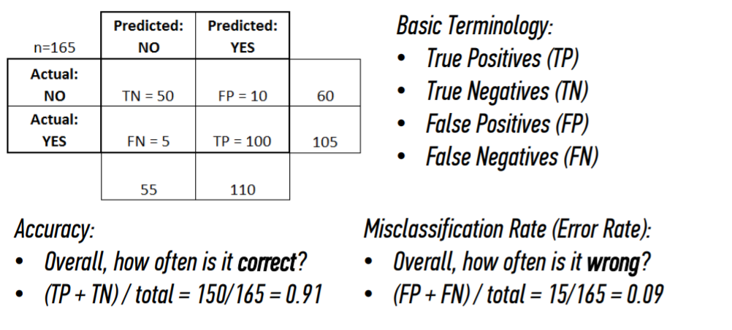
CLASSIFICATION
CONFUSION MATRIX
Type I Error
Type II Error

Slide 11
CLASSIFICATION
CONFUSION MATRIX

Slide 12
CLASSIFICATION
CONFUSION MATRIX

Slide 13
CLASSIFICATION
CONFUSION MATRIX

Slide 14
CLASSIFICATION
CONFUSION MATRIX

Slide 15
CLASSIFICATION
CONFUSION MATRIX

Slide 16
CLASSIFICATION
CONFUSION MATRIX

Slide 17
CLASSIFICATION
CONFUSION MATRIX

Slide 18
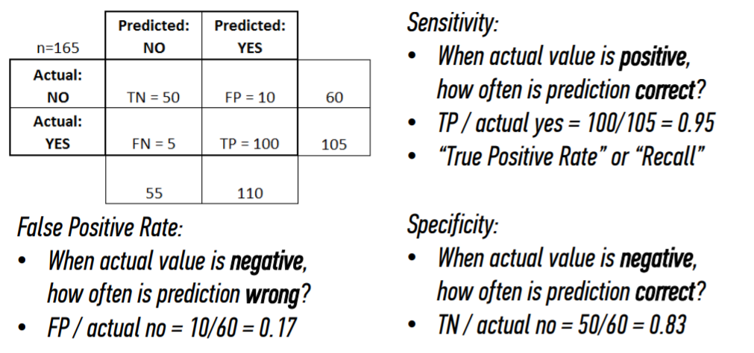
CLASSIFICATION
CONFUSION MATRIX

Slide 19
CLASSIFICATION
CONFUSION MATRIX

Slide 20
CLASSIFICATION
CONFUSION MATRIX

Slide 21
CLASSIFICATION
CONFUSION MATRIX

Slide 22
CLASSIFICATION
CONFUSION MATRIX

Slide 23
CLASSIFICATION
CONFUSION MATRIX

Slide 24
CLASSIFICATION
CONFUSION MATRIX

Slide 25
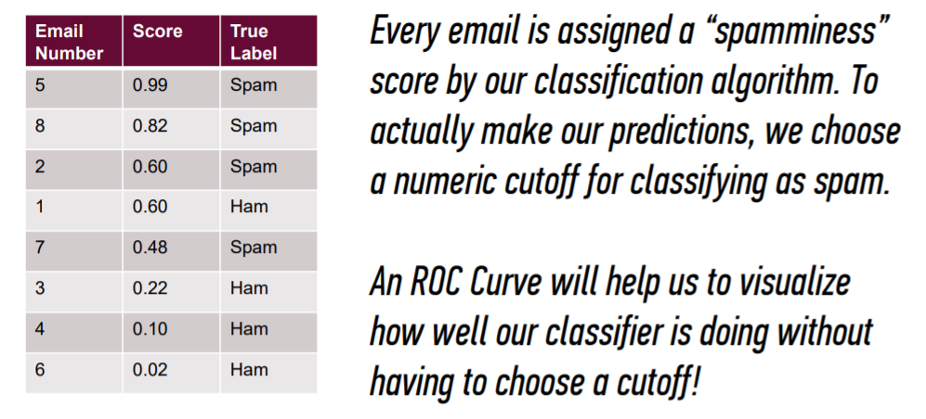
CLASSIFICATION
RECEIVING OPERATOR CHARACTERISTIC
(ROC) CURVE

Slide 26
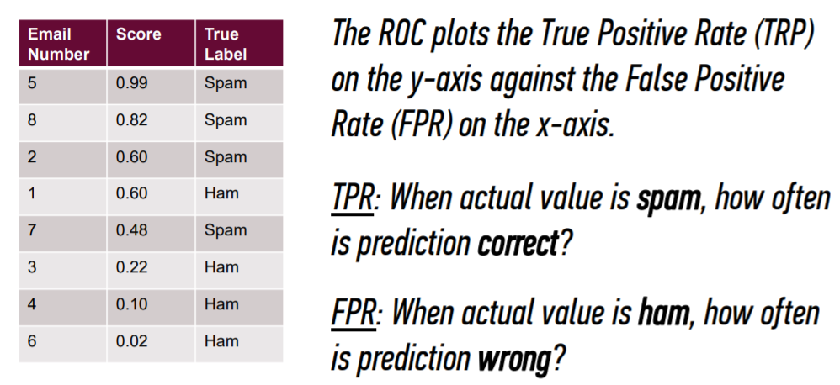
CLASSIFICATION
ROC CURVE / AUC

Slide 27
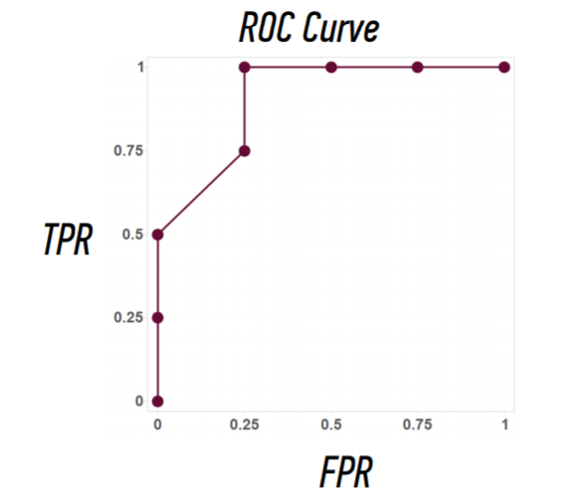
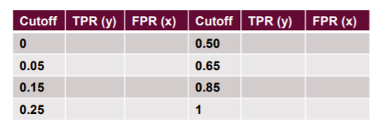
CLASSIFICATION
ROC CURVE / AUC
 | Predicted: HAM | Predicted: SPAM
Actual: HAM
Actual: SPAM
?
?
Notes:
When threshold is 0, then all are predicted to be SPAM. But only 4 were actually SPAM.

Slide 28
CLASSIFICATION
ROC CURVE / AUC
 | Predicted: HAM | Predicted: SPAM
Actual: HAM | 0 | 4 | 4
Actual: SPAM | 0 | 4 | 4
 | 0 | 8
1
1

Slide 29
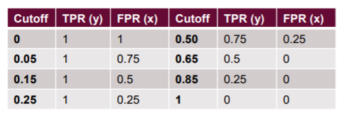
CLASSIFICATION
ROC CURVE / AUC
 | Predicted: HAM | Predicted: SPAM
Actual: HAM
Actual: SPAM
Notes:
Lets move from 0.00 to 0.05

Slide 30
CLASSIFICATION
ROC CURVE / AUC
 | Predicted: HAM | Predicted: SPAM
Actual: HAM
Actual: SPAM
Notes:
Predicted to be SPAM if above 0.05. I got 7 as SPAM and 1 as HAM

Slide 31
CLASSIFICATION
ROC CURVE / AUC
 | Predicted: HAM | Predicted: SPAM
Actual: HAM
Actual: SPAM
 |  | 1
Notes:
Predicted to be SPAM if above 0.05. I got 7 as SPAM and 1 as HAM

Slide 32
CLASSIFICATION
ROC CURVE / AUC
 | Predicted: HAM | Predicted: SPAM
Actual: HAM
Actual: SPAM
 |  | 2
Notes:
Predicted to be SPAM if above 0.05. I got 7 as SPAM and 1 as HAM

Slide 33
CLASSIFICATION
ROC CURVE / AUC
 | Predicted: HAM | Predicted: SPAM
Actual: HAM
Actual: SPAM
 |  | 3
Notes:
Predicted to be SPAM if above 0.05. I got 7 as SPAM and 1 as HAM

Slide 34
CLASSIFICATION
ROC CURVE / AUC
 | Predicted: HAM | Predicted: SPAM
Actual: HAM
Actual: SPAM
 |  | 4
Notes:
Predicted to be SPAM if above 0.05. I got 7 as SPAM and 1 as HAM

Slide 35
CLASSIFICATION
ROC CURVE / AUC
 | Predicted: HAM | Predicted: SPAM
Actual: HAM
Actual: SPAM
 |  | 5
Notes:
Predicted to be SPAM if above 0.05. I got 7 as SPAM and 1 as HAM

Slide 36
CLASSIFICATION
ROC CURVE / AUC
 | Predicted: HAM | Predicted: SPAM
Actual: HAM
Actual: SPAM
 |  | 7
Notes:
In fact, we predicted 7 to be SPAM! Only 4 of those were actually SPAM. One was not SPAM.

Slide 37
CLASSIFICATION
ROC CURVE / AUC
 | Predicted: HAM | Predicted: SPAM
Actual: HAM
Actual: SPAM
 | 1 | 7
Notes:
Since we changed the cutoff, one is predicted as not being SPAM.

Slide 38
CLASSIFICATION
ROC CURVE / AUC
 | Predicted: HAM | Predicted: SPAM
Actual: HAM |  | 3
Actual: SPAM
 | 1 | 7
Notes:
Since we changed the cutoff, one is predicted as not being SPAM.

Slide 39
CLASSIFICATION
ROC CURVE / AUC
 | Predicted: HAM | Predicted: SPAM
Actual: HAM | 1 | 3
Actual: SPAM
 | 1 | 7
Notes:
Since we changed the cutoff, one is predicted as not being SPAM.

Slide 40
CLASSIFICATION
ROC CURVE / AUC
 | Predicted: HAM | Predicted: SPAM
Actual: HAM | 1 | 3 | 4
Actual: SPAM
 | 1 | 7
Notes:
Since we changed the cutoff, one is predicted as not being SPAM.

Slide 41
CLASSIFICATION
ROC CURVE / AUC
 | Predicted: HAM | Predicted: SPAM
Actual: HAM | 1 | 3 | 4
Actual: SPAM | ?
 | 1 | 7
Notes:
Since we changed the cutoff, one is predicted as not being SPAM.

Slide 42
CLASSIFICATION
ROC CURVE / AUC
 | Predicted: HAM | Predicted: SPAM
Actual: HAM | 1 | 3 | 4
Actual: SPAM | 0
 | 1 | 7
Notes:
Since we changed the cutoff, one is predicted as not being SPAM.

Slide 43
CLASSIFICATION
ROC CURVE / AUC
 | Predicted: HAM | Predicted: SPAM
Actual: HAM | 1 | 3 | 4
Actual: SPAM | 0 | ?
 | 1 | 7
Notes:
Since we changed the cutoff, one is predicted as not being SPAM.

Slide 44
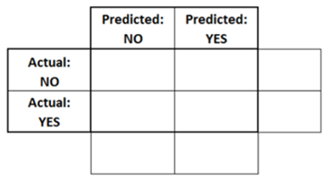
CLASSIFICATION
ROC CURVE / AUC
1
3
4
0
?
1
7
Notes:
Since we changed the cutoff, one is predicted as not being SPAM.

Slide 45
CLASSIFICATION
ROC CURVE / AUC
 | Predicted: HAM | Predicted: SPAM
Actual: HAM | 1 | 3 | 4
Actual: SPAM | 0 | 4
 | 1 | 7
Notes:
Since we changed the cutoff, one is predicted as not being SPAM.

Slide 46
CLASSIFICATION
ROC CURVE / AUC
 | Predicted: HAM | Predicted: SPAM
Actual: HAM | 1 | 3 | 4
Actual: SPAM | 0 | 4
 | 1 | 7
Notes:
Since we changed the cutoff, one is predicted as not being SPAM.

Slide 47
CLASSIFICATION
ROC CURVE / AUC
 | Predicted: HAM | Predicted: SPAM
Actual: HAM | 1 | 3 | 4
Actual: SPAM | 0 | 4 | 4
 | 1 | 7
Notes:
Since we changed the cutoff, one is predicted as not being SPAM.

Slide 48
CLASSIFICATION
ROC CURVE / AUC
 | Predicted: HAM | Predicted: SPAM
Actual: HAM | 1 | 3 | 4
Actual: SPAM | 0 | 4 | 4
 | 1 | 7
=3/4 → 0.75
Notes:
Since we changed the cutoff, one is predicted as not being SPAM.

Slide 49
CLASSIFICATION
ROC CURVE / AUC
 | Predicted: HAM | Predicted: SPAM
Actual: HAM | 1 | 3 | 4
Actual: SPAM | 0 | 4 | 4
 | 1 | 7
=3/4 → 0.75
Notes:
Since we changed the cutoff, one is predicted as not being SPAM.

Slide 50
CLASSIFICATION
ROC CURVE / AUC
 | Predicted: HAM | Predicted: SPAM
Actual: HAM | 1 | 3 | 4
Actual: SPAM | 0 | 4 | 4
 | 1 | 7
=4/4 → 1
Notes:
Since we changed the cutoff, one is predicted as not being SPAM.

Slide 51
CLASSIFICATION
ROC CURVE / AUC
 | Predicted: HAM | Predicted: SPAM
Actual: HAM | 1 | 3 | 4
Actual: SPAM | 0 | 4 | 4
 | 1 | 7
=4/4 → 1
Notes:
Since we changed the cutoff, one is predicted as not being SPAM.

Slide 52
CLASSIFICATION
ROC CURVE / AUC

Slide 53
CLASSIFICATION
ROC CURVE / AUC

Slide 54
CLASSIFICATION
ROC CURVE / AUC

Slide 55
CLASSIFICATION
ROC CURVE / AUC

Slide 56
CLASSIFICATION
ROC CURVE / AUC

Slide 57
CLASSIFICATION
ROC CURVE / AUC

Slide 58
CLASSIFICATION
CONFUSION VS ROC?
Discuss in your groups:
What information do you take away from each of these evaluation techniques?
What decisions can be made from each tool?

Slide 59
CLASSIFICATION
CODING

Slide 60
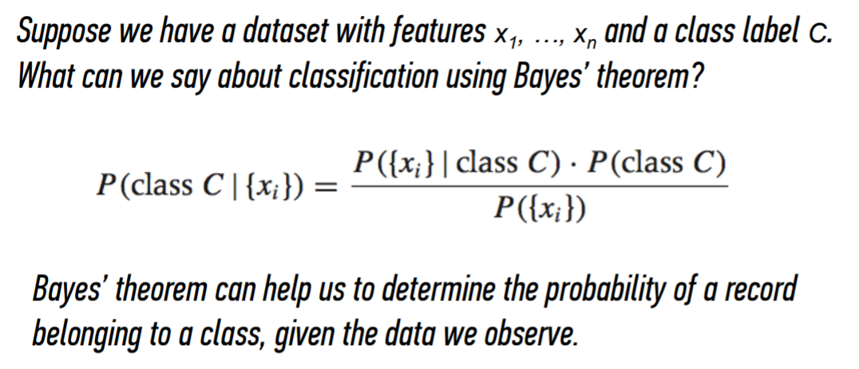
CLASSIFICATION
NAÏVE BAYES THEOREM

Slide 61
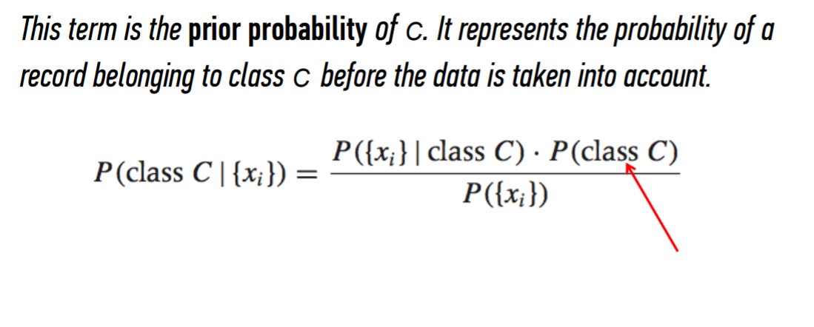
CLASSIFICATION
NAÏVE BAYES THEOREM

Slide 62
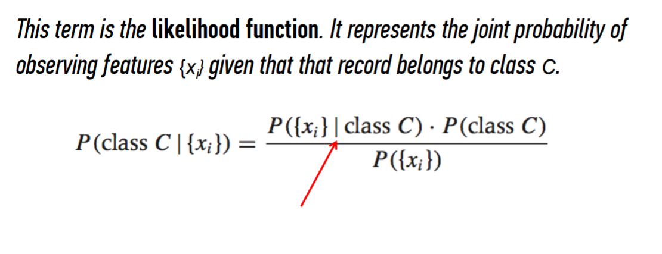
CLASSIFICATION
NAÏVE BAYES THEOREM

Slide 63
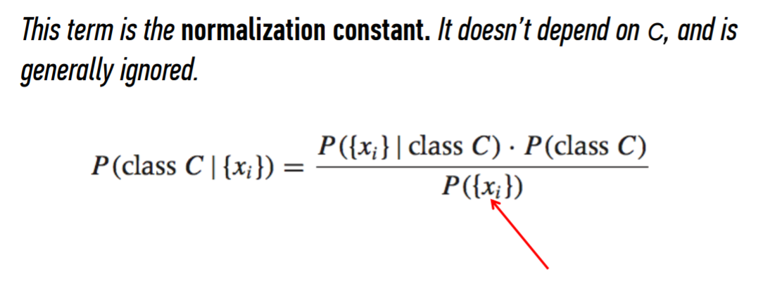
CLASSIFICATION
NAÏVE BAYES THEOREM

Slide 64
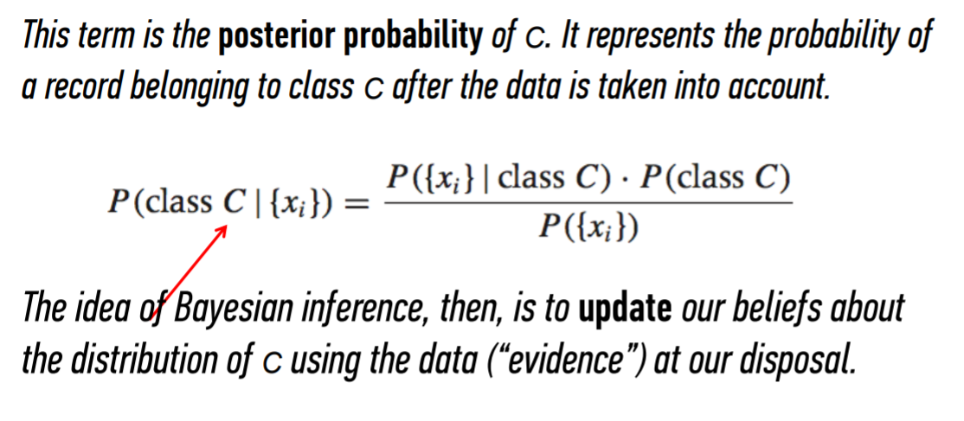
CLASSIFICATION
NAÏVE BAYES THEOREM

Slide 65
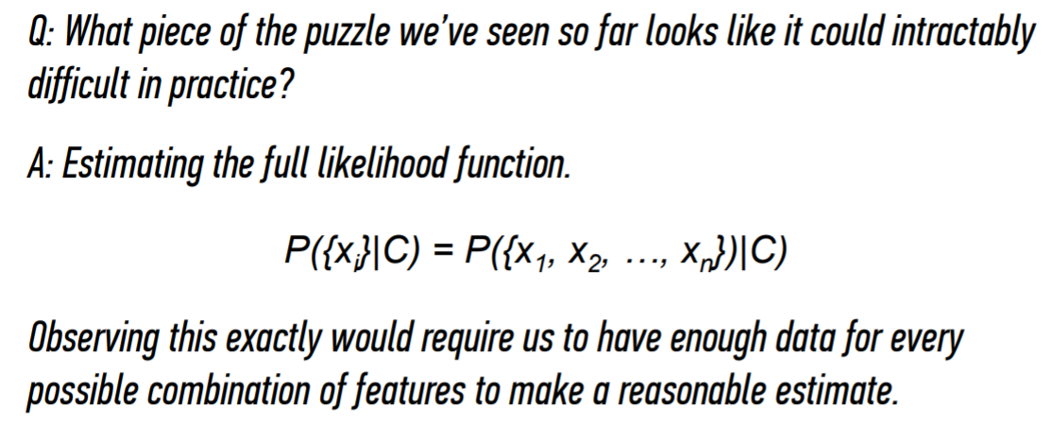
CLASSIFICATION
NAÏVE BAYES THEOREM

Slide 66
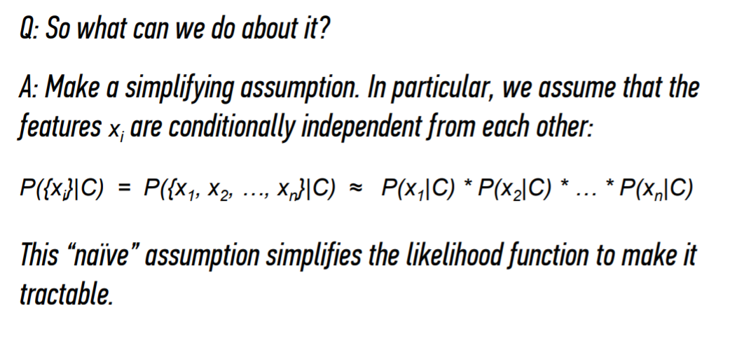
CLASSIFICATION
NAÏVE BAYES THEOREM
Notes:
https://translatingnerd.com/2018/02/08/searching-for-lost-nuclear-bombs-bayes-rule-in-action/

Slide 67
CLASSIFICATION
CODING

Slide 68
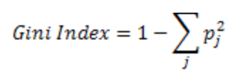
CLASSIFICATION
DECISION TREES
Find the purest split (using gini index)
Find the next purest split
Continue until max depth is reached
Tuning: max_depth, min_sample_leaf

Slide 69
CLASSIFICATION
DECISION TREES
Advantages
Easy to interpret and make for straightforward visualizations.
The internal workings are capable of being observed and thus make it possible to reproduce work.
Can handle both numerical and categorical data.
Perform well on large datasets
Are extremely fast
Disadvantages
Purest split at each step might lead to local maximum not global maximum
Prone to overfitting, leads to high variance from sample to sample

Slide 70
CLASSIFICATION
CODING

Slide 71
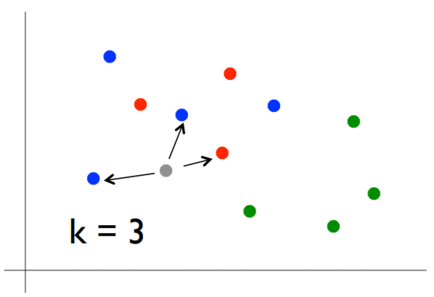
CLASSIFICATION
KNN
Pick a value for k
Find colors of k nearest neighbors
Assign the most common color to the gray dot
Tuning: k_neighbors
Notes:
Use Game of Thrones example!

Slide 72
CLASSIFICATION
KNN
Advantages
Can learn complex topics by local approximation (simple methods)
No assumptions or cost of learning
Disadvantages
Does not handle categorical values well
Can’t be interpreted
Computationally expensive

Slide 73
CLASSIFICATION
CODING

Slide 74
CLASSIFICATION
Q&A

