Slide 1
MACHINE LEARNING GUILD
MACHINE LEARNING OVERVIEW

Slide 2
MACHINE LEARNING GUILD
WHAT IS MACHINE LEARNING?
The application of statistical algorithms to create artificial intelligence which can understand data about the world.
In 1959, Arthur Samuel defined Machine Learning as:
“a field of study that gives computers the ability to learn without being explicitly programmed”
Today, Data Scientists and others apply ML algorithms to a myriad of client problems

Slide 3
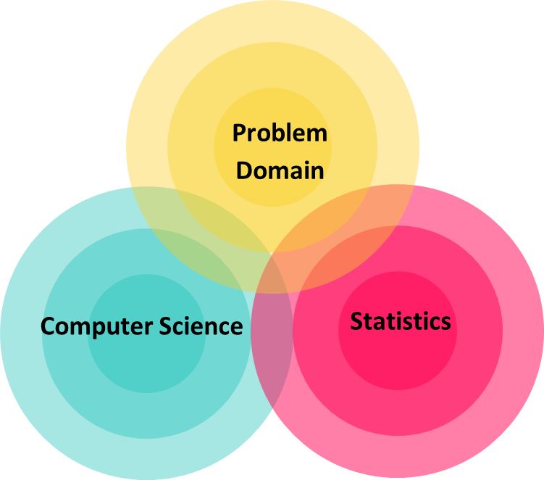
WHAT IS A DATA SCIENTIST?
OUR DEFINITION
Data Scientists apply machine learning and visualization techniques to generate new insights that increase efficiencies / give businesses a competitive advantage

Slide 4
WHAT IS A DATA SCIENTIST?
Data
Warehousing
Business
Domain
Visualization
Programming
Statistics
Machine
Learning

Slide 5






WHAT IS A DATA SCIENTIST?
Data
Warehousing
Business
Domain
Visualization
Programming
Statistics
Machine
Learning

Slide 6
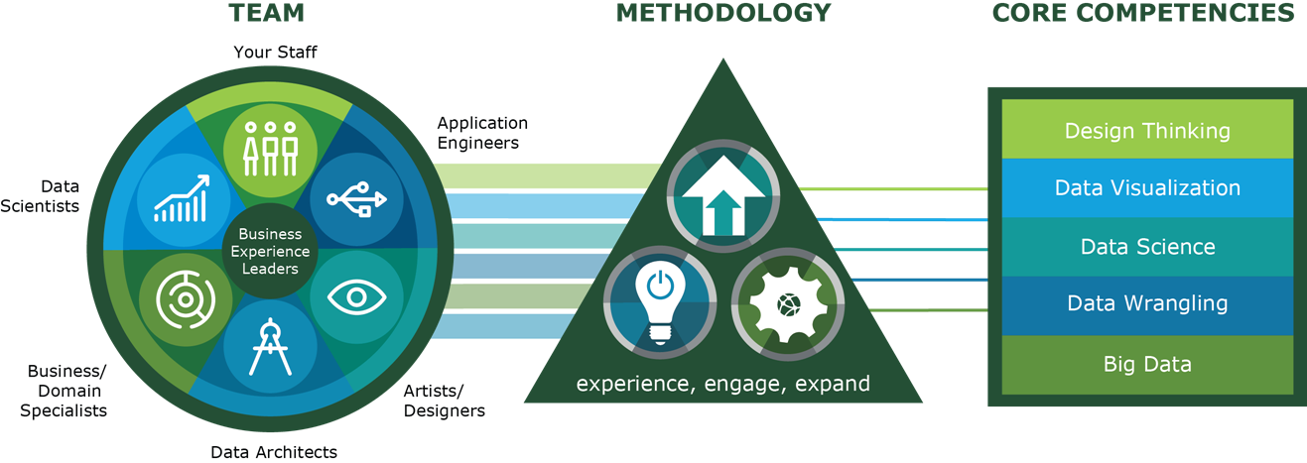


WHO DO DATA SCIENTISTS WORK WITH?
TEAM

Slide 7
HOW DO DATA SCIENTISTS ADD VALUE?
VALUE ADD
Predicting the bad
Identifying the good
Automating existing processes
“Every good data analysis starts with a bad data analysis.”
– Hadley Wickham

Slide 8
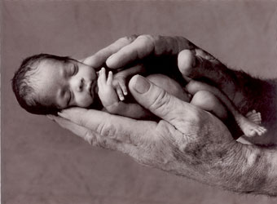
HOW DO DATA SCIENTISTS ADD VALUE?
PREDICTING NEONATAL INFECTION
Problem: Children born prematurely are at high risk of developing infections, many of which are not detected until after the baby is sick
Goal: Detect subtle patterns in the data that predicts infection before it occurs
Data: 16 vital signs such as heart rate, respiration rate, blood pressure, etc…
Impact: Model is able to predict the onset of infection 24 hours before the traditional symptoms of infection appear
Image: http://www.babycaretips4u.com/wp-content/uploads/2014/03/premature-baby.jpg
Case Study: http://www.amazon.com/Big-Data-Revolution-Transform-Think/dp/0544002695

Slide 9

HOW DO DATA SCIENTISTS ADD VALUE?
AUTOMATING GOVT PAPER-PUSHING
Problem: Processing disability claims at the Social Security Administration is a time-intensive process, with many claims taking over 2 years to adjudicate
Goal: Automate the approval of a subset of the “simplest” disability claims
Data: Free text in the claims form
Impact: Able to fully automate 20% of the simplest claims. Rating accuracy of the algorithm is higher than the average claims examiner.
Case Study: http://datamininglab.com/images/case-studies/ERI_Text_Mining_SSA_Claims_for_Disability_Approval.pdf

Slide 10
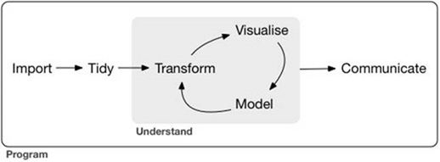
WHAT IS THE DATA SCIENCE WORKFLOW?
WORKFLOW
Define the problem / question
Identify and collect data
Explore and prepare data
Build and evaluate model
Communicate results

Slide 11
WHAT TOOLS DO DATA SCIENTISTS USE?
WHY PYTHON?
Created for simplicity and readability
Rapid prototyping, ease of production
Open source, importable libraries
Broad range of applications
Fast growing community
Founded by
Guido van Rossum
in 1991

Slide 12



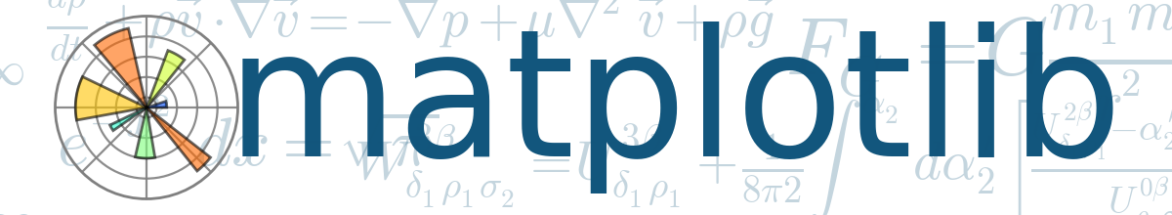
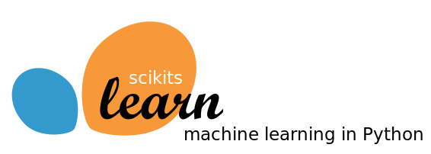

WHAT TOOLS DO DATA SCIENTISTS USE?
KEY TOOLS
Querying /
Collection
Manipulation / Modeling
Exploration / Visualization
Database Queries
Web Scraping
API Calls
Munging and wrangling
Merging and enhancing
Building Models
Exploratory analysis
Plotting and graphing
Dashboard creation

Slide 13
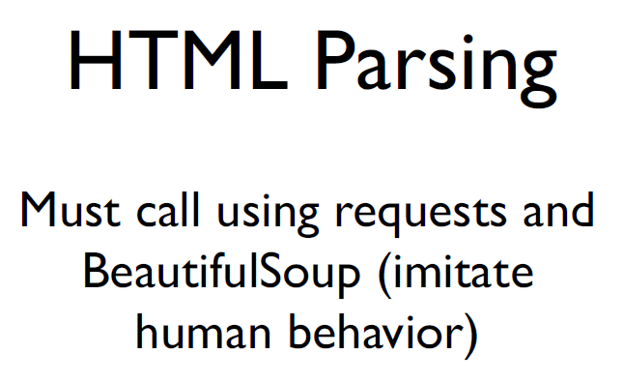

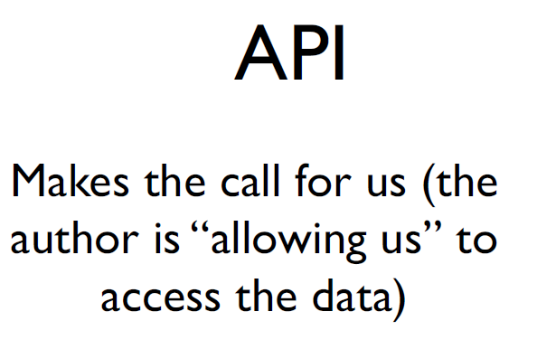
WHAT TOOLS DO DATA SCIENTISTS USE?
KEY TOOLS
Regular
Expressions
Querying /
Collection
Database Queries
Web Scraping
API Calls

Slide 14
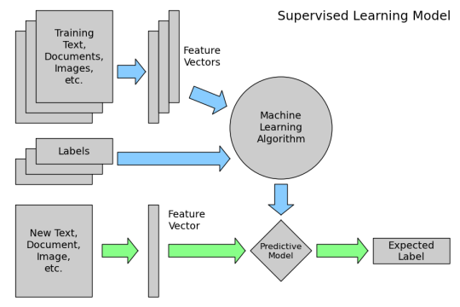
WHAT TOOLS DO DATA SCIENTISTS USE?
KEY TOOLS
Manipulation / Modeling
Munging and wrangling
Merging and enhancing
Building Models

Slide 15
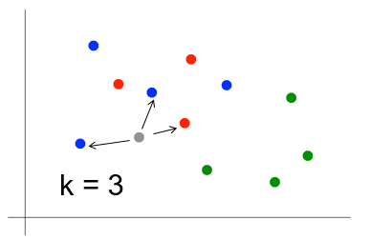
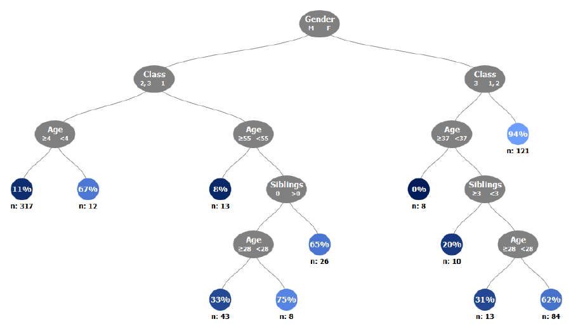
WHAT TOOLS DO DATA SCIENTISTS USE?
KEY TOOLS
Manipulation / Modeling
KNN vs. Decision Trees
Munging and wrangling
Merging and enhancing
Building Models

Slide 16





WHAT TOOLS DO DATA SCIENTISTS USE?
KEY TOOLS
Exploration / Visualization
Exploratory analysis
Plotting and graphing
Dashboard creation

Slide 17

BACKGROUND
ALPHA GO

Slide 18
ML 101
Q & A

