Slide 1
MapReduce and Apache Spark
Y.M.V.M. Yapa
229412H

Slide 2
MapReduce
Hadoop MapReduce Overview:
Component of Apache Hadoop for distributed computing.
Developed in 2004 for parallel processing on large clusters.
Key Tasks of MapReduce:
Handles mapping and reducing tasks.
Ideal for iterative computations on massive datasets.
Applications:
Used in data analysis, fraud detection, genetic algorithms, and more.
Adopted by Amazon, Walmart, eBay, Linkedin, Facebook, Twitter, and Netflix.
Industry Adoption:
Widely used by e-commerce, social media, and entertainment companies.
Versatile for large-scale distributed computing requirements.

Slide 3
Apache Spark
Apache Spark Overview:
Open-source, distributed computing system.
Developed for faster and more flexible big data processing.
In-Memory Processing:
Utilizes in-memory processing, enhancing speed for iterative algorithms.
Reduces the need for frequent data storage and retrieval.
Versatility in Applications:
Suitable for batch processing, streaming analytics, machine learning, and graph processing.
Enables a unified platform for diverse data processing tasks.
Resilient Distributed Datasets (RDDs):
Core data structure for fault-tolerant parallel processing.
Facilitates efficient data sharing across nodes in a cluster.
Ease of Use and Compatibility:
Supports multiple programming languages, including Java, Scala, and Python.
Compatible with Hadoop Distributed File System (HDFS), easing integration with existing big data ecosystems.

Slide 4
Demo

Slide 5
MapReduce Vs Apache Spark

Slide 6
Ease of Use
Programming Language Support:
MapReduce: Primarily Java-based, which may be challenging for developers with expertise in other languages.
Spark: Supports multiple languages, including Java, Scala, Python, and R, offering greater flexibility for developers with diverse language preferences.
Complexity of Programming Model:
MapReduce: Requires explicit definition of mappers and reducers, often resulting in longer code for even simple tasks.
Spark: Provides high-level APIs (e.g., DataFrame and Spark SQL), reducing the complexity of code and making it more concise and readable.
Iterative Processing:
MapReduce: Involves multiple Map and Reduce stages, requiring extensive disk I/O and making iterative algorithms less efficient.
Spark: Capitalizes on in-memory processing, significantly improving the speed of iterative algorithms and making them more user-friendly.
Data Sharing and Caching:
MapReduce: Relies on disk storage between stages, leading to increased I/O operations.
Spark: Utilizes Resilient Distributed Datasets (RDDs) for fault-tolerant, in-memory data sharing, minimizing the need for frequent disk I/O.
Learning Curve:
MapReduce: Typically has a steeper learning curve due to its low-level abstractions and verbosity.
Spark: Offers higher-level abstractions, making it more user-friendly for developers with varying levels of experience, resulting in a shorter learning curve.

Slide 7
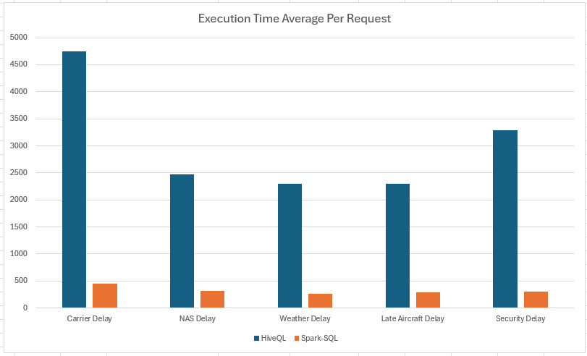
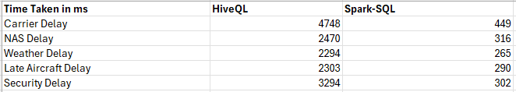
Fast Process

Slide 8
Conclusion
Both works well for distributed big data processing.
Spark has slight win over Hadoop map reduce because it is developed to overcome some disadvantages of map reduce
The decision of selecting one over another might be decided by many reasons.

Slide 9
Thank you

