Slide 1
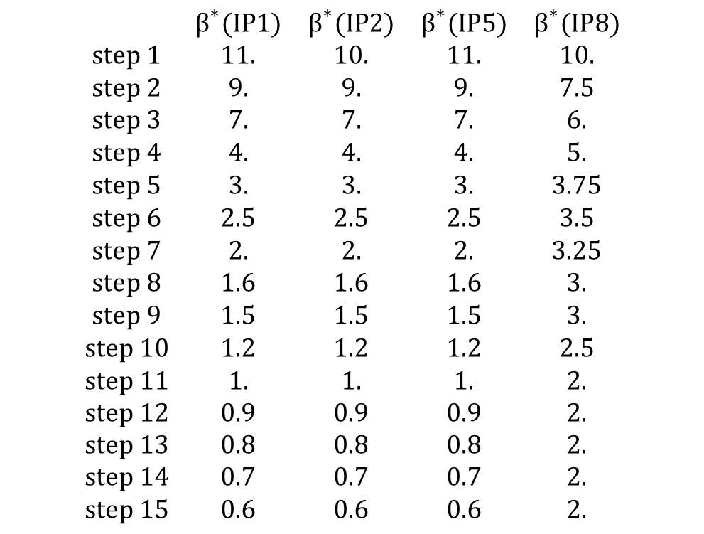
Squeeze for p-Pb in January 2013
$$\begin{matrix} & β^{∗}(IP1) & β^{∗}(IP2) & β^{∗}(IP5) & β^{∗}(IP8) \\ step 1 & 11. & 10. & 11. & 10. \\ step 2 & 9. & 9. & 9. & 7.5 \\ step 3 & 7. & 7. & 7. & 6. \\ step 4 & 4. & 4. & 4. & 5. \\ step 5 & 3. & 3. & 3. & 3.75 \\ step 6 & 2.5 & 2.5 & 2.5 & 3.5 \\ step 7 & 2. & 2. & 2. & 3.25 \\ step 8 & 1.6 & 1.6 & 1.6 & 3. \\ step 9 & 1.5 & 1.5 & 1.5 & 3. \\ step 10 & 1.2 & 1.2 & 1.2 & 2.5 \\ step 11 & 1. & 1. & 1. & 2. \\ step 12 & 0.9 & 0.9 & 0.9 & 2. \\ step 13 & 0.8 & 0.8 & 0.8 & 2. \\ step 14 & 0.7 & 0.7 & 0.7 & 2. \\ step 15 & 0.6 & 0.6 & 0.6 & 2.\end{matrix}$$

