Slide 1

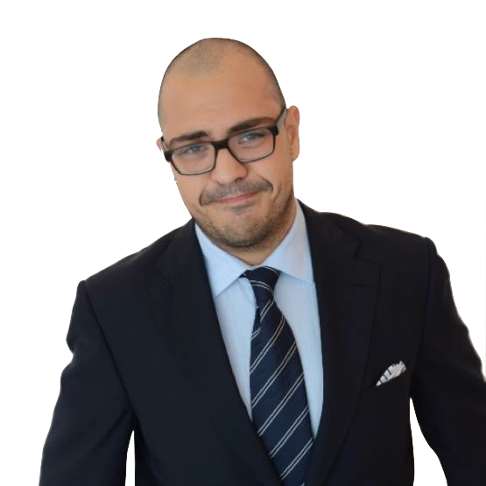
Notes:
Ted Talent, looking for fame
Scouting Scott, looking for talent

Slide 2

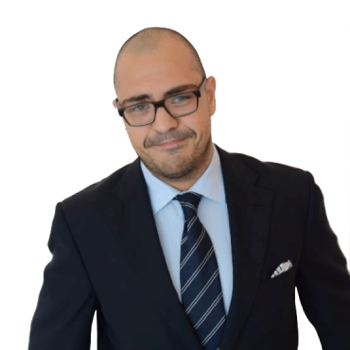

Notes:
The Problem:
Find the talents
Help them to develop
Bind them to the company
Unfair Relationships

Slide 3
The Question
How can Scott scout Ted, help him to develop and bind him to his company at low cost and in a fair way?

Slide 4

The Answer

Slide 5


Create free profile
Upload Content
Wait / Rate others
Create free profile 1.
Browse Content (filters) 2.
Request by like 3.
Wait / Rate others 4.

Slide 6
Develop: Groups of liked talents
Binding: Scout offers support -> contract?
Profit: Handshake for fee / premium
Attract Users: Prices for popular content
Notes:
Develop: Groups of liked talents (community) -> take courses together, exchange interests and knowledge in virtual classrooms
Binding: Scout offers support (Courses, Supervision, Materials e.g. instruments) -> contract?
Profit: Scouts only get contact when they pay or have premium account
Attract users: offer gifts for popular content -> inviting to record a tape in a studio

