Slide 1
Analysis of Genome Variation, Phylogenetic Relationships and Geographic/Temporal Patterns in Porcine Circovirus 3 (PCV3)
MSc Big Data Analytics — Bioinformatics & Unsupervised Machine Learning Project
Student Practical Examination | Dataset: 500 PCV3 Complete Genomes | Tools: Biopython, MAFFT, IQ-TREE 3, scikit-learn

Slide 2
MSC BIG DATA ANALYTICS — PRACTICAL EXAMINATION
Problem Statement & Biological Context
Biological Background
• Porcine Circovirus 3 (PCV3) is an emerging circular ssDNA circovirus associated with porcine dermatitis, nephropathy syndrome (PDNS), and reproductive failure.
• First identified in 2015–2016, PCV3 has rapidly been detected in swine herds globally.
• Investigating whether PCV3 genomes exhibit distinct genomic subgroups and whether these subgroups correlate with geographical regions or collection years is vital for surveillance.
Analytical Problem
• Identify genome-wide variations (SNPs, conserved vs. polymorphic positions) across 500 complete genomes.
• Perform unsupervised dimensionality reduction (PCA) and clustering (K-Means) on genome-derived features without metadata bias.
• Determine statistical associations between genome-based clusters and geographic location / sample year using rigorous permutation tests.
• Evaluate phylogenetic tree structure to determine consistency with unsupervised genomic clusters.

Slide 3
MSC BIG DATA ANALYTICS — PRACTICAL EXAMINATION
Project Objectives & Technical Scope
1. Bioinformatic QC & Alignment
• Inspect FASTA sequences and Excel metadata.
• Perform sequence quality control (lengths, GC%, ambiguous bases).
• Perform Multiple Sequence Alignment (MAFFT).
• Identify conserved, variable, and parsimony-informative positions.
2. Unsupervised ML Pipeline
• Extract one-hot binary SNP matrix (genome features only).
• Compute PCA (explained variance, PC1 vs PC2).
• Evaluate K-Means clustering ($k=2..10$) using Silhouette scores.
• Isolate metadata from feature extraction to prevent data leakage.
3. Statistical & Phylogenetic Evaluation
• Construct Cluster x Country and Cluster x Year contingency tables.
• Run Chi-square permutation tests & calculate Cramér's V.
• Construct Maximum Likelihood tree (IQ-TREE 3 ModelFinder: GTR+F+I+G4, 1000 UFBoot).
• Derive evidence-based findings while avoiding causal overclaims.

Slide 4
MSC BIG DATA ANALYTICS — PRACTICAL EXAMINATION
Input Data Audit & Metadata Matching
Input Files Validation
• viral_genome.fasta: 500 complete genomes (~2,000 bp). Header format: <Accession>_<Country>_<Year>.
• accessions.csv.xlsx: 500 metadata rows with columns 'accession ' and 'Region '.
• Audit Result: Direct index matching matched only 22/500 rows. Key-based accession matching resolved records cleanly.
• No raw files were modified or deleted.
Metadata Provenance Categorization
• Excel_Verified (474 records): Accession and country matched Excel without conflict.
• Geography_Conflict_Excel (16 records): Accession matched Excel, but Excel contained conflicting regions (e.g. Spain vs Poland). Flagged explicitly.
• FASTA_Header_Only (10 records): Accession absent from Excel sheet; metadata derived directly from FASTA header.
• No metadata values were fabricated or silently overwritten.

Slide 5
MSC BIG DATA ANALYTICS — PRACTICAL EXAMINATION
End-to-End Bioinformatics Pipeline Architecture
Sequential Analysis Workflow
• Phase 1: Input Data Inspection (FASTA & Excel integrity verification)
• Phase 2: Master Metadata Construction (Provenance flagging: Excel_Verified, Geography_Conflict, FASTA_Header_Only)
• Phase 3: Sequence Quality Control (Length distribution, GC content, ambiguous base filtering)
• Phase 4: Multiple Sequence Alignment (MAFFT alignment to 2,156 bp)
• Phase 5: Genome Variation & SNP Extraction (Identification of 890 variable sites, 466 parsimony-informative)
• Phase 6: Feature Extraction (Primary: 2,067 binary SNP features | Supplementary: 256 k-mer features)
• Phase 7 & 8: PCA & K-Means Clustering (Standardized mean-centering, PC variance ratio, Silhouette evaluation for k=7)
• Phase 9 & 10: Statistical Association (Chi-square permutation tests, Cramér's V, expected count diagnostics)
• Phase 11 & 12: Phylogenetics & Distance Heatmap (IQ-TREE 3 ModelFinder GTR+F+I+G4, 1000 UFBoot, evaluating tree-cluster consistency)

Slide 6
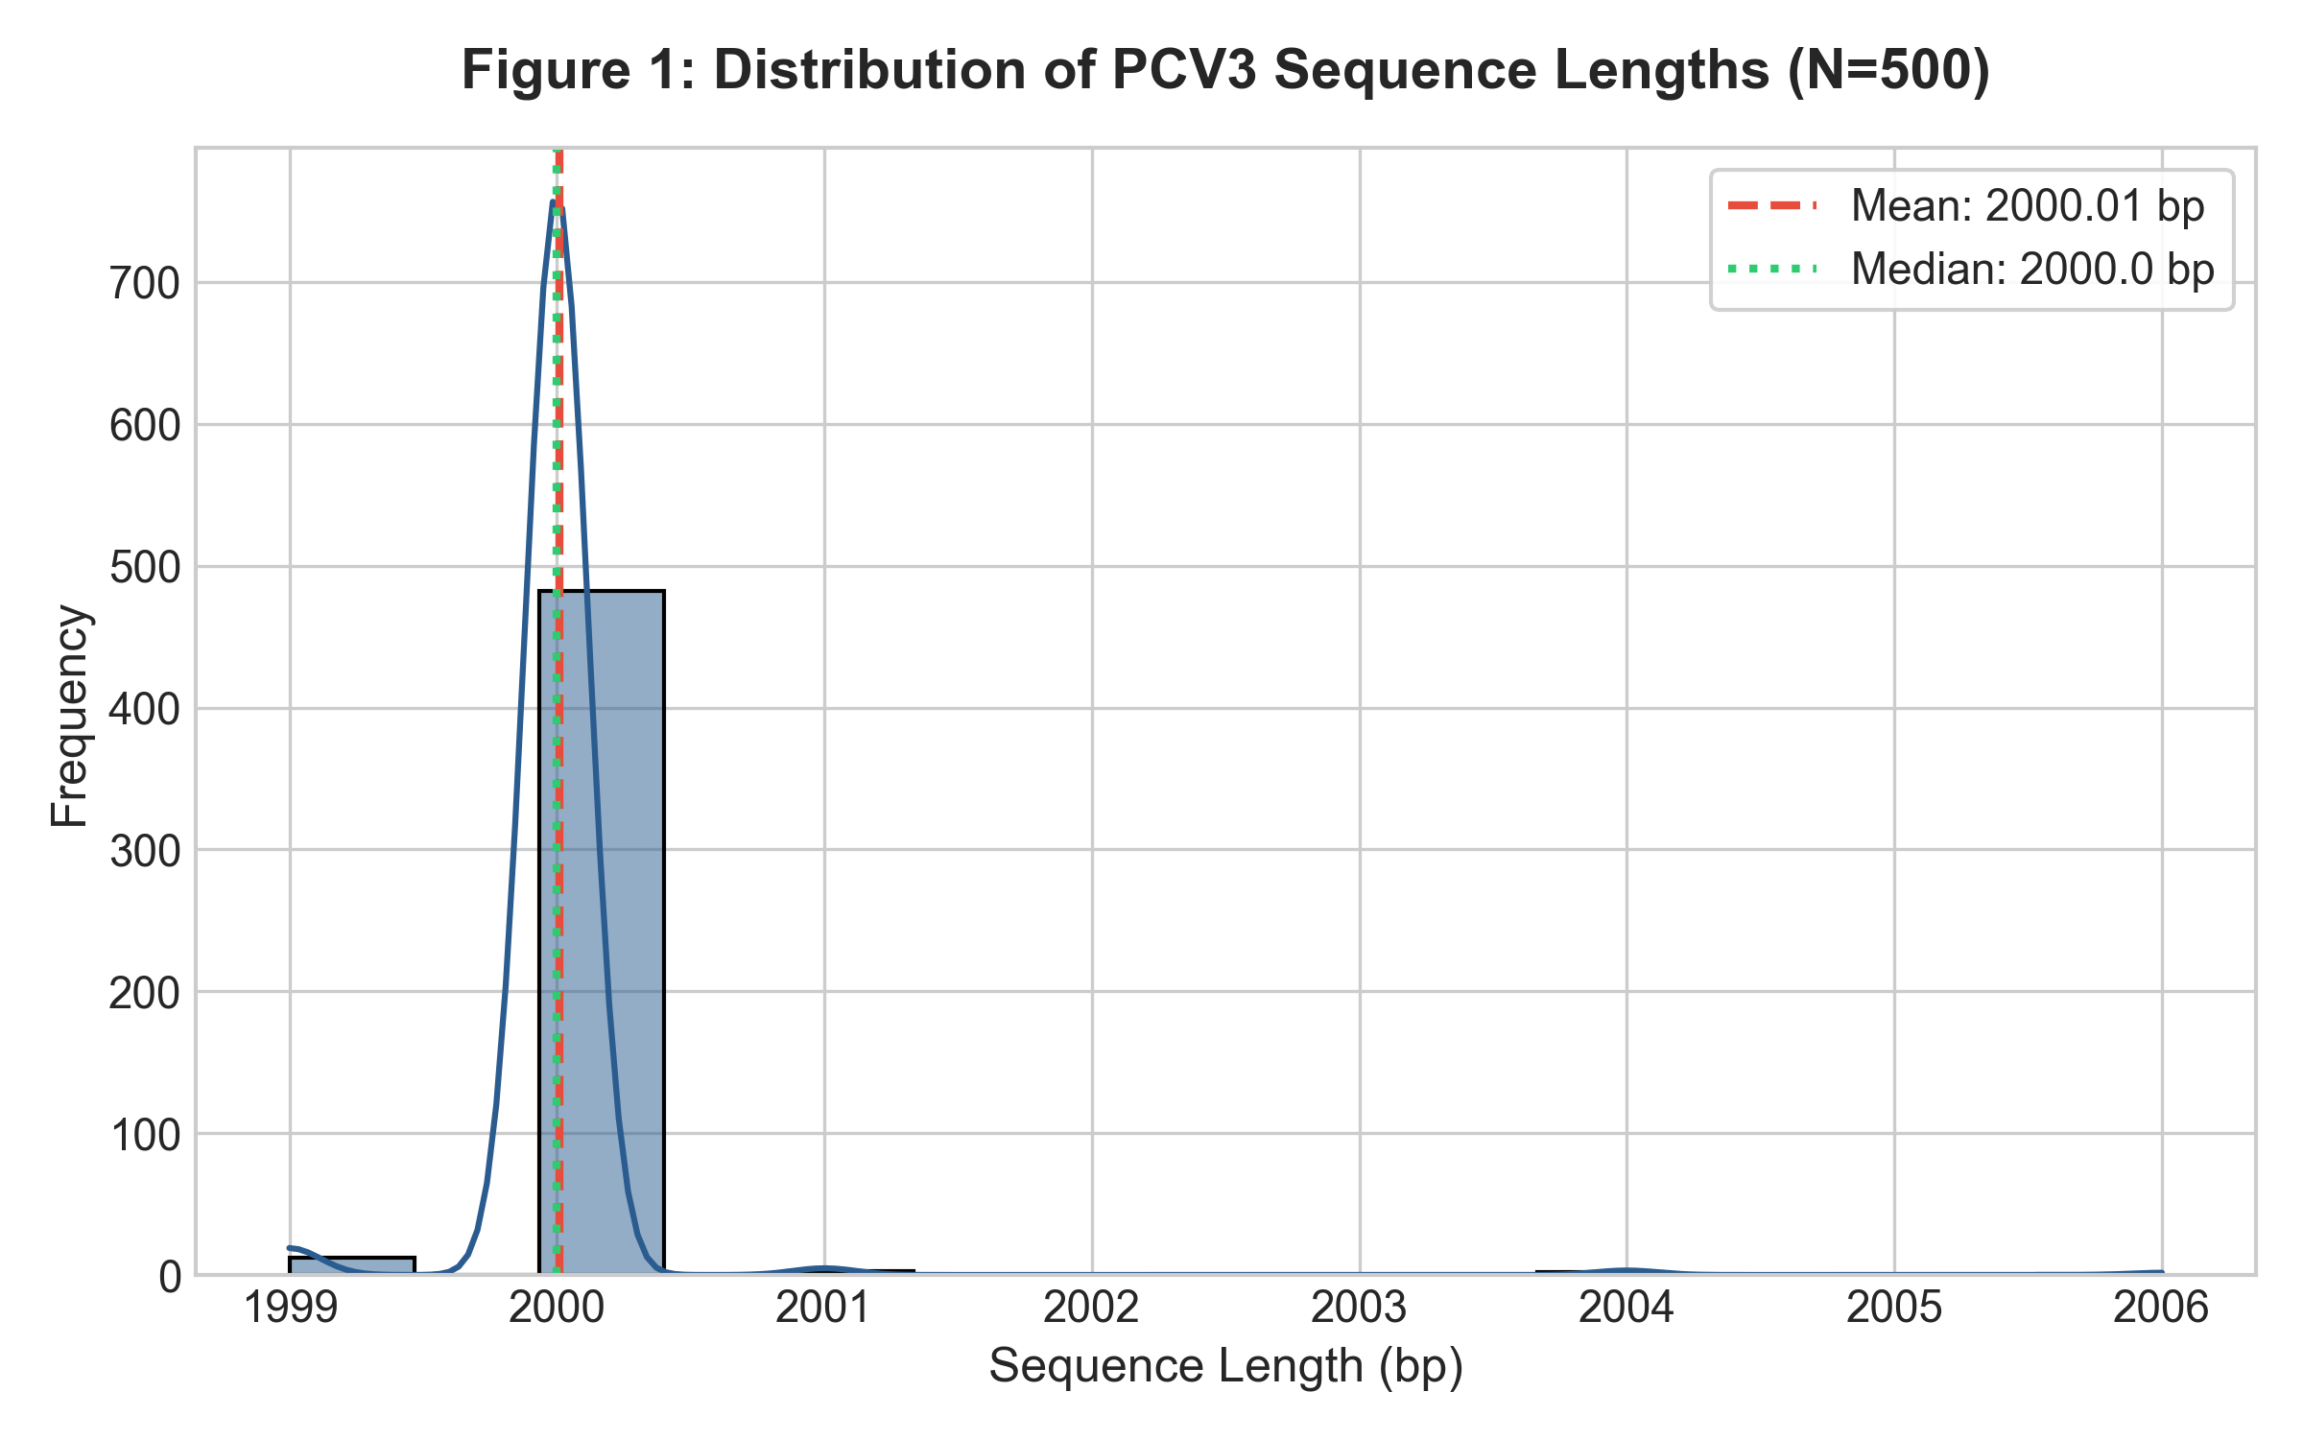
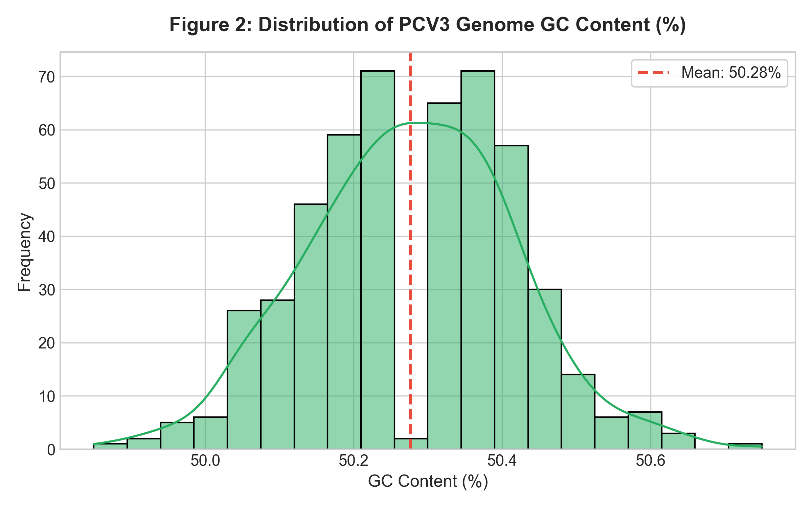
PHASE 3 — QUALITY CONTROL
Sequence Quality Control (Length & GC Content)

Slide 7
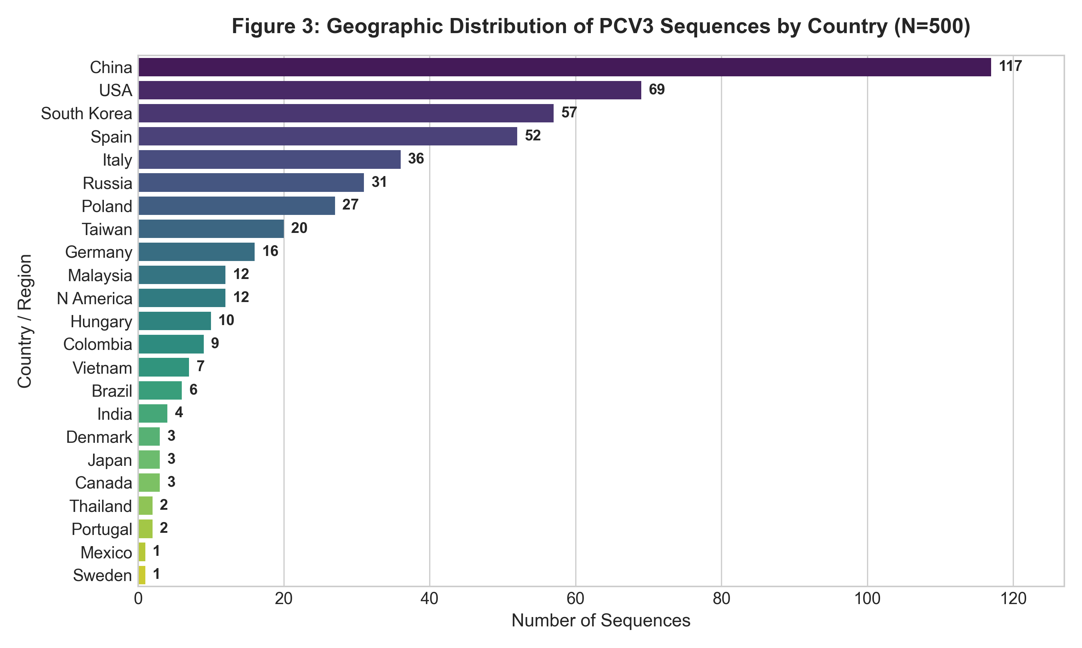
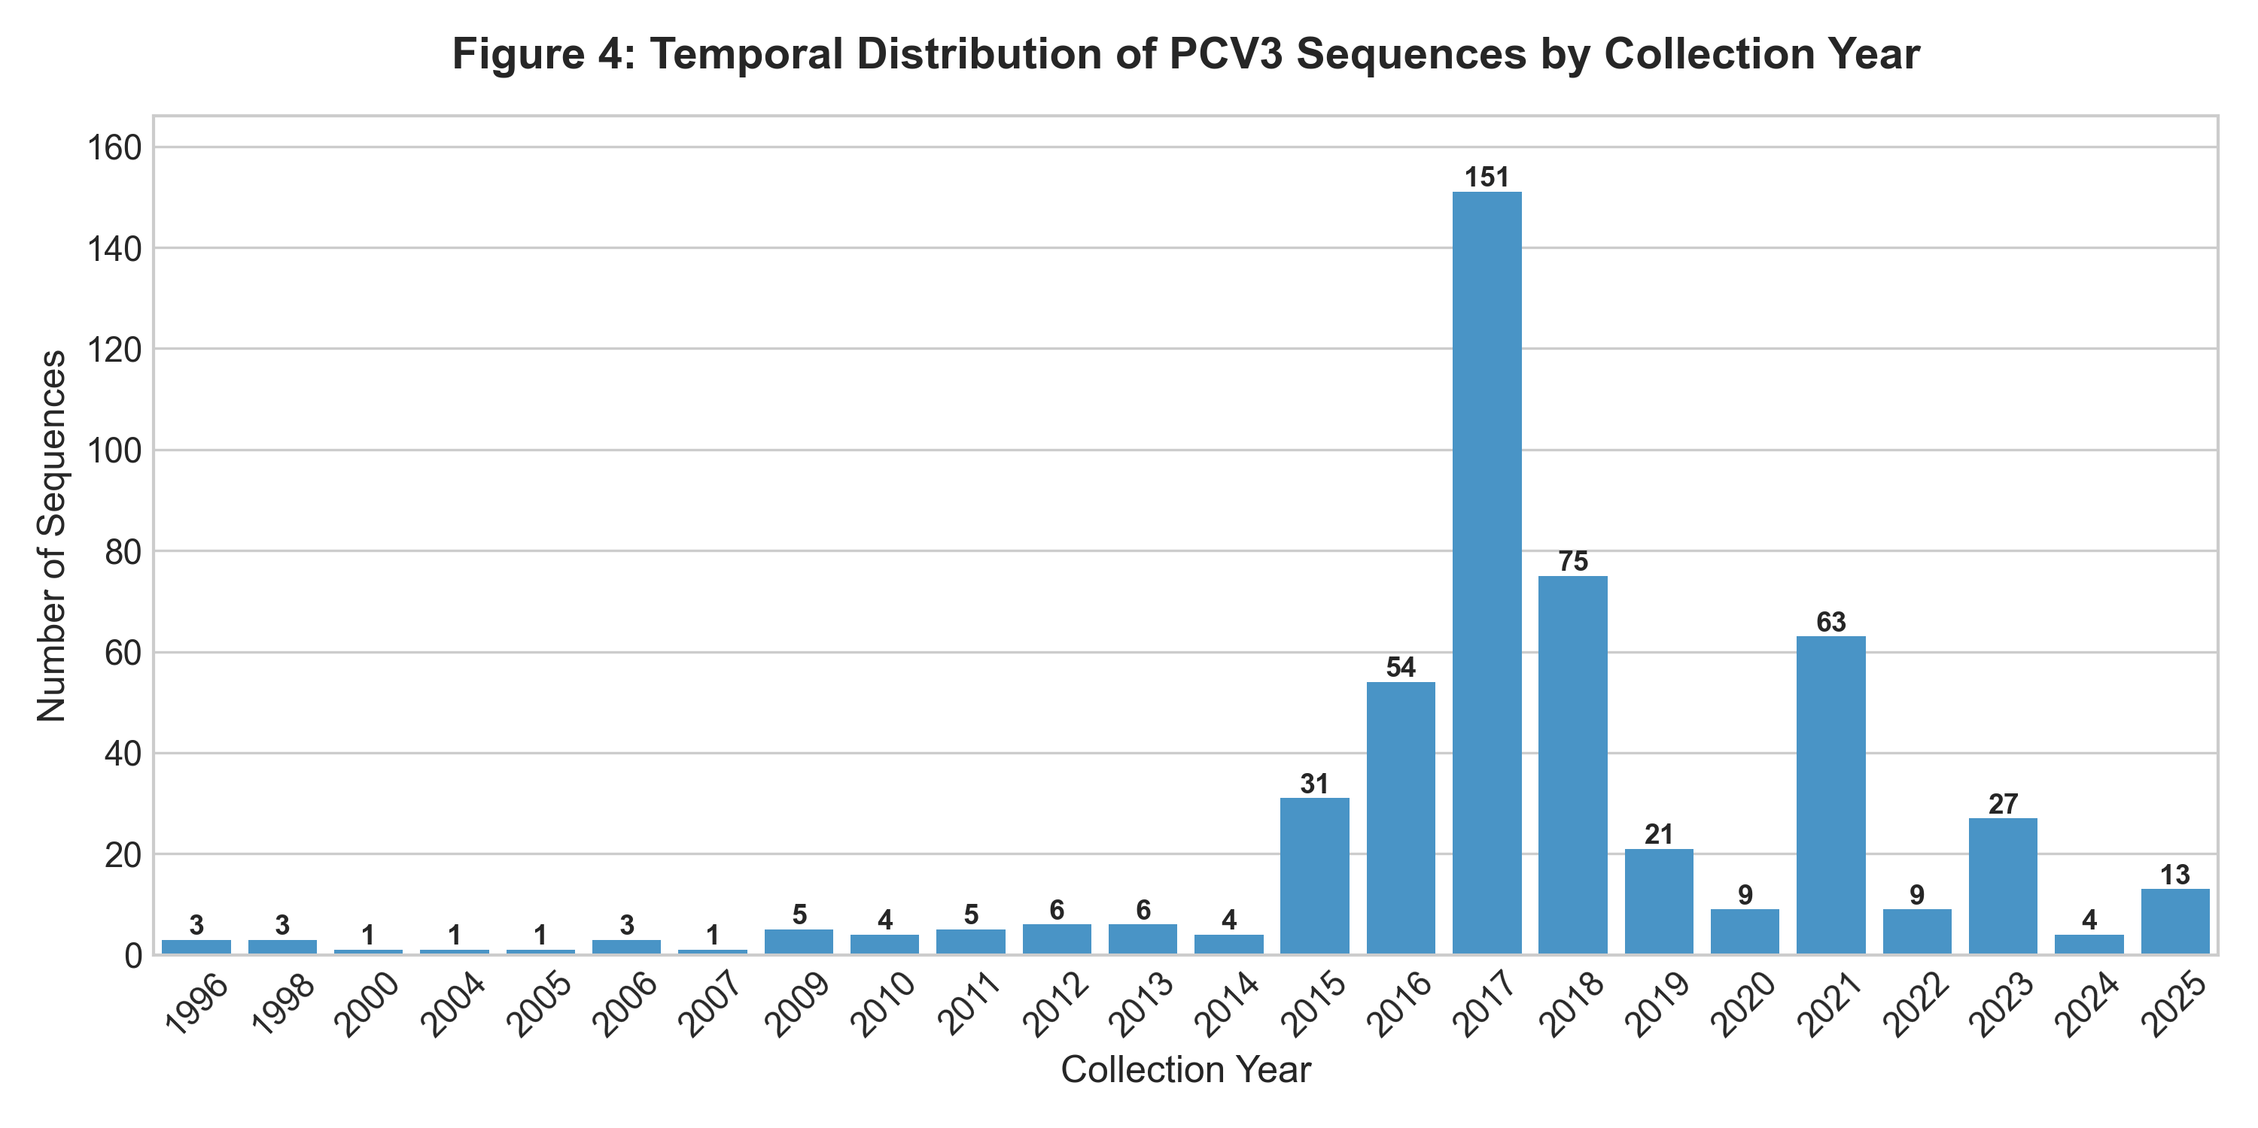
PHASE 3 — METADATA DISTRIBUTION
Geographic & Temporal Metadata Distribution

Slide 8
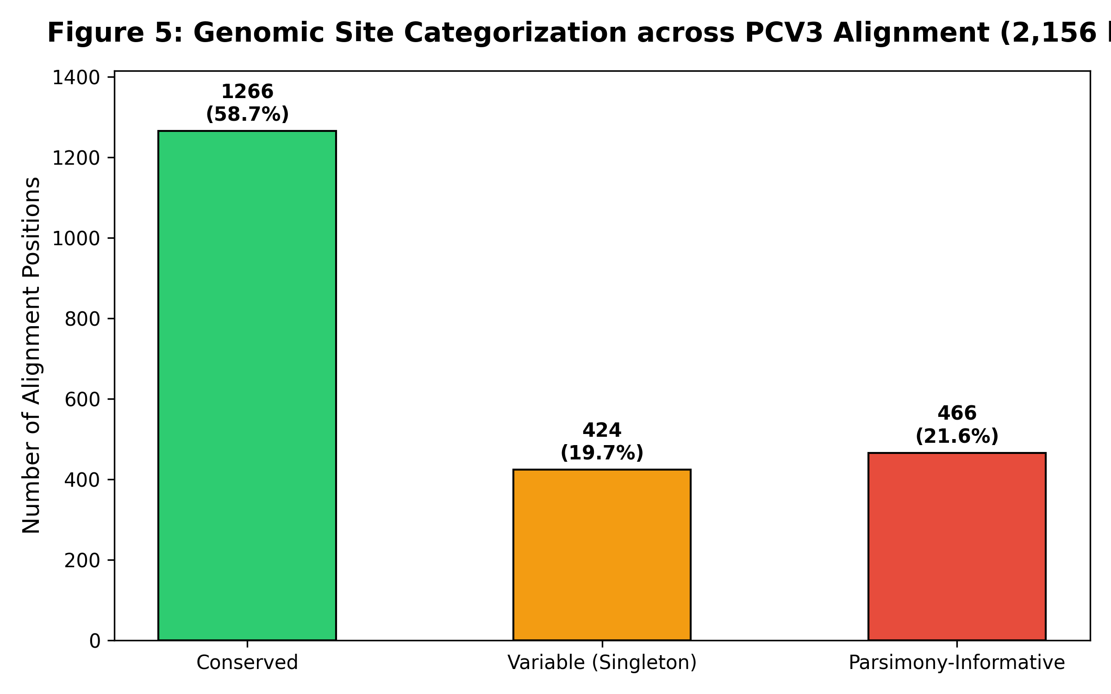
PHASE 4 — ALIGNMENT ANALYSIS
Multiple Sequence Alignment (MAFFT)
MAFFT Alignment Summary
• Alignment length: 2,156 bp across all 500 sequences.
• Conserved Positions: 1,266 bp (58.72% of genome).
• Variable / Polymorphic Sites: 890 bp (41.28%).
• Parsimony-Informative Sites: 466 bp (21.61%).
• Overall gap percentage: 7.24% across alignment matrix.

Slide 9
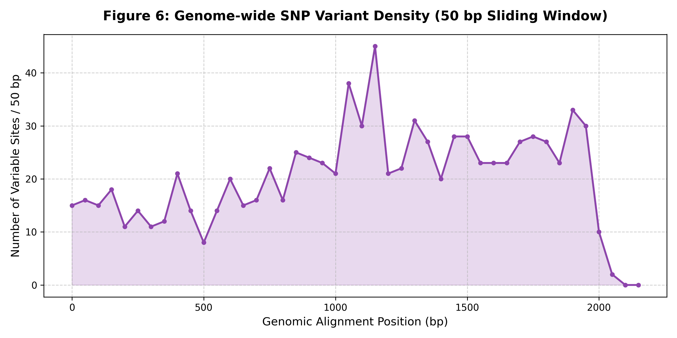
PHASE 5 — VARIATION PROFILING
Genome Variation & SNP Density Analysis
SNP Density & Variant Summary
• Identified 890 variable positions across PCV3 alignment.
• SNP density analyzed in 50 bp sliding windows.
• Highest variation observed in specific genomic regions corresponding to viral capsid (Cap) and replicase (Rep) genes.
• All 890 variable positions exported to table01_snp_positions_summary.csv for downstream feature extraction.

Slide 10
PHASE 6 — FEATURE EXTRACTION
Genome-Derived Feature Extraction Matrix
Primary Feature Matrix (SNP Matrix)
• One-Hot / Binary encoding of 890 aligned variable nucleotide positions across all 500 sequences.
• Feature Expansion: 890 variable positions produce 2,067 binary features due to one-hot encoding of non-constant nucleotide states (A, C, G, T) per site.
• Captures exact nucleotide substitution patterns at every variable genomic locus.
• Used as the PRIMARY input matrix for PCA and K-Means clustering.
Supplementary k=4 K-mer Matrix
• Extracted 256 k-mer tetranucleotide frequencies (k=4) normalized by sequence length.
• Provides alignment-free complementary feature representation.
• Strict Isolation: Country, Region, and Year were STRICTLY EXCLUDED from feature matrices to prevent metadata leakage.

Slide 11
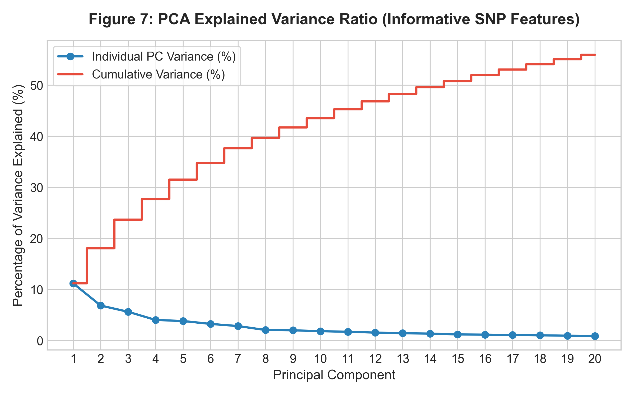
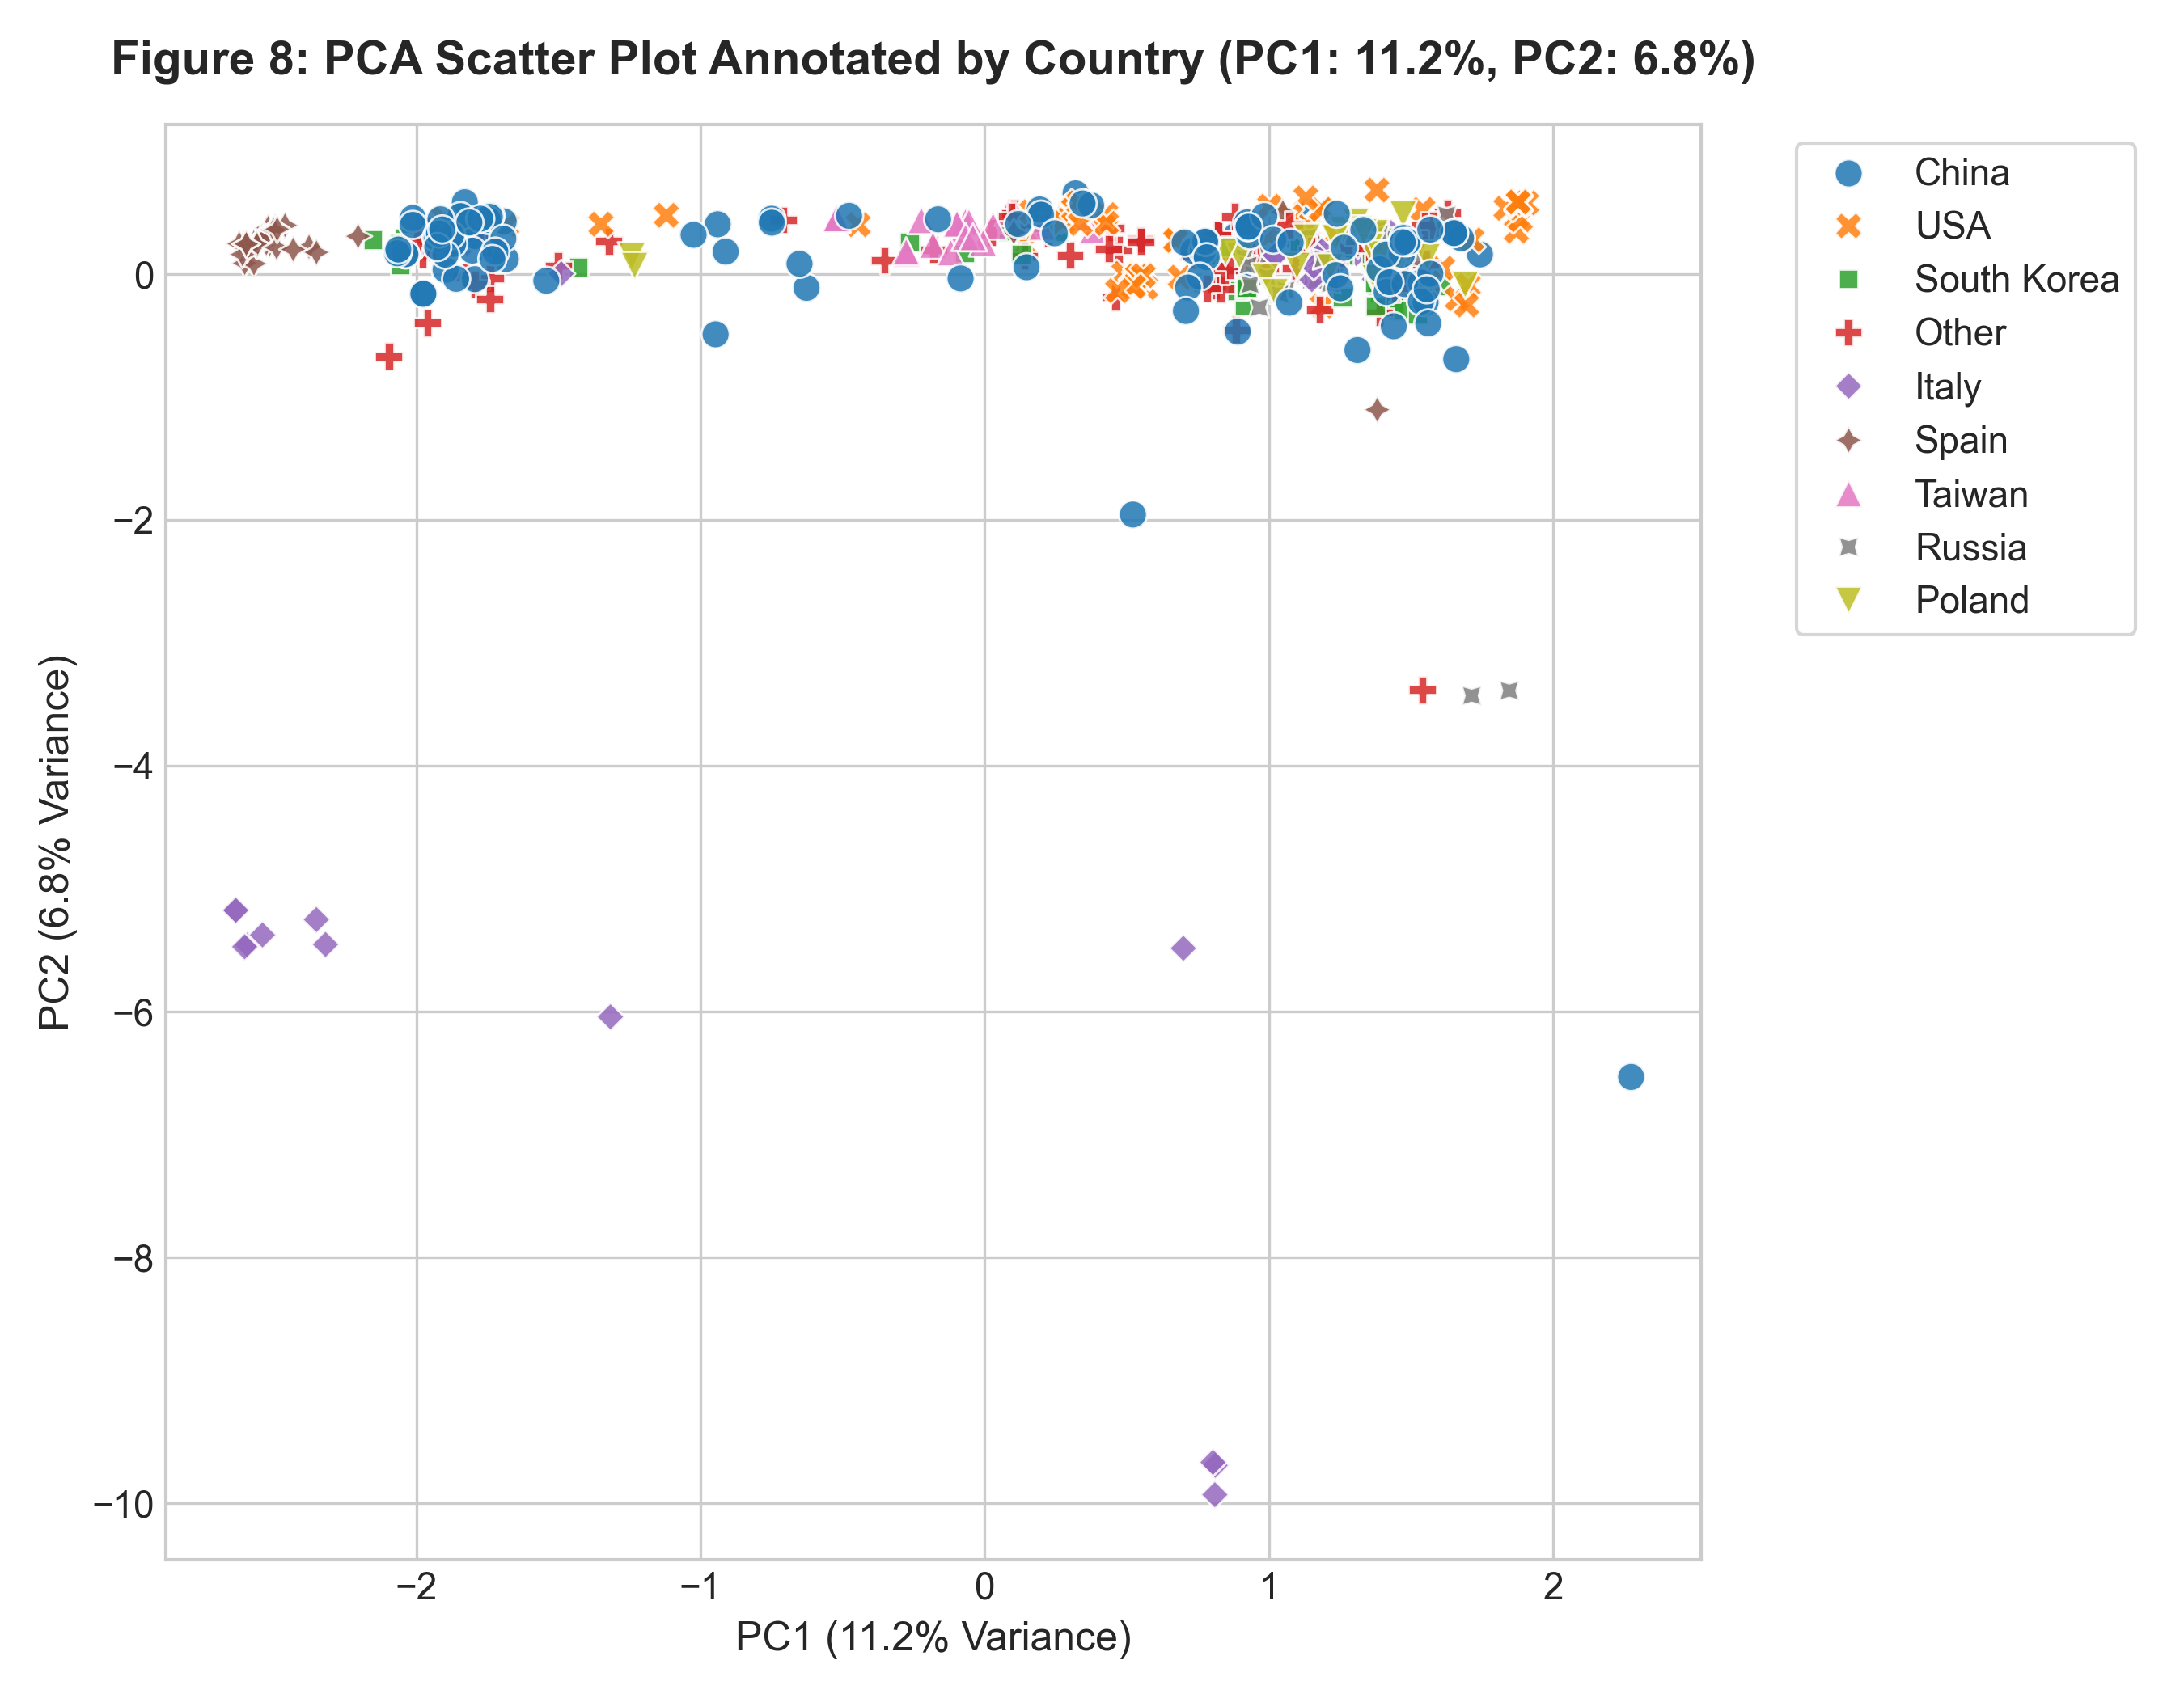
PHASE 7 — DIMENSIONALITY REDUCTION
Principal Component Analysis (PCA)

Slide 12
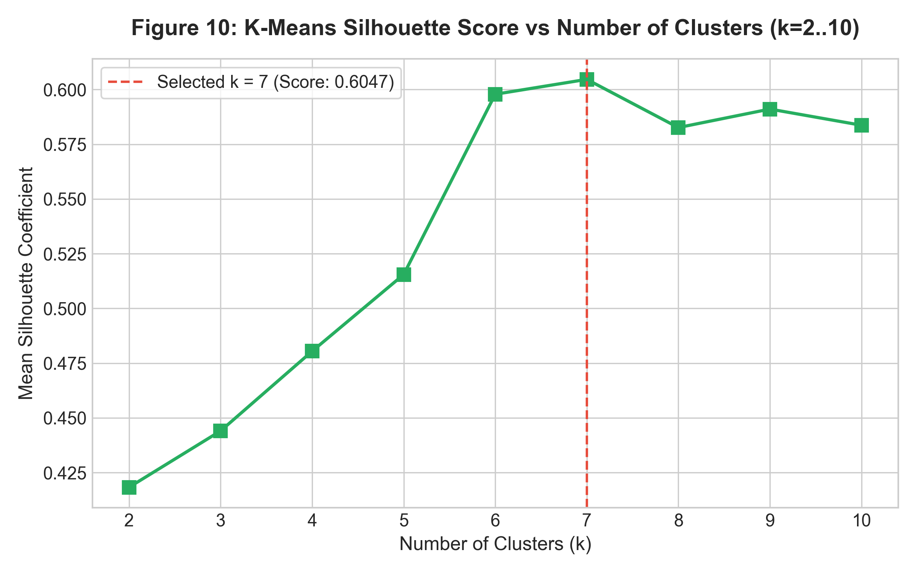
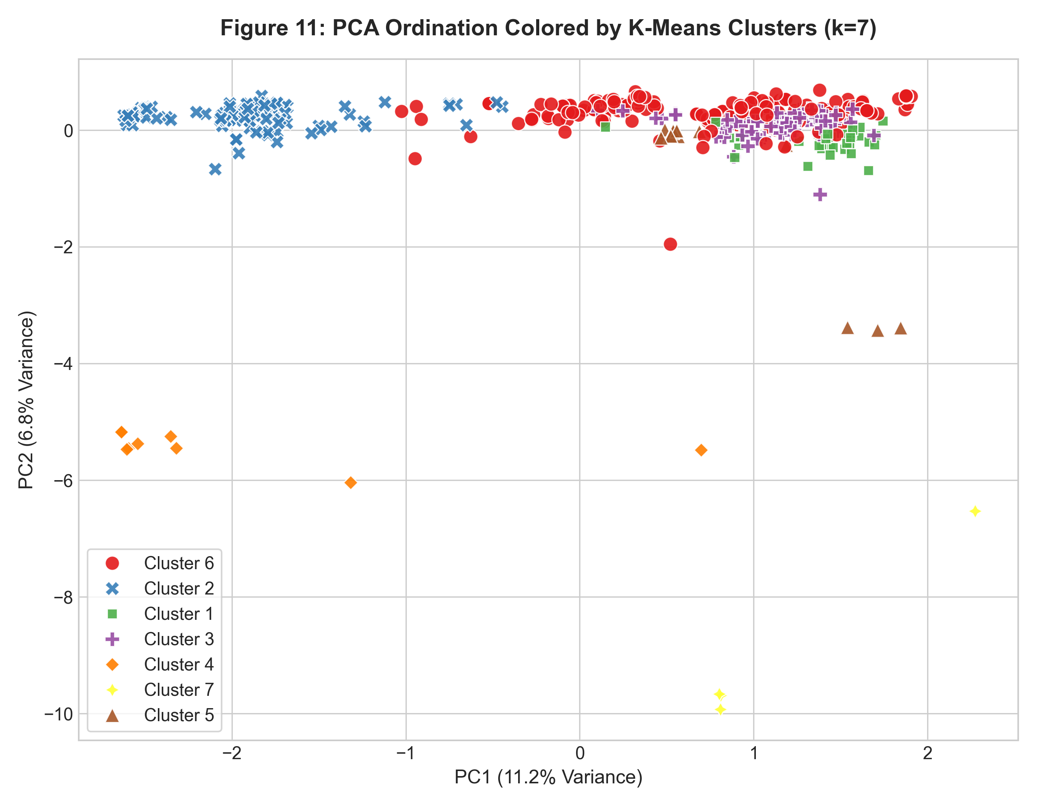
PHASE 8 — UNSUPERVISED CLUSTERING
K-Means Clustering & Silhouette Evaluation

Slide 13
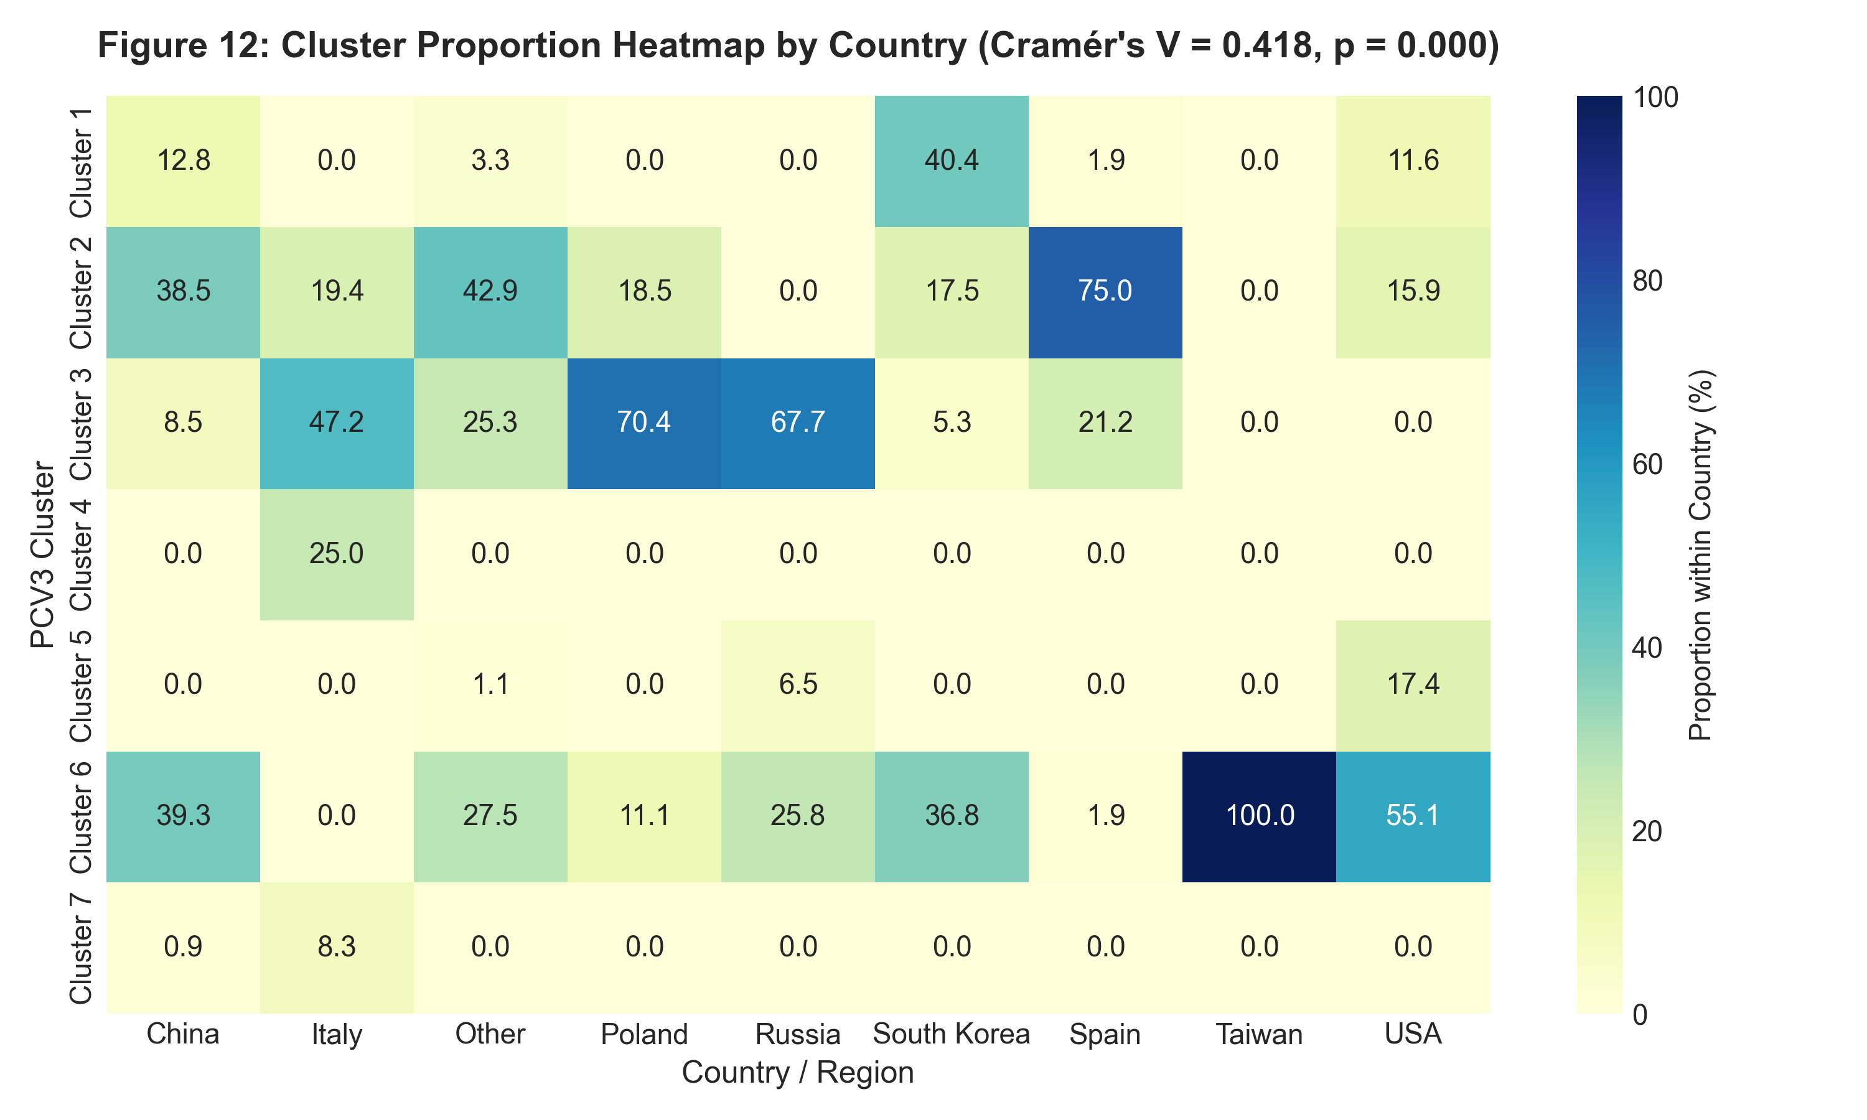
PHASE 9 — GEOGRAPHICAL ASSOCIATION
Cluster vs. Geographical Location Association
Geographical Statistical Test
• Constructed 7 x 9 Cluster x Country contingency table.
• Chi-square Statistic: 525.36 (dof = 48).
• Asymptotic p-value: 1.56e-81.
• Monte Carlo Permutation p-value (5,000 perms): p = 0.0002.
• Cramér's V = 0.4185 (Strong geographical association).
• Diagnostics: 50.8% of cells had expected count < 5; permutation test confirms validity.
• Caution: Statistical association does NOT prove geographical transmission routes, origin, or causal divergence.

Slide 14
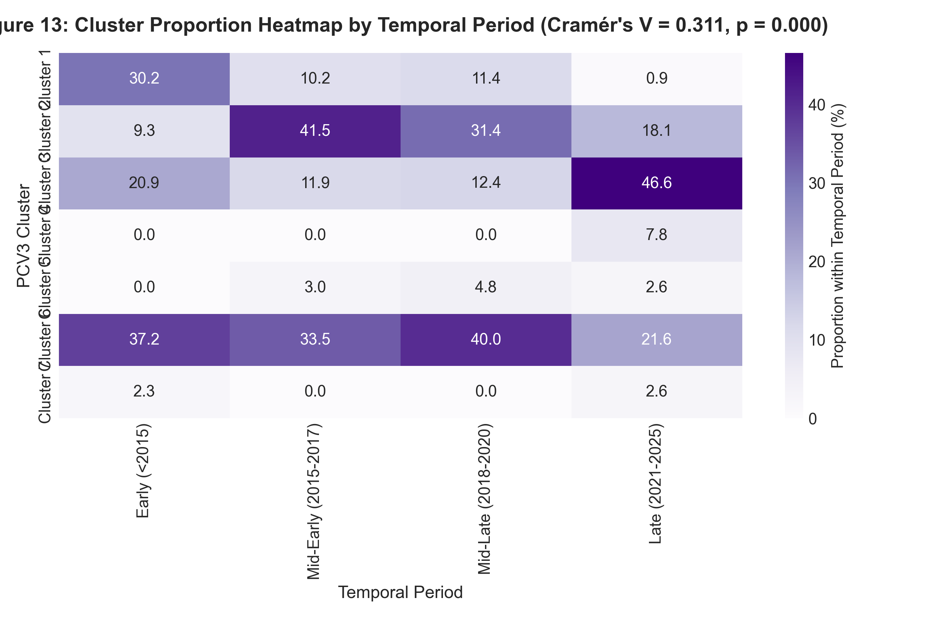
PHASE 10 — TEMPORAL ASSOCIATION
Cluster vs. Collection Year Association
Temporal Association Test
• Grouped collection years into 4 temporal bins (<2015, 2015-17, 2018-20, 2021-25).
• Chi-square Statistic: 145.50 (dof = 18).
• Asymptotic p-value: 5.54e-22.
• Monte Carlo Permutation p-value (5,000 perms): p = 0.0002.
• Cramér's V = 0.3114 (Moderate-to-strong temporal association).
• Temporal grouping prevents sparse cell count distortions.
• Caution: Statistical association does NOT prove temporal origin or molecular clock evolutionary rates.

Slide 15
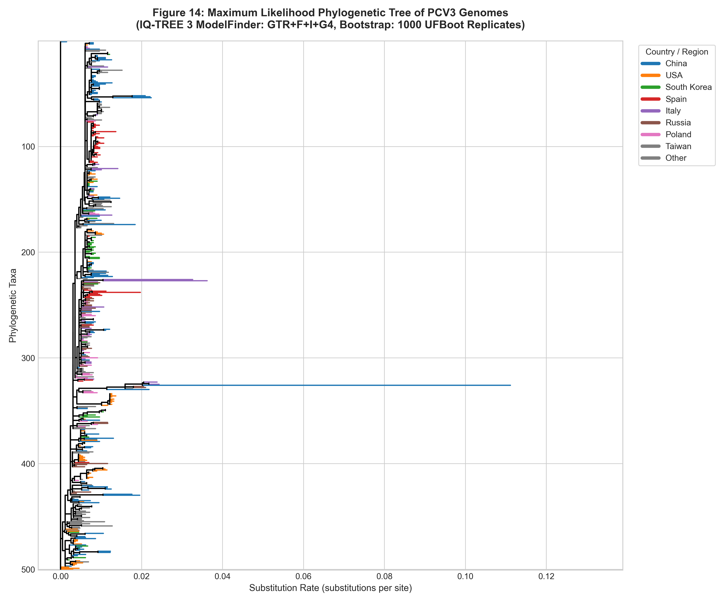
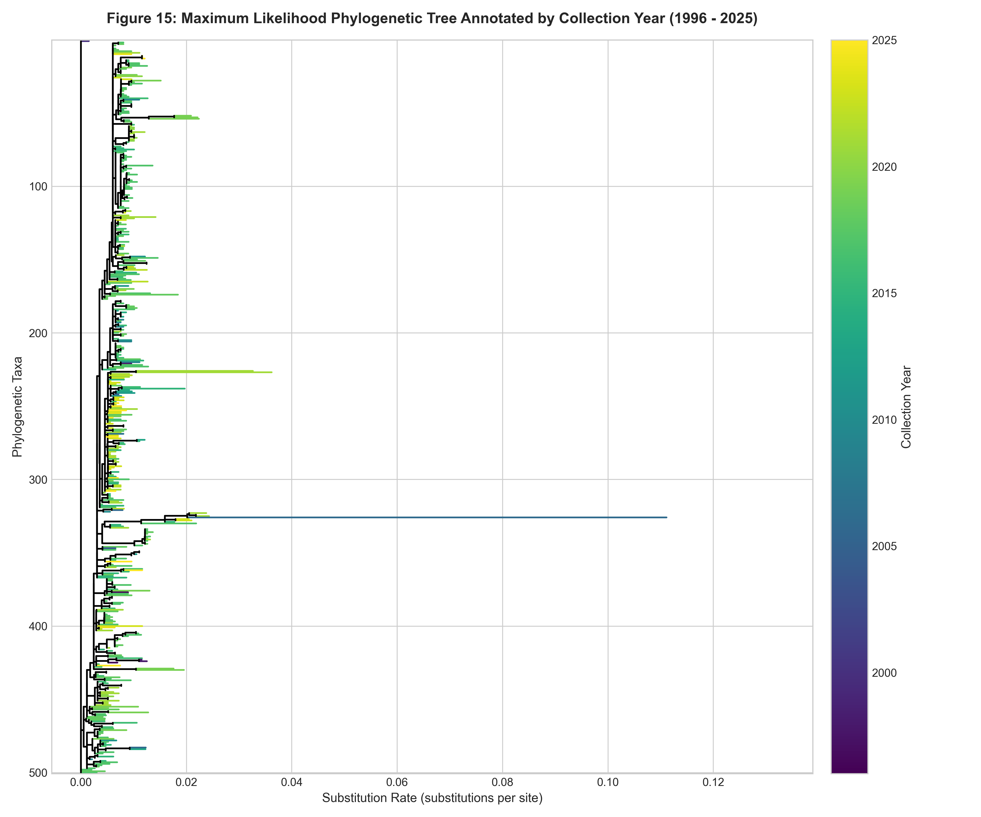
PHASE 11 & 12 — PHYLOGENETICS
Maximum Likelihood Phylogenetic Tree (IQ-TREE 3)

Slide 16
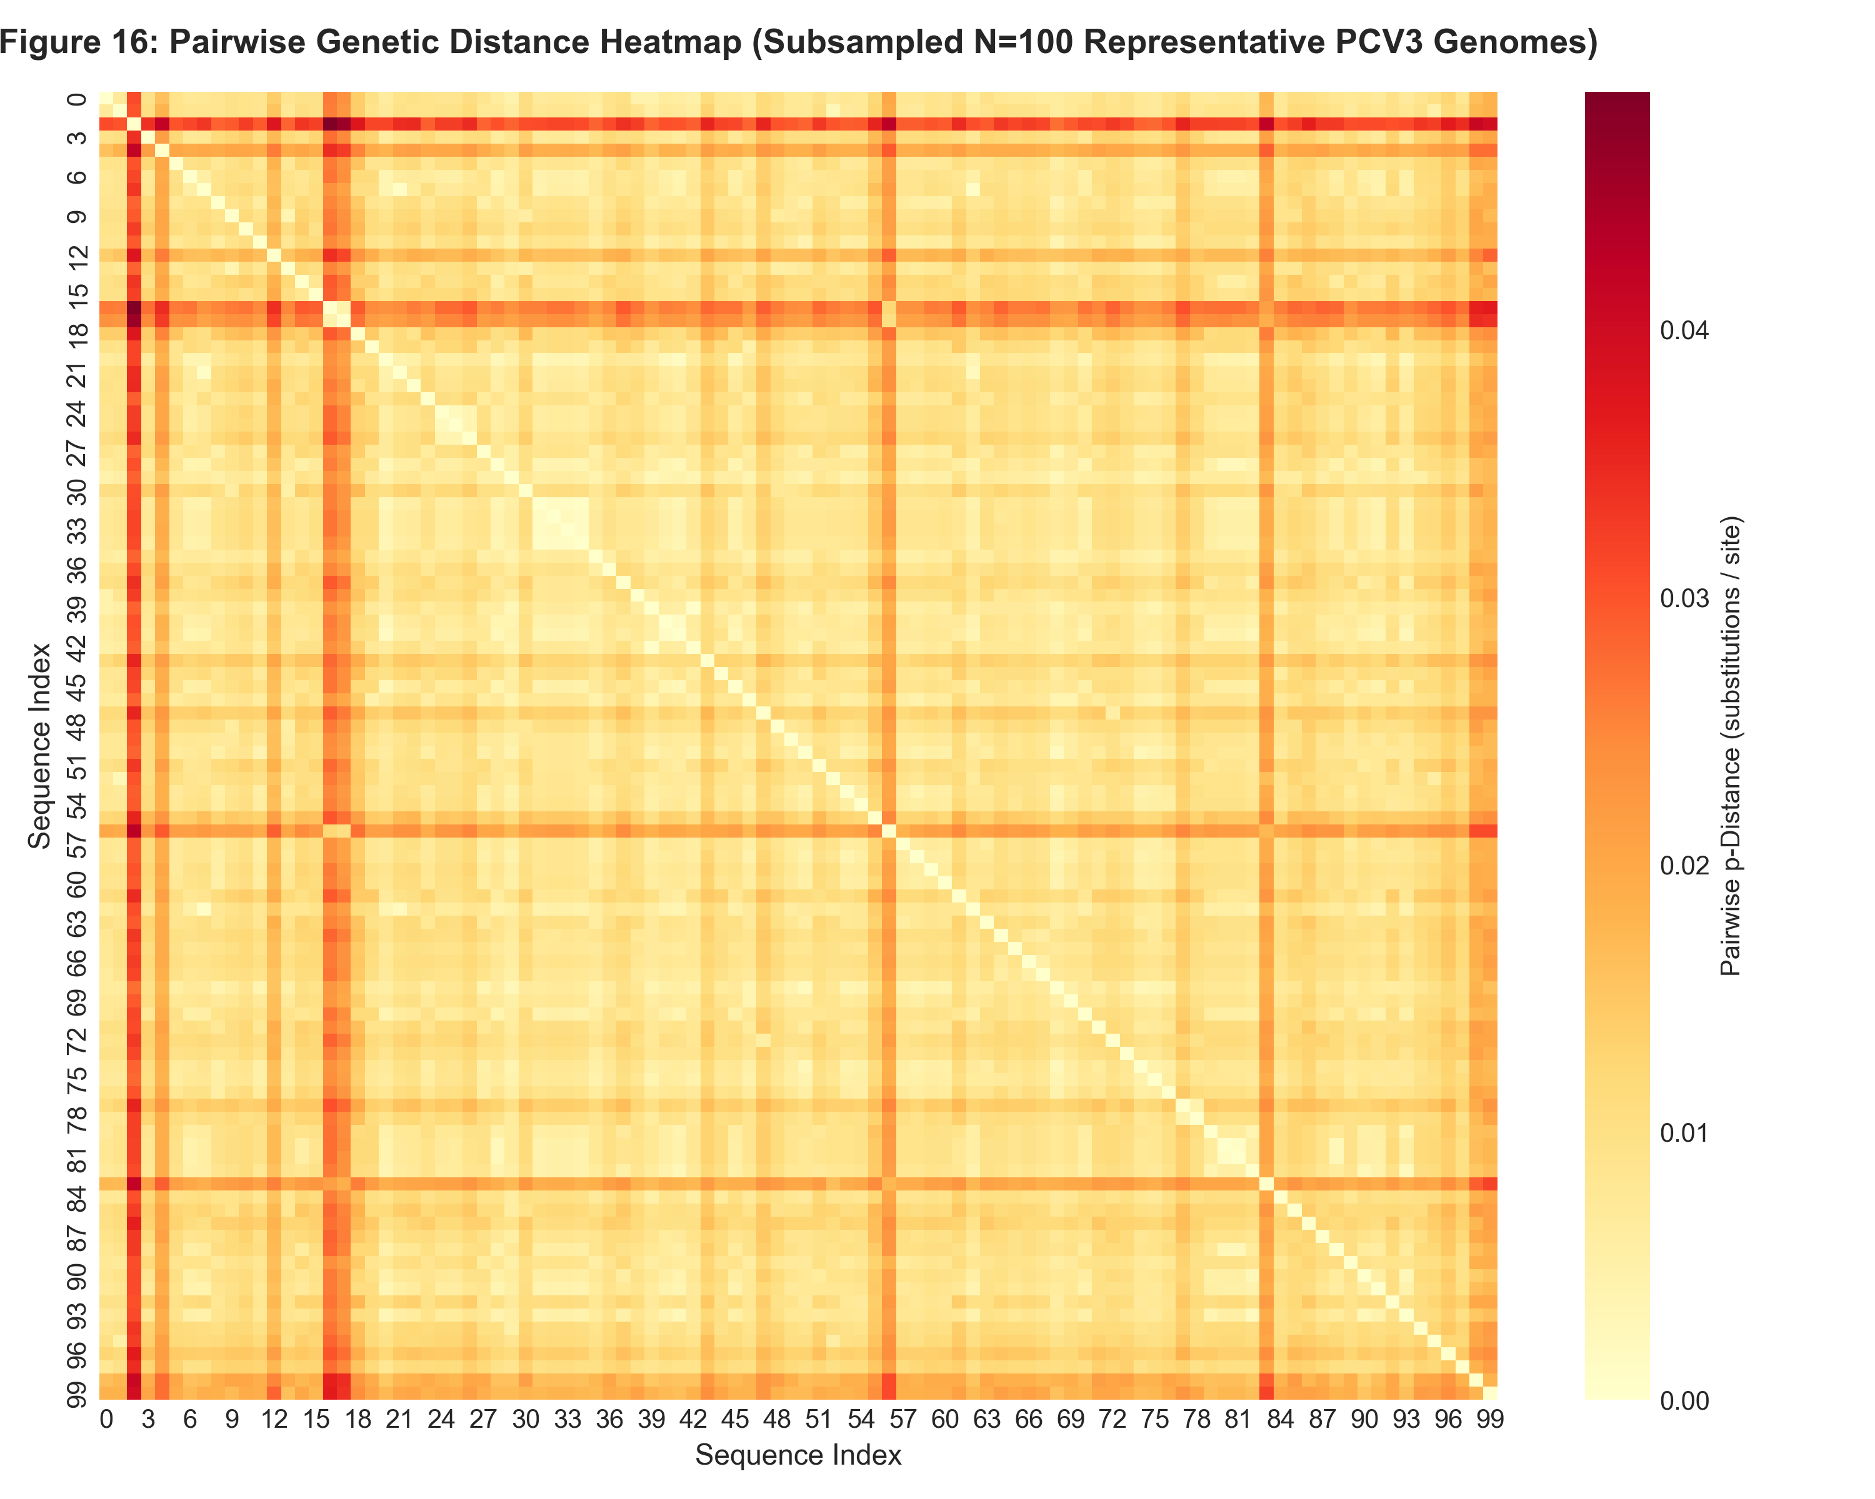
PHASE 13 — GENETIC DISTANCE
Pairwise Genetic Distance Heatmap
Genetic Distance Metrics
• Computed pairwise nucleotide p-distances across aligned PCV3 genomes.
• Mean Pairwise Distance: 0.0117 (1.17% mean nucleotide divergence).
• Max Pairwise Distance: 0.0489 (4.89% maximum divergence).
• High sequence conservation observed across global PCV3 isolates, consistent with single-stranded circular circovirus genomes.

Slide 17
PHASE 14 — INTEGRATED ANALYSIS
Integrated Synthesis & Study Limitations
Integrated Findings
• Genome Variation: 890 variable sites define PCV3 genomic divergence.
• Unsupervised Grouping: PCA and K-Means Silhouette analysis identify 7 distinct genomic clusters.
• Geographic & Temporal Trends: Clusters display strong statistical association with country (V=0.4185) and temporal period (V=0.3114).
• Phylogenetic Consistency: The phylogenetic tree structure was broadly consistent with the K-Means genomic clustering patterns.
Study Limitations
• Sampling Imbalance: High sample counts from China (117), USA (69), Spain (57), South Korea (51) vs single isolates from Sweden/Mexico.
• Metadata Inconsistencies: 16 records in Excel had conflicting regions (Spain vs Poland); 10 were absent from Excel.
• Causality Constraint: Statistical association does NOT prove geographical transmission routes, origin, or functional virulence alterations.

Slide 18
SUMMARY & CONCLUSION
Conclusion & Key References
Summary Conclusions
• PCV3 maintains a highly conserved circular genome (1.17% mean divergence) with clear SNP-defined sublineages.
• Unsupervised ML successfully partitions genomic variation without metadata bias.
• Observed sequence patterns are significantly associated with geographical location and collection year.
• Complete pipeline and figures are fully reproducible.
Key References
• Phan TG, et al. (2016). Detection of a novel circovirus PCV3 in pigs with cardiac and multi-systemic inflammation. Virology.
• Stadejek T, et al. (2020). Global transcriptional and phylogenetic analysis of PCV3. PLOS ONE.
• Franzo G, et al. (2020). Porcine circovirus 3 phylodynamics and evolutionary rate. Scientific Reports.
• Minh BQ, et al. (2020). IQ-TREE 2: New models and efficient algorithms for phylogenomics. Mol Biol Evol.

