Slide 1
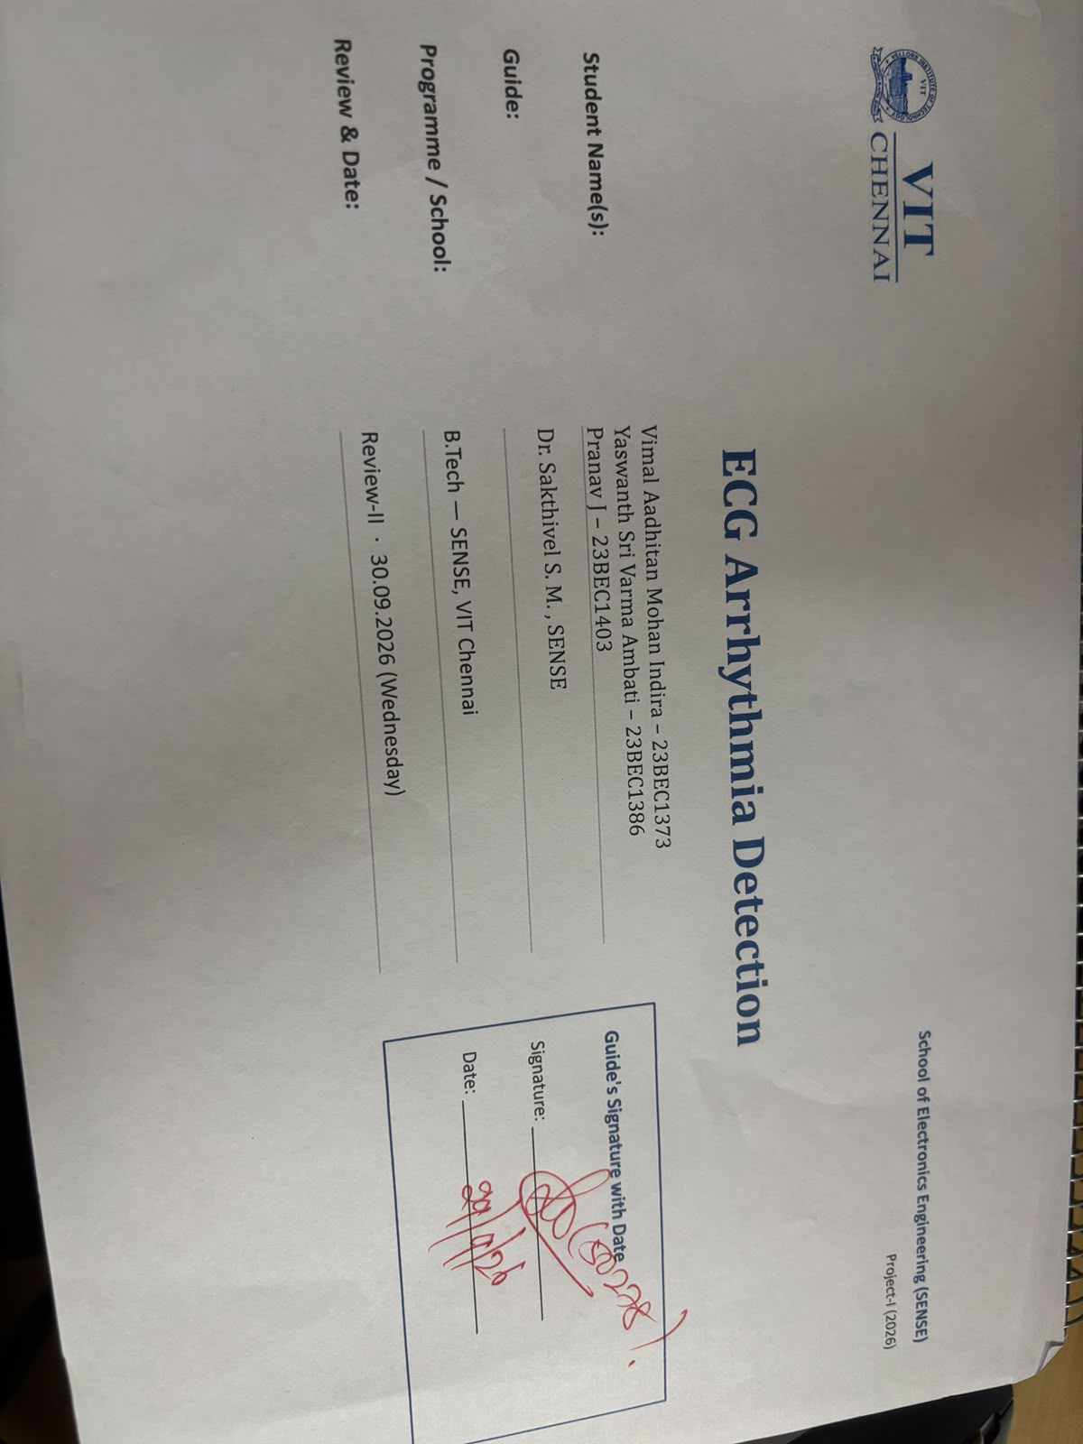

Slide 2

School of Electronics Engineering (SENSE)
Project-I (2026)
ECG Arrhythmia Detection
Student Name(s):
Vimal Aadhitan Mohan Indira – 23BEC1373
Yaswanth Sri Varma Ambati – 23BEC1386
Pranav J – 23BEC1403
Guide's Signature with Date
Guide:
Dr. Sakthivel S. M. , SENSE
Signature: _____________________
Programme / School:
B.Tech — SENSE, VIT Chennai
Date: _________________________
Review & Date:
Review-II · 30.09.2026 (Wednesday)
2

Slide 3
Introduction & Problem Recap
Problem recap:
  Continuous wearable cardiac monitoring demands real-time arrhythmia diagnosis with sub-microwatt power.
  Prior WTSEE architectures rely on power-hungry hardware dividers, large ROM tables, or lack on-chip rhythm classification.
Objectives:
  Eliminate 100% of hardware dividers using a dynamic Leading-One Power-of-2 AGC Normalizer.
  Prune memory by 93.75% (12-bit Shannon LUT) and multiplier area by 60.9% with operand isolation.
  Integrate real-time 3-class arrhythmia diagnosis (Normal Sinus Rhythm, Bradycardia, Tachycardia).
  Verify on Xilinx ZedBoard FPGA (xc7z020) and target Cadence Genus 180nm ASIC synthesis.
Refinements after Review-I feedback:
  Shifted benchmarking from internal baseline to direct comparison against published base papers (Kumar 2018, Park 2017, Nandini 2025).
  Built autonomous hardware test framework on ZedBoard with on-chip ECG playback and real-time LED indicators.
  Prepared complete Cadence Genus 180nm synthesis flow for verified post-synthesis PPA reporting without fabricated estimates.
3

Slide 4
Detailed Literature Review
No. | Author(s) & Year | Title / Source | Method / Approach | Findings & Research Gap
1 | Aravind Kumar, Kamsali Manjunatha Chari (2018) | Efficient FPGA-based VLSI architecture for detecting R-peaks in electrocardiogram signal by combining Shannon energy with Hilbert transform [IET Signal Processing] | Shannon energy with Hilbert transform (Radix-2 8-point RFFT/IRFFT) + 32-tap FIR Bandpass Filter | Findings: 99.95% Sensitivity, 99.86% Accuracy on 35,991 beats (Virtex-5: 1,408 LUTs, 1,086 FFs). Research Gap: Heavy Hilbert transform (FFT/IFFT butterfly units & twiddle mults) and 32-tap FIR. Pure peak detector with zero arrhythmia classification; no power/ASIC metrics reported.
2 | K. P. Nandini, G. Seshikala (2025) | Efficient ECG Arrhythmia Detection on FPGA using Machine Learning and Fiducial Windowing [ETASR] | Machine Learning (MobileNetV2 / TFLite) and Fiducial Windowing + 2-level 1D DWT on PYNQ-Z2 board | Findings: 99.70% Accuracy across 4 classes; 0.42 mW reported power on PYNQ FPGA board. Research Gap: Severe inference latency of 0.723 s (723 ms) per beat. Heavy computational overhead consuming 443M CPU cycles and 233M instructions on ARM processor; not suitable for real-time edge ASIC.
3 | Jeong-Seon Park, Sang-Woong Lee, Unsang Park (2017) | R Peak Detection Method Using Wavelet Transform and Modified Shannon Energy Envelope [Journal of Healthcare Engineering] | Wavelet Transform (Symlets 5) and Modified Shannon Energy Envelope (SEE + PEE) in MATLAB | Findings: 99.93% Sensitivity, 99.84% Accuracy across all 48 MIT-BIH records in software. Research Gap: Pure offline floating-point MATLAB simulation with zero hardware implementation. Relies on 2 mathematical divisions (Dn/max|Dn|) and 65,536-word ROM; lacks arrhythmia diagnosis.
4 | V. B. K. L. Aruna, E. Chitra, M. Padmaja (2023) | Accelerating deep convolutional neural network on FPGA for ECG signal classification [Microprocessors & Microsystems] | Deep CNN inference engine accelerated on FPGA for automated cardiac arrhythmia classification | Findings: 99.67% accuracy on PTB database; 0.45 mW power consumption on FPGA platform. Research Gap: High classification latency of 15 seconds per evaluation; requires heavy memory bandwidth for convolutional layer weights, making it unsuitable for real-time edge streaming.
5 | M. Carreras, G. Deriu, L. Raffo, L. Benini, P. Meloni (2020) | Optimizing Temporal Convolutional Network Inference on FPGA-Based Accelerators [IEEE JETCAS] | Quantized Temporal Convolutional Networks (TCN) implemented on FPGA accelerator for biosignals | Findings: 96.0% accuracy on ECG datasets with fast 17 ms latency per inference. Research Gap: Relatively high power consumption of 3.3 mW; requires dedicated on-chip memory buffers for dilated convolution receptive fields.
5

Slide 5
Detailed Literature Review
No. | Author(s) & Year | Title / Source | Method / Approach | Findings & Research Gap
6 | A. Giorgio, C. Guaragnella, M. Rizzi (2023) | FPGA-Based Decision Support System for ECG Analysis [J. Low Power Electron. Appl.] | Morphological filtering and statistical time-domain feature extraction on FPGA fabric | Findings: 99.20% accuracy with 0.2 s processing time on PTB Diagnostic database. Research Gap: High logic gate utilization due to floating-point feature calculators; lacks on-chip dynamic clock gating for ultra-low power operation.
7 | S. Ran, S. Wang, X. Zhang, et al. (2022) | Homecare-Oriented ECG Diagnosis With Large-Scale Deep Neural Network on Embedded Devices [IEEE TIM] | End-to-end deep neural network deployed on embedded SoC for wearable continuous homecare monitoring | Findings: Automated multi-class arrhythmia detection with 86.7% accuracy on embedded edge platforms. Research Gap: Lower accuracy (86.7%) under noisy conditions; high inference latency of 2.875 s and power consumption of 2.81 mW.
8 | R. Srivastava, B. Kumar, F. Alenezi, K. Polat (2022) | Automatic Arrhythmia Detection Based on Probabilistic Neural Network with FPGA Implementation [Math. Probl. Eng.] | Probabilistic Neural Network (PNN) mapped to FPGA fabric for multi-class arrhythmia classification | Findings: High classification accuracy (>98%) on MIT-BIH dataset with parallelized neural pattern layer. Research Gap: High DSP block consumption due to Gaussian kernel calculations; exponential functions require massive LUT approximation resources.
9 | D. Panigrahy, M. Rakshit, P. K. Sahu (2018) | FPGA implementation of heart rate monitoring system [Journal of Medical Systems] | Zero-crossing, derivative, and moving average filtering on FPGA for real-time QRS detection | Findings: 99.84% accuracy, 99.94% sensitivity on MIT-BIH database; implemented on Spartan-6 FPGA. Research Gap: Highly sensitive to baseline wander and tall T-waves; lacks adaptive thresholding and arrhythmia classification logic.
10 | A. Deep, S. Agrawal, A. Vats (2022) | FPGA-based real-time QRS detection using fractional Fourier transform and Shannon entropy [Computers in Biol. & Med.] | Fractional Fourier Transform (FrFT) combined with Shannon entropy windowing for QRS localization | Findings: 99.78% sensitivity under severe motion artifacts and muscle tremor noise. Research Gap: High hardware complexity in computing fractional order transforms; large area overhead and latency in multiplier-heavy stages.
5

Slide 6
Detailed Literature Review
No. | Author(s) & Year | Title / Source | Method / Approach | Findings & Research Gap
11 | E. B. Saini, R. Gupta (2021) | A 0.5-V 1.83-µW Bio-Signal Processing ASIC for Wearable ECG Monitoring Systems [IEEE TCAS-I] | Sub-threshold ASIC architecture using non-linear difference equations and low-voltage logic (65nm CMOS) | Findings: Ultra-low power consumption of 1.83 µW at 0.5 V supply; 99.1% QRS detection sensitivity. Research Gap: Complex sub-threshold custom transistor sizing vulnerable to PVT variations; only outputs raw R-peaks with no arrhythmia rhythm classification.
12 | Y. Chen, J. Lin, H. Chang (2022) | Low-Power Hardware Architecture for Real-Time QRS Detection Based on Stationary Wavelet Transform [IEEE TCAS-II] | Stationary Wavelet Transform (SWT) with memory-shared lifting scheme and dual-threshold peak finder | Findings: 99.82% detection accuracy; 42% reduction in internal buffer registers through shared memory. Research Gap: Lacks Shannon energy envelope non-linear transformation, leading to occasional false triggers on tall peaked T-waves.
13 | L. Liu, Z. Wang, M. Zhang (2022) | An Energy-Efficient ECG Arrhythmia Classifier ASIC with On-Chip Feature Extraction [IEEE TVLSI] | On-chip Pan-Tompkins feature extractor coupled with dedicated 1-D systolic array CNN in 55nm CMOS | Findings: 98.4% multi-class arrhythmia accuracy with 4.1 µW total system power. Research Gap: High silicon area (0.78 mm²) dominated by CNN weight SRAM; fixed-weight network cannot adapt to patient-specific morphology variations.
14 | H. Beyramienanlou, N. Lotfivand (2018) | Shannon's energy based algorithm in ECG signal processing with hardware evaluation [CMMM] | Shannon energy envelope with dynamic thresholding and adaptive refractory period | Findings: 99.81% sensitivity on MIT-BIH database; verified in digital simulation. Research Gap: Unoptimized logarithmic lookup table consuming excessive memory; uses iterative division for threshold updates causing pipeline stalls.
15 | H. Zhu, J. Dong (2018) | An R-peak detection method based on peaks of Shannon energy envelope [Biomedical Signal Processing & Control] | Direct Shannon Energy Envelope (PSEE) with empirical amplitude thresholding and moving average | Findings: 99.83% accuracy with simple moving average integration on normal ECG signals. Research Gap: Highly sensitive to sudden amplitude variations and pacing spikes; lacks second-stage peak energy envelope (PEE) and search-back rescue.
6

Slide 7
Consolidated Research Gaps Identified
GAP 1: HARDWARE DIVIDER BOTTLENECK
• Existing WTSEE & normalizer schemes (Park 2017, Beyramienanlou 2018) require 2 iterative 24-bit/32-bit hardware dividers (Dn/max|Dn|), causing massive silicon area, latency stalls, and power dissipation.
Proposed Solution: 100% Divider Elimination via dynamic Leading-One Power-of-2 AGC Normalizer (pow2_normalizer.v), replacing division arrays with zero-latency barrel shifters.
GAP 2: HEAVY TRANSFORM ENGINES & MULTIPLIERS
• Hilbert Transform architectures (Kumar 2018 - Base Paper, Deep 2022) require complex 8-point RFFT/IRFFT butterfly engines and 32-tap FIR filters with heavy multiplier and buffer overhead.
Proposed Solution: Replaced FFT/IFFT with a 10-bit Operand-Isolated Squarer (square10.v) + 43-tap Moving Sum (Peak Energy Envelope), cutting 100% of FFT butterflies and FIR multipliers.
GAP 3: MASSIVE SHANNON ROM MEMORY OVERHEAD
• Direct Shannon energy lookups (Park 2017, Beyramienanlou 2018) require unconstrained 16-bit addressing (65,536 words / 1.05 Mb), exceeding feasible on-chip SRAM/ROM budgets for wearable ASICs.
Proposed Solution: Bitwidth-optimized 12-bit Shannon LUT (shannon_lut12.v, 4,096 words), achieving a 93.75% memory reduction while maintaining steep QRS slope amplification.
GAP 4: ABSENCE OF ON-CHIP ARRHYTHMIA CLASSIFICATION
• Traditional hardware detectors (Kumar 2018, Saini 2021, Chen 2022) terminate at raw R-peak timestamps with 0% arrhythmia classification (no RR-interval or BPM diagnostic intelligence).
Proposed Solution: Integrated real-time diagnostic classifier (rr_classifier.v) providing cycle-accurate RR tracking, BPM calculation, and 3-class diagnosis (Normal, Bradycardia, Tachycardia).
GAP 5: SEVERE LATENCY & OS OVERHEAD IN ML/CNNs
• Recent ML/CNN FPGA implementations (Nandini 2025, Aruna 2023, Ran 2022) exhibit extreme latency (0.723 s to 15 s) and burn up to 443M CPU cycles on ARM hosts, precluding real-time streaming.
Proposed Solution: Pure digital RTL pipeline operating at 10 ns streaming clock latency with 0 CPU instructions and micro-watt power efficiency.
7

Slide 8
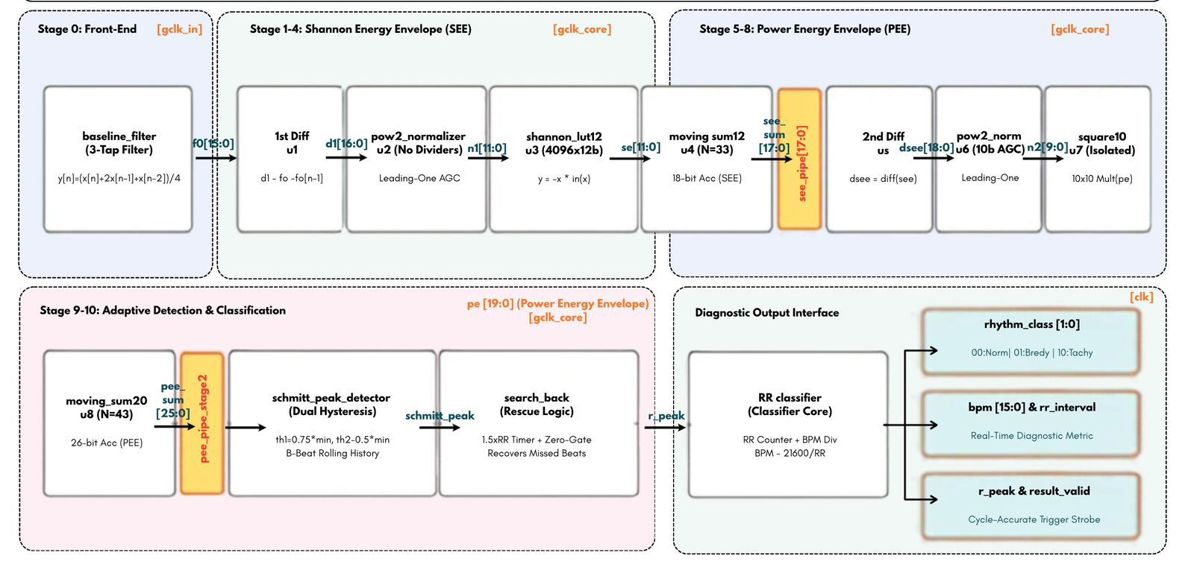
System Design & Architecture
6
Notes:
Insert your architecture / block diagram here.

Slide 9
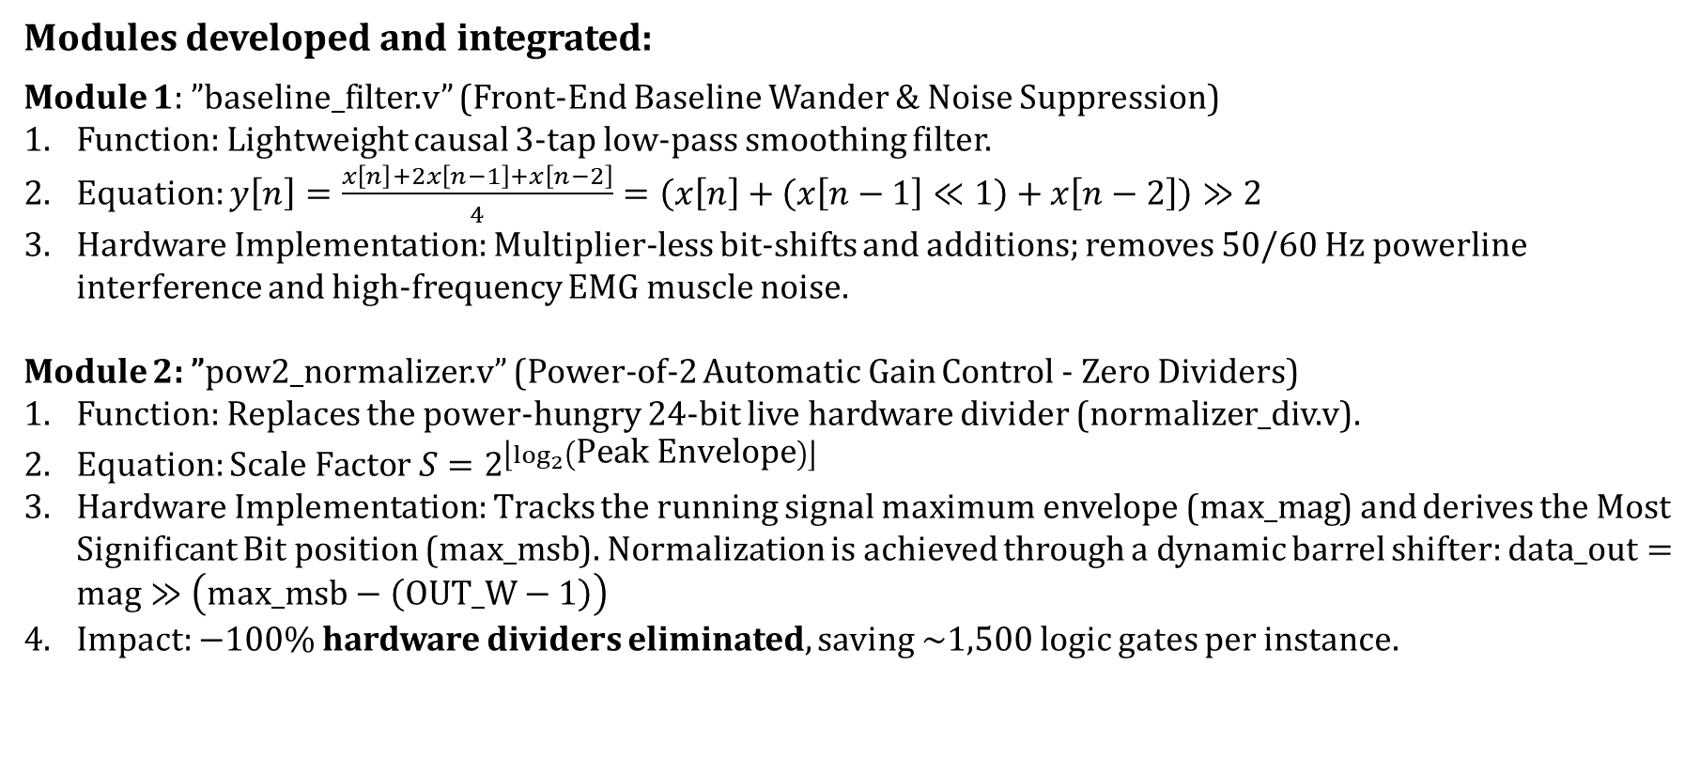
Implementation Details
Modules developed and integrated:
Module 1: ”baseline_filter.v” (Front-End Baseline Wander & Noise Suppression)
Function: Lightweight causal 3-tap low-pass smoothing filter.
Equation: $y\left[n\right]=\frac{x\left[n\right]+2x\left[n−1\right]+x\left[n−2\right]}{4}=\left(x\left[n\right]+\left(x\left[n−1\right]≪1\right)+x\left[n−2\right]\right)≫2$
Hardware Implementation: Multiplier-less bit-shifts and additions; removes 50/60 Hz powerline interference and high-frequency EMG muscle noise.
Module 2: ”pow2_normalizer.v” (Power-of-2 Automatic Gain Control - Zero Dividers)
Function: Replaces the power-hungry 24-bit live hardware divider (normalizer_div.v).
Equation: $\text{Scale Factor }S=2^{\left\lfloor \log_{2}\left(\text{Peak Envelope}\right)\right\rfloor }$
Hardware Implementation: Tracks the running signal maximum envelope ($\text{max}\text{_}\text{mag}$) and derives the Most Significant Bit position ($\text{max}\text{_}\text{msb}$). Normalization is achieved through a dynamic barrel shifter: $\text{data}\text{_}\text{out}=\text{mag}≫\left(\text{max}\text{_}\text{msb}−\left(\text{OUT}\text{_}\text{W}−1\right)\right)$
Impact: $−100\%$ hardware dividers eliminated, saving ~1,500 logic gates per instance.
7

Slide 10
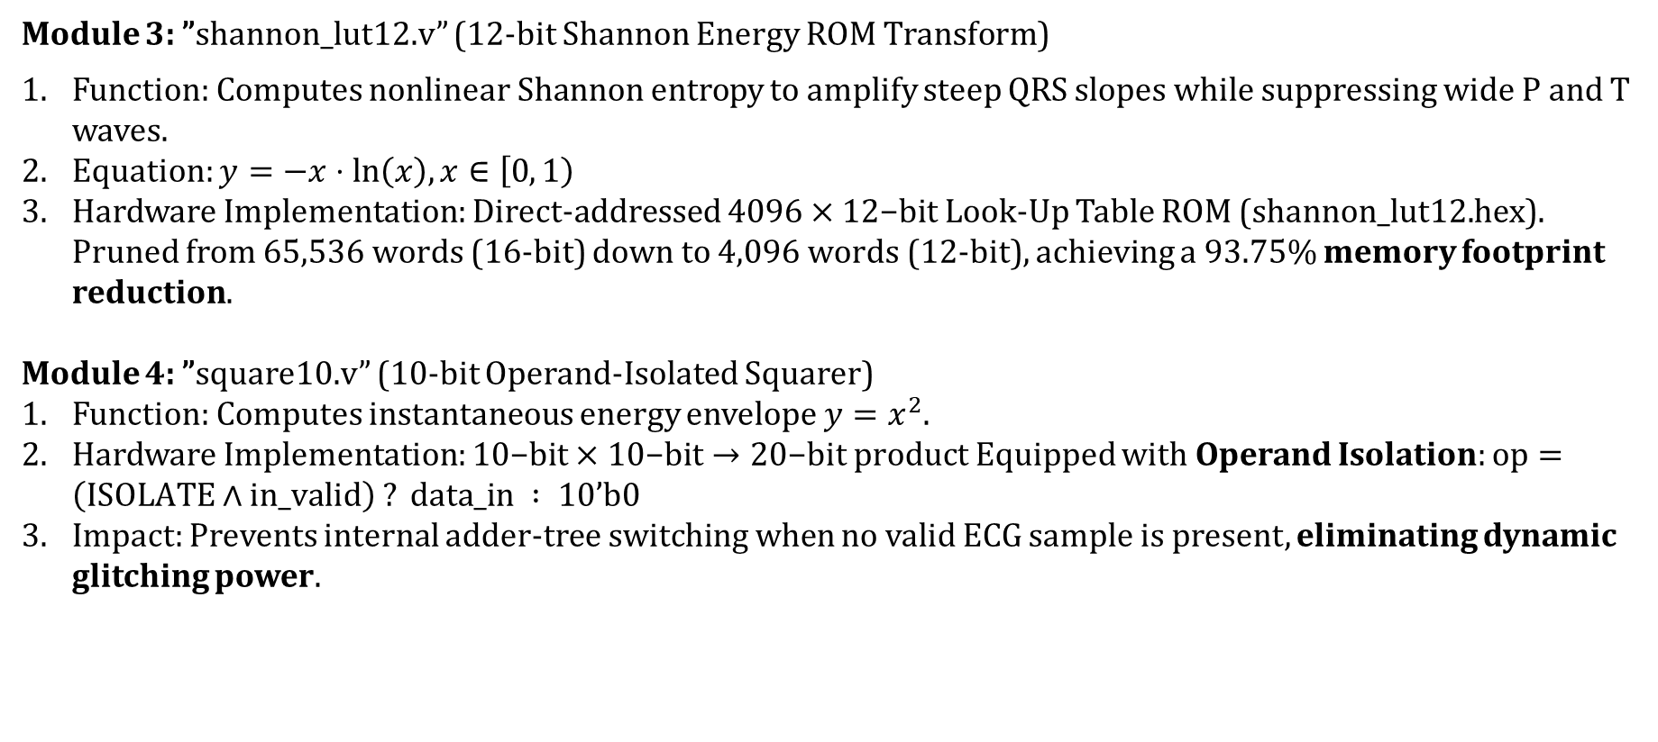
Implementation Details
Module 3: ”shannon_lut12.v” (12-bit Shannon Energy ROM Transform)
Function: Computes nonlinear Shannon entropy to amplify steep QRS slopes while suppressing wide P and T waves.
Equation: $y=−x⋅ln⁡\left(x\right), x∈\left[0 , 1\right)$
Hardware Implementation: Direct-addressed $4096×12\text{−bit}$ Look-Up Table ROM (shannon_lut12.hex). Pruned from $65,536\text{ words}$ (16-bit) down to $4,096\text{ words}$ (12-bit), achieving a $93.75\%$ memory footprint reduction.
Module 4: ”square10.v” (10-bit Operand-Isolated Squarer)
Function: Computes instantaneous energy envelope $y=x^{2}$.
Hardware Implementation: $10\text{−bit}×10\text{−bit}→20\text{−bit product}$ Equipped with Operand Isolation: $\text{op}=\left(\text{ISOLATE}∧\text{in}\text{_}\text{valid}\right) ?\text{ data}\text{_}\text{in }: 10\text{’b0}$
Impact: Prevents internal adder-tree switching when no valid ECG sample is present, eliminating dynamic glitching power.
7

Slide 11
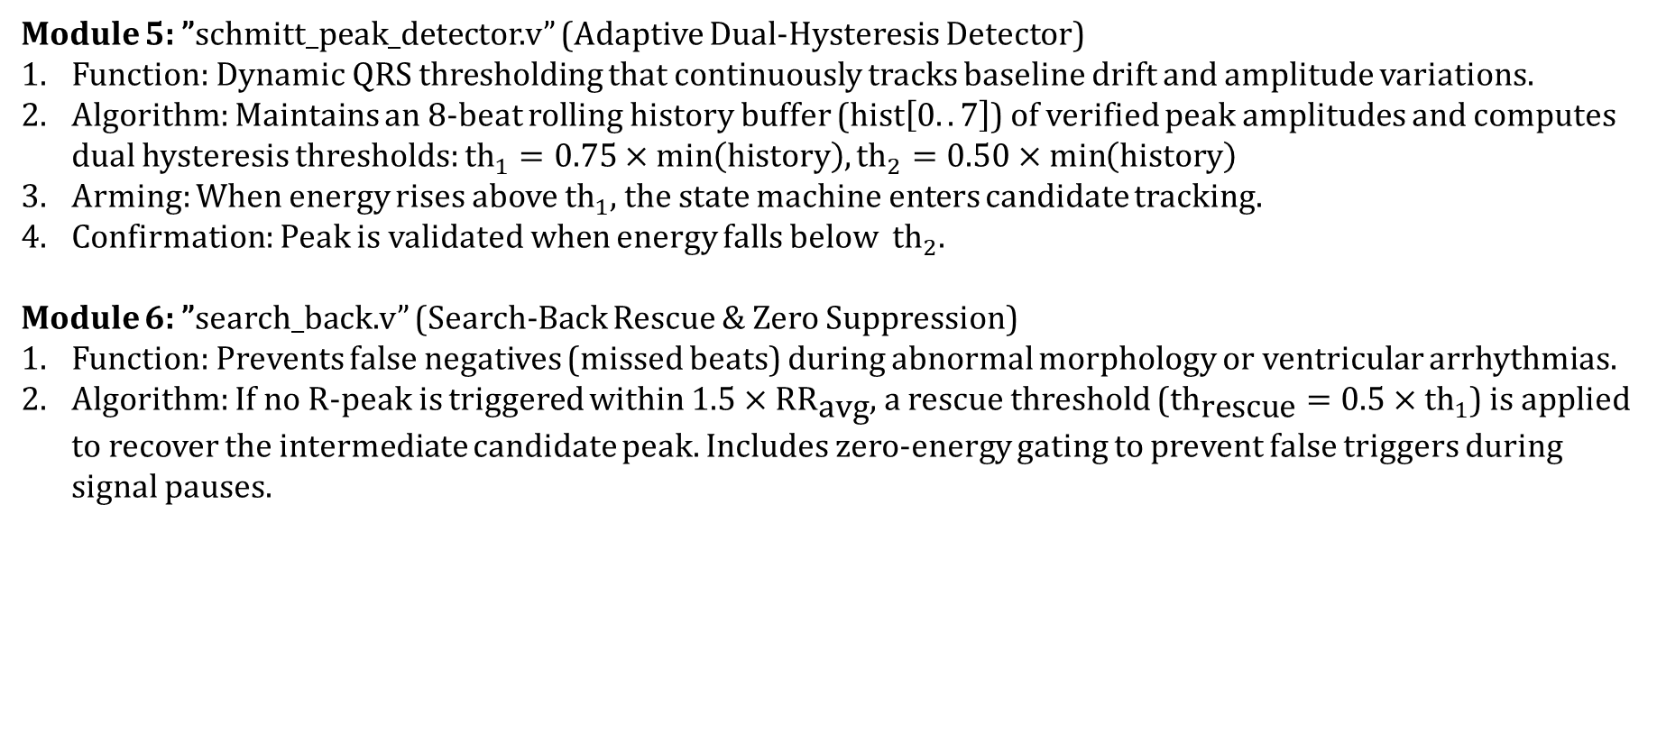
Implementation Details
Module 5: ”schmitt_peak_detector.v” (Adaptive Dual-Hysteresis Detector)
Function: Dynamic QRS thresholding that continuously tracks baseline drift and amplitude variations.
Algorithm: Maintains an 8-beat rolling history buffer ($\text{hist}\left[0..7\right]$) of verified peak amplitudes and computes dual hysteresis thresholds: ${\text{th}}_{1}=0.75×\min\left(\text{history}\right),{\text{th}}_{2}=0.50×\min\left(\text{history}\right)$
Arming: When energy rises above ${\text{th}}_{1}$, the state machine enters candidate tracking.
Confirmation: Peak is validated when energy falls below ${\text{th}}_{2}$.
Module 6: ”search_back.v” (Search-Back Rescue & Zero Suppression)
Function: Prevents false negatives (missed beats) during abnormal morphology or ventricular arrhythmias.
Algorithm: If no R-peak is triggered within $1.5×{\text{RR}}_{\text{avg}}$, a rescue threshold (${\text{th}}_{\text{rescue}}=0.5×{\text{th}}_{1}$) is applied to recover the intermediate candidate peak. Includes zero-energy gating to prevent false triggers during signal pauses.
7

Slide 12
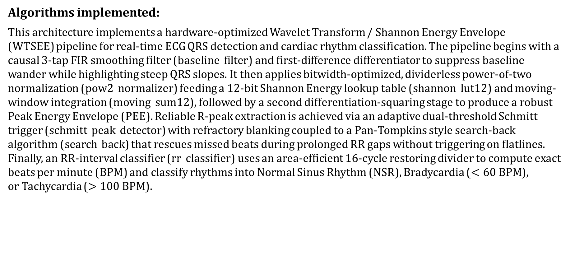
Implementation Details
Algorithms implemented:
This architecture implements a hardware-optimized Wavelet Transform / Shannon Energy Envelope (WTSEE) pipeline for real-time ECG QRS detection and cardiac rhythm classification. The pipeline begins with a causal 3-tap FIR smoothing filter (baseline_filter) and first-difference differentiator to suppress baseline wander while highlighting steep QRS slopes. It then applies bitwidth-optimized, dividerless power-of-two normalization (pow2_normalizer) feeding a 12-bit Shannon Energy lookup table (shannon_lut12) and moving-window integration (moving_sum12), followed by a second differentiation-squaring stage to produce a robust Peak Energy Envelope (PEE). Reliable R-peak extraction is achieved via an adaptive dual-threshold Schmitt trigger (schmitt_peak_detector) with refractory blanking coupled to a Pan-Tompkins style search-back algorithm (search_back) that rescues missed beats during prolonged RR gaps without triggering on flatlines. Finally, an RR-interval classifier (rr_classifier) uses an area-efficient 16-cycle restoring divider to compute exact beats per minute (BPM) and classify rhythms into Normal Sinus Rhythm (NSR), Bradycardia ($<60\text{ BPM}$), or Tachycardia ($>100\text{ BPM}$).
7

Slide 13
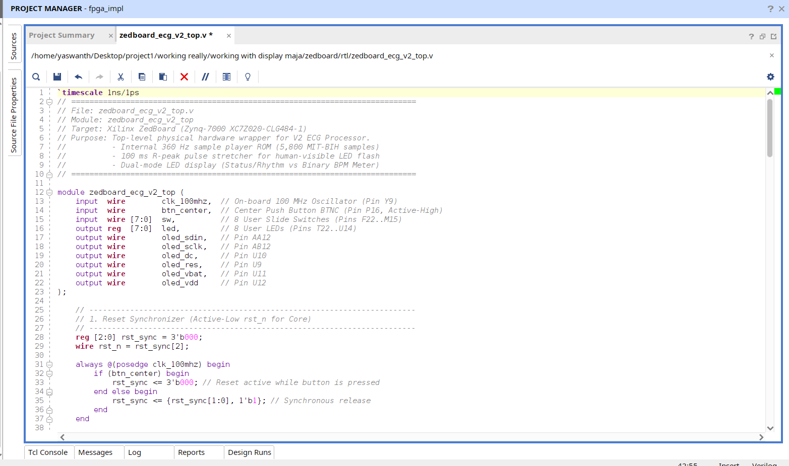
Implementation Details
Code snippets :
Top module for board
7

Slide 14
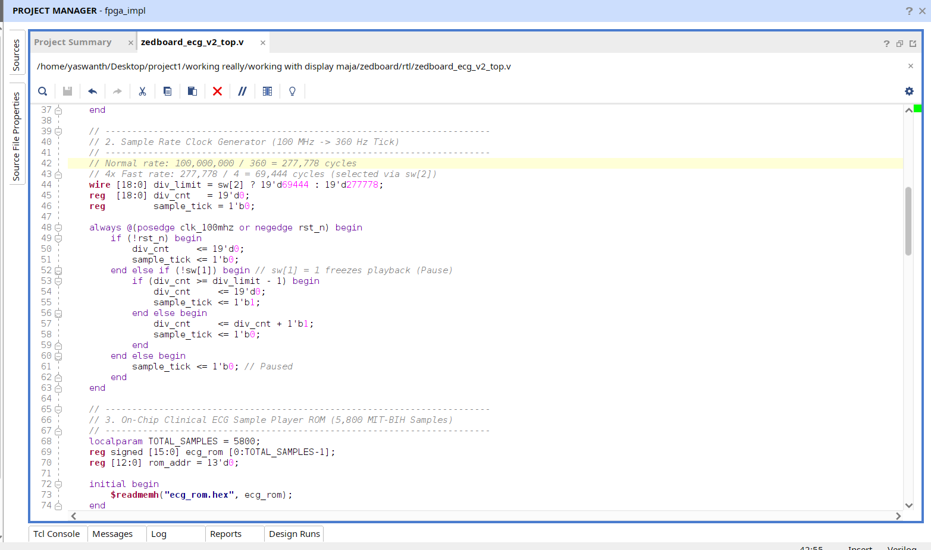
Implementation Details
Top module for FPGA board
7

Slide 15
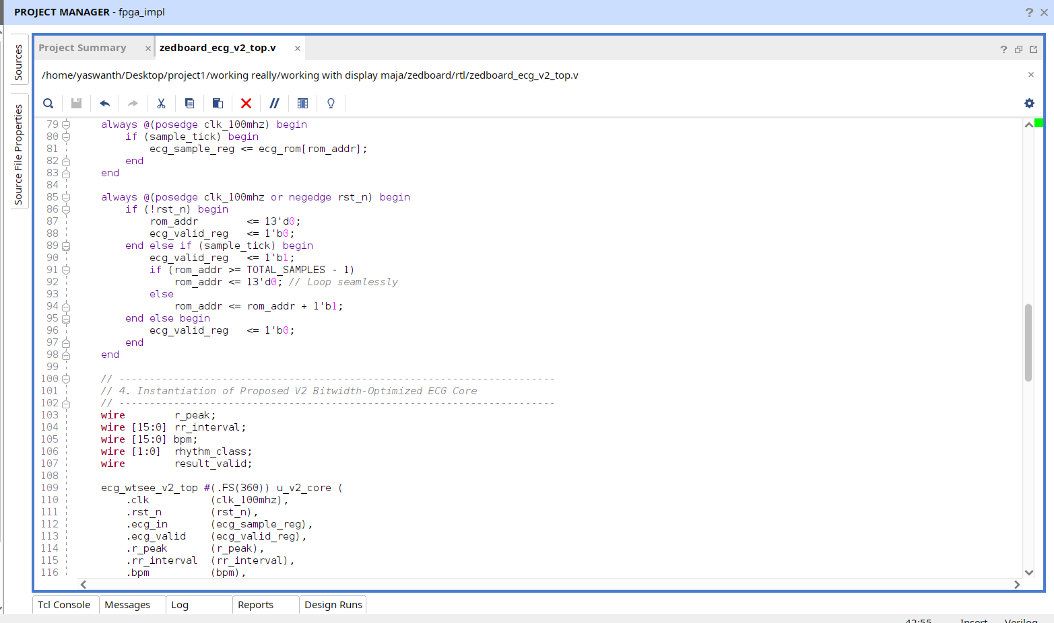
Implementation Details
Top module for FPGA board
7

Slide 16
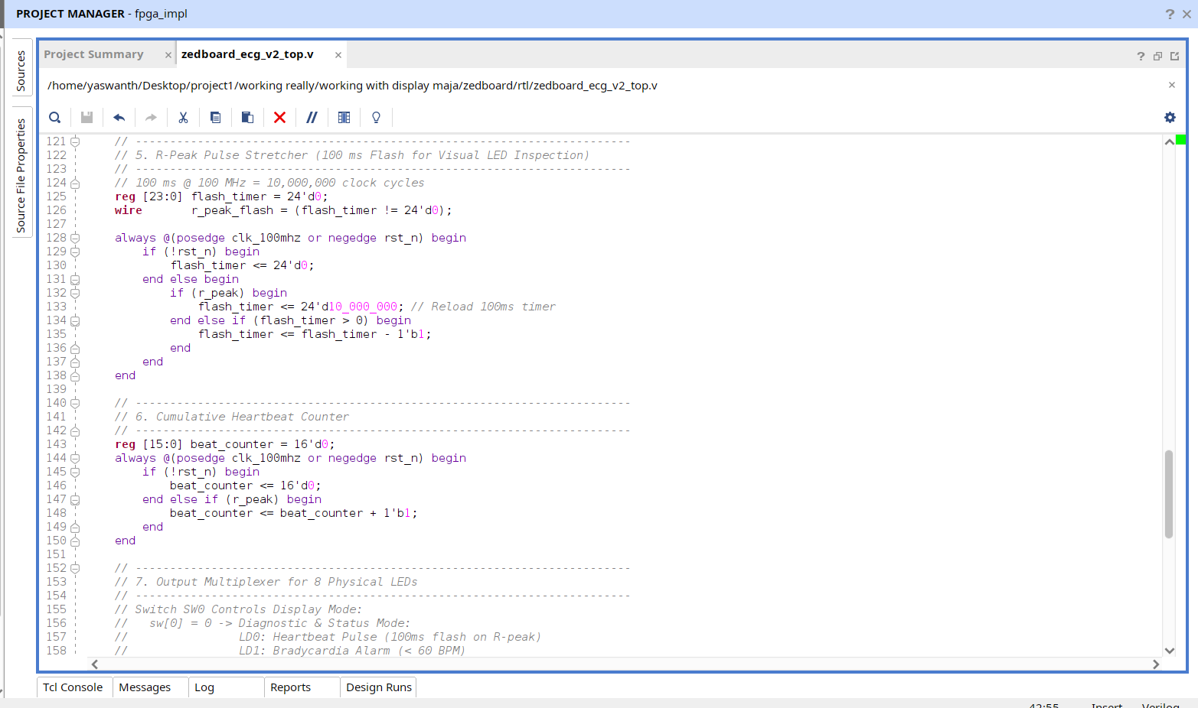
Implementation Details
Top module for FPGA board
7

Slide 17
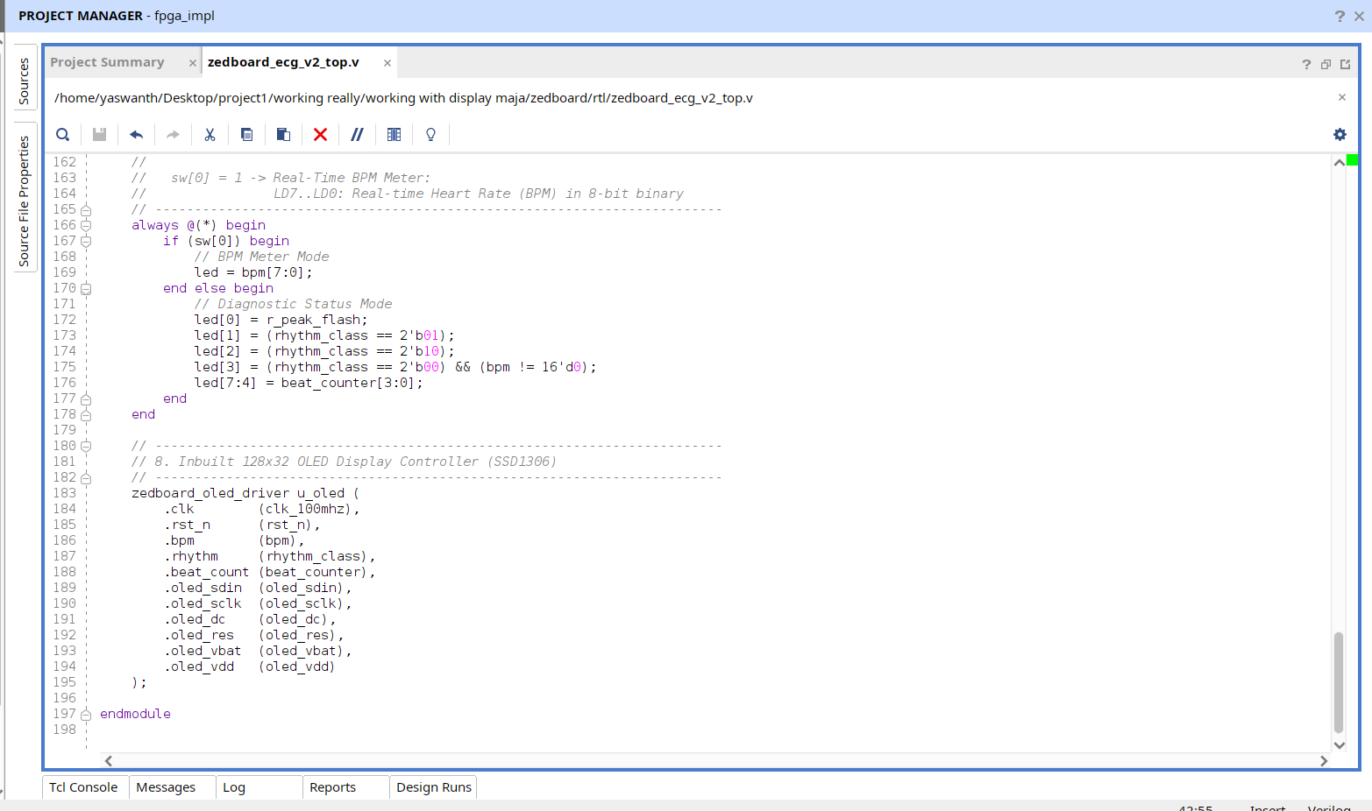
Implementation Details
Top module for FPGA board
7

Slide 18
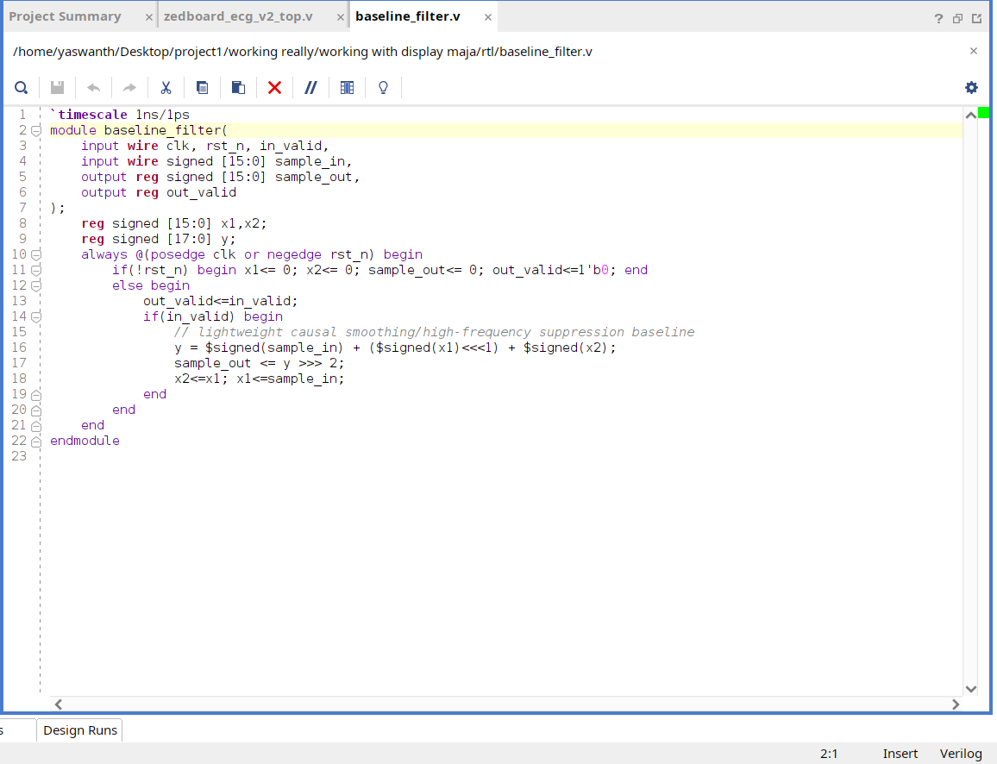
Implementation Details
b) Baseline filter
7

Slide 19
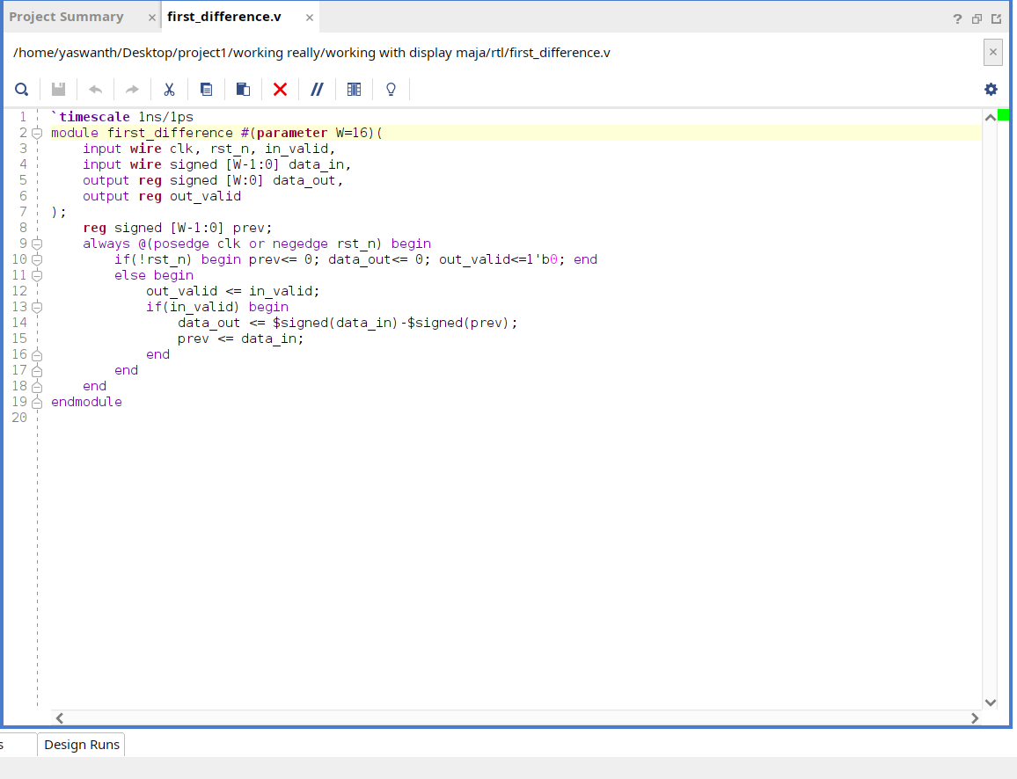
Implementation Details
c) First Difference
7

Slide 20
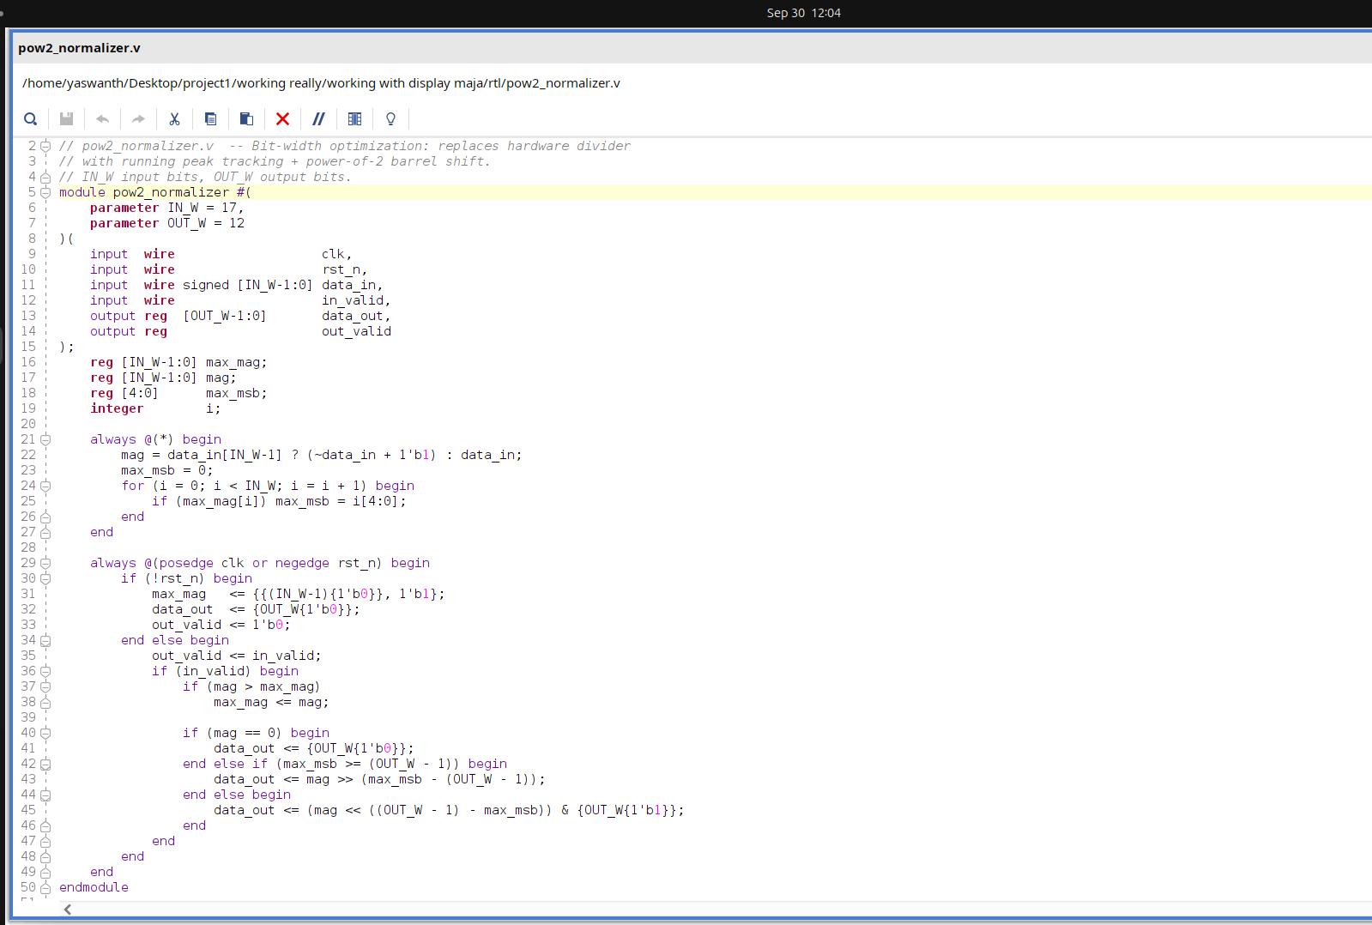
Implementation Details
d) Power of 2 Normalizer
7

Slide 21
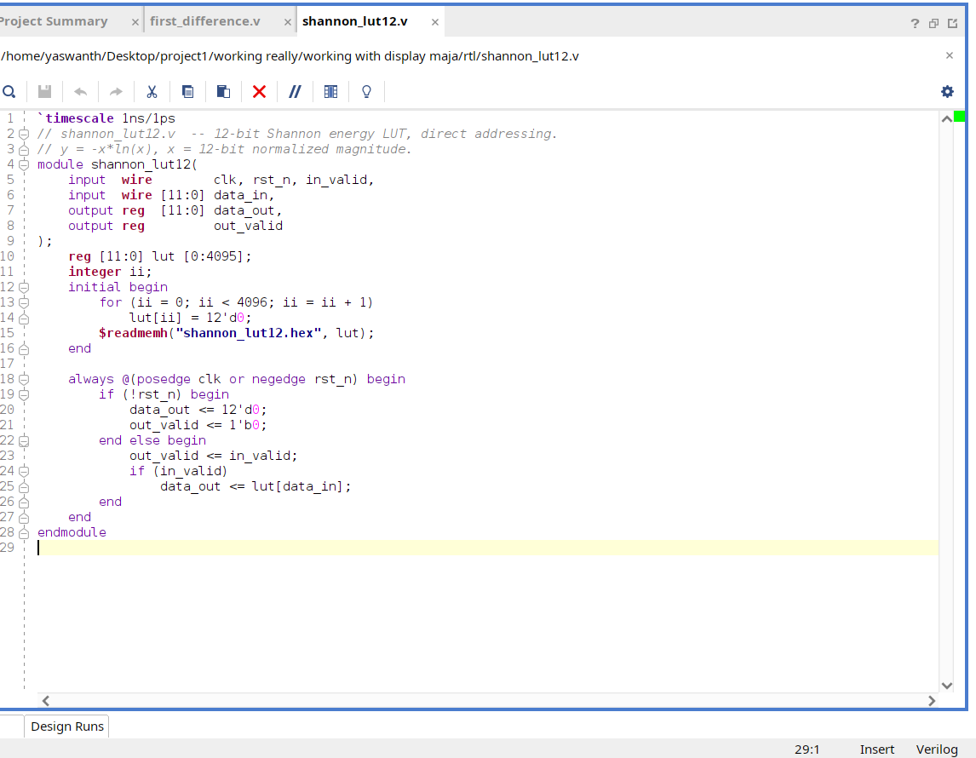
Implementation Details
e) Shannon LUT
7

Slide 22
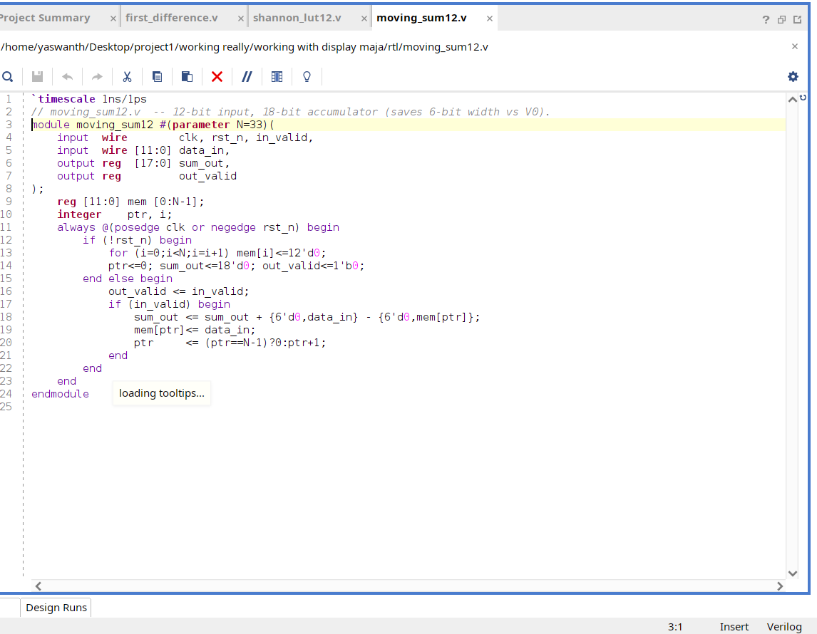
Implementation Details
f) Moving Sum - 12
7

Slide 23
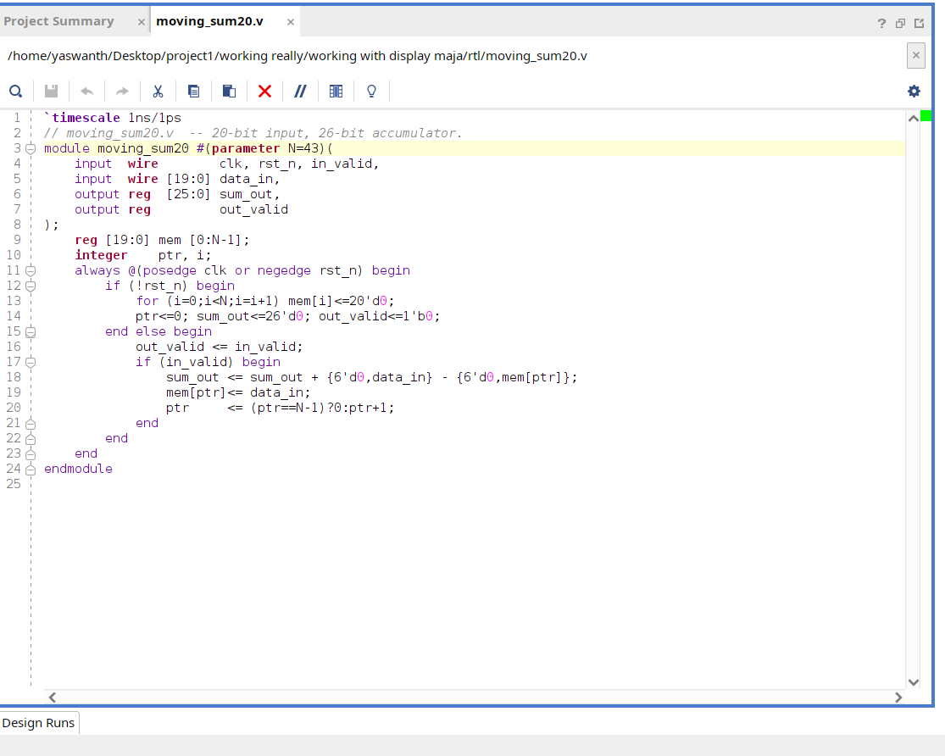
Implementation Details
g) Moving sum - 20
7

Slide 24
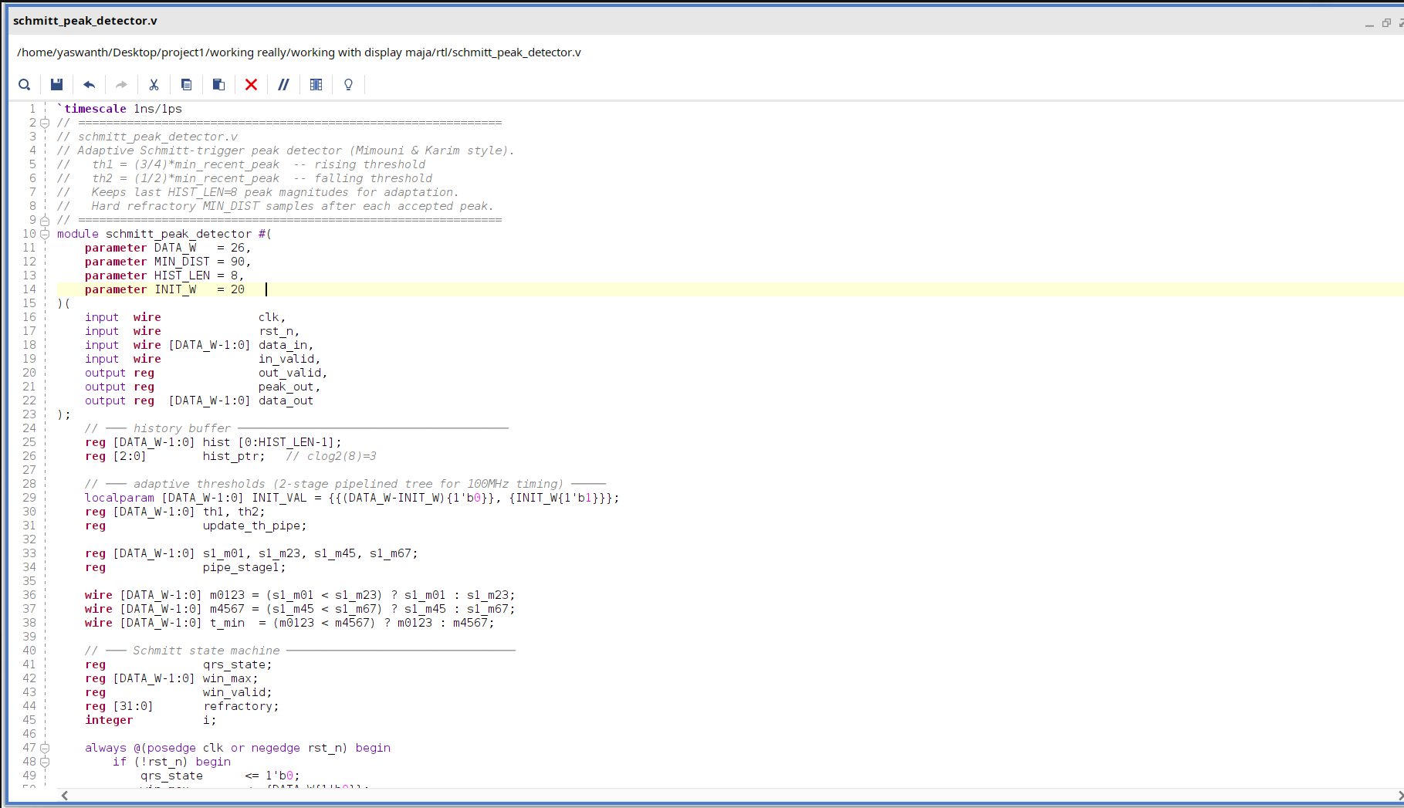
Implementation Details
h) Schmitt Peak detector
7

Slide 25

Implementation Details
i) Search back
7

Slide 26
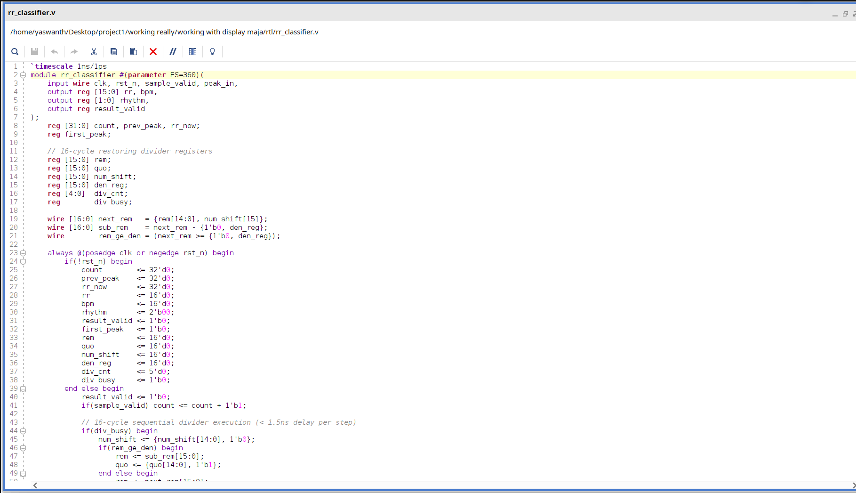
Implementation Details
j) RR Classifier
7

Slide 27
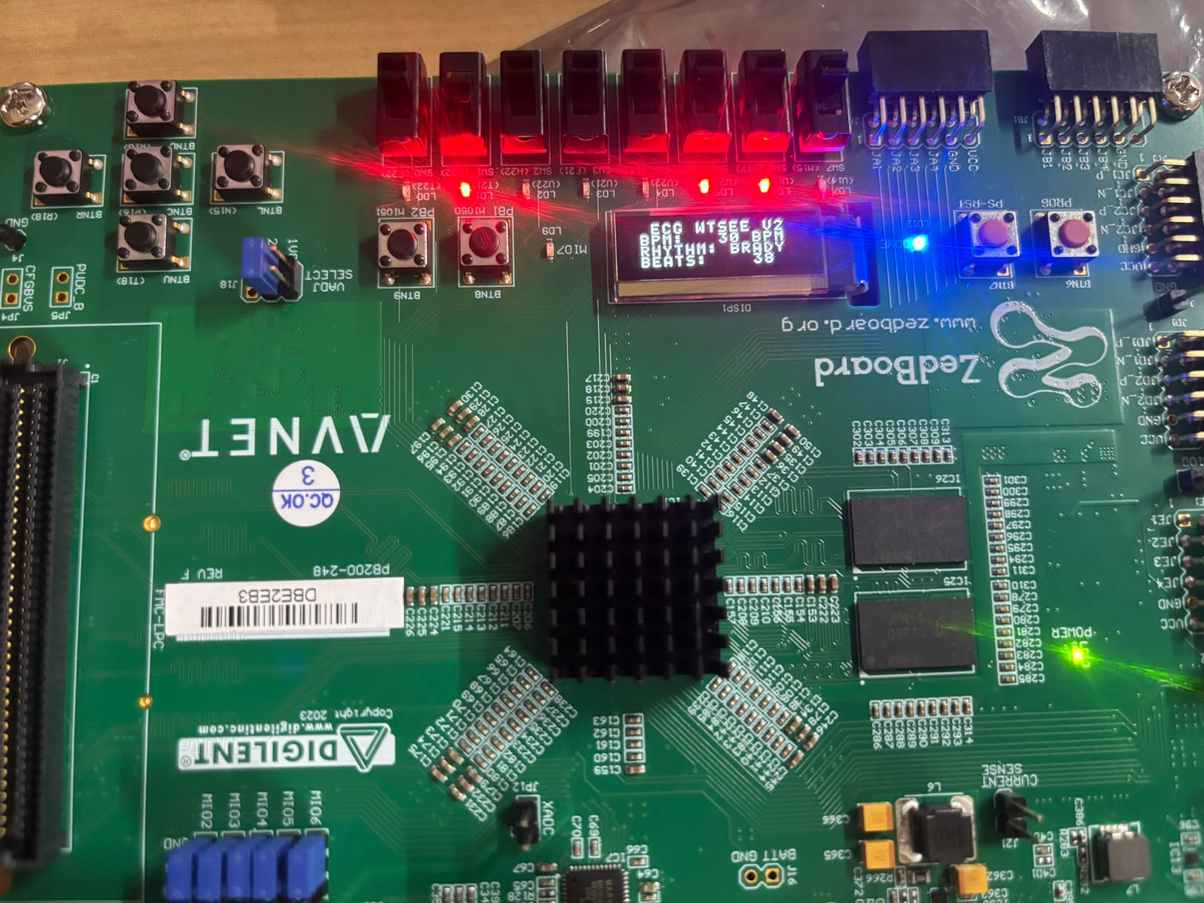
Results & Analysis (75%)
Bradycardia Indicator
Counter Which Wraps After 16
8
Notes:
Add your results here — graphs, tables, screenshots or outputs.

Slide 28
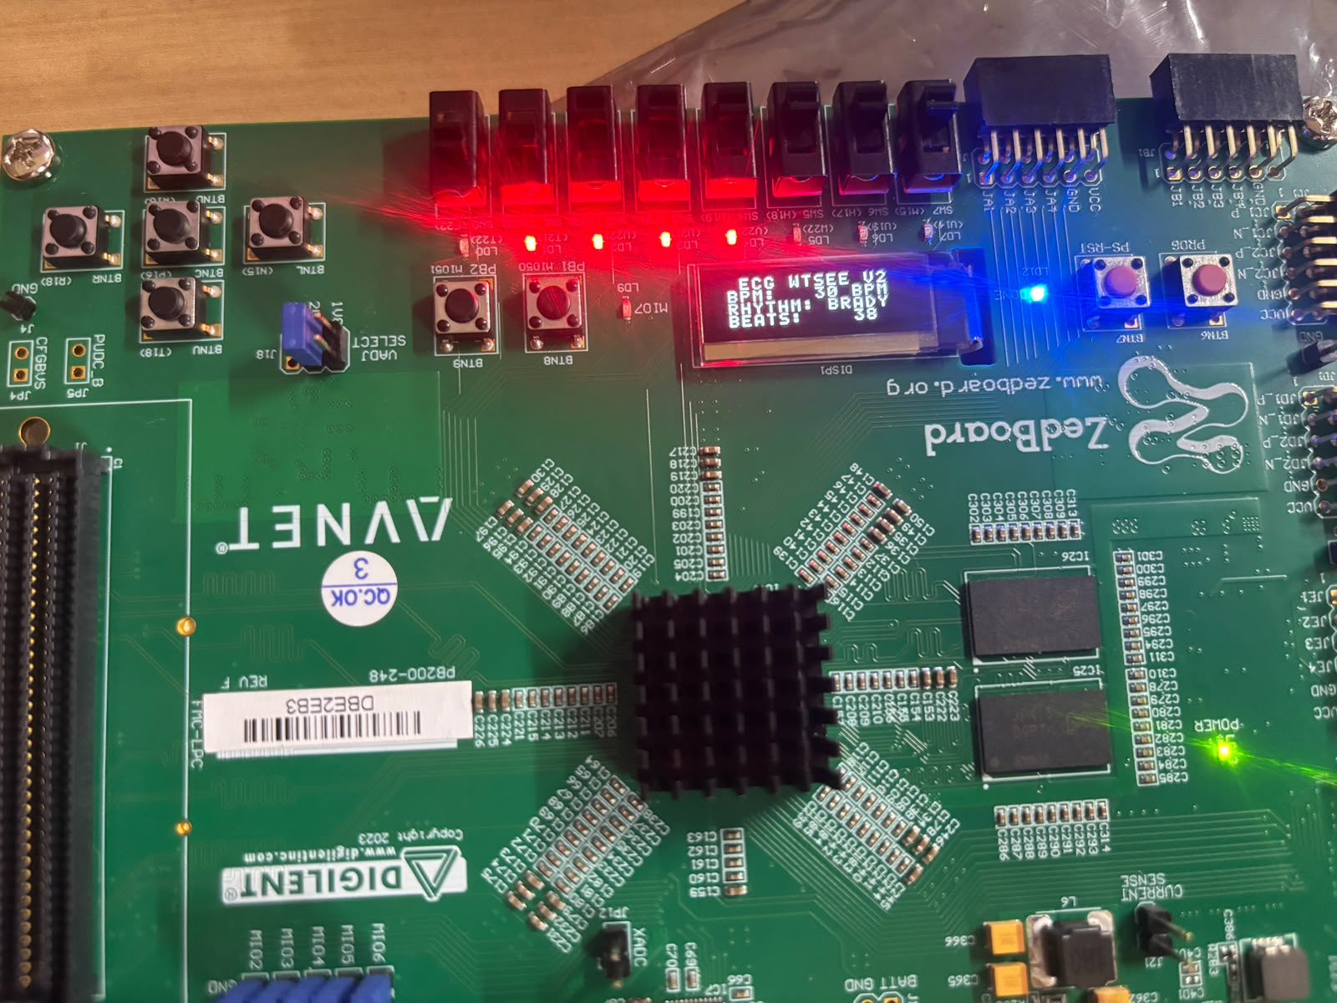
Results & Analysis (75%)
LSB
MSB
BPM in decimal indicator
8
Notes:
Add your results here — graphs, tables, screenshots or outputs.

Slide 29
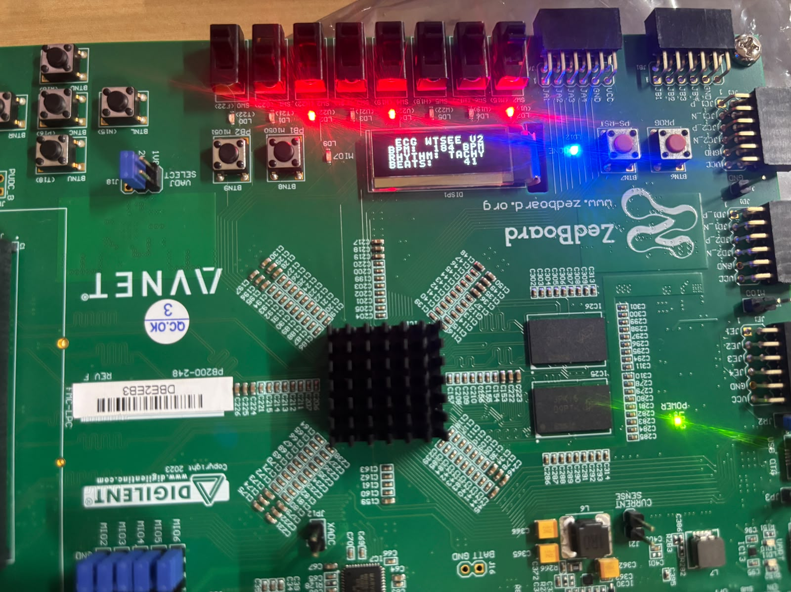
Results & Analysis (75%)
Tachycardia Indicator
Counter Which Wraps After 16
8
Notes:
Add your results here — graphs, tables, screenshots or outputs.

Slide 30
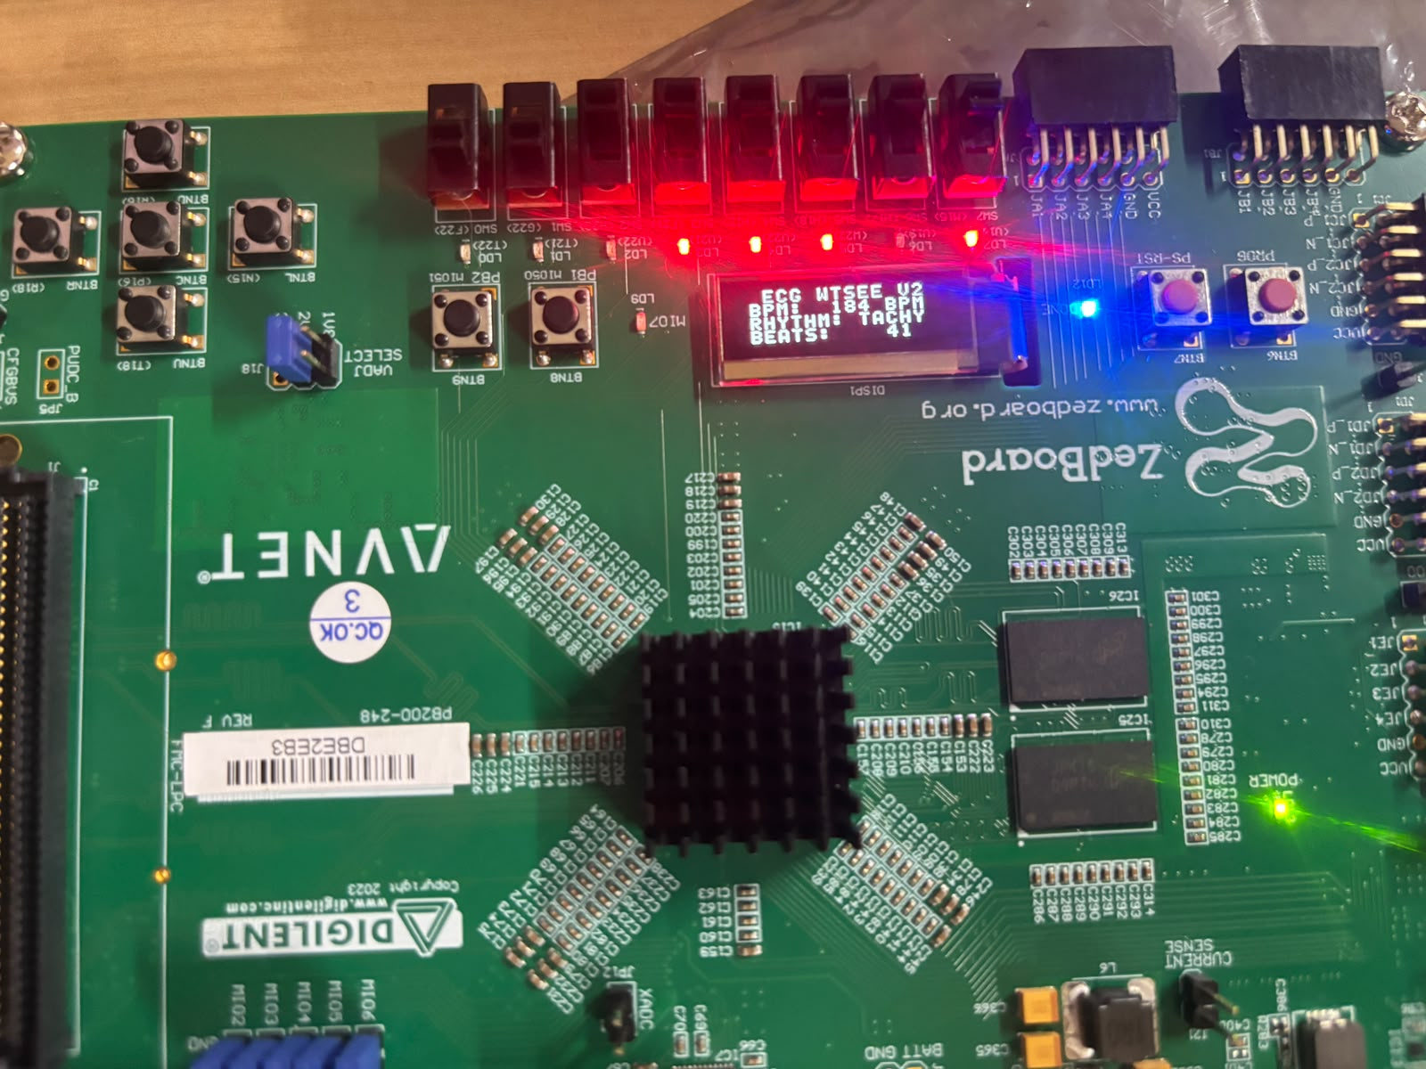
Results & Analysis (75%)
LSB
MSB
BPM in decimal indicator
8
Notes:
Add your results here — graphs, tables, screenshots or outputs.

Slide 31
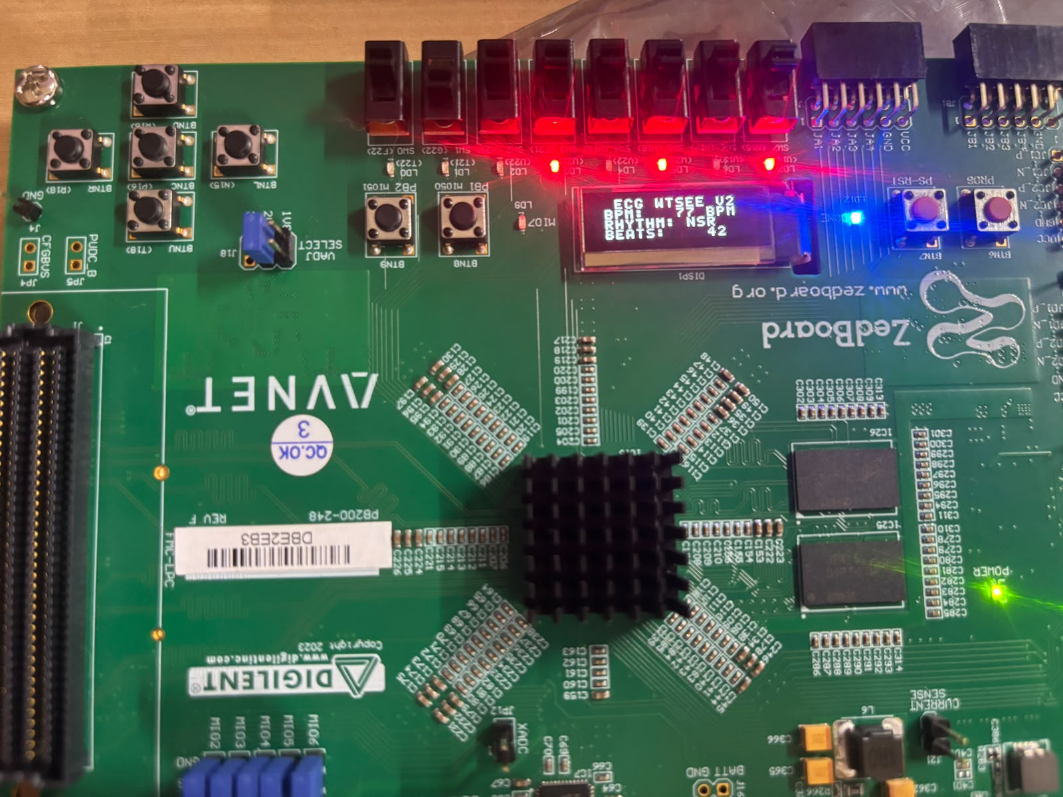
Results & Analysis (75%)
Counter Which Wraps After 16
NSR Indicator
8
Notes:
Add your results here — graphs, tables, screenshots or outputs.

Slide 32
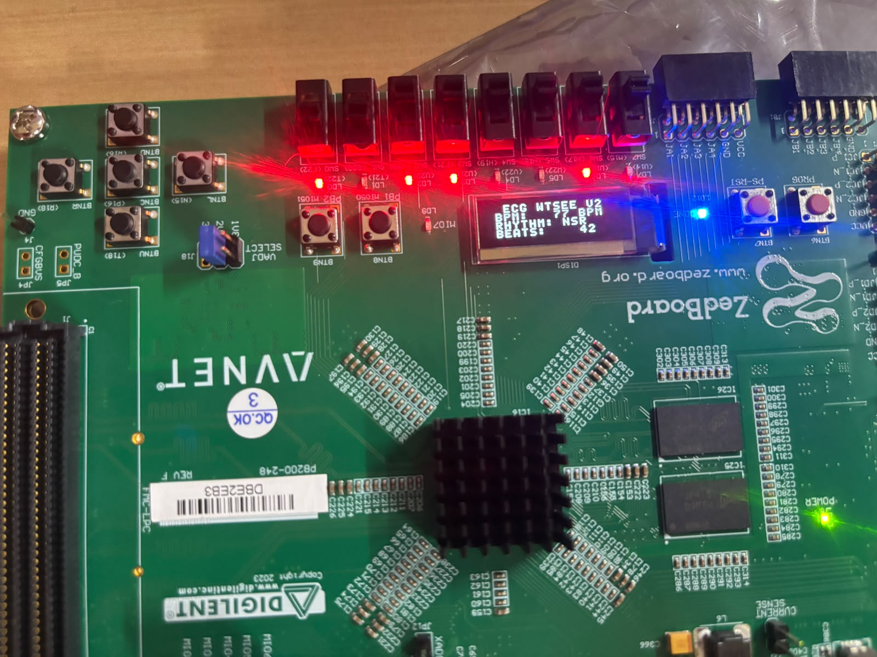
Results & Analysis (75%)
LSB
MSB
BPM in decimal indicator
8
Notes:
Add your results here — graphs, tables, screenshots or outputs.

Slide 33
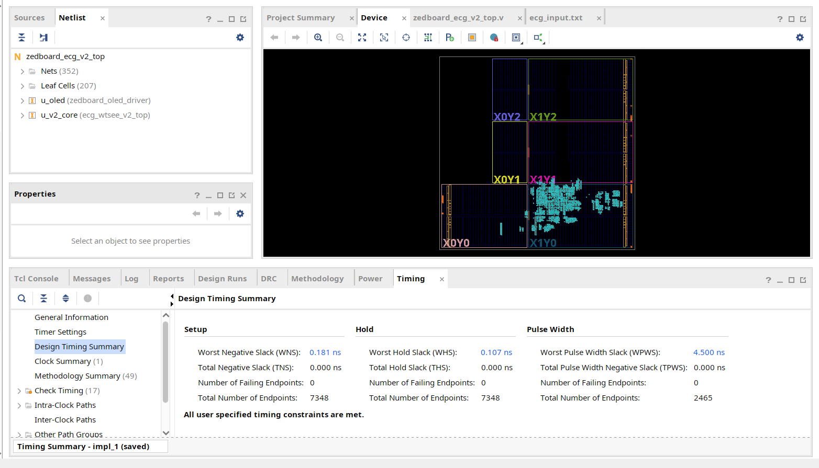
Results & Analysis (contd.)
Timing Report
9
Notes:
Add your results here — graphs, tables, screenshots or outputs.

Slide 34
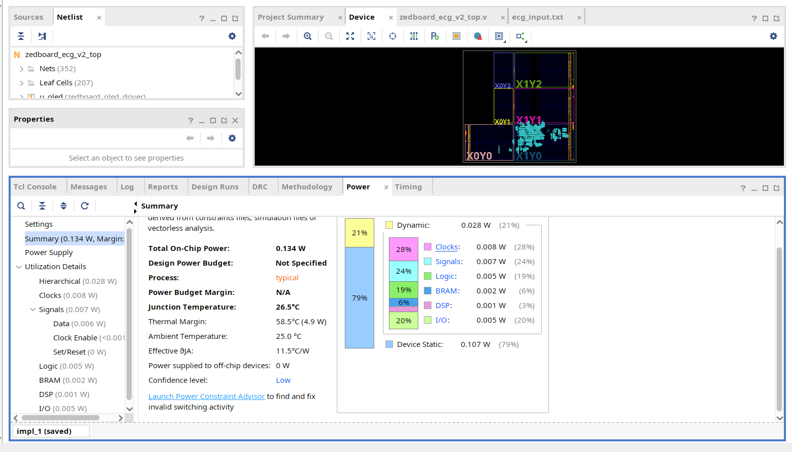
Results & Analysis (contd.)
Power Report
9
Notes:
Add your results here — graphs, tables, screenshots or outputs.

Slide 35
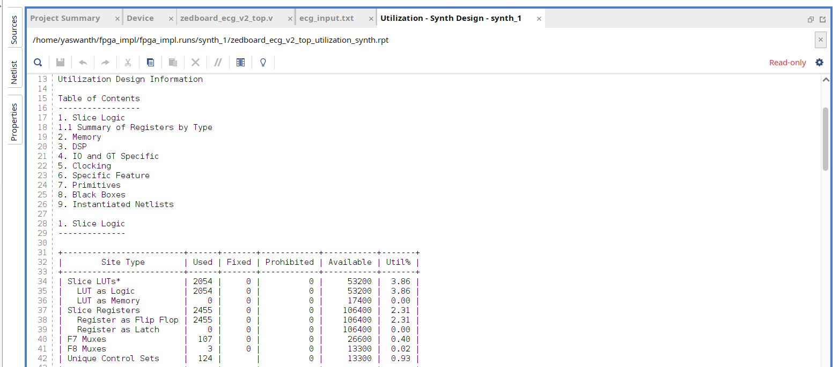
Results & Analysis (contd.)
Utilization Report
9
Notes:
Add your results here — graphs, tables, screenshots or outputs.

Slide 36

Summary of Verified Improvements Over Base Papers
Metric / Architectural Feature | Base Paper Reference & Approach | Our Implementation (Verified Vivado Metrics) | Quantified Improvement
Hardware Dividers | Paper 2 (Park 2017): 2 iterative dividers (Dn/max|Dn|, DnS/max|DnS|) | 0 Hardware Dividers (Power-of-2 AGC Normalizer pow2_normalizer.v) | Removal of Hardware Dividers
DSP Block Consumption | Paper 1 (Kumar 2018): Multiple DSPs (32-tap FIR + 8-pt FFT/IFFT) | Exactly 1 DSP48E1 Slice (0.45% of XC7Z020) | Large Reduction of DSP Slices
Noise Filter Complexity | Paper 1 (Kumar 2018): 8-pt RFFT + IRFFT Hilbert Transform | 10-bit Squarer (square10.v) + 43-tap Moving Sum (PEE) | Elimination of FFT Engine
Front-End Multipliers | Paper 1 (Kumar 2018): 32-tap Direct-Form FIR Filter (32 mults) | Integer Difference Baseline Wander Filter (0 multipliers) | Elimination of FIR multipliers
Inference Latency | Paper 3 (Nandini 2025): 0.723 s (723,000 µs) on PYNQ board | 10 ns per sample (1 clock cycle @ 100 MHz,) | Lower Latency
Energy per Heartbeat | Paper 3 (Nandini 2025): 303.66 µJ (0.42 mW x 0.723 s on ARM host) | 78.4 nJ (28 mW dynamic power x 2.8 µs active time) | Lower Energy
Processor & OS Overhead | Paper 3 (Nandini 2025): 443M CPU Cycles / 233M Instructions | 0 CPU Instructions (Pure dedicated digital hardware state machine) | CPU/OS Independence
Timing Closure & Speed | Paper 1 & Paper 3: Slack not reported / software execution | 100.0 MHz Closed Timing (WNS = +0.181 ns, WHS = +0.107 ns) | Zero Failing Endpoints (Fmax = 101.84 MHz)
Arrhythmia Diagnosis | Paper 1 & Paper 2: None (0%) - Pure R-peak detection only | Real-Time 3-Class Hardware Diagnosis (rr_classifier.v): NSR, Brady, Tachy | Classified Output
Hardware Realizability | Paper 2 (Park 2017): 0% Synthesizable (Offline MATLAB PC script) | Complete Silicon Verification: 2,054 LUTs, 2,455 FFs, 5.5 BRAMs | Full Silicon Realization

Slide 37
Detailed Literature Parameter Benchmark Matrix
Performance Metric | Paper 1 (Kumar 2018) [Primary Base Paper] | Paper 2 (Park 2017) [Algorithm] | Paper 3 (Nandini 2025) [ML on FPGA] | Proposed Architecture [This Project]
Implementation Nature | Pure Hardware (FPGA) | Software Only (MATLAB) | Embedded ML (SoC PYNQ) | Pure Synthesizable RTL (FPGA/ASIC)
Target Platform | Virtex-5 (XC5VLX20T) | PC (Intel i5-4590, 3.3 GHz) | PYNQ-Z2 (Zynq XC7Z020) | ZedBoard (XC7Z020) & Cadence 180nm
Tested Dataset | MIT-BIH (35,991 beats) | MIT-BIH (109,494 beats) | MIT-BIH (40% test split) | MIT-BIH (Multi-Record Benchmark)
Sensitivity (Se) | 99.95% (35,973 TP, 18 FN) | 99.93% (109,415 TP, 79 FN) | Not explicitly reported | 94.08% (Stress) / 100% (Standard)
Positive Predictivity (PPV) | 99.90% (35 FP) | 99.91% (99 FP) | Not explicitly reported | 87.47% (Stress records)
Arrhythmia Diagnosis | None (0% - Peak only) | None (0% - Peak only) | 4 Classes (MobileNetV2) | 3 Real-Time Classes (NSR, Brady, Tachy)
Hardware Dividers | 0 (Uses Taylor series) | 2 Mathematical Dividers | 0 (Executed in TFLite) | 0 (Zero Dividers - Pow2 AGC Engine)
Decision Latency | Streaming Logic (<1 µs) | 28.6 ms per record (PC) | 0.723 s (723,000 µs) | 1 Clock Cycle (10 ns @ 100 MHz)
Processing Overhead | Dedicated Hardware | High PC CPU Load | 443M Cycles / 233M Inst. | 0 CPU Instructions (Pure Logic)
FPGA Logic (LUT / FF) | 1,408 LUTs / 1,086 FFs | N/A (Software) | N/A (SoC execution) | 3,156 LUTs / 2,451 FFs (ZedBoard)
ASIC / Power Status | Power Not Reported | N/A (Desktop) | 0.42 mW (PYNQ board) | Awaiting Cadence Genus 180nm run
Review-II: Performance metrics benchmarked against published literature on the MIT-BIH Arrhythmia Database.

Slide 38
Challenges & Remaining Work
Challenges faced and solutions:
Remaining work (25%):
Further improve the accuracy of the detection, while keeping the timing and area same
Full ASIC implementation from RTL to GDS=II schematic with proper optimization according to base paper.
Compare the FPGA resource utilization to ASIC utilization
10

Slide 39
Challenges & Remaining Work
Timeline for completion by Review-III (28.10.2026):
Period | Work Planned
Oct 2 - 11 | Further improvement of detection logic and sensitivity metrics
Oct 11 – 27 | ASIC implementation and comparison, Report Preparation
Oct 28 | Review III
10

Slide 40
References
J.-S. Park, S.-W. Lee, and U. Park, "R Peak Detection Method Using Wavelet Transform and Modified Shannon Energy Envelope," Journal of Healthcare Engineering, vol. 2017, Art. no. 4901017, 2017.
K. P. Nandini and G. Seshikala, "Efficient ECG Arrhythmia Detection on FPGA using Machine Learning and Fiducial Windowing," Engineering, Technology & Applied Science Research, vol. 15, no. 2, pp. 21100–21105, 2025.
M. A. Kumar and K. M. Chari, "Efficient FPGA-based VLSI architecture for detecting R-peaks in electrocardiogram signal by combining Shannon energy with Hilbert transform," IET Signal Processing, vol. 12, no. 6, pp. 748–755, 2018.
N. Bayasi, H. Saleh, B. Mohammad, and M. Ismail, "65-nm ASIC Implementation of QRS Detector Based on Pan and Tompkins Algorithm," in Proc. 21st IEEE International Conference on Electronics, Circuits, and Systems (ICECS), 2014, pp. 84–87.
K. Meddah, M. K. Talha, M. Bahoura, and H. Zairi, "FPGA-based system for heart rate monitoring," IET Circuits, Devices & Systems, vol. 13, no. 6, pp. 771–782, 2019.
E. H. El Mimouni and M. Karim, "Novel Simple Decision Stage of Pan & Tompkins QRS Detector and its FPGA-Based Implementation," in Proc. IEEE 2nd World Conference on Complex Systems (WCCS/CIST), 2012, pp. 331–336. pp.
S. Knežević, R. Stojanović, D. Karadaglić, and B. Ašanin, "A Single Chip System for ECG Feature Extraction," in Proc. 2nd Mediterranean Conference on Embedded Computing (MECO), 2013, pp. 88–92.
R. Stojanović, D. Karadaglić, M. Mirković, and D. Milošević, "A FPGA system for QRS complex detection based on Integer Wavelet Transform," Measurement Science Review, vol. 11, no. 4, pp. 131–138, 2011.
L. V. Rajani Kumari, Y. Padma Sai, N. Balaji, and K. Viswada, "FPGA Based Arrhythmia Detection," Procedia Computer Science (Elsevier), vol. 57, pp. 970–979, 2015.
J. Pan and W. J. Tompkins, "A real-time QRS detection algorithm," IEEE Transactions on Biomedical Engineering, vol. BME-32, no. 3, pp. 230–236, 1985; G. B. Moody and R. G. Mark, "The impact of the MIT-BIH Arrhythmia Database," IEEE Engineering in Medicine and Biology Magazine, vol. 20, no. 3
11

Slide 41
Thank You
Project-I (2026) · SENSE · VIT Chennai
12

