Slide 1
GiT & GiTHub
A versioning system

Slide 2
Where to use Git
Git works on your computer, but you also use it with online services like GitHub, GitLab, or Bitbucket to share your work with others. These are called remote repositories.

Slide 3
Installation of Git
Download gitbash from the git-scm.com.

Slide 4
Commands
Git –-version
To change directory
Git /d/
It will move to drive git

Slide 5
Configuration
git config --global user.name “vimal jawla“
git config --global user.email “vimal.jawla@anudip.org“
To list all config
git config –-list
To view specific setting
git config user.name
Changing or Unsetting Config Values
git config --global --unset code.editor

Slide 6
Create and initialize the git directory
Create a project folder
Navigate to the folder
Initialize a Git repository
Mkdir myproject
Cd myproject
Now init the git
Git init

Slide 7
Adding files to git repository
Git status :- to view the git status
Git add filename :- to add a file to state
git add –- all :- adding all files to state
git add foldername :- to add folder to stage

Slide 8
commit
A commit is like a save point in your project.
It records a snapshot of your files at a certain time, with a message describing what changed.
You can always go back to a previous commit if you need to.
git commit -m "message" - Commit staged changes with a message
git commit -a -m "message" - Commit all tracked changes (skip staging)
git log - See commit history

Slide 9
Create an empty commit:
git commit --allow-empty -m "Start project"
Use previous commit message (no editor):
git commit --no-edit
Quickly add staged changes to last commit, keep message:
git commit --amend --no-edit

Slide 10
Git History
git log - Show full commit history
git log --oneline - Show a summary of commits
git show <commit> - Show details of a specific commit
git diff - See unstaged changes
git diff --staged - See staged changes

Slide 11
Git branch
In Git, a branch is like a separate workspace where you can make changes and try new ideas without affecting the main project. Think of it as a "parallel universe" for your code.
Git branch branch_name
Listing all branch
Git branch
Change branch
Git checkout helloworld

Slide 12
Git Merge
Merging in Git means combining the changes from one branch into another.
This is how you bring your work together after working separately on different features or bug fixes.
First we move to master branch
Git checkout master
Now we will merge the master and branch1
Git merge branch1

Slide 13
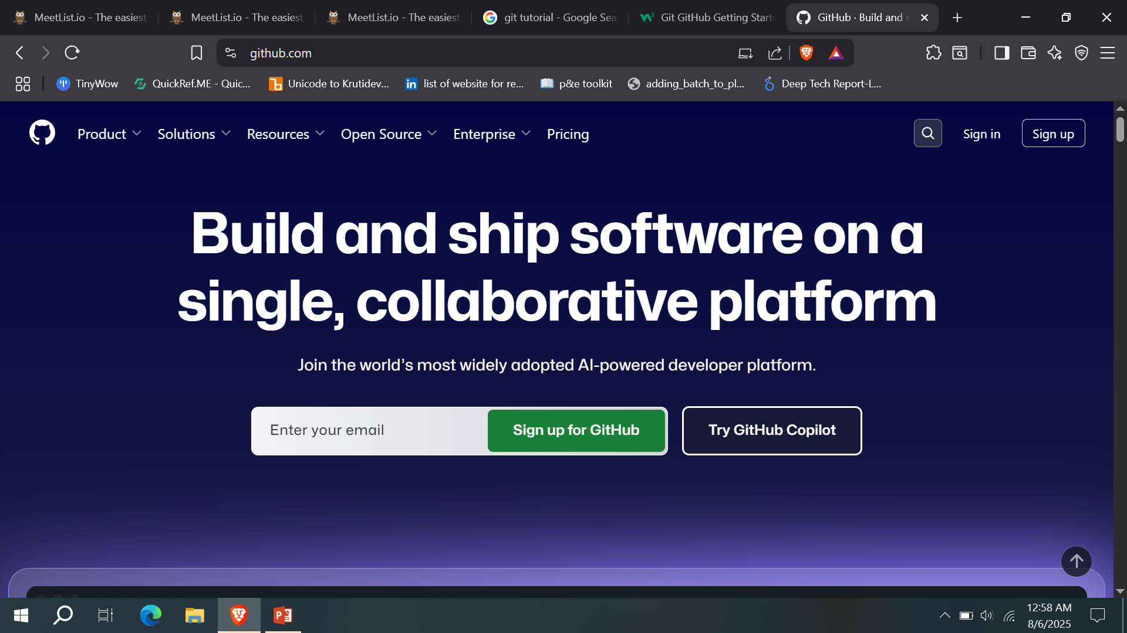
Git with github
First signup to github.com

Slide 14
Git Security SSH
SSH (Secure Shell) is a way to connect securely to remote computers and services, like Git repositories.
SSH uses a pair of keys (public and private) to make sure only you can access your code.

Slide 15
Git Set Remote from GitHub
Test Your SSH Connection
ssh -T git@github.com

Slide 16
Add or Update the Remote Origin
git remote add origin git@github.com:your-username/your-repo.git
Example
git remote set-url origin git@github.com:your-username/your-repo.git

Slide 17
Pull from Remote
Key Pull Commands
Fetch
Merge
Pull
Pull is combination of fetch and merge
git fetch origin
Now we will see the status of origin and master
Git log origin/master

Slide 18
If difference between origin and master
git diff origin/master

Slide 19
Git Merge
merge combines the current branch, with a specified branch.
We have confirmed that the updates are as expected, and we can merge our current branch (master) with origin/master
git merge origin/master

Slide 20
Git Pull
git pull origin

Slide 21
Git Push to GitHub
When we have made changes locally, we want to update our remote repository with the changes.
Transferring our local changes to our remote is done with a push command.
Basic Push
git push origin
Force Push
git push --force origin feature-branch

Slide 22
Git GitHub Branch
Create a Branch
On GitHub, access your repository and click the "master" branch button.
There you can create a new Branch. Type in a descriptive name, and click Create branch:
Switch Branch
git switch branch-name

Slide 23
To delete a branch on GitHub, go to the branches page, find your branch, and click the delete icon (trash can).
To delete a branch using the command line:
git branch -d branch-name
git push origin --delete branch-name
To rename a branch using the command line:
git branch -m old-name new-name
git merge branch-name

