Slide 1

AI-Powered Personal Health Companion for Early Risk Detection
Problem Statement Title - A secure, AI-powered Personal Health Companion that delivers real-time, privacy-preserving health monitoring and early warning capabilities, helping individuals recognize health risks before they become emergencies. The solution should improve resilience during heat waves, floods, pollution events, and other disasters common in India while enabling continuous health support through on-device intelligence.
Theme - MedTech / BioTech / HealthTech
Category – Hardware
Team Name – STRAW HATS
1
Notes:
SLIDE 1 TIPS: This is the only slide judges see before reading further — copy the PS ID, title, theme and category exactly from the portal, and use your REGISTERED team name. Official rule: max 6 slides total including this title slide; final upload must be a PDF export.

Slide 2
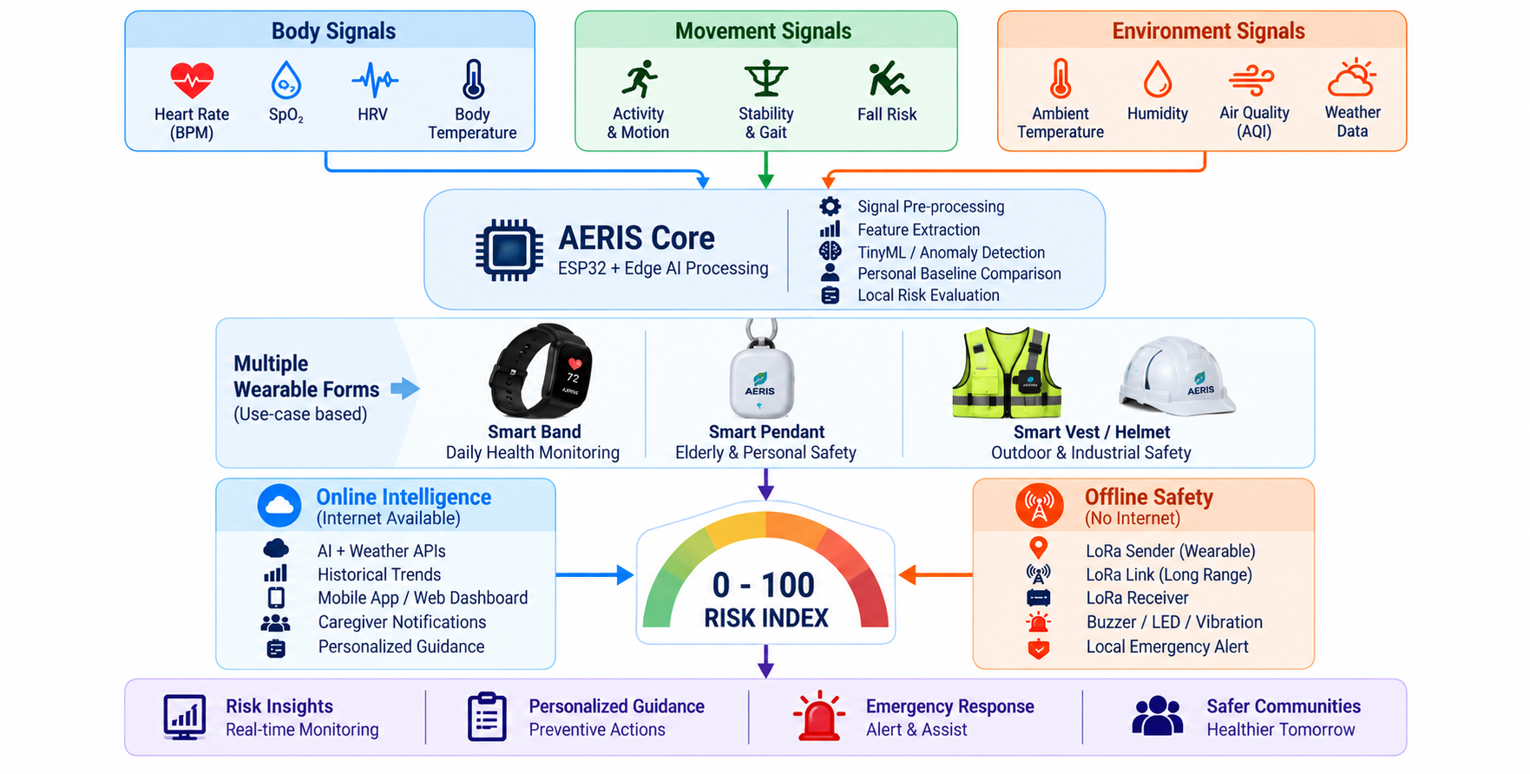
PROPOSED SOLUTION
AERIS: AI-BASED EARLY RISK & INTELLIGENT SAFETY COMPANION
Problem Vs Our Solution
Our Solution
Existing Problem | AERIS Solution
Single-sensor monitoring | Multi-sensor risk detection
Fixed health thresholds | Personal baseline
Internet dependency | Online + Offline LoRa
Delayed alerts | Early risk detection
No environmental context | Health + environment correlation
Raw data monitoring | 0–100 Risk Index
Limited personalization | Personalized guidance
Cloud-dependent processing | Edge-first, privacy-focused processing
Why We Stand Out
Multi-Modal Risk Correlation : Correlates physiological + mobility + environmental signals instead of interpreting isolated sensor values.
Converts interacting signal changes into one interpretable 0–100 AERIS Risk Index instead of isolated sensor alerts
RISK-TO-ACTION, NOT JUST MONITORING
Converts detected patterns into a 0–100 AERIS Risk Index → guidance → alerts → escalation.
2
Notes:
SLIDE 2 TIPS: Keep each problem box to one sharp sentence — judges skim. The 'Why We Stand Out' box is where teams most often just restate the idea instead of naming a real point of difference versus an existing/competing solution — be specific.

Slide 3
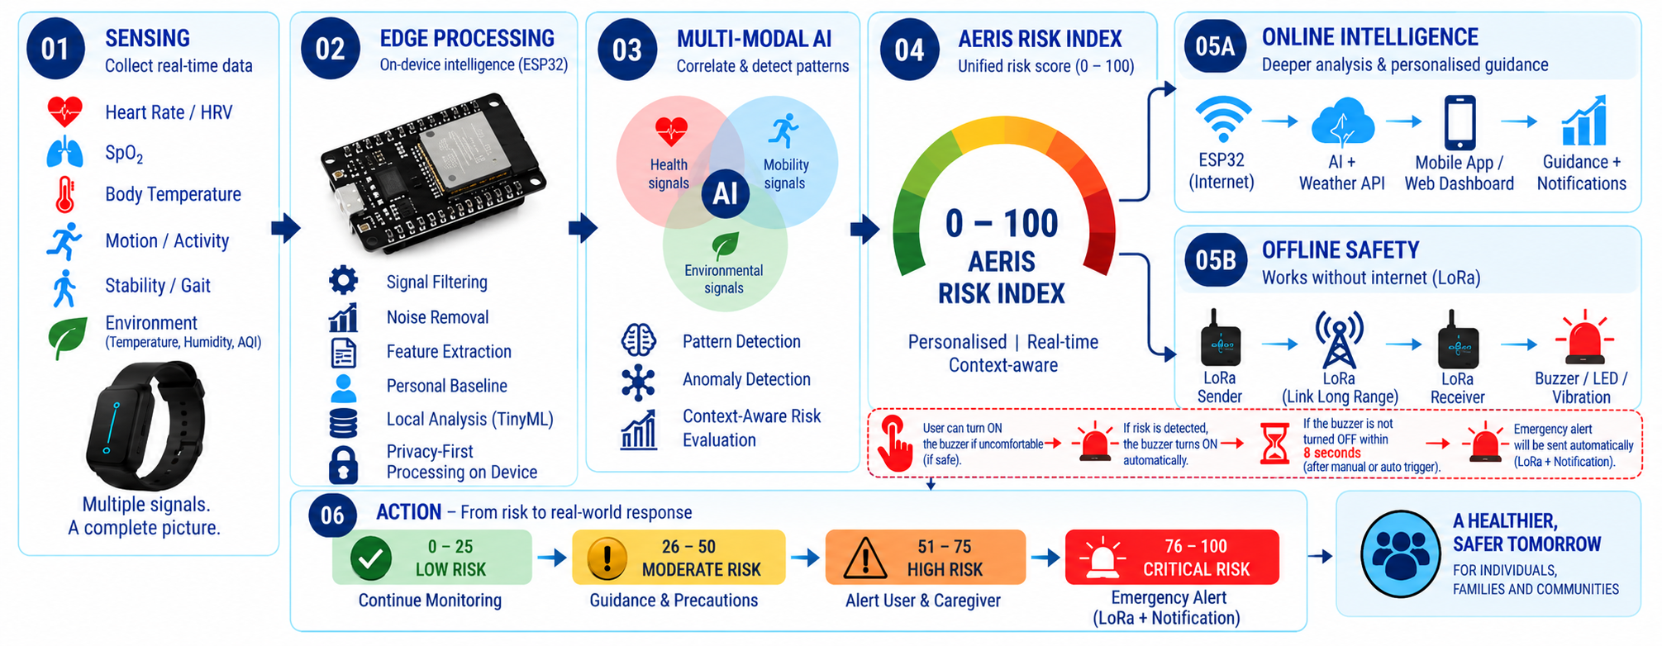
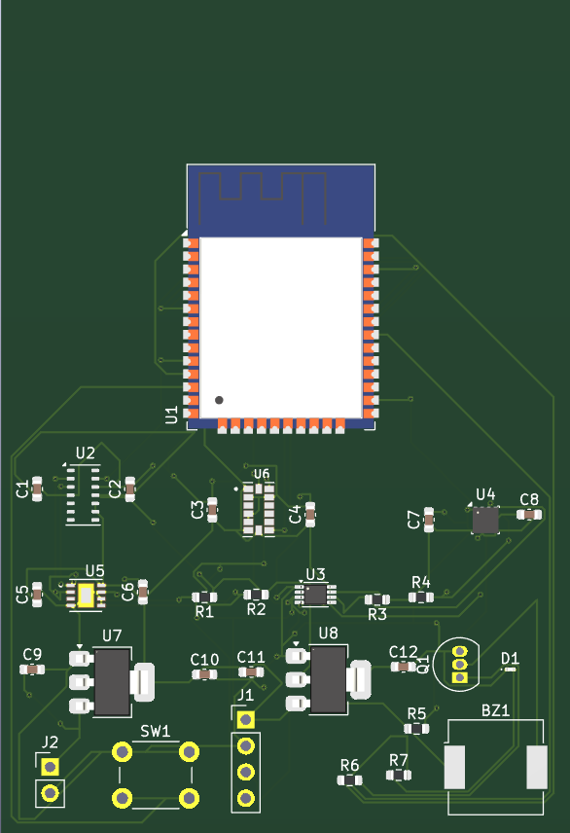
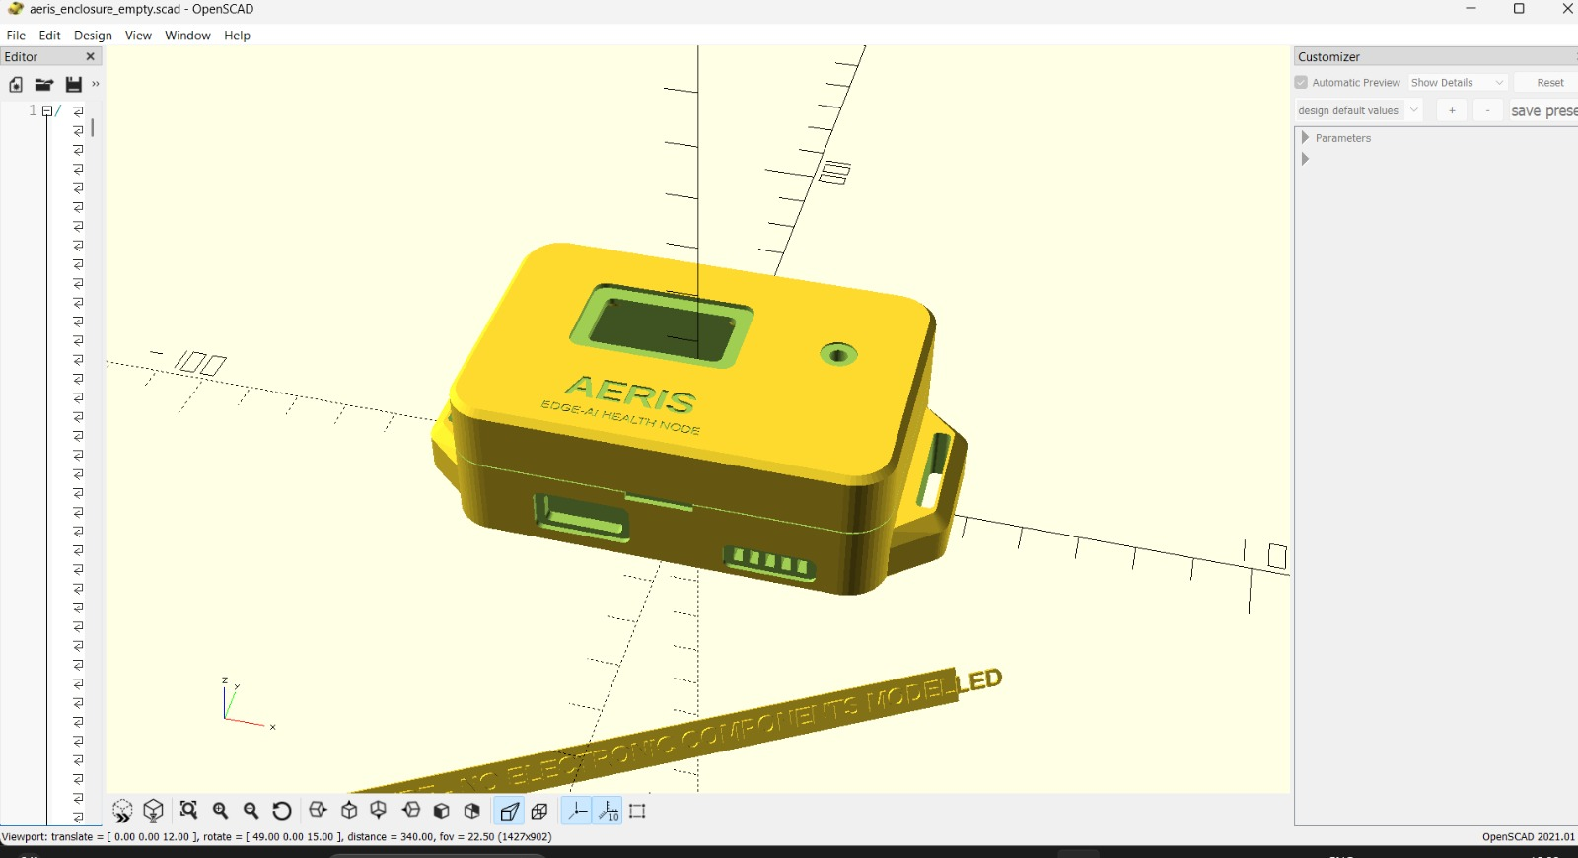
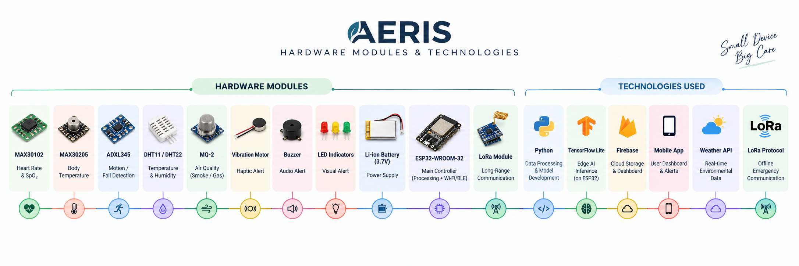
TECHNICAL APPROACH
“AERIS detects the direction of risk, not just the current sensor value.”
PROPOSED HARDWARE ARCHITECTURE:
CUSTOM PCB INTEGRATION
EDITABLE SYSTEM ARCHITECTURE & OFFLINE COMMUNICATION FLOW
1. Sensors
Data Acquisition
(PPG, Temp, IMU, Env)
2. ESP32 Core
Local Processing
& Noise Filtering
3. Edge AI Engine
TinyML Anomaly &
Feature Extraction
4. Risk Index
0–100 Multi-Modal
Unified Scoring
5. Alert System
Threshold Decision
& 8s Escalation
6. User / Contact
Audible Siren & Care-
giver Notification
OFFLINE PATHWAY:
(No Internet / Disasters)
LoRa Transceiver Module (433/868 MHz)
Long-Range Offline Chirp Spread Spectrum Protocol
Emergency / Remote Receiver (Gateway / Siren)
Direct Offline Siren, Local Piezo Buzzer & First-Responder Alert
PROPOSED 3D CAD ENCLOSURE DESIGN
3
Notes:
SLIDE 3 TIPS: Judges use this slide to pressure-test feasibility claims made elsewhere in the deck. A real, labelled architecture diagram plus a working prototype/demo link or QR code consistently outperforms idea-only entries.

Slide 4
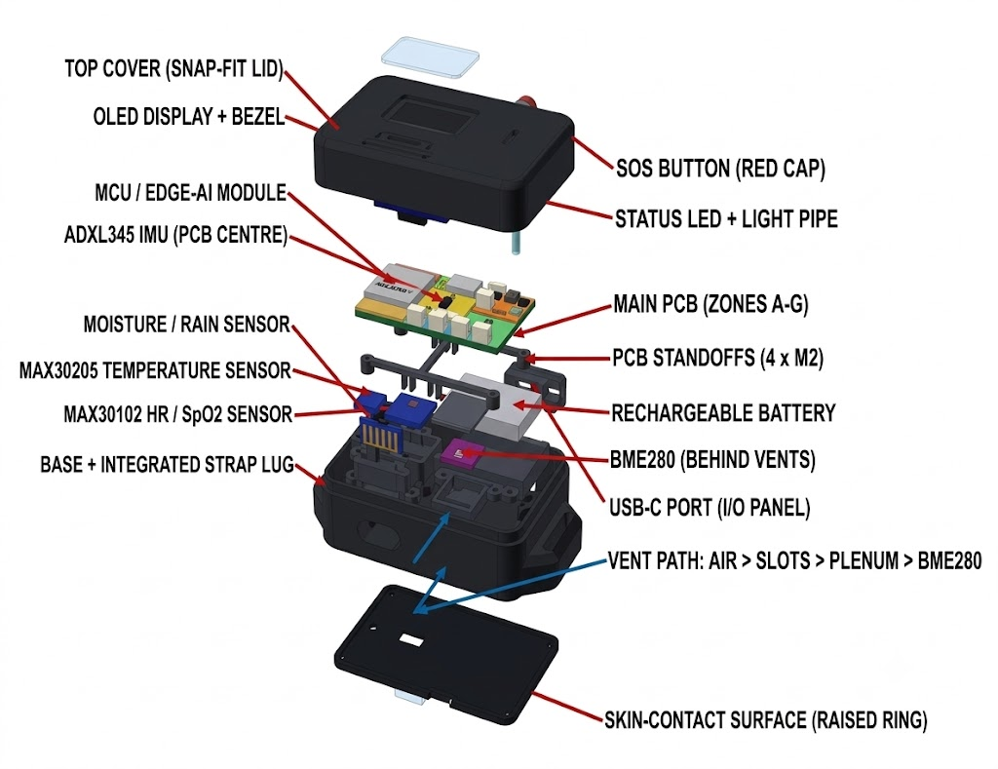
FEASIBILITY AND VIABILITY
Risk Index Becomes More Intelligent
FEASIBILITY - Can we build it?
VIABILITY- Can it work in the real
world?
AERIS: Intelligence in Every Layer
• Compact • Intelligent
• Wearable • Deployment-Ready
AREA | AERIS HIGHLIGHT
🧩 Sensing | Multi-modal health + motion + environment
🧠 Edge AI | ESP32 + personal baseline
📊 Risk Engine | Unified 0–100 Risk Index
🔧 Custom PCB | Proposed modular PCB design
📐 3D CAD | Wearable enclosure designed
📡 Connectivity | Internet + LoRa
🧪 Prototype | Sensor acquisition validated on benchtop
AREA | AERIS ADVANTAGE
🔐 Privacy | Edge-first processing
📡 Resilience | Online + offline LoRa
🚨 Safety | Risk → Alert → Emergency
🌦 Context | Health + environment + weather
🧠 Smart Stress | GSR-free HRV-based estimation
🔄 Scalable | Prototype → PCB → Wearable
🏥 Non-Diagnostic | Risk awareness, not diagnosis
4
Notes:
SLIDE 4 TIPS: Don't present only strengths — naming 2-3 real, specific risks with a credible mitigation reads as maturity. Keep the comparison table honest and sourced; overclaiming cost/market numbers without evidence is a common way teams lose credibility here.

Slide 5
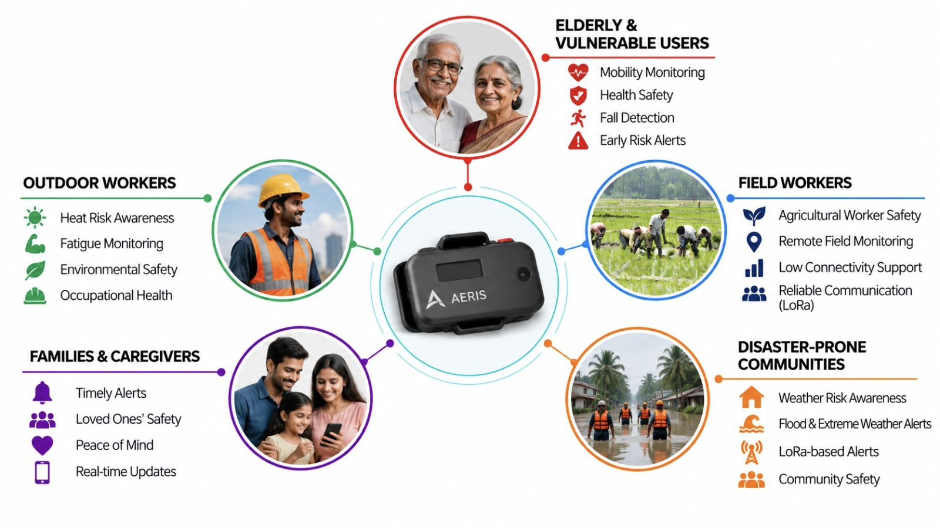
IMPACT AND BENEFITS
BENEFITS
IMPACT AT A GLANCE
Impact Metric | AERIS Target / Value
👥 Year-1 Reach Target | 10,000 pilot users (Target)
💰 Estimated Prototype Cost | Estimated: ₹1,000–1,500 (BOM Component Target)
🧠 Processing Architecture | Edge-first, privacy-preserving on-device AI
📡 Connectivity Resilience | Online (BLE/Wi-Fi) + Offline (LoRa) safety
🚨 Rapid Response Protocol | Risk Index → Buzzer → 8s confirmation → Alert
📈 Long-Term Scalability Target | 1M+ users (Modular multi-form architecture target)
🌦️ Risk Coverage Scope | Multi-modal: Vitals + Mobility + Environment + Weather
📊 Market Growth Estimate | 11.49% CAGR (Preventive Healthcare Tech 2024–2032)*
ABDM — Digital healthcare and interoperability
NPCCHH — Climate and environmental health
ALIGNED WITH NATIONAL PRIORITIES
Digital India / IndiaAI Mission-
Secure, inclusive Edge-AI & IoT innovation
*Market Source: Research and Markets – Global Preventive Healthcare Technologies and Services Market Report (2024–2032), 11.49% CAGR.
5
Notes:
SLIDE 5 TIPS: Numbers beat adjectives — quantify impact (%, ₹, number of beneficiaries) rather than saying 'huge impact'. Tying the outcome to a named government scheme or SDG is rewarded when the link is genuine, not forced.

Slide 6
RESEARCH AND REFERENCES
RESEARCH
REFERENCES
Research Area | How it supports AERIS
Wearable Health Monitoring | HR, SpO₂ & temperature sensing
HRV & Stress Analysis | HRV-based personal risk patterns
Fall & Mobility Detection | Motion, gait & stability monitoring
Edge AI & Privacy | Local processing & reduced raw-data transmission
Environmental Health | Heat, humidity & weather-related risk
LoRa Emergency Communication | Offline long-range safety alerts
NATIONAL POLICY & STANDARDS BENCHMARKS
• Ayushman Bharat Digital Mission (ABDM): National Health Authority & MoHFW, Govt. of India (2021–2024). Operational Guidelines & Unified Health Interface (UHI) interoperability standards for wearable integration. [Source: abdm.gov.in / pib.gov.in]
• Digital Personal Data Protection (DPDP) Act, 2023: Ministry of Law & Justice, Govt. of India (Aug 2023). Statutory compliance for on-device edge processing, user data minimization, and privacy-first architecture. [Source: meity.gov.in / egazette.gov.in]
• National Programme on Climate Change & Human Health (NPCCHH): NCDC & MoHFW, Govt. of India (2019–2024). Standard surveillance protocols for extreme heatwave indices and climate-sensitive physiological risk warnings. [Source: ncdc.mohfw.gov.in]
• NDMA & Dept. of Telecommunications (DoT): National Disaster Management Authority (2023–2024). Common Alerting Protocol (CAP) & Cell Broadcast emergency warning architecture. [Source: ndma.gov.in]
PEER-REVIEWED TECHNICAL RESEARCH REFERENCES
• Wearable Optical Photoplethysmography (PPG & SpO₂): Tamura, T., et al. (2014). 'Wearable Photoplethysmographic Sensors—Past and Present.' Electronics, 3(2), 282–302. — Validates reflective pulse oximetry on wrist.
• HRV RMSSD & GSR-Free Stress Quantification: Shaffer, F., & Ginsberg, J. P. (2017). 'An Overview of Heart Rate Variability Metrics and Norms.' Front. Public Health, 5:258. — Establishes baseline drift without GSR.
• Tri-Axial Accelerometry & Inertial Fall Detection: Igual, R., et al. (2013). 'Challenges, issues and trends in fall detection systems.' Biomed. Eng. OnLine, 12:66. — Informs MPU6050 impact vector thresholds.
• Edge AI, TinyML & Ultra-Low-Power Embedded ML: Ray, P. P. (2021). 'A Review on TinyML: State-of-the-Art and Advances.' J. King Saud Univ. - CIS, 34(6), 1595–1623. — Validates on-device inference on ESP32 MCU.
• Long-Range Low-Power Disaster Telemetry (LoRa): Augustin, A., et al. (2016). 'A Study of LoRa: Long Range & Low Power Networks for IoT.' Sensors, 16(9), 1466. — Validates sub-GHz offline emergency broadcast.
🌐 Project Website 🔧 PCB Design
Thank You | Team STRAW HATS | AERIS: Edge-AI Personal Health & Environmental Monitoring System
6
Notes:
SLIDE 6 TIPS: Real, checkable citations with links read as credibility; generic references ('Wikipedia', 'Google') read as a red flag. Explicitly studying at least one existing/competing solution and stating the delta is a consistent trait in winning decks.

