Slide 1
Design Pattern In Java and their implementation in Automation Framework

Slide 2
Topics Of Discussion 1. Creational Design Patterns 2. Structural Design Patterns 3. Behavioral Design Patterns

Slide 3
What is Design pattern in java
Design patterns are essential concepts in software development that provide reusable solutions to common design problems. In Java, several design patterns are widely used to improve code organization, maintainability, and flexibility. In this tutorial, we will explore three popular design patterns: Singleton, Factory, and Builder. Additionally, we will demonstrate how to implement them in an Automation framework.

Slide 4
Creational Design Patterns
Creational patterns deal with object creation mechanisms, abstracting the instantiation process. They provide more flexibility and decouple the system from the specific classes that need to be instantiated.
Factory Method Pattern: It provides an interface for creating objects, allowing subclasses to decide which class to instantiate.
Abstract Factory Pattern: It allows creating families of related or dependent objects without specifying their concrete classes.
Singleton Pattern: Ensures a class has only one instance and provides a global access point to that instance.
Prototype Pattern: Allows cloning objects, creating new instances by copying the state of existing objects.
Builder Pattern: Separates the construction of a complex object from its representation, allowing the same construction process to create different representations.

Slide 5
Singleton Design Pattern
The Singleton pattern ensures that a class has only one instance and provides a global point of access to that instance. It is commonly used for classes that manage shared resources, configurations, or caches.
Implementation: In the context of loggers and extent reports, let’s see how we can implement the Singleton design pattern to ensure that we have only one instance of these objects throughout the application.
Singleton Design Pattern for Logger: In many applications, logging is an essential part of tracking events and debugging. By using the Singleton pattern for a logger, we can centralize logging functionality and ensure that all parts of the application use the same logger instance.

Slide 6
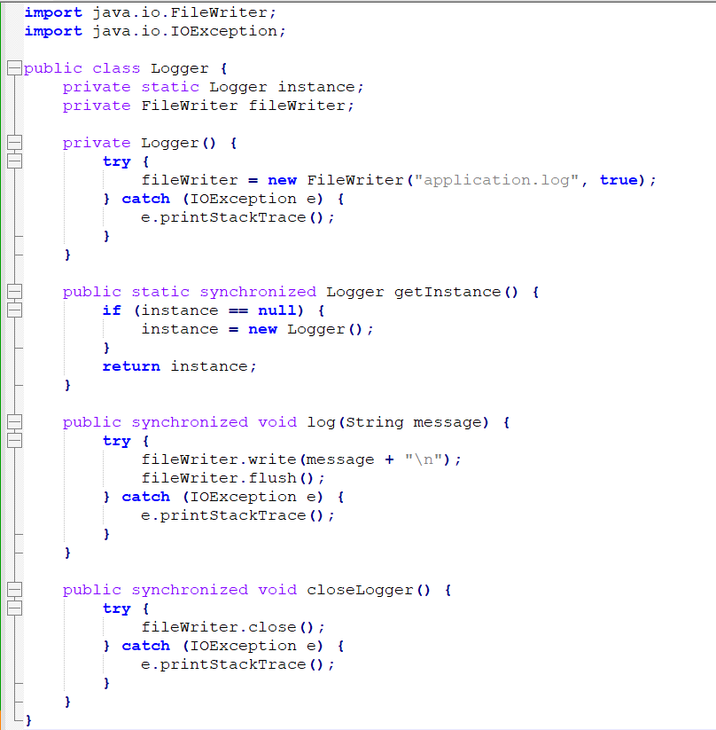
In this example, we have a Logger class with a
private constructor to prevent direct
instantiation from outside the class.
The getInstance() method provides the global access point to the Logger instance, ensuring that only one instance is created throughout the application.
The log() method is used to write log messages,
and the closeLogger() method is used to close the file
writer when it’s no longer needed.

Slide 7
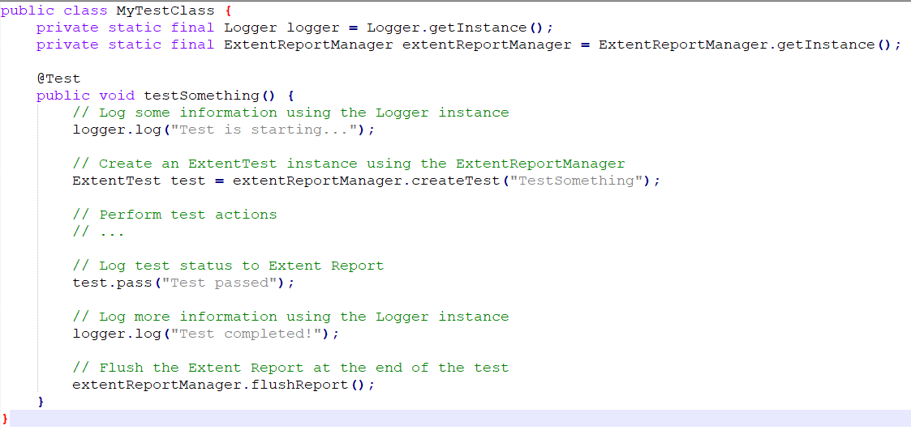
Usage in Automation Framework:In your Automation Framework, you can now use these Singleton instances to log test results and generate the extent report:

Slide 8
Singleton design pattern
By using the Singleton design pattern for loggers and extent reports, you ensure that all parts of your automation framework use the same logger and report instances, avoiding unnecessary duplication of resources and data. This improves the overall efficiency and consistency of your logging and reporting mechanisms.

Slide 9
Factory Design Pattern
The Factory pattern is a creational pattern that provides an interface for creating objects, but allows subclasses to decide which class to instantiate. It promotes loose coupling by delegating the responsibility of object creation to factory classes.
In the context of the WebDriver Manager and WebDriver initialization, we can use the Factory Design Pattern to encapsulate the process of creating and initializing the WebDriver instances for different browsers. This approach allows us to switch between browser types easily and centralizes the WebDriver creation logic. Let’s see how it can be implemented:

Slide 10
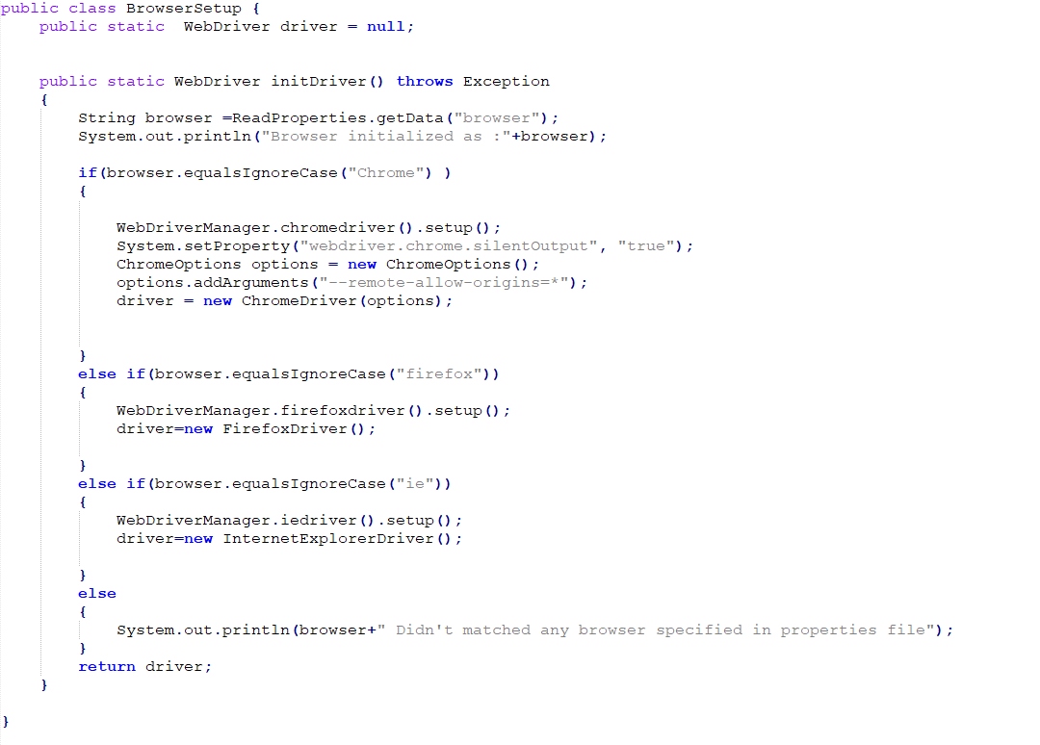

Slide 11
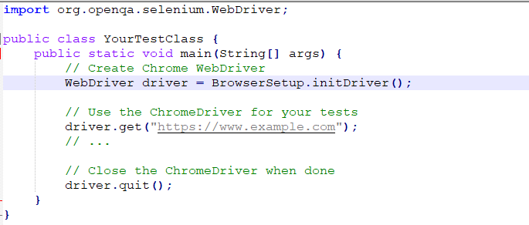
Now, in your test classes or test setup, you can create WebDriver instances using the initDriver method:
With this implementation, you can easily switch between different browsers by passing the appropriate BrowserType to the initDriver method. Additionally, if you need to support more browsers in the future, you can simply add new browser types in the cofig file and update the initDriver method accordingly.
By using the Factory Design Pattern in this way, you promote code reusability and maintainability, as the WebDriver creation logic is centralized and isolated from the rest of the codebase.

Slide 12
Builder Design Pattern
The Builder pattern separates the construction of a complex object from its representation. It allows you to create different representations of an object using the same construction process.
In the context of a Selenium Automation framework, the Builder Design Pattern can be used to create page objects representing different pages of a web application. Each page object can have multiple elements and actions associated with it. Let’s see an example of how to implement the Builder pattern for page objects:

Slide 13
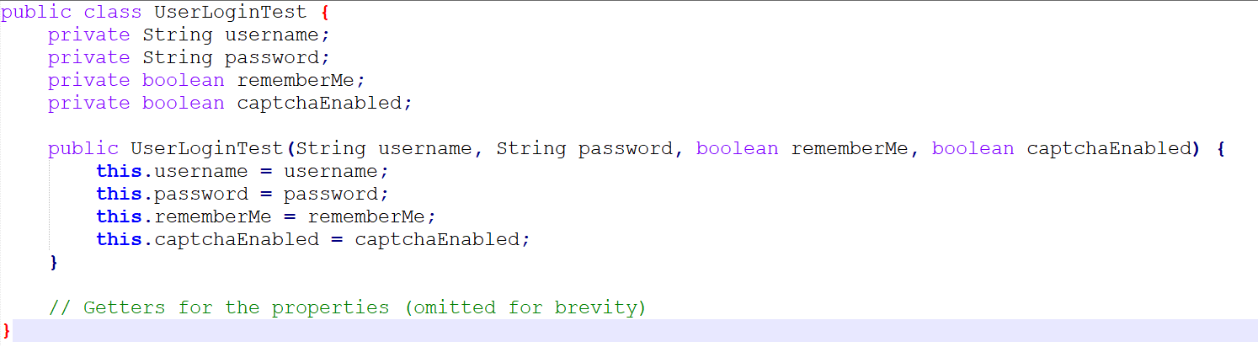
Create the UserLoginTest class,which will be the product we want to build.
Create the UserLoginTestBuilder class, which will be responsible for constructing the UserLoginTest object.

Slide 14
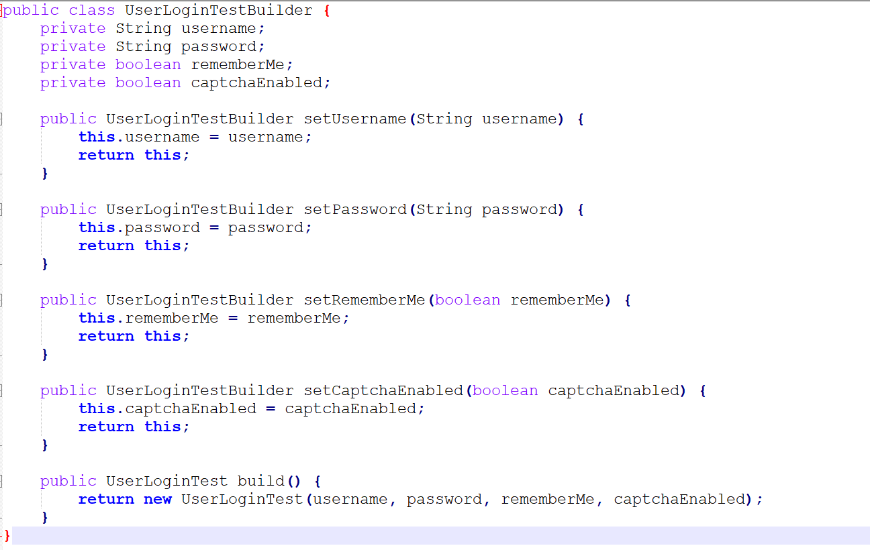

Slide 15
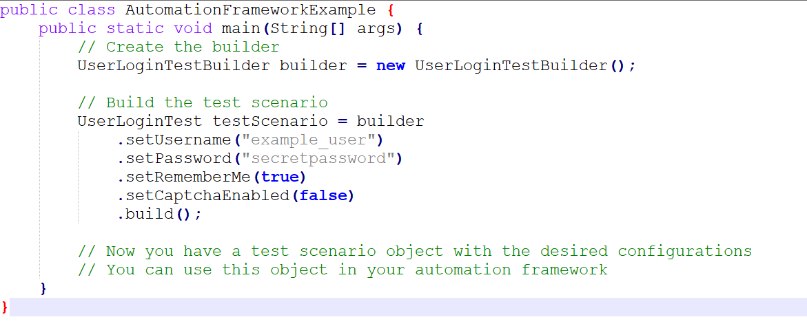
Use the builder to create a UserLoginTest object with the desired configurations.

Slide 16
In this example, we’ve used the Builder pattern to construct a UserLoginTest object step by step, allowing us to create test scenarios with different configurations easily. This is just a simplified example, and in a real automation framework, you might have more complex scenarios and additional properties to set. The Builder pattern is flexible and can be extended to handle various cases in your automation framework.
By using the Builder pattern, we can encapsulate the construction of page objects and create clean, readable code for interacting with different pages in the web application. It also makes the code more maintainable and extensible as the number of page objects increases in the automation framework.

Slide 17
Structural Design Patterns
Structural patterns focus on class composition and object structure. They help create flexible and efficient class hierarchies and relationships.
Adapter Pattern: Converts the interface of one class into another interface that clients expect.
Bridge Pattern: Decouples an abstraction from its implementation, allowing both to vary independently.
Composite Pattern: Treats individual objects and compositions of objects uniformly, forming a tree-like structure.
Decorator Pattern: Allows adding additional behavior or responsibilities to objects dynamically.
Facade Pattern: Provides a simplified interface to a complex system, acting as a high-level interface.
Flyweight Pattern: Shares common state between multiple objects to save memory.
Proxy Pattern: Acts as a substitute or placeholder for another object, controlling access to it.

Slide 18
Behavioral Design Patterns
Behavioral patterns deal with communication and interaction between classes, focusing on how objects collaborate and distribute responsibilities.
Chain of Responsibility Pattern: Creates a chain of objects to handle a request, passing it along the chain until it's processed.
Command Pattern: Encapsulates a request as an object, allowing parameterization of clients with different requests, queuing, and logging of requests.
Interpreter Pattern: Provides a way to interpret a language or grammar.
Iterator Pattern: Provides a way to sequentially access elements of a collection without exposing its underlying representation.

Slide 19
Mediator Pattern: Centralizes complex communications between objects, promoting loose coupling.
Memento Pattern: Allows capturing and restoring an object's internal state without exposing its structure.
Observer Pattern: Defines a dependency between objects so that when one object changes state, its dependents (observers) are notified.
State Pattern: Allows an object to change its behavior when its internal state changes.
Strategy Pattern: Defines a family of algorithms, encapsulates each one, and makes them interchangeable.
Template Method Pattern: Defines the structure of an algorithm in a method but delegates the steps to subclasses.
Visitor Pattern: Separates an algorithm from the object structure it operates on, allowing new operations to be added without modifying the objects.

