Slide 1

Programming in Java
Lecture 11: ArrayList

Slide 2
Introduction
Standard Java arrays are of a fixed length.
After arrays are created, they cannot grow or shrink, which means we can not resize Arrays.
Arrays are useful when we know in advance how many elements the array is to hold.
ArrayList is a collection which provides the implementation of resizable array.

Slide 3
ArrayList
The ArrayList class extends AbstractList and implements the List interface.
Defined in java.util package.
ArrayList supports dynamic arrays that can grow as needed.
Array lists are created with an initial size.
When this size is exceeded, the collection is automatically enlarged.
When objects are removed, the array may be shrunk.

Slide 4
ArrayList Constructors
T he ArrayList class supports three constructors.
ArrayList() : creates an empty array list with an initial capacity sufficient to hold 10 elements.
ArrayList(int capacity) : creates an array list that has the specified initial capacity.
ArrayList(Collection c) : creates an array list that is initialized with the elements of the collection c.

Slide 5
Methods of ArrayList
void add(int index, Object element)
Inserts the specified element at the specified position index in this list.
Throws IndexOutOfBoundsException if the specified index is is out of range.

Slide 6
boolean add(Object o)
Appends the specified element to the end of this list.
boolean addAll(Collection c )
Appends all of the elements in the specified collection to the end of this list.
Throws NullPointerException if the specified collection is null.
boolean addAll(int index, Collection c )
Inserts all of the elements of the specified collection into this list, starting at the specified position.
Throws NullPointerException if the specified collection is null.

Slide 7
void clear()
Removes all of the elements from this list.
Object remove(int index)
Removes the element at the specified position in this list.
Object clone()
Returns a shallow copy of this ArrayList.
int size()
Returns the number of elements in the list.

Slide 8
boolean contains(Object o)
Returns true if this list contains the specified element.
Object get(int index)
Returns the element at the specified position in this list.
int indexOf(Object o)
Returns the index in this list of the first occurrence of the specified element, or -1 if the List does not contain the element.
int lastIndexOf(Object o)
Returns the index in this list of the last occurrence of the specified element, or -1.

Slide 9
void ensureCapacity(int minCapacity)
Increases the capacity of this ArrayList instance, if necessary, to ensure that it can hold at least the number of elements specified by the minimum capacity argument.

Slide 10
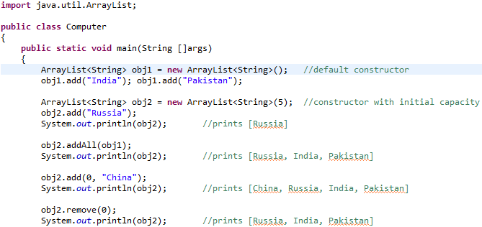
Example

Slide 11
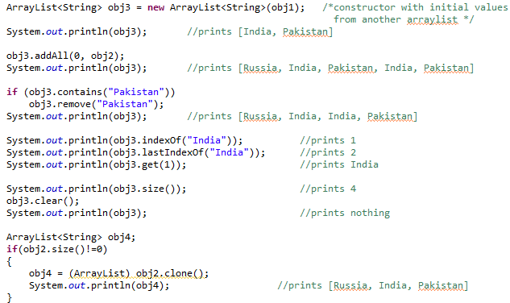
Example

Slide 12
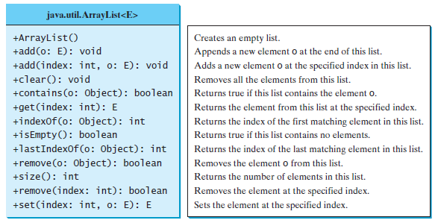

Slide 13


