Slide 1

Modern Programming Tools And Techniques-I Lecture 13: Packages
Lovely Professional University, Punjab

Slide 2
Introduction
What is Package?
A package is a namespace that organizes a set of related classes and interfaces.
Or
A Java package is a mechanism for organizing Java classes into namespaces.
A package is a logical container of classes, interfaces and sub-packages.

Slide 3
Package
Package provides unique namespace for classes (i.e. facility of uniquely identifying a class or interface and resolving name conflicts).
If a class or interface is stored in a package, then it is referenced by using the package name.

Slide 4
Introduction
What is the need of Package?
A unique name should be used for each class to avoid name collisions.
Without some way to manage the name space, we could run out of convenient, descriptive names for individual classes.

Slide 5
Reasons to use packages
Grouping related classes.
In large programs prevents name conflicts.
Allows effective use of default "package" visibility.

Slide 6
Defining a Package
Each file may have a package declaration which precedes all non-comment code.
The package name must be the same as the enclosing directory.
Default package:
If a package declaration is omitted, all classes in that directory are said to belong to the "default" package.

Slide 7
Defining a Package
package Package_Name;
must be the first statement in a class or interface definition.
Example:
package P1;
public class Test
{
public static void main(String arr[])
{
System.out.println(“This is package P1”);
}
}

Slide 8
Compilation:
\Package \P1> javac Test.java
Execution:
\Package> java P1.Test
Note: To execute the class file of a package, we need to go back
to the parent folder of package and refer the class as-
package_name.class_name

Slide 9
classes in different packages
package P1;
public class Test11
{ public void display()
{System.out.println(“This is package P1”);}
}
package P2;
import P1.Test11;
public class Test1 {
public static void main(String arr[]) {
P1.Test 11 t = new P1.Test11();
t.display(); }
}

Slide 10
Importing a Package
‘import’ keyword is used to import the classes of one package into another package.
import package_name.*;
A class must be publically defined in the package in order to be imported in other package.

Slide 11
Once a class is imported in any package, it can be referenced without package name.
If a class is imported but not referenced in importing class, then it will not be loaded (i.e. the imported class will be loaded only when it is referenced ).

Slide 12
Core Packages in Java
java.lang : basic language functionality and fundamental types
java.util : collection data structure classes
java.io : file operations
java.math : multiprecision arithmetics
java.nio : the New I/O framework for Java
java.net : networking operations, sockets
java.security : key generation, encryption and decryption
java.sql : Java Database Connectivity (JDBC) to access databases
java.awt : basic hierarchy of packages for native GUI components
javax.swing : hierarchy of packages for platform-independent rich GUI components
java.applet : classes for creating an applet
Note: The java.lang package is available without the use of an import statement.

Slide 13
Access Specifiers

Slide 14
Access Specifiers
Specifier | Sub class (Same Package) | Non-Sub class (Same Package) | Sub class (Different Package) | Non-Sub class (Different Package)
Public | Yes | Yes | Yes | Yes
Protected | Yes | Yes | Yes | No
default | Yes | Yes | No | No
Private | No | No | No | No

Slide 15

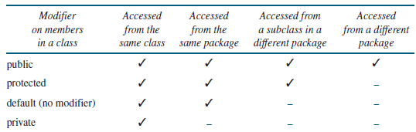
Visibility modifiers

Slide 16
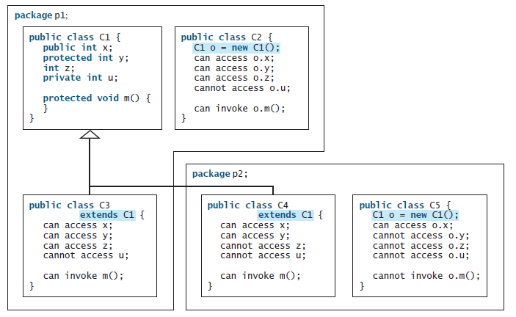

Slide 17


