Slide 1

Modern Programming Tools And Techniques-I Lecture 16: Multi-threading
Lovely Professional University, Punjab

Slide 2
Agenda
Runnable Interface
Thread class
Creating a Thread
Creating Multiple Threads
Synchronization of Threads
Inter-thread Communication
Suspending, Resuming and Stopping Threads

Slide 3
Runnable Interface
Runnable interface contains a single method run().
public interface Runnable
{
public void run();
}
Inside run( ), we will define the code that constitutes the new thread.
run( ) can call other methods, use other classes, and declare variables.

Slide 4
Thread Class
Thread class provides methods to start a thread, suspend a thread and obtain the state of a thread.
public class Thread {
public Thread(Runnable R); // Thread ⇒ R.run()
public Thread(Runnable R, String name);
public void start(); // begin thread execution
...
}

Slide 5
Methods of Thread class
currentThread(): used to obtain the reference of thread object for the current thread.
public static Thread currentThread()
getName(): returns the name of the thread.
public String getName()
setName(): used to change the name of a thread.
public void setName(String Name)
getPriority(): used to obtain the priority of thread.
public int getPriority()

Slide 6
Methods of Thread class
start(): used to start the execution of a thread.
public void start()
sleep(): is used to suspend the current thread for the specified time.
public static void sleep(long milliseconds) throws InterruptedException
isAlive(): used to find out whether a thread is completed or not .
public boolean isAlive()

Slide 7
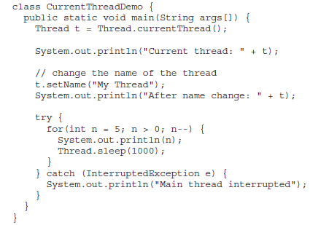
Controlling main Thread

Slide 8
Creating Threads in Java
A user thread is represented by run().
There are two ways of defining a thread:
By extending Thread class
By implementing Runnable interface
Runnable Runnable
Thread
MyThread MyThread
The first case is not recommended because our class may already have a super class, so we can not extend another class.

Slide 9
Implementing Runnable
We can construct a thread on any object that implements Runnable.
To implement Runnable, a class need only implement run( ).
Inside run( ), we will define the code that constitutes the new thread.
run( ) can call other methods, use other classes, and declare variables, just like the main thread can.
The only difference is that run( ) establishes the entry point for another, concurrent thread of execution within our program.
This thread will end when run( ) returns.

Slide 10
class MyThread implements Runnable
{
Thread t;
MyThread()
{
t = new Thread(this, "My Thread");
System.out.println("Child thread: " + t);
t.start();
}
public void run()
{
try {
for(int i = 5; i > 0; i--)
{
System.out.println("Child Thread: " + i);
Thread.sleep(500);
}
}
catch (InterruptedException e)
{
System.out.println("Child interrupted.");
}
System.out.println("Exiting child thread.");
}
}

Slide 11
class ThreadDemo1
{
public static void main(String args[])
{
new MyThread();
try {
for(int i = 5; i > 0; i--)
{
System.out.println("Main Thread: " + i);
Thread.sleep(1000);
}
}
catch (InterruptedException e)
{
System.out.println("Main thread interrupted.");
}
System.out.println("Main thread exiting.");
}
}

Slide 12
Extending Thread Class
The second way to create a thread is to create a new class that extends Thread.
Create an instance of that class.
Override the run( ) method.
Call start( ) to begin execution of the new thread.

Slide 13
class MyThread1 extends Thread {
MyThread1() {
super("Demo Thread");
System.out.println("Child thread: " + this);
start(); }
public void run() {
try {
for(int i = 5; i > 0; i--) { System.out.println("Child Thread: " + i);
Thread.sleep(500); }
}
catch (InterruptedException e) {
System.out.println("Child interrupted."); }
System.out.println("Exiting child thread.");
}
}

Slide 14
class ExtendThread {
public static void main(String args[]) {
new MyThread1();
try {
for(int i = 5; i > 0; i--) {
System.out.println("Main Thread: " + i);
Thread.sleep(1000);
}
}
catch (InterruptedException e) {
System.out.println("Main thread interrupted.");
}
System.out.println("Main thread exiting.");
}
}

Slide 15
Creating Multiple Threads
class MultiThreadDemo
{
public static void main(String args[]) {
new MyThread2("One");
new MyThread2("Two");
new MyThread2("Three");
try {
Thread.sleep(10000);
}
catch (InterruptedException e) {
System.out.println("Main thread Interrupted");
}
System.out.println("Main thread exiting.");
}
}

Slide 16
class MyThread2 implements Runnable {
String name; Thread t;
MyThread2(String threadname)
{
name = threadname;
t = new Thread(this, name);
System.out.println("New thread: " + t);
t.start(); }
public void run() {
try {
for(int i = 5; i > 0; i--) {
System.out.println(name + ": " + i);
Thread.sleep(1000);
}
} catch (InterruptedException e) {
System.out.println(name + "Interrupted");
}
System.out.println(name + " exiting.");
}
}

Slide 17
Notice the call to sleep(10000) in main( ).
This causes the main thread to sleep for ten seconds and ensures that it will finish last.
Two ways exist to determine whether a thread has finished.
Call isAlive( ) on the thread.
final boolean isAlive( )
Call join( ) on thread.
final void join( ) throws InterruptedException
This method waits until the thread on which it is called terminates.
Additional forms of join( ) allow to specify a maximum amount of time that you want to wait for the specified thread to terminate.

Slide 18
Synchronization
Race Condition: Multiple threads calling the same method, on the same object, at the same time.
When two or more threads need access to a shared resource, they need some way to ensure that the resource will be used by only one thread at a time.
The process by which this is achieved is called synchronization.
Monitor (Semaphore) is used for synchronization.

Slide 19
Monitor
A monitor is an object that is used as a mutually exclusive lock, or mutex.
Only one thread can own a monitor at a given time.
When a thread acquires a lock, it is said to have entered the monitor.
All other threads attempting to enter the locked monitor will be suspended until the first thread exits the monitor.
These other threads are said to be waiting for the monitor.

Slide 20
Need of Synchronization: Example
class Callme
{
void call(String msg)
{
System.out.print("[" + msg);
try
{ Thread.sleep(1000); }
catch(InterruptedException e)
{ System.out.println("Interrupted"); }
System.out.println("]");
}
}
Here, Callme Class is used to print message

Slide 21
Example
class Caller implements Runnable
{
String msg;
Callme target;
Thread t;
public Caller(Callme targ, String s)
{
target = targ;
msg = s;
t = new Thread(this);
t.start();
}
public void run()
{
target.call(msg);
}
}
Reference variable of Callme Class to print message

Slide 22
Example
class Synch
{
public static void main(String args[])
{
Callme target = new Callme();
Caller ob1 = new Caller(target, "Hello");
Caller ob2 = new Caller(target, "Synchronized");
Caller ob3 = new Caller(target, "World");
// wait for threads to end
try {
ob1.t.join();
ob2.t.join();
ob3.t.join();
} catch(InterruptedException e)
{
System.out.println("Interrupted");
}
}
}
Reference variable of Callme Class to print message
message

Slide 23

O/P without synchronization

Slide 24
Using Synchronized Methods
Methods qualified with synchronized keyword are called Synchronized Methods.
While a thread is inside a synchronized method, all other threads
that try to call it (or any other synchronized method) on the same instance have to wait.
To exit the monitor and relinquish control of the object to the next waiting thread, the owner of the monitor simply returns from the synchronized method.

Slide 25
Using Synchronized Methods
A synchronized method can be executed by only one thread at a time.
Example: Synch.java and Synch1.java

Slide 26
Synchronized Method: Example
class Callme
{
synchronized void call(String msg)
{
System.out.print("[" + msg);
try
{ Thread.sleep(1000); }
catch(InterruptedException e)
{ System.out.println("Interrupted"); }
System.out.println("]");
}
}

Slide 27
The synchronized Statement
A synchronized block ensures that a call to a method occurs only after the current thread has successfully entered object’s monitor.
put calls to the methods defined by the class inside a synchronized block.
synchronized(object)
{
// statements to be synchronized
}
Here, object is a reference to the object being synchronized.

Slide 28
Synchronized Statement: Example
class Caller implements Runnable
{
String msg;
Callme target;
Thread t;
public Caller(Callme targ, String s)
{
target = targ; msg = s;
t = new Thread(this); t.start();
}
public void run()
{
synchronized(target)
{ // synchronized block
target.call(msg);
}
}
}

Slide 29
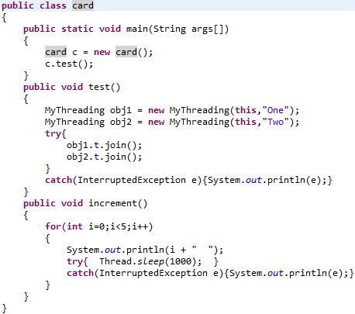
Example – 1 Using Synchronized block
Creating 2 Threads through another class

Slide 30
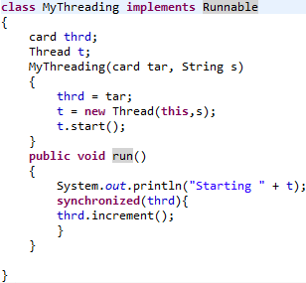
Example – 1 Using Synchronized block
Calling method of previous class inside synchronized block

Slide 31
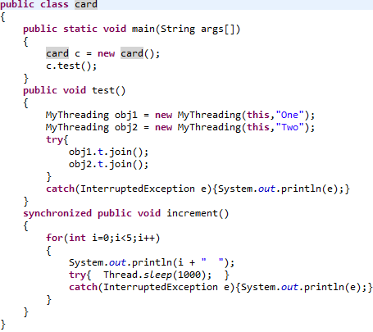
Example – 2 Using Synchronized method
Using synchronized mehtod

Slide 32
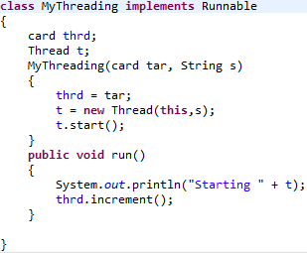
Example – 2 Using Synchronized method
calling synchronized method of previous class

Slide 33
Suspending, Resuming, and Stopping Threads
Execution of a thread can be suspended.
Restarting the execution of a suspended thread is also possible.
Prior to Java 2, suspend( ) and resume( ) methods (defined by
Thread), were used to pause and restart the execution of a thread.
final void suspend( )
final void resume( )
The Thread class also defines a method called stop( ) that stops a thread.
final void stop( )
Once a thread has been stopped, it cannot be restarted using resume( ).

Slide 34
suspend( ), resume( ), and stop( ) methods defined by Thread were deprecated by Java2.
Why???
suspend( ) can sometimes cause serious system failures as in case of locking.
resume() is deprecated because it cannot be used without the suspend( ).
stop( ) can also cause serious system failures so it was also deprecated.

Slide 35
Now how to
suspend, resume and stop
a thread?

Slide 36
New Approach for suspending, resuming and stopping a thread
A thread must be designed so that the run( ) method periodically checks to determine whether that thread should suspend, resume, or stop its own execution.
This is accomplished by establishing a flag variable that indicates the execution state of the thread.
As long as this flag is set to “running,” the run( ) method must continue to let the thread execute.
If this variable is set to “suspend,” the thread must pause.
If it is set to “stop,” the thread must terminate.

Slide 37
class NewThread implements Runnable
{
NewThread(String threadname) { //code }
public void run() { //code }
void mysuspend()
{
suspendFlag = true;
}
synchronized void myresume()
{
suspendFlag = false;
notify();
}
}

Slide 38
class SuspendResume
{
public static void main(String args[]) {
NewThread ob1 = new NewThread("One");
NewThread ob2 = new NewThread("Two");
try {
Thread.sleep(1000);
ob1.mysuspend();
System.out.println("Suspending thread One");
Thread.sleep(1000);
ob1.myresume();
System.out.println("Resuming thread One");
ob2.mysuspend();
System.out.println("Suspending thread Two");
Thread.sleep(1000);
ob2.myresume();
System.out.println("Resuming thread Two");
}
catch (InterruptedException e)
{ System.out.println("Main thread Interrupted"); }

Slide 39
try
{
System.out.println("Waiting for threads to finish.");
ob1.t.join();
ob2.t.join();
}
catch (InterruptedException e)
{
System.out.println("Main thread Interrupted");
}
System.out.println("Main thread exiting.");
}
}

Slide 40
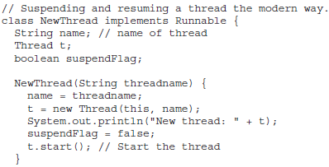
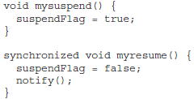
Detailed Example
Constructor initializing & starting thread and disabling suspendFlag
Function to enable suspendFlag
Function to disable suspendFlag & waking thread

Slide 41
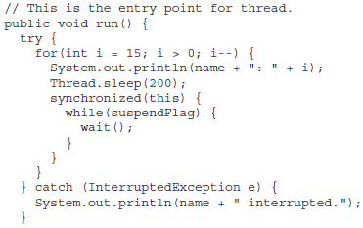

Synchronized block to check suspendFlag and suspend execution

Slide 42
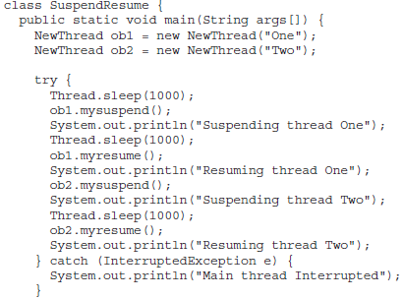

Slide 43
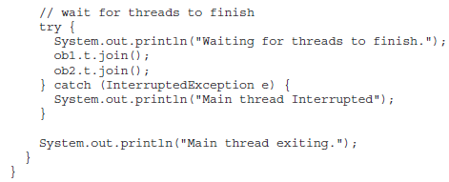

Slide 44
wait( ) and notify( ) methods are inherited from Object class can be used to control the execution of a thread.
The NewThread class contains a boolean instance variable named suspendFlag, which is used to control the execution of the thread.
It is initialized to false by the constructor.
The run( ) method contains a synchronized statement block that checks suspendFlag.
If that variable is true, the wait( ) method is invoked to suspend the execution of the thread.
The mysuspend( ) method sets suspendFlag to true.
The myresume( ) method sets suspendFlag to false and invokes notify( ) to wake up the thread.
Finally, the main( ) method has been modified to invoke the mysuspend( ) and myresume( ) methods.

Slide 45
Inter-thread Communication
wait( ), notify( ), and notifyAll( ) methods are used for communication among threads.
All three methods can be called only from within a synchronized context.
wait( ) tells the calling thread to give up the monitor and go to sleep until some other thread enters the same monitor and calls notify( ).
notify( ) wakes up a thread that called wait( ) on the same object.
notifyAll( ) wakes up all the threads that called wait( ) on the same object. One of the threads will be granted access.

Slide 46
Inter-thread Communication
These methods are declared within Object, as shown here:
final void wait( ) throws InterruptedException
final void notify( )
final void notifyAll( )

Slide 47

All the Best
for
END-Term Exams

