Slide 1

Modern Programming Tools And Techniques-I Lecture 17: I/O Basics and Streams
Lovely Professional University, Punjab

Slide 2
Introduction
Most real applications of Java are not text-based, console programs.
Java’s support for console I/O is limited.
Text-based console I/O is not very important to Java programming.
Java does provide strong, flexible support for I/O as it relates to files and networks.

Slide 3
Streams
Java implements streams within class hierarchies defined in the java.io package.
A stream is a sequence of data.
A stream is linked to a physical device by the Java I/O system.
All streams behave in the same manner, even if the actual physical devices to which they are linked differ.
An I/O Stream represents an input source or an output destination.

Slide 4
I/O Streams
A stream can represent many different kinds of sources and destinations
– disk files, devices, other programs, a network socket, and memory arrays
Streams support many different kinds of data
– simple bytes, primitive data types, localized characters, and objects
Some streams simply pass on data; others manipulate and transform the data in useful ways.

Slide 5
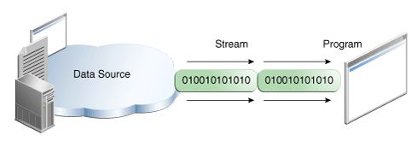
Input Stream
A program uses an input stream to read data from a source, one item at a time.
Reading information into a program.

Slide 6
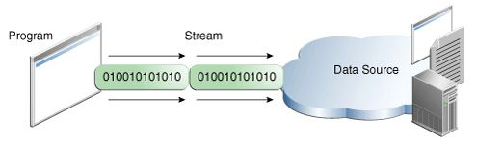
Output Stream
A program uses an output stream to write data to a destination, one item at time:
Writing information from a program.

Slide 7
Types of Streams
Java defines two different types of Streams-
Byte Streams
Character Streams
Byte streams provide a convenient means for handling input and output of bytes.
Byte streams are used, for example, when reading or writing binary data.
Character streams provide a convenient means for handling input and output of characters.
In some cases, character streams are more efficient than byte streams.

Slide 8
Byte Streams
Programs use byte streams to perform input and output of 8-bit bytes.
Byte streams are defined by using two class hierarchies.
At the top, there are two abstract classes: InputStream and OutputStream.
The abstract classes InputStream and OutputStream define several key methods that the other stream classes implement.
Two of the most important methods are read( )and write( ), which, respectively, read and write bytes of data.
Both methods are declared as abstract inside InputStream and OutputStream.

Slide 9
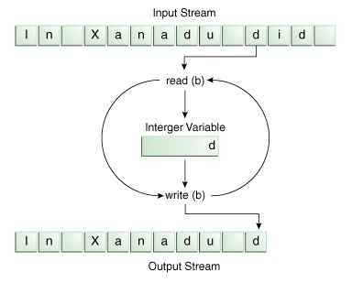
Reading/ Writing File using Streams

Slide 10
Using Byte Streams
import java.io.*;
class ShowFile {
public static void main(String args[]) throws IOException
{
int i;
FileInputStream fin;
try { fin = new FileInputStream(args[0]); }
catch(FileNotFoundException e)
{ System.out.println("File Not Found"); return; }
catch(ArrayIndexOutOfBoundsException e)
{ System.out.println("Usage: ShowFile File"); return; }
// read characters until EOF is encountered
do {
i = fin.read();
if(i != -1) System.out.print((char) i);
} while(i != -1);
fin.close();
}}

Slide 11
Using Byte Streams
import java.io.FileInputStream;
import java.io.FileOutputStream;
import java.io.IOException;
public class CopyBytes {
public static void main(String[] args) throws IOException
{ FileInputStream in = null;
FileOutputStream out = null;
try {
in = new FileInputStream(“ravi.txt");
out = new FileOutputStream(“Copy.txt");
int c;
while ((c = in.read()) != -1)
{ out.write(c); }
}
finally { if (in != null)
{ in.close(); }
if (out != null)
{ out.close(); }
} } }

Slide 12
Byte Stream Contd…
Note: read() returns an int value.
Using a int as a return type allows read() to use -1 to indicate that it has reached the end of the stream.

Slide 13
Closing the Streams
Closing a stream when it's no longer needed is very important.
It is so important that we have used a finally block to guarantee that both streams will be closed even if an error occurs. This practice helps avoid serious resource leaks.
One possible error is that CopyBytes was unable to open one or both files. When that happens, the stream variable corresponding to the file never changes from its initial nullvalue.
That's why CopyBytes makes sure that each stream variable contains an object reference before invoking close.

Slide 14
Use of Byte Stream
Byte streams should only be used for the most primitive I/O.
Since ravi.txt contains character data, the best approach is to use character streams.
Byte Stream represents a kind of low-level I/O.
So why talk about byte streams?
Because all other stream types are built on byte streams.

Slide 15
Byte Stream Classes
Stream Class | Meaning / Use
BufferedInputStream | Buffered input stream
BufferedOutputStream | Buffered output stream
DataInputStream | contains methods for reading the Java standard data types
DataOutputStream | contains methods for writing the Java standard data types
FileInputStream | Input stream that reads from a file
FileOutputStream | Output stream that writes to a file
InputStream | Abstract class that describes stream input
OutputStream | Abstract class that describes stream output
PrintStream | Output stream that contains print() and println( )
PipedInputStream | Input Pipe
PipedOutputStream | Output Pipe

Slide 16
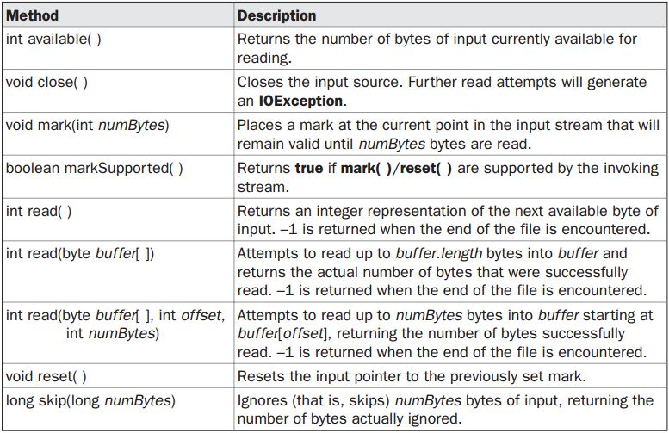
Methods defined by ‘InputStream’

Slide 17
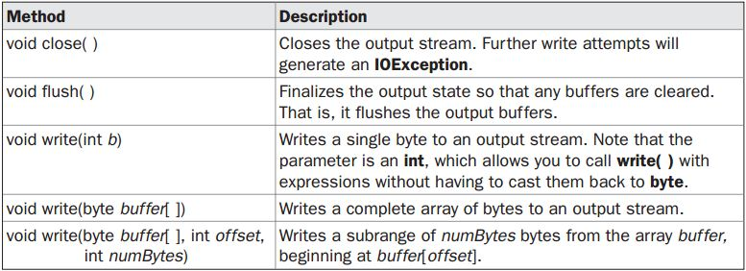
Methods defined by ‘OutputStream’

Slide 18


FileInputStream

Slide 19
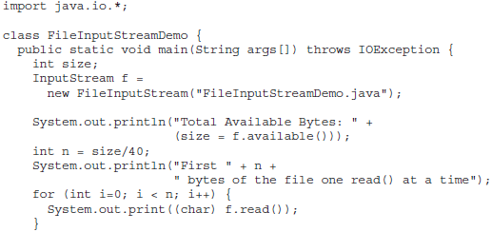

Example

Slide 20
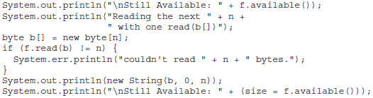
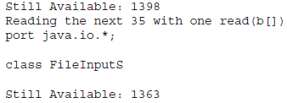
Example (cont.)

Slide 21
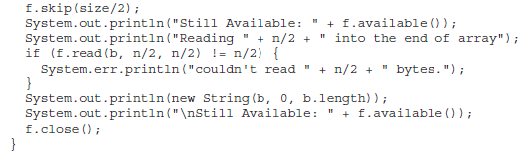
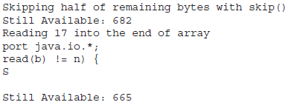
Example (cont.)

Slide 22
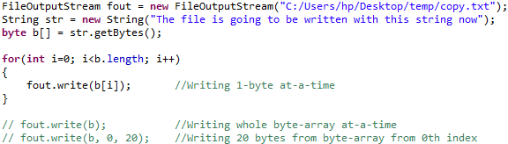
FileOutputStream
Used to write bytes to file.
Commonly used constructors:
FileOutputStream (String filePath)
FileOutputStream (File fileObj)
FileOutputStream (String filePath, boolean append)
FileOutputStream (File fileObj, boolean append)

Slide 23
FileInputStream
Used to read bytes from file.
Commonly used constructors:
FileInputStream (String filePath)
FileInputStream (File fileObj)

Slide 24
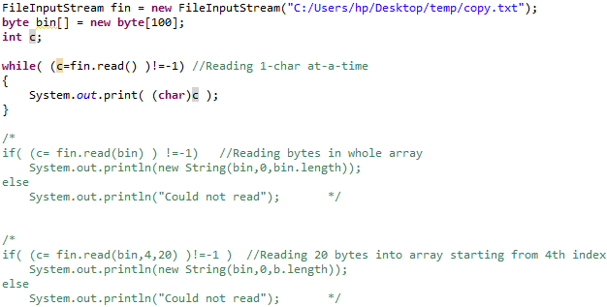
FileInputStream

Slide 25
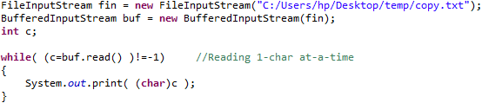
BufferedInputStream
BufferedInputStream class allows to wrap any InputStream into buffered stream and achieve performance optimization.
Commonly used constructors:
BufferedInputStream (InputStream inputstream)
BufferedInputStream (InputStream inputstream, int bufSize)

Slide 26
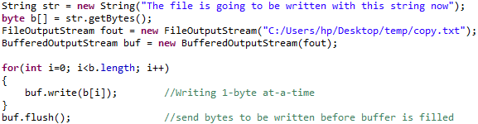
BufferedOutputStream
Used to improve performance by reducing no. of times system actually writes data.
flush() needs to be called if data is to be written immediately.

Slide 27
DataInputStream & DataOutputStream
DataOutputStream & DataInputStream enables to write or read primitive data to or from a stream.
They implement DataOutput and DataInput interfaces, respectively; which define methods that convert primitive values to or from sequence of bytes.
These steams make it easy to store binary data such as integers or floating-point values in a file.

Slide 28
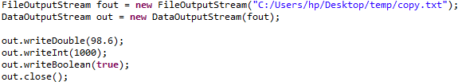
DataOutputStream
It has following constructor:
DataOutputStream (OutputStream outputStream)
It contains following methods:
final void writeDouble (double value) throws IOException
final void writeBoolean (boolean value) throws IOException
final void writeInt (int value) throws IOException

Slide 29
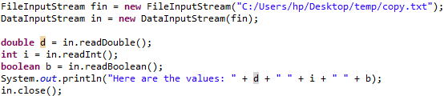
DataInputStream
It has following constructor:
DataInputStream (InputStream inputStream)
It contains following methods:
double readDouble( ) throws IOException
boolean readBoolean( ) throws IOException
int readInt( ) throws IOException

Slide 30
RandomAccessFile
It implements DataInput & DataOutput interfaces, which define basic I/O methods.
It is special since it supports positioning requests, i.e. you can position file-pointer within file.
It has 2 constructors:
RandomAccessFile (File fileObj, String access) throws FileNotFoundException
RandomAccessFile (String filename, String access) throws FileNotFoundException
access: “r” → file can be read but not written
“rw” → file can be read & written
“rws” → file opened in read/write mode & every change to file data is immediately written to physical device.

Slide 31
RandomAccessFile
It has following methods:
void seek (long newPos) throws IOException
void setLength (long len) throws IOException
Specifies new position in bytes from beginning of file
Used to lengthen or shorten a file

Slide 32
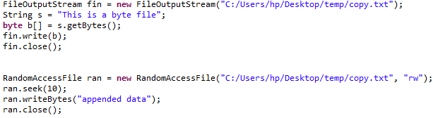
RandomAccessFile

Slide 33
Character Stream
The Java platform stores character values using Unicode conventions.
Character stream I/O automatically translates this internal format to and from the local character set.
Character streams are defined by using two class hierarchies.
At the top are two abstract classes, Reader and Writer.
These abstract classes handle Unicode character streams.
Similar to Byte Streams, read() and write() methods are defined in Reader and Writer class.

Slide 34
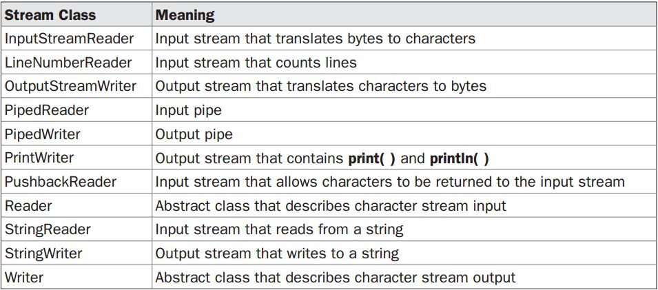
Character Stream Classes

Slide 35
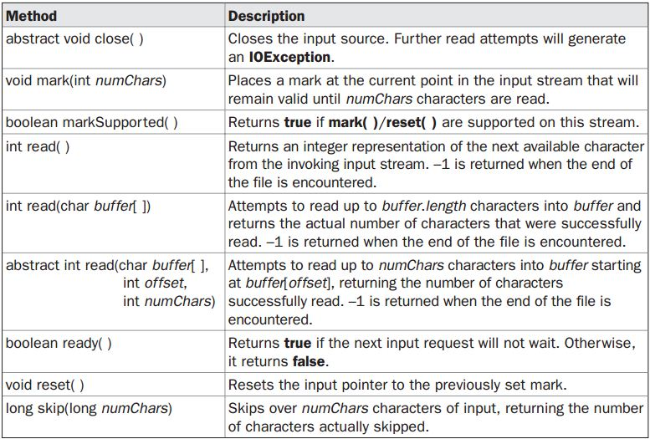
Methods defined by ‘Reader’

Slide 36
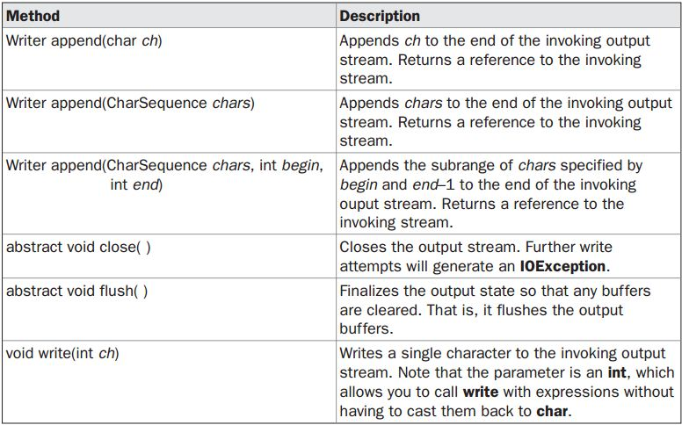
Methods defined by ‘Writer’

Slide 37
Predefined Streams
java.lang package defines a class called System, which encapsulates several aspects of the run-time environment.
System contains three predefined stream variables:
in, out, and err.
These fields are declared as public, static, and final within System.
This means that they can be used by any other part of your program and without reference to a specific System object.

Slide 38
Predefined Streams
System.out refers to the standard output stream. By default, this is the console.
System.in refers to standard input, which is the keyboard by default.
System.err refers to the standard error stream, which also is the console by default.
However, these streams may be redirected to any compatible I/O device.
System.in is an object of type InputStream;
System.out and System.err are objects of type PrintStream.
These are byte streams, even though they typically are used to read and write characters from and to the console.

Slide 39
Reading Console Input
In Java 1.0, the only way to perform console input was to use a byte stream.
In Java, console input is accomplished by reading from System.in.
To obtain a character-based stream that is attached to the console, wrap System.in in a BufferedReader object.
BufferedReader supports a buffered input stream.
Its most commonly used constructor is:
BufferedReader (Reader inputReader)
Here, inputReader is the stream that is linked to the instance of BufferedReader that is being created.
Reader is an abstract class. One of its concrete subclasses is InputStreamReader, which converts bytes to characters.

Slide 40
To obtain an InputStreamReader object that is linked to System.in, use the following constructor:
InputStreamReader(InputStream inputStream)
Because System.in refers to an object of type InputStream, it can be used for inputStream.
Putting it all together, the following line of code creates a BufferedReader that is connected to the keyboard:
BufferedReader br = new BufferedReader(new InputStreamReader(System.in));
After this statement executes, br is a character-based stream that is linked to the console through System.in.

Slide 41
reading Characters and Strings
To read a character from a BufferedReader, use read( ).
int read( ) throws IOException
Each time read( ) is called, it reads a character from the input stream and returns it as an integer value.
It returns –1 when the end of the stream is encountered.
It can throw an IOException.
To read a string from the keyboard, use readLine( ) that is a member of the BufferedReader class.
String readLine( ) throws IOException

Slide 42
reading Characters
import java.io.*;
class BRRead {
public static void main(String args[]) throws IOException
{
char c;
BufferedReader br = new BufferedReader (new InputStreamReader(System.in));
System.out.println("Enter characters, 'q' to quit.");
do {
c = (char) br.read();
System.out.println(c);
}
while(c != 'q');
}
}

Slide 43
reading String
import java.io.*;
class BRReadLines {
public static void main(String args[]) throws IOException
{
BufferedReader br = new BufferedReader(new InputStreamReader(System.in));
String str;
System.out.println("Enter lines of text.");
System.out.println("Enter 'stop' to quit.");
do {
str = br.readLine();
System.out.println(str);
}
while(!str.equals("stop"));
}
}

Slide 44
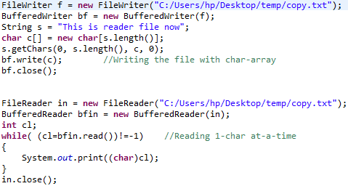
Writing & Reading file

Slide 45
Serialization

Slide 46
Serialization
Serialization is the process of writing the state of an object to a byte stream.
This is useful when we want to save the state of our program to a persistent storage area, such as a file.
At a later time, we may restore these objects by using the process of de-serialization.
Serialization is also needed to implement Remote Method Invocation (RMI).

Slide 47
An object to be serialized may have references to other objects, which, in turn, have references to still more objects.
If we attempt to serialize an object at the top of an object graph, all of the other referenced objects are recursively located and serialized.

Slide 48
Serialization: Interfaces and Classes
An overview of the interfaces and classes that support serialization follows:
Serializable
Only an object that implements the Serializable interface can be saved and restored by the serialization facilities.
The Serializable interface defines no members.
It is simply used to indicate that a class may be serialized.
If a class is serializable, all of its subclasses are also serializable.

Slide 49
2) Externalizable
The Externalizable interface is designed for compression or encryption .
The Externalizable interface defines two methods:
void readExternal (ObjectInput inStream)throws IOException, ClassNotFoundException
void writeExternal (ObjectOutput outStream) throws IOException
In these methods, inStream is the byte stream from which the object is to be read, and outStream is the byte stream to which the object is to be written.

Slide 50
3) ObjectOutput
The ObjectOutput interface extends the DataOutput interface and supports object serialization.
It defines the methods several methods. All of these methods will throw an IOExceptionon error conditions.
writeObject( )method is called to serialize an object.
4) ObjectOutputStream
The ObjectOutputStream class extends the OutputStream class and implements the ObjectOutput interface.
It is responsible for writing objects to a stream. Constructor is:
ObjectOutputStream(OutputStream outStream) throws IOException
The argument outStream is the output stream to which serialized objects will be written.

Slide 51
Serialization Example
class MyClass implements Serializable
{
String s;
int i;
double d;
public MyClass(String s, int i, double d) {
this.s = s;
this.i = i;
this.d = d;
}
public String toString()
{
return "s=" + s + "; i=" + i + "; d=" + d;
}
}

Slide 52
import java.io.*;
public class SerializationDemo {
public static void main(String args[]) {
try {
MyClass object1 = new MyClass("Hello", -7, 2.7e10);
System.out.println("object1: " + object1);
FileOutputStream fos = new FileOutputStream("serial");
ObjectOutputStream oos = new ObjectOutputStream(fos);
oos.writeObject(object1);
oos.flush();
oos.close();
}
catch(IOException e) {
System.out.println("Exception during serialization: " + e);
System.exit(0);
}

Slide 53
// Object deserialization
try {
MyClass object2;
FileInputStream fis = new FileInputStream("serial");
ObjectInputStream ois = new ObjectInputStream(fis);
object2 = (MyClass)ois.readObject();
ois.close();
System.out.println("object2: " + object2);
}
catch(Exception e) {
System.out.println("Exception during deserialization: " + e);
System.exit(0);
}
}
}

Slide 54
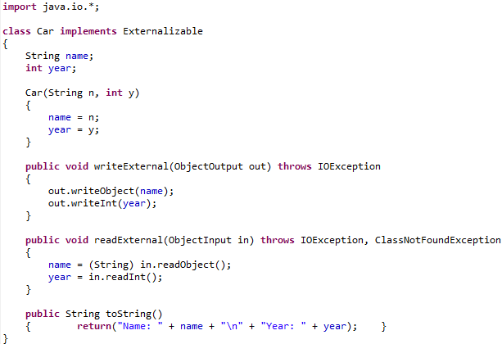
Externalization example

Slide 55
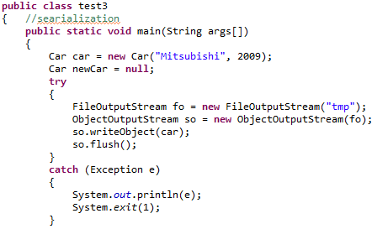

Slide 56
