Slide 1

Modern Programming Tools And Techniques-I Lecture 18: Applets
Lovely Professional University, Punjab

Slide 2
Introduction
A Java applet is a special kind of Java program that a java-enabled browser can download from the internet and run.
An applet is typically embedded inside a web page and runs in the context of a browser.
An applet must be a subclass of the java.applet.Applet class.
The Applet class provides the standard interface between the applet and the browser environment.

Slide 3
Applets are not stand-alone programs.
Instead, they run within either a web browser or an applet viewer.
Execution of an applet does not begin at main( ).
Output to applet’s window is not performed by System.out.println( ).

Slide 4
Types of Applets
There are two types of applets.
The first are based directly on the Applet class and use the AWT to provide the graphic user interface.
These applets has been available since Java was first created.
The second type of applets are based on the Swing class JApplet.
Swing applets use the Swing classes to provide the GUI.

Slide 5
Swing offers a richer and often easier-to-use user interface than does the AWT.
Swing-based applets are now the most popular. However, traditional AWT-based applets are still used, especially when only a very simple user interface is required.
Thus, both AWT and Swing-based applets are valid.
Because JApplet inherits Applet, all the features of Applet are also available in JApplet

Slide 6
Applet Class
Applet provides all necessary support for applet execution, such as starting and stopping.
It also provides methods that load and display images, and methods that load and play audio clips.
Applet extends the AWT class Panel. In turn, Panel extends Container, which extends Component.

Slide 7
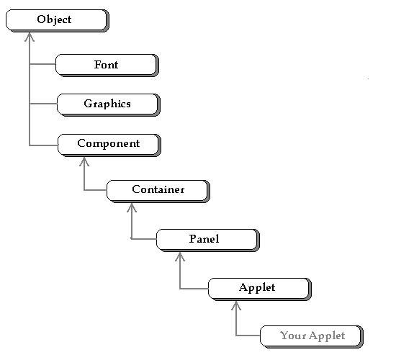
Applet Class Hierarchy

Slide 8
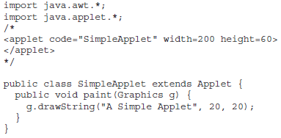
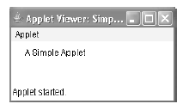
Simple Applet program

Slide 9

Steps to follow

Slide 10

Points to remember

Slide 11
Applet Methods called by the system
public void init()
To initialize the Applet When the applet is first loaded.
public void start()
Starts applet when the applet is displayed.
Automatically called after init( ) when an applet first begins.
public void stop()
When the browser leaves the page containing the applet.
public void destroy()
Called by the browser just before an applet is terminated.
public void paint(Graphics g)

Slide 12
Applet Initialization and Termination
When an applet begins, the following methods are called, in this sequence:
1.init( )
2.start( )
3.paint( )
When an applet is terminated, the following sequence of method calls takes place:
1.stop( )
2.destroy( )

Slide 13
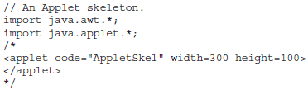
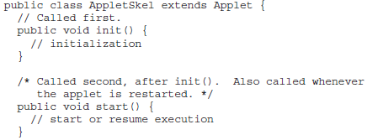
An Applet Skeleton

Slide 14
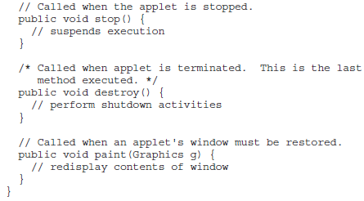
An Applet Skeleton

Slide 15
init( )
The init( ) method is the first method to be called.
This is where we should initialize variables.
This method is called only once during the run time of your applet.

Slide 16
start( )
The start( ) method is called after init( ).
It is also called to restart an applet after it has been stopped.
init( )is called once—the first time an applet is loaded whereas start( ) is called each time an applet’s HTML document is displayed on screen.
So, if a user leaves a web page and comes back, the applet resumes execution at start( ).

Slide 17
paint( )
The paint( ) method is called each time the applet’s output must be redrawn.
This situation can occur for several reasons. For example, the window in which the applet is running may be overwritten by another window and then uncovered. Or the applet window may be minimized and then restored.
paint( ) is also called when the applet begins execution.
The paint( ) method has one parameter of type Graphics, which describes the graphics environment in which the applet is running.

Slide 18
stop( )
The stop( ) method is called when a web browser leaves the HTML document containing the applet(e.g. when it goes to another page).
When stop( )is called, the applet may be running. We can restart them when start( )is called if the user returns to the page.

Slide 19
destroy( )
The destroy( ) method is called when the environment determines that the applet needs to be removed completely from memory.
It frees up any resources the applet may be using.
The stop( ) method is always called before destroy( ).

Slide 20
Simple Applet Display Methods
drawString( )
used to output a string to an applet.
is a member of the Graphics class.
called from within either update( ) or paint( ).
void drawString (String message, int x, int y)
The drawString( ) method will not recognize new line characters.
If we want to start a line of text on another line, we must do so manually, specifying the precise X, Y location where we want the line to begin.

Slide 21
setBackground() & setForeground()
To set the background color of an applet’s window, we use setBackground( ).
void setBackground(Color newColor)
To set the foreground color (the color in which text is shown, for example), we use setForeground( ).
void setForeground(Color newColor)
These methods are defined by Component.
A good place to set the foreground and background colors is in the init( ) method.

Slide 22
repaint()
Whenever an applet needs to update the information displayed in its window, it simply calls repaint( ).
The repaint( ) method is defined by the AWT.
It causes the AWT run-time system to execute a call to applet’s update( ) method, which, in its default implementation, calls paint( ).
void repaint( )
void repaint(int left, int top, int width, int height)
void repaint(long maxDelay)
void repaint(long maxDelay, int x, int y, int width, int height)

Slide 23
Example
import java.awt.*;
import java.applet.*;
/* <applet code="Banner" width=300 height=50> </applet> */
public class Banner extends Applet implements Runnable
{
String msg = " This is a message ";
Thread t = null;
int state;
boolean stopFlag;
// Set colors and initialize thread.
public void init()
{
setBackground(Color.cyan);
setForeground(Color.red);
}

Slide 24
// Start thread
public void start()
{ t = new Thread(this);
stopFlag = false;
t.start(); }
public void run()
{ char ch;
// Display banner
for( ; ; ) { try {
repaint();
Thread.sleep(450);
ch = msg.charAt(0);
msg = msg.substring(1, msg.length());
msg += ch;
if(stopFlag) break;
}
catch(InterruptedException e) {}
}
}

Slide 25
// Pause the banner.
public void stop()
{
stopFlag = true;
t = null;
}
// Display the banner.
public void paint(Graphics g)
{
g.drawString(msg, 50, 30);
}
}

Slide 26
Status Window in Applets
An applet can output a message to the status window of the browser or applet viewer on which it is running.
showStatus( ) method is used to display the status message.
The status window is a good place to give the user feedback about what is occurring in the applet, suggest options, or possibly report some types of errors.

Slide 27
Example
import java.awt.*;
import java.applet.*;
/* <applet code="StatusWindow" width=300 height=50> </applet> */
public class StatusWindow extends Applet
{
public void init()
{
setBackground(Color.cyan);
}
public void paint(Graphics g)
{
g.drawString(“This is applet message", 10, 20);
showStatus("This applet is running on Appletviewer.");
}
}

Slide 28
The HTML APPLET Tag
< APPLET
[CODEBASE = codebaseURL]
CODE = appletFile
[ALT = alternateText]
[NAME = appletInstanceName]
WIDTH = pixels HEIGHT = pixels
[ALIGN = alignment]
[VSPACE = pixels] [HSPACE = pixels]
>
[< PARAM NAME = AttributeName VALUE = AttributeValue>]
[< PARAM NAME = AttributeName2 VALUE = AttributeValue>]
. . .
</APPLET>

Slide 29
The HTML APPLET Tag
CODEBASE: CODEBASE is an optional attribute that specifies the base URL of the applet code, which is the directory that will be searched for the applet’s executable class file (specified by the CODE tag). The HTML document’s URL directory is used as the CODEBASE if this attribute is not specified. The CODEBASE does not have to be on the host from which the HTML document was read.
CODE: CODE is a required attribute that gives the name of the file containing your applet’s compiled.class file. This file is relative to the code base URL of the applet, which is the directory that the HTML file was in or the directory indicated by CODEBASE if set.

Slide 30
The HTML APPLET Tag
ALT : The ALT tag is an optional attribute used to specify a short text message that should be displayed if the browser recognizes the APPLET tag but can’t currently run Java applets. This is distinct from the alternate HTML you provide for browsers that don’t support applets.
NAME: NAME is an optional attribute used to specify a name for the applet instance. Applets must be named in order for other applets on the same page to find them by name and communicate with them.
To obtain an applet by name, use getApplet( ), which is defined by the AppletContext interface.
WIDTH and HEIGHT: WIDTH and HEIGHT are required attributes that give the size (in pixels) of the applet display area.

Slide 31
The HTML APPLET Tag
ALIGN: ALIGN is an optional attribute that specifies the alignment of the applet. This attribute is treated the same as the HTML IMG tag with these possible values: LEFT, RIGHT, TOP, BOTTOM, MIDDLE etc.
VSPACE and HSPACE: These attributes are optional. VSPACE specifies the space, in pixels, above and below the applet. HSPACE specifies the space, in pixels, on each side of the applet.
They’re treated the same as the IMG tag’s VSPACE and HSPACE attributes. PARAM NAME and VALUE The PARAM tag allows you to specify applet-specific arguments in an HTML page. Applets access their attributes with the getParameter( ) method.

Slide 32
Passing Parameters to Applets
The APPLET tag in HTML allows to pass parameters to your applet.
To retrieve a parameter, use the getParameter( ) method. It returns the value of the specified parameter in the form of a String object.
Thus, for numeric and boolean values, you will need to convert their string representations into their internal formats.

Slide 33
Graphics
The Graphics class is the abstract base class for all graphics contexts that allow an application to draw onto components.
All graphics are drawn relative to a window. This can be the main window of an applet, a child window of an applet, or a stand-alone application window.
The Graphics class defines a number of drawing functions.
Drawing Text
To Draw texts on the graphics screen we use drawString() method, shown here:
drawString(String str, int xBaselineLeft, int yBaselineLeft);
Drawing Lines
Lines are drawn by means of the drawLine( )method, shown here:
void drawLine(int startX, int startY, int endX, int endY)
drawLine( )displays a line in the current drawing color that begins atstartX,startYand ends at endX,endY.

Slide 34
Drawing Rectangles
The drawRect( )and fillRect( )methods display an outlined and filled rectangle, respectively.
They are shown here:
void drawRect(int top, int left, int width, int height)
void fillRect(int top, int left, int width, int height)
The upper-left corner of the rectangle is at top,left.The dimensions of the rectangle are specified by width and height.
To draw a rounded rectangle, use drawRoundRect( )or fillRoundRect( ), both shown here:
void drawRoundRect(int top, int left, int width, int height,int xDiam, int yDiam)
void fillRoundRect(int top, int left, int width, int height,int xDiam, int yDiam)
A rounded rectangle has rounded corners.
The diameter of the rounding arc along the X axis is specified by xDiam.The diameter of the rounding arc along the Y axis is specified by yDiam.

Slide 35
Drawing Ellipses and Circles
To draw an ellipse, use drawOval( ). To fill an ellipse, use fillOval( ). These methods are shown here.
void drawOval(int top, int left, int width, int height)
void fillOval(int top, int left, int width, int height)
The ellipse is drawn within a bounding rectangle whose upper-left corner is specified by top,leftand whose width and height are specified by width and height. To draw a circle, specify a square as the bounding rectangle.
Drawing Arcs
Arcs can be drawn with drawArc( ) and fillArc( ), shown here:
void drawArc(int top, int left, int width, int height, int startAngle, int sweepAngle)
void fillArc(int top, int left, int width, int height, int startAngle, int sweepAngle)
The arc is bounded by the rectangle whose upper-left corner is specified by top,left and whose width and height are specified by width and height. The arc is drawn from startAnglethrough the angular distance specified by sweepAngle.Angles are specified in degrees. Zero degrees is on the horizontal, at the three o’clock position. The arc is drawn counterclockwise if sweepAngle is positive, and clockwise if sweepAngle is negative.

Slide 36
Drawing Polygons
It is possible to draw arbitrarily shaped figures using drawPolygon( )and fillPolygon( ),shown here:
void drawPolygon(int x[ ], int y[ ], int numPoints)
void fillPolygon(int x[ ], int y[ ], int numPoints)
The polygon’s endpoints are specified by the coordinate pairs contained within thexandy arrays. The number of points defined by x and y is specified by numPoints.

Slide 37
Color
The java.awt package defines a class named Color.
There are 13 predefined colors:
Color.BLACK Color.PINK Color.GREEN Color.DARK_GRAY Color.RED Color.CYAN Color.GRAY Color.ORANGE Color.BLUE Color.LIGHT_GRAY Color.YELLOW Color.WHITE Color.MAGENTA
Java also allows color names in lowercase:
Color.black, Color.darkGray, etc.
You can also create your own colors, one of the color constructors forms is shown here:
Color(int red, int green, int blue)
The first constructor takes three integers that specify the color as a mix of red, green, and blue. These values must be between 0 and 255, as in this example:
new Color(255, 100, 100); // light red

Slide 38
Java’s coordinate system
(0, 0)
(50, 0)
(0, 20)
(50, 20)
(w-1, h-1)
Java uses an (x, y) coordinate system
(0, 0) is the top left corner
(50, 0) is 50 pixels to the right of (0, 0)
(0, 20) is 20 pixels down from (0, 0)
(w - 1, h - 1) is just inside the bottom right corner, where w is the width of the window and h is its height

Slide 39
The complete applet
import java.applet.Applet; import java.awt.*;
public class Drawing extends Applet {
public void paint(Graphics g) {
g.setColor(Color.BLUE); g.fillRect(20, 20, 50, 30); g.setColor(Color.RED); g.fillRect(50, 30, 50, 30); } }

Slide 40
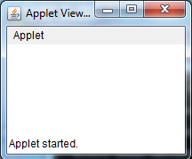
The simplest possible applet
TrivialApplet.java
import java.applet.Applet;
public class TrivialApplet extends Applet { }
TrivialApplet.html
<applet code="TrivialApplet.class” width=200 height=100>
</applet>

Slide 41
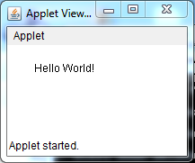
The simplest reasonable applet
import java.awt.*;
import java.applet.Applet;
public class HelloWorld extends Applet { public void paint( Graphics g ) {
g.drawString( "Hello World!", 30, 30 );
}
}
<html>
<applet code ="HelloWorld.class" width =“200" height = “100">
</applet>
</html>

Slide 42
Running the applet
Compile
javac HelloWorld.java
If no errors, bytecodes stored in HelloWorld.class
Create an HTML file
ends in .htm or .html(HelloWorld.html)
To execute an applet
appletviewer HelloWorld.html

Slide 43
Displaying Numerical values
import java.awt.*;
import java.applet.Applet;
public class ab extends Applet{
public void paint(Graphics g){
int a=10, b=20;
int d=a+b;
String s= “sum:“+String.valueOf(d);
g.drawString(s, 100, 100);
}
}

Slide 44
Topics to be covered in Applet
life cycle
paint
Graphics class (all the methods to draw shapes and strings on the applet window)
Note: Go through the Graphics class methods to draw different shapes.
Sample Question: WAP to create an applet to display:

