Slide 1

Modern Programming Tools And Techniques-I Lecture 20: Java GUI API (Swing)
By
Ravi Kant Sahu
Asst. Professor
Lovely Professional University, Punjab

Slide 2
Introduction
AWT is fine for developing simple graphical user interfaces, but not for developing comprehensive GUI projects.
Swing components depend less on the target platform and use less of the native GUI resource.
Swing GUI component classes are named with a prefixed J.

Slide 3
Why AWT and Swing?
Although Swing eliminates a number of the limitations inherent in the AWT, Swing does not replace it.
Instead, Swing is built on the foundation of the AWT. This is why the AWT is still a crucial part of Java.
Swing also uses the same event handling mechanism as the AWT. Therefore, a basic understanding of the AWT and of event handling is required to use Swing.

Slide 4
Key Features of Swing
Swing Components Are Lightweight
means that they are written entirely in Java and do not map directly to platform-specific peers.
Swing Supports a Pluggable Look and Feel
means that it is possible to separate the look and feel of a component from the logic of the component.
The classes shipped by Oracle provide a look and feel that matches that of the platform. The Synth package allows you to create your own look and feel. The GTK+ look and feel makes hundreds of existing look and feels available to Swing programs.
A program can specify the look and feel of the platform it is running on, or it can specify to always use the Java look and feel, and without recompiling, it will just work.

Slide 5
Swing API
GUI API contains classes that can be classified into three groups: component classes, container classes, and helper classes.
The component classes, such as JButton, JLabel, and JTextField, are for creating the user interface.
The container classes, such as JFrame, JPanel, and JApplet, are used to contain other components.
The helper classes, such as Graphics, Color, Font, FontMetrics, and Dimension, are used to support GUI components.

Slide 6
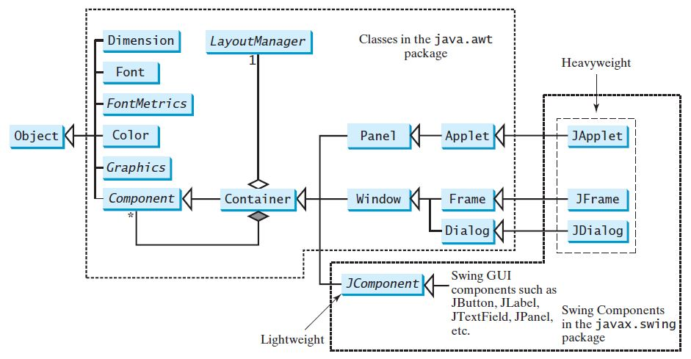
Class hierarchy for AWT and Swing

Slide 7
MVC Connection
A visual component is a composite of three distinct aspects:
1) The way that the component looks when rendered on the screen
2) The way that the component reacts to the user
3) The state information associated with the component
Model-View-Controller architecture is successful because each piece of the design corresponds to an aspect of a component.
By separating a component into a model, a view, and a controller, the specific implementation of each can be changed without affecting the other two.

Slide 8
MVC
In MVC terminology, the model corresponds to the state information associated with the component.
For example, in the case of a check box, the model contains a field that indicates if the box is checked or unchecked.
The view determines how the component is displayed on the screen, including any aspects of the view that are affected by the current state of the model.
The controller determines how the component reacts to the user.
For example, when the user clicks a check box, the controller reacts by changing the model to reflect the user’s choice (checked or unchecked).

Slide 9
Swing Architecture
By separating a component into a model, a view, and a controller, the specific implementation of each can be changed without affecting the other two.
Although the MVC architecture and the principles behind it are conceptually sound, the high level of separation between the view and the controller is not beneficial for Swing components.
Swing uses a modified version of MVC that combines the view and
the controller into a single logical entity called the UI delegate.
For this reason, Swing’s approach is called either the Model Delegate architecture or the Separable Model architecture.
Therefore, although Swing’s component architecture is based on MVC, it does not use a classical implementation of it.

Slide 10
Swing MVC
Swing’s pluggable look and feel is made possible by its Model-Delegate architecture.
Because the view (look) and controller (feel) are separate from the model, the look and feel can be changed without affecting how the component is used within a program.
To support the Model-Delegate architecture, most Swing components contain two objects.
The first represents the model and second represents the UI delegate.
Models are defined by interfaces. For example, the model for a button is defined by the ButtonModel interface.
UI delegates are classes that inherit ComponentUI. For example, the UI delegate for a button is ButtonUI.

Slide 11
Swing Components
Swing components are derived from the JComponent class.
JComponent provides the functionality that is common to all components.
For example, JComponent supports the pluggable look and feel.
JComponent inherits the AWT classes Container and Component.
Thus, a Swing component is built on and compatible with an AWT component.

Slide 12
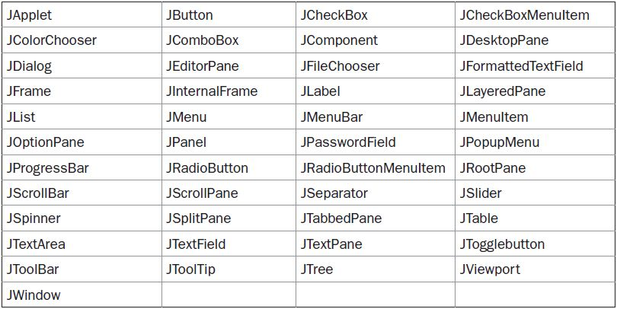
Components

Slide 13
Swing Containers
Swing defines two types of containers.
The first are top-level containers: JFrame, JApplet, JWindow, and JDialog.
These containers do not inherit JComponent.
They do, however, inherit the AWT classes Component and Container.
Unlike Swing’s other components, which are lightweight, the top-level containers are heavyweight.
This makes the top-level containers a special case in the Swing component library.

Slide 14
Swing Containers
The second type of containers supported by Swing are lightweight containers.
Lightweight containers do inherit JComponent.
An example of a lightweight container is JPanel, which is a general-purpose container.
Lightweight containers are often used to organize and manage groups of related components because a lightweight container can be contained within another container.
Thus, we can use lightweight containers such as JPanel to create subgroups of related controls that are contained within an outer container.

Slide 15
Top-Level Container Panes
Each top-level container defines a set of panes.
At the top of the hierarchy is an instance of JRootPane.
JRootPane is a lightweight container whose purpose is to manage the other panes. It also helps manage the optional menu bar.
The panes that comprise the root pane are called the glass pane, the content pane, and the layered pane.
The glass pane is the top-level pane. It sits above and completely covers all other panes. By default, it is a transparent instance of JPanel.
The layered pane is an instance of JLayeredPane. The layered pane allows components to be given a depth value. The layered pane holds the content pane and the (optional) menu bar.

Slide 16
Color class
We can set colors for GUI components by using the java.awt.Color class.
We can use one of the 13 standard colors (BLACK, BLUE, CYAN, DARK_GRAY, GRAY, GREEN, LIGHT_GRAY, MAGENTA, ORANGE, PINK, RED, WHITE, and YELLOW) defined as constants in java.awt.Color.
Colors are made of red, green, and blue components, each represented by an int value that describes its intensity, ranging from 0(darkest shade) to 255(lightest shade). This is known as the RGB model.

Slide 17
We can create a color using the following constructor:
public Color(int r, int g, int b);
Color color = new Color(128,100,100);
The arguments r, g, b are between 0 and 255. If a value beyond this range is passed to the argument, an IllegalArgumentException will occur.
Example:
JButton jb1 = new JButton("OK");
jb1.setBackground(color);
jb1.setForeground (new Color(100,1,1));

Slide 18
Font class
We can create a font using the java.awt.Font class and set fonts for the components using the setFont method in the Component class.
The constructor for Font is:
public Font (String name, int style, int size);
You can choose a font name from SansSerif, Serif, Monospaced, Dialog, or DialogInput.
Choose a style from Font.PLAIN(0), Font.BOLD(1), Font.ITALIC(2), and Font.BOLD+Font.ITALIC(3), and specify a font size of any positive integer.
Example:
Font font1 = new Font("SansSerif", Font.BOLD, 16);
Font font2 = new Font("Serif", Font.BOLD + Font.ITALIC, 12);
JButton jbtOK = new JButton("OK");
jbtOK.setFont(font1);

Slide 19
Setting Default operations in a JFrame
setDefaultCloseOperation() is used for setting the default operation for close button of a JFrame.
void setDefaultCloseOperation (int what)
What is the constant to represent the behavior. These constants are declared in WindowConstants, which is an interface declared in javax.swingthat is implemented by JFrame.
JFrame.HIDE_ON_CLOSE
JFrame.DO_NOTHING_ON_CLOSE
JFrame.EXIT_ON_CLOSE

Slide 20
Event Dispatching Thread
Swing programs are event-driven. An event is passed to the application by calling an event handler defined by the application.
The handler is executed on the event dispatching thread provided by Swing and not on the main thread of the application.
Thus, although event handlers are defined by our program, they are called on a thread that was not created by the program.
So all Swing GUI components must be created and updated from the event dispatching thread, not the main thread of the application.

Slide 21
Event Dispatching Thread
To enable the GUI code to be created on the event dispatching thread, we must use one of two methods that are defined by the SwingUtilities class.
These methods are invokeLater( ) and invokeAndWait( ).
static void invokeLater (Runnable obj)
static void invokeAndWait(Runnable obj) throws InterruptedException, InvocationTargetException

Slide 22
Swing Components

Slide 23
Image Icons
An icon is a fixed-size picture; typically it is small and used to decorate components.
Java supports three image formats: GIF, JPEG, and PNG.
The image file names for these types end with .gif, .jpg, and .png, respectively.
To display an image icon, first create an ImageIcon object using new javax.swing.ImageIcon(filename).
ImageIcon icon = new ImageIcon (“ravi.jpg");
An image icon can be displayed in a label or a button using new JLabel(image-Icon) or new JButton(imageIcon).

Slide 24
JLabel
JLabel is used to display text and/or an icon. It is a passive component in that it does not respond to user input.
JLabel(Icon icon)
JLabel(String str)
JLabel(String str, Icon icon, int align)
The align argument specifies the horizontal alignment of the text and/or icon within the dimensions of the label.
It must be one of the following values: LEFT, RIGHT, CENTER, LEADING, or TRAILING.
These constants are defined in the SwingConstants interface.

Slide 25
The icon and text associated with the label can be obtained by the following methods:
Icon getIcon( )
String getText( )
The icon and text associated with a label can be set by these methods:
void setIcon(Icon icon)
void setText(String str)

Slide 26
JTextField
JTextField allows us to edit one line of text.
It is derived from JTextComponent.
JTextField uses the Document interface for its model.
JTextField(int cols)
JTextField(String str, int cols)
JTextField(String str)
If the number of columns is not specified, the text field is sized to fit the specified string.

Slide 27
Swing Buttons
Swing defines four types of buttons, all are subclasses of the AbstractButton class, which extends JComponent.
JButton,
JToggleButton,
JCheckBox, and
JRadioButton
AbstractButton contains many methods:
String getText( )
void setText(String str)
void setDisabledIcon(Icon di)
void setPressedIcon(Icon pi)
void setSelectedIcon(Icon si)
void setRolloverIcon(Icon ri)

Slide 28
JButton
JButton class provides the functionality of a push button.
JButton allows an icon, a string, or both to be associated with the push button.
JButton(Icon i)
JButton(String str)
JButton(String str, Icon i)
When the button is pressed, an ActionEvent is generated.
Using the ActionEvent object passed to the actionPerformed( ) method of the registered ActionListener, we can obtain the action command string associated with the button.
We can set the action command by calling setActionCommand( ) on the button.
We can obtain the action command by calling getActionCommand( ) on the event object.

Slide 29
JToggleButton
A toggle button looks just like a push button, but it acts differently because it has two states: pushed and released.
Toggle buttons are objects of the JToggleButton class.
JToggleButton implements AbstractButton.
JToggleButton is a super-class for two other Swing components that also represent two-state controls. These are:
JCheckBox and JRadioButton
JToggleButton(String str)
By default, the button is in the off position.

Slide 30
JCheckBox
JCheckBox class provides the functionality of a check box.
Its immediate super class is JToggleButton, which provides support for two-state buttons.
JCheckBox(String str)
When the user selects or deselects a check box, an ItemEvent is generated.

Slide 31
JRadioButton
Radio buttons are a group of mutually exclusive buttons, in which only one button can be selected at any one time.
They are supported by the JRadioButton class, which extends JToggleButton.
A button group is created by the ButtonGroup class.
Its default constructor is invoked for this purpose.
Elements are added to the button group by using add().
void add(AbstractButton ab)
JRadioButton generates action events, item events, and change events each time the button selection changes.

Slide 32
JTable
JTable is a component that displays rows and columns of data.
We can drag the cursor on column boundaries to resize columns.
We can also drag a column to a new position.
Depending on its configuration, it is also possible to select a row, column, or cell within the table, and to change the data within a cell.
JTable has many classes and interfaces associated with it. These are packaged in javax.swing.table.
JTable does not provide any scrolling capabilities of its own. Instead, we normally wrap a JTable inside a JScrollPane.

Slide 33
JTable(Object data[ ][ ], Object colHeads[ ])
data is a two-dimensional array of the information to be presented, and colHeads is a one-dimensional array with the column headings.
JTable can generate several different events.
ListSelectionEvent is generated when the user selects something in the table.
By default, JTable allows us to select one or more complete rows, but we can change this behavior to allow one or more columns, or one or more individual cells to be selected.
TableModelEvent is fired when that table’s data changes in some way.

Slide 34
Steps to create a JTable
1. Create an instance of JTable.
2. Create a JScrollPane object, specifying the table as the object to scroll.
3. Add the table to the scroll pane.
4. Add the scroll pane to the content pane.

Slide 35
JList
It supports the selection of one or more items from a list.
JList(Object [ ] items)
JListis based on two models.
The first is ListModel. This interface defines how access to the list data is achieved.
The second model is the ListSelectionModel interface, which defines methods that determine what list item or items are selected.
A JList generates a ListSelectionEvent when the user makes or changes a selection.

Slide 36
JList allows the user to select multiple ranges of items within the list, but we can change this behavior by calling setSelectionMode( ), which is defined by JList.
void setSelectionMode(int mode)
Here, mode specifies the selection mode. It must be one of these values defined by
SINGLE_SELECTION
SINGLE_INTERVAL_SELECTION
MULTIPLE_INTERVAL_SELECTION
The default, multiple-interval selection, lets the user select multiple ranges of items within a list.

Slide 37
JScrollPane
JScrollPaneis a lightweight container that automatically handles the scrolling of another component.
The component being scrolled can either be an individual component, such as a table, or a group of components contained within another lightweight container, such as a JPanel.
The viewable area of a scroll pane is called theviewport. It is a window in which the component being scrolled is displayed.
JScrollPane(Component comp)

Slide 38
Steps to create JScrollPane
Create the component to be scrolled.
Create an instance of JScrollPane, passing to it the object to scroll.
Add the scroll pane to the content pane.

Slide 39
JTabbedPane
JTabbedPane encapsulates a tabbed pane.
It manages a set of components by linking them with tabs.
Selecting a tab causes the component associated with that tab to come to the forefront.
JTabbedPane()
add() is used to add tabs to the TabbedPane.
void addTab(String name, Component comp)

Slide 40
JComboBox
Combo box is a combination of a text field and a drop-down list.
A combo box normally displays one entry, but it will also display a drop-down list that allows a user to select a different entry.
JComboBox(Object[ ]items)
Items can be dynamically added to the list of choices via the addItem( ) method.
void addItem(Object obj)

Slide 41
Topics to be covered in Swings
MVC
JButton
JList
JLabel
JCheckbox
JRadioButton
JTextField
JTextArea
JTable
JTabbedPane
JScrollPane
JWindow
JComboBox
Color
Font
Layout Managers (Covered in AWT)

